Slide 1
Update Lara

Slide 2
Action plan requirements
Introduction
Explain the scientific context and practical relevance of the research.
Identify the problem or technical challenge being addressed.
Support with sources for credibility.
Theoretical Framework
Provide a background on the physics concepts relevant to the research.
Ensure it's understandable for someone with general physics knowledge.
Include references for further study.
Research Questions & Hypotheses
Define clear, non-overlapping research questions and possible sub-questions.
Ensure questions are experimentally or computationally testable.
Formulate and justify hypotheses with references.
Specify research boundaries and assumptions.
Experimental Method
Provide diagrams of the setup and a step-by-step plan.
Explain how data reliability will be ensured.
Indicate if a numerical model (Python/FEM) will be used.
Include safety measures for personnel and equipment.
Expected Results
Describe how data will be presented (graphs, tables, images).
Explain how the results will answer research questions.
Consider error margins and uncertainties.
Planning & Risk Assessment
Outline a timeline for the research process, including deadlines.
Include feedback moments for supervisors or peers.
Identify potential risks that could affect the schedule.

Slide 3
Current Action Plan
Missing
Only code optimization:
Streamlining
dB to linear
Known issues
Window filter
Comparison
Control room? Parameter tweaking
Bigger picture
Full research
The current Action Plan focuses on the initial coding task but need a clearer picture of the entire project.
Code optimization is for a bigger goal.
Characterization of eight BBQ systems

Slide 4
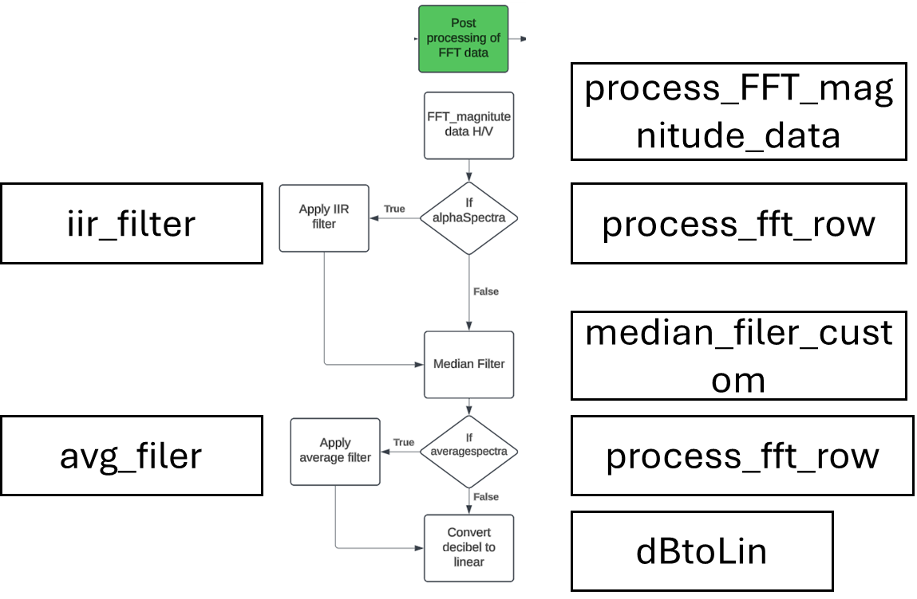
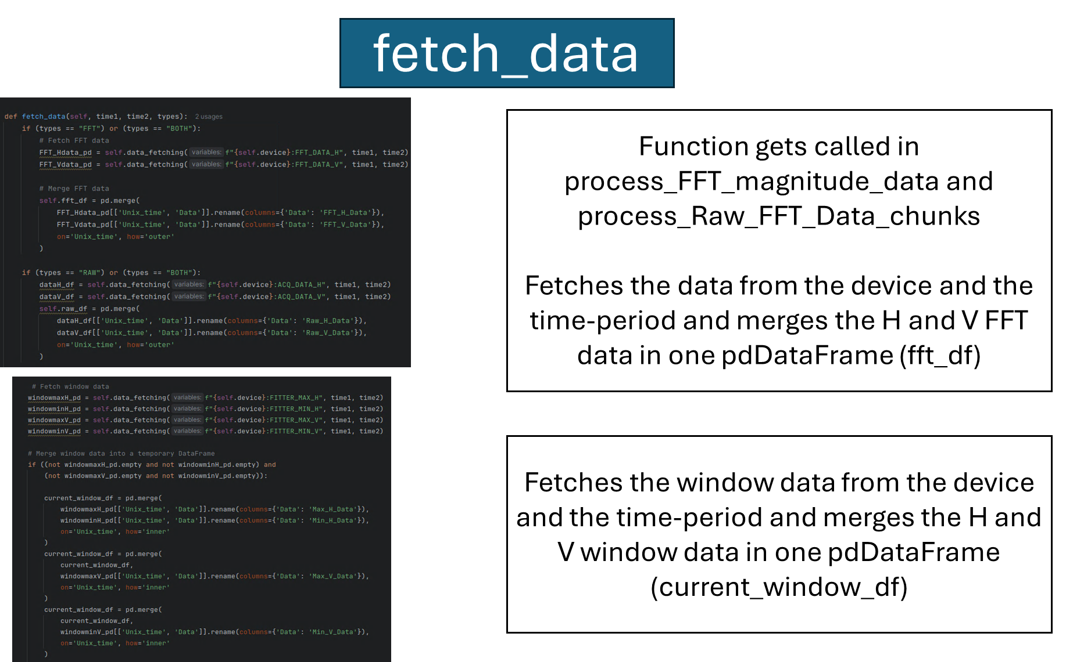
Updates
VM has been set up.
Quick introduction with Manuel
First look at the code
Making some documentation
Following some python courses online. (DataCamp)

