Slide 1
SolidJS and React: Two Paths to Reactive UI
Karol Kosek | Full-Stack Developer | EN-IM-AMM
09.05.2025

Slide 2
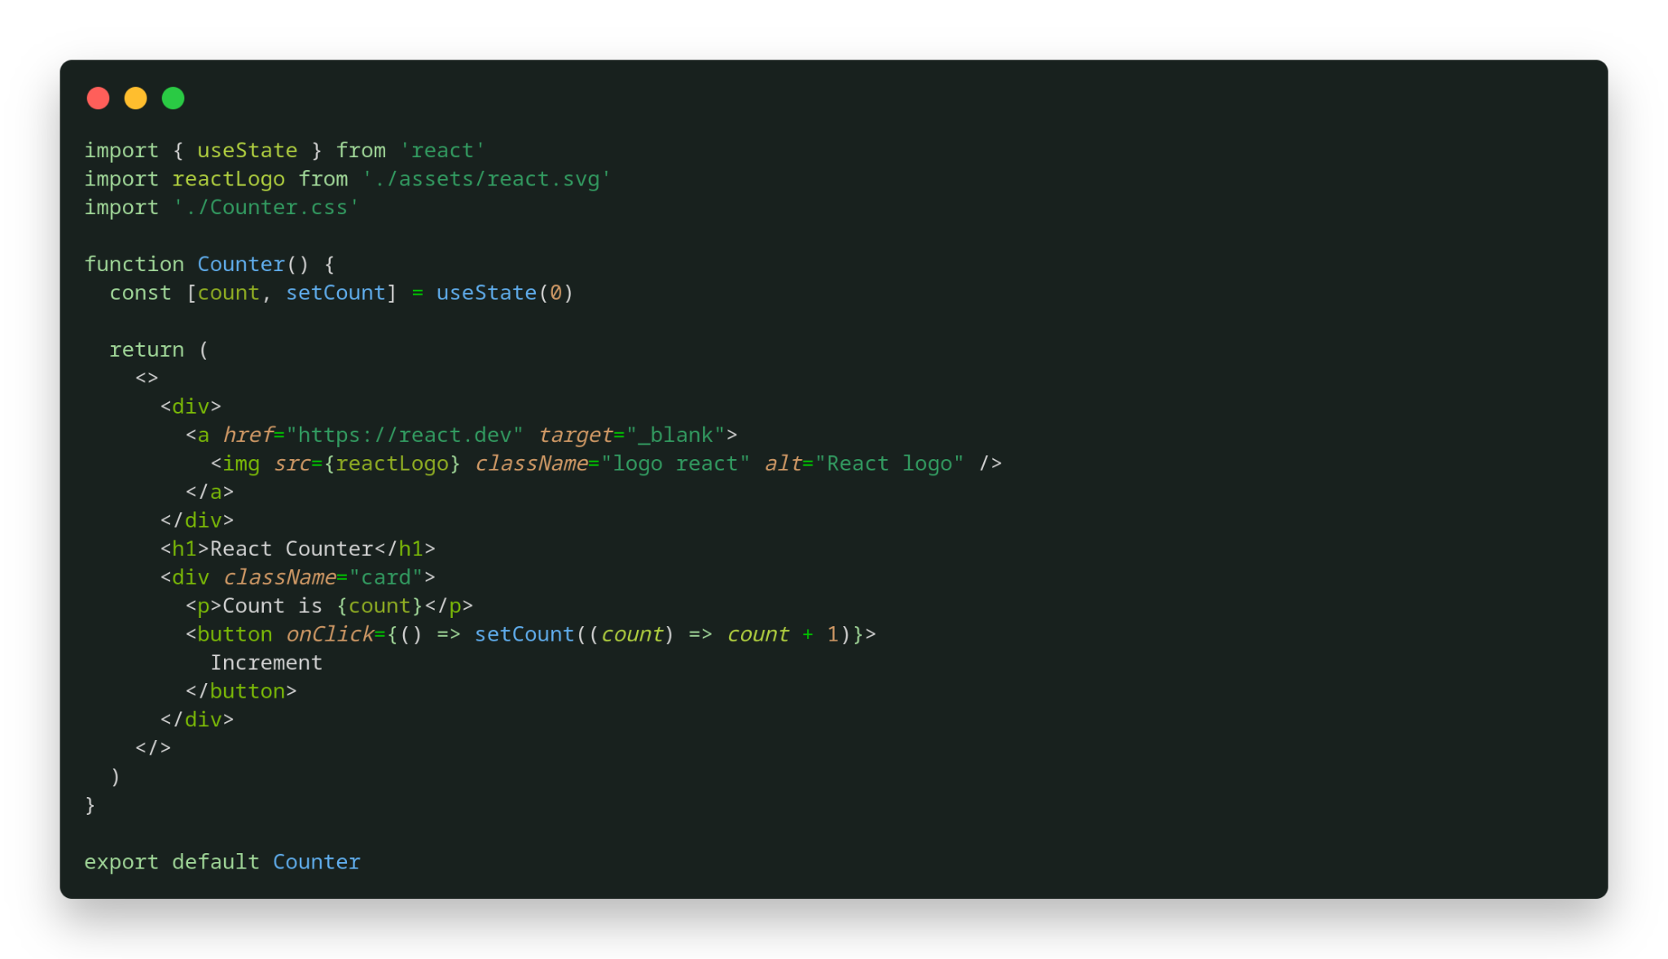
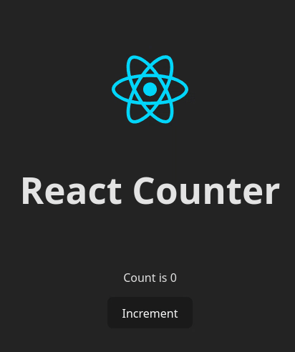
React app
React Counter component code
React Counter application

Slide 3
React app
React Counter component code
React Counter application
If the state changes (e.g., when the user clicks the button), React schedules another execution of the Counter function.

Slide 4
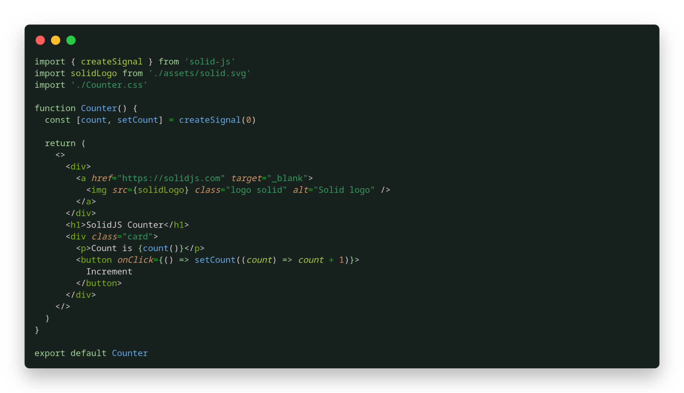
React and SolidJS code
React Counter component code
SolidJS Counter component code

Slide 5
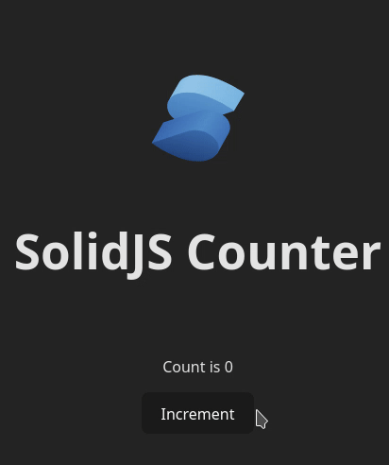
SolidJS app
SolidJS Counter component code
SolidJS Counter application

Slide 6
SolidJS app
SolidJS Counter component code
SolidJS Counter application
If the state changes (e.g., when the user clicks the button), the count getter function will be executed again.

Slide 7
React and SolidJS code
React Counter component code
SolidJS Counter component code

Slide 8


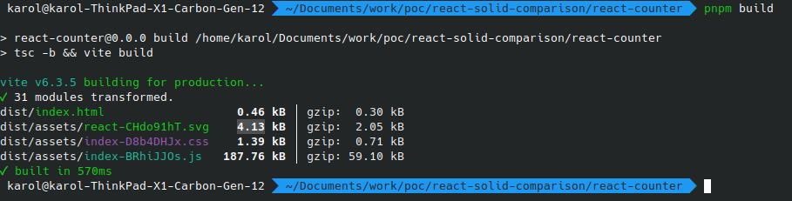
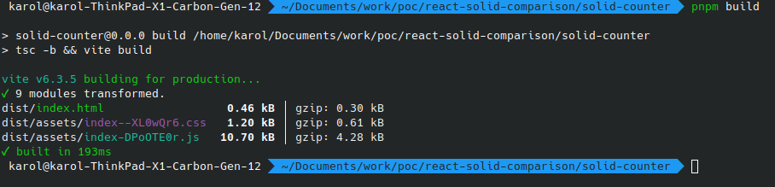
Key differences
Built the UI using the components
JSX
State is bound to the component
The component function is executed whenever the state changes
Component hierarchy has an impact on performance
The size of index.js (React@19.1.0 & React-DOM@19.1.0) is 187.76kb, which is larger than SolidJS's equivalent.
Built the UI using the components
JSX
State is independent from the component
Component function executed only once
Component hierarchy has no impact on performance
Smaller size of index.js than React (solid-js@1.9.5 package) - 10.70 kb
react app build command output (vite)
solidJS app build command output (vite)

Slide 9
Thank you!

Slide 10
Resources
1.https://react.dev/ - React Docs
2.https://www.solidjs.com/ - SolidJS Docs
3.SolidJS creator statements and opinions about component-state relation https://ryansolid.medium.com/components-are-pure-overhead-12358123bc2b
4.Github repo with the code presented in this presentation ://github.com/karolkos-glitch/react-and-solid-counters

