Slide 1
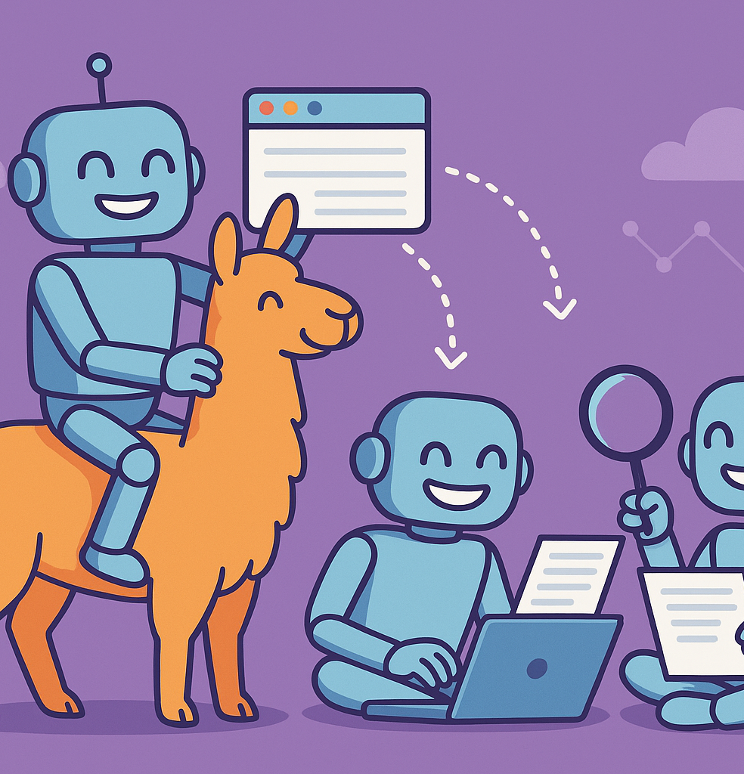
Running Local LLMs with Ollama, Open-WebUI, and Browser-Use
Presented by Igor Jakovljevic
<igor.jakovljevic at cern.ch>

Slide 2

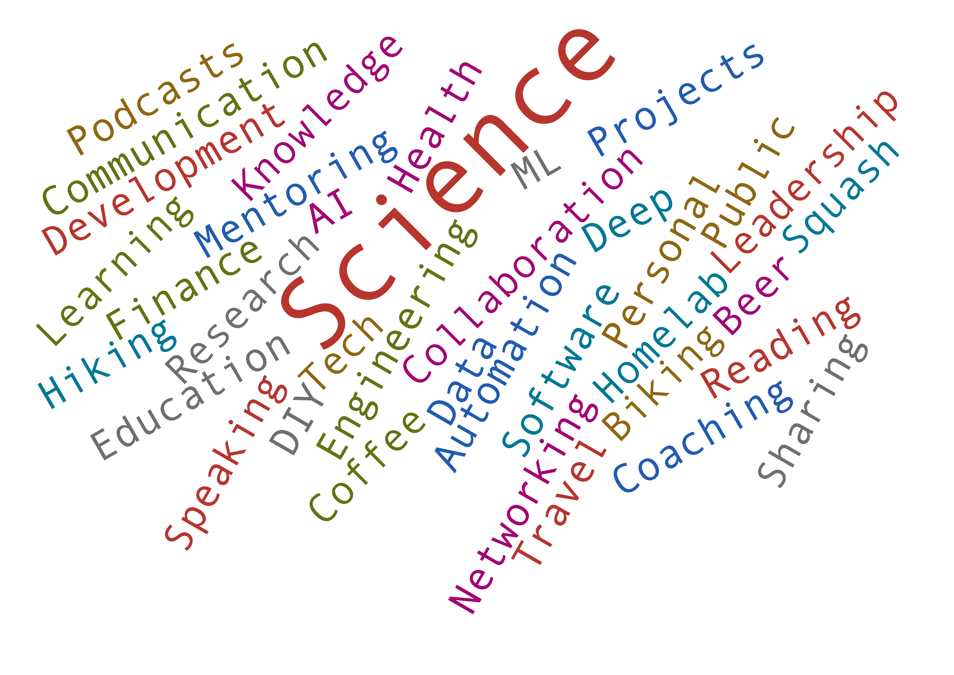

Introduction
Igor Jakovljevic
IT-PW-WA
Things that interest me
My Research

Slide 3
🧠 Why Run Local LLMs?
🔒 Privacy & Data Control
🌐 Offline Accessibility
💸 Cost Efficiency (Maybe)
🧩 Customization & Flexibility

Slide 4
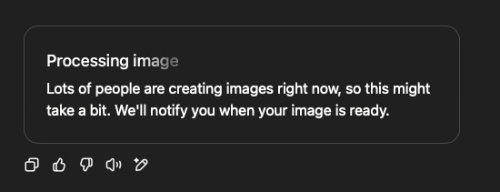
🧠 Why Run Local LLMs?
🔒 Privacy & Data Control
🌐 Offline Accessibility
💸 Cost Efficiency (Maybe)
🧩 Customization & Flexibility

Slide 5
Ollama​
Install, Use, and Simple Workflows
Ollama is a locally deployed AI model runner, designed to allow users to download and execute large language models (LLMs) directly on their personal computer .
Ollama eliminates the need for cloud services such as OpenAI, Hugging Face, Mistral, Claude, or others.
Alternatives include LM Studio, KoboldCpp, GPT4All, Text Generation WebUI and many more.
Random Reddit users have suggested that these are better than Ollama:
Vllm - https://github.com/vllm-project/vllm
Aphrodite - https://github.com/aphrodite-engine/aphrodite-engine

Slide 6
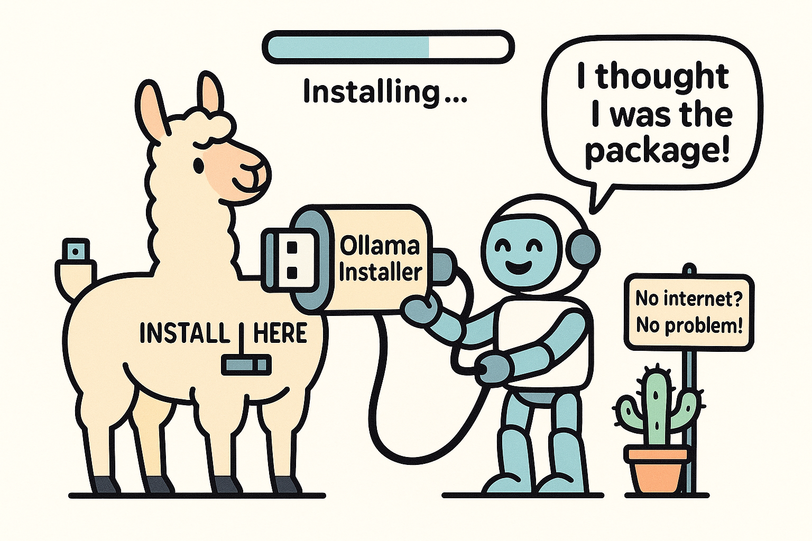
Installing
Ollama​
💻 I am a Windows or Mac User
Download Link : https://ollama.com/download
Install Ollama by running the executable file
📺 I am a Linux User
curl –fsSL https://ollama.com/install.sh | sh
🤖 I want to run it in docker
The official Ollama Docker image ollama/ollama is available on Docker Hub.
📍 Github https://github.com/ollama/ollama

Slide 7
“What Now? What can I do with this?”
– Everyone after installing a tool that sounded cool

Slide 8
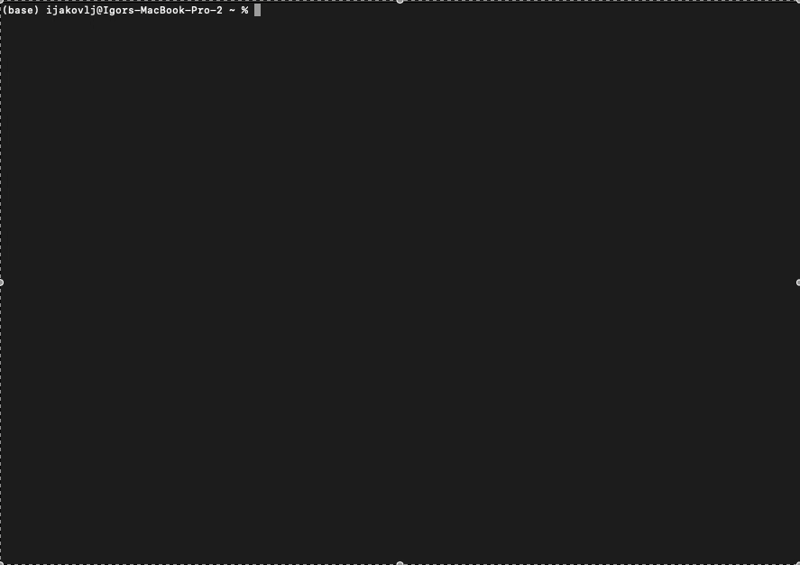
Using
Ollama​
Simple Use Case – get all available commands

Slide 9
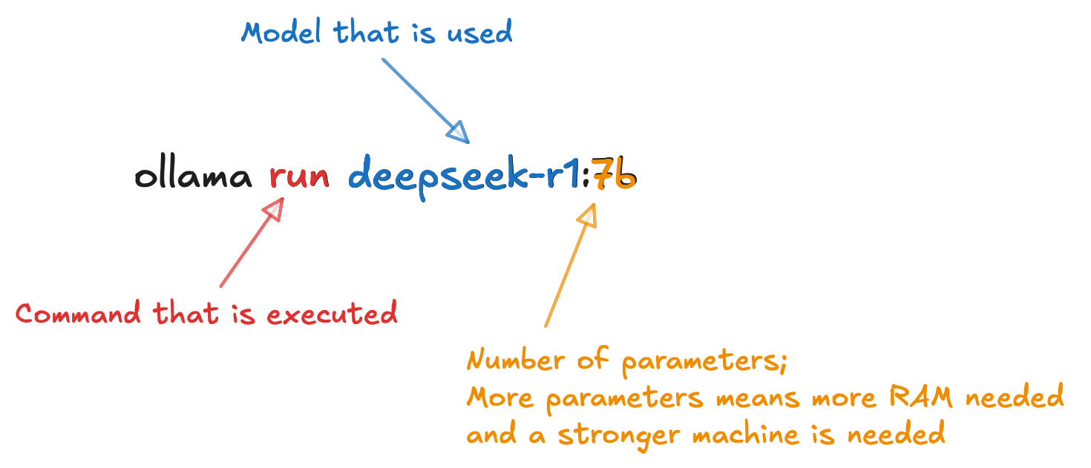
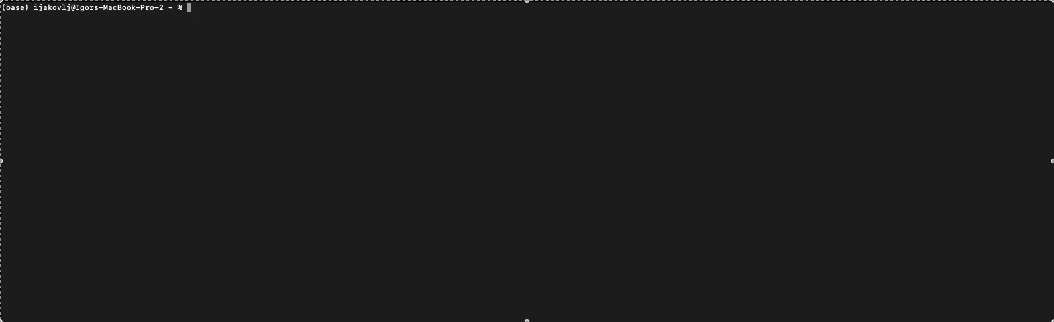
Using
Ollama​

Slide 10
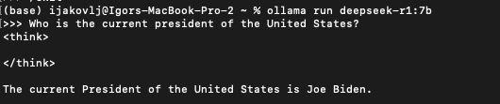
"60% of the time it works every time."
Brian Fantana

Slide 11
“What Now? What can I do with this?”
– Everyone after installing a tool that sounded cool

Slide 12
open-webui
Install, Use, and Simple Workflows
Open WebUI is a free, open-source web-based user interface for interacting with large language models (LLMs)
🔍 What It Is?
A self-hosted chat interface similar to ChatGPT or Claude that can connect to LLMs served via Ollama or other backends using OpenAI-compatible APIs.
More Information https://github.com/open-webui/open-webui

Slide 13
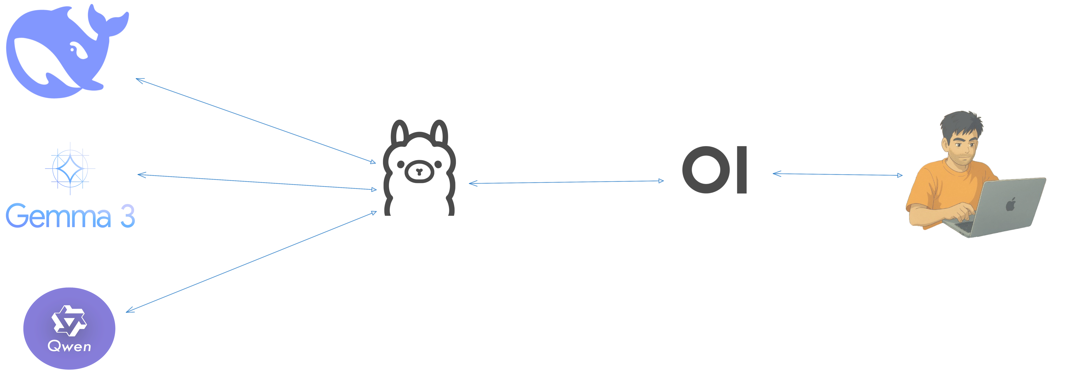
How to use open-webui?​
💻 Install via Pip and run
  pip install open-webui
  open-webui serve
🤖 I want to run it in docker
  The official Ollama Docker image dyrnq/open-webui is available on Docker Hub.

Slide 14
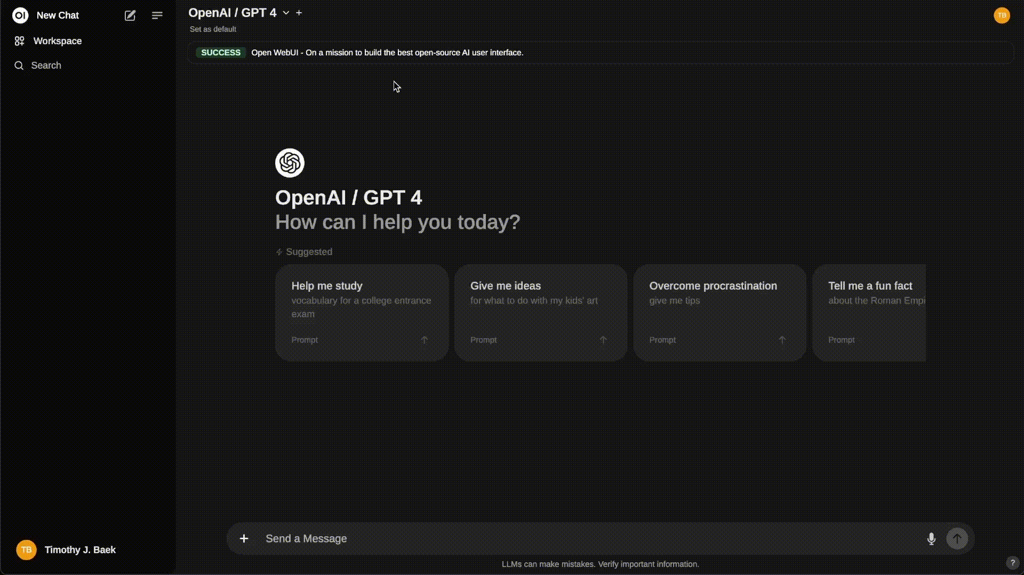

Slide 15
Why should I use open-webui?​
📚 RAG (Retrieval-Augmented Generation) Support - Upload or link documents (PDFs, text, etc.) and ask questions based on them. For Ollama you would need to write custom scripts and integrate with vector DBs
🧵 Multi-Turn Conversation Memory - Keeps full chat history and memory per session. Ollama is stateless by default, each command is a fresh prompt.
🔍 Web Search for RAG – Perform web searches using different providers and inject results into the chat
🧩 Pipelines, Open WebUI Plugin Support – Integration of custom logic and Python libraries, available plugin and tools marketplace
🖥️ API – Interact with the API to use RAG, Web Search, Chat Memory functionality

Slide 16
“This is great, I don’t need anything more! Right? Right?”
– Everyone after using open-webui

Slide 17
browser-use
Install, Use, and Simple Workflows
browser-use is an open-source Python library designed to enable AI agents to interact with and control web browsers.
🔍 What It Is?
Allows AI agents to perform complex browser tasks autonomously.
Open AI Operators cost 200$ per month (for now)
More Information https://github.com/browser-use/browser-use

Slide 18
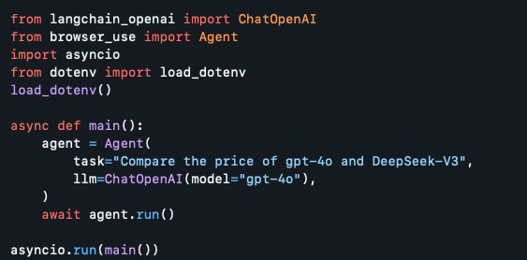
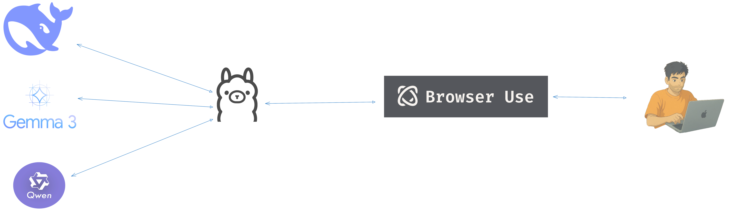
How to use browser-use?​
💻 Install via Pip
  pip install browser-use

Slide 19
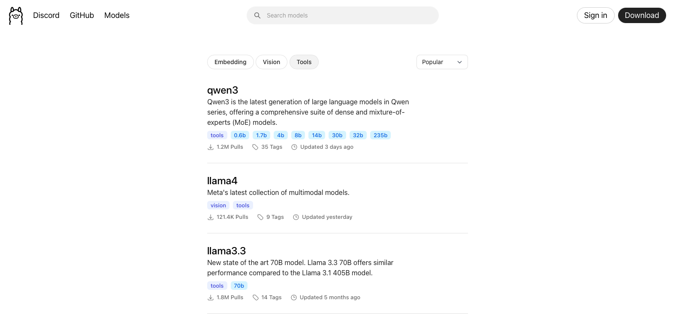

Slide 20
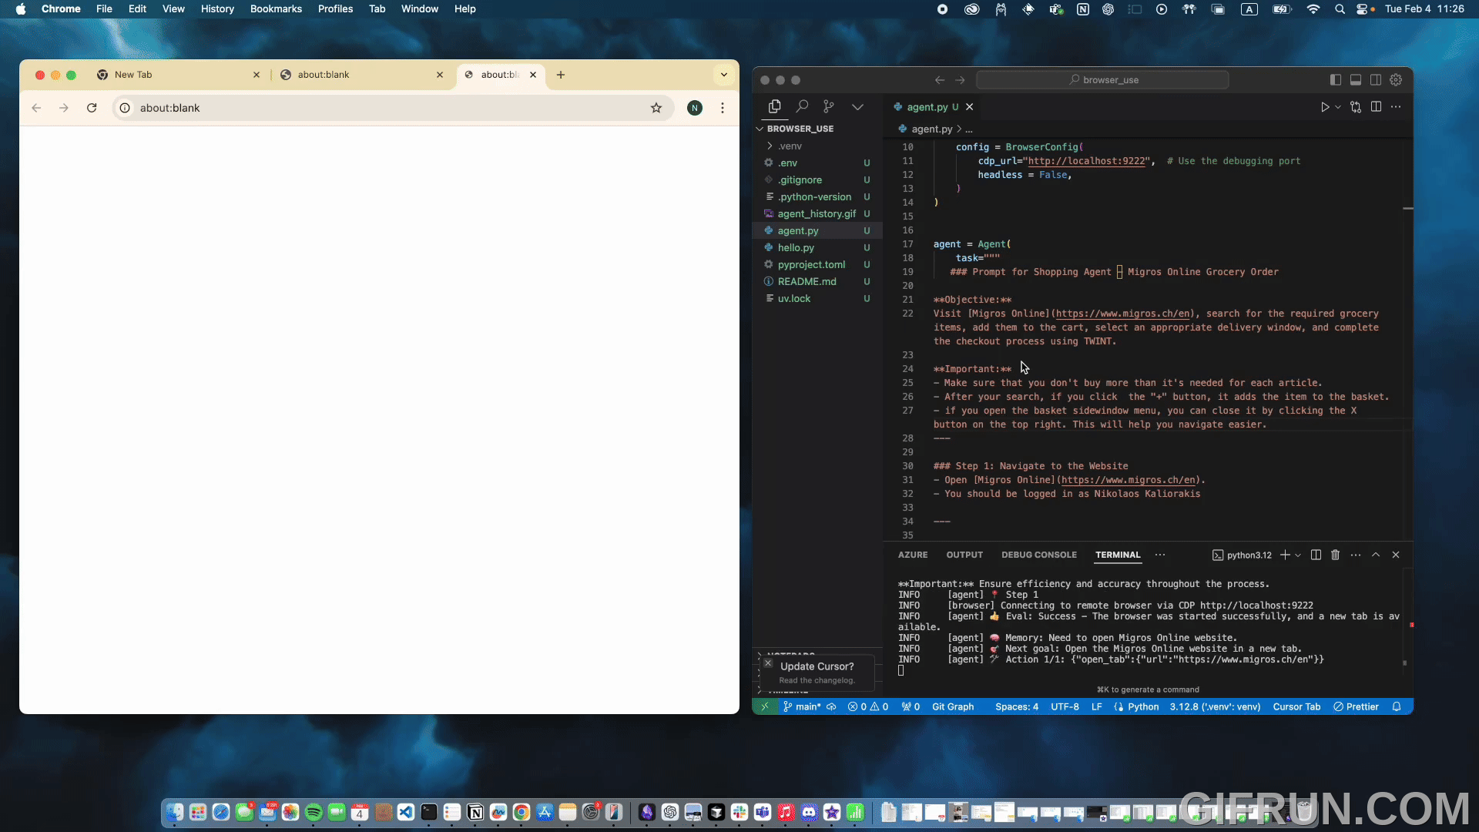

Slide 21
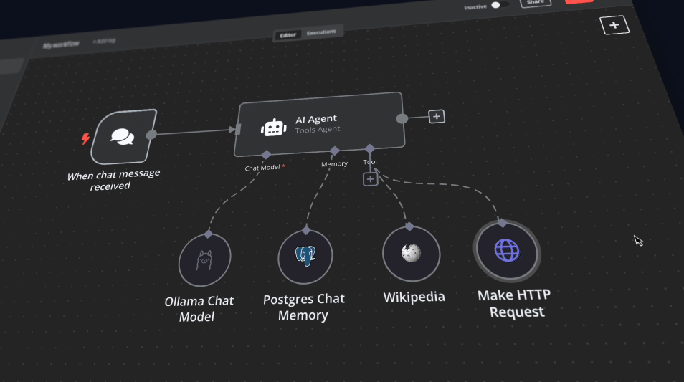
N8N – Workflow automation with AI [BONUS] https://github.com/n8n-io/self-hosted-ai-starter-kit
Summarize multiple RSS feeds and send a telegram message (every morning)
Generate weekly stock report
Write a blog post based on multiple sources

Slide 22
Thanks for your attention!

Slide 23
GenAI at CERN
AccGPT - https://accgpt.docs.cern.ch/
GenAI Docs - https://genai.docs.cern.ch/
LLM Use Cases at CERN - https://codimd.web.cern.ch/s/mUHn2fVny
  If you have other use-cases, please share them
AccGPT App - https://accgpt-ui.app.cern.ch/

Slide 24

Q & A

Slide 25
I want to try it out
Ollama https://ollama.com/
Open Web UI https://github.com/open-webui/open-webui
Ollama + Open WebUI https://docs.openwebui.com/getting-started/quick-start/starting-with-ollama
Browser-Use https://github.com/browser-use/browser-use
N8N Automation with AI https://github.com/n8n-io/self-hosted-ai-starter-kit
How to add real-Time Web Search to Open WebUI https://www.youtube.com/watch?v=_KoifHHJhNY

