Slide 1
RF MD Plans for 2025
H. Timko, P. Alonso, D. Barrientos, H. Bartosik, X. Buffat, A. Butterworth, R. Calaga, N. Catalan, G. Hagmann, B. Karlsen-Baeck, I. Karpov, S. Kostoglou, C. Marrelli, S. Morales, N. Mounet, B. Salvachua, D. Soriano, A. Spierer, K. Turaj, D. Valuch, M. Zampetakis
HL-LHC WP2 meeting, 13th March 2025

Slide 2
MDs with HL-LHC Intensities
Batches at 2.3x10¹¹ p/b, at least 36b, preferably 4x36b BCMS
  Beam variants that are optimized in SPS are preferred (72b batches welcome if optimized)
  Should try to reach as much as possible LIU baseline in SPS (10 MV + 2 MV, 1.65 ns)
MD#1: refine RF capture and fill the machine
  In continuation: e-cloud at injection + 2 ramps of single bunches (ABP)
  At flattop, we can study longitudinal LLD parasitically
    Ramp 1: 6 bunches, nominal bunch length
    Ramp 2: More bunches, lower bunch length target for BUP to ~1.0 ns; open phase loop to observe
      Parasitic data also for intensity effects on controlled emittance blow-up at HL-LHC intensities
MD#2(-4): determine max no. bunches that can be accelerated
  Present estimate is ~750b due to start-of-ramp BLM thresholds
  Apply improved cleaning and updated BLM thresholds if available​

Slide 3
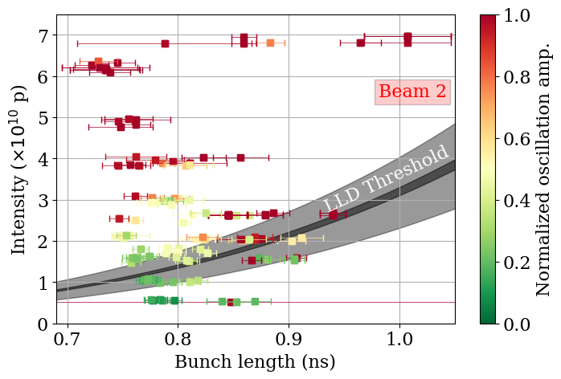
MDs on LHC Impedance
MD#1/2: complete longitudinal LLD measurements with single bunches of different intensities and 1.0 ns bunch length
  Parasitic measurements at flattop
MD#2-4: other measurement methods to refine the longitudinal impedance
  E.g. de-bunching of long bunches as was done in SPS
  Methods presently being evaluated in simulations
Measurement data from 2024,
M. Zampetakis at HL-LHC coll. meeting 2024

Slide 4
Other MDs
MD#1: improved cleaning of de-bunched beam at flat bottom
  ADT intra-batch cleaning, RF noise cleaning?
  (If needed) in addition to the commissioning time requested for this activity
MD#2-4: full detuning at LHC injection
  Evaluate power requirements and beam losses when injecting directly in full-detuning mode
MD#1 (before TS1): full power reach of LHC klystrons with batched beam
MD#4: WR frequency distribution with beam

