Slide 1
MDs for electron cloud effects
L. Mether

Slide 2
Planned MDs
Heat load measurements with high intensity
Heat load with 2.3e11 p/b at injection
  Trains of 2 x 72b or 3 x 48b and > 2500 bunches
Heat load with 8b+4e beam with 2.3e11 p/b at flat top
  With 2 x 56 b (compatible with 4x36b AGK) we could reach 1700-1800 bunches (TBC with RF)
Motivation:
Collect (better) data for electron cloud modelling
Test high-intensity for HL-LHC
Test HL-LHC electron cloud mitigation scheme

Slide 3
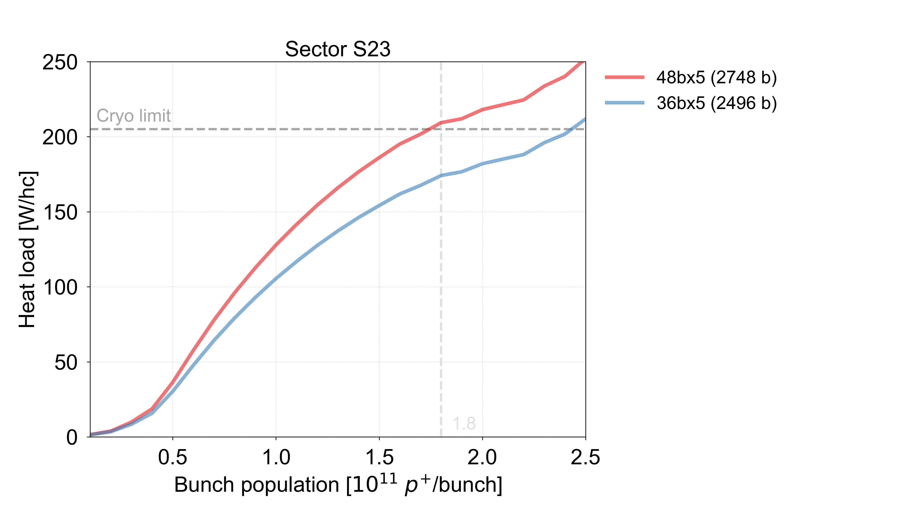
Planned MDs
Heat load measurements for comparison to Run 1 and Run 2
Heat load measurement with ~1.1e11 p/b in trains of 2 x 72 b at 450 GeV
Heat load measurement with ~1.2e11 p/b, in trains of 3 x 48 b or 2 x 72 b at flat top (single and both beams)
  Use shorter bunch length, if possible, for closer comparison
Motivation:
Quantifying the beam screen degradation in LS2,
without relying on extrapolations from simulations
w.r.t. filling scheme, intensity, bunch length

Slide 4
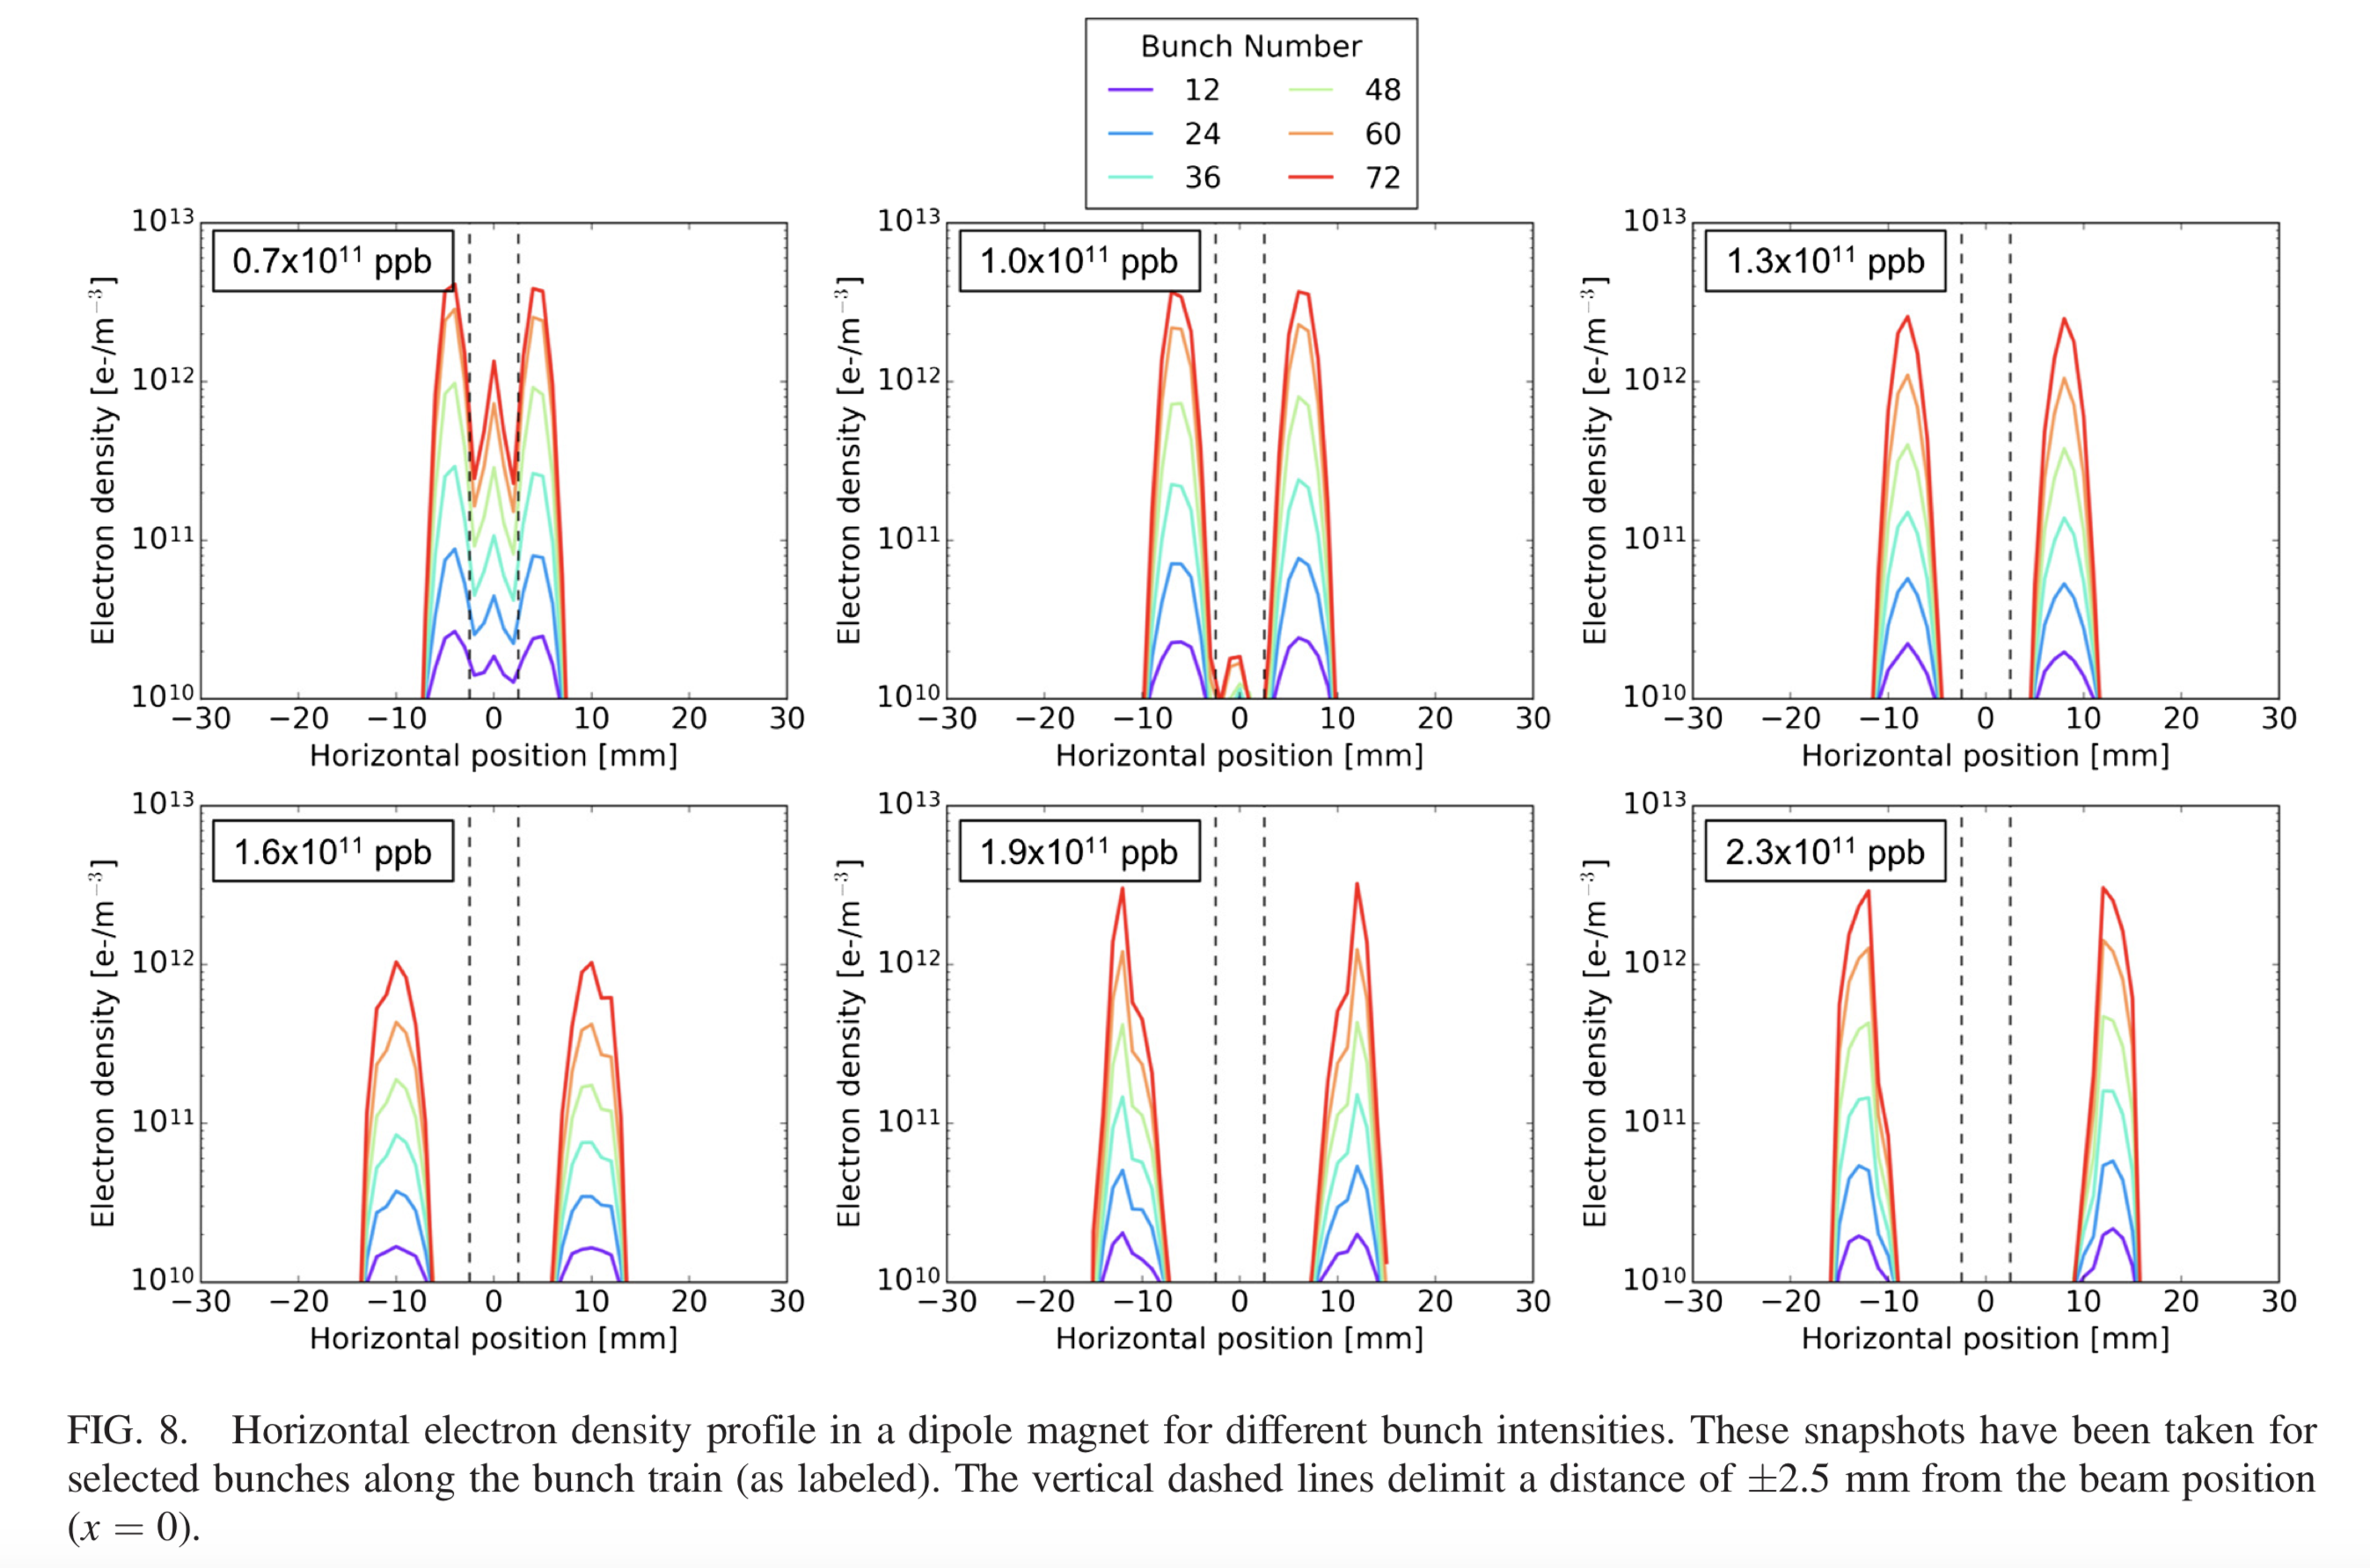
Planned MDs
Electron cloud instabilities in dipoles at flat top
Characterize beam stability as a function of bunch intensity and chromaticity
  Inject trains of 2 x 72 b with varying intensity: e.g., 0.8e11, 1e11, 1.2e11 and 1.4e11 p/b with high chromaticity
  Ramp, then gradually lower chromaticity at flat top and monitor stability
  Repeat with and without beam-beam effects (1/2 IPs?)
Motivation:
Collect data for electron cloud instability modelling (new PhD starting 4/25)
Identify chromaticity margins for operation (instabilities observed in operation with only 1 IP colliding)
A. Romano et al, Phys. Rev. Accel. Beams 21, 061002

