Slide 1
LHC configuration MD’s
S. Fartoukh
What is left for 2025/2026 ?
ATS optics development for the future
Summary

Slide 2
What is left for 2025/2026? (1/2)
2026 CYCLE (further optimized cycle and pushed β*)
Test the mechanics and measure/correct the optics of a new cycle with:
Full squeeze in the ramp requesting (i) a change of the ATS optics gymnastic in the ramp (anti-telescope starting @2.5 m vs. 2.0 m).and. (ii) the new parabolization procedure (see MD15003 posted by Michi)
ATLAS/CMS/LHCb rotation in the ramp
Beta*-leveling extended down to 40/12 cm after X-angle anti-levelling (or 50/15 cm only @ nTCT=8.5 sigma, but “super-tight settings” are continued on the collimation side)
Intensity ramp up to 1-2 trains would be great for the ramp (to observe the lifetime with the rotation embedded). Not more than probe beam needed for the squeeze extension (or set-up beam if aperture measurement is deemed to be necessary).
3-4 shifts requested, out of which 1 shift is already requested for MD15003.
Optics not ready (first shift of the program to be scheduled in MD2 at the earliest).

Slide 3
What is left for 2025/2026? (2/2)
Missing D1
The LHC should be ready to operate with the MBWXA modules disconnected in IR1 (radiation), and the other 5 modules pushed up by 20% (~900 A, which is beyond ultimate), but ideally less (~820 A) to minimize the risks and remain compatible with the existing FMCM system.
Dedicated orbit bumps (optics dependent knob acting on MCBXH3, D2 and CODs @ Q4/5/6) can meet this goal (see appendix).
The idea is to mimic this failure scenario by testing the 2026 cycle with the D1 strength reduced by ~10% + new special knob to compensate.
Can be included in the previous program (if 4 shifts allocated) to test the new knob over the full 2026 cycle; or simple test(s) at injection and/or EoR using the 2025 cycle (therefore for the injection and/or the FT optics only).

Slide 4
ATS optics development and MD for the future
More than a decade ago, the ATS optics concepts were invented to provide a solution for the HL-LHC optics, then developed, heavily tested in MD, and implemented gradually in the LHC since 2017.
The focus was put on IR1 and IR5, for boosting the beta* beyond 50-40 cm, otherwise limited by matching quadrupoles and sextupoles, while keeping under perfect control the chromatic aberrations induced (off-momentum beta-beating, spurious dispersion from crossing bumps)
Limits on these chromatic aberrations were first observed in the LHC
in 2023 during the ion run (on_disp knobs missing inducing background in Alice),
then in 2024 for the proton run (uncorrected vertical spurious dispersion in IR7 from Alice/LHCb + machine imperfections, inducing collimation hierarchy breakage).
Limits on off-momentum beta-beating are not (yet) known/observed, but should come when (if?) Alice and/or LHCb will request even lower beta* in the future.
The ATS optics concept should therefore be generalized to Alice & LHCb as well
Concept .and. corresponding new ATS optics NOT ready (many approach can be imagined). But as soon as available, 1 or 2 shifts in 2025 or 2026 would be welcome to test the next ATS optics generation before HL-LHC.

Slide 5
Summary
As of MD2 (2025): 4 shifts for the 2026 cycle (including the preventive action against D1 failure), out of which 1 is already requested in MD15003
As soon as available (in 2025 or 2026): 1-2 shifts for testing the next ATS optics generation

Slide 7
Appendix (MBXWA failure mitigation)

Slide 8
D1 transfer function
(D1 made of 6 MBXW modules in IR1, powered in series left and right)
890 A (w/o MBWXA)
810 A
(ultimate)
IPNO=662 A
@ 6.8 TeV
Courtesy of Pierre Thonet
Strong saturation beyond I_ultimate=810 A: ITF reduced by ~ 2
(even not talking about b3)

Slide 9
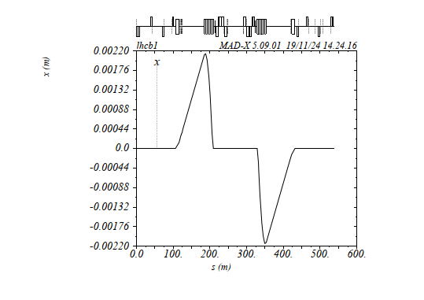
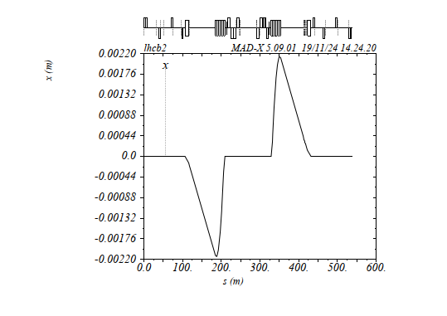
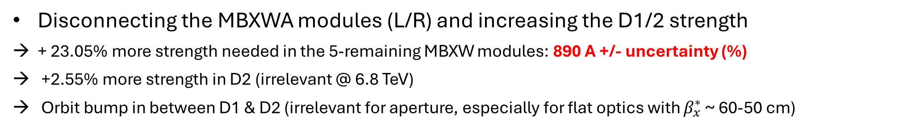
Option 1
Disconnecting the MBXWA modules (L/R) and increasing the D1/2 strength
+ 23.05% more strength needed in the 5-remaining MBXW modules: 890 A +/- uncertainty (%)
+2.55% more strength in D2 (irrelevant @ 6.8 TeV)
Orbit bump in between D1 & D2 (irrelevant for aperture, especially for flat optics with $β_{x}^{∗}$ ~ 60-50 cm)
Beam1
Beam2
Note: this optics independent orbit bump will be strongly mitigated when the H crossing is ON (after the ATLAS/CMS
rotation) and is only needed towards the EoR (e.g. could be ramped up from 0 to 1 as of 5 TeV only)

Slide 10
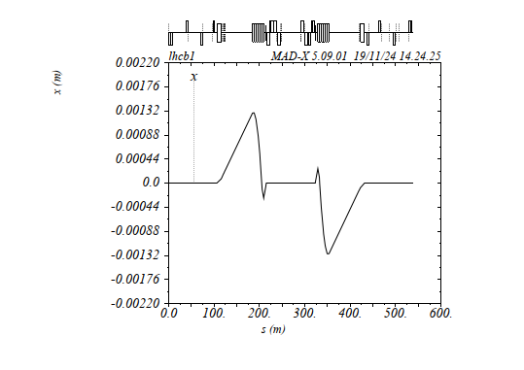
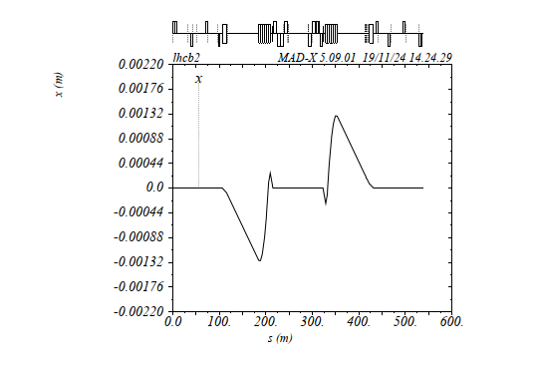
Option 2
Disconnecting the MBXWA modules (L/R), limit the D1 current to 815 A, and match the orbit with D2 & MCBXH3
D1@815 A (~ultimate current)
+1.55% more strength in D2 (decreases w.r.t. option 1)
+ 385 A needed in MCBXH3 (vs. 400 A for the radial MCBXH/V spec), reduced when the H-crossing is ON
Beam1
Beam2
Note: this optics independent orbit bump will be strongly mitigated when the H crossing is ON (after the ATLAS/CMS
rotation) and is only needed towards the EoR (e.g. could be ramped up from 0 to 1 as of 5 TeV only)

Slide 11
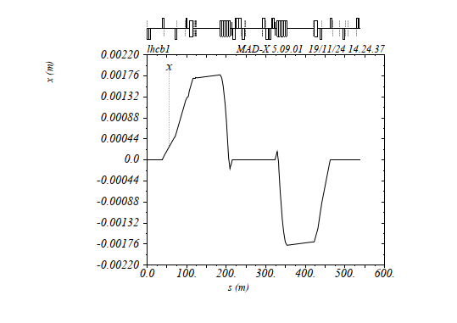
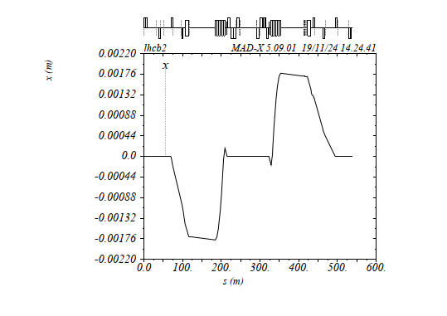
Option 3
Disconnecting the MBXWA modules (L/R), limit the D1 to 815 A, MCBXH3 to 250 A, and use the usual MCBY/C (at Q4/5/6) to match the orbit
D1@815 A (~ultimate) & D2 even reduced by 5.0% w.r.t. 2024 (optimize for minimizing the usage of the CODs @ Q4/5/6)
MCBXH3@250A: OK for the 400 A radial spec., accounting for 100/200 A more in MCBXH3 for the flat machine
MCBC (@Q5/6) and MCBYS (@Q4) not more than 50% of nominal, then reduced with H crossing (→ no impact on lumi knob)
Beam1
Beam2
Note: this optics dependent orbit bump will be strongly mitigated when the H crossing is ON (after the ATLAS/CMS
rotation) and is only needed towards the EoR (e.g. could be ramped up from 0 to 1 as of 5 TeV only)

