Slide 1
Beam Instrumentation MD requests 2025
B. Salvachua on behalf of the SY-BI group
Inputs from D.Butti, M.Gasior, K.Lasocha, S.Morales, J.Pucek
LSWG 1 April 2025

Slide 2
Content
Beam Losses (BLM)
  Beam loss patterns
  TCT response factors
  Off-momentum halo
Beam halo (Coronagraph)
Tune and Chromaticity (BBQ and Schottky)
Transverse Beam Size (BGC)
Beam Position (DOROS)

Slide 3
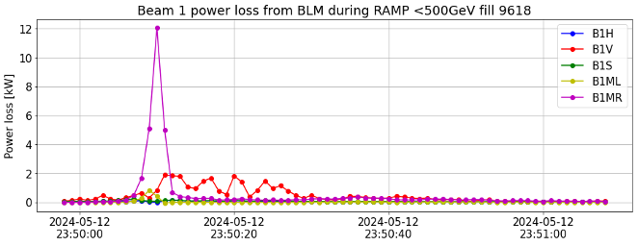
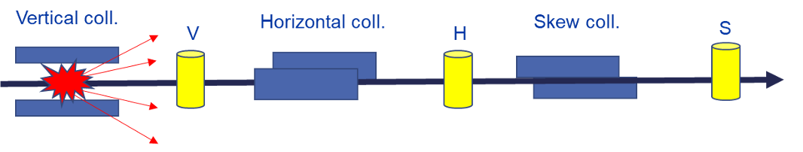
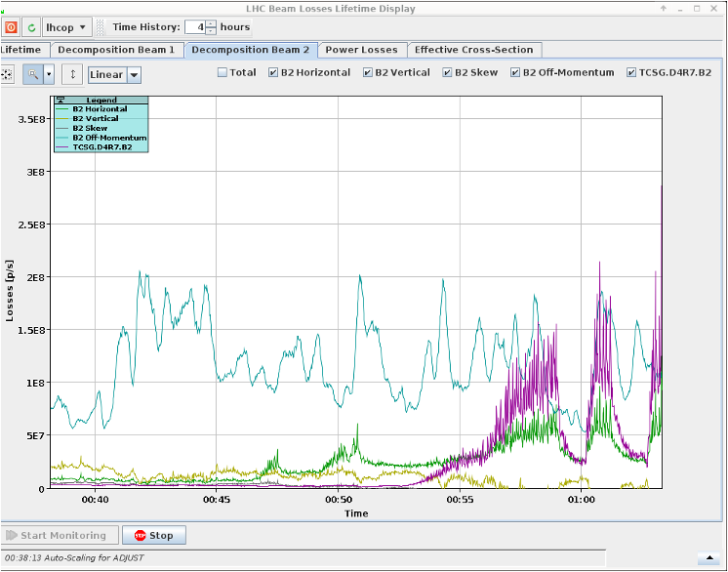
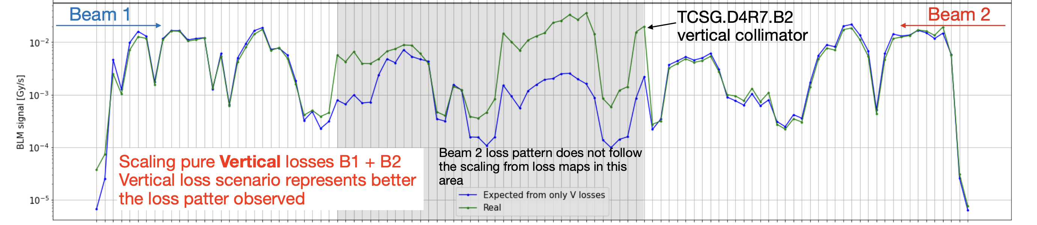
Beam Loss: Beam loss patterns
Sara Morales
Losses at start of ramp
Beam Scraping at low intensity to study machine loss patterns. BLM signals depend on collimation setup, needs to be repeated every year.
IR3 internal jaw
IR7 vertical loss
Successful MD 2024:
  Scraping IR3/IR7 with independent jaws at injection and top energy
  Study of hierarchy breakage loss pattern (TCSG.D4R7.B2)
What could not be done:
  Scraping IR3 at injection with ions -> beam not available
Beam Lifetime and more
Direct impacts in TCSG.D4R7.B2

Slide 4
Beam loss patterns proposal for 2025
Sara Morales
Repeat beam scraping with protons at injection and top energy in IR3 and IR7 for the BLM calibration.
Single jaw scraping to include differences in the BLM calibration between left and right jaws.
  5 nominal bunches during injection and 3 nominal bunches for top energy to stay below SBF.
  BIC mask collimators, BLMs and BPMs.
  No change of BLM thresholds.
  One session of 8 hours or two sessions of 4 hours each.
  Could be performed during commissioning if final optics and collimation are in place.
  MD procedure for injection energy in MD#9504 and for top energy in MD#6950.

Slide 5
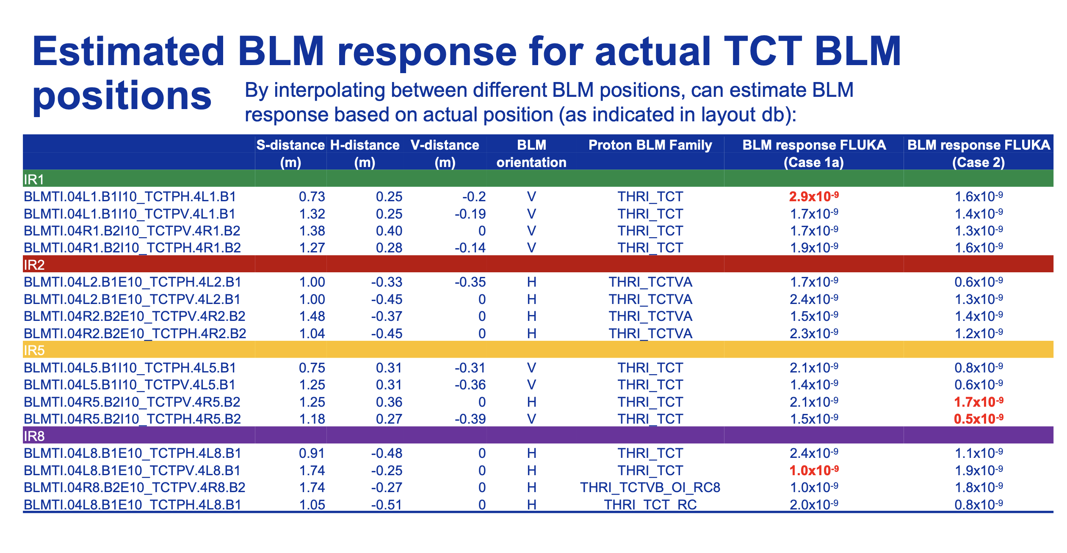
Beam Loss: TCT BLM response
Belen Salvachua
BLM dump thresholds for the TCT collimators were a limitation during the ion run.
BLM thresholds were reviewed and updated based on simulations, tracking, energy deposition and and thermo-mechanical (see BLMTWG)
Goal of the MD: Measure if similar responses could be assumed for protons.
Direct scraping
MD request MD#15210:
  Injection and Top energy
  Scrape with TCTs, collimation setup in place.
  8 hours, or we could split in 4 + 4 separated by injection and top energy.

Slide 6
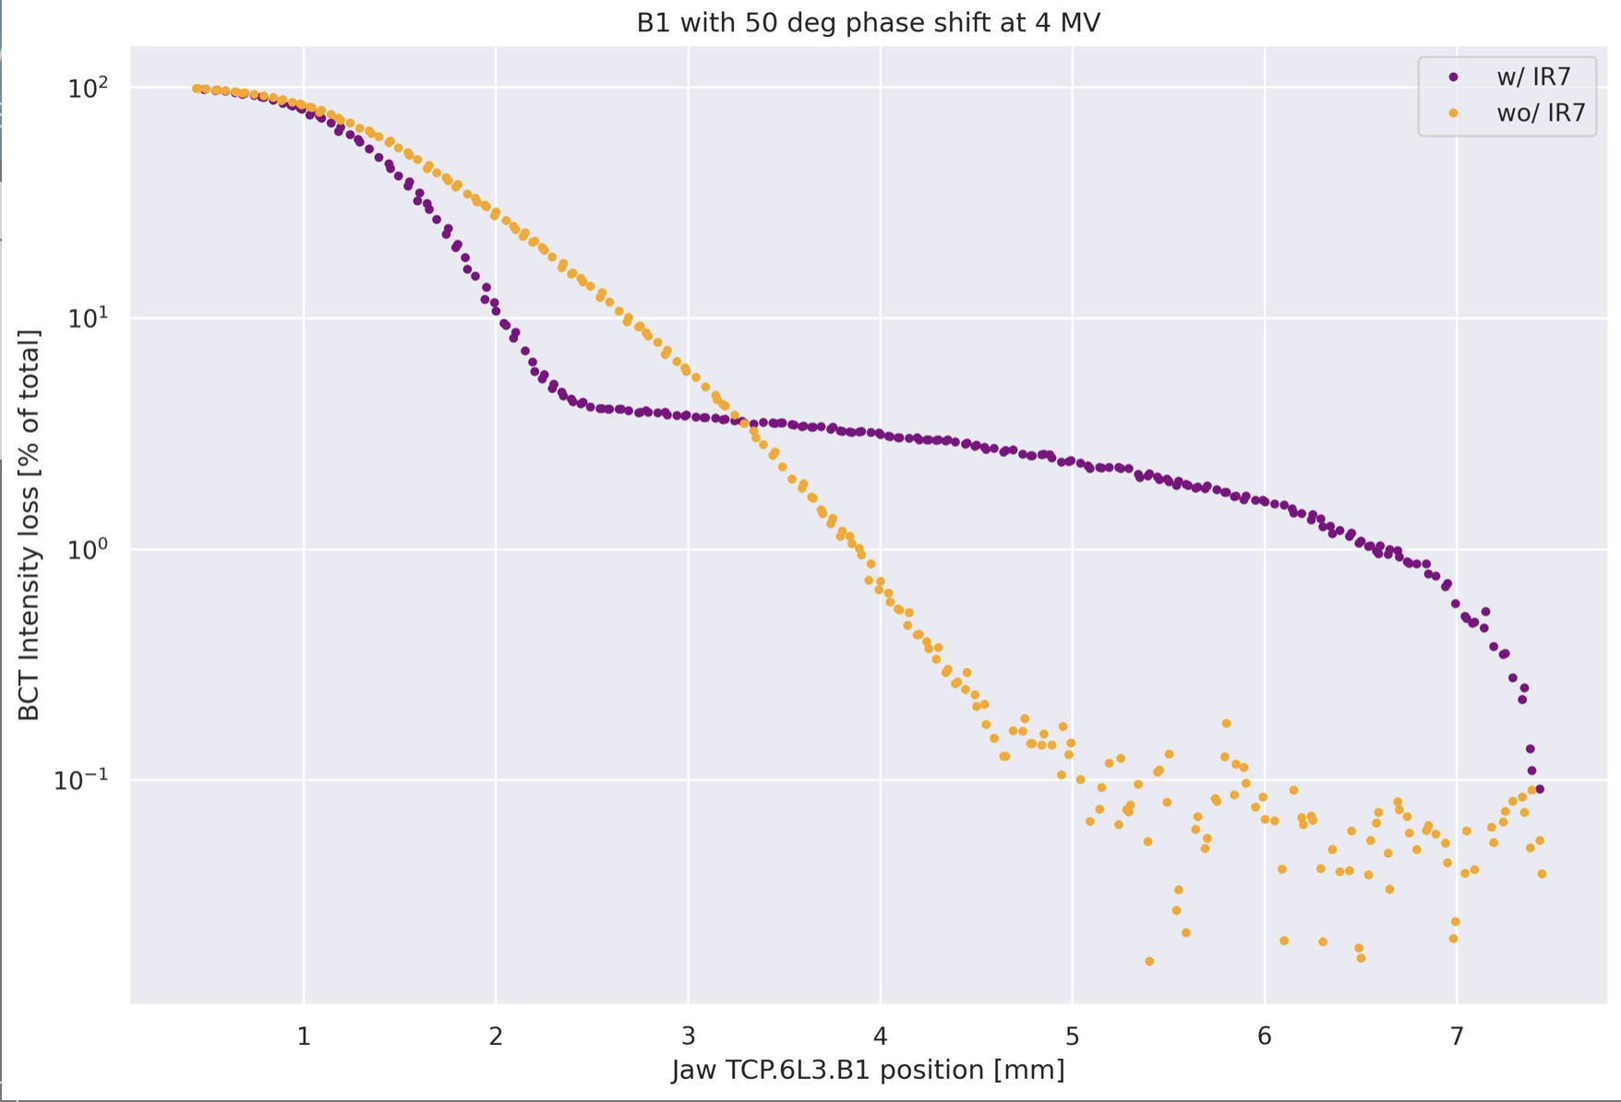
Off-momentum halo scraping
Belen Salvachua
Study off-momentum halo and correlation with RF settings. MD in collaboration with RF and Collimation. Develop model for off-momentum halo.
Last year we had an MD to study the effect of the RF voltage and phase in the off-momentum halo -> MD#11787
We propose this year a modification of the procedure, where scraping is only performed with single jaws.
MD request:
  Injection energy with 1 bunch - 4 hours
  Scrape betatron halo, then scan full bunch in IR3 - one jaw only
  Change RF settings and repeat.
  Change maybe other knobs.
Milica Rakic

Slide 7
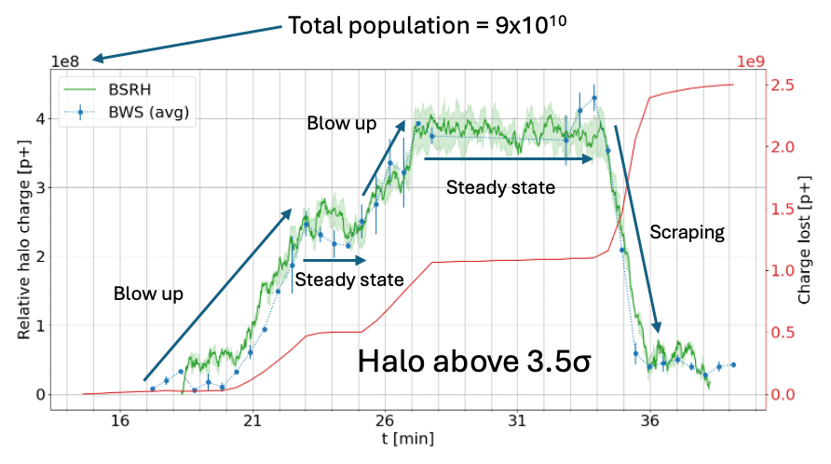

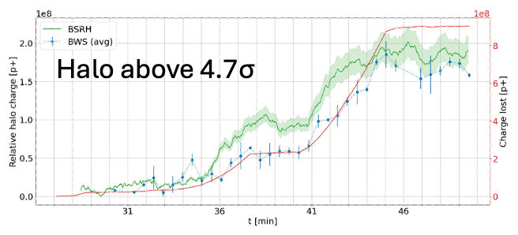
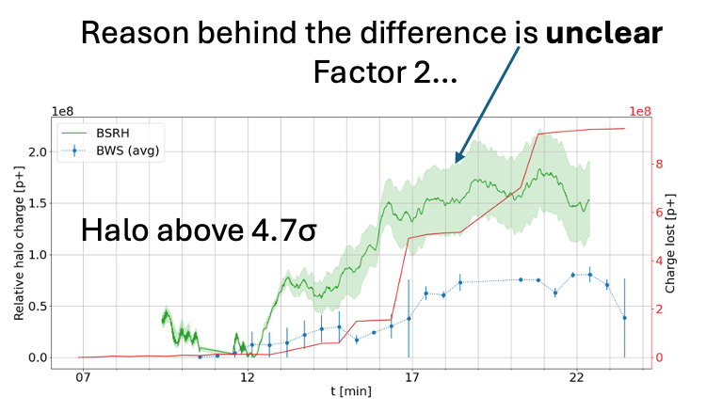
Beam halo (Coronagraph)
Jan Pucek
Study the use of the coronagraph as beam halo measurement instrument.
Horizontal
Horizontal
2024 measurements
Successful MD in 2024 with few uncertainties:
  Long term stability
  Discrepancies in H-plane
  Background subtraction uncertainty: bkg level depends on CORE distribution.
  Automatic instrument operation procedure.
Vertical

Slide 8


Proposal for 2025 – 1 slot, 8h
Jan Pucek
Assuming BSRT and BSRH can run parallel (EYETS upgrade, will be determined with the first FT beams in LHC)
Take calibration data during BSRT calibration fill with BSRH (April?)
Obtain first available MD slot
  Re-measure calibration (long term stability)
  Perform the same measurement in H and V plane, providing ONLINE data analysis to address discrepancies
  Test automatic measurement capabilities
  Quantify the background subtraction uncertainty
  New BWS, better resolution? More precise comparison of the two systems?
Fill parameters same as MD13144 (~28 pilots, different emittances)

Slide 9
Tune and Chromaticity
Kacper Lasocha
The aim of the MD is to study the effect of the ADT gain on BBQ and Schottky spectra.
  Spurious spectral components are the limiting factor for the Schottky analysis. Past MDs, all with the nominal ADT settings, failed to determine their source.
  BBQ spectra are strongly affected by Q’, beam-beam and ADT. The goal of the MD is to understand, and if possible quantify, the effect of the latter.
Short MD description: (preferable MD1)
  1 + 12 nominal intensity p bunches
  Variable ADT gain
  INJ + Flat Top
  Time needed: 8h
  MD#15206

Slide 10
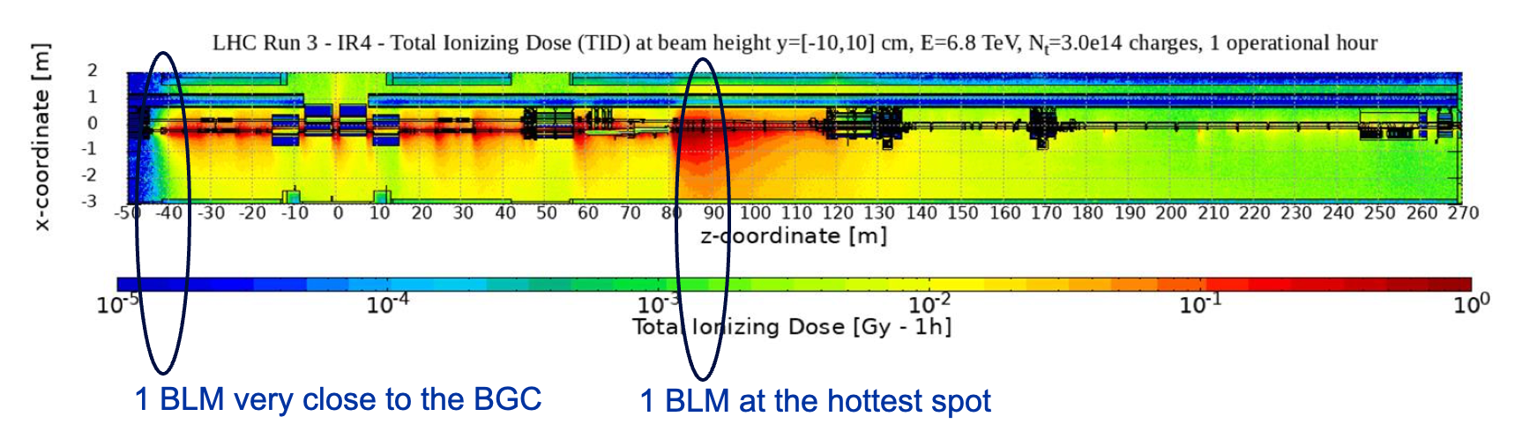
Transverse beam size
Daniele Butti
MERIT: investigate losses crated by the beam gas curtain as potential tool for future beam diagnostics. The main objective is trying to resolve losses created by the gas jet from the losses create by the residual BGC background.
Installation of 2 BLMs to monitor the beam losses created by the Beam Gas Curtain for beam diagnostics purposes (not machine protection). Installation done on Beam 1 only.
Displace the beam with an orbit bump to scan the beam across the beam jet emulating a jet profiler.
https://asm.cern.ch/md-planning/lhc-requests/15103
Short MD description:
tentative beam intensity <3e11 with smallest achievable emittance (<2um)
Injection on Beam 1 only
time slot 4h
Readiness depends on commissioning tests.

Slide 11
Beam Position
Marek Gasior
Optimisation of DOROS BPMs settings for VdM beams.
VdM scans are the most important and challenging application of the DOROS system.
VdM DOROS measurements have always been done with regular physics beam settings, which are not optimal for the larger VdM bunch spacing and smaller beam offsets in Q1 BPMS.
The goal of the MD:
  Optimise the system settings for VdM beam conditions, in particular the bunch spacing, bunch number, moderate beam offsets in Q1 BPMs and bunch intensity.
  Study the limits of the stripling Q1 BPMs during VdM scans, in particular B1/B2 and X/Y coupling.
MD request MD#15203 (8hours):
  VdM bunch scaping, ~ VdM bunch number, ~ VdM bunch intensity (Emittance not important)
  VdM beam optics at Flat top
Special requirements:
  Beam position from Experiments
  Optimised VdM scans best revealing DOROS weaknesses, in particular scale errors
  Reduced number of point per scan required.
  Maybe even 3-point scans should considered, i.e. +/- extreme positions and the centre.
  Scans in one experiment at the time to avoid any crosstalk.
  No parallel studies which may in any way affect beam positions in Q1 BPMs.

