Slide 1


Collimation and Halo studies
B. Lindström on behalf of BE-ABP-NDC
Acknowledgements: OP, LNO, CEI, RF, BI, MPE, STI
1st April 2025 – 2025 MD plans overview

Slide 2
MDs
Halo MDs:
  MD9325 – Beam Halo Population Measurements using Collimator Scans at the End of Squeeze
  MD14903 – Reducing uncertainty on B2V transverse halo population
  MD14963 – Halo cleaning with stable islands
HL-LHC collimation:
  MD15146 – Rematched IR7 optics for improved cleaning and impedance – High intensity part
  MD15163 – Collimation performance with HL-LHC settings (part 2)
  Impedance measurements
Quench tests:
  MD9546 – B1 collimation quench test with protons (IR7)
  IR3 Q6 quench test (presented by M. Solfaroli)
  MD10723 – Crystal collimation quench test with heavy ions
Crystal collimation:
  MD15043 – Crystal collimation performance with oxygen beam
  MD15044 – Crystal collimation performance with neon beam
  MD15183 – New IR7 optics for improved ions and crystal collimation

Slide 3
Halo MDs

Slide 4
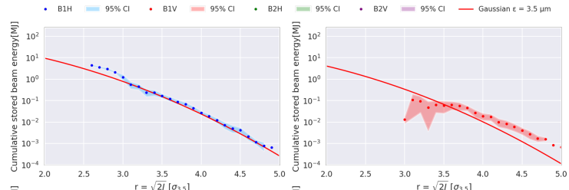
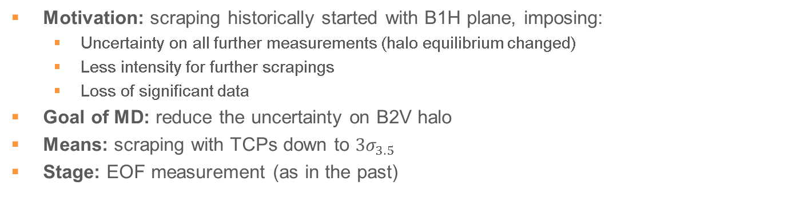
MD 14903 – Reducing uncertainty on B2V transverse halo population
Motivation: scraping historically started with B1H plane, imposing:
  Uncertainty on all further measurements (halo equilibrium changed)
  Less intensity for further scrapings
  Loss of significant data
Goal of MD: reduce the uncertainty on B2V halo
Means: scraping with TCPs down to $3σ_{3.5}$
Stage: EOF measurement (as in the past)
contact person: M. Rakic

Slide 5
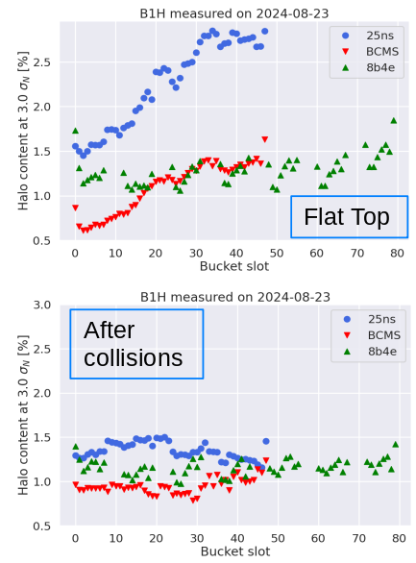
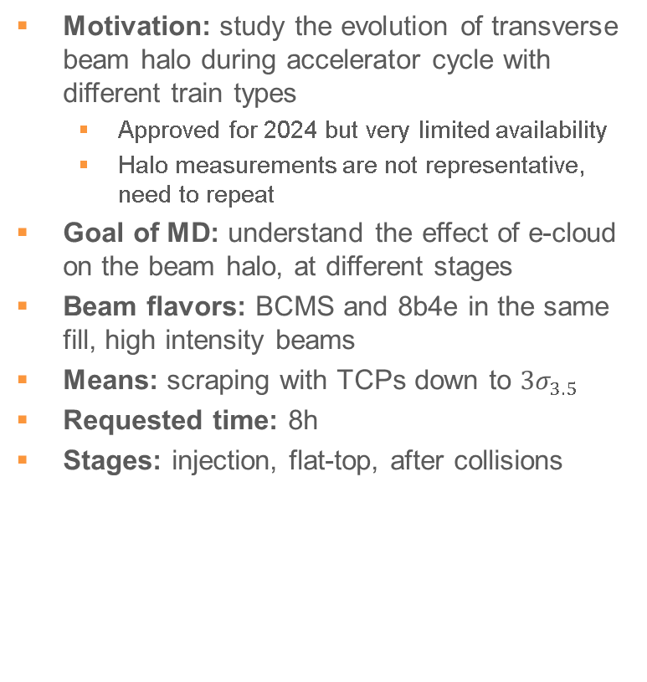
MD 9325 – Beam Halo Population Measurements using Collimator Scans at the End of Squeeze
Motivation: study the evolution of transverse beam halo during accelerator cycle with different train types
  Approved for 2024 but very limited availability
  Halo measurements are not representative, need to repeat
Goal of MD: understand the effect of e-cloud on the beam halo, at different stages
Beam flavors: BCMS and 8b4e in the same fill, high intensity beams
Means: scraping with TCPs down to $3σ_{3.5}$
Requested time: 8h
Stages: injection, flat-top, after collisions
contact person: M. Rakic

Slide 6
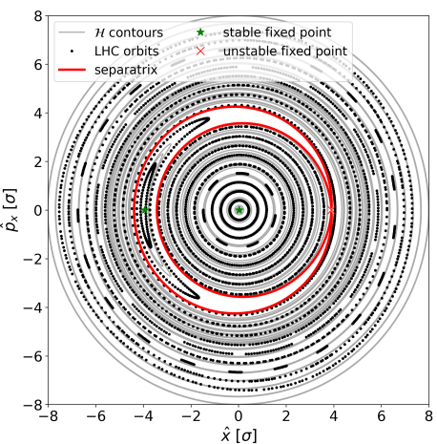
MD14963 – Halo cleaning with stable islands
New
Overpopulated beam halo is a serious machine protection risk in HL-LHC with fast failures (e.g. CLIQ)
HEL has been descoped from baseline
→ alternative solutions for halo cleaning needed
Stable islands produced by AC multipoles can transport
halo particles to the collimators
Proof of principle using ADT AC dipole
MD parameters:
  8h
  450 GeV
  One beam (parallel to other MD ok)
  3-5 bunches (<3e11 tot)
  ADT used for blow-up and
  special AC dipole excitation
contact person: D. Veres

Slide 7
HL-LHC collimation

Slide 8
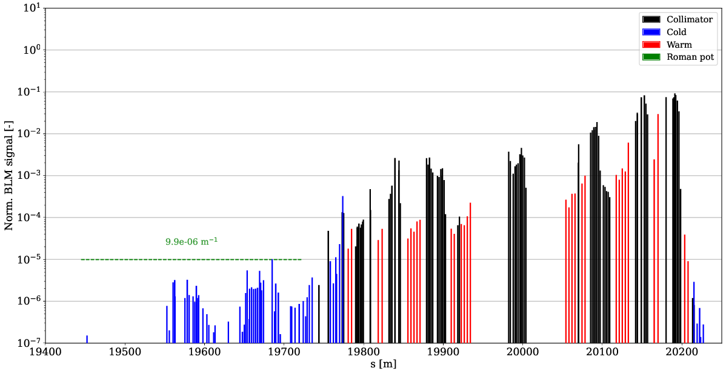
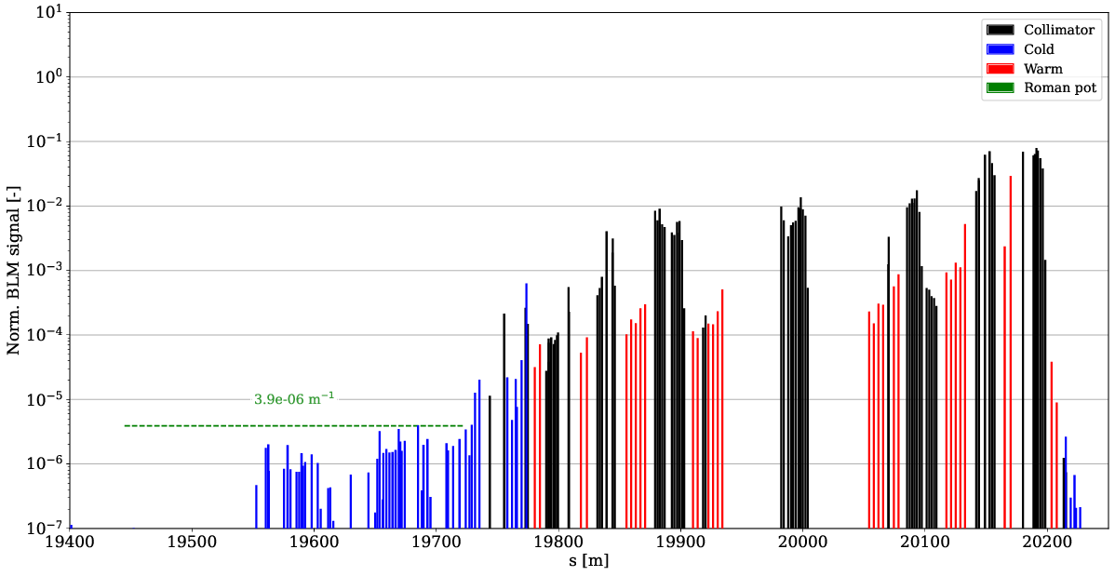
MD 15146 – Rematched IR7 optics for improved cleaning and impedance – High intensity part
HL-LHC beam intensity and brightness:
  Beam losses in IR7 DS could cause quenches
  Impedance can cause instabilities
Very successful MD last year:
  Up to 61 % reduction of DS losses
  Up to 33 % reduction of impedance
Optics require combined ramp and desqueeze
  Must test with high-intensity beams to ensure
  no issues with beam lifetime or loss spikes in IR7
16h for 6 fills:
  1 (4h): 3 pilots, optics measurement
  2 (2h): 3 pilots to validate corrections (if needed)
  3 (2h): 1 nominal and 15 pilots to cross-check alignment, betatron and off-momentum loss maps and asynchronous dump
  4 (2h): 3 nominal bunches
  5 (2h): 75 nominal bunches
  (MP checklist before proceeding?)
  6 (2h): 400 nominal bunches
New ramp compared to last year compatible with 2025 physics cycle
nominal meas.
HL MD meas.
Ideally MD1 due to contract of participant
contact person: B. Lindström

Slide 9
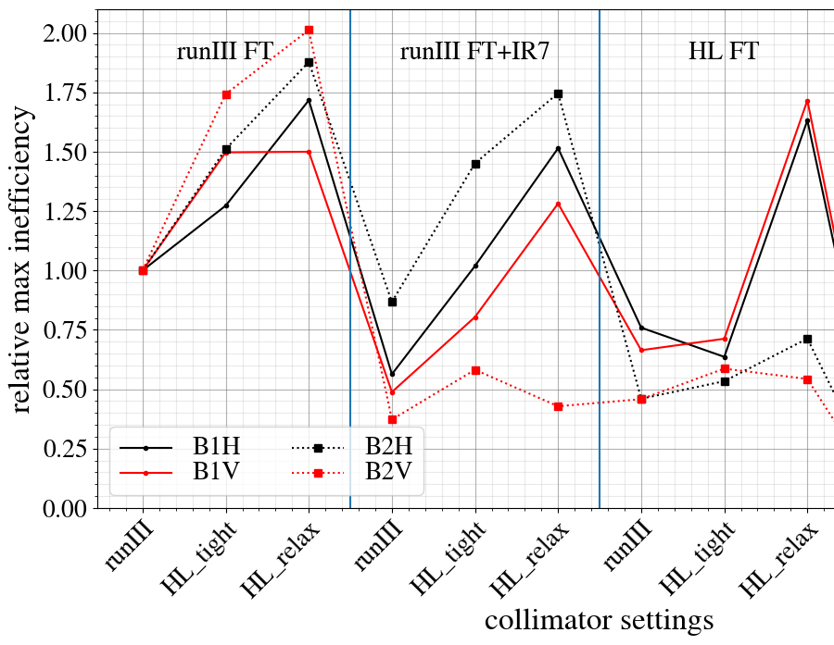
MD 15163 – Collimation performance with HL-LHC settings (part 2)
Two sets of collimator settings are envisaged for HL-LHC
(tight and relaxed)
Large worsening observed for relaxed settings
Need more data to understand discrepancies to simulations
8h
1 nominal bunch and several pilots (<3e11 total intensity)
Can be partially combined with MD on optics/other MDs or commissioning
contact person: A. Donadon Servelle

Slide 10
Impedance measurements
First phase of low-impedance IR7 collimators installed in LS2
  4 MoGr primary (TCPPM) collimators
  8 Mo-coated MoGr secondaries (TCSPM)
  Second installation phase foreseen for LS3
Important to carry out measurements in Run3
  Impedance and stability measurements
  Carried out together with HL-LHC WP2
  Typically done during commissioning – in that case, no MD needed
  Could also be combined with IR3 tune shift measurement MD from CEI
contact person: X. Buffat, B. Lindström

Slide 11
Quench tests

Slide 12
MD 9546 – B1 collimation quench test with protons (IR7)
2022 collimation quench test successful
  650 kW power loss without quench, excellent control of losses with ADT, indication that there is no need for 11T upgrade
Remaining caveats / uncertainties:
  Difficult to reach 1 MW design losses due to other constraints – BLM electronic limits and temperature interlocks
  Quench limit scaling from 6.8 to 7 TeV uncertain
  Symmetric response left / right of IR7?
Test requested 2024 – Qualified but Precluded by Spurious event
Request again (three ramps with multiple quench attempts, before TS)
Time: 12h
contact person: P. Hermes

Slide 13
IR3 Q6 quench test (presented by M. Solfaroli)
New
Potential risk of Q6 quench in IR3
Propose quench test in IR3
  Evaluate Q6 quench limit in operational conditions
  Extract optimized BLM thresholds
  Details, for example beam loss scenario etc, to be studied
Time: 12h
contact person: D. Mirarchi

Slide 14
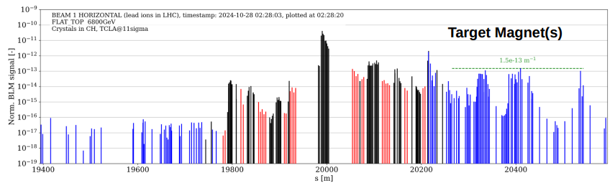
MD10723 – Crystal collimation quench test with heavy ions
Ultimate performance limitation for heavy ions with crystals unknown
Aim to probe levels of 60 kW & 100 kW in LHC design loss scenario (steady state over 10s)
Last test (2015) in B2H plane: aim for B1H plane here
6.8 Z TeV beams at FT (lower quench limit than 2015)
2x56 bunches per quench attempt, 4x56 bunches per fill
Time: 12h (up to three fills for contingency)
Collimator settings: nominal
BLM thresholds: Nominal OP settings with increased MF
contact person: P. Hermes
Approved for 2024 but machine not available

Slide 15
Crystal collimation

Slide 16
MD15043 – Crystal and standard collimation performance with oxygen beam
MD15044 – Crystal and standard collimation performance with neon beam
New
Collimation with ions: different physical processes at play than for protons
Unique opportunity to test with different ions, minimal investment
Important for benchmarking simulation models and preparing for potential future ”light” heavy ion runs (Run5)
Characterize crystals and measure collimation performance
Time: ideally 12h
Crystal alignment and characterization at injection and FT
contact person: M. Zielinska

Slide 17
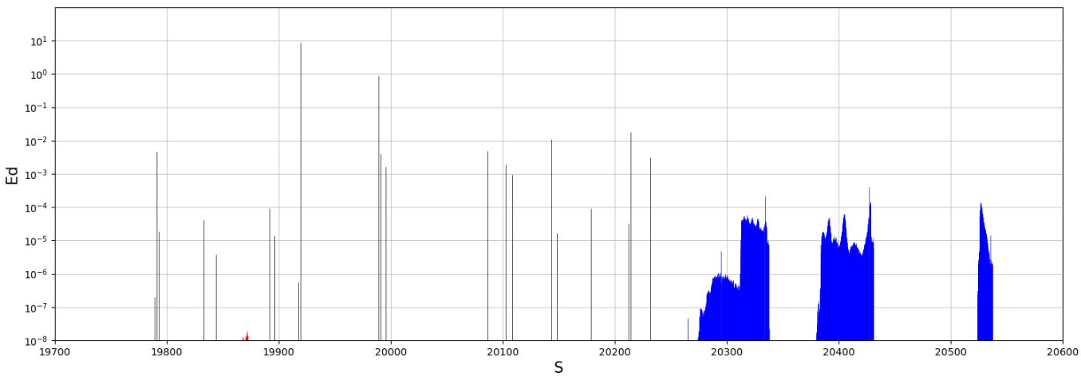
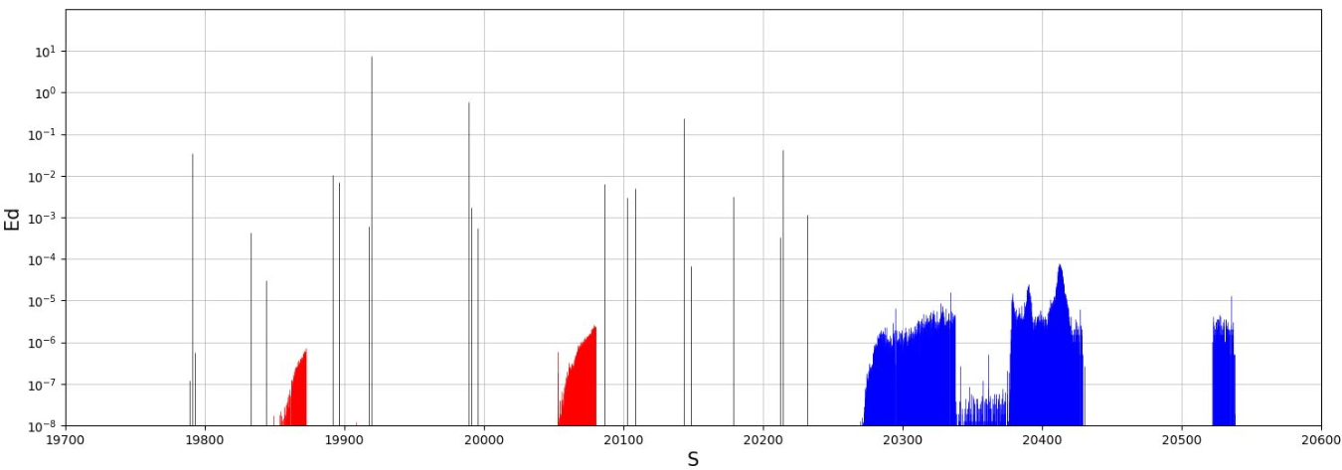
MD15183 – New IR7 optics for improved ions and crystal collimation
New
Ion collimation challenging due to nuclear dissociation, creating ions with different charge/mass ratio
No single-pass dispersion downstream of crystal collimators
Concentrated loss spikes in DS (much worse than proton collimation)
Proof of principle MD with new optics for ion collimation
  Significant improvements seen in simulations
  > factor of 2
Three fills over 12h:
  3 pilots, normal ramp to FT, IR7 desqueeze, optics measurements, crystal alignment
  3 pilots, normal ramp to FT, IR7 desqueeze, optics cross-check
  Multiple pilots, normal ramp to FT, IR7 desqueeze, loss maps
M. Zielinska
contact person: B. Lindström

Slide 18
Miscellaneous (not requested yet)
Further mitigations of start of ramp losses:
  Improved IR3 cleaning: tighter TCLA settings
  Scraping of halo during injection (possibly combined with optics changes)
Tighter collimation hierarchy for lower beta* reach

