Slide 1


Initial OMC MD plans for 2025
E.H.Maclean on behalf of the OMC team
J.Dilly, F.Carlier, Y.Angelis, S.Horney, K.Ujani, J.Keintzel, K.Skoufaris, F.Soubelet, R.Tomas, J.Gray, M.Steffanelli, P.Zisopoulos, C.Hernalsteens

Slide 2
Various MD proposals- mostly continued/adapted from previous years
Long-range beam-beam measurement / benchmarking / compensation
NL optics at injection
Ballistic optics
High-order error measurement via RDT feed-down
ADT-optics measurements with strong MO/Q’
60 degree optics to study IBS
As usual actual requests for 2025 may depend on commissioning outcomes

Slide 3
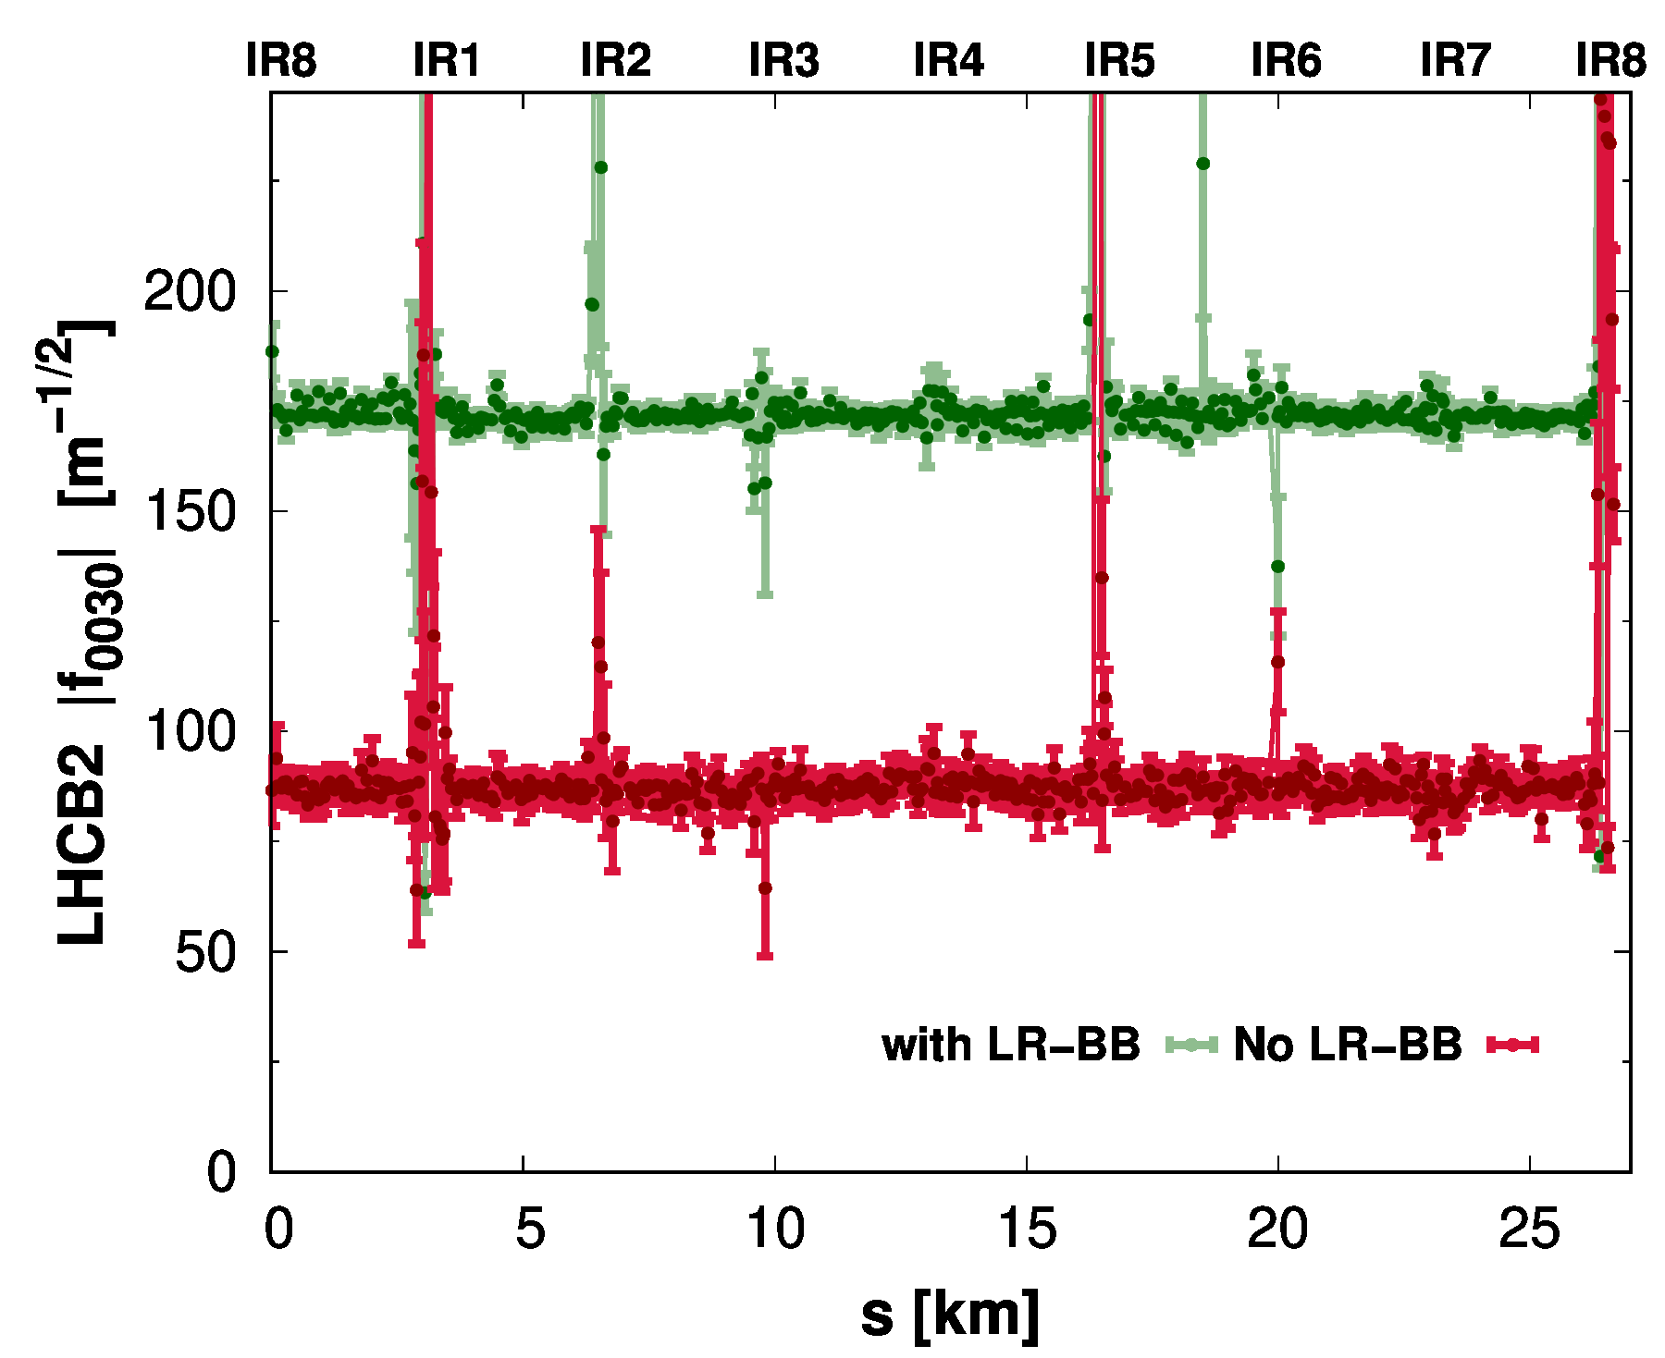
Long-range Beam-beam measurement/compensation
MD in 2024 demonstrated measurement of the nonlinear RDT driven by LRBB
Now target exploitation in current/future runs

Slide 4
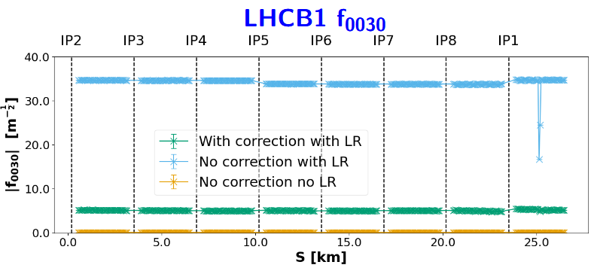
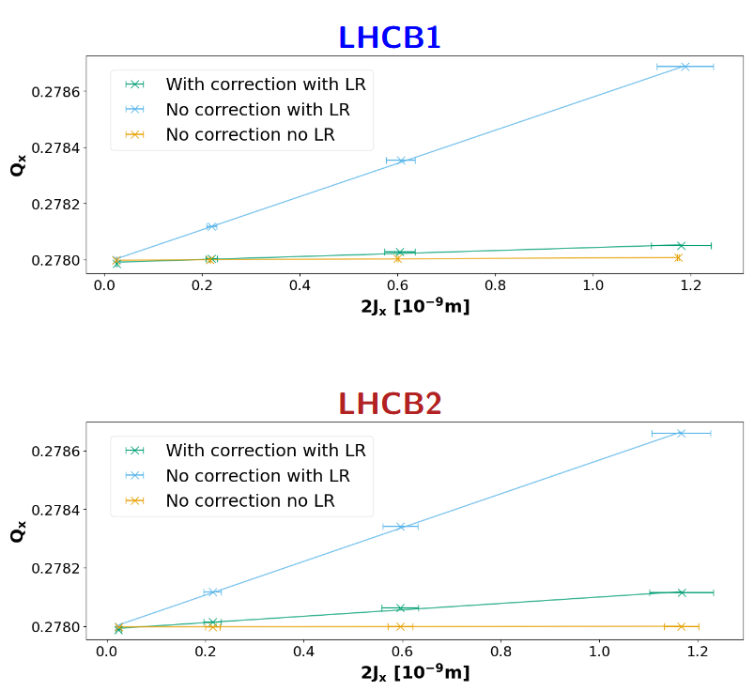
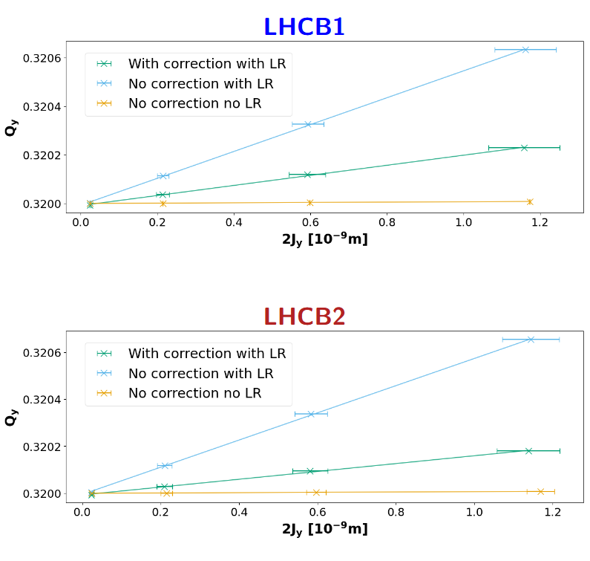
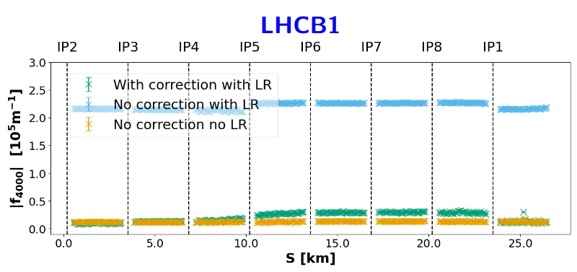
Long-range Beam-beam measurement/compensation
MD in 2024 demonstrated measurement of the nonlinear RDT driven by LRBB
Now target exploitation in current/future runs
S.Horney identified promising corrections in simulation for LRBB direct detuning terms and octupole + sextupole resonances

Slide 5
Long-range Beam-beam measurement/compensation
Some measurements proposed during commissioning
Aim of MD is to extend/continue benchmarking + correction beyond commissioning
Effectively same as previously requested MD13547 from 2024, with new corrections & flat-optics
→ same procedure as employed operationally during MD12263 & reviewed at RMPP 20sept 2024
Request 10h for 2-3 fills. Measurement/train beams swapping between fills.
MD at top energy, end-of-squeeze
Measure optics with ACD for 3 pilots of 1 beam, in collision with unkicked trains on the other beam
→ precise filling scheme to be defined: 1 pilot non-colliding / 1 pilot with full LR / 1 pilot with partial LR
Test various working points for resonance measurement and different corrections using MCSSX, MCSX, MCOX, pre-validated during commissioning.

Slide 6
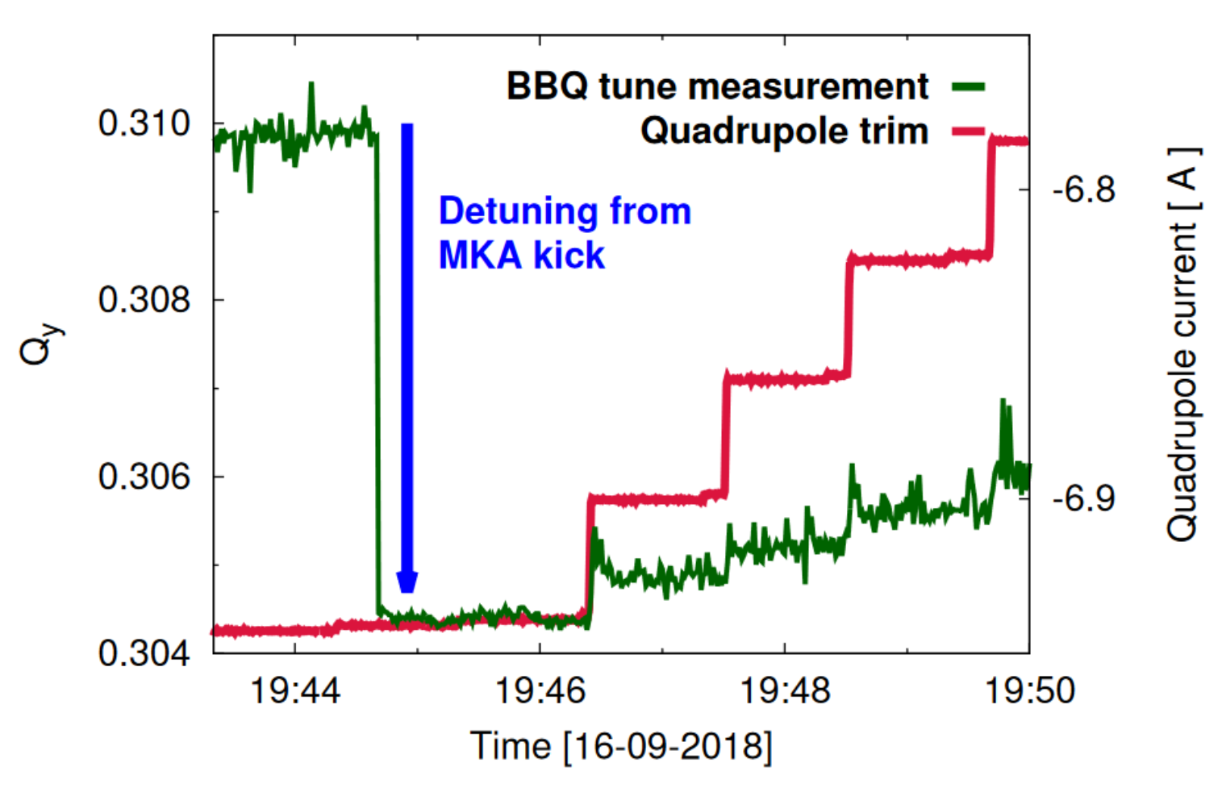
Linear/nonlinear optics at injection
Various open questions at injection remaining from past
commissioning and MD requests
MD12724 – Landau octupole response and phase knob tests
→ MO response doesn’t match model. Study individual responses
MD13548 – doughnut beams for NL-optics
→ test alternative detuning measurement via MKA kick & persistent
tune measurement in BBQ or ADT. Aim to speed up certain detuning studies in future
MD13546 – large amplitude kicks in decay and ramp
→ magnetic model predicts large b5 decay but never observed directly. Attempt large amplitude kicks
immediately on arriving at 450GeV to observe f1004 shifts. Perform large amplitude kicks through
ramp to study changing nonlinear errors vs energy / knob incorporation
Vertical dispersion source studies, alternative f1020 corrections via MCSX rather than MS
Request 8H – start measurements after pre-cycle/rampdown, measurement at injection, finishing with measurements in ramp
Single pilot measurements with AC-dipole, ADT, and aperture kicker at injection, then single pilot with ACD in ramp.
Depending on outcome of commissioning amalgamate key open tasks and study in parallel on different beams

Slide 7
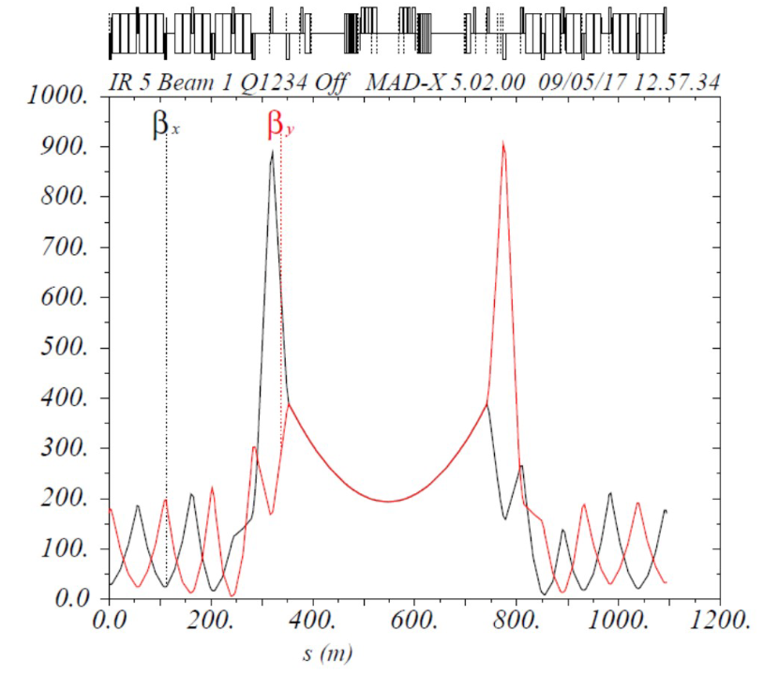
Ballistic optics
Existing request → MD13545
Perform beam-based calibration of IR BPMs
Study long-term evolution of IR-BPM calibration
(input to HL-commissioning strategy)
Try calibration of IR DOROS BPMs w.r.t. arc BPM to test APJ corrections
(input to HL-commissioning strategy to support use of APJ local correction)
Study local errors left/right of IR (input to HL-commissioning)
Request 10H for measurements with pilots
Re-use ballistic optics tested in 2022 commissioning
2.5 hours for degaussing of triplets + Q4 in IR1
inject/circulate pilots with the 2024 reference orbit and coarse collimator settings
Measure with AC-dipole: kicking 3 non-colliding pilots at 450 GeV and then ramp and measure at top energy

Slide 8
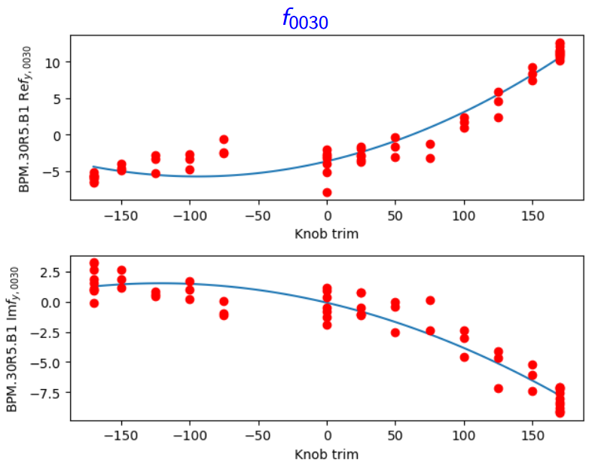
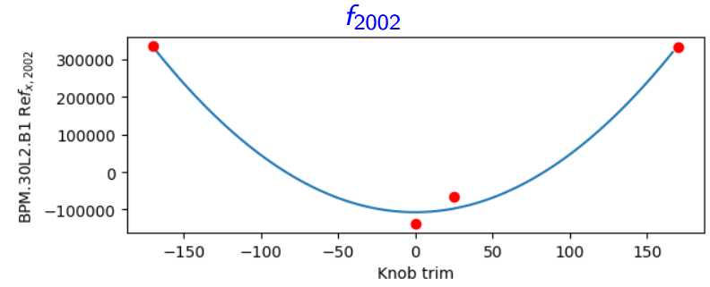
High-order error measurement at top energy
New request
In HL-LHC have new IRNL correctors for a5,b5,a6 + b6
No demonstrated observable which could be used to test/define a6 (skew-dodecapole) corrections
→ one possibility is measuring feed-down to Nonlinear RDTs
Observables for decapole and normal dodecapole (feed-down to amplitude detuning) are extremely time consuming
→ variation of nonlinear-RDT with crossing-angle could offer time
efficient method to test/define corrections
Plan to employ RDT FD measurements in commissioning at lower order to study skew-octupole correction. Depending on progress MD would aim to study precision when attempting to measure higher-order
Request 6H: measurements with 3 pilots at top-energy, end-of-squeeze
Perform large amplitude ACD kicks while varying crossing angles
Artificially vary MCTX to check measurement precision at dodecapole order

Slide 9
ADT optics measurements
Several existing requests
MD13545 – methods for nonlinear optics at small action
MD10397 – extended ADT for optics and ecloud
Long-term ADT-ACD measurements have been successful for linear and nonlinear optics measurements in PS and PSB
→ ADT-ACD is lower amplitude than ACD, but can excite for longer
Aim of MD is to test whether ADT-ACD can be used to perform optics measurements in OP configuration
→ can we measure optics with long-term small-amplitude excitation in presence of strong MO and Q’
→ does the ADT-ACD measurement quality improve significantly with nominal bunches
Request 6h @ injection → using extended ADT-ACD excitation (40k turns)
Optics measurements with pilots and extended ADT-ACD excitation, varying MO and Q’
Optics measurements with single-nominal and extended ADT-ACD, varying MO and Q’ (coarse collimator settings)
Optics measurements with single-nominal + extended ADT-ACD and OP collimator settings to see if losses remain acceptable

Slide 10
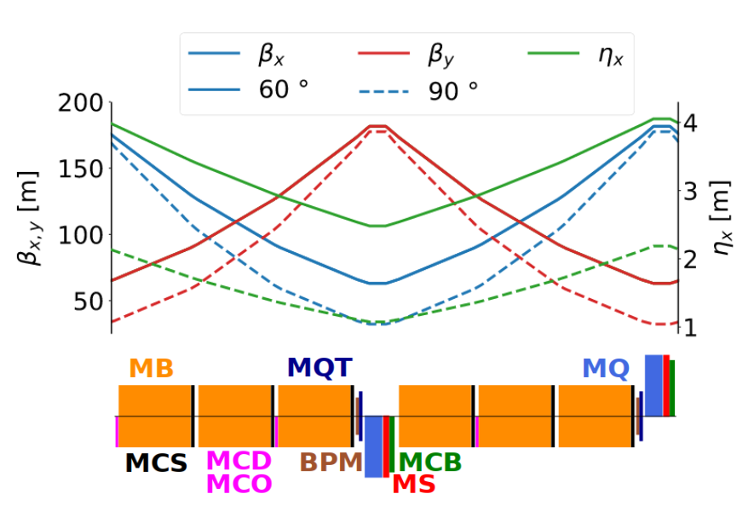
60 degree optics studies
J.Keintzel https://indico.cern.ch/event/1531923/
60deg MD program from 2023/2024 has been successful:
Identified 3% calibration error in arc BPMs
Confirmed by BI
60deg optics significantly modifies the injection optics
→ Can substantially change e.g. IBS emittance growth rates
MD proposal to re-commission 60deg optics for 2025/6 RP
Significant investment, so contingent on interest/support
from other teams utilizing e.g. emittance growth rate
with 60deg as additional data point to study IBS
Could be particularly relevant if 60deg turns out to be beneficial to IBS
Similar procedure as 2024 60deg MD (MD6943). But with additional steps to allow measurements with few nominals
Request 12h: 4h setup/thredding, 4h optics commissioning with pilots, 4h collimation
Followed by additional MD time – several 1h slots, for emittance growth rate measurements with multiple proton indivs (various emittance) and ions, to study impact on emittance growth. Remaining below safe beam flag.

