Slide 1
Importance of high-intensity tests in preparation of Run 4
O. Brüning, Nicolas Mounet, Rogelio Tomás, M. Zerlauth
Many thanks to Chiara Antuono, Xavier Buffat, Giovanni Rumolo and Carlo Zannini
LSWG – 01/04/2025

Slide 2
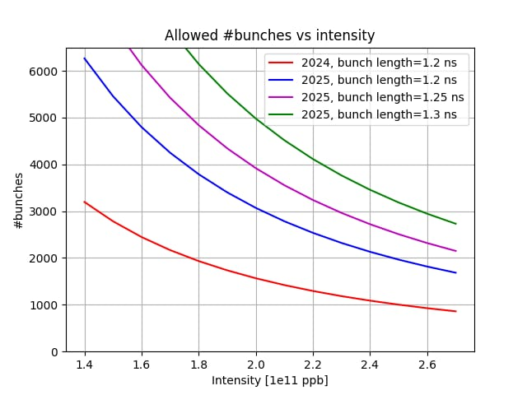
Local impedance heating in HL-LHC
Localised heating from impedance, and the possible consequences in terms of damage, is a major source of concern for high-intensity beams.
The only known sources of intensity limit in the LHC are under control (in particular thanks to the excellent bunch length control):
  4 single-beam (ID212) warm modules
  24 elliptical (ID128/53) warm modules
→ None of these limit the intensity up to 1.8 10¹¹ p+/b, or even 2.3 10¹¹ p+/b with 1.25 ns (full beam, flat top)
Yet some concerns remain when going to high-intensity (full HL-LHC beam).
→ Initial proposal (see NM et al, Chamonix 2025): tests in 2025/2026 at 2.3 10¹¹ p+/b:
  at injection, std or BCMS, full beam,
  at flat top, 8b+4e, full beam (no collisions)
  at ~2 TeV, std or BCMS, full beam.
2700
Courtesy of C. Antuono, JAP workshop 2024

Slide 3
HL-LHC statement
Discussions are already ongoing to formally confirm in the LHC schedule the two-week period of high-intensity operation at the end of June 2026 (see M. Lamont’s Chamonix summary)
  Needs to be well-prepared: strategies for injection, different filling schemes (standard, 8b4e, BCMS, 12-24b) and possible mitigations for the current voltage limitations and losses.
  Filling the LHC with as many bunches as possible + first ramp tests already in 2025, will allow early validation of these preparations to make most efficient use of time in mid 2026.
Advancing some tests in 2025 could also allow the early identification of possible hardware limitations, gaining time for addressing them.
On the warm modules, such tests will not induce more heat load than standard operation, provided the bunch length is large enough.
→ For HL-LHC it is vital to continue the program of nominal HL-LHC intensity at injection in 2025 (2.3 10¹¹ p+/b, >~2000 bunches).
→ Proposal: first high-intensity MDs for the 2nd MD block (towards full machine at injection) and then aim for some first ramp tests in blocks 3 and 4.

