Slide 1
RF MD Requests for 2025
H. Timko, P. Alonso, D. Barrientos, H. Bartosik, R. Bruce, X. Buffat, A. Butterworth, R. Calaga, N. Catalan,
G. Hagmann, B. Karlsen-Baeck, I. Karpov, S. Kostoglou, C. Marrelli, S. Morales, N. Mounet, B. Salvachua,
D. Soriano, A. Spierer, K. Turaj, D. Valuch, N. Triantafyllou, M. Zampetakis
LSWG meeting, 18th March 2025

Slide 2
MDs with HL-LHC Intensities
Batches at 2.3x10¹¹ p/b, at least 36b, preferably 4x36b BCMS
  Start with beam variants that are optimized in SPS are preferred, later 72b batches are welcome, too
  In SPS, should try to reach as much as possible LIU baseline (10 MV + 2 MV, 1.65 ns)
MD#1: 6 h – refine RF capture and fill the machine
  In continuation: e-cloud at injection + 2 ramps of single bunches (ABP)
  At flattop, we can study longitudinal LLD parasitically
    Ramp 1: 6 bunches, nominal bunch length
    Ramp 2: More bunches, lower bunch length target for BUP to ~1.0 ns; open phase loop to observe
      Parasitic data also for intensity effects on controlled emittance blow-up at HL-LHC intensities
MD#2: 8 h – determine max no. bunches that can be accelerated, 2-3 ramps
  Present estimate is ~750b due to start-of-ramp BLM thresholds
  Apply improved cleaning and updated BLM thresholds if available​
MD#3: 8 h – study 72b beam, full beam at injection (synergy w/ ABP) and ramp

Slide 3
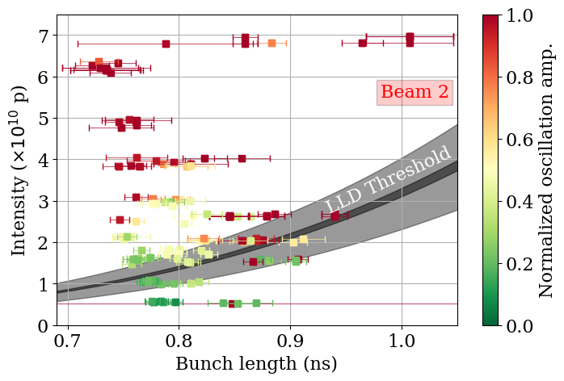
MDs on LHC Impedance
MD#1: 4 h – complete longitudinal LLD measurements with single bunches of different intensities and 1.0 ns bunch length
  In MD#1, profit also from parasitic measurements during ramp and at flattop
MD#2: 8 h – other measurement methods to refine the longitudinal impedance
  E.g. de-bunching of long bunches as was done in SPS
  Methods presently being evaluated in simulations
Measurement data from 2024,
M. Zampetakis at HL-LHC coll. meeting 2024

Slide 4
Other MDs
MD#1: 8 h – improved cleaning of de-bunched beam at flat bottom
  ADT intra-beam cleaning, RF noise cleaning?
  (Only if needed) in addition to the commissioning time requested for this activity
MD#3/4: 6 h – full detuning at LHC injection
  Evaluate power requirements and beam losses when injecting directly in full-detuning mode
MD#4 (before TS2): 4 h – full power reach of LHC klystrons with batched beam
  Should check whether can be done after ion commissioning #1, right before TS#2
  Backup time slot: MD#1 (before TS1) or during commissioning
MD#4: 8 h – White Rabbit frequency distribution with beam
  Provided rapid switching between old/new system feasible
MD#5: 8 h – ion lifetime studies at injection
  Using bunch shaping methods (sine-modulation or batch-by-batch blow-up)
  Vary intensity from SPS/LEIR and compare IBS evolution in LHC to separate IBS from RF noise

Slide 5
Summary
MD block | Length | What
MD#1 | 6 h | RF capture and full machine with HL-LHC beams, 4x36b
MD#1 | 4 h | Longitudinal loss of Landau damping at injection, single bunches
MD#1 | (8 h) | Improved cleaning of de-bunched beam at injection
MD#2 | 8 h | Maximum number of bunches that can be accelerated with HL-LHC beams, 4x36b
MD#2 | 8 h | Refining the longitudinal impedance model of the LHC
MD#3 | 8 h | RF capture and ramp with HL-LHC beams, 4x72b
MD#3/4 | 6 h | Capturing HL-LHC beams in full detuning
MD#4 | (4 h) | Full power reach of LHC klystrons with beam
MD#4 | 8 h | White Rabbit frequency distribution with beam
MD#5 | 8 h | Ion lifetime studies at injection
Total | 60(+ 8) h
cf. 2024: 10 MDs, 65 h

