Slide 1
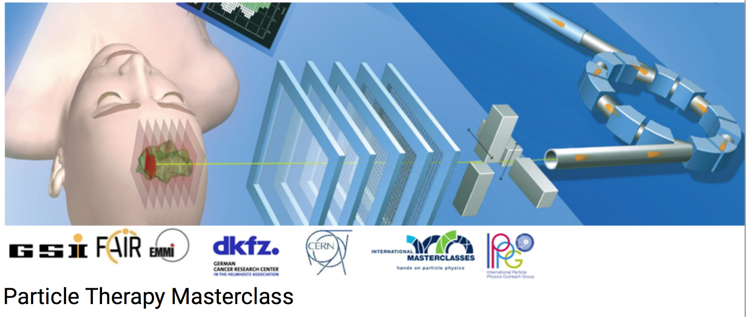

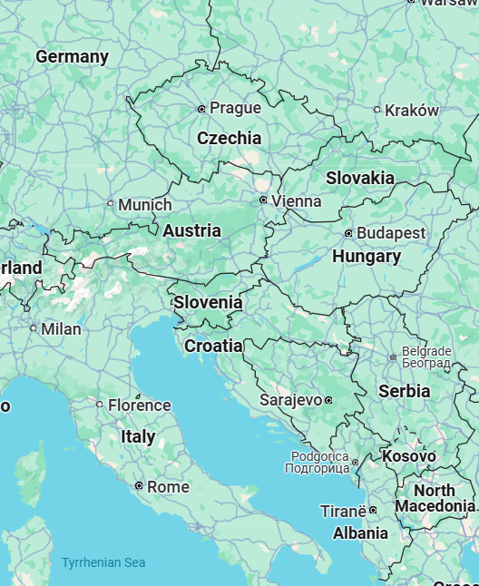
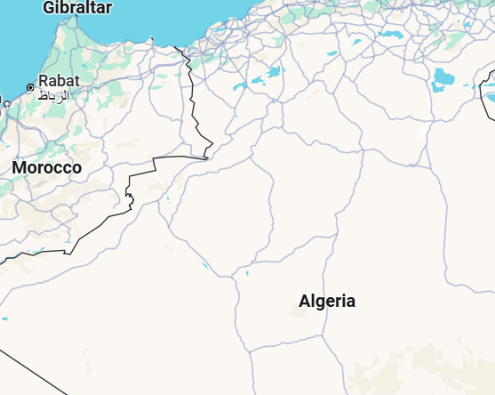
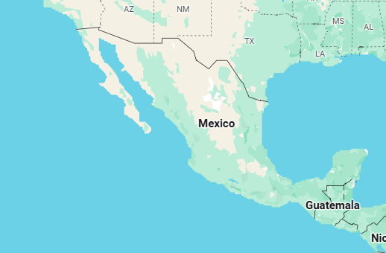

PTMC Video Conference 13 March 2025
PARTICLE THERAPY MASTERCLASS

Slide 2
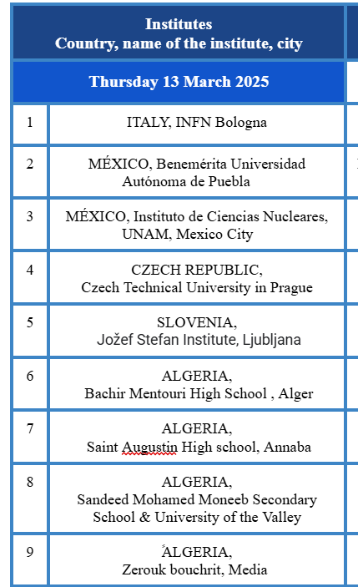
PTMC Video Conference 13 March 2025
PARTICLE THERAPY MASTERCLASS

Slide 3
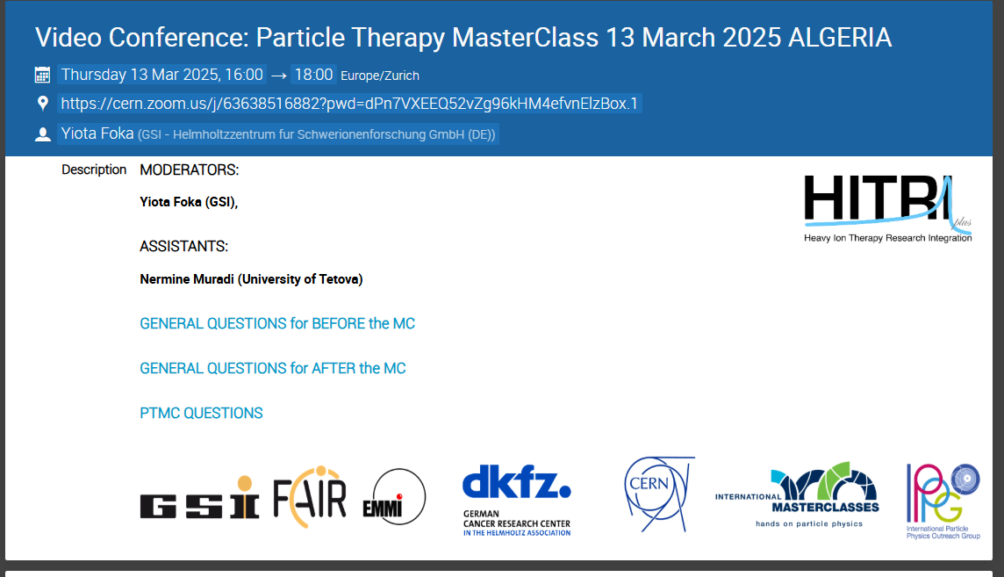
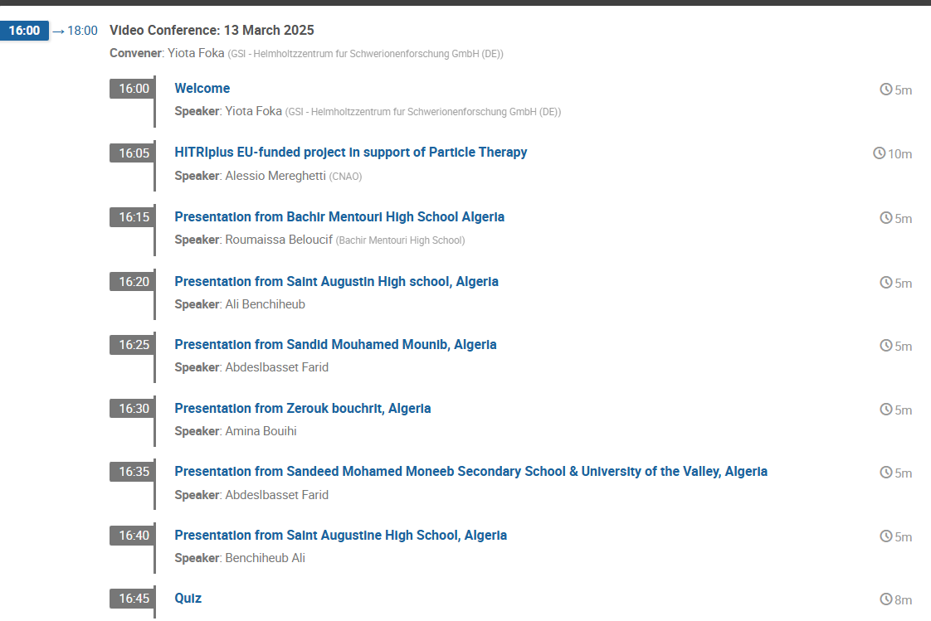
PTMC Video Conference 13 March 2025
https://indico.cern.ch/event/1524450/
Moderators: Yiota Foka (GSI),
Asistants : Nermine Muradi (Uni Tetova), Mitrou Theodoros (AUTH)

Slide 4
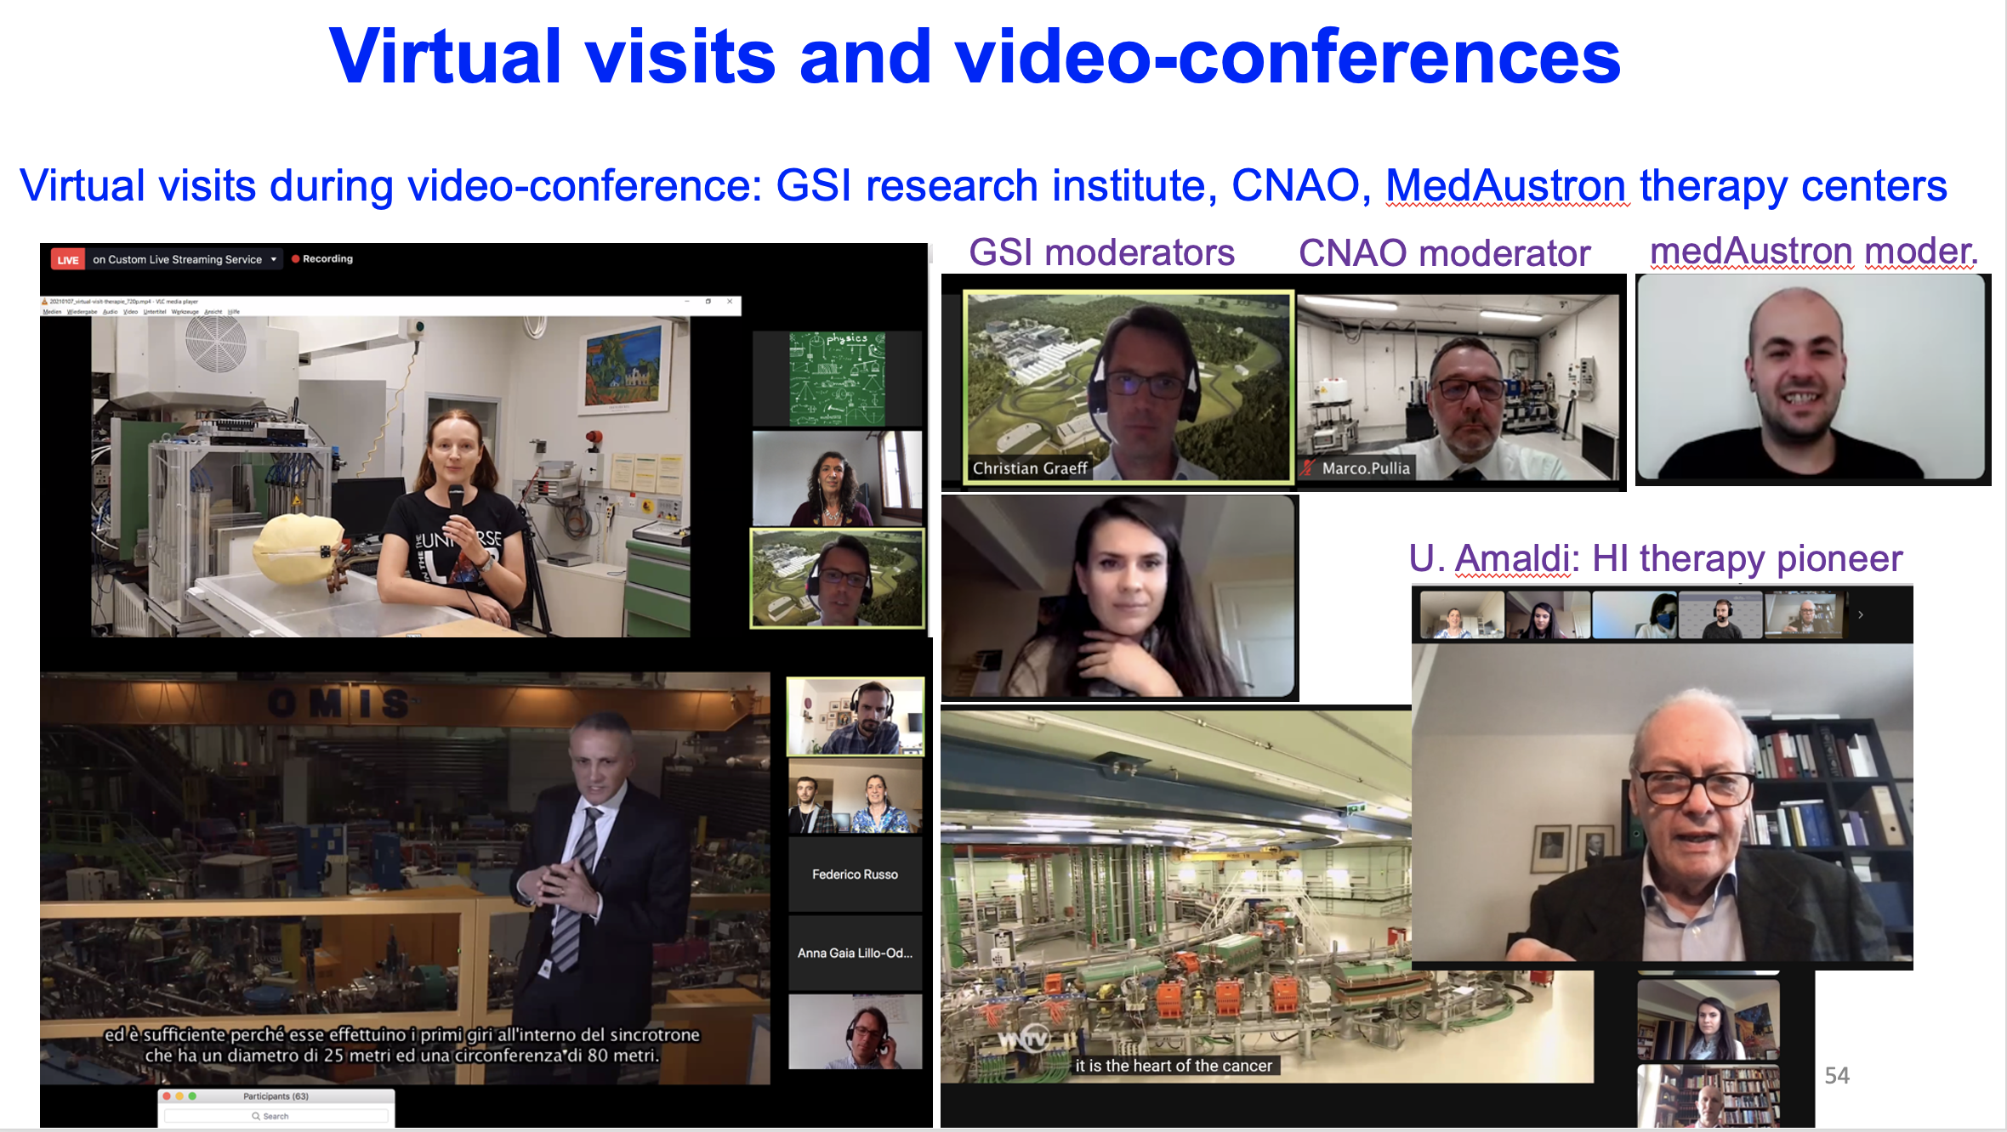

Slide 5
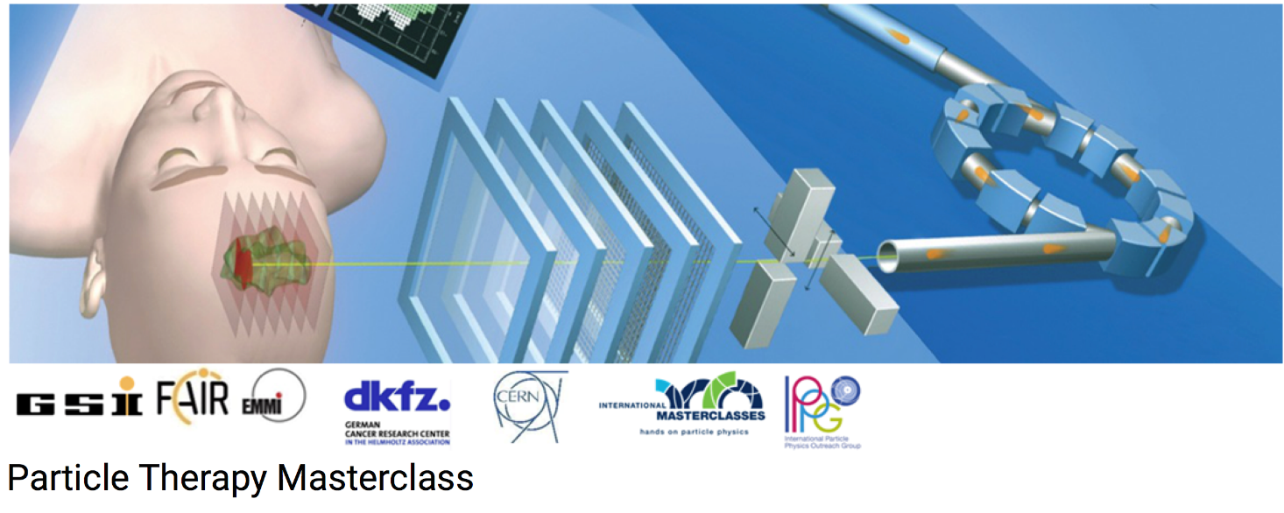
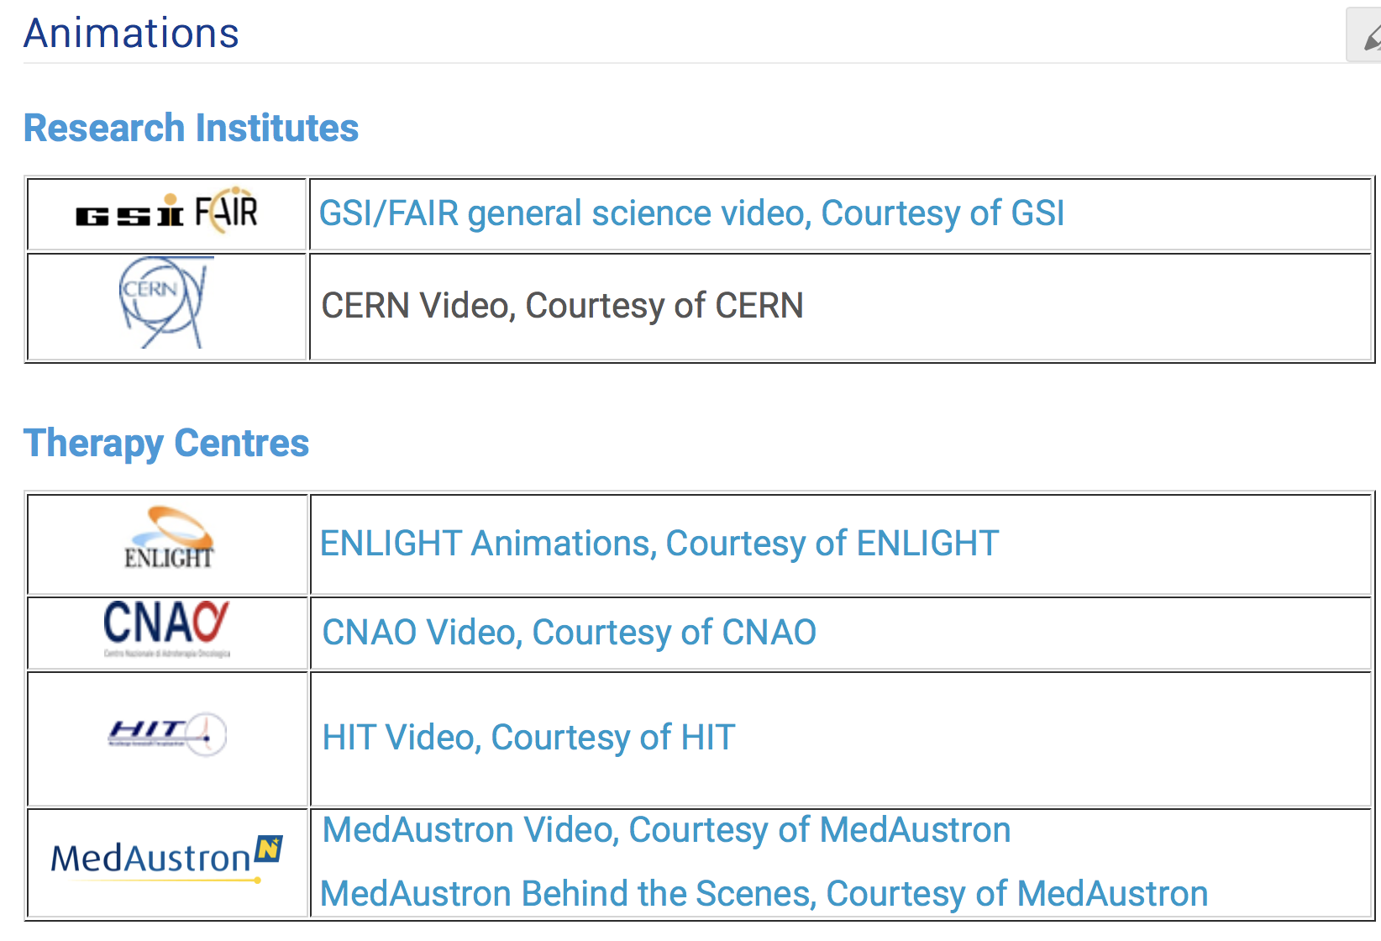
https://indico.cern.ch/event/840212/page/18000-animations

Slide 6


Slide 7
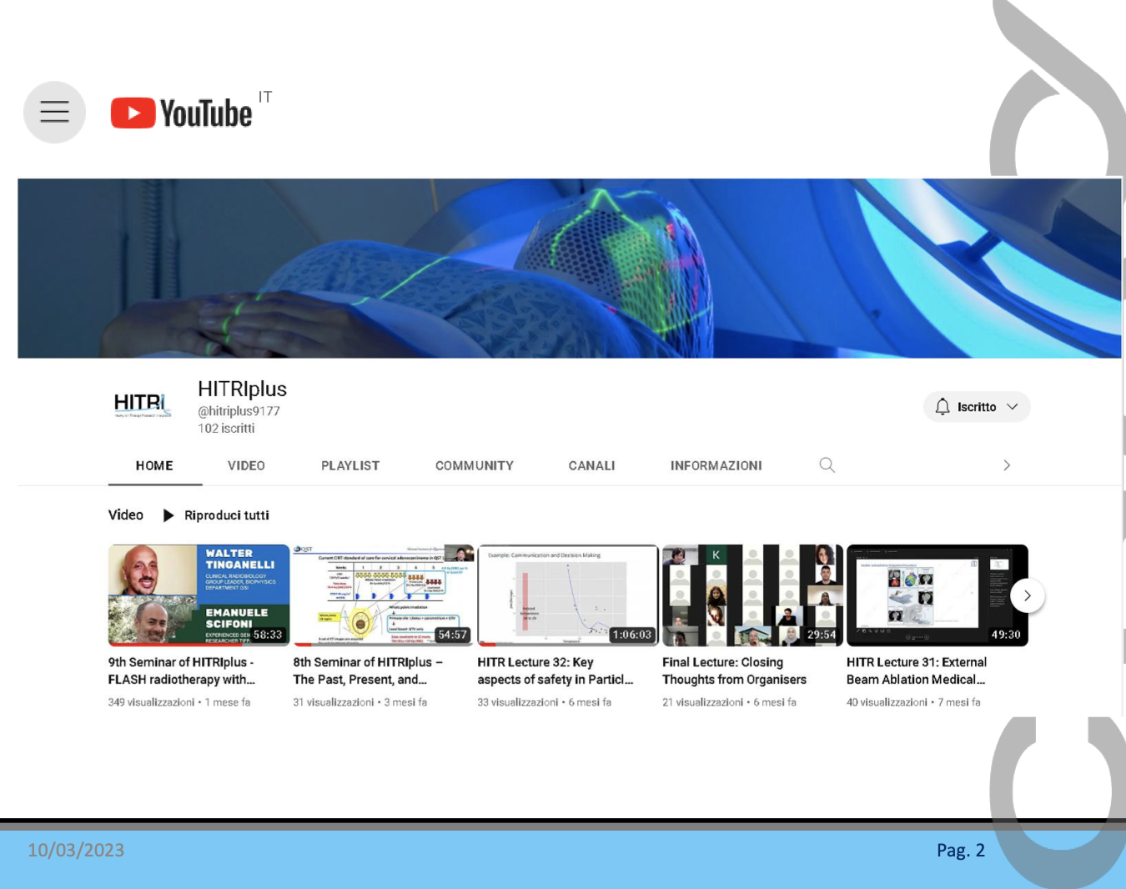

Slide 8
PTMC Video Training 18 January 2024
Many thanks to the PTMC core team,
all moderators and local organisers,
the HITRIplus project
for contributions and support

