Slide 1



The UK’s input to ESPPU
a summary
Stephanie Hills
All images in this presentation are © CERN unless otherwise indicated

Slide 2
The drafting team
Senior researchers
Early career researchers
UK ECFA delegates
STFC Particle Physics Advisory Panel
Experimental and theoretical communities

Slide 3
What was discussed
European Strategy Group questions
Detector R&D
Software and computing
Attracting and maintaining talent and expertise
Industrial return
Public engagement and outreach (I talked to one of the drafting team very early in the process to get this included)

Slide 4
Summary
Fully exploit HL-LHC (highest priority)
Strong support for “a new large circumference tunnel at CERN”
Strong and sustainable non-collider particle physics programme (potential for groundbreaking discoveries in the next 10-20 yrs)
Sustained investment in R&D for accelerators, detectors, computing and environmentally sustainable technologies
Sustained and coordinated support for PP theory
Notes:
CERN should remain at the forefront of energy frontier exploration.

Slide 5
ECRs
“The ECR community needs certainty that collider physics has a future beyond the HL-LHC”
Ensure the future roadmap meets the needs and aspirations of ECRs
Stress the importance of a definitive decision in this round of ESPPU for the next European flagship collider
Continued UK commitment to broad programme of non-collider projects – shorter timescale experiments parallel to and in-between major collider projects
Retaining talent is a big concern.

Slide 6
The next project for CERN
Either FCC-ee followed by FCC-hh, or FCC-hh
Anxiety about what happens between LHC and FCC (≥10 years) – civil engineering for FCC needs to start ASAP
“It is essential for both ethical reasons and public support that environmental concerns are fully taken into account. This includes ensuring that negative environmental impacts of PP research and infrastructure are identified, minimised and mitigated, including comprehensive life cycle assessments of future experiments”

Slide 7
Public engagement and outreach
The manifold societal and economic benefits of a future collider programme need to be highlighted to policymakers, funders and the public.
“Europe must invest in all forms of public engagement to improve public opinions of science, illustrate the wider impact of research to justify the funding of large-scale experiments, and inspire the next generation of scientists.”

Slide 8
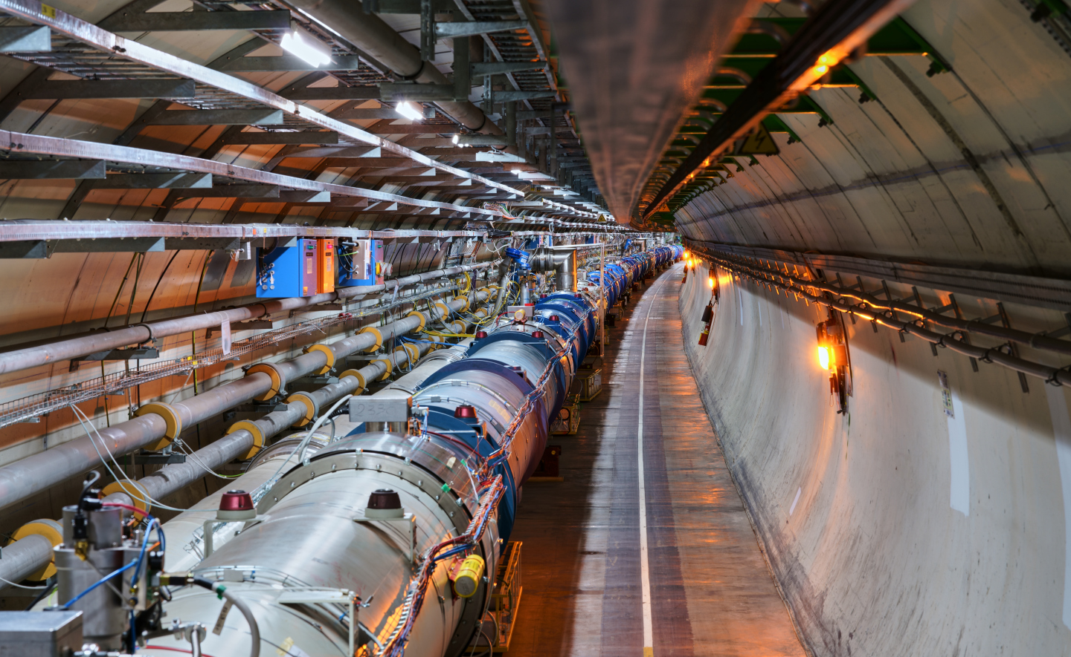
@stephhills.bsky.social
#UKatCERN

