Slide 1

WR Switch v4
25 June 2025
14th WR Workshop
CERN
On behalf of WRSv4 members of WRC Project
CERN, GMV

Slide 2
WRSv4 project – goal and timeline
Goal: create a new WR Switch that:
  Supports 1 and 10 Gbps (data and timing)
  Serves as drop-in replacement for WRS-v3 (obsolescence)
  Provides industry-level reliability features
  Serves as a platform for new features, functionality extensions and performance enhancements
  Meets needs of the WR Community
Timeline:
  2014: first idea
  2018-2020 : Studies on specifications, choice of FPGA
  2020-2022 : Schematics and mechanics design
  2022-2024 : Layout design, prototype v1 (GW/SW/PCB/mechanics), GMV joins the project
  2024 July : WR Synchronisation over 1G
  2025 : prototype v2, WR synch over 1G and 10G, exp board support, first SW/GW release
  https://gitlab.com/ohwr/project/wr-switch-hw-v4/-/wikis/home

Slide 3


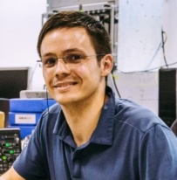







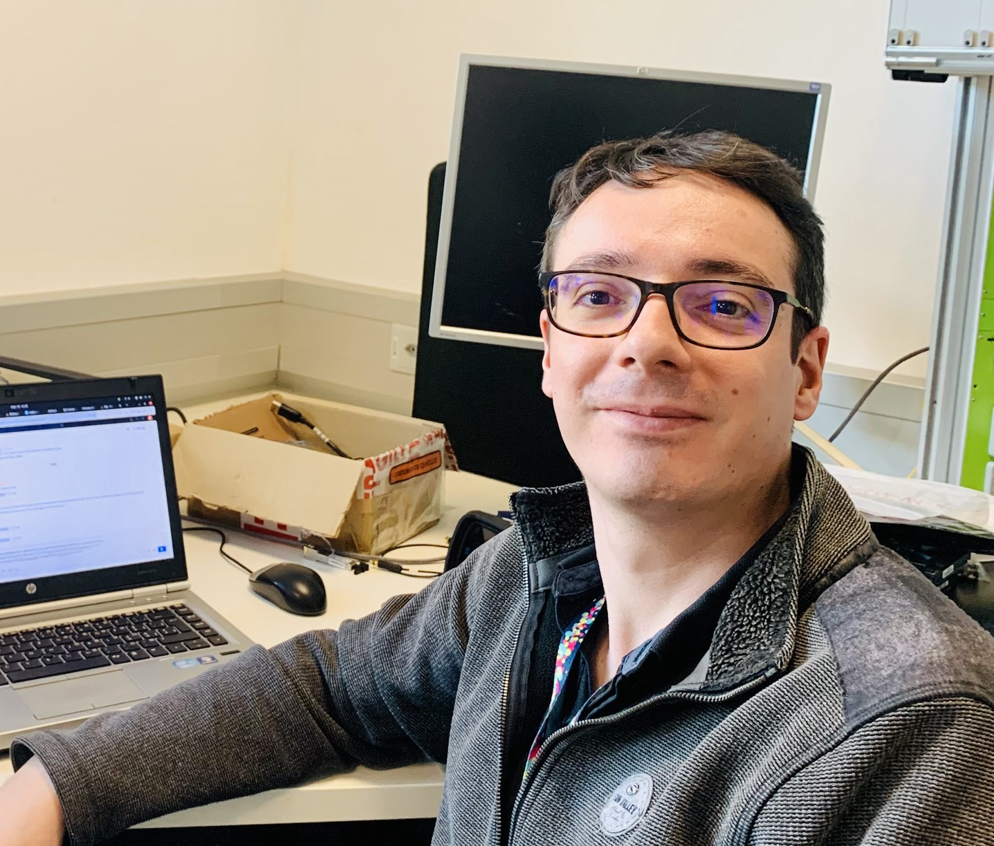


Current WRSv4 team
Maciej
Technical Lead
Daniel
PM/Technical lead
Vikas
Gateware
Developer
Harvey
Hardware/Gateware
Developer
You?
Hardware/Gateware
Developer
(hiring)
Binish
Hardware
Engineer
Alon
Hardware
engineer
Adam
Software
Developer
Quentin
Software
Developer
Satyam
Software Developer
Aravind
Software
Developer

Slide 4
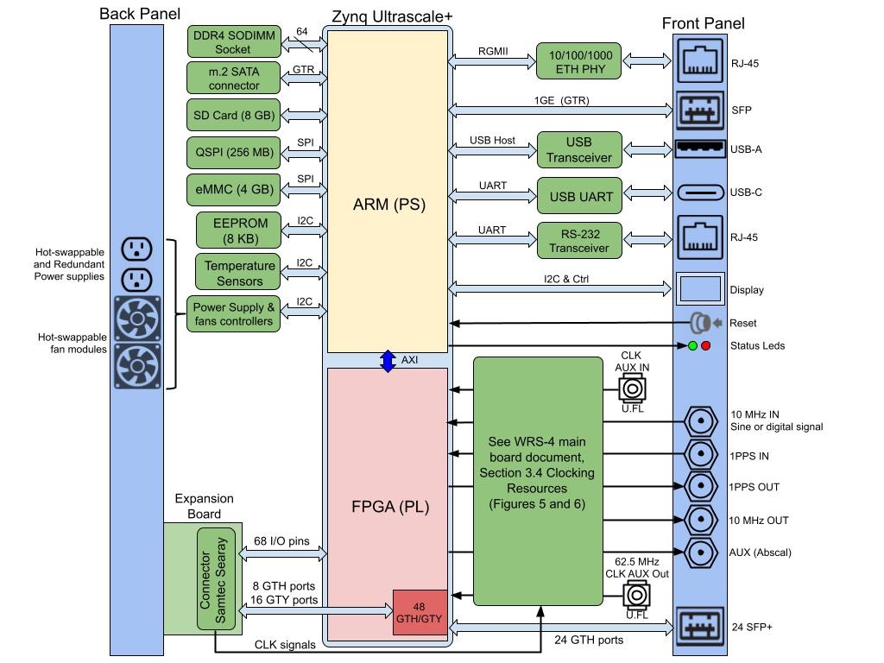
Main Board Architecture
One single Main Board with expansion slot
Based on a SoC:
  Xilinx Zynq Ultrascale+ XCZU17EG-1FFVC1760E
  32 GTH 16.3Gb/s and 16 GTY 32.75Gb/s
  Footprint compatible with ZU11EG and ZU19EG
Clocking architecture
  Flexibility with multiple options using multiplexers, fanout buffers and the expansion board
  Meant for mixed scenario for simultaneous 1G & 10G
  Low-jitter performance
Expansion slot:
  Functionally FMC LPC compatible (Ansi Vita 57.1)
  High speed data I/Fs: 4 GTH and 16 GTY ports
  (45 diff-pairs to GTH/GTY quads)
  Clock inputs connected to WR transceivers and main PLL
  Existing/possible expansion boards:
    Holdover expansion board
    GPS-disciplined frequency/time source

Slide 5
Prototype v1

Slide 6
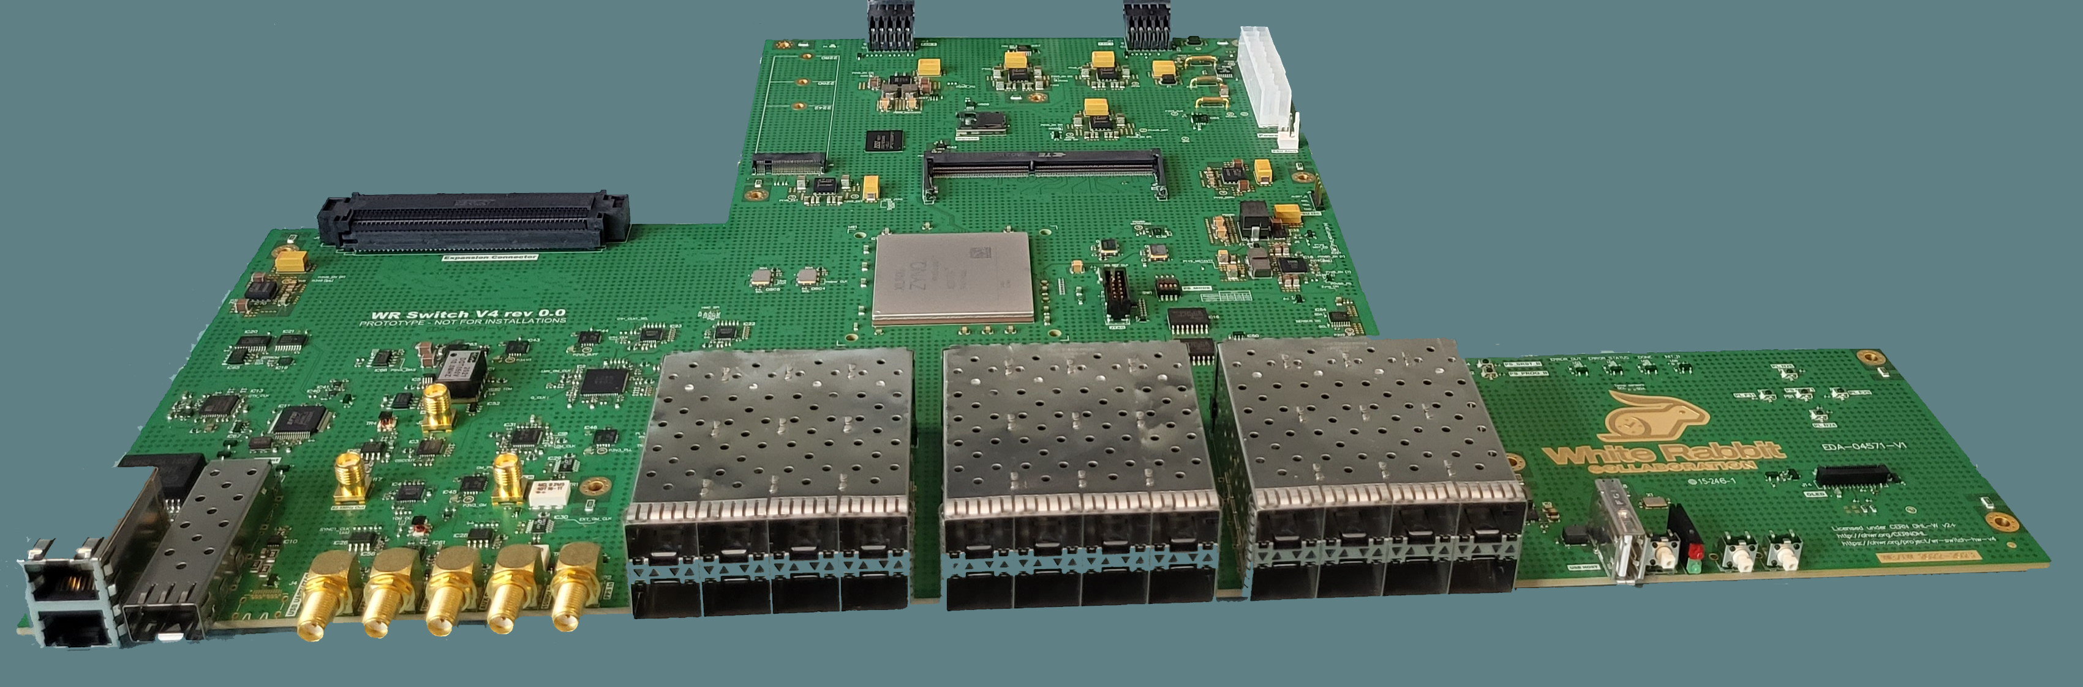
Prototype v1: PCB
Main board layout finished in December 2023, arrived in May 2024
6 prototypes
16 layers, blind vias, megtron substrate
https://gitlab.com/ohwr/project/wr-switch-hw-v4/-/wikis/Prototype-v1

Slide 7
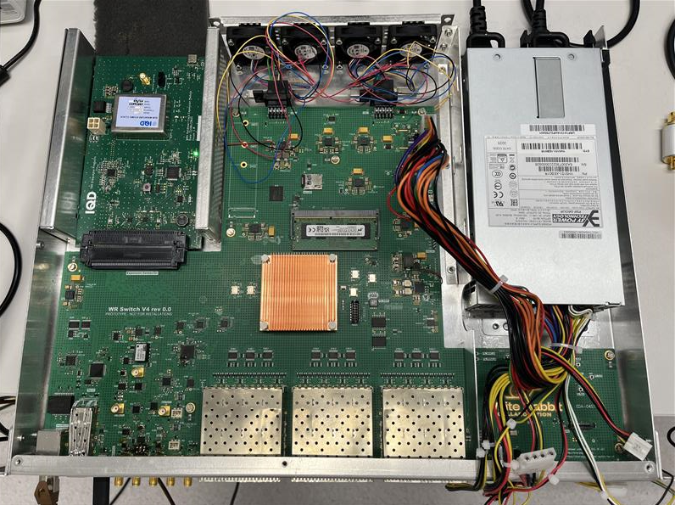
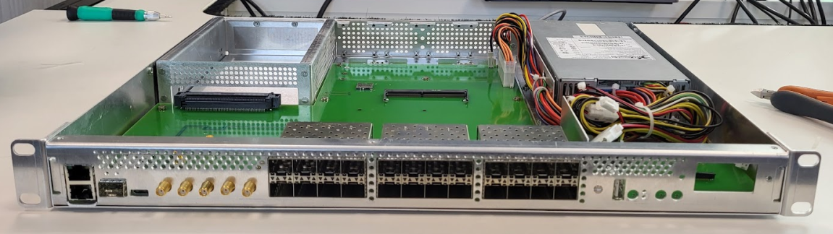
Prototype v1: Enclosure
19“ rack-mountable 1U (height: 44.45 mm, wide: 482.6 mm, depth: 310 mm)
Separate airflow for Main Board and PSU (and optionally expansion board)
Simple design for hot-swappable elements (fans and power supply) and expansion board
https://gitlab.com/ohwr/project/wr-switch-hw-v4/-/wikis/v1.2-mechanics-feedback

Slide 8
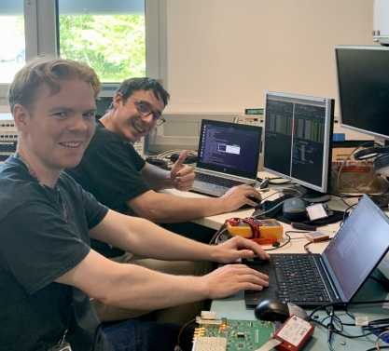
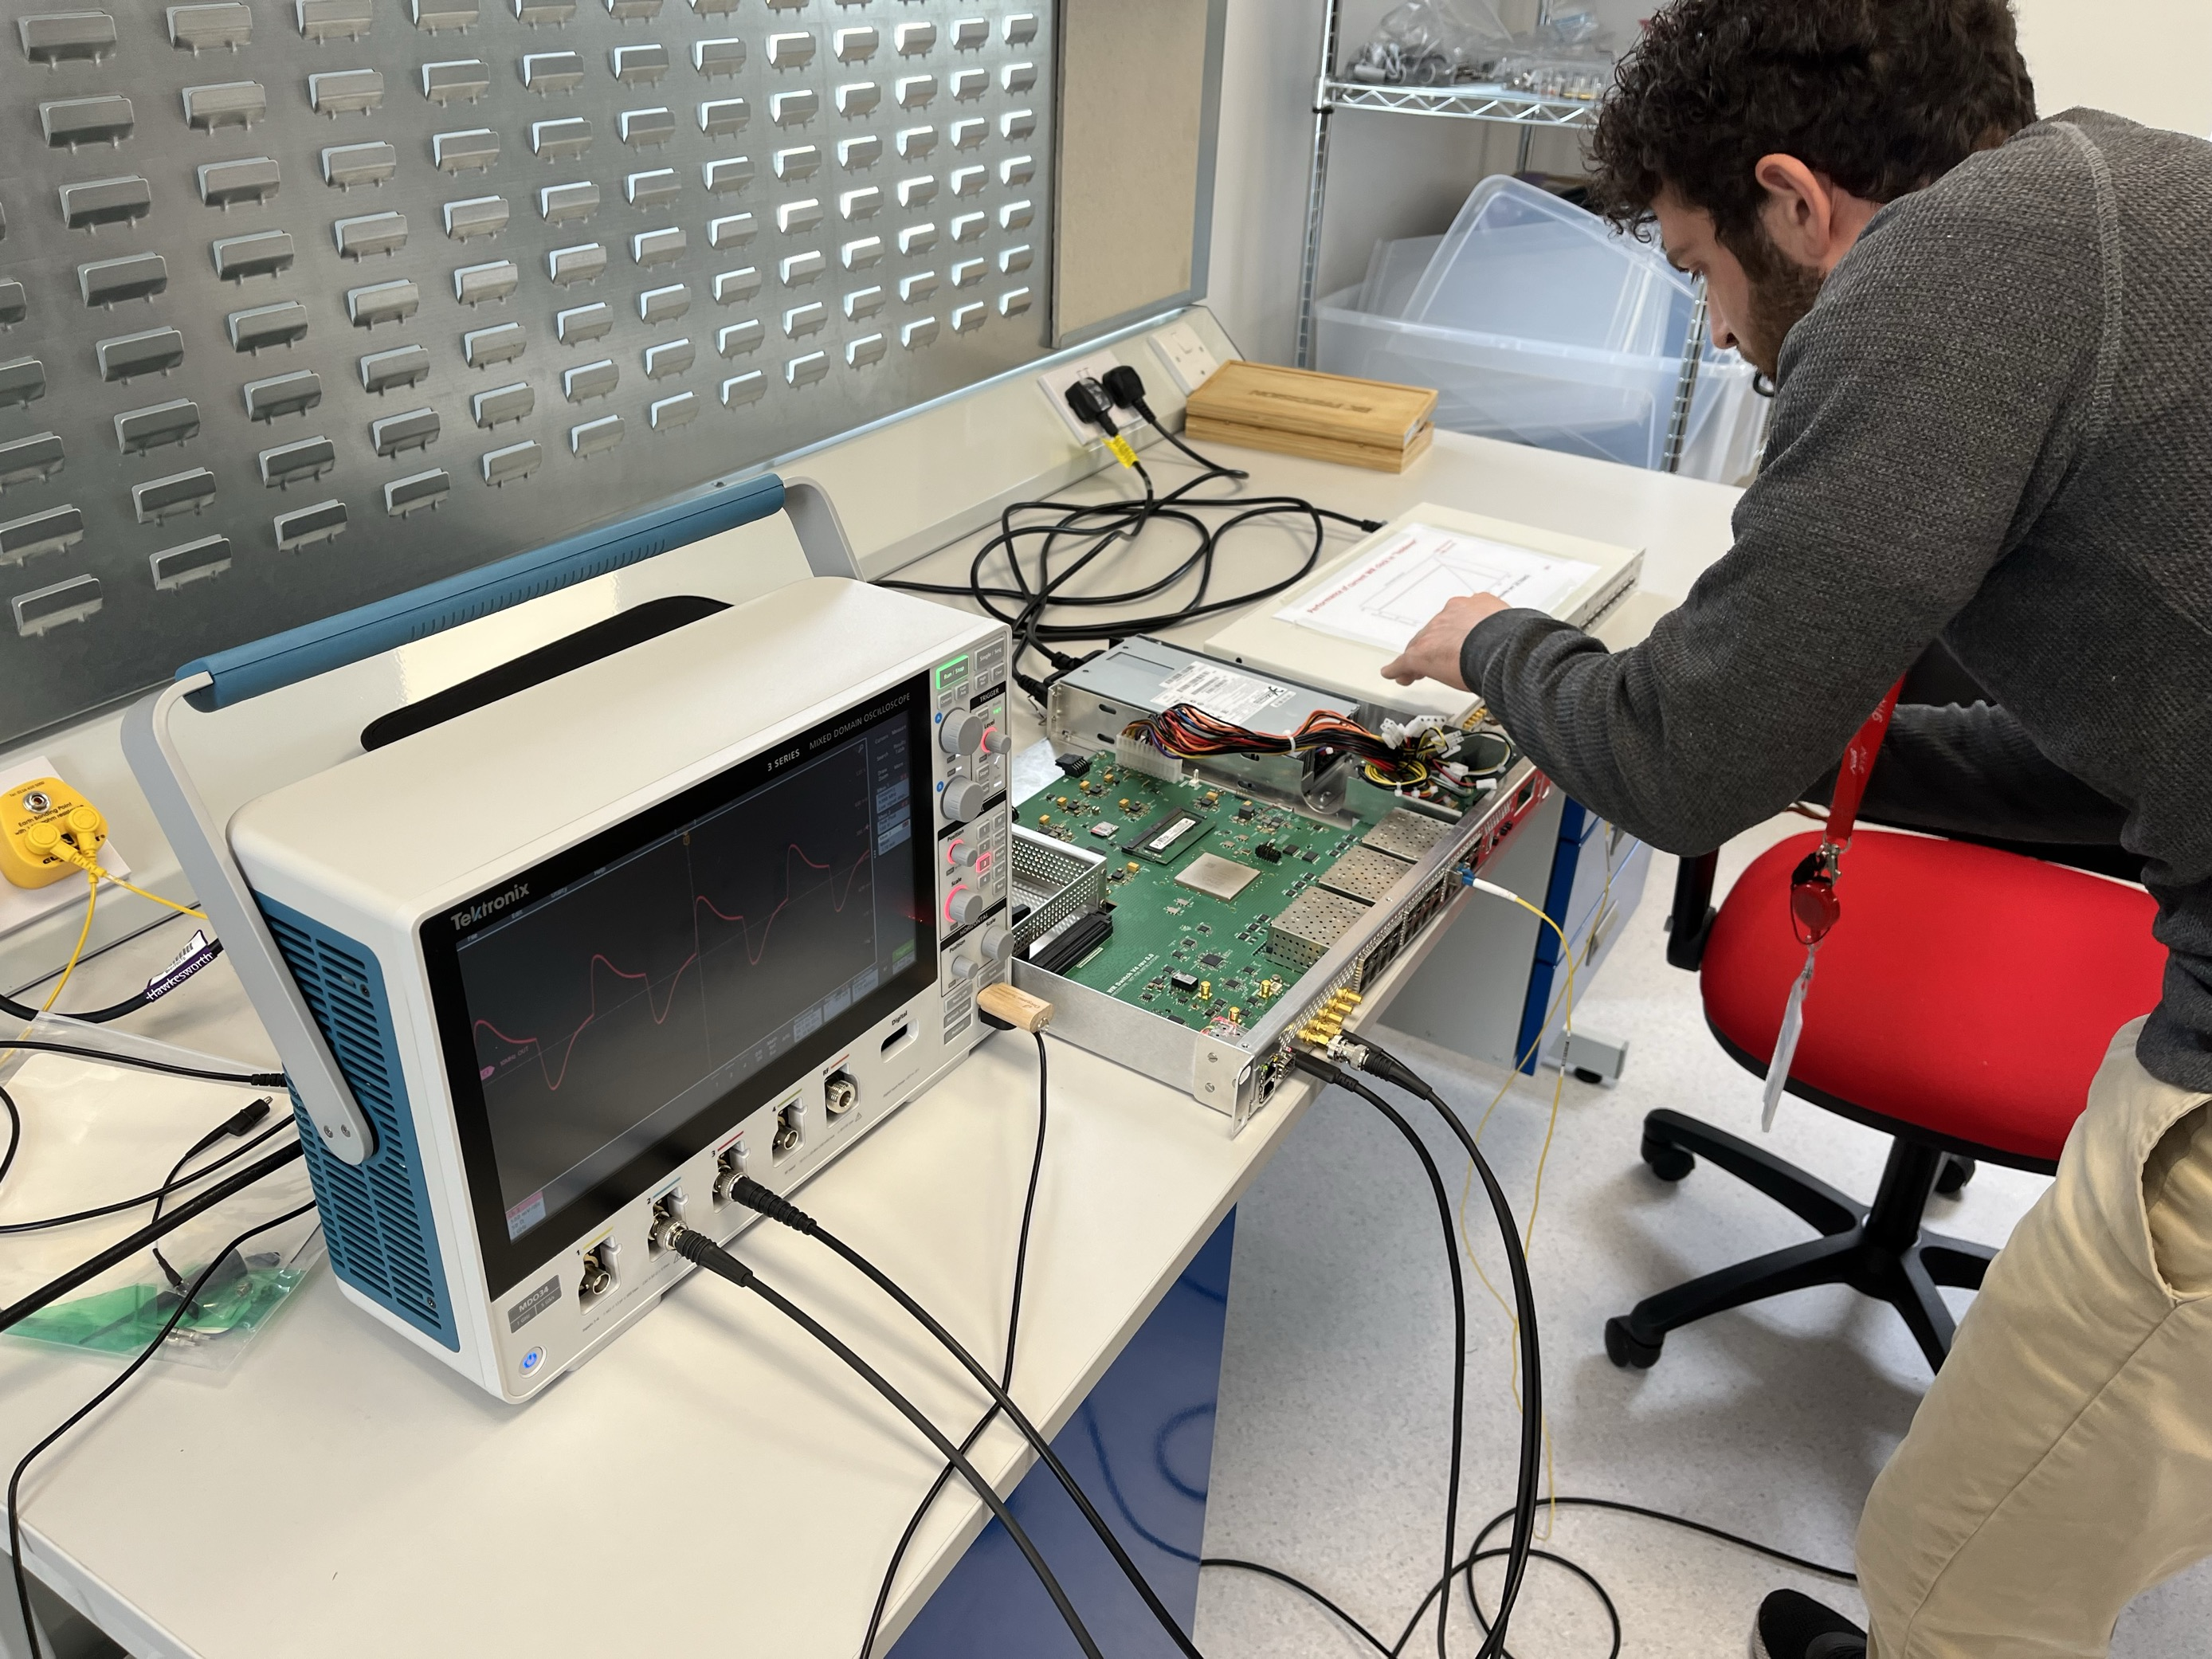
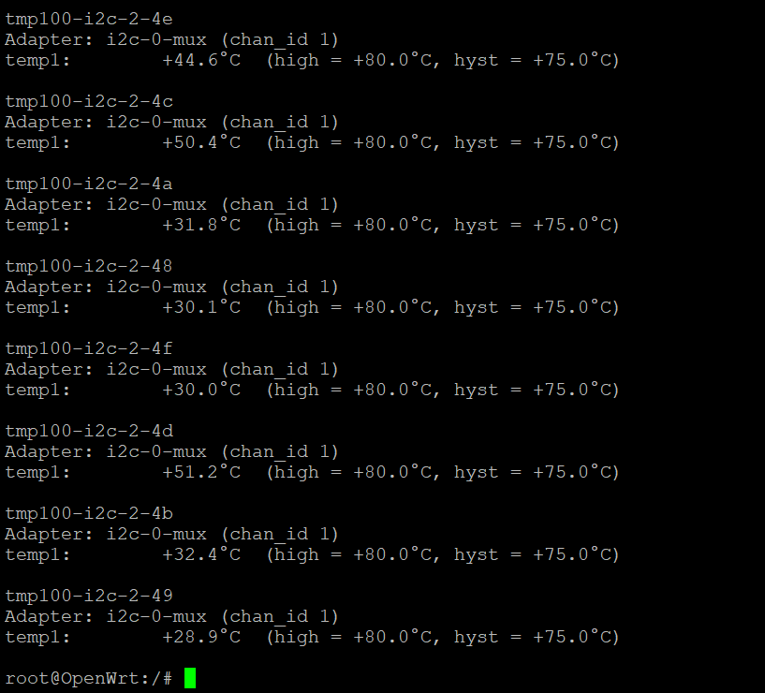
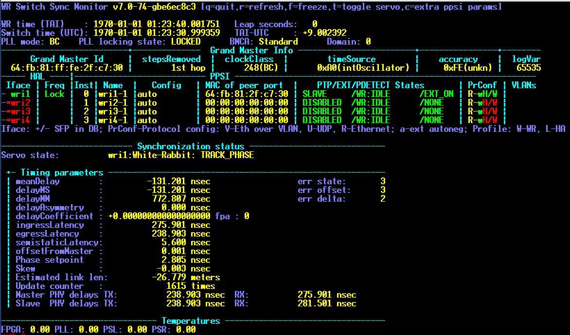
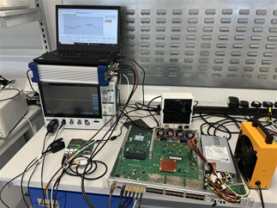
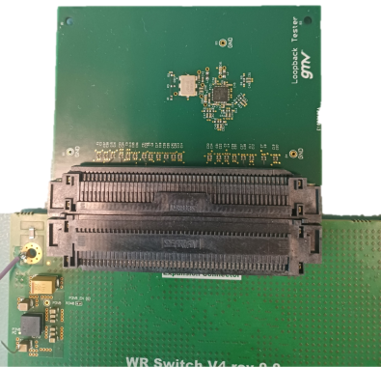
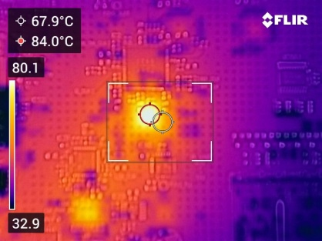
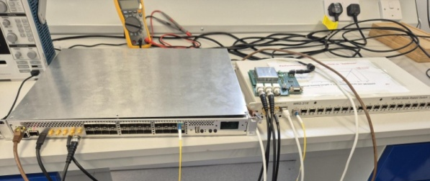
Prototype v1: verification and validation
Voltages
Peripherals
Temperature
In/out signal (10MHz in/out, PPS in/out, AUX)
Linux Booting, FPGA loading
WR synchronisation
Data links in the front panel (1G and 10G)
Expansion slot – functionally FMC-compliant
  Connections defined by standard
  Additional data links
  (1G, 10G, 25G – dedicated loopback board)

Slide 9
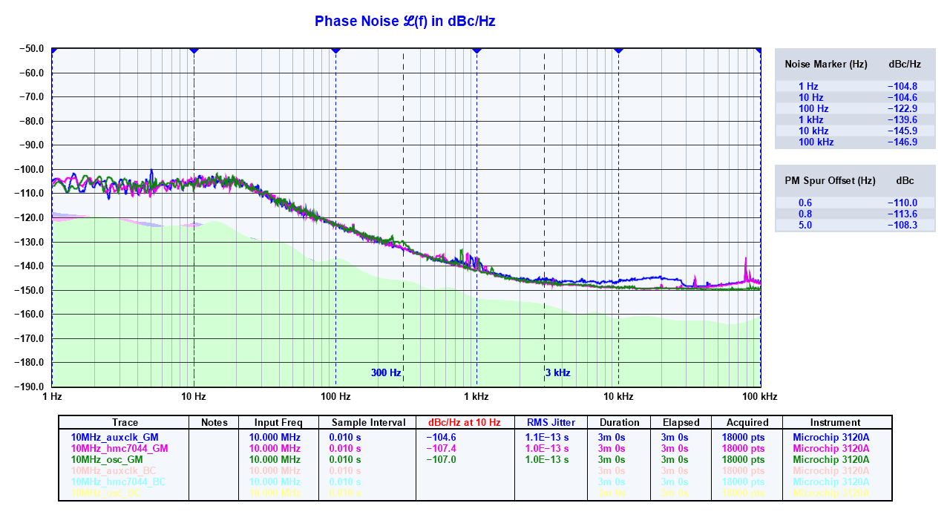
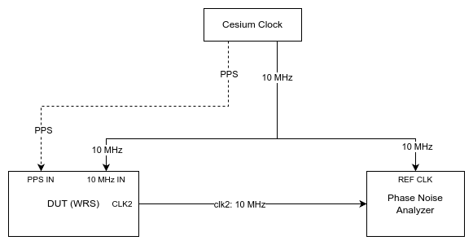
Prototype v1: GM frequency transfer performance
10 MHz outputs
  Auxclk: generated in FPGA and cleaned with FF
  HMC7044: directly from main PLL
  OSC: from main oscillator after fanout buffer (MHC6832)
Slightly better than WRSv3 Low Jitter
https://gitlab.com/ohwr/project/wr-switch-hw-v4/-/wikis/Prototype-v1-Phase-Noise

Slide 10
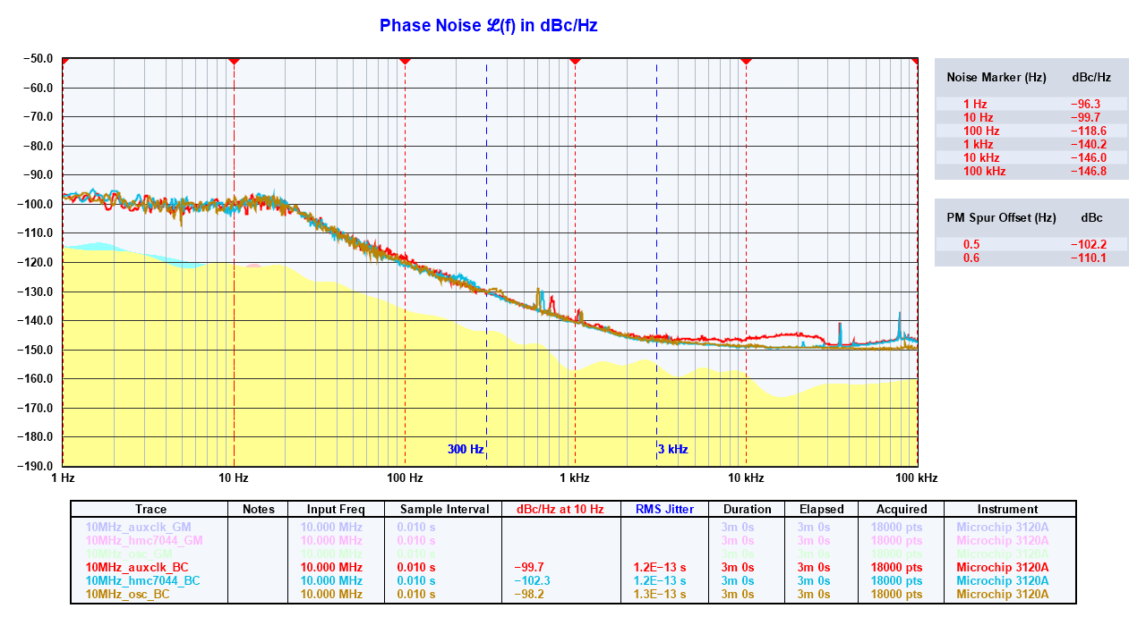
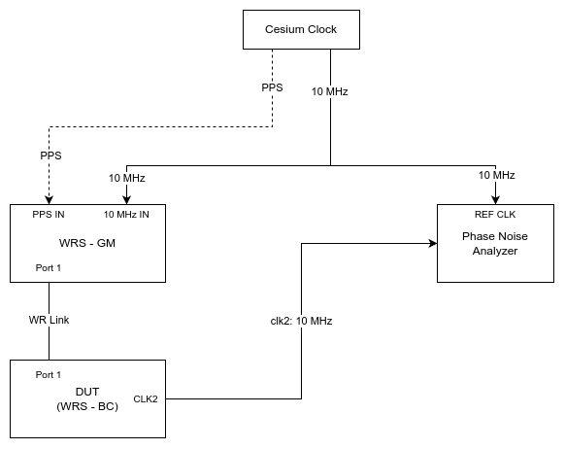
Prototype v1: BC frequency transfer performance
10 MHz outputs
  Auxclk: generated in FPGA and cleaned with FF
  HMC7044: directly from main PLL
  OSC: from main oscillator after fanout buffer (MHC6832)
Slightly better than WRSv3 Low Jitter
https://gitlab.com/ohwr/project/wr-switch-hw-v4/-/wikis/Prototype-v1-Phase-Noise

Slide 11
Prototype v2

Slide 12
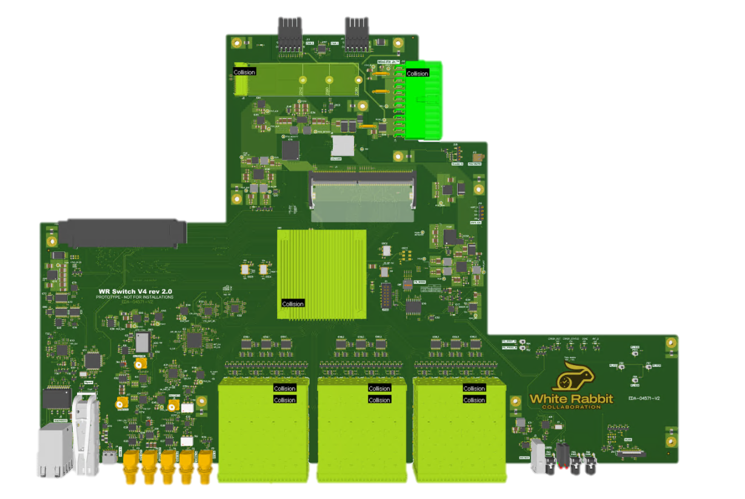
Prototype v2: PCB (WIP)
https://gitlab.com/ohwr/project/wr-switch-hw-v4/-/milestones/2#tab-issues
Improve powering and allow remote power-cycle
over management port
Move fan and PSU connectors for mechanical reasons
Update substrate to modified FR4 (TU872 SLK SP)
(Megatron substrate difficult to produce and expensive)
Update main PLL to support frequency required
for implementation of WR on 10G
Update end-of-life components
Expansion connector :
  Change from 300 to 400 pins to deliver required
  current for 12P0V, 3P3V, 1P8V
  (as per FMC standard)
  Improve signal integrity for high speed links
  Add second clk signal to drive WR GTH quads
M.2
Power
FPGA
8xSFP
8xSFP
8xSFP

Slide 13
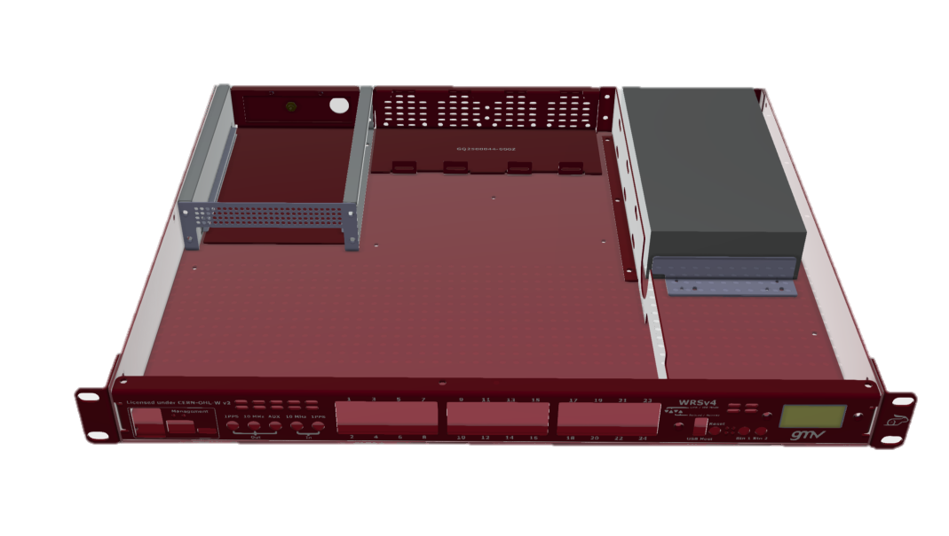
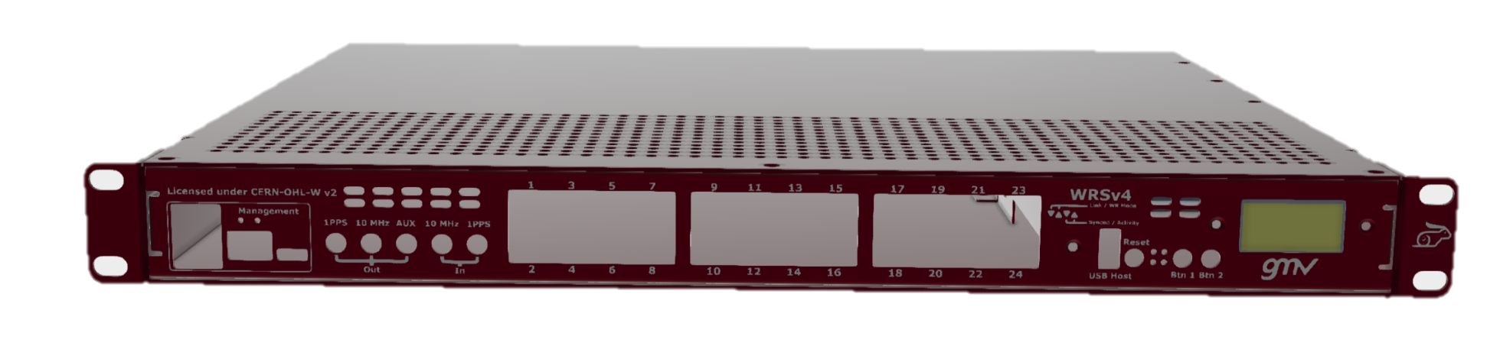
Prototype v2: mechanics
Update fan tray to accommodate bigger fans
(increased slightly depth of enclosure)
Improve rigidity to support weight of the PSU
Add front panel labeling
Improve OLED mounting
Update holes for ventilation

Slide 14
1G and 10G WR clocking

Slide 15
1G and 10G WR clocking
Separate CLK and DDMTD for 1G and 10G
All CLKs from the same source
CLK_COMMON marks phase alignment between CLK 1G and 10G
1PPS
CLK_10G
CLK_1G
CLK_COMMON
Dual-SoftPLL
SPLL_1G/10G
DAC 16 bits
Main
PLL
CLK_COMMON
PPSGen
(WR Time)
Time
tags
tags
TCVCXO
CLK_10G
CLK_10G
QPLL
CLK_TX
CLK_1G
DDMTD
10G
CLK_10G_DDMTD
DCXO
Timestamp
GTH
SOF
Tx/Rx Data
CLK_1G
CLK_RX
Example frequencies:
CLK_COMMON = 7.8125MHz
CLK_10G = 257.8125MHz
CLK_1G = 62.5MHz
DDMTD
1G
CLK_1G_DDMTD
DCXO

Slide 16
Software and gateware

Slide 17
Gateware and Software
Gateware
1G timing and data adapted from WRSv3
Added support for new peripherals
Status: stable prototype
  No major updates needed for release v1 (1G-only)
  Major re-make needed for release v3
Software
Operating system based OpenWRT (buildroot-based, like in WRSv3)
User-space daemons based on WRSv3
New boot sequence, considering expansion board
  Status: proof of concept
  Support of all peripherals
  Linux drivers ported
  1G Timing and Data
  Major effort still needed for release v1 (1G-only)
  Rather smaller effort needed for release v2/v3 (1&10G)
Gateware and software of WRSv3 and WRSv4 share the same repository and common codebase.
For prototype v1, Gateware/software is based on v7.0 release of WRSv3. Porting to v8.0 is expected
Gateware/software timeline:
Dec 2025: Release v1.0
1G time/data
18 ports
Dec 2026: Release v2.0 (?)
10G timing, 1G data
18 ports
Dec 2027: Release v3.0
1G and 10G timing/data
24 ports
Hardware timeline:
2025: Prototype v2
2026: Commercial product

Slide 18
Summary

Slide 19
Summary
Prototype v1
  Working
  No show-stoppers for release v1.0
Prototype v2
  Expected in 2025
  Many improvements
1G and 10G concept
  Basic ideas in place
  Prototyping
Release v1.0 of software/gateware
  1G for timing and data on 18 ports
  Expected end of 2025
Commercial availability of WRSv4 expected in 2026

