Slide 1

Entanglement distribution of photon pairs coexisting with White Rabbit synchronization signals on the same optical fiber
White Rabbit workshop 25/06/2025
Annick Teepe

Slide 2
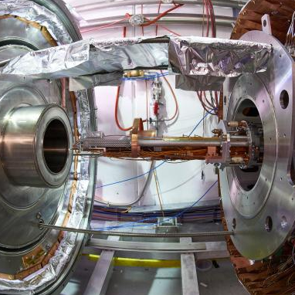




Quantum Technology Initiative
CERN QUANTUM TECHNOLOGY PLATFORMS
Initialized in 2020
“Phase 2” started in 2024
HYBRID QUANTUM COMPUTING AND ALGORITHMS
COLLABORATION FOR IMPACT
QUANTUM NETWORKS AND COMMUNICATIONS
https://quantum.cern/

Slide 3
Quantum Technology Initiative
Notes:
-Explore how quantum tech can be useful for CERN
-Explore how CERN can be useful for quantum tech
The quantum networking CoC is in these first years focussing on the second question.
In future, we could imagine CERN could be interested in a network of quantum computers or sensors, connected by quantum networks.

Slide 4
Contents
      How It Works?!
      1) Background Quantum physics
        2) Entanglement distribution and White Rabbit
      Experiments in Berlin (with Deutsche Telekom – Qunnect)
      1) Experimental set-up
      2) Results “Compensating Mode” without coincidence detection
      3) Results “Compensating Mode” with coincidence detection
      Summary
      Outlook

Slide 5
Contents
      How It Works?!
      1) Background Quantum physics
        2) Entanglement distribution and White Rabbit
      Experiments in Berlin (with Deutsche Telekom – Qunnect)
      1) Experimental set-up
      2) Results “Compensating Mode” without coincidence detection
      3) Results “Compensating Mode” with coincidence detection
      Summary
      Outlook

Slide 6

Quantum is everywhere…

Slide 7
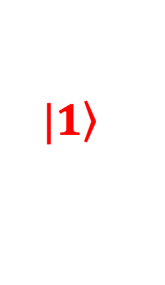

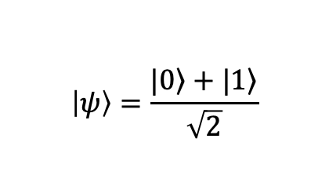


Superposition Principle
Classical bits:
0 or 1
Quantum bits:
0 and/or 1
$$\left.|0\right\rangle$$
$$0$$
$$\left|ψ\right\rangle =\frac{\left.|0\right\rangle +\left.|1\right\rangle }{\sqrt{2}}$$
$$1$$
$$\left.|1\right\rangle$$

Slide 8
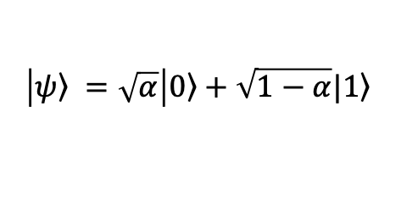
Superposition Principle
Classical bits:
0 or 1
Quantum bits:
0 and/or 1
$$\left.|0\right\rangle$$
$$0$$
$$\left|\left.ψ\right\rangle =\sqrt{α}\right|\left.0\right\rangle +\sqrt{1−α}|\left.1\right\rangle$$
$$1$$
$$\left.|1\right\rangle$$
Quantum states are normalised

Slide 9


Superposition Principle
Classical bits:
0 or 1
A measurement ‘collapses’ the state to one of the two outcomes, 0 or 1!
Quantum bits:
0 and/or 1
$$\left.|0\right\rangle$$
$$0$$
$$\left|\left.ψ\right\rangle = \right|\left.0\right\rangle$$
$$1$$
$$\left.|1\right\rangle$$

Slide 10
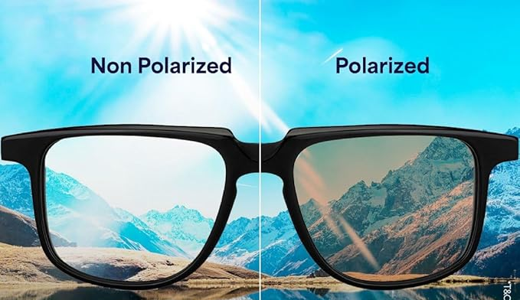
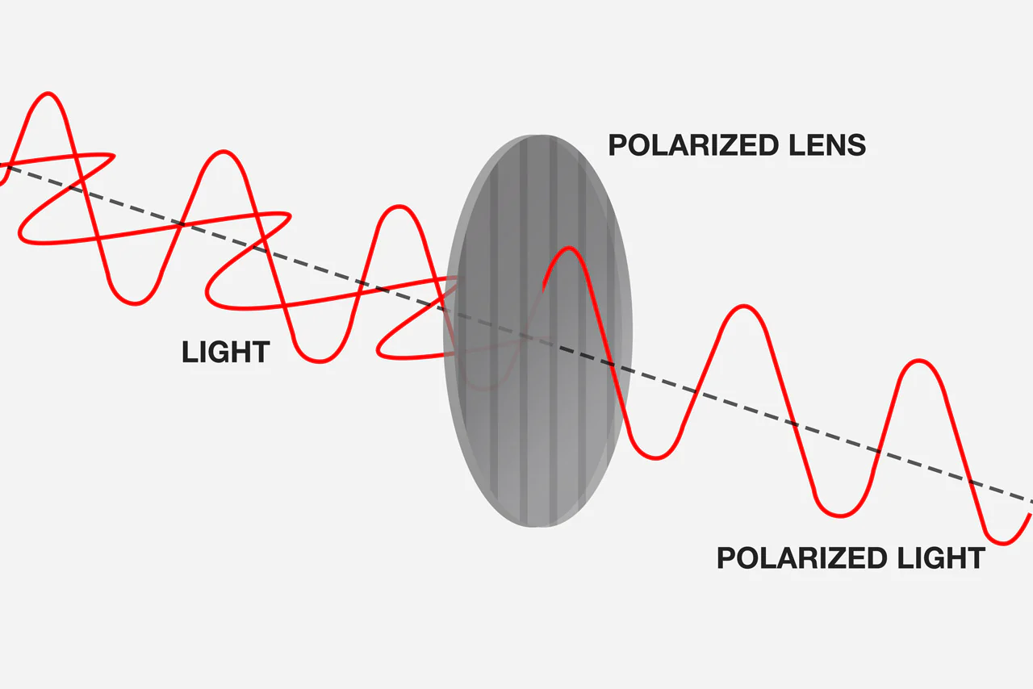
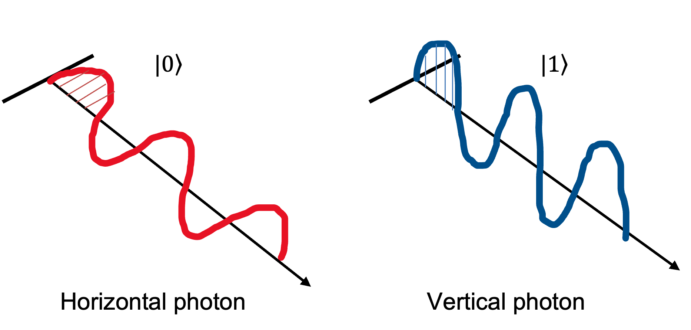
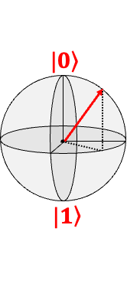
Photons as qubits
Polarized sunglasses remove “glare”
Qubit = Two Level System
  Quantum dots
  Trapped ions
  Superconducting
  And photons!
Photon = light particle
  Polarisation
  Distinct polarisation state = Qubit!
Notes:
Qubits are created by manipulating and measuring quantum particles

Slide 11

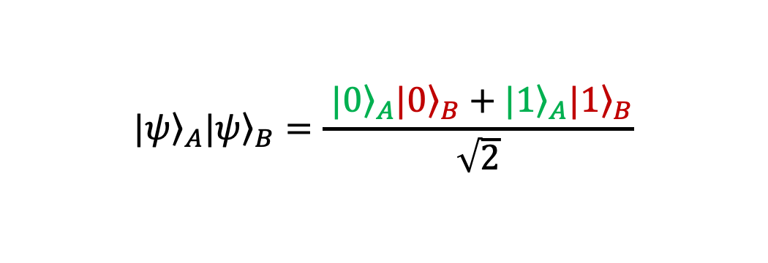
Entanglement
A
B
$${\left.|ψ\right\rangle }_{A}{\left.|ψ\right\rangle }_{B}=\frac{{\left. |0\right\rangle }_{A}{\left.|0\right\rangle }_{B}+{\left.|1\right\rangle }_{A}{\left.|1\right\rangle }_{B}}{\sqrt{2}}$$
Measure A

Slide 12


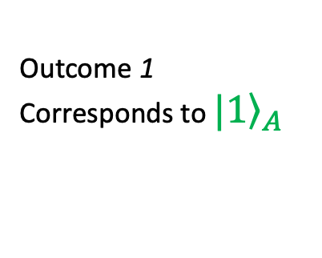
Entanglement
A
B
$${\left.|1\right\rangle }_{A}{\left.|1\right\rangle }_{B}$$
Measure A
Outcome 1
Corresponds to ${\left.|1\right\rangle }_{A}$
State ${\left.|1\right\rangle }_{B}$
100% probability!!!

Slide 13


Using Entanglement
Source emitting entangled photon pairs over two fibers, to two locations
…
…
A
B
Alice
Bob
A
B
A
B
Source
Notes:
Qubits are created by manipulating and measuring quantum particles

Slide 14
Using Entanglement
Measuring yields Quantum Key!
…
…
A
B
0
0
Alice
Bob
A
B
K = 011
1
1
K = 011
A
B
1
1
Source
“Entanglement-based Quantum Key Distribution”
Notes:
Qubits are created by manipulating and measuring quantum particles

Slide 15



The need for synchronization
Emission is simultaneous, detection is not !
A
B
0
0
Alice
Bob
A
B
1
1
A
B
1
1
Source
Bandwidth of biphotons : 0.1 - 10 GHz → 10 – 10e3 ps
Notes:
Qubits are created by manipulating and measuring quantum particles

Slide 16

Entanglement distribution and WR in practice
15xx nm
15xx nm
White Rabbit Switch
White Rabbit Switch
TimeTagger
DWDM
DWDM
Source
1320 nm
1320 nm
Pol. Optics
Photon detector
785 nm
TimeTagger
Photon detector
Pol. Optics
Alice
Bob
Notes:
Explain 2 node versus 3 node network (with source at different location)

Slide 17
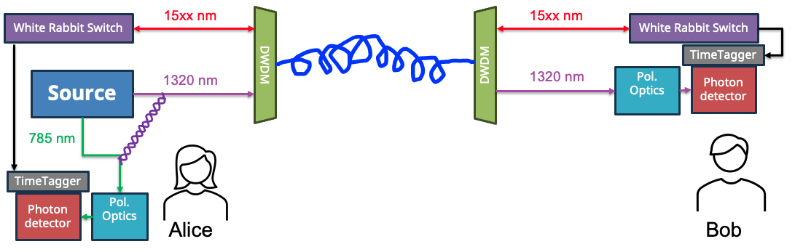
Why?
Multiplexing
→ usage existing fiber infrastructure
→ use WR light as real-time indicator of changes in the link/fiber
White Rabbit
  → sub ns clock synchronisation between nodes
  → increase suitability for quantum networks

Slide 18
Contents
      How It Works?!
      1) Background Quantum physics
-superposition principle
        -photons as qubits
        -entanglement
        2) Entanglement distribution and White Rabbit
      Experiments in Berlin (with Deutsche Telekom – Qunnect)
      1) Experimental set-up
      2) Results “Compensating Mode” without coincidence detection
      3) Results “Compensating Mode” with coincidence detection
      Summary
      Outlook

Slide 19


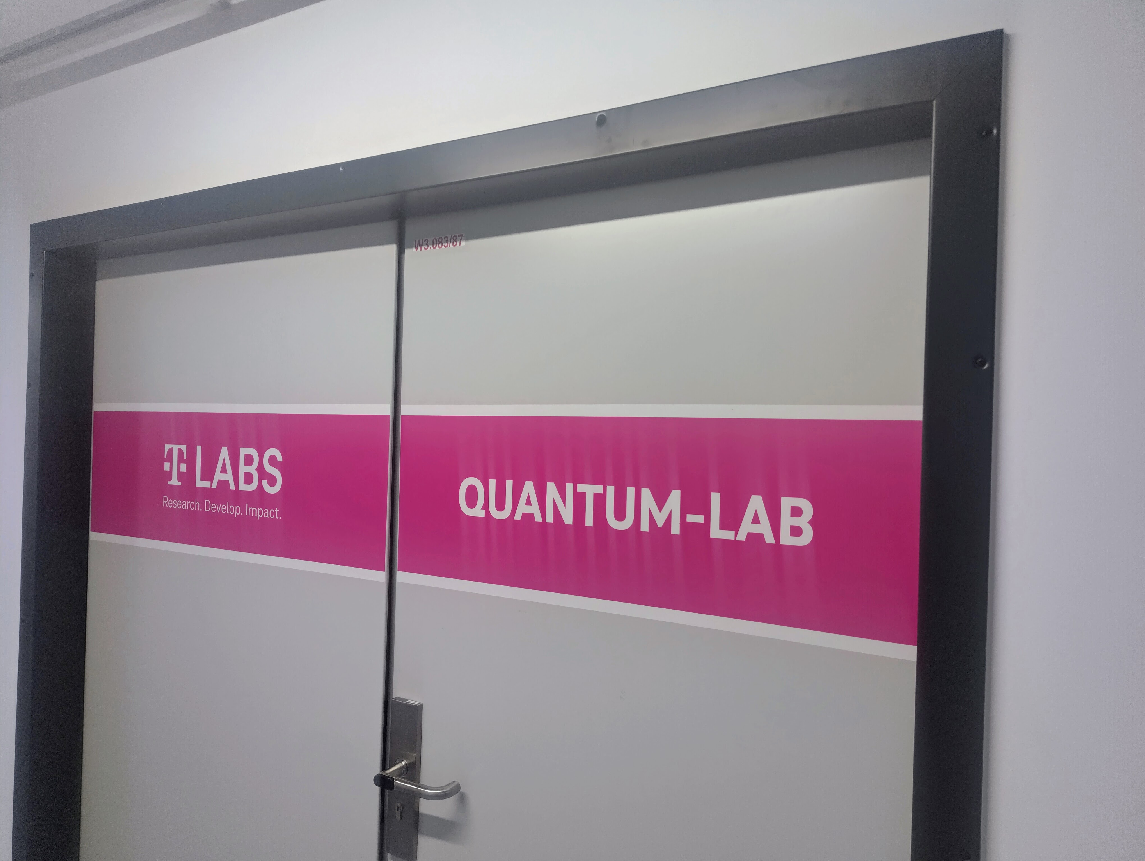

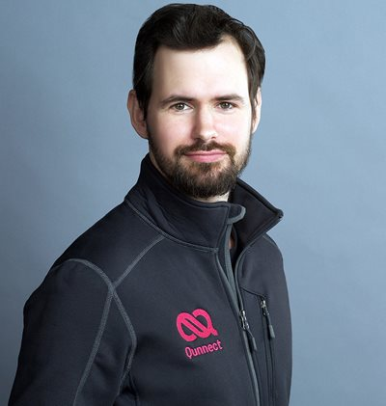

Caution ! VERY fresh results !
Part 2 : Experiments in Berlin
Matheus Sena
Deutsche Telekom
Maël Flament
Qunnect
Photon detectors
Adam Wujek for WR support

Slide 20
Goal
      Distribute entangled photon pairs over deployed fiber with high fidelity AND minimize downtime of network
      Active polarisation compensation → ensure high fidelity
      When compensating → network is down!
      Solution : only compensate “When Needed” → Trigger
      Extend role WR beyond time synchronisation
  Continuously monitor link delay, optical power levels, and polarisation at 15xxnm
  → Trigger compensation quantum signal at 1320 nm
Trade-off!
Extension of work M. Sena et al., “High-Fidelity Entanglement Distribution Through Berlin Using an Operator’s Fiber Infrastructure,” OFC 2025.

Slide 21

Experimental set-up
Grandmaster
White Rabbit Switch
polarizer
White Rabbit Switch
APC cmp
1550 nm
DWDM
DWDM
Trigger
Source
APC inj
1320 nm
APC cmp
1320 nm
TimeTagger
TimeTagger
Photon detector 785nm
Pol. Optics
785nm
Pol. Optics
1320nm
Photon detector 1320nm

Slide 22
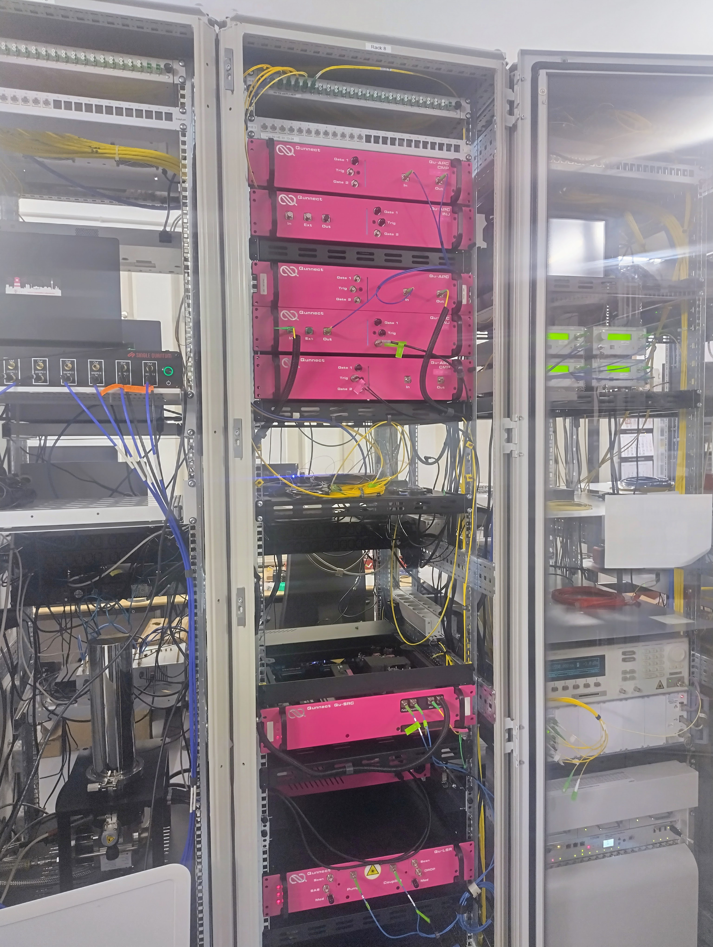
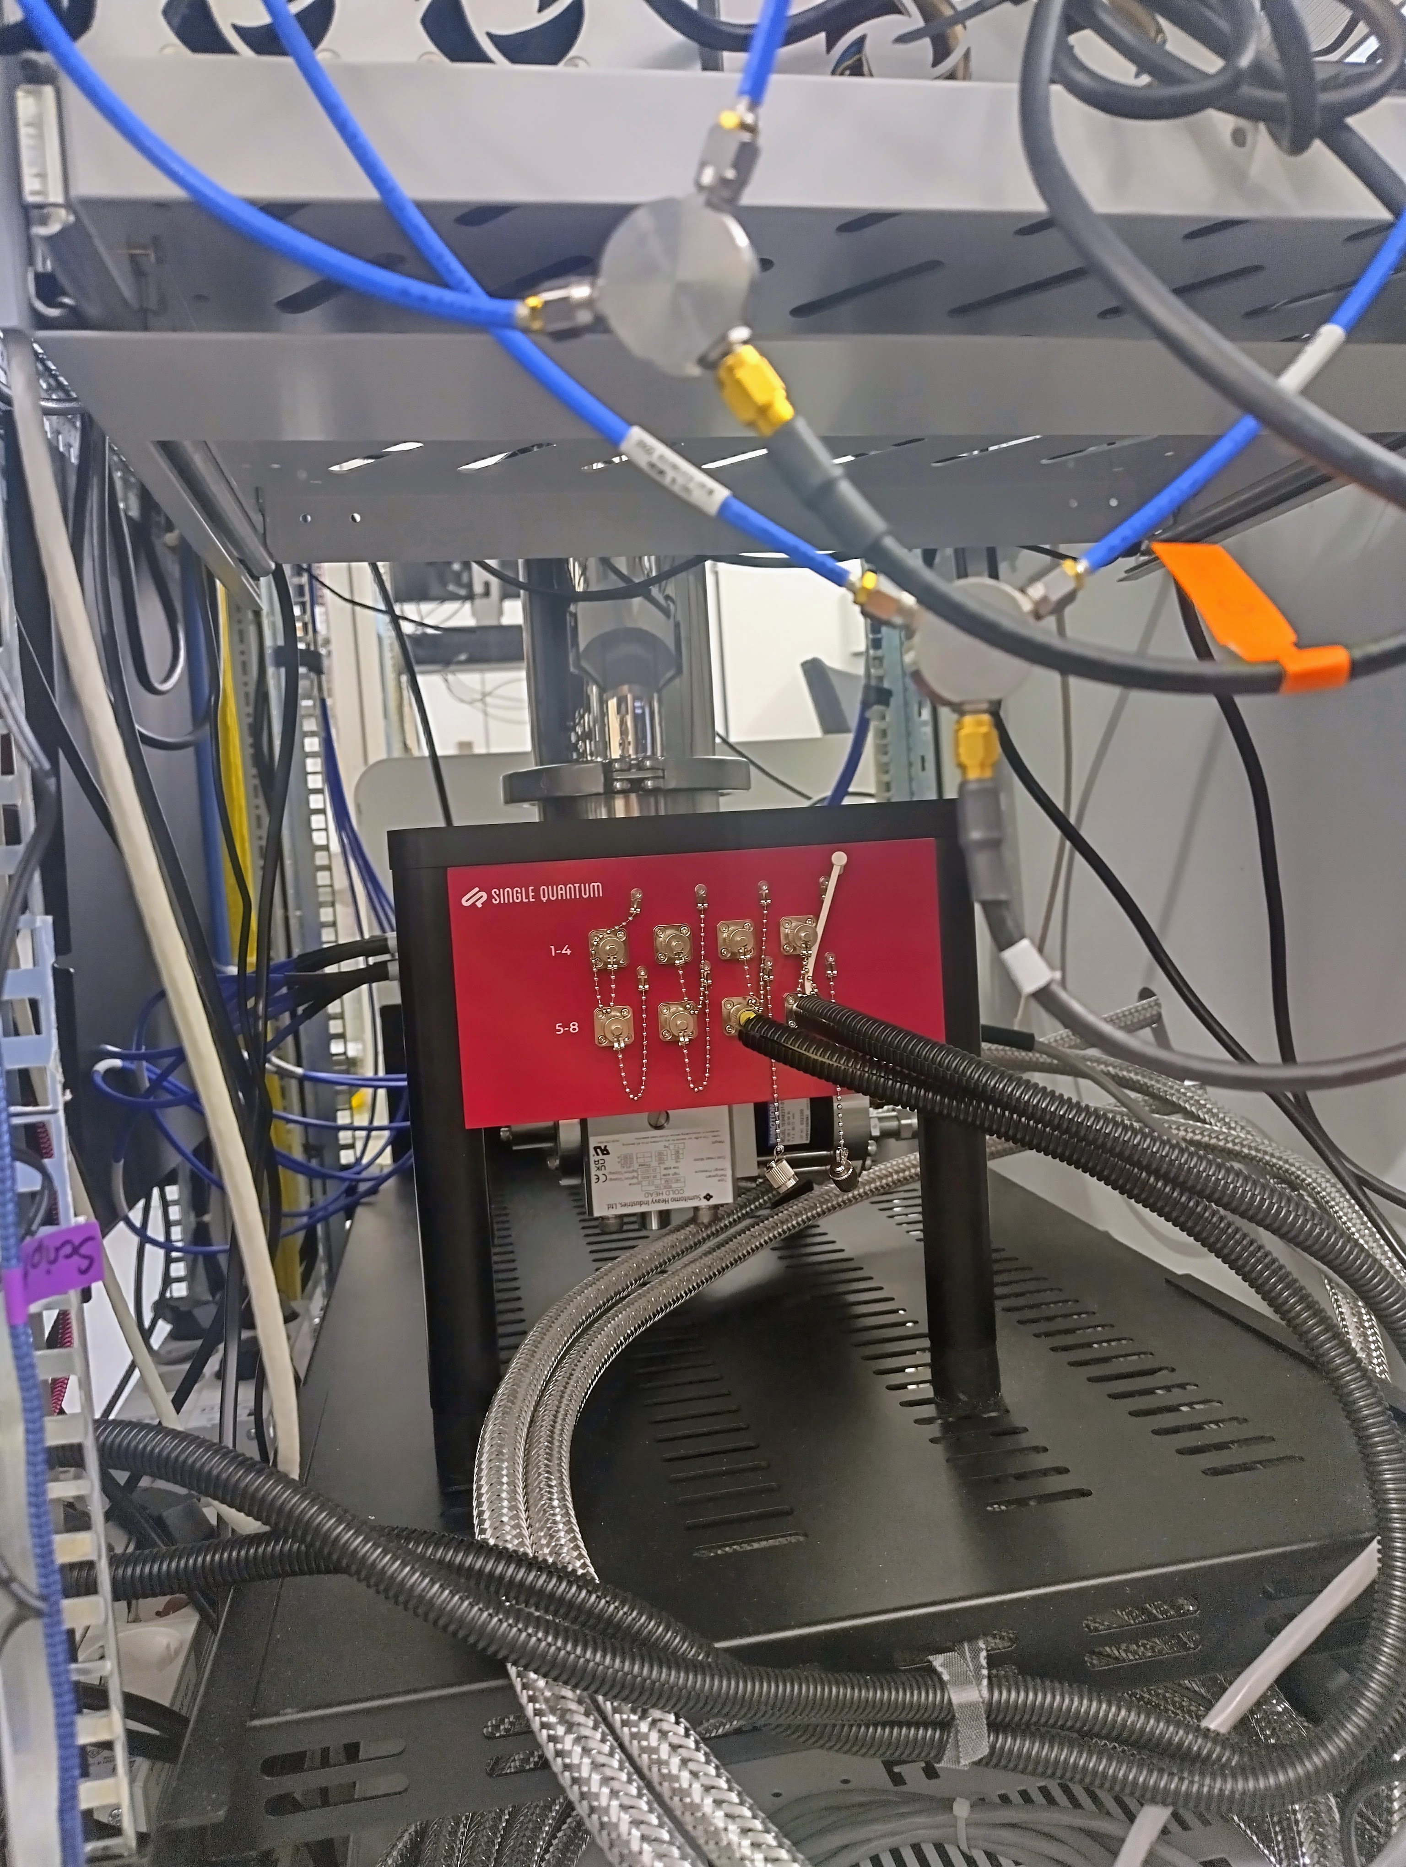
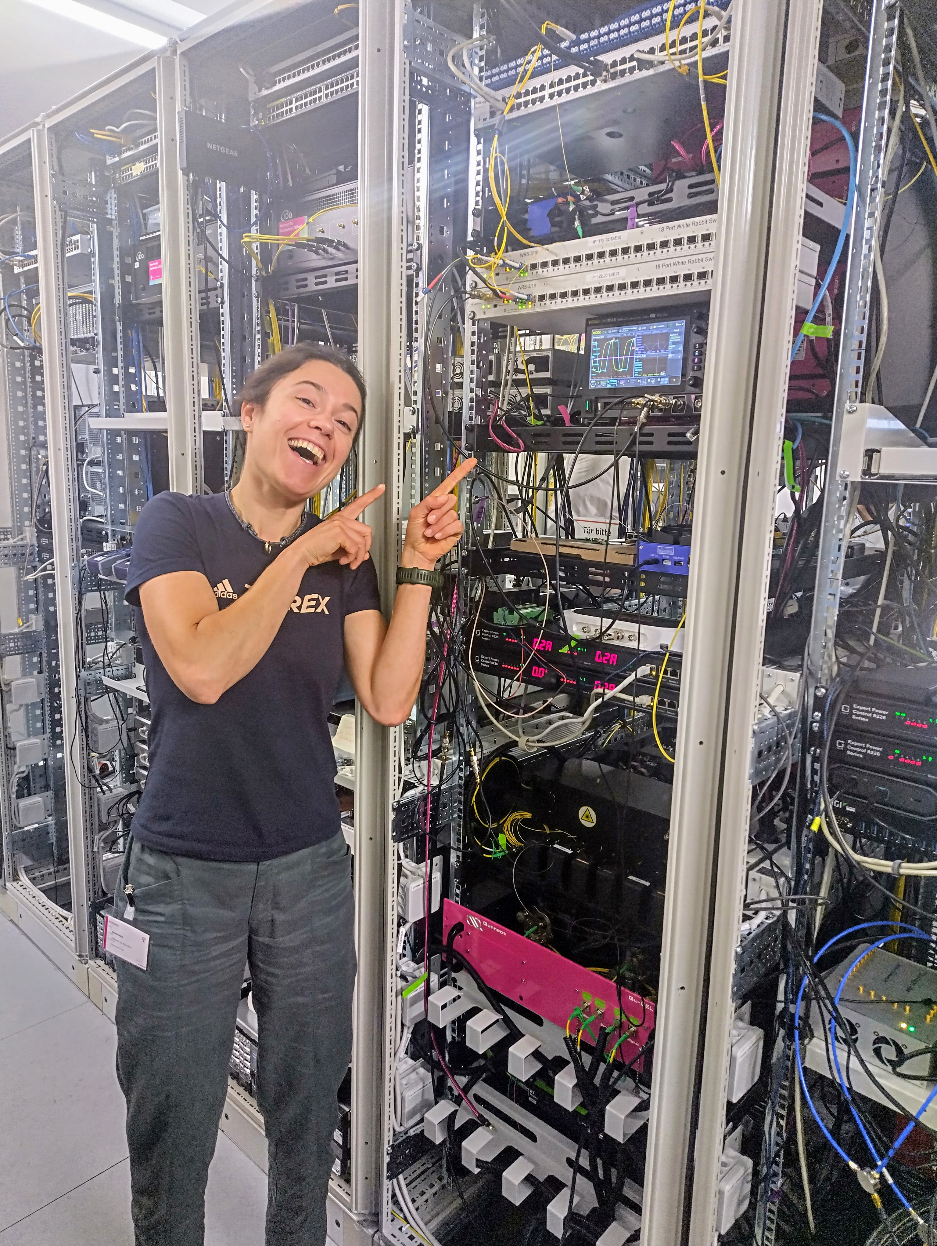
Experimental set-up

Slide 23
Measurement with triggers – without coincidences
Grandmaster
White Rabbit Switch
polarizer
White Rabbit Switch
APC cmp
1550 nm
DWDM
DWDM
Trigger
Source
APC inj
1320 nm
APC cmp
1320 nm
Real deployed fiber; ~ 27km
TimeTagger
TimeTagger
Photon detector 785nm
Pol. Optics
785nm
Pol. Optics
1320nm
Photon detector 1320nm

Slide 24
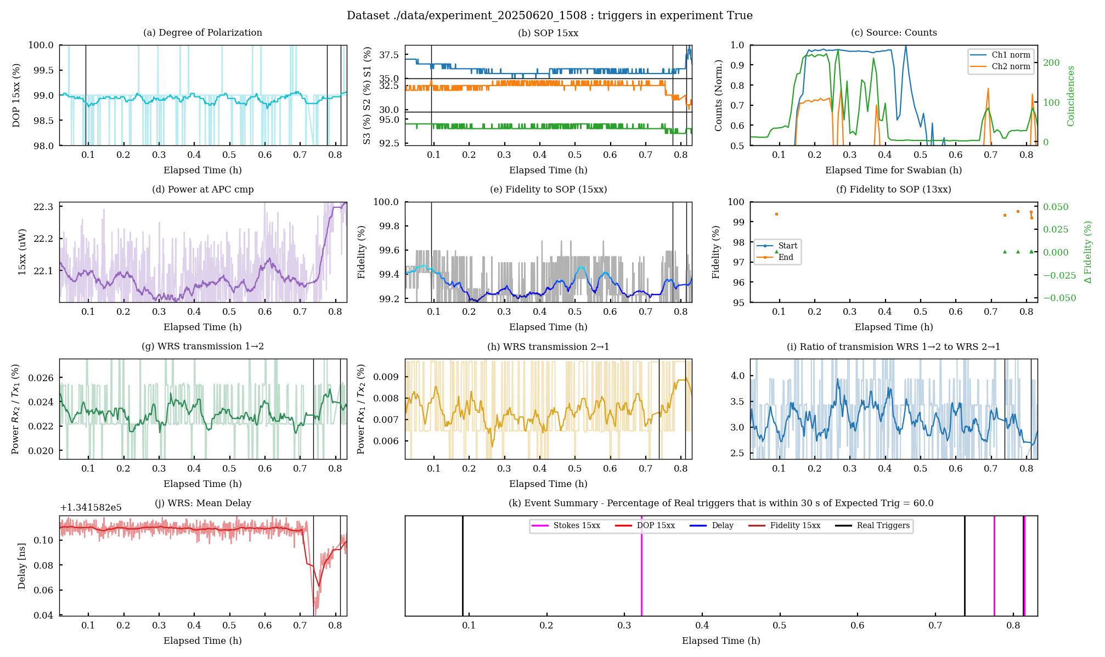
Results ~1 hour

Slide 25
Results ~1 hour

Slide 26
Results ~1 hour

Slide 27
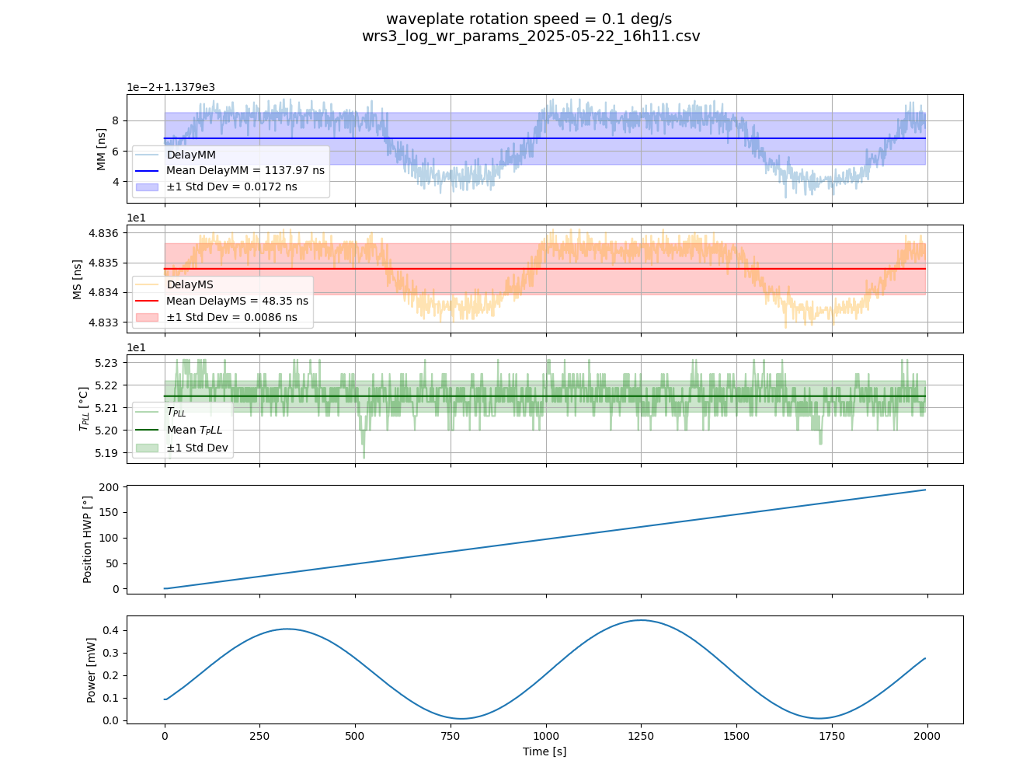
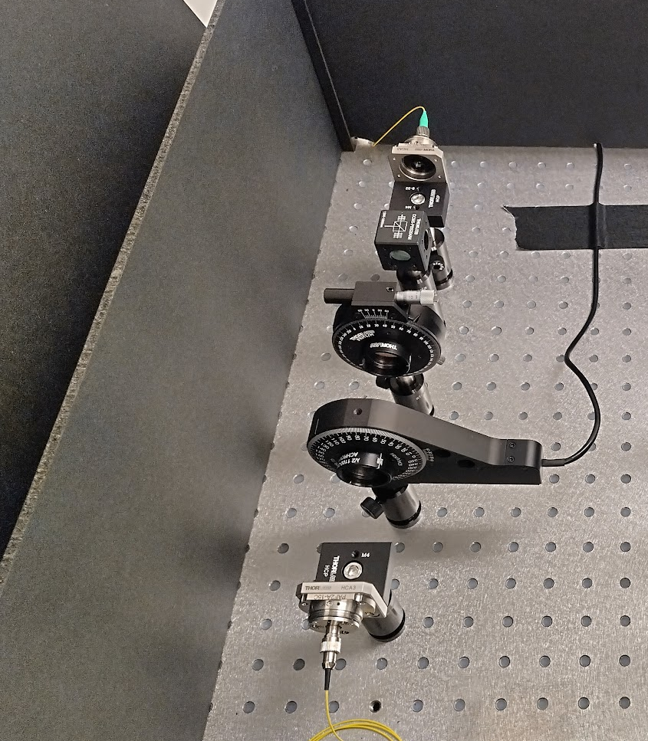
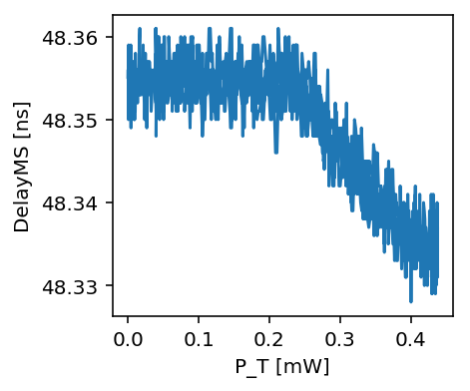


Intermezzo : power fluctuations with WR in Free Space
WRS1
785 nm
Fiber coupler
PowerMeter
¼ waveplate
½ waveplate
Fiber coupler
Laser
Dependency of delay on transmitted power
Linear fit yields slope of:
-0.101 ns per mW
WRS2

Slide 28
Measurement with triggers – with coincidences
Grandmaster
White Rabbit Switch
polarizer
White Rabbit Switch
APC cmp
1550 nm
DWDM
DWDM
Trigger
Source
APC inj
1320 nm
APC cmp
1320 nm
Real deployed fiber; ~ 27km
TimeTagger
TimeTagger
Photon detector 785nm
Pol. Optics
785nm
Pol. Optics
1320nm
Photon detector 1320nm

Slide 29
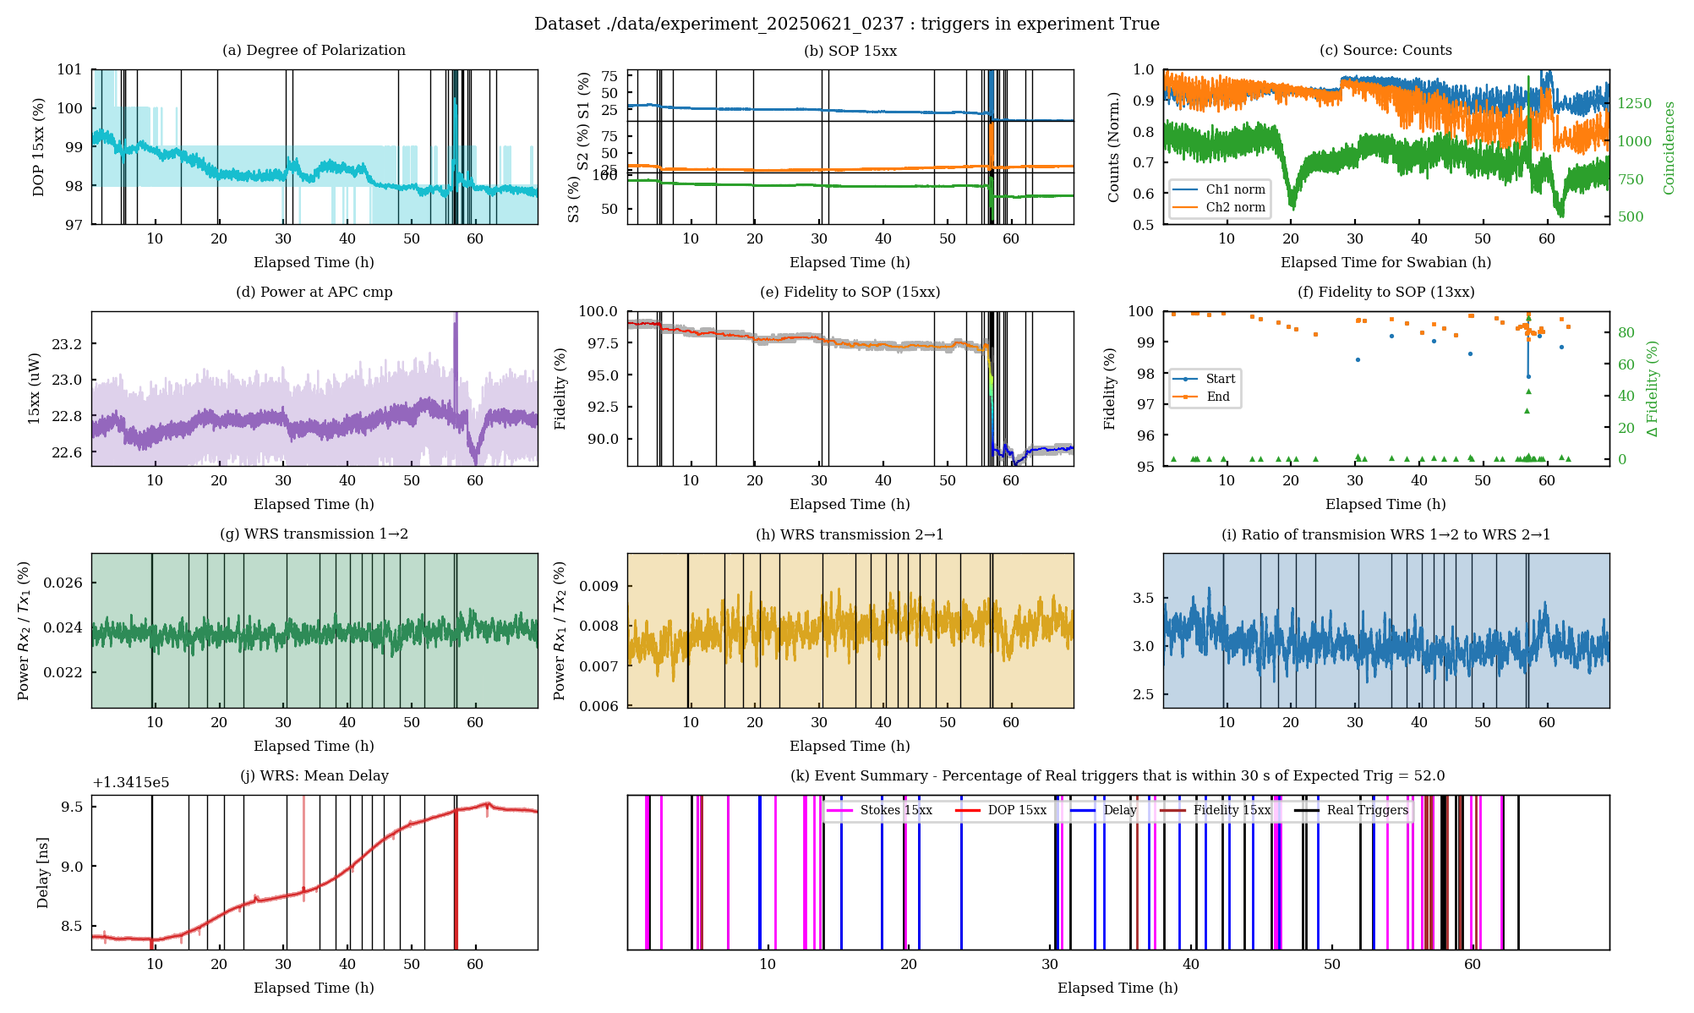
Results ~ 70 hours

Slide 30
Results ~ 70 hours

Slide 31
Results ~ 70 hours

Slide 32
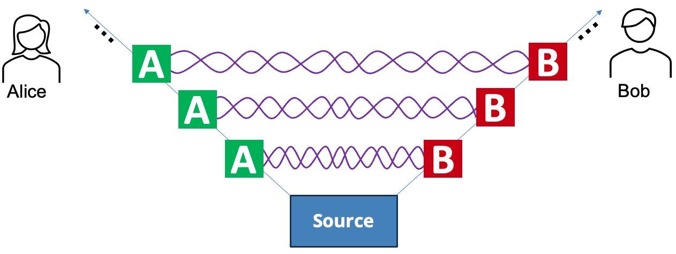
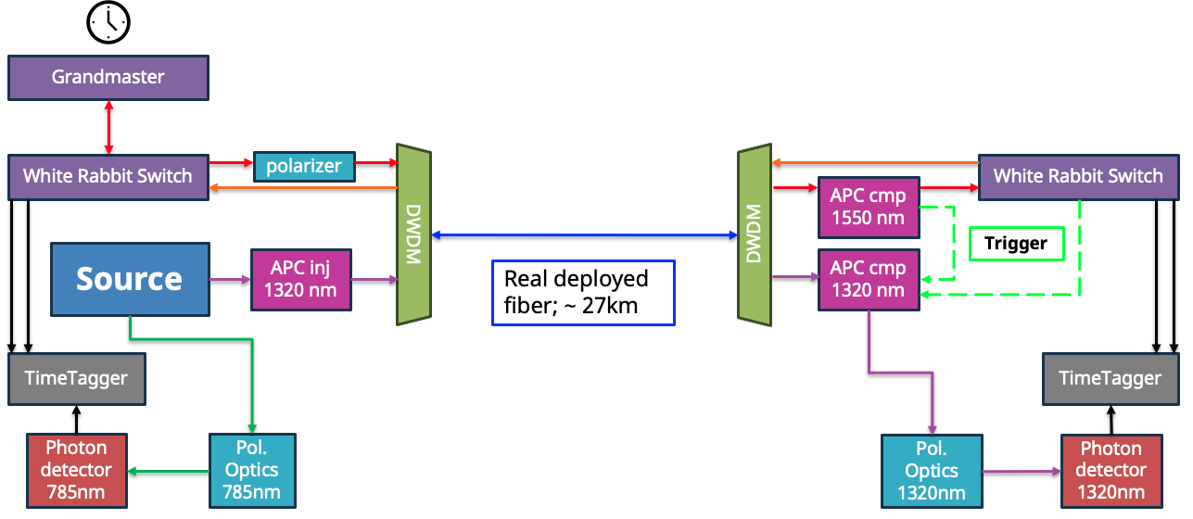
Summary
How It Works ?!
  Background quantum physics
  Entanglement distribution and WR
Joint experiments Deutsche Telekom & Qunnect
  Extend role WR beyond time synchronisation:
  monitoring link delay, optical powers and polarisation state of WR signal to trigger for compensation in quantum signal
It is possible that WR can provide live network metrics that improve the performance of quantum networking testbeds, beyond just time synchronization, without additional hardware

Slide 33
Outlook
Further analysis of Berlin data + gather more data
Local experiment @ CERN : Collaboration Single Quantum – Qunnect
  In-kind contribution of EPS and detectors
  Test different White Rabbit wavelengths and powers

Slide 34
Questions?

Slide 35
Monitoring only set-up
Grandmaster
White Rabbit Switch
polarizer
White Rabbit Switch
APC cmp
1550 nm
DWDM
DWDM
APC inj
1320 nm
Real deployed fiber; ~ 40km
APC cmp
1320 nm

Slide 36
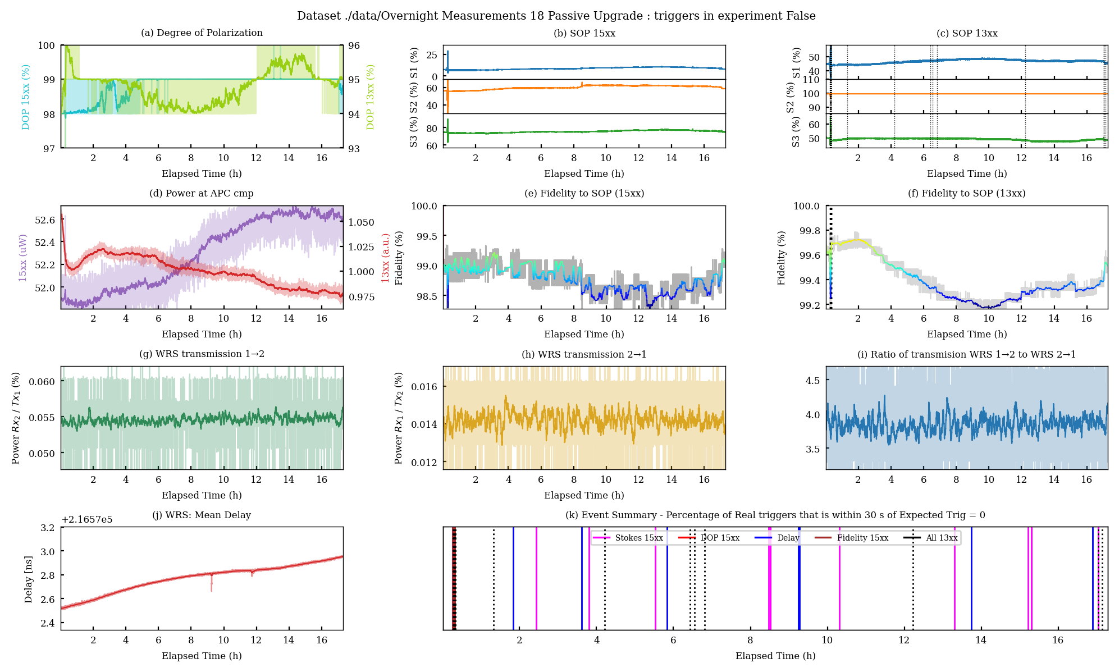
Results monitoring only

