Slide 1
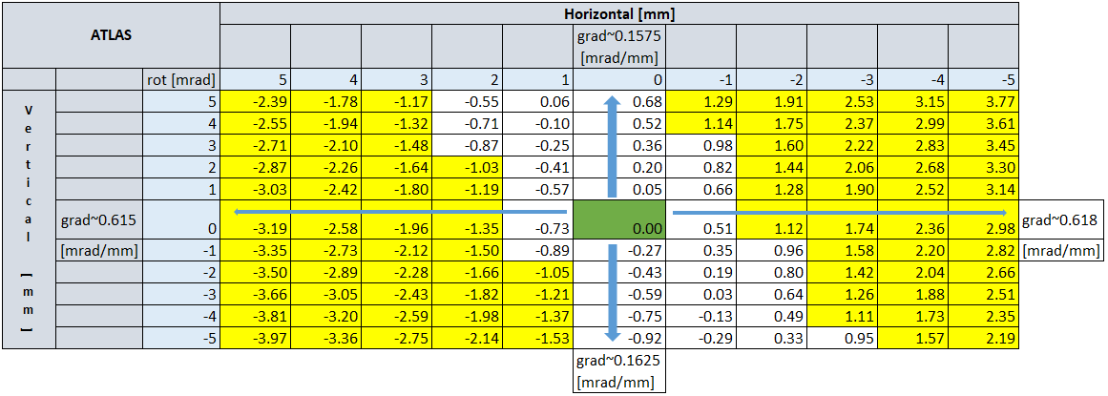
Initial results - ATLAS
TAXS pure horizontal movement
TAXS zero position
TAXS pure vertical movement

Slide 2
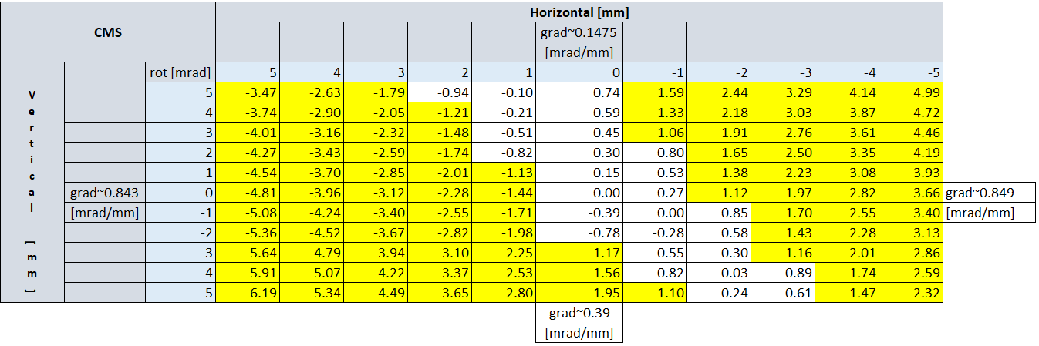
Initial results - CMS

Slide 3


TAXS rotation study - continued
Cases being analyzed:
Rotation compensation by the
perpendicular jack movement
Vertical rods 2 rotules/horizontal
rods unchanged
Horizontal rods 2 rotules/vertical
rods unchanged

Slide 4
Correction by perpendicular movement
alignment
movement
corrective
movement
alignment
movement
corrective
movement
Ineffective!

Slide 5
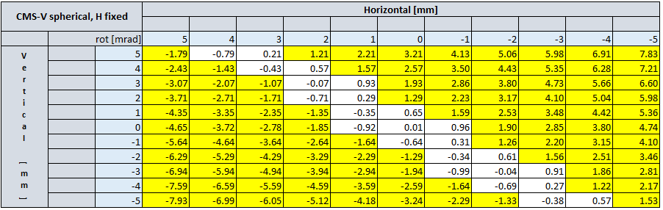
Vertical rods 2 rotules/
horizontal rods unchanged
Still not effective solution, even worse!

Slide 6
Still to be analyzed
Horizontal rod 2 rotules/vertical rods unchanged
Effects of the rotule configurations in ATLAS
- Moving vertical rod support closer inside TAXS (reducing moment arm of vertical rod tensile force)

