Slide 1
Dispersion through TT20 and P42
Fabian Metzger, Dipanwita Banerjee, Laurie Nevay, Florian Stummer
Matthew Fraser, Alex Gorn, Francesco Velotti
03.04.2025

Slide 2
Dispersion along TT20 and P42
Through the extraction, we ramp the fields in some of the magnets according to the sweep in momentum, while some stay fixed at the reference field for 400GeV/c
  This results in a centroid shift for off-momentum particles through non-swept magnets
  Macroscopically, we account this to dispersion as it appears as a blow-up of beam size after integrating over the full spill
  Normal dispersion is just the symmetric increase in beam size due to a finite, symmetric Δp
We can investigate the dispersion function in BDSIM by comparing the following two particles to the reference particle
  Particle 1 on-axis and on-time being off-momentum by 10⁻⁴ → Nominal dispersion
  Particle 2 on-axis at the end of the spill being off-momentum by 10⁻⁴ relative to the reference particle in that time slice, i.e. at t=0 we have 400GeV/c as reference and at t=0.6s we have 400.6GeV/c as reference
  → Maximal dispersion as furthest away from reference momentum in non-swept magnets

Slide 3
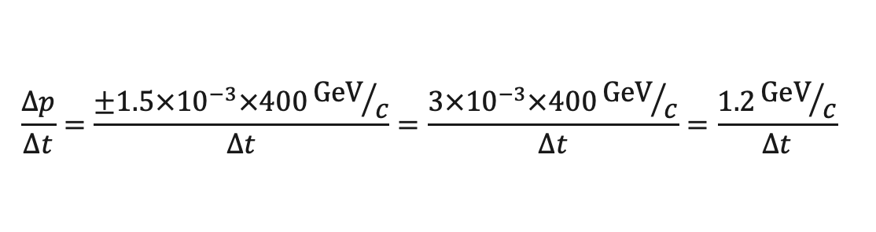
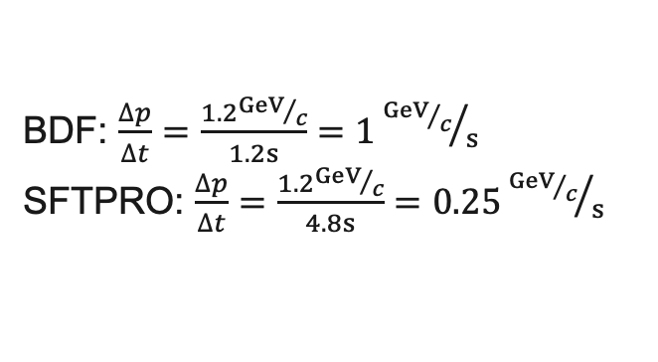
Momentum Sweep
$$\frac{∆p}{∆t}=\frac{±1.5×{10}^{−3}×400{GeV}/c}{Δt}=\frac{3×{10}^{−3}×400{GeV}/c}{Δt}=\frac{1.2{GeV}/c}{Δt}$$
BDF: $\frac{∆p}{∆t}=\frac{1.2{GeV}/c}{1.2s}=1{{GeV}/c}/s$
SFTPRO: $\frac{∆p}{∆t}=\frac{1.2{GeV}/c}{4.8s}=0.25{{GeV}/c}/s$

Slide 4
Sweep Possibilities
We focus on the Post LS3 option!
Today
TT20
TT21
TT22
TT24
P42/BA80
P42/BA81
✅
✅
✅
❌
❌
❌
Post LS3
TT20
TT21
TT22
TT24
P42/BA80
P42/BA81
✅
✅
✅
❌❓
✅
❌
Post LS4
TT20
TT21
TT22
TT24
P42/BA80
P42/BA81
✅
✅
✅
❌❓
✅
✅

Slide 5
Nominal Dispersion

Slide 6
Maximal Dispersion
Effect in y only visible at the end as first-non ramped, vertical dipole is B9 in P42
In x much more pronounced whole TT24 is not ramped and main set of non-ramped dipoles in P42 are horizontal

