Slide 1
NbTi Hybrid Block Coil Designs
- The BOND Case -
Ariel Haziot
HFM Forum
April 4th, 2025

Slide 2
Introduction
In high field magnets (above 12 T) wound with high amounts of Nb₃Sn, the cost is mostly driven by the price of the conductor, thus impacting significantly the cost of future accelerator using this technology.
Material grading is the concept of replacing an expensive conductor by a cheaper one in lower field regions where the performances of the original conductor are not required.
NbTi is a good candidate to replace Nb₃Sn in field region below 8 T. It can carry up to 1600 A/mm² at 10 T for a price 7-10 times lower than Nb₃Sn.

Slide 3
Outline
Context
  D19A
  Malta & Snowmass
  LPF1
  HFM (DAISY, SMACC)
The BOND Case
  14T – flat & stepped versions
  12T – flat and 4.5 K versions
  AC-losses digression
Short Model Coil Validation

Slide 4
1. Context

Slide 5
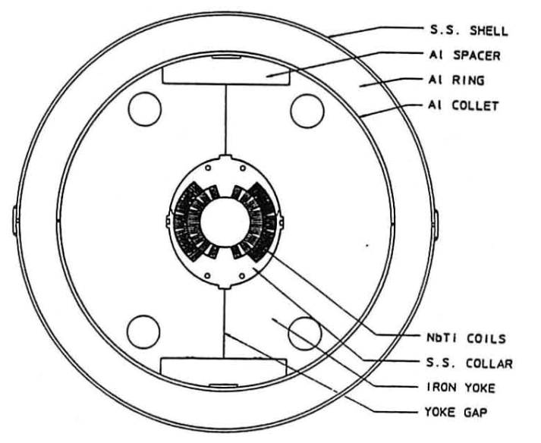
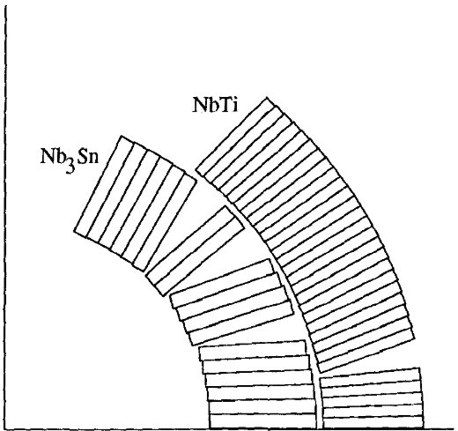
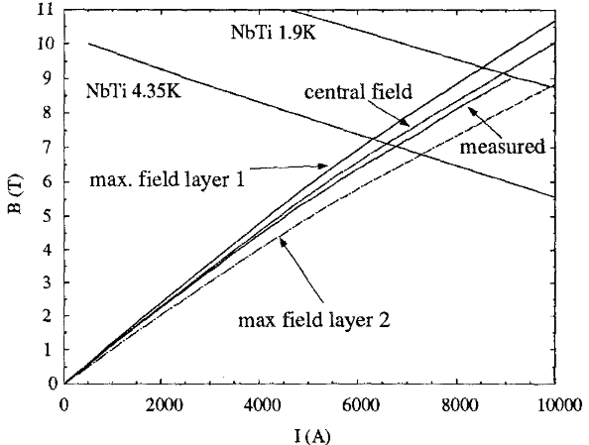
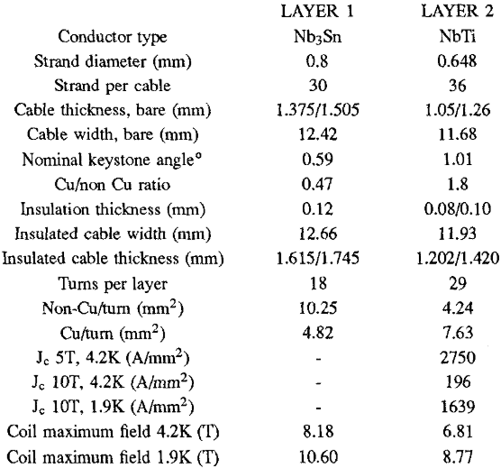
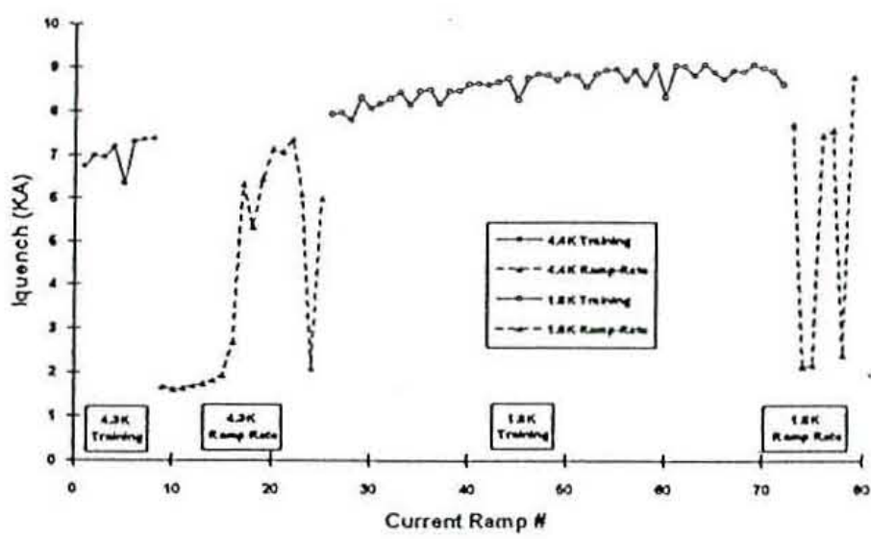
Context
D19A at LBNL (1997)
D19A was built from D19, a 50 mm bore NbTi Cos-θ dipole generating 7.6 T at 4.35K and 10 T at 1.8K.
The Nb₃Sn outer layer was replaced by a NbTi coil.
  Nb₃Sn ratio: 42 %
The Nb₃Sn coil was wound reacted and impregnated. The NbTi coil was connected to the inner layer with an internal splice.
At 4.35 K, the magnet reached a bore field of 7.56 T (7360 A)
  All quenches in the NbTi coil
At 1.7 K, it trained untill 8.99T (9092 A) bore field
  20 firsts quenches in the Nb₃Sn coil
  20 limiting quenches in NbTi
  Unsufficient pre-loading on the NbTi coil is suspsected
S. Caspi et al., Design and Construction of a Hybrid - Nb3Sn, NbTi - Dipole Magnet, IEEE Trans. Appl. Supercond. 7, 547 (1997)
A. Lietzke et al., Test Results on Nb3Sn Dipole Magnets, IEEE Trans. Appl. Supercond. 7, 739 (1997)

Slide 6
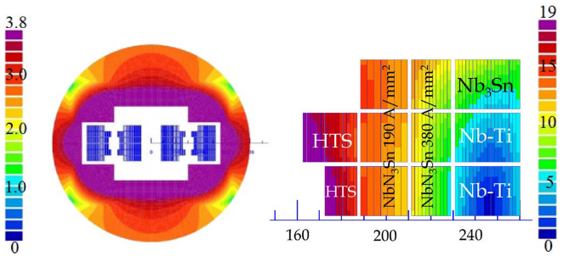
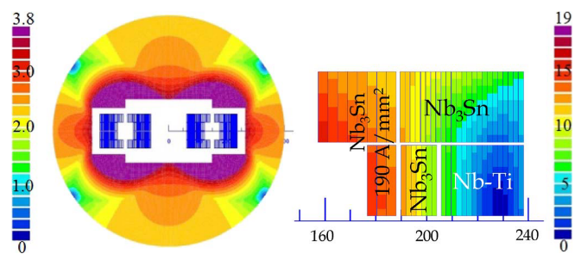
Context
Malta & Snowmass (2014)
Malta
Two conceptual designs toward a conductor cost effective high field magnet using hybrid block coil designs.
Malta is a complex 20 T dipole with 6 coils including 3 different materials and 2 different grades of Nb₃Sn.
  Nb₃Sn ratio: 61 %
  It exist different simpler variations removing either materials or grading
Snowmass is a simpler 15 T dipole with 3 coils including NbTi and 2 different grades of Nb₃Sn.
  Nb₃Sn ratio: 77 %
Snowmass
E. Todesco et al., Dipoles for High-Energy LHC, IEEE Trans. Appl. Supercond. 24, 4004306 (2014)

Slide 7
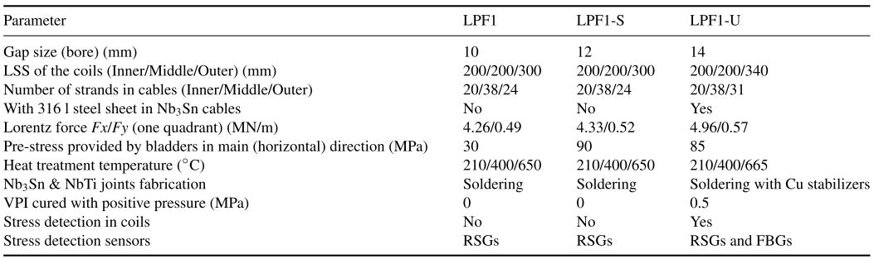
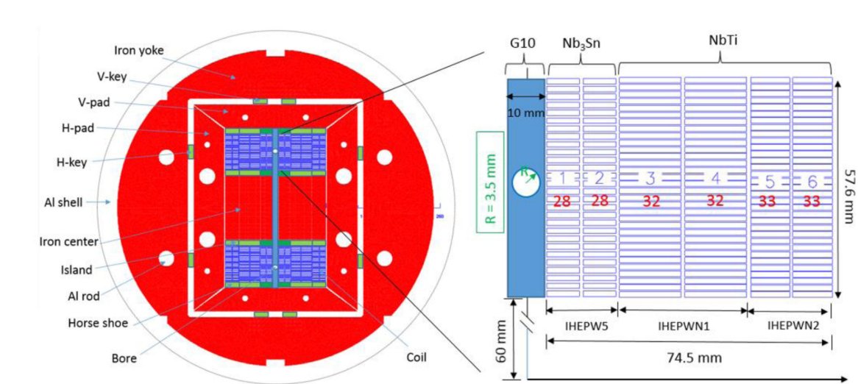
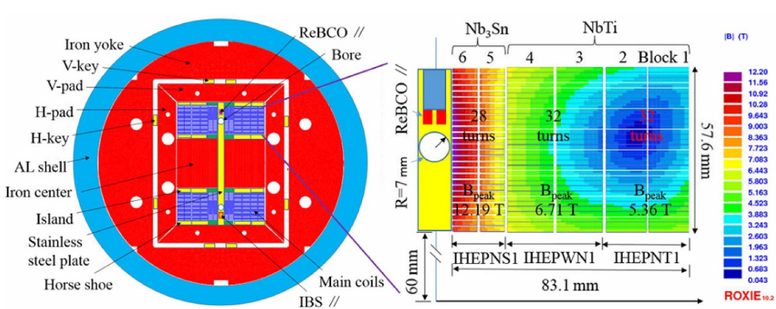
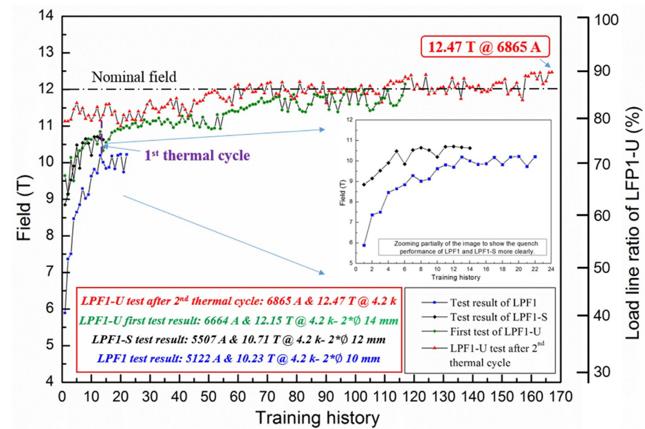
Context
FECD1,LPF1, LFP1-S, LFP1-U at IHEP (2017-2023)
FECD1 is a 12 T hybrid racetrack coils test bench with 4 Nb₃Sn and 4 NbTi double pancakes.
LFP1: Hybrid CC with 2 Nb₃Sn and 4 NbTi layers
  Nb₃Sn ratio: 25 %
  10.2 T in a 10 mm aperture at 4.2 K (72% I_{SS})
  Quenches in NbTi outer coils
LFP1-S: LFP1 with higher pre-load,
  10.7 T in a 12 mm aperture at 4.2 K (77% I_{SS})
  Quenches in 1 Nb₃Sn coil, HF region
LFP1-U: New cables, new coils
  Nb₃Sn ratio: 23 %
  12.5 T in a 14 mm aperture at 4.2 K (90% I_{SS})
  Quenches in 1 Nb₃Sn coil, on a localised defect
The coils were prepared independantly and spliced outside.
LFP1
LFP1-U
C. Wang et al., Electromagnetic design of a 12 T twin-aperture dipole magnet, Int. J. Mod. Phys. 32, 1746008 (2017)
K. Zhang et al., Mechanical Design of FECD1 at IHEP: A 12-T Hybrid Common-Coil Dipole Magnet, IEEE Trans. Appl. Supercond. 27, 4001605 (2017)
D. Cheng et al., Quench simulation results for a 12-T twin-aperture dipole magnet, Cryogenics 92, 13-19 (2018)
C. Wang et al., Electromagnetic design, fabrication, and test of LPF1: A 10.2-T common-coil dipole magnet with graded coil configuration, IEEE Trans. Appl. Supercond. 29, 4003807 (2019)
C. Wang et al., Mechanical Design, Assembly, and Test of LPF1: A 10.2 T Nb3Sn Common-Coil Dipole Magnet with Graded Coil Configuration, IEEE Trans. Appl. Supercond. 29, 4000108 (2019)
C. Wang et al., Development of superconducting model dipole magnets beyond 12 T with a combined common-coil configuration, Supercond. Sci. Technol.. 36, 065006 (2023)

Slide 8
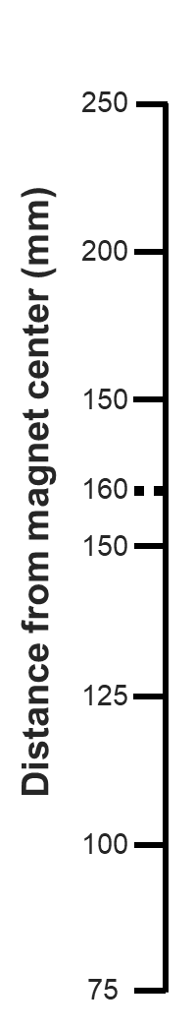
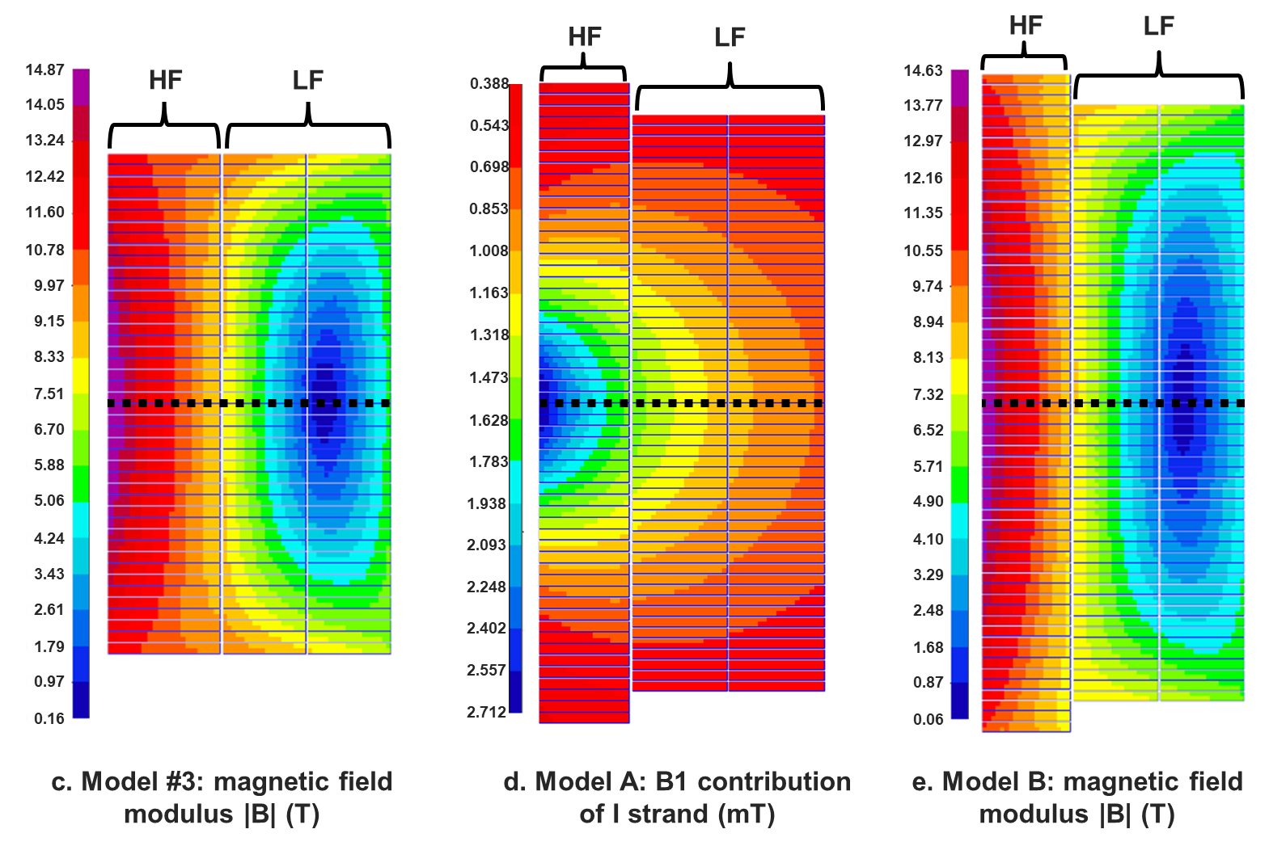
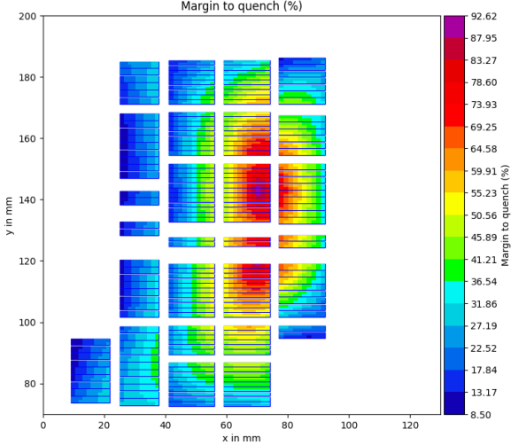
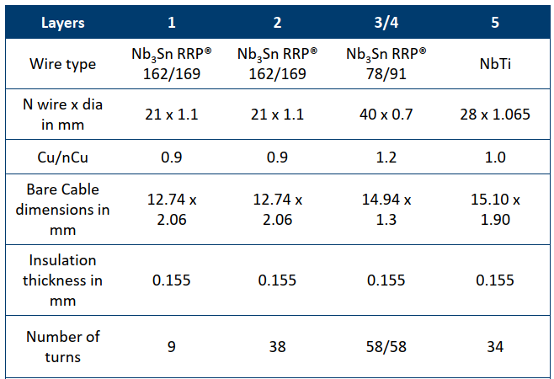
Context
DAISY and SMACC for HFM (2024)
Nb₃Sn
NbTi
Nb₃Sn
NbTi
Nb₃Sn
Nb₃Sn
Within the HFM programme:
DAISY (CIEMAT) is a CC with 1 layer of Nb3Sn and 2 layers of NbTi, generating 14 T in 2 apertures of 50 mm.
  Nb₃Sn ratio: 36 %
SMACC (PSI) exists in a 14 T version with 4 layers of Nb₃Sn (with grading) and 1 layer of NbTi.
  Nb₃Sn ratio: 77 %
Nb₃Sn
NbTi
J. Garcia-Matos et al., Magnetic Design of a 14 T Common Coil Demonstrator Magnet (DAISY), IEEE Trans. Appl. Supercond. 35, 4002605 (2025)
D. Araujo, Status of Subscale Stress-Managed Common-Coils Manufacturing and on the SMACC conceptual design HFM Forum, HFM Forum, Indico 1389304 (2024)

Slide 9
2. The BOND Case

Slide 10
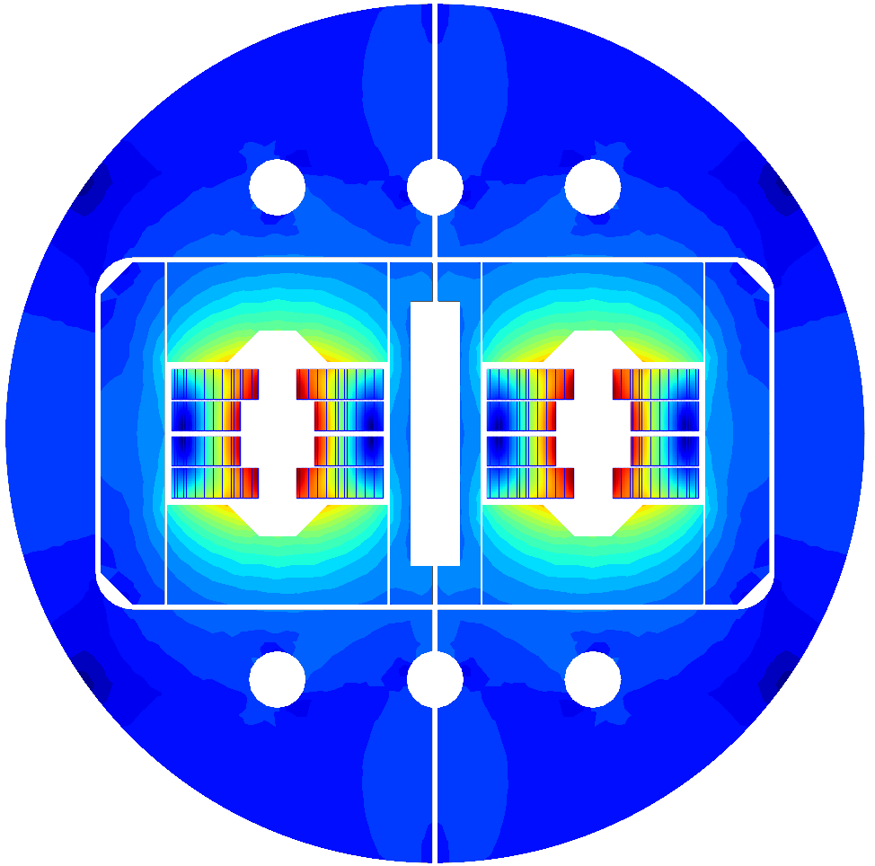
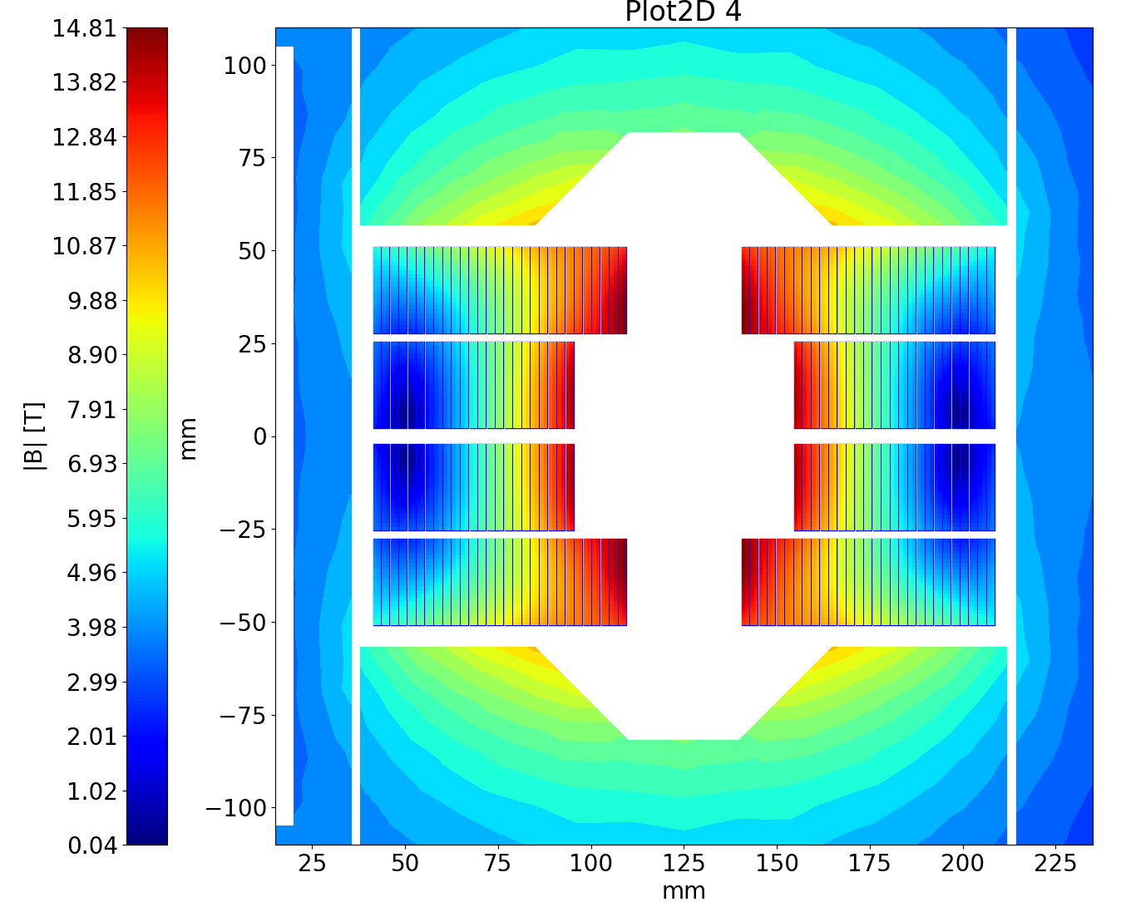
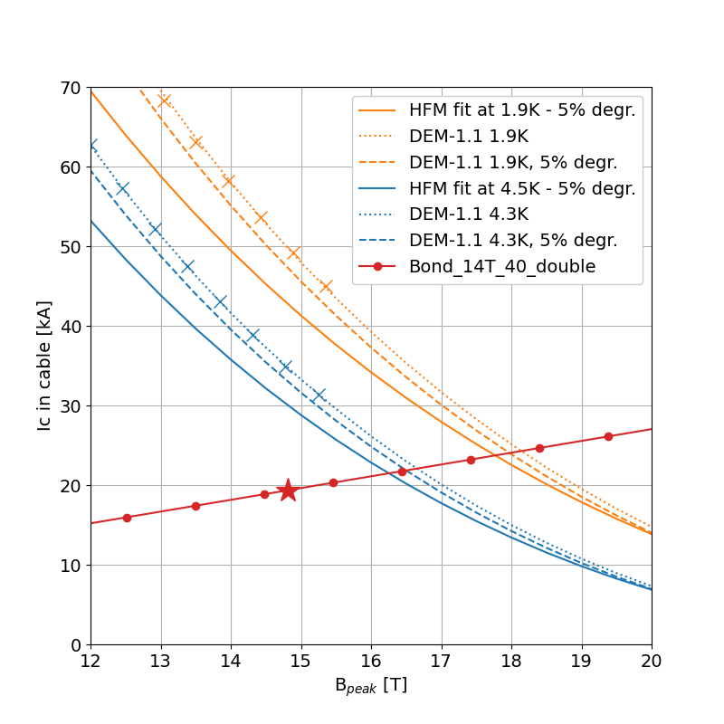
The BOND Case
Baseline with Nb₃Sn
The block coil design used for this case study is the BOND double aperture magnet:
Double aperture of 50 mm
2 double layers Nb₃Sn coils per aperture
14 T bore field with 20% margin at 1.9 K
Operational parameters
Current (I_{nom}) | (kA) | 19.34
Peak Field | (T) | 14.81
Short sample current @ 1.9 K | (kA) | 23.66
Short sample current @ 4.2 K | (kA) | 21.20
Short sample field @ 1.9 K | (T) | 17.8
Short sample field @ 4.2 K | (T) | 16.0
j overall | (A/mm²) | 348
j strand | (A/mm²) | 509
j superconductor | (A/mm²) | 967
j copper | (A/mm²) | 1074
Loadline fraction @ 1.9 K | (%) | 81.7
Loadline fraction @ 4.5 K | (%) | 91.2
Stored energy/m | (MJ/m) | 2.064
Inductance/m | (mH/m) | 10.24
Overall Parameters
Aperture | (mm) | 50
Field | (T) | 14.0
Number of apertures | (adim) | 2
Distance between apertures | (mm) | 250
Yoke outer diameter | (mm) | 680
Coil design
Insulated cable surface (one aperture) | (mm²) | 12746
Equivalent coil width | (mm) | 56.9
Coil efficiency | (T mm / A) | 0.00077
N. layers | (adim) | 2
N. turns/pole | (adim) | 52
J.C. Perez et al., Conceptual Design of BOND: A 14 T Dipole for FCC-hh, IEEE Trans. Appl. Supercond. 35, 4002506 (2025)

Slide 11
The BOND Case
Conductor choice
Conductor parameters |  | Nb₃Sn |  | NbTi
Strand diameter | (mm) | 1.10 |  | 1.10
Layout |  | RRP 162/169
Effective filament diameter | (µm) | 64 |  | 7
Jc at 4.2 K and 16 T | (A/mm²) | 1200
Cu/NonCu ratio |  | 0.9 |  | 1.0
No. of strands in cable |  | 40 |  | 40
Bare cable width | (mm) | 23.045 |  | 23.275
Bare cable thickness | (mm) | 1.98 |  | 2.0
Bare cable width (reacted) | (mm) | 23.275
Bare cable thickness (reacted) | (mm) | 2.06
Insulation thickness | (mm) | 0.150 |  | 0.150
Insulated cable width (reacted) | (mm) | 23.575 |  | 23.575
Insulated cable thickness (reacted) | (mm) | 2.36 |  | 2.3
A strand | (mm²) | 0.950 |  | 0.950
A sc | (mm²) | 0.500 |  | 0.475
A cu | (mm²) | 0.450 |  | 0.475
The Nb₃Sn cable in BOND is made of 40 DEM-1.1 strands of 1.1 mm.
For this study, an hypethtical NbTi conductor was considered:
  1.1 mm strand
  cable identical to the BOND cable
A more realistic conductor using LHC01 strands (1.065 mm) is under consideration for further studies.

Slide 12
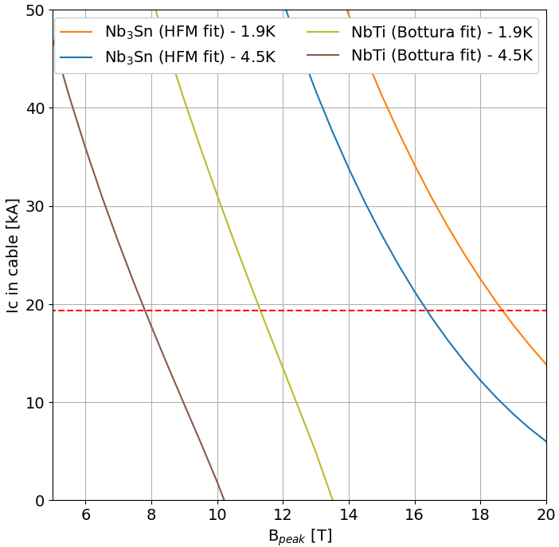
The BOND Case
The Low Field Region
20%
Same current as in BOND: 19.34 kA
Field region suitable for using NbTi with 20% margin on the loadline.

Slide 13
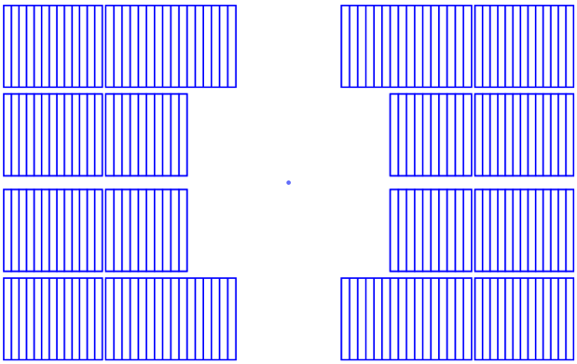
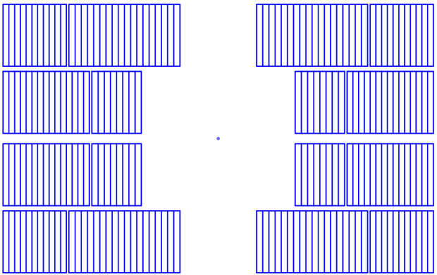
The BOND Case
Alternative versions
Flat coil
Stepped coil
Easier for fabrication
Less NbTi turns
Optimal use of the low field region
More NbTi turns

Slide 14
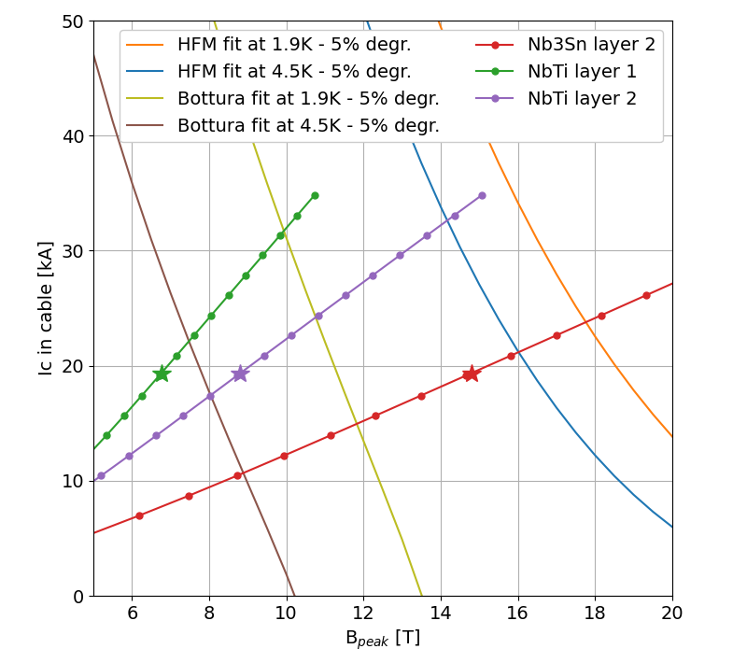
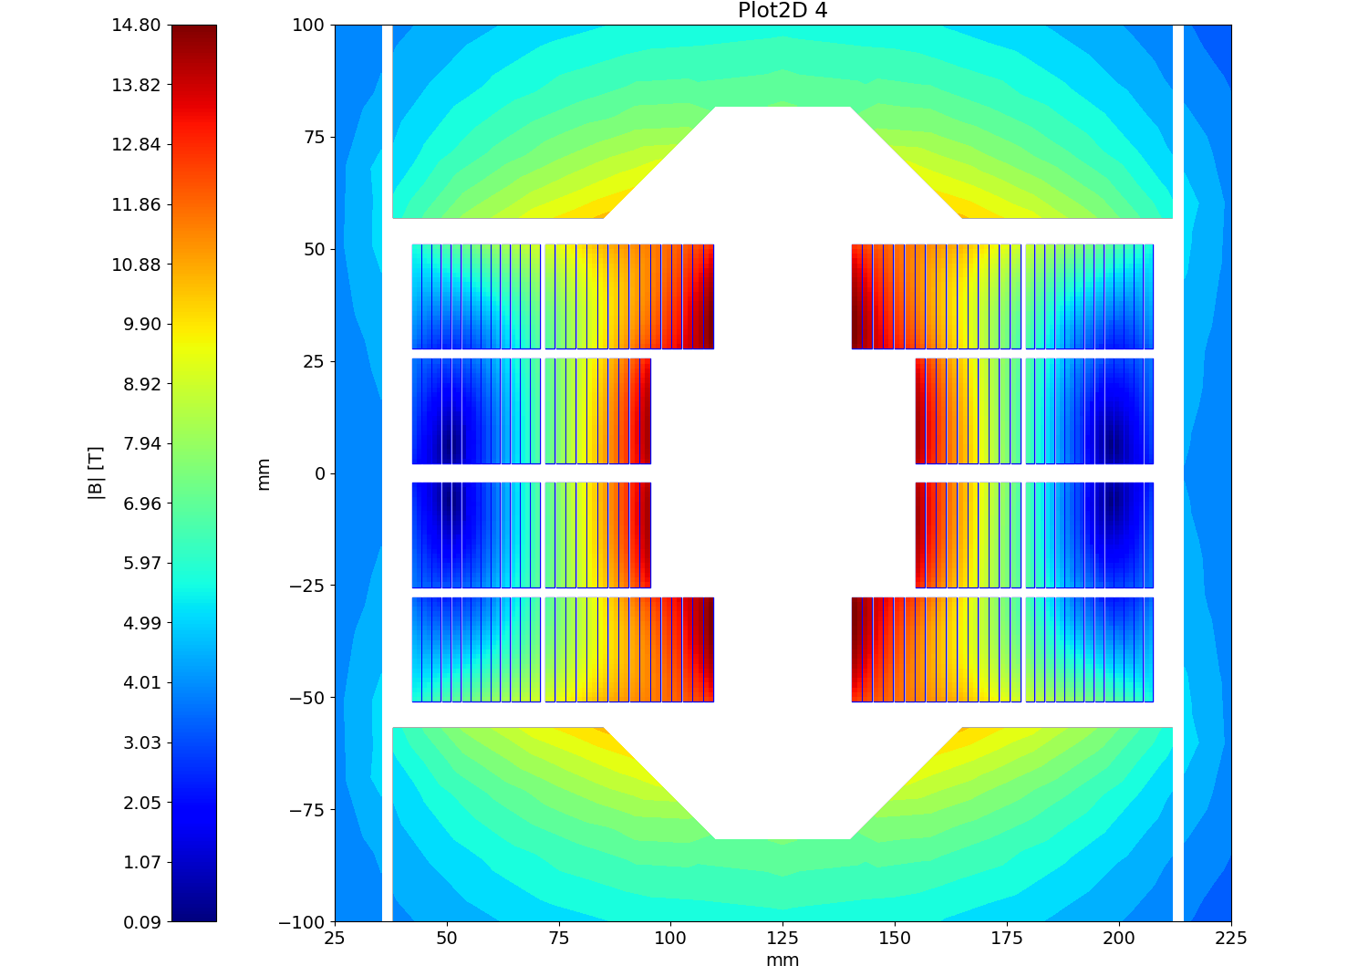


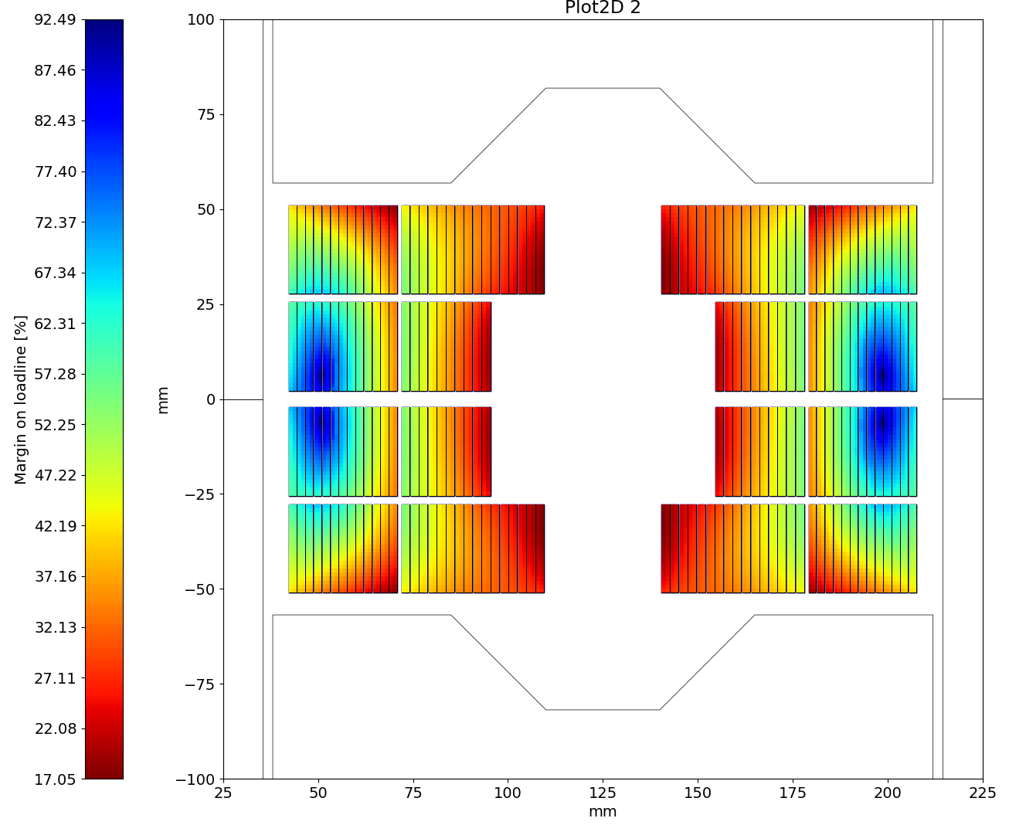
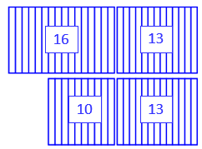
The BOND Case
14T – Flat version
Magnetic Field
Nb₃Sn: 26 turns (10+16)
NbTi: 26 turns (13+13)
Nb₃Sn ratio: 50 %
Loadline at 1.9 K: below 82 %, limited by the Nb₃Sn coil.
Margin on the loadline
Nb₃Sn
Nominal current | [kA] | 19.34
SS field at 1.9 K | [T] | 17.8
SS current at 1.9 K | [kA] | 23.65
Loadline fraction | (%) | 81.8
NbTi layer 1
Nominal current | [kA] | 19.34
SS field at 1.9 K | [T] | 9.9
SS current at 1.9 K | [kA] | 31.65
Loadline fraction | (%) | 61.1
NbTi layer 2
Nominal current | [kA] | 19.34
SS field at 1.9 K | [T] | 10.8
SS current at 1.9 K | [kA] | 24.03
Loadline fraction | (%) | 80.5

Slide 15
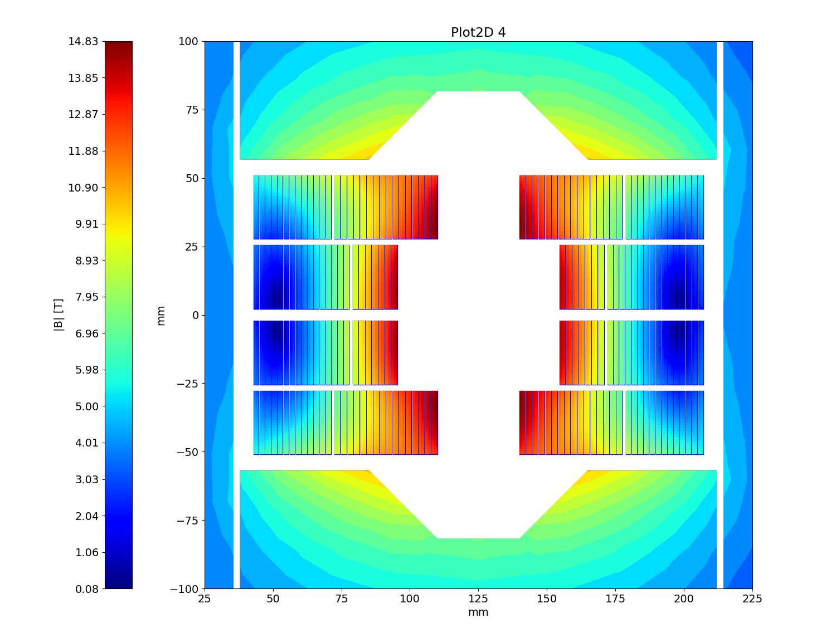
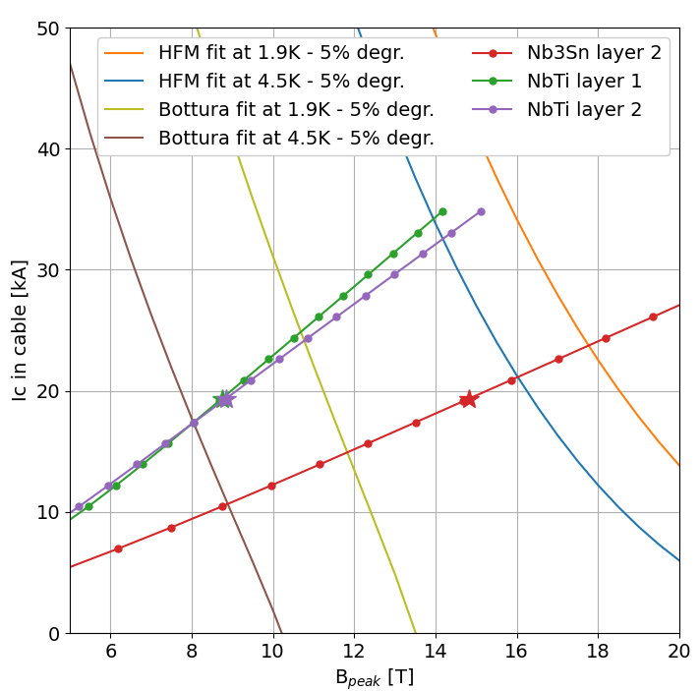
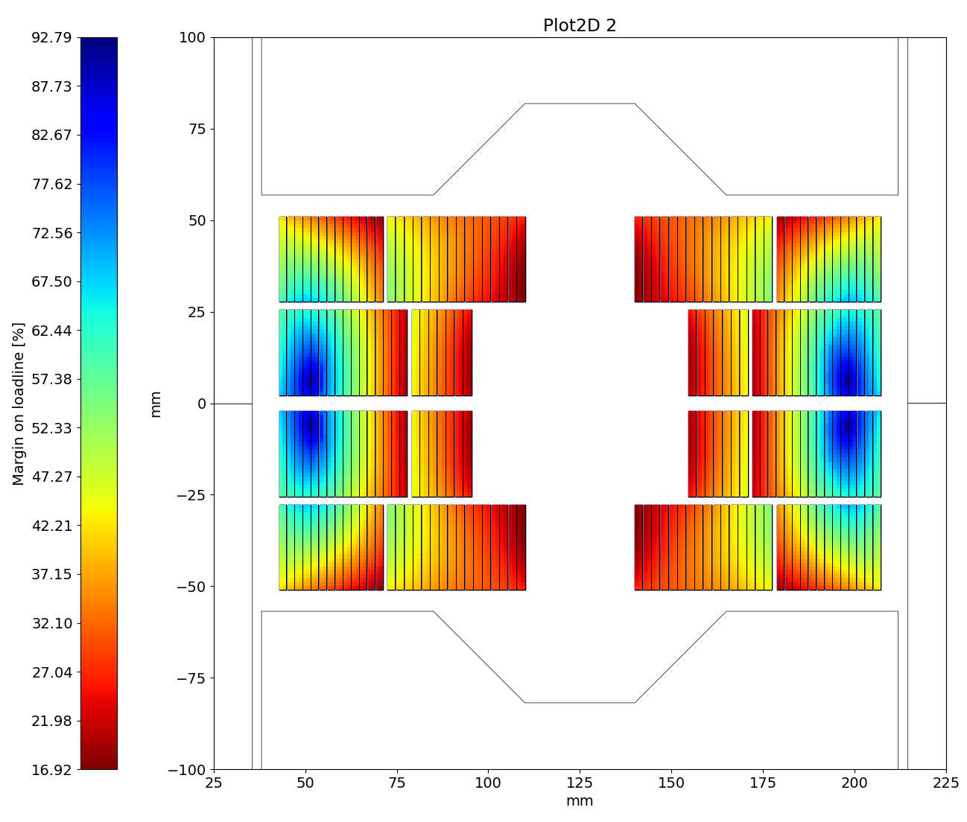
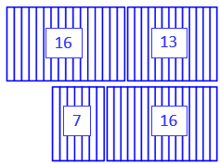
The BOND Case
14T – Stepped version
Magnetic Field
Nb₃Sn: 23 turns (7+16)
NbTi: 29 turns (16+13)
Nb₃Sn ratio: 44 %
Loadline at 1.9 K: below 82 %, limited by the Nb₃Sn coil.
Margin on the loadline
Nb₃Sn
Nominal current | [kA] | 19.34
SS field at 1.9 K | [T] | 17.8
SS current at 1.9 K | [kA] | 23.63
Loadline fraction | (%) | 81.9
NbTi layer 1
Nominal current | [kA] | 19.34
SS field at 1.9 K | [T] | 10.7
SS current at 1.9 K | [kA] | 24.79
Loadline fraction | (%) | 78.0
NbTi layer 2
Nominal current | [kA] | 19.34
SS field at 1.9 K | [T] | 10.8
SS current at 1.9 K | [kA] | 23.99
Loadline fraction | (%) | 80.6

Slide 16
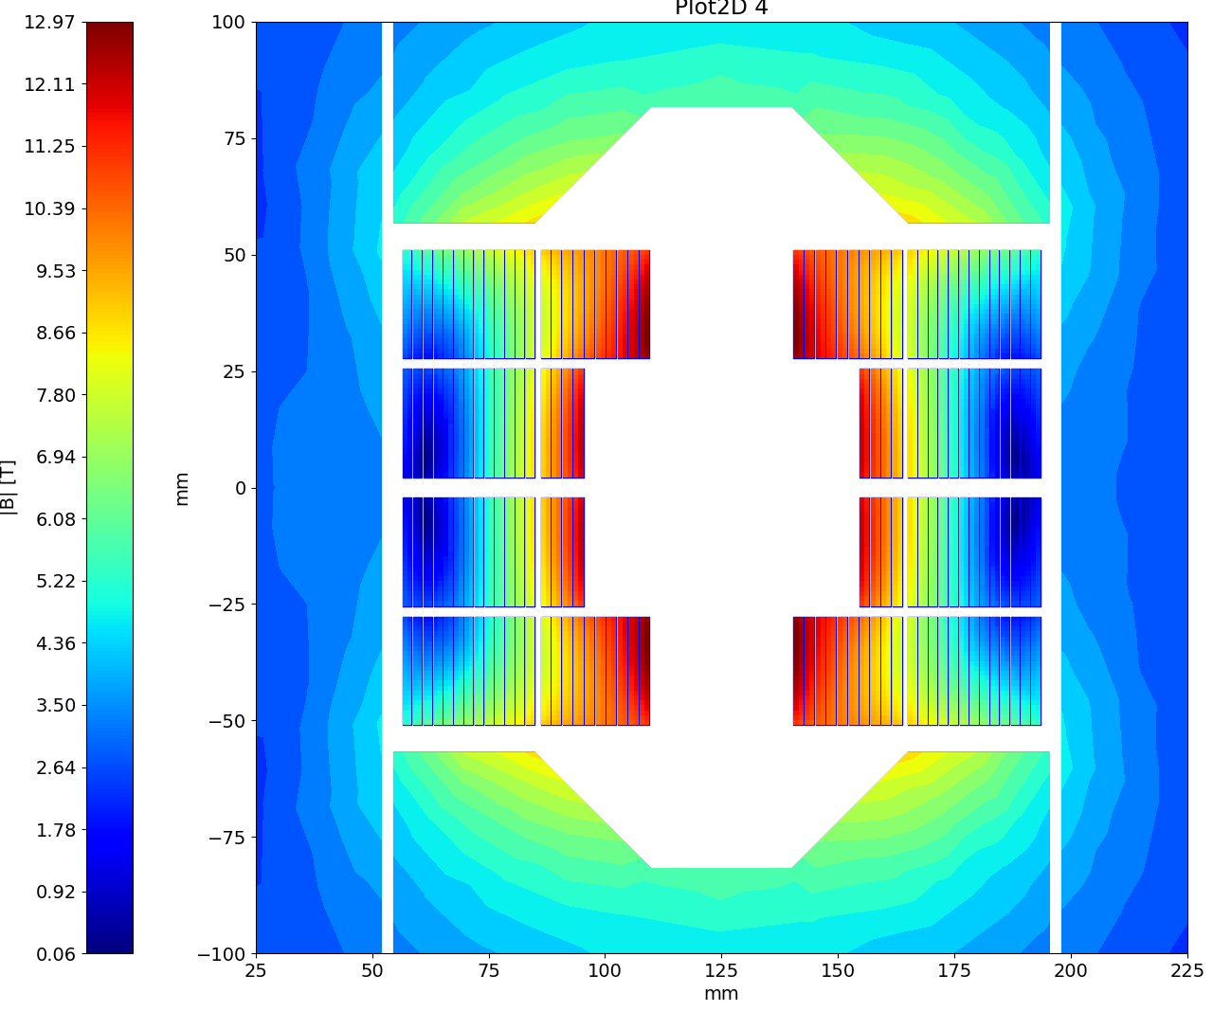
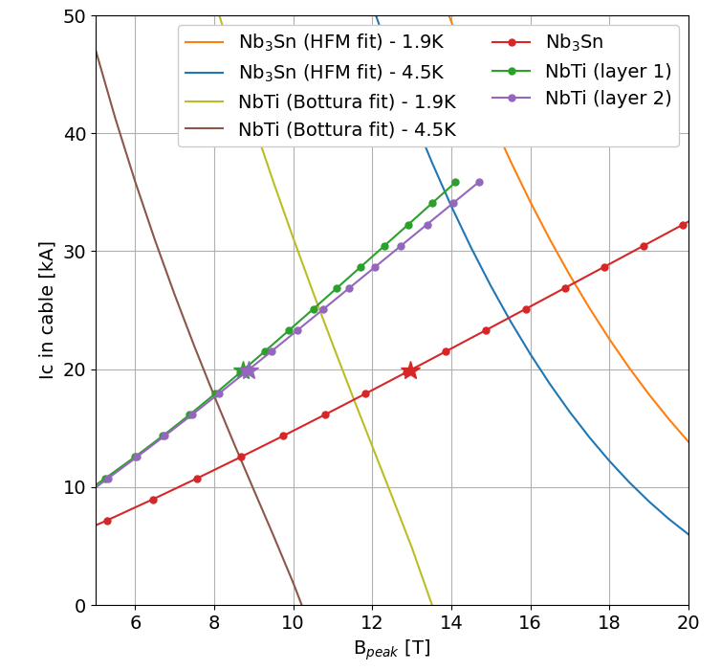
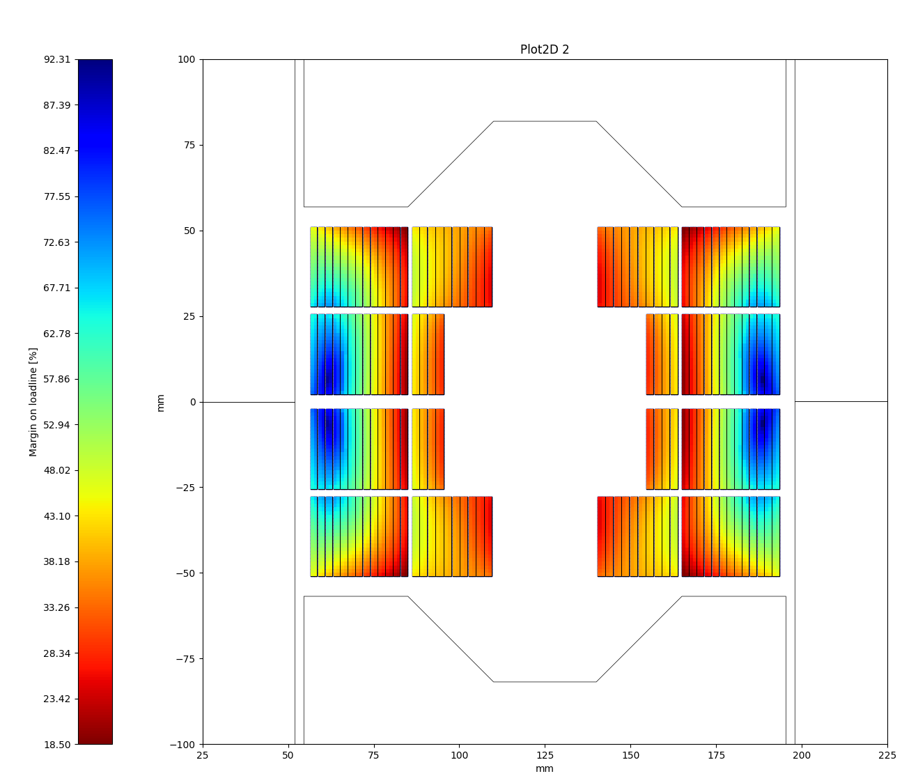
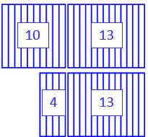
The BOND Case
12T – Flat version
Magnetic Field
Nb₃Sn: 14 turns (4+10)
NbTi: 26 turns (13+13)
Nb₃Sn ratio: 35 %
Loadline at 1.9 K: below 80 %, limited by the NbTi coil.
Margin on the loadline
Nb₃Sn
Nominal current | [kA] | 19.92
SS field at 1.9 K | [T] | 17.1
SS current at 1.9 K | [kA] | 27.27
Loadline fraction | (%) | 73.0
NbTi layer 1
Nominal current | [kA] | 19.92
SS field at 1.9 K | [T] | 10.6
SS current at 1.9 K | [kA] | 25.38
Loadline fraction | (%) | 78.5
NbTi layer 2
Nominal current | [kA] | 19.92
SS field at 1.9 K | [T] | 10.7
SS current at 1.9 K | [kA] | 24.91
Loadline fraction | (%) | 80.0

Slide 17
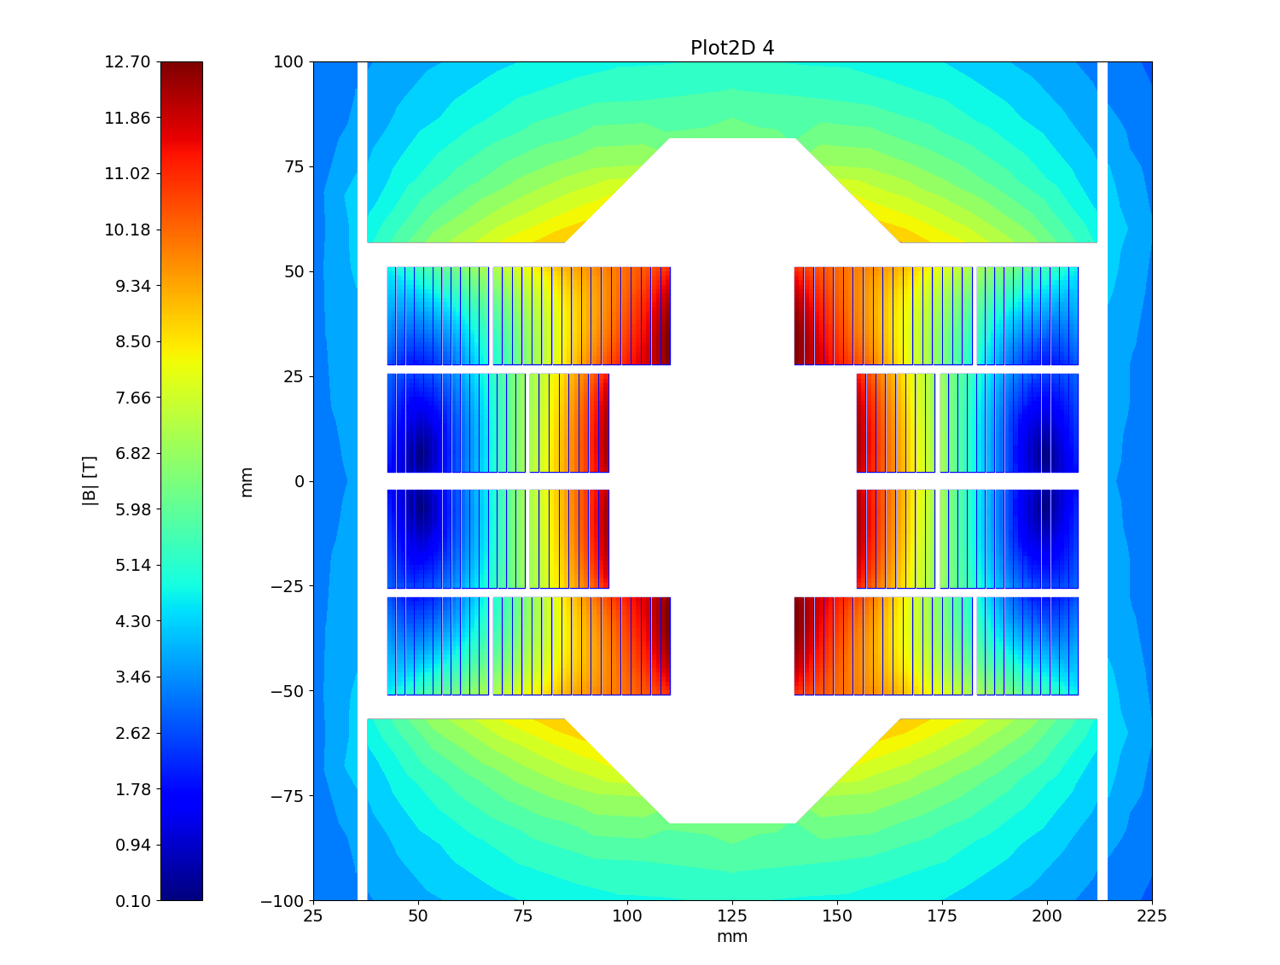
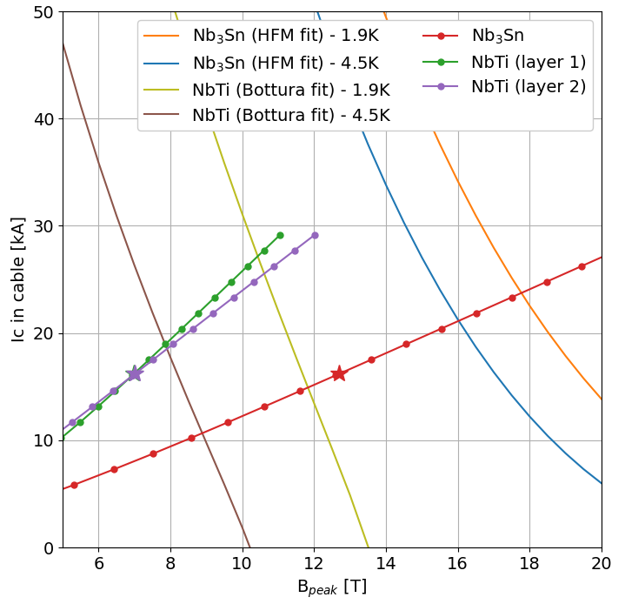

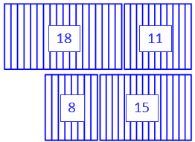
The BOND Case
12T – 4.5 K version
Magnetic Field
Nb₃Sn: 24 turns (8+18)
NbTi: 26 turns (15+11)
Nb₃Sn ratio: 50 %
Loadline at 4.5 K: 78% in the Nb₃Sn coil and 90 % in the NbTi coil.
Margin on the loadline
Nb₃Sn
Nominal current | [kA] | 16.20
SS field at 4.5 K | [T] | 16.0
SS current at 4.5 K | [kA] | 21.02
Loadline fraction | (%) | 77.1
NbTi layer 1
Nominal current | [kA] | 16.20
SS field at 4.5 K | [T] | 7.9
SS current at 4.5 K | [kA] | 18.95
Loadline fraction | (%) | 85.5
NbTi layer 2
Nominal current | [kA] | 16.20
SS field at 4.5 K | [T] | 7.9
SS current at 4.5 K | [kA] | 18.43
Loadline fraction | (%) | 87.9

Slide 18
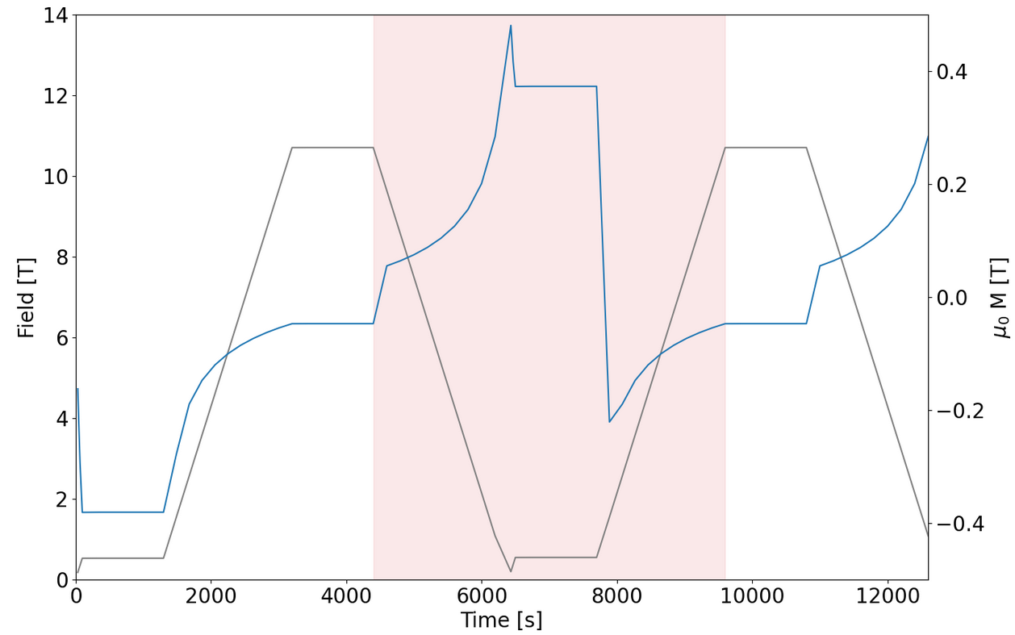
The BOND Case
AC-losses digression
Calculation interval
AC-losses are calculated over a typical current cycle in the LHC:
  Ramp down from nominal to reset (100 A) of 10 A/s
  Injection plateau of 20 min at 1 kA
  Ramp up to nominal of 10 A/s
Calculation is done over the second cycle to account for magnetization.
Today the target in HFM for the loss during this cycle is 10 kJ/m.
Beam dump
Collision
Reset
current
Injection

Slide 19
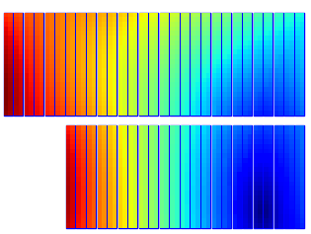
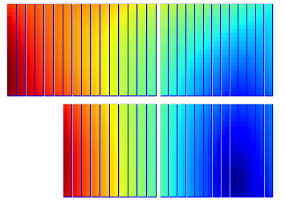
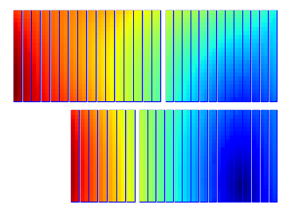
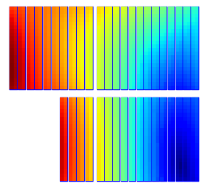
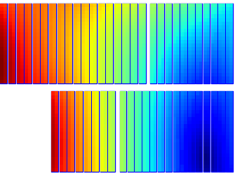
The BOND Case
AC-losses digression
Strand parameters |  | Nb₃Sn | NbTi
Strand diameter | (mm) | 1.10 | 1.10
Strand twist pitch | (mm) | 121 | 115
Effective filament diameter | (µm) | 64 | 7
Filament twist pitch | (mm) | 19 | 4
Crossover resistance (R_{c}) | (µΩ) | 30 | 30
Adjacent resistance (R_{a}) | (µΩ) | 0.3 | 0.3
Filling factor in strand | (mm) | 0.5 | 0.5
Results of the simulations for the different designs
 |  | BOND | Hybrid 14T Flat | Hybrid 14T Stepped | Hybrid 12T Flat | Hybrid 12T 4.5 K
Persistent current losses | [kJ/m] | 24.216 | 14.879 | 13.485 | 8.147 | 14.058
Interfilament coupling current losses | [kJ/m] | 0.009 | 0.007 | 0.006 | 0.003 | 0.005
Interstrand coupling current losses | [kJ/m] | 0.343 | 0.352 | 0.351 | 0.182 | 0.244
Total cable losses | [kJ/m] | 24.569 | 15.238 | 13.842 | 8.332 | 14.308

Slide 20
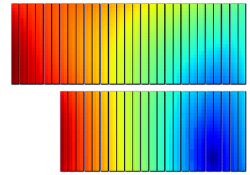
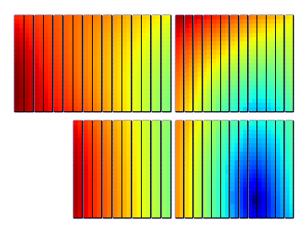
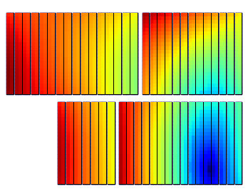
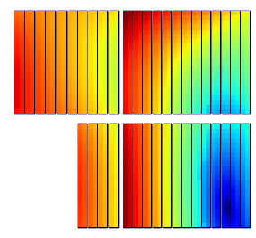
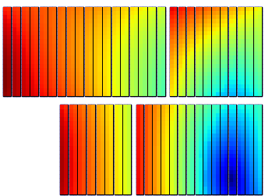
The BOND Case
Comparison
Coil design |  | BOND | Hybrid 14T Flat | Hybrid 14T Stepped | Hybrid 12T Flat | Hybrid 12T 4.5K
Nb₃sn Insulated cable surface (one aperture) | (mm²) | 11 572 | 5 786 | 5 119 | 3 116 | 5 786
NbTi Insulated cable surface (one aperture) | (mm²) | 0 | 5 394 | 6 016 | 5 394 | 5 394
Nb₃sn ratio to BOND | (%) | 100 | 50 | 44 | 27 | 50
Operational parameters
Current | (kA) | 19.34 | 19.34 | 19.34 | 19.92 | 16.20
Peak Field on Nb₃Sn | (T) | 14.8 | 14.8 | 14.8 | 13.0 | 12.7
Short sample current @ 1.9 K on Nb₃Sn | (kA) | 23.66 | 23.65 | 23.63 | 27.27 | 21.02
Short sample field @ 1.9 K on Nb₃Sn | (T) | 17.8 | 17.8 | 17.8 | 17.1 | 16.0
Loadline fraction @1.9 K on Nb₃Sn | (%) | 81.7 | 81.8 | 81.9 | 73.0 | 77.1
Peak Field on NbTi 1st layer | (T) |  | 6.8 | 8.7 | 8.7 | 7.0
Short sample current @ 1.9 K on NbTi 1st layer | (kA) |  | 31.65 | 24.79 | 25.38 | 18.95
Short sample field @ 1.9 K on NbTi 1st layer | (T) |  | 9.9 | 10.7 | 10.6 | 7.9
Loadline fraction @1.9 K on NbTi 1st layer | (%) |  | 61.1 | 78.0 | 78.5 | 85.5
Peak Field on on NbTi 2nd layer | (T) |  | 8.8 | 8.8 | 8.9 | 7.0
Short sample current @ 1.9 K on NbTi 2nd layer | (kA) |  | 24.04 | 23.99 | 24.91 | 18.43
Short sample field @ 1.9 K on NbTi 2nd layer | (T) |  | 10.8 | 10.8 | 10.7 | 7.9
Loadline fraction @1.9 K on NbTi 2nd layer | (%) |  | 80.5 | 80.6 | 80.0 | 87.9
AC-losses over a full cycle | (kJ/m) | 24.6 | 15.2 | 13.8 | 8.3 | 14.3
AC-losses ratio | (%) | 100 | 62 | 56 | 34 | 58
Loadline at 4.5 K

Slide 21
3. Short Model Coil Validation

Slide 22
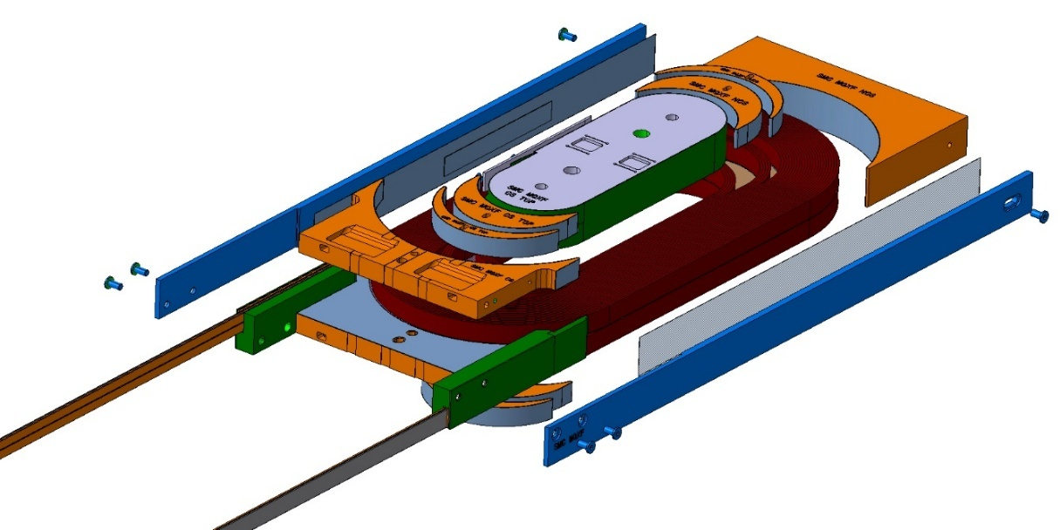

Short Model Coil Validation
Hybrid racetrack coil
The Short Model Coil (SMC) assembly has been designed as a test bench for short racetrack coils wound with Nb₃Sn cable.
SMC MQXF 3G uses a cable made of 32 MQXF strands in a double pancake racetrack coil of 31 turns.
A similar cable made of 35 LHC02 strands could be used to make a hybrid version with:
  Nb₃Sn coil of 8 turns
  NbTi coil of 23 turns
Conductor parameters |  | Nb₃Sn |  | NbTi
Strand diameter | (mm) | 0.850 |  | 0.825
Layout |  | RRP 108/125
Effective filament diameter | (µm) | 55 |  | 7
Cu/NonCu ratio |  | 1.2 |  | 1.9
No. of strands in cable |  | 32 |  | 35
Bare cable width | (mm) | 14.7 |  | 14.75
Bare cable thickness | (mm) | 1.525 |  | 1.48
Bare cable width (reacted) | (mm) | 14.88
Bare cable thickness (reacted) | (mm) | 1.59
Insulation thickness | (mm) | 0.150 |  | 0.150
Insulated cable width (reacted) | (mm) | 15.18 |  | 15.05
Insulated cable thickness (reacted) | (mm) | 1.89 |  | 1.78
A strand | (mm²) | 0.567 |  | 0.535
A sc | (mm²) | 0.258 |  | 0.184
A cu | (mm²) | 0.310 |  | 0.350
8
23

Slide 23
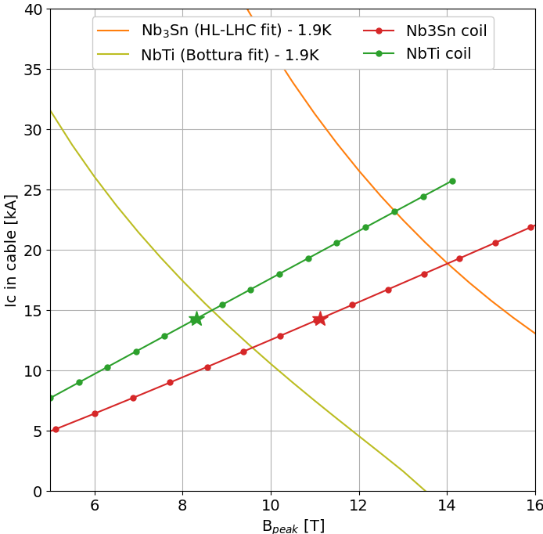
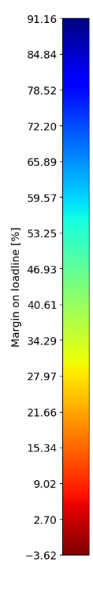


Short Model Coil Validation
Magnetic design
The hybrid SMC includes only 25% of Nb₃Sn.
The magnet will be limited by the NbTi coil:
  8.7 T at 15.1 kA
At this limit, the Nb₃Sn will still have 25% margin on the loadline.
Coil design |  | SMC MQXF 3G | SMC MQXF H
Nb₃sn Insulated cable surface (one aperture) | (mm²) | 3558 | 858
NbTi Insulated cable surface (one aperture) | (mm²) | 0 | 2644
Nb₃sn ratio | (%) | 100 | 25
Operational parameters
Current | (kA) | 18.93 | 14.30
Peak Field on Nb₃Sn | (T) | 14.0 | 11.12
Short sample current @ 1.9 K on Nb₃Sn | (kA) | 18.93 | 18.93
Short sample field @ 1.9 K on Nb₃Sn | (T) | 14.0 | 14..0
Loadline fraction @1.9 K on Nb₃Sn | (%) | 100 | 75.6
Peak Field on NbTi | (T) |  | 8.31
Short sample current @ 1.9 K on NbTi | (kA) |  | 15.11
Short sample field @ 1.9 K on NbTi | (T) |  | 8.7
Loadline fraction @1.9 K on NbTi | (%) |  | 94.6
SMC MQXF 3G
SMC MQXF H

Slide 24


Short Model Coil Validation
Engineering of hybrid SMC
Engineering design is still at early stage.
The Nb₃Sn coil of 8 turns incorporates the 2 sets of headspacers.
After winding and reaction of the Nb₃Sn coil, an internal splice against the second headspacers allows the connection to the NbTi cable.
The NbTi coil is then wound around the Nb₃Sn coil, layer per layer.
The coil could then be fully impregnated.
Courtesy of J.C. Perez

Slide 25
Conclusion
Material grading is a great way to reduce conductor cost in high field magnets by replacing the Nb₃Sn by NbTi in the low field regions of the coils.
The case study of BOND generating 14 T at 1.9 K, shows that 50 % or more of the Nb₃Sn could be replaced by NbTi in this block coil design.
In a 12 T hybrid version, the amount of Nb₃Sn is reduced by 70% compared to the non-hybrid 14 T version. For 12 T, a hybrid magnet working at 4.5 K could be foreseen.
The gain in AC-losses per cycle due to the smaller filaments of NbTi is also significant with a reduction around 40% getting us closer to the HFM target.
A hybrid short model racetrack magnet with internal splices is under development with a conceptual and an engineering designs on-going.

Slide 27



NbTi version 1
Straight bloc
Nb3Sn: 30 turns 6676 mm2 insulated surface (per aperture)
NbTi: 22 turns 4652 mm2 insulated surface (per aperture)
62%
82%
18
11
12
11

Slide 28



NbTi version 2
Blocs with different size
Nb3Sn: 25 turns 5563 mm2 insulated surface (per aperture)
NbTi: 27 turns 5710 mm2 insulated surface (per aperture)
82%
85%
18
11
7
16

