Slide 1
Coherent Effects and Impedances section (CEI) – general information
BE-ABP-CEI
Coherent Effects and Impedance
Giovanni RUMOLO
David AMORIM
Chiara ANTUONO
Miltiadis BOZATZIS
Xavier BUFFAT
Elena DE LA FUENTE GARCIA
Dora GIBELLIERI
Fredrik GRØNVOLD
Evangelos KATRALIS
Peter KICSINY
Jintao LI
Elena MACCHIA
Lotta METHER
Elias MÉTRAL
Nicolas MOUNET
Luca SABATO
Daniel SCHULTE
Leonardo SITO
Roxana SOOS
R TAYLOR
Carlo ZANNINI
Giovanni Rumolo
CEI Section Meeting, 03/04/2025
Scientific secretary: Elena de la Fuente
https://indico.cern.ch/event/1524845/

Slide 2
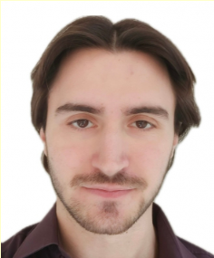
New arrivals
Evangelos Katralis:
PhD student under Lotta’s supervision, started on 1 April and
will be working, among other things, on electron cloud effects
for LHC, specifically on the study of electron cloud instabilities
and emittance growth through macro-particle tracking
simulations using the state-of-the-art models for the LHC beam
screen surfaces.

Slide 3
Upcoming events and deadlines
IPAC paper preparation:
  IPAC authors have received instructions to upload their papers on the IPAC 2025 - Taipei - IPAC conference - CERN Confluence
  Internal deadline for papers agreed at last meeting (for papers to be uploaded on the Confluence site and ready for me to read): 28 April
Talks for the FCC week: Anybody who would like to rehearse at our section meeting first? Please let me know
  Take into account that there will be no CEI section meeting on 8 (my holiday) nor 15 May (ABP management retreat day), so we might find an alternative slot in the week 12-16 May

Slide 4

Arising matters
Zoom’s AI Companion has been officially available on CERN Zoom since beginning 2025.
Handy tool with features such as meeting summaries, in-meeting questions, chat summaries or smart recordings. You can find an overview of the features on the Videoconference service website.
AI Companion is disabled by default. If you’d like to use it, you’ll need to switch it on from your Zoom profile.
While the AI Companion helps streamline your work, it is strongly recommended reviewing any AI-generated content before sharing it. For details on staying secure and avoiding risks, check out the security and privacy guide.
To help you get started, you can watch the recording of the Zoom training session for the CERN community.
If you have any questions, please contact the CERN Videoconference service team.

Slide 5
Arising matters
EDH signature password will be removed from the Submit/Sign pop-up.
Instead, users will need to type some “confirmation” value such as document number or person ID or just tick a checkbox like “I have read and agreed” (to be yet decided).
When: By the end of May 2025

Slide 6
LHC schedule
Hardware commissioning ongoing
Beam now expected around 8-9 April

Slide 7
Injectors schedule
Scrubbing run ended last Friday with the achievement of the LIU beam parameters
Today test of beam stability with crab cavity in.

Slide 8
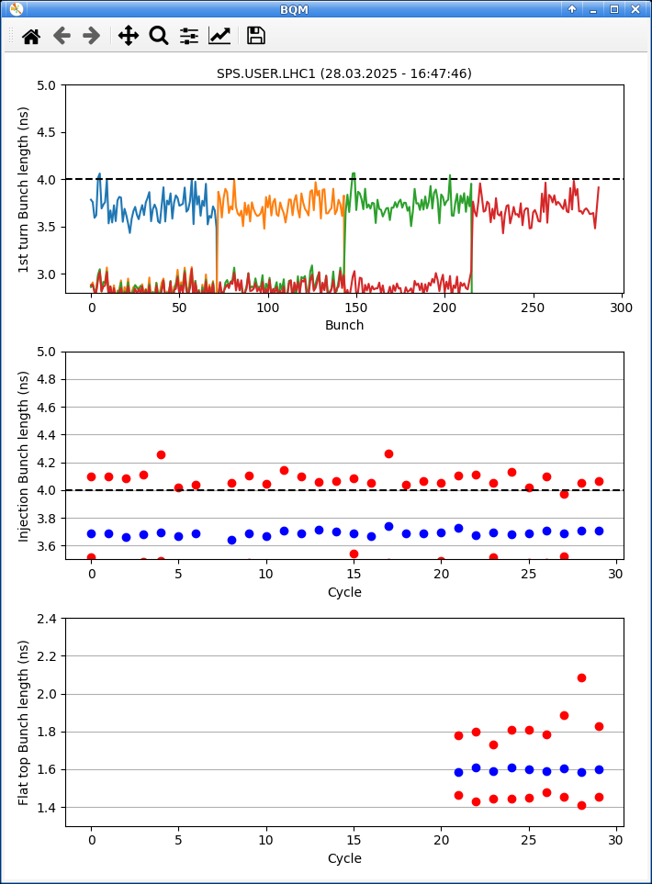
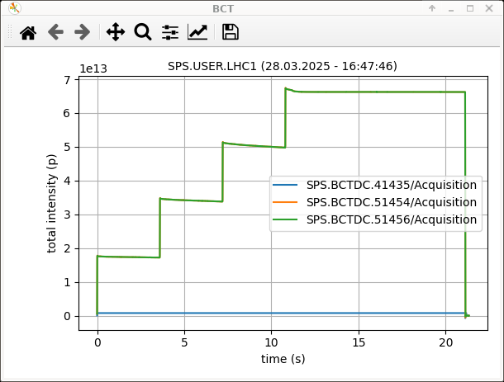
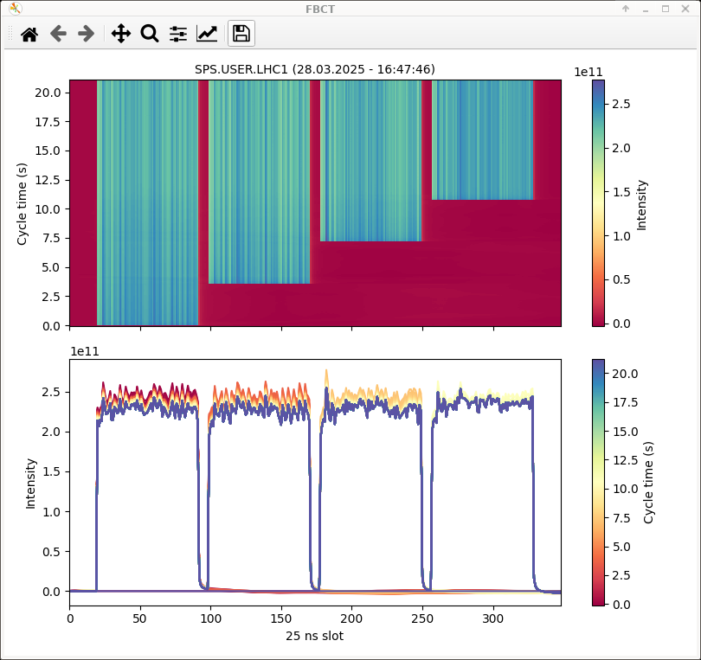
Scrubbing achievements
4x72 bunches with 2.3e11 p/b at extraction with 1.65 ns bunch length

Slide 9
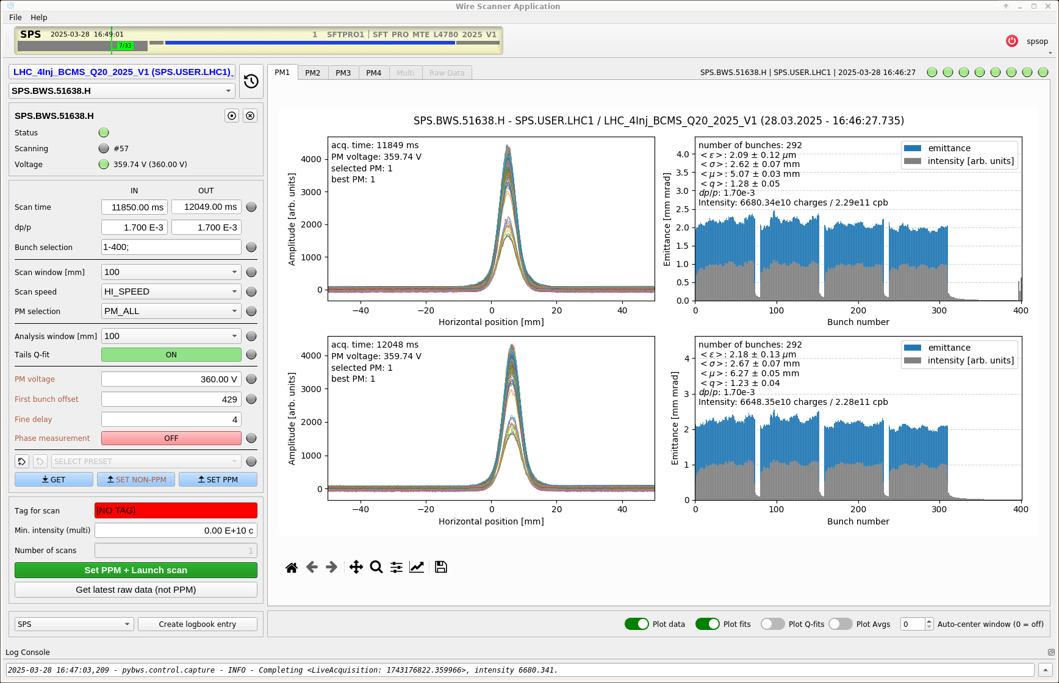
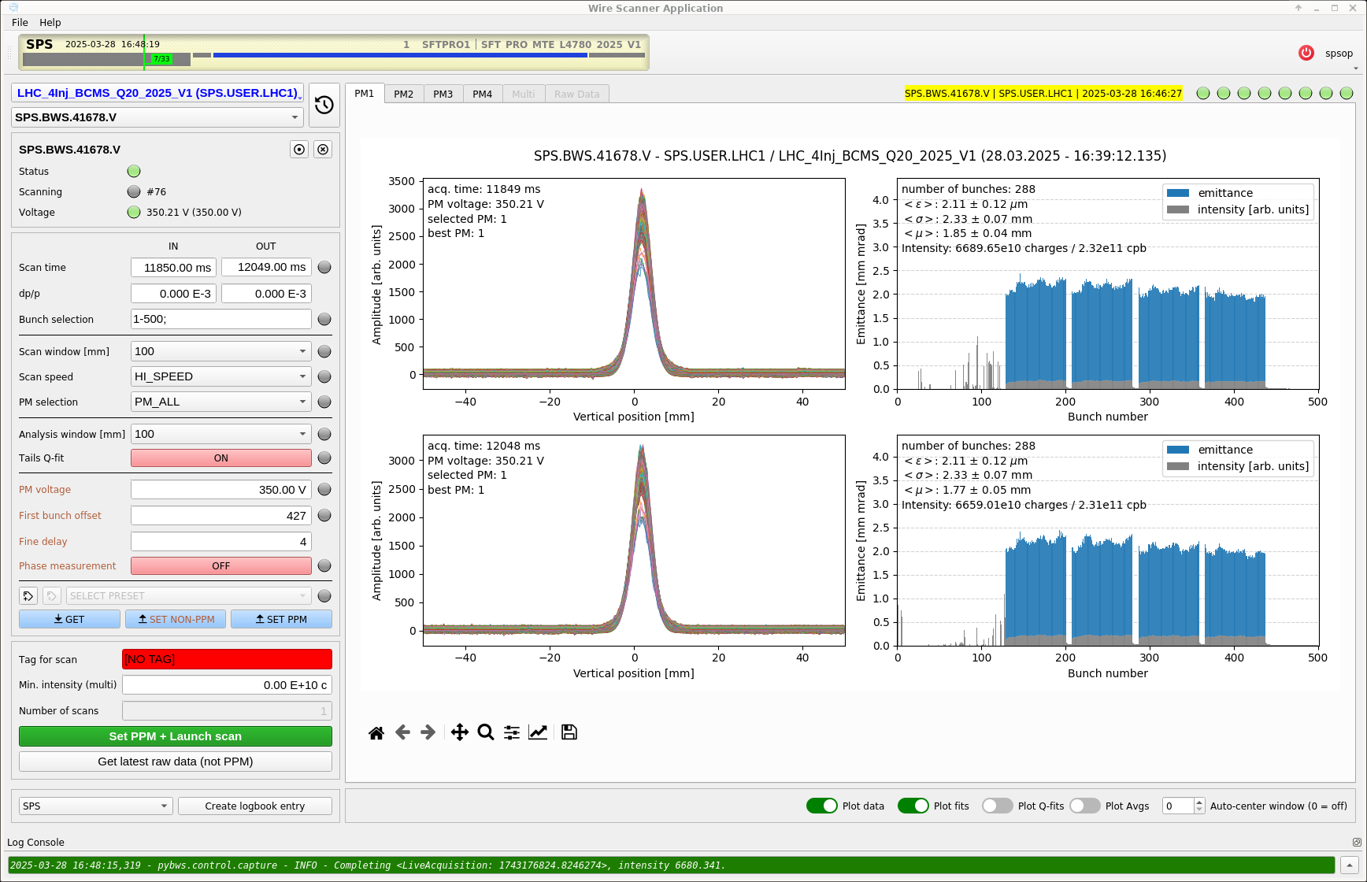
Scrubbing achievements
4x72 bunches with 2.3e11 p/b at extraction with 1.65 ns bunch length

Slide 10
Scrubbing achievements
4x72 bunches with 2.3e11 p/b at extraction with 1.65 ns bunch length
This lasted about half an hour, until the beam was repeatedly cut by trips of cavities 1 & 2, caused by an amplifier on fire in BA3
  LIU beam still quite at the limit of the RF power due to persisting limitations in cavity 3

Slide 11
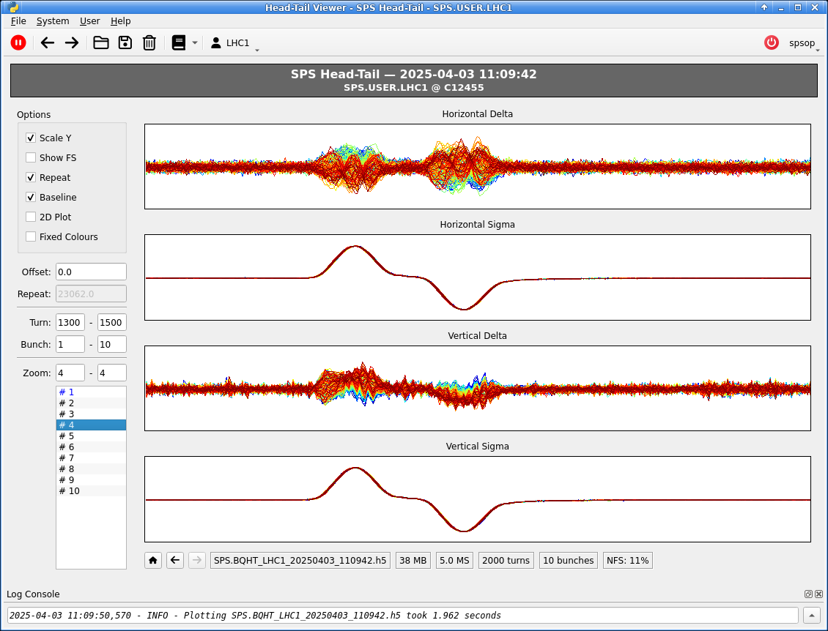
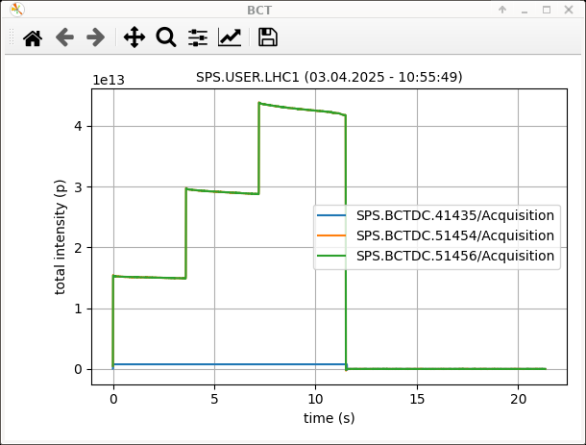
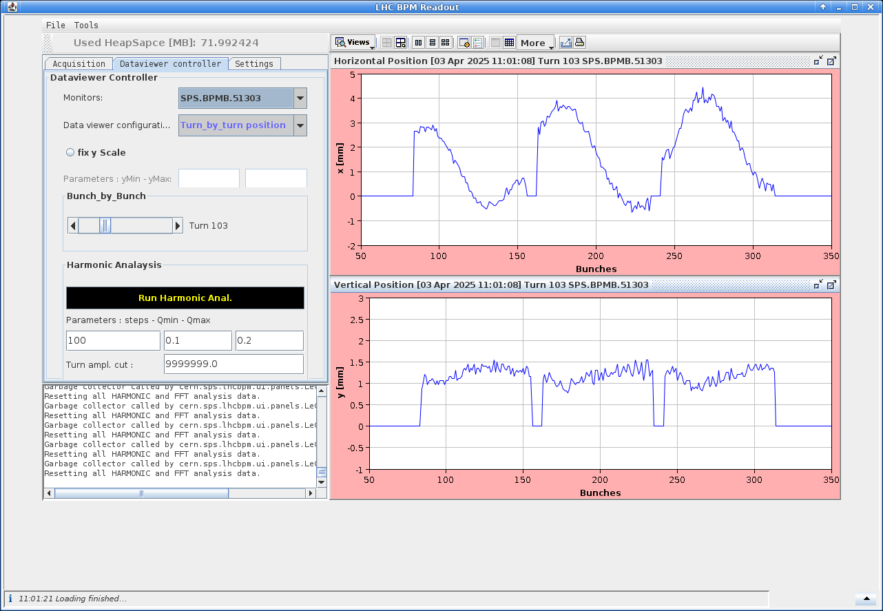
CC instability in the SPS?
Today some clear signs of horizontal coupled bunch instability with intra-bunch motion have been caught during today’s crab cavity test

Slide 12
Future projects
FCC news?
Muon collider news?

