Slide 1
High-intensity tests in preparation of Run 4
Nicolas Mounet
Many thanks to Chiara Antuono, Xavier Buffat, Elias Métral, Giovanni Rumolo, Benoît Salvant, Leonardo Sito, Rogelio Tomás Carlo Zannini, Markus Zerlauth
ABP-CEI – 03/04/2025

Slide 2
HL-LHC statement on high-intensity tests
Discussions are already ongoing to formally confirm in the LHC schedule the two-week period of high-intensity operation at the end of June 2026 (see M. Lamont’s Chamonix summary)
  Needs to be well-prepared: filling the LHC with as many bunches as possible + first ramp tests already in 2025, will allow early validation of these preparations to make most efficient use of time in mid 2026.
Advancing some tests in 2025 could also allow the early identification of possible hardware limitations, gaining time for addressing them.
→ For HL-LHC it is vital to continue the program of nominal HL-LHC intensity at injection in 2025 (2.3 10¹¹ p+/b, >~2000 bunches).
… but experiments do not want to take any risk beyond normal operation before the end-of-run tests (LPC statement), and this is backed-up by Jorg Wenninger’s statement in his Chamonix talk (slide 26)
"[...] the heating power should not exceed the level validated in regular operation"

Slide 3
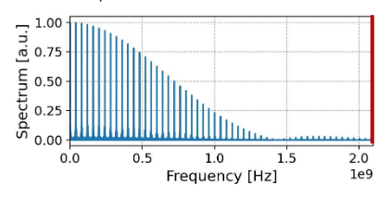
Strategy we could adopt
Ask still for maximum beam intensity at injection as an end-of-2025 test (<1 day), after the ions. Several checks needed (many thanks Benoît):
  Cryo (switch to economy mode for ions? Compatible with high-intensity test at injection?)
  Radio-protection (cool down before YETS)
  MP checks needed (loss maps…)? Quench test after high-intensity test or before?
Ask a MD with less bunches, keeping the same M x Nb² as in normal operation, knowing that the power loss (many thanks Elias & Giovanni):
  scales with M x Nb² for a broad-band impedance,
  scales with (M x Nb)² for a narrow band impedance (this case is even safer),
  decreases with longer bunches (in most cases … what if it sits here?)
Power spectrum for a q-Gaussian beam. Courtesy of L. Sito, ABP CEI meeting, 10/10/2024

