Slide 1
SPS scrubbing run overview and takeaways
L. Mether
with the SPS scrubbing team

Slide 2
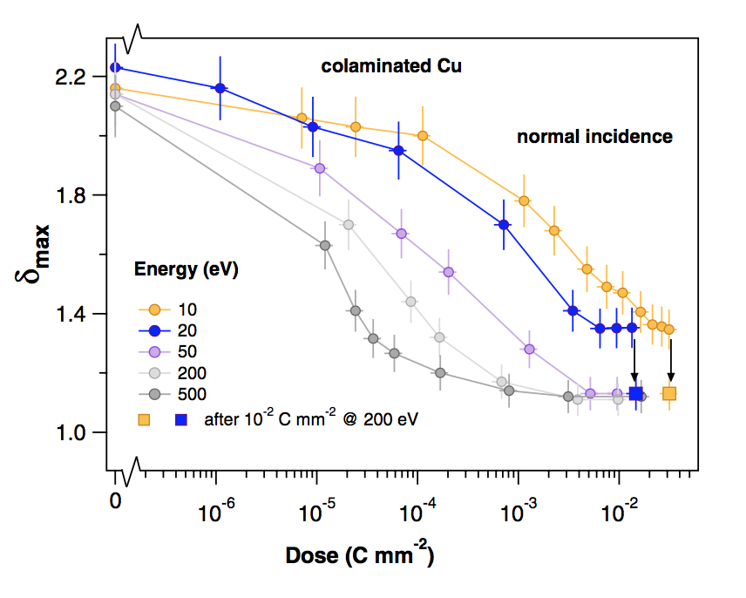
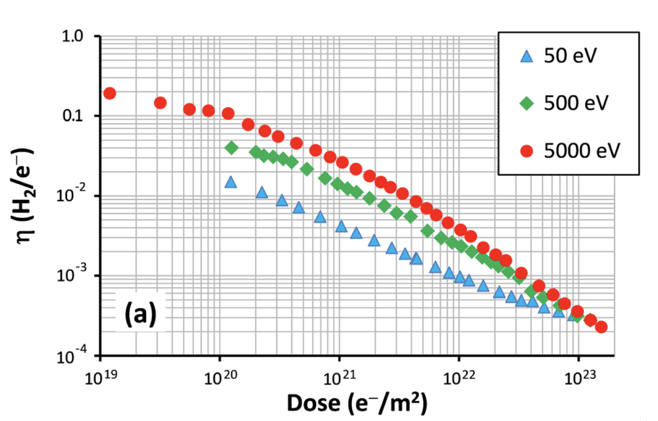
Introduction
R. Cimino et al. Phys. Rev. Lett. 109, 064801 – 2012
Surface conditioning with electrons
  Irradiating a surface by electrons is known from lab measurements to lower the secondary electron yield (SEY)
  Electron irradiation also reduces the electron-stimulated desorption (ESD) yield
When surfaces are exposed to air, both the SEY and the ESD yield increase
  During scrubbing, the aim is to condition the surface (with the electrons of the electron cloud) to lower these yields, to reduce electron cloud and pressure rise during operation
During scrubbing, we aim to maximize the beam current, without compromising too much on beam quality or machine availability
  Working at the limit of beam stability and/or machine tolerance
The vacuum pressure is the best observable for measuring the scrubbing progress, but it doesn’t distinguish between reduction in SEY vs ESD yield
O. Malyshev et al, J. Vac. Sci. A 31, 031601 (2013)

Slide 3
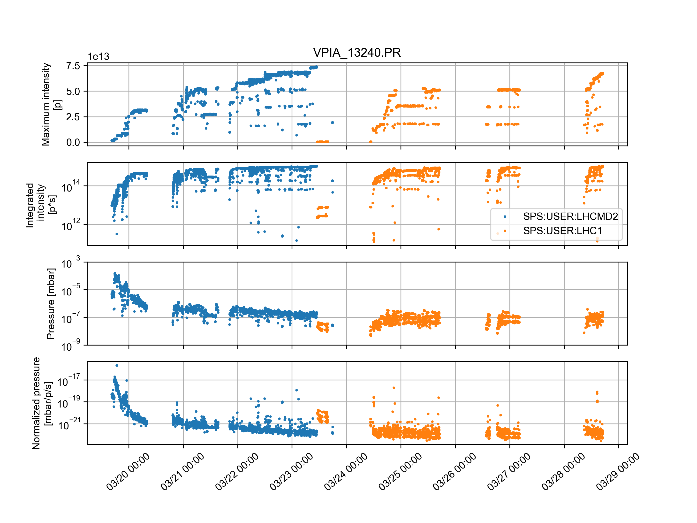
Scrubbing overview
The scrubbing run took place over a 9-day period, 19.3 16:00 – 28.3 18:00
  Many stops between effective scrubbing periods for a few different reasons
Flat bottom scrubbing
up to 4x48b and 1.8e11
Flat bottom scrubbing
4x72b up to 2.5e11
Flat top scrubbing
1-3x72b
Flat top scrubbing 3x72b
Flat top scrubbing 4x72b
PS cavity issue
MKP-S cooldown
RF cavity 2
powering
PS cavity issue
MKP-S cooldown
AD DSO tests
MKP-S cooldown
Flat bottom cycle
Acceleration cycle

Slide 4
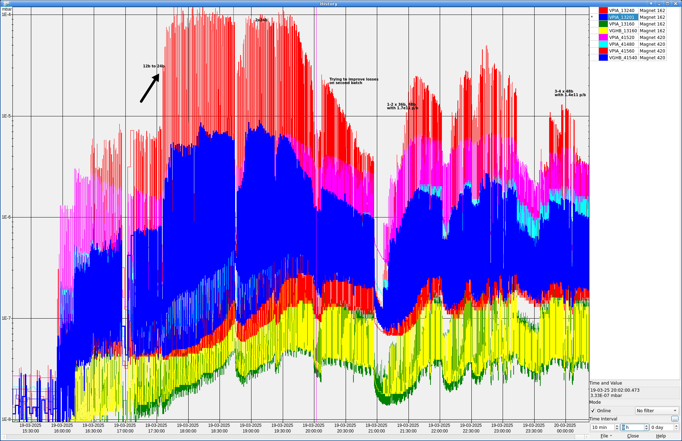
Conditioning vented regions
Already with 12 bunches, very high pressures were observed, especially in areas where magnets had been exchanged
Vacuum interlock thresholds set to
1e-5 mbar in all arcs before scrubbing
Scrubbing could advance at a good pace
Scrubbing limited by pressures in vented regions only during the first few hours
1e-4 mbar
24b
2x24b
1e-5 mbar
1-2x36b
1.7e11 p/b
3-4x48b
1.4e11 p/b
12b
1.2e11 p/b
1e-6 mbar
1e-7 mbar

Slide 5
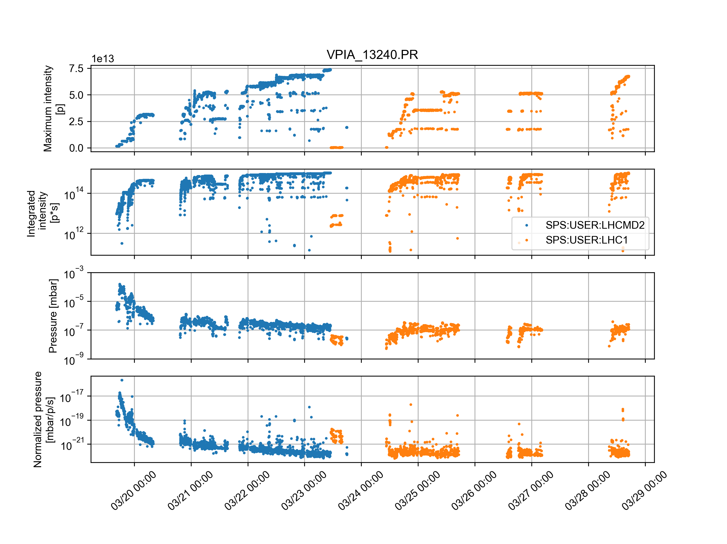
Conditioning vented regions
Regions with exchanged magnets conditioned fast, in accordance with previous studies from 2024,
see K. Paraschou at IPP
No significant change in pressure observed when accelerating beam
Flat bottom scrubbing is effective for conditioning most vented areas
Flat bottom cycle
Acceleration cycle

Slide 6
Most active regions
List of vacuum activities during the YETS from A. Harrison at SPS MPC
Sextant | Sector | Position | Intervention
BA1 | 120 | 10101 - 10701 | Magnet exchange Corroded vacuum chamber exchange
 | 134 | 11692 – 11699 | Access chambers
 | 135 | 11699 – 11759 | E-Cloud Ion pump modification
 | 136 | 11759 – 11832 | Scraper installation
 | 150 | 11960 - 12301 | Magnet exchange
 | 162 | 13101 - 20101 | Magnet exchange
BA2 | 212 | 20501 – 21301 | Magnet exchange Ion pump and gauge non-conformities
 | 231 | 21603 – 21699 | Leak on ZS HV feedthrough
 | 240 | 21880 – 21903 | Access chambers
 | 262 | 21301 - 30101 | Magnet exchange (x2)
Sextant | Sector | Position | Intervention
BA3 | 334 | 31740 – 31797 | RF Cavity #3 HOM exchange
 | 351 | 31998 – 32301 | Ion pump consolidation
 | 361 | 32301 – 33101 | Ion pump consolidation
 | 362 | 33101 – 40101 | Ion pump consolidation Magnet exchange Endoscopy Sector valve exchange
BA4 | 411 | 40101 – 40701 | Magnet exchange
 | 420 | 41301 – 41620 | Magnet exchange
BA5 | 520 | 51301 – 51678 | BGI – 3rd magnet Wire Scanners TECS crystal exchange
 | 532 | 51759 – 51859 | TECS crystal exchange
BA6 | 633 | 61731 – 61757 | Crab Cavities
 | 640 | 61880 – 61903 | Access chambers
 | 651 | 61903 – 62301 | Gamma Factory laser pillar installation
Open to air >24h
High vacuum activity

Slide 7
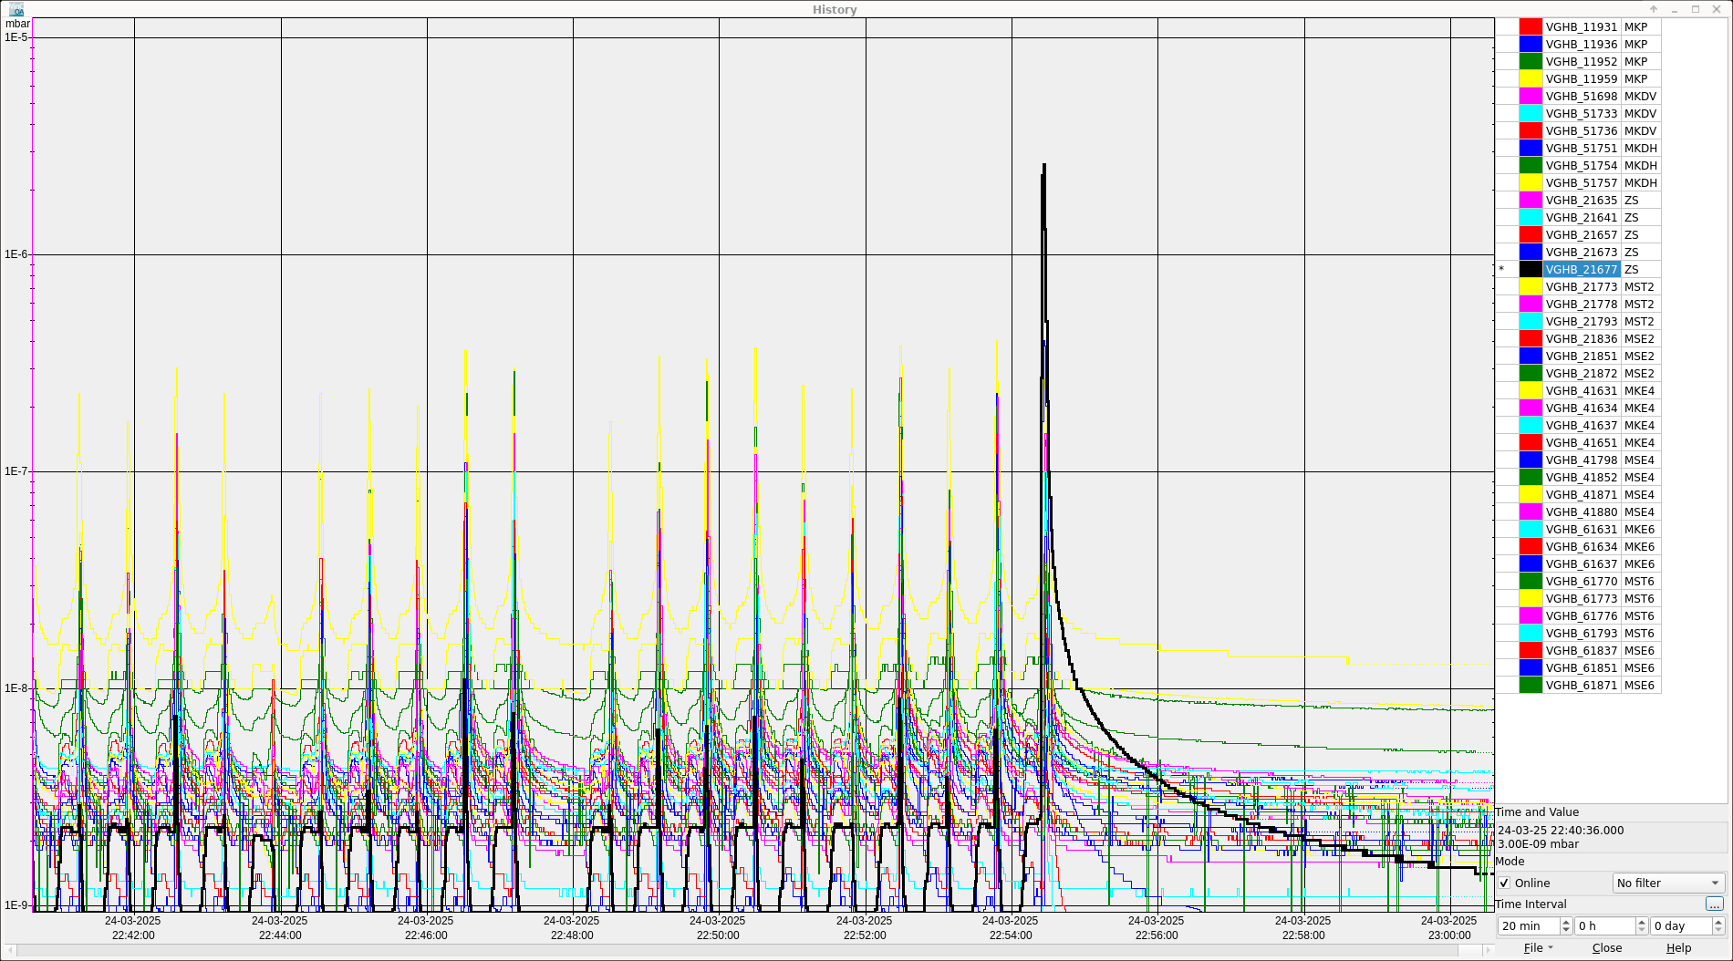
Conditioning on the ramp: ZS
After moving to scrubbing on the accelerating cycle, sporadic pressure spikes occurred in the ZS, the electrostatic septa for extraction to the North Area experiments
  The beam was paused on several occasions, for experts to check the ZS status after spikes, but no issues were found

Slide 8
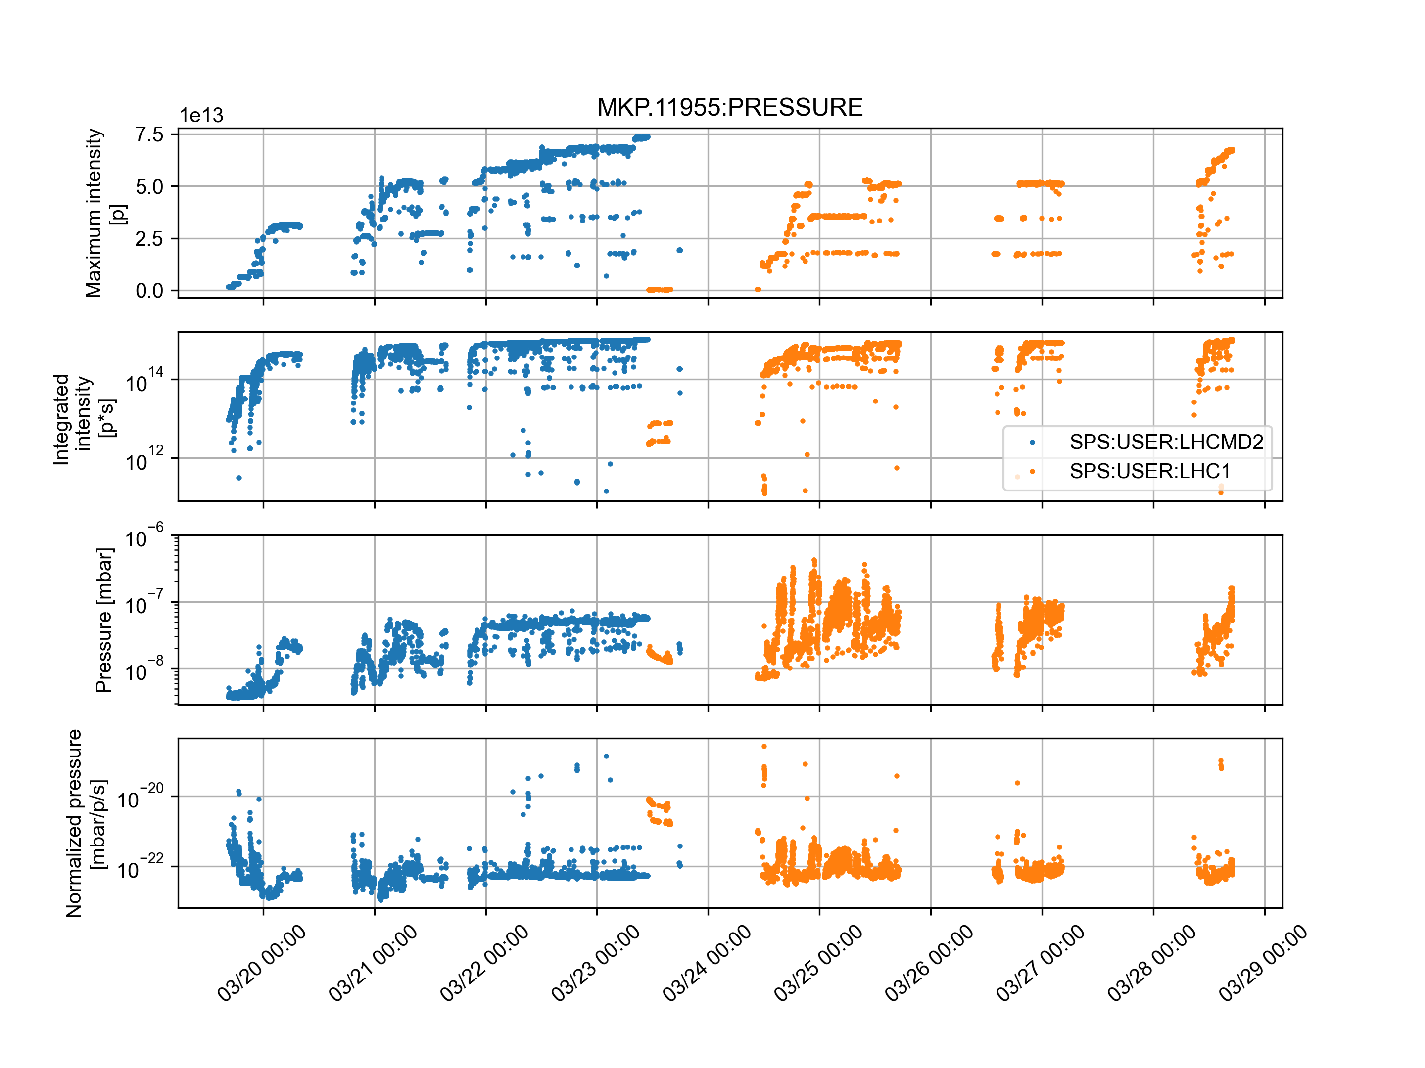
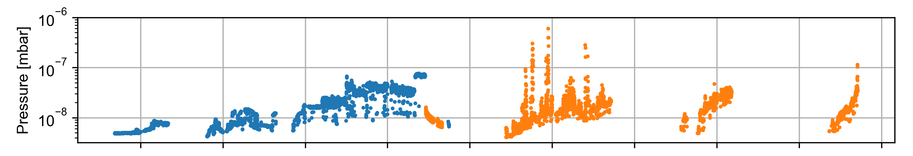
Conditioning on the ramp: kickers
Unlike in most arc regions, the pressure in most kickers increases on the ramp, with the bunch length decrease
Strong pressure spikes seen in both MKP-L and MKDH with first LIU batches at flat top
Conditioning observed during scrubbing days
Kickers are ready for LIU beam after initial scrubbing
Flat bottom cycle
Acceleration cycle
MKP-L pressure
Interlock threshold
MKDH pressure
Interlock threshold

Slide 9
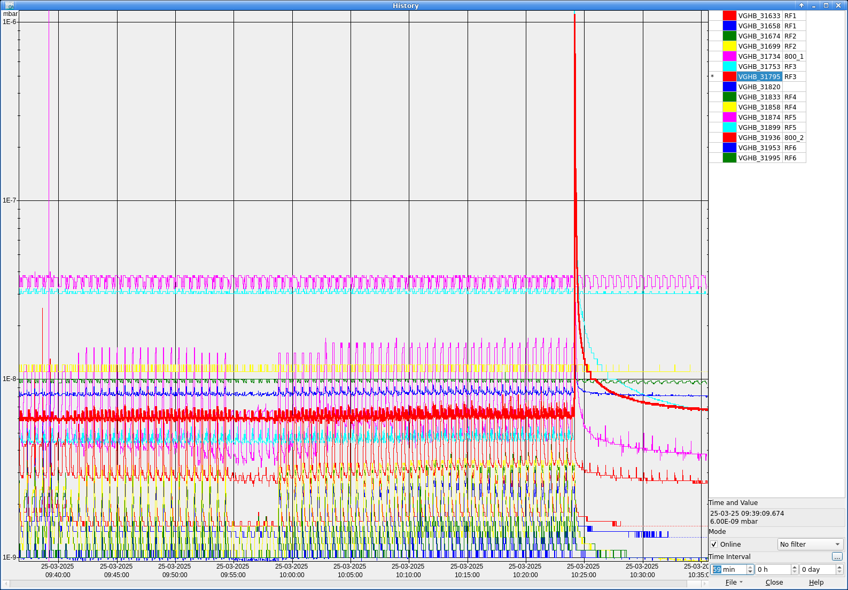
Conditioning on the ramp: RF cavities
In 2024, pressure spikes in the RF cavities and associated amplifier module breakages were the main limitations to the scrubbing
  This year, only one major spike occurred, leading to ~5 broken amplifier modules
More extensive RF conditioning by RF team before and during scrubbing
Different intensity ramp-up approach
  2025: ramp-up bunch intensity for each step in number of batches with fixed nominal flat top bunch length
  2024: ramp up number of batches for each step in intensity with gradual reduction of flat top bunch length
The pressure spike occurred on the single occasion when deviating from this pattern (no proof of causation)

Slide 10
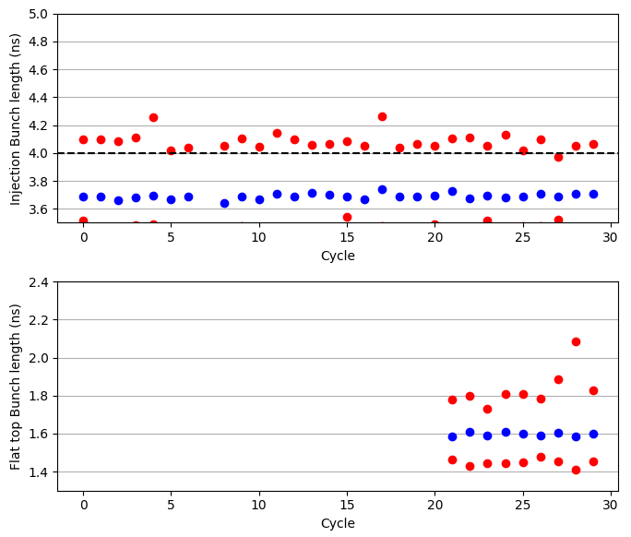
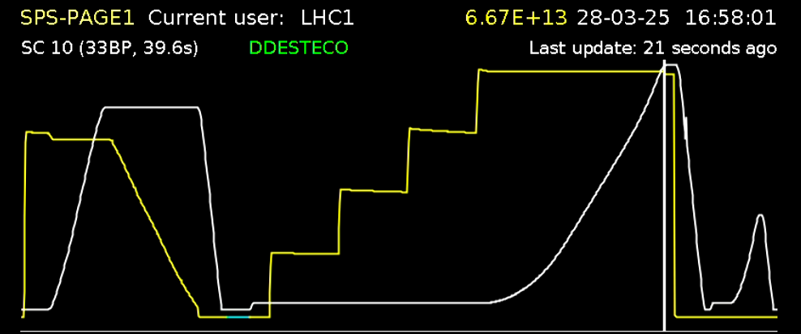
LIU beam parameters
The intensity ramp-up to the standard LIU beam at the end of flat top was achieved over ~3 days of beam time
  Recovered LIU beam at flat top on 28 March, precisely a year after first reaching this milestone!
  2.3e11 p/b, 1.6 ns bunch length at end of flat top
Nice short bunches also injected from the PS

Slide 11
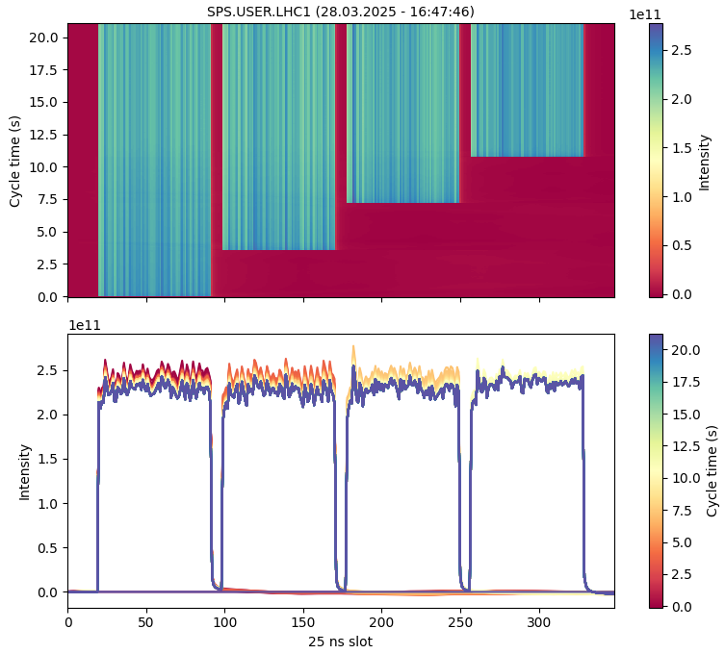
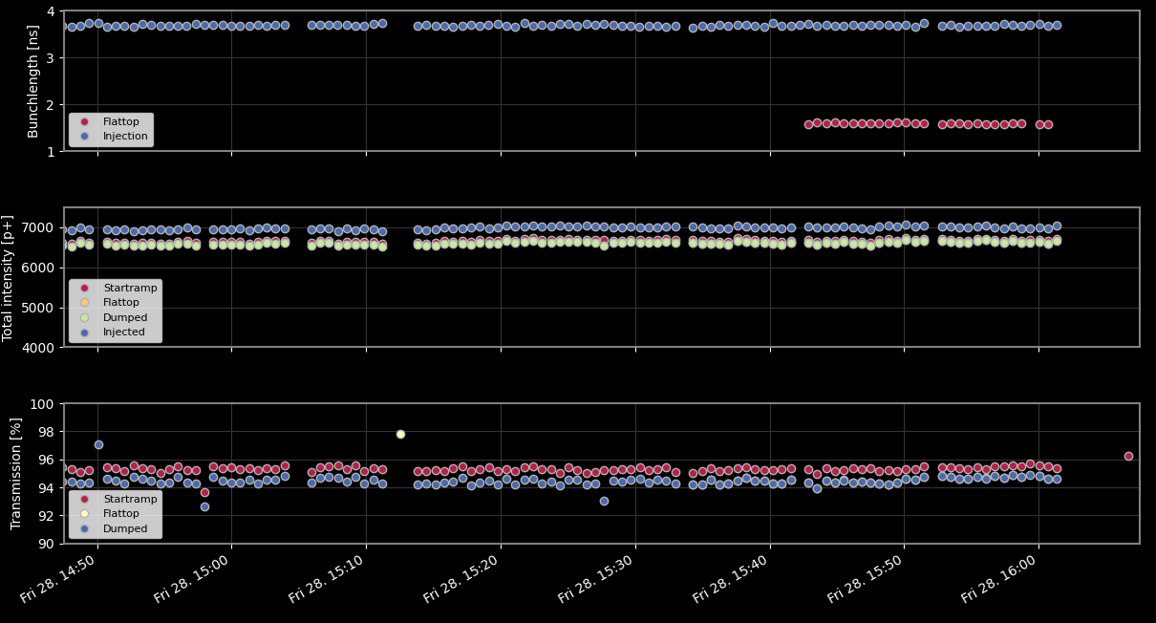
LIU beam parameters
The intensity ramp-up to the standard LIU beam at the end of flat top was achieved over ~3 days of beam time
  Recovered LIU beam at flat top on 28 March, precisely a year after first reaching this milestone!
  Very good beam quality!
  Good transmission: ≳ 94% from injection to end of flat top

Slide 12
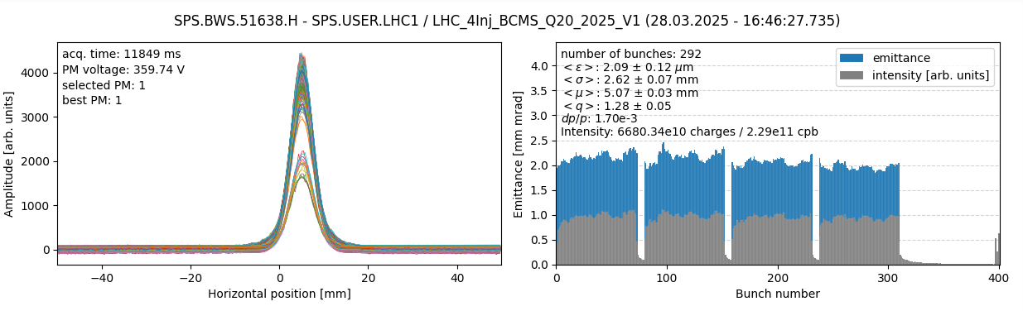
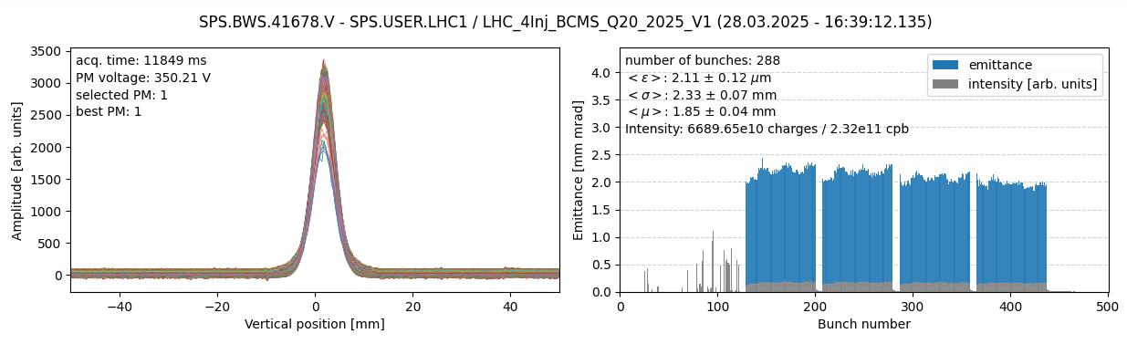
LIU beam parameters
The intensity ramp-up to the standard LIU beam at the end of flat top was achieved over ~3 days of beam time
  Recovered LIU beam at flat top on 28 March, precisely a year after first reaching this milestone!
  And this time with nominal emittances!
  Measurements at end of flat bottom
  on average:
    2.11 µm in H
    2.09 µm in V

Slide 13
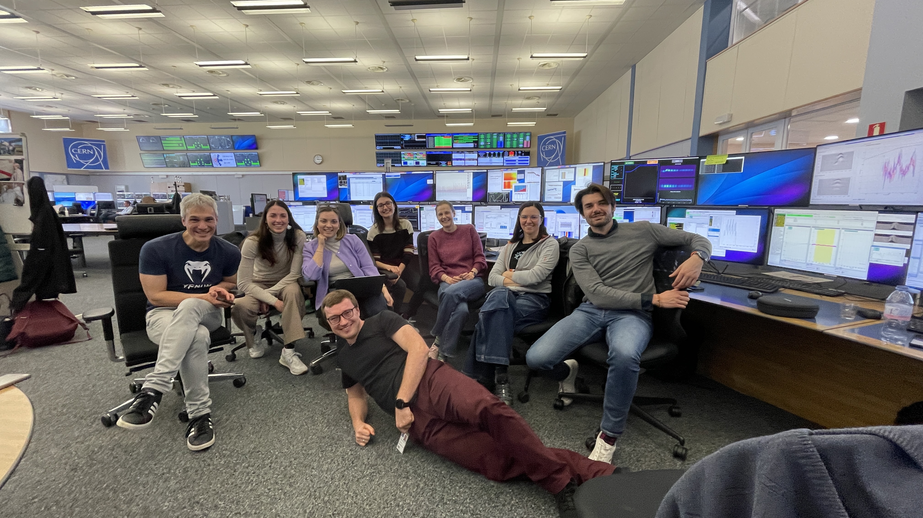
LIU beam parameters
The intensity ramp-up to the standard LIU beam at the end of flat top was achieved over ~3 days of beam time
  Recovered LIU beam at flat top on 28 March, precisely a year after first reaching this milestone!
  Happy scrubbers!

Slide 14
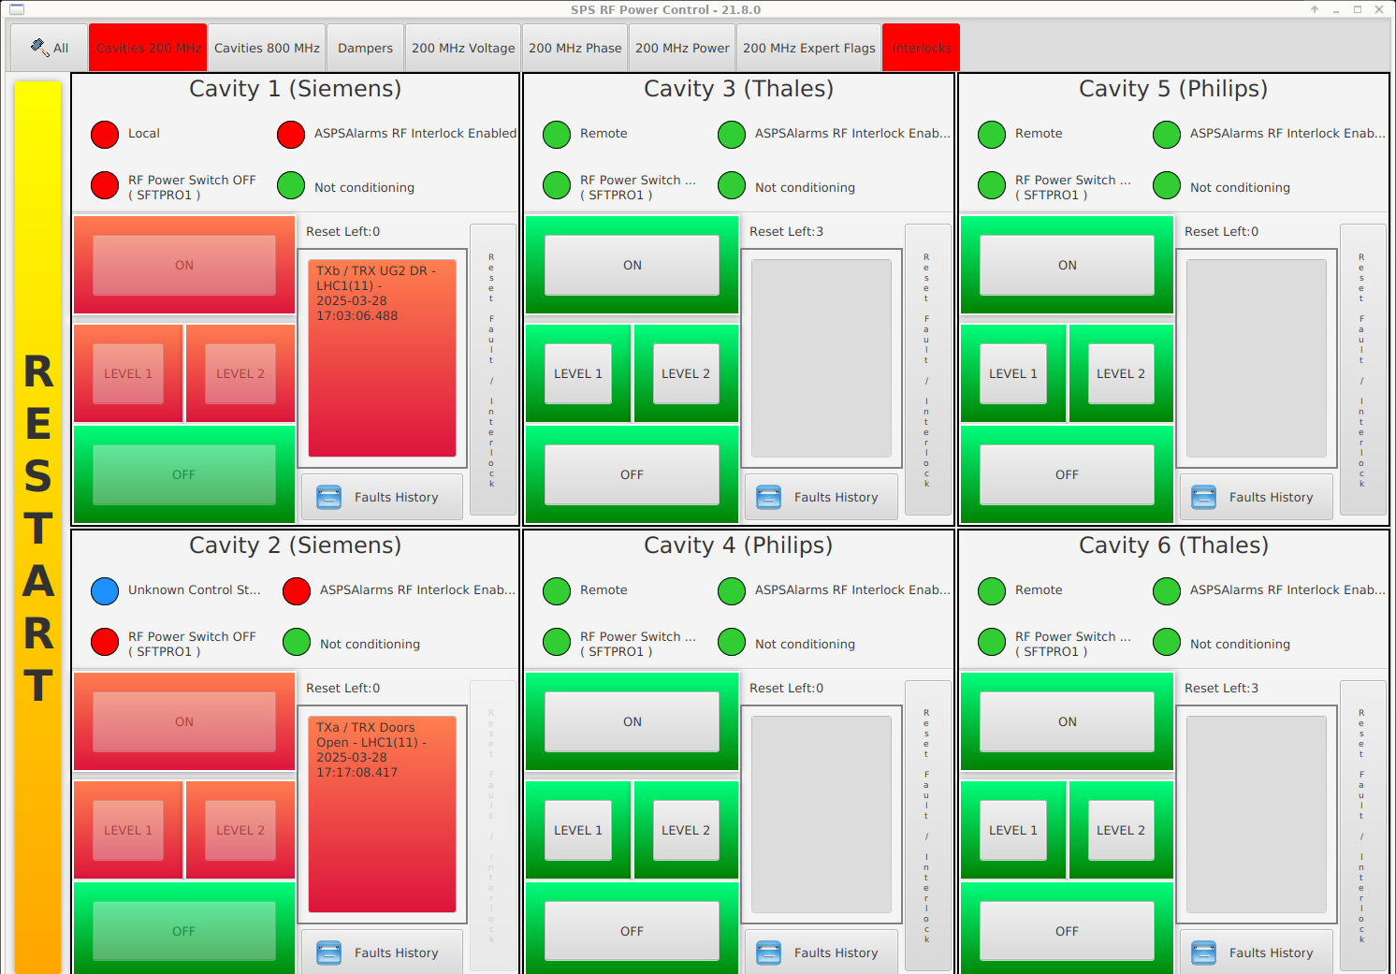
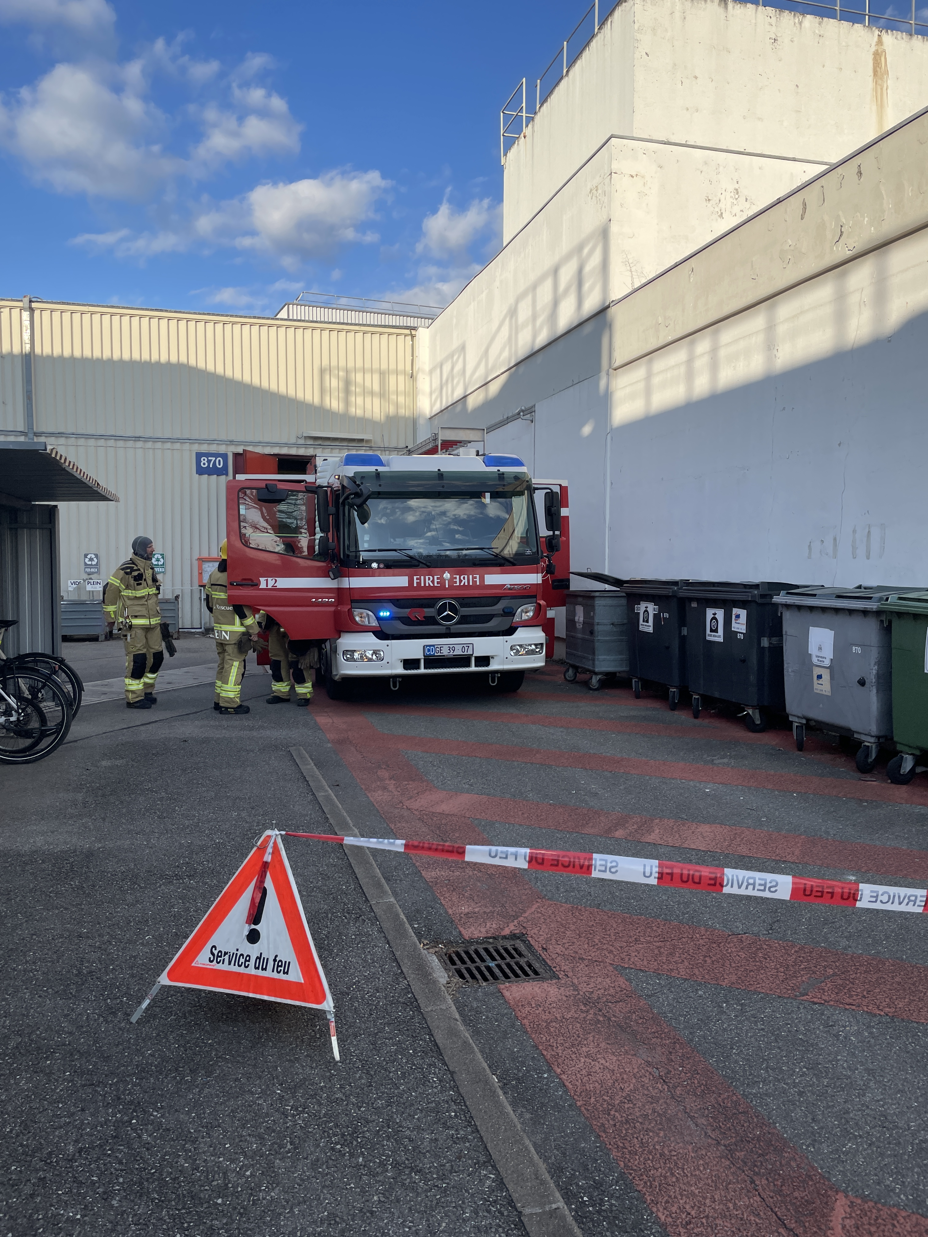
15 minutes later…
The party was over… along with the scrubbing run

Slide 15
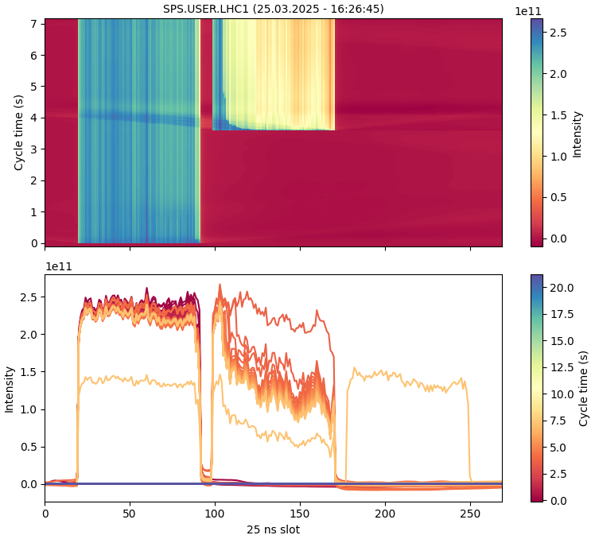
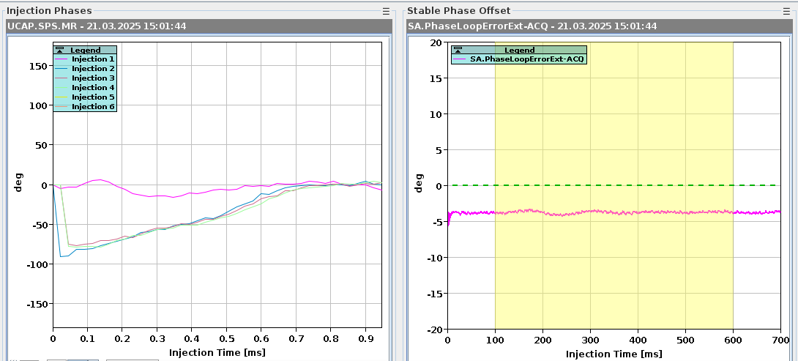
Encountered issues
Much of the machine equipment, settings and tools are used for the first time each year during the scrubbing run
  Debugging issues that arise, especially related to multi-bunch and -batch beams, is an integral part of the scrubbing run
  Since scrubbing is necessary already as of 12 bunches, there are not that many other ways to approach this
Diagnosing a problem and fixing it requires time (that can usually not be efficiently used for scrubbing)
and very often also requires the intervention of experts
  This must be considered when scrubbing time is allocated,
  both in terms of length and time of day/week

Slide 16
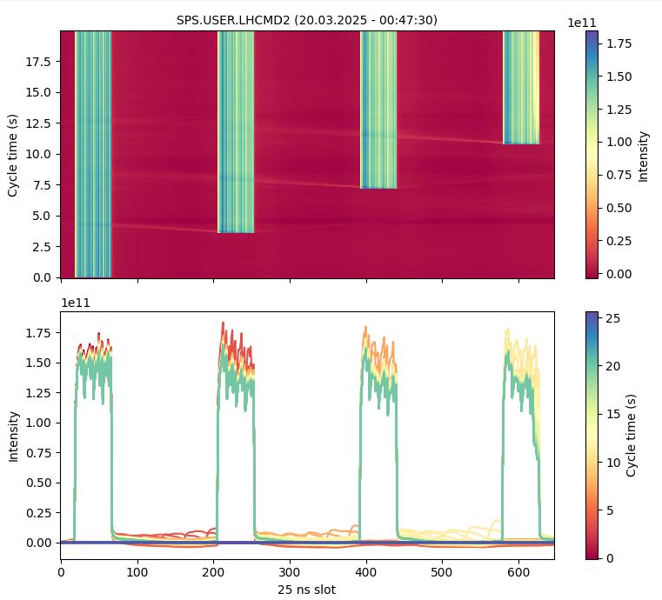
Encountered issues
Longitudinal feed-forward
  Issue: Phase reading from pickup not correctly translated somewhere along the way
  Observation: Capture losses on 2nd and later batches
  Time to diagnose: ~1 day with beam, time to fix: ~8 h with expert on site
RF rephasing
  Issue: Gain in phase-locked loop in LSA a factor 10 too large
  Observation: Frequent trips of 800 MHz cavities at flat top?, jump in bunch length
  Time to diagnose: ~1 day at flat top, time to fix: 10 minutes

Slide 17
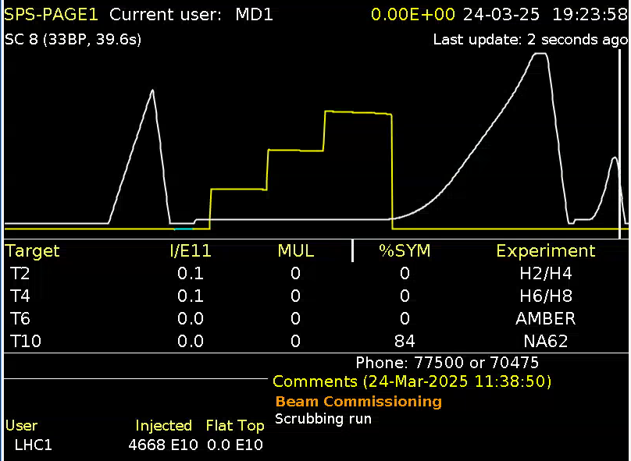
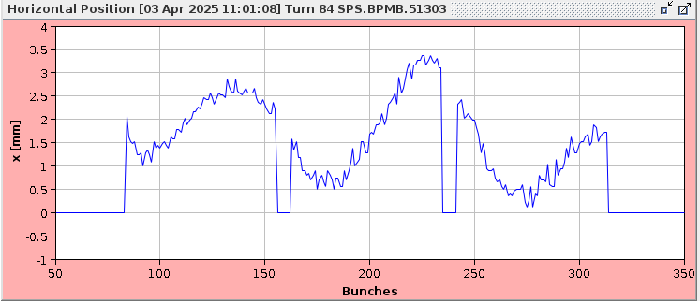
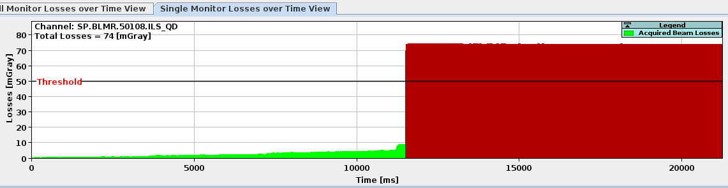
Encountered issues
Crab cavities
  Issue: Keeping the crab cavities inserted introduces an additional impedance source
  Observation: Beam dumps due to extremely fast losses with sharp threshold in bunch intensity and number of batches
  Time to diagnose: ~15 h, time to fix: 0.5 h
  (crab cavities moved out of the beam)
Reason confirmed only with dedicated test several days later
  Fast horizontal coupled-bunch instability

Slide 18
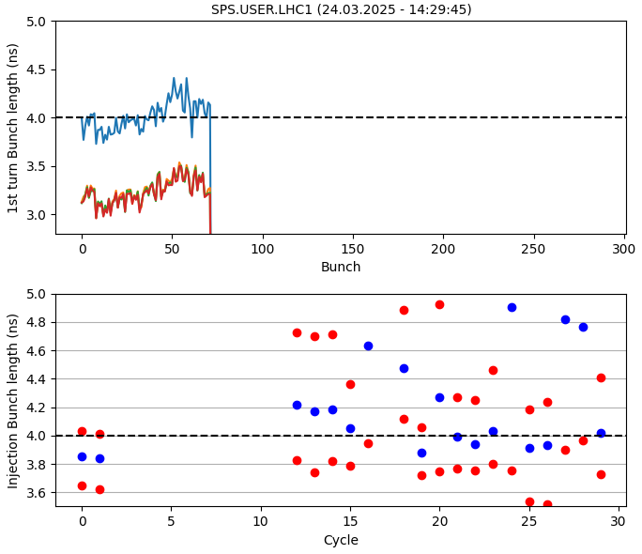
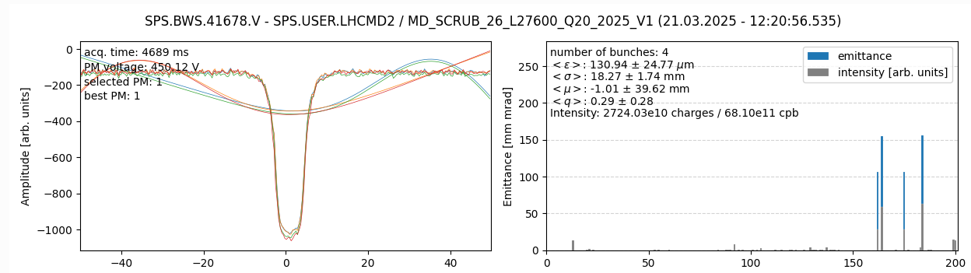
Other encountered issues
Beam preparation in the PS (Scrubbing is the first real client for multi-bunch and high-intensity beams)
  Issues e.g., when changing intensity or bunch train length,
  settings not copied from one cycle to another
  Observations: poor splitting, long bunches, …
Wire scanners
  Issues with wire scanner electronics and application
  Observation: Not able to launch scans, negative data,
  nonsensical profiles and emittances

Slide 19
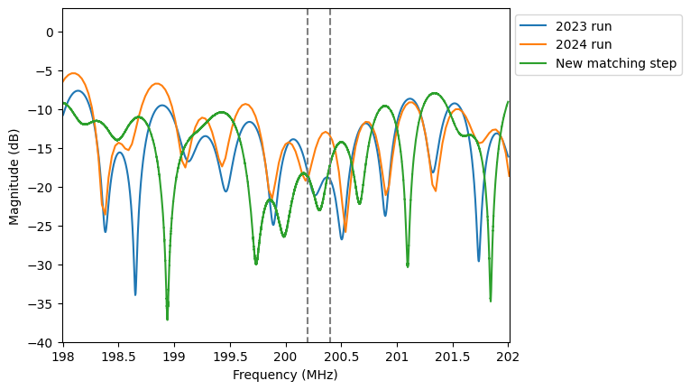
RF power limitations
The main limitation for the LIU beam at flat top came from the limited RF power
  Cavity 1 & 2 are limited to 800 kW (1 MW) by current transformer
  Cavity 3 is limited to 1.4 MW (1.6 MW) due to reflected power
    Suspected to be due to arcing in matching step – new matching step being manufactured
To reach the LIU beam at flat top, the power was pushed on all other cavities to compensate for Cavity 3
  Cavity 2 was limited by amplifiers with weak load resistors → one caught fire 15 minutes after reaching the LIU beam
  Broken module was replaced by spare, but scrubbing cannot continue until is rebuilt and tested as solid spare
Scrubbing on the ramp in these conditions relies on the
presence of RF experts to fine-tune settings to optimise
available power while considering the cavity constraints
  Scrubbing needs to take place (also) during daytime
See presentation by S. Pitman at SPS MPC for details
S. Pitman, SPS MPC

Slide 20
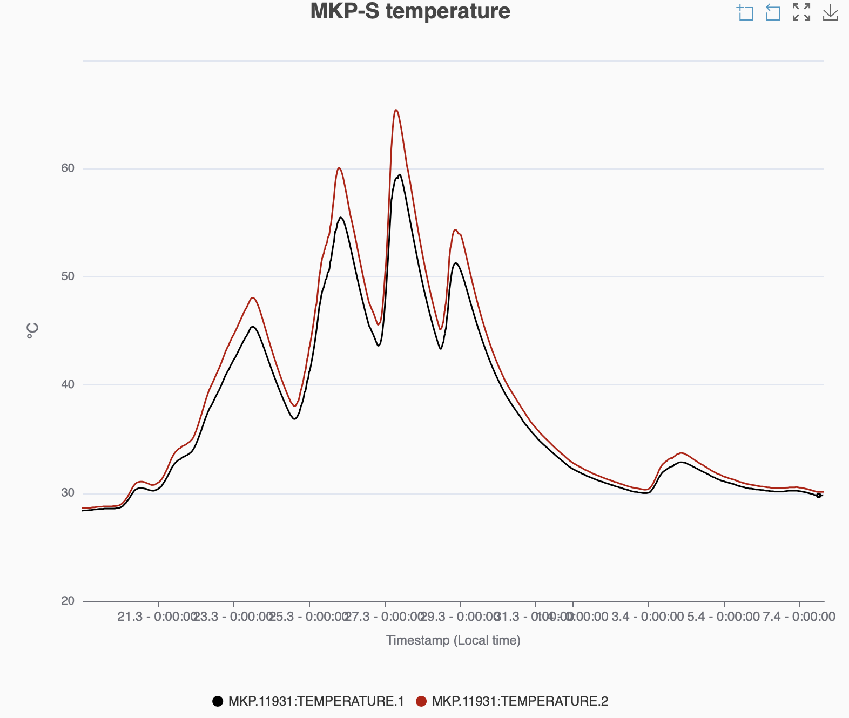
MKP-S heating
Scrubbing had to be stopped on multiple occasions due to MKP-S heating
Estimated heating and cooling rates:
  LIU beam at flat bottom: 0.35°C / h
  LIU beam at flat top (3x72b): 3°C / h
  (could be higher still with 4x72b)
  Cooldown without beam: 0.7-0.8°C / h
MKP-S heating with LIU beams puts us in a similar situation as we were with the old MKP-L with the beams of its time
  Scrubbing with full LIU beam can take place only for a few hours per day,
  5-6h/24 h
3x72b
at flat top
2x72b
at flat top
4x72b
at flat top
Flat bottom scrubbing
MKP
cooldown
MKP
cooldown
MKP
cooldown
MKP
cooldown

Slide 21
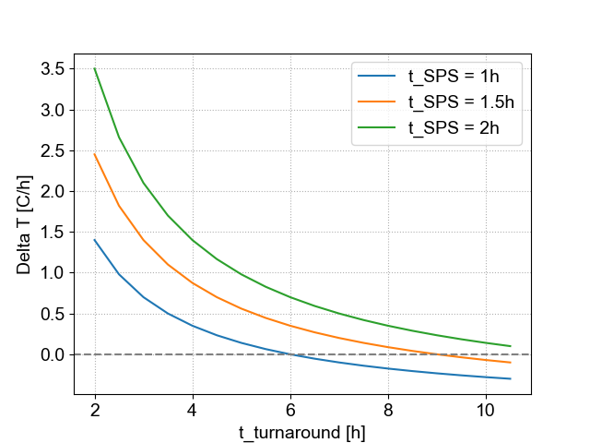
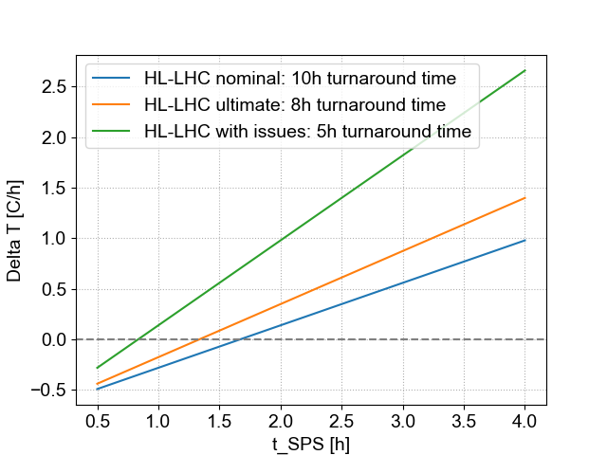

MKP-S heating in HL-LHC era
Without mitigation, MKP-S heating will clearly be a limitation during scrubbing runs, but could it be a problem for HL-LHC operation?
Assuming a heating rate of 3.5°C/h with 4x72b and a cooling rate of 0.7°C/h, the temperature change during one turnaround time (from start of stable beams to start of stable beams) can be estimated as
where
Under nominal conditions, no heating is expected, but margins are limited
  For nominal turnaround, no heating if time in the SPS stays below ~1.5h
  If total time in the SPS is 1h, the turnaround time must be above 6h to avoid heating
Impact of possible SPS MDs with LIU beam?

Slide 22
Conclusions & takeaways
Vented arc regions were sufficiently scrubbed for LIU requirements in 3-4 days of dedicated scrubbing time
  In agreement with observations from previous years → can be assumed as standard after a YETS
The standard LIU beam was successfully brought to 450 GeV with the specified parameters!
  Required 2-3 days of dedicated time for scrubbing on the ramp, with significant time during working hours
In addition, debugging issues with equipment, settings and applications is inevitably interleaved with the scrubbing run, and the allocated scrubbing time must include additional time for this during working hours with experts available

Slide 23
Conclusions & takeaways
Scrubbing stopped on March 28th by lack of spare amplifier unit for RF cavity 2 after fire
  Spare now available, but there may not be time in the schedule due to ongoing NA and LHC beam commissioning, and NA physics scheduled to start already next week
  May need to wait for high-intensity MDs to continue working with the LIU beams
No showstopper for reaching the LIU parameters at flat top again re expected, but there are some constraints
  RF power constraints currently limit the available time with LIU beams
  It is still unclear how quickly the beam can be restored after a pause without triggering vacuum issue
  Needs to be understood in view of upcoming LIU reliability run

Slide 24
Conclusions & takeaways
Heating of the MKP-S significantly limits scrubbing with LIU beams
  Only around 20-25% of the time with the full LIU beam can be used for scrubbing to avoid heating
  Must be considered for scrubbing strategy in Run 4 and beyond
Extrapolations suggest that MKP-S heating can become limiting also for HL-LHC operation in special situations, e.g., where there are issues either with beam preparation in SPS/LHC filling or where LHC fills are frequently dumped

