Slide 2
Cryogenic assemblies and components
T. Koettig, CERN TE/CRG-CL

Slide 3
Content
Cryogenic design steps
PID
Materials overview
ISO norms
Actively cooled thermal shields
Cryogenic valves, transfer lines
Phase separator, subcooler
Summary

Slide 4
Cryogenic design

Slide 5
Cryogenic System Design
Low temperature environment
Source of refrigeration
Heat exchange strategy
Sample environment
Thermal insulation
Structural support
Instrumentation and control
Refrig.
T_{high}
Thermal insulation
Instr. &
Control
T_{low}
Heat load
Vacuum
Structural support

Slide 6
Cryogenic design steps Reference material
Requirements from the experimental side etc.:
Temperature, pressure, mechanics and their stability?
Environment (fluid, vacuum, beam vacuum…)?
Current leads and magnet field?
Electrical insulation, non-magnetic, non-conducting materials necessary?
Energy balance:
Available cooling power vs. heat inleaks: cryocooler or liquid/gas cooling,
Heat generated inside the low temperature environment: SC AC losses, Quench, are the clients newcomers in the world of low temperatures …
Thermal shielding strategy, MLI, instrumentation
Volume to surface ratio, accident scenarios, pressure safety equipment.
Infrastructure requirements: gas recovery, cooling water, press. air, controls
Physical properties of the materials:
Mechanical strength, fatigue, thermal dilatation,
Specific heat of materials, latent heat of cryogenic fluids, virtual heat leaks from c_{p}
Thermal conductivity and contact interfaces,
Magnetic properties.

Slide 7
PID
Piping (Process) and Instrumentation Diagram

Slide 8
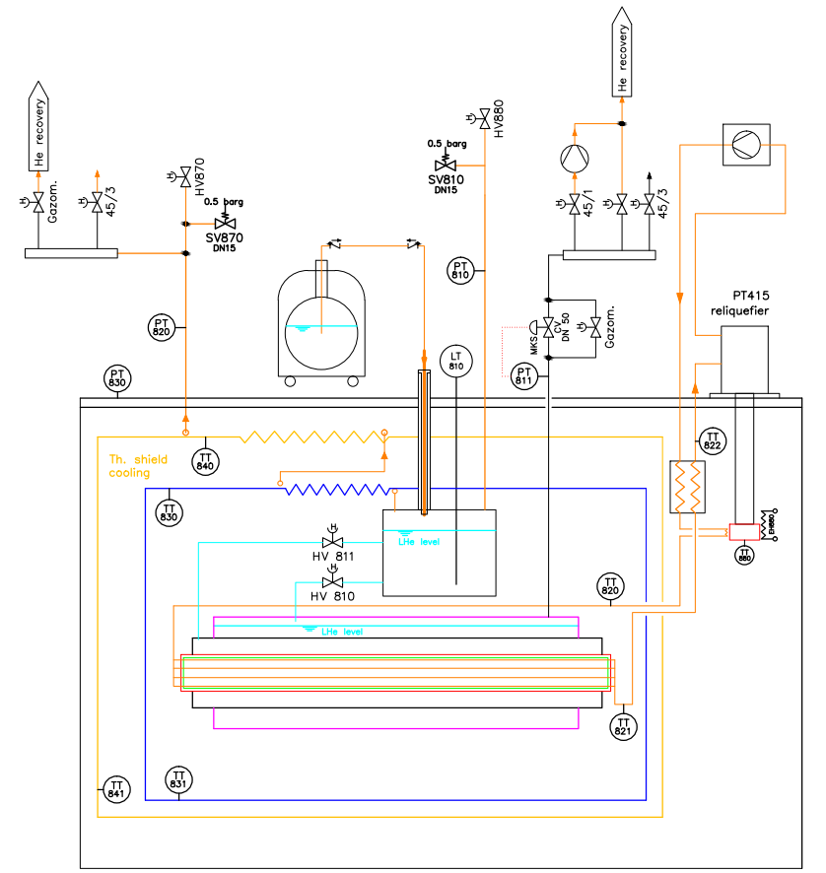
PID rules
Symbols and strategy to be found in ISO14617
Naming convention for the location …
PTC

Slide 9
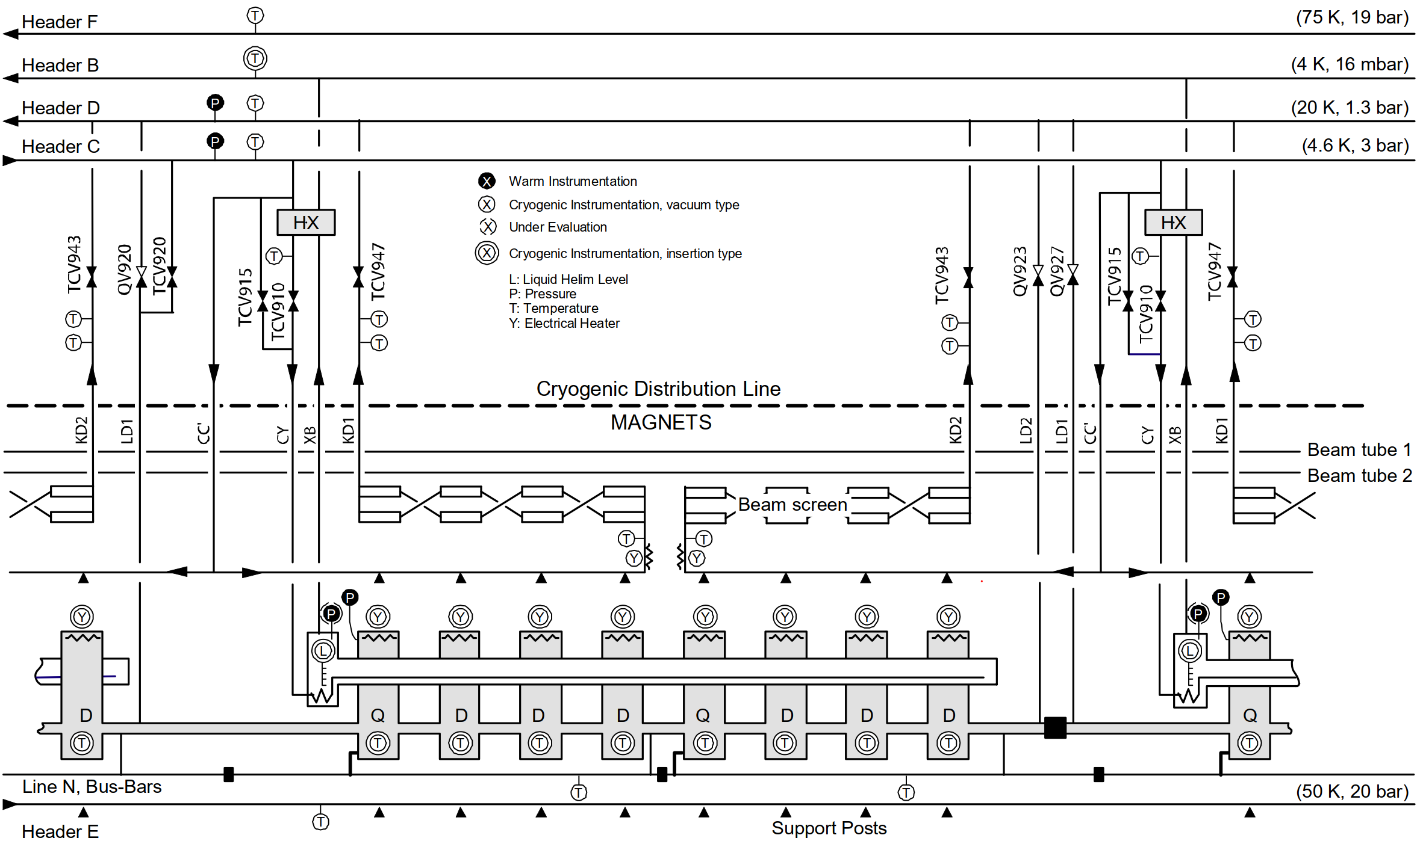
PID of the LHC continuous cryostat and QRL
From: LHC Project Report 1079, COMMISSIONING THE CRYOGENIC SYSTEM OF THE FIRST LHC SECTOR

Slide 10
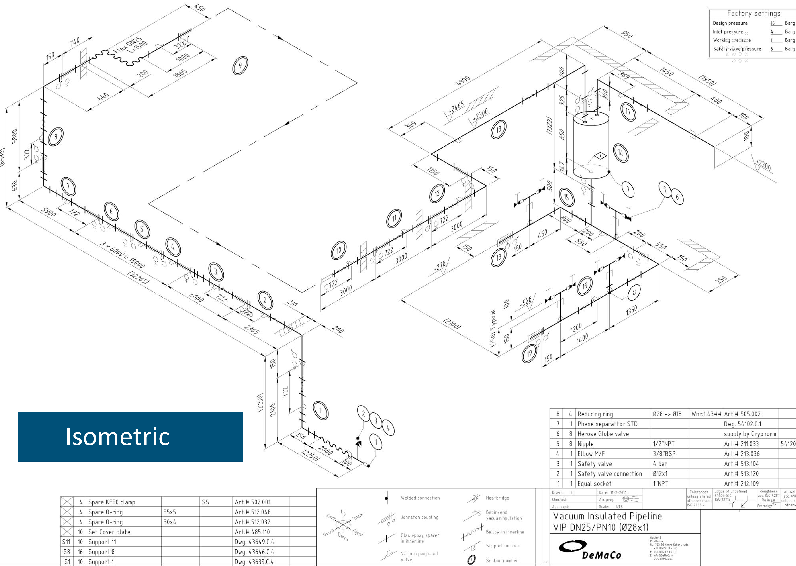
PID 3D isometric

Slide 11
Structural materials

Slide 12
Material for use at low temperature Reference material
Austenitic stainless steel
  e.g.
  1.4301 (304),
  1.4306/07 (304L),
  1.4311 (304LN),
  1.4401 (316),
  1.4404/35 (316L),
  1.4541 (321),
  1.4550 (347)
Properties
– universally applicable
– good weldability
Reference
– AD W10
Remark:
(L) Low carbon => allows welding w/o need
to anneal the weld
(N) High nitrogen => stronger and makes 316LN really non-magnetic at very low T
Low temperature steel
  e.g.
  1.3912 (FeNi36, Invar)
  1.5662 (X8Ni9, 9% nickel steel)
Properties
– high strength (1.5662)
– low thermal contract. (1.3912)
– cheaper than stainless steel
Remark:
– 1.5662 is not suitable for
application below -196°C
Courtesy: G. Perinic, Introduction to Cryogenic Engineering, CERN 2005

Slide 13
Material for use at low temperature Reference material
Al and Aluminium alloys
e.g.
  AW3003 (Al-Mn1Cu),
  AW1100 (Al99.0Cu),
  AW6061 (Al-Mg1SiCu),
  AW6063 (Al-Mg),
  AW5083 (Al-Mg4.5Mn)
Properties
– high thermal cond. (1100, 6063)
– moderate strength (6061, 5083)
– good vacuum properties, low emissivity
– extrudable
– weldable
Reference
– AD W 6/1
Cu and Copper alloys
e.g.
  OFHC Cu (99.9) RRR~100
  high thermal cond. (annealed)
  CuZn28Sn1 (2.0470, brass)
  CuNi30Mn1Fe (2.0882, Ni-bronze)
  CuBe1.9 (Beryllium bronze)
  high strength and good thermal
  conductivity (needs heat treatment,
  don’t create any dust etc.)
Reference
– AD W 6/2
Courtesy: G. Perinic, Introduction to Cryogenic Engineering, CERN 2005

Slide 14
Material for use at low temperature Reference material
Non-filled polymers
  – PET (Mylar)
    superinsulation, windows
  – PI (Kapton, Vespel), Ultem, PEEK
    insulation, seals
  – PTFE (Teflon)
    seals, fixation (highest shrinkage)
Epoxy resins
  CTD101K
  MY750
  Paraffin wax
  impregnation
Titanium Ti-6Al-4V alloy
low th. cond. high strength, supports
Filled + fibre reinforced polymers:
  – with glass fibres
  thermal expansivity like metals
  – with carbon fibres
  thermal conductivity like steel
  thermal expansion ~0
  – Kevlar fibres
  low weight
  powder filled polymers
  – with powders to adjust the
  thermal expansivity
  – with powders to increase the
  thermal conductivity (Cu or Al₂O₃)
References:
G. Hartwig, Polymer Properties at Room and Cryogenic Temperatures“, 1994, Plenum Press
Courtesy: G. Perinic, Introduction to Cryogenic Engineering, CERN 2005

Slide 15
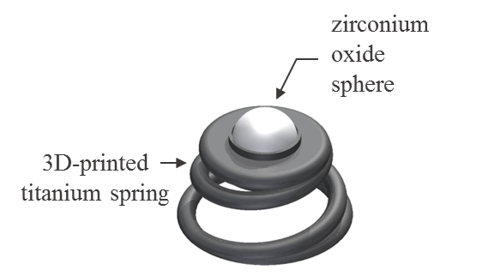
Material for use at low temperature Reference material
Glass/Crystals
  – Borosilicate glass (Pyrex, Duran)
  cryostats
  – Quartz => crystal vs. glass
  windows
  – Sapphire (Al₂O₃ crystal)
  el. insulating thermal interfaces/links
Ceramics
  e.g.
  – Aluminiumoxide, Al₂O₃ - Alumina
  – Zirconiumoxide, support spheres
  – Zirconiumsilicate
  filler powders, spacer supports
  – Silicondioxide
  Perlite insulation
Glues:
  - Araldite CW1304GB/HY1300GB,
  - Eccobond 285 + Catalyst 24LV,
  - Epo-Tek T7110,
  - Scotch-Weld DP190,
  - Stycast 2850FT + catalyst 9 or 24 LV
  - Double bubble (5 min)
Reference: A. Perin, Study of materials and Adhesives for Superconducting Cable Feedthroughs, LHC Report 504
Courtesy: G. Perinic, Introduction to Cryogenic Engineering, CERN 2005

Slide 16
Material for use at low temperature under radiation
Reference material
Avoid heavy metals => activation and long-lived isotopes
Some special stainless steels => know alloy components
Aluminium for high thermal conductivity or structural parts
  Most of the aluminium alloys are radiologically similar, especially if they contain elements such as Mg and Si, which are very close to Al from an activation point of view.
  Two of the most used alloys (at least in the LHC experiments) are Aluminium 6060 (EN AW-6060) and Aluminium 6082 (EN AW-6082).
For information, samples of AW-6082 bought from the CERN store are used to aid the radiological zoning in the LHC experiments and comparison with FLUKA are typically good.
It would be good to avoid in general alloys that include on purpose elements such as Cu (for instance EN AW-2219 contains around 6% in mass of Cu) or Mn (for instance EN AW-3030 contains up to 2% in mass of Mn).
Info from: CERN, Davide Bozzato

Slide 17
Norms
EN 12480/13445 “Unfired pressure vessels” harmonized with PED(2014/68/EU)
EN 12300 or ISO 23208 cleanliness
EN 13480 Piping
EN 13445 Pressure vessels
EN 13458 Cryogenic vessels-Static vacuum insulated vessels
EN 13648 “Cryogenic vessels - Safety devices for protection against excessive pressure”.
Part 1: Safety valves for cryogenic service EN 13648-1 : 2009
Part 3: Determination of required discharge: capacity and sizing EN 13648-3 : 2002
EN 14917 Design and manufacturing of bellows
AD2000 German standard, Sicherheitseinrichtungen gegen Drucküberschreitung – Sicherheitsventile
ISO 21013-3 “Cryogenic vessels - Pressure-relief accessories for cryogenic service
Part 3: Sizing and capacity determination”
EN 17527 Helium cryostats – Protection against excessive pressure

Slide 18
Thermal shields (actively cooled)

Slide 19
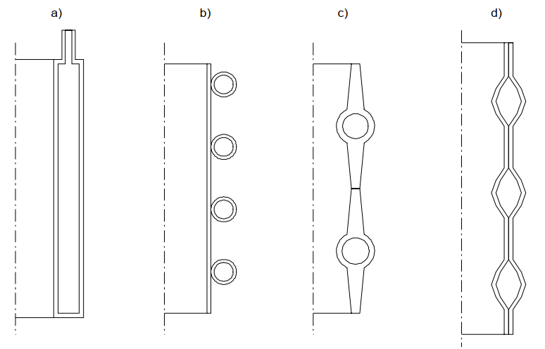
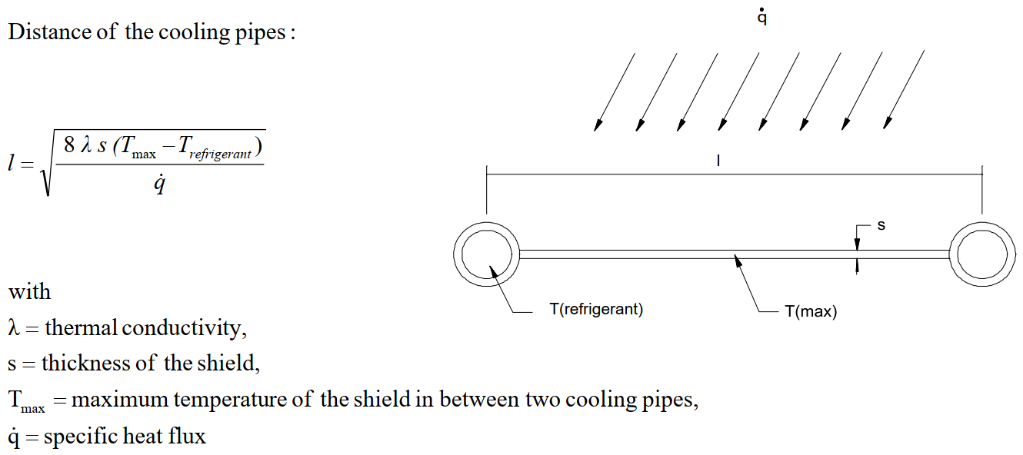
Thermal shielding strategy/heat intercepts
a) shield out of two concentric cylinders
b) shield with brazed cooling pipes
c) shield assembled from extruded
elements (e.g. finned pipes)
d) quilted panel type shield
(made by 1. spot welding two plates
and 2. hydraulically forming them)
Courtesy: G. Perinic, Introduction to Cryogenic Engineering, CERN 2005

Slide 20
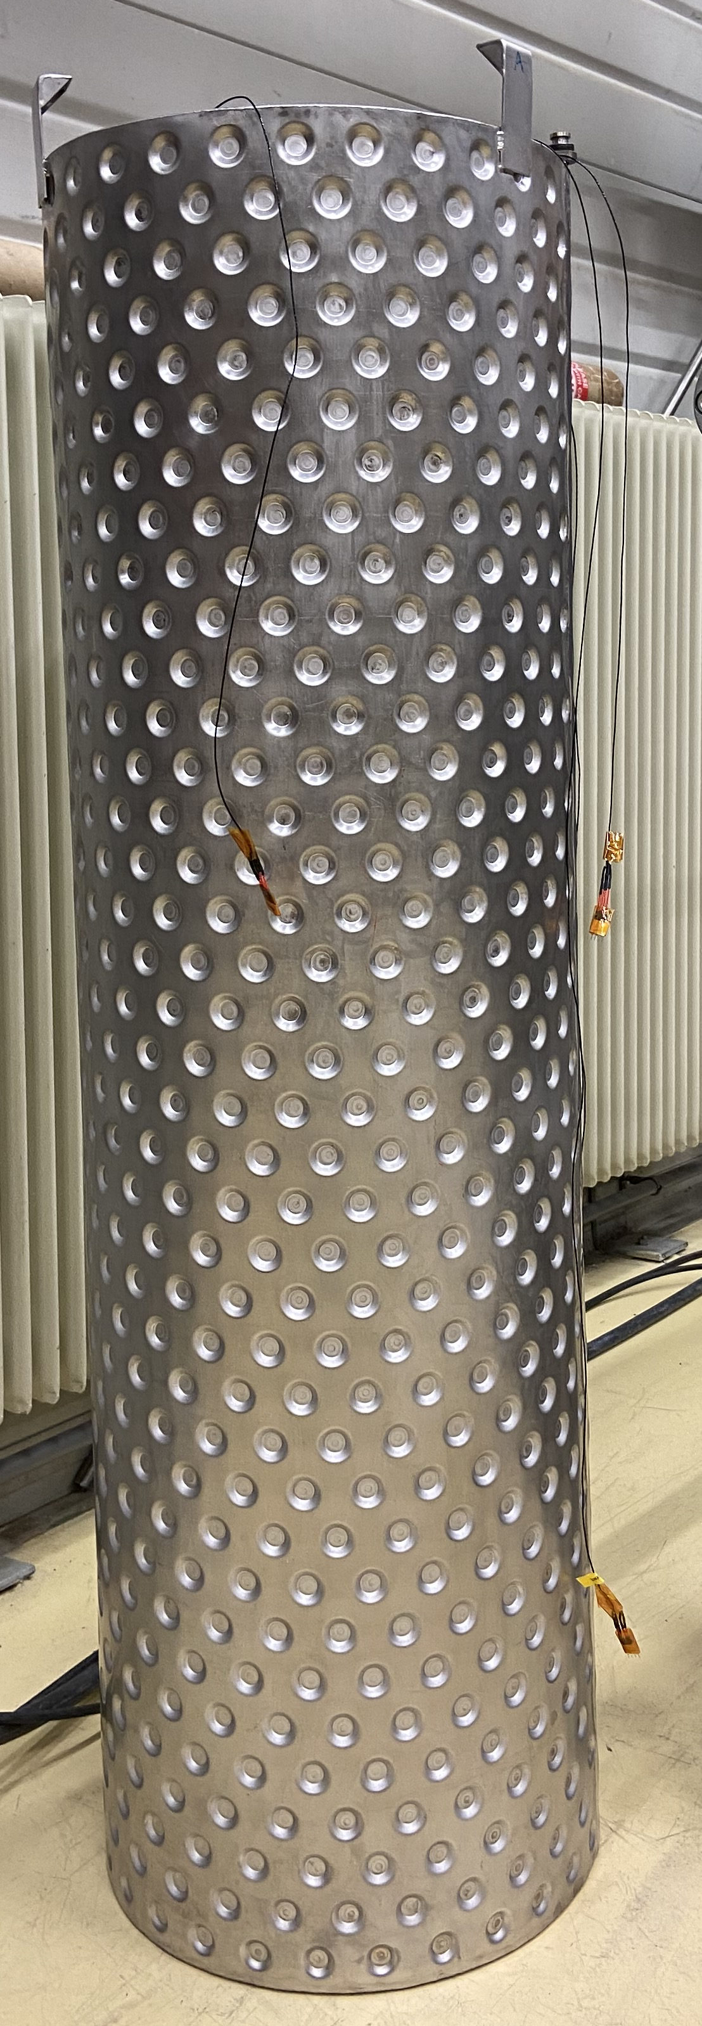
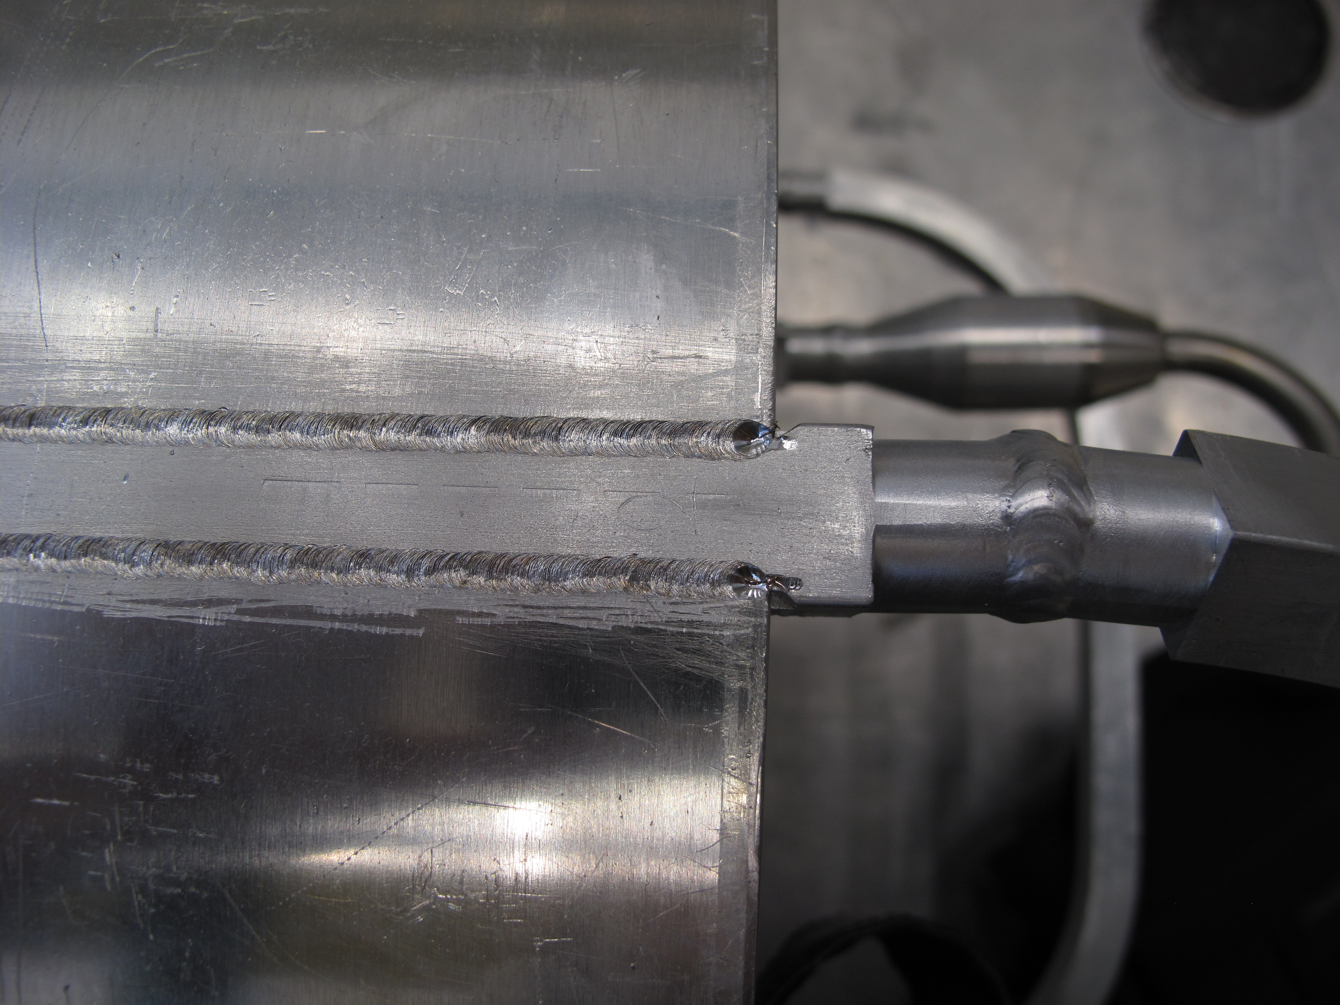
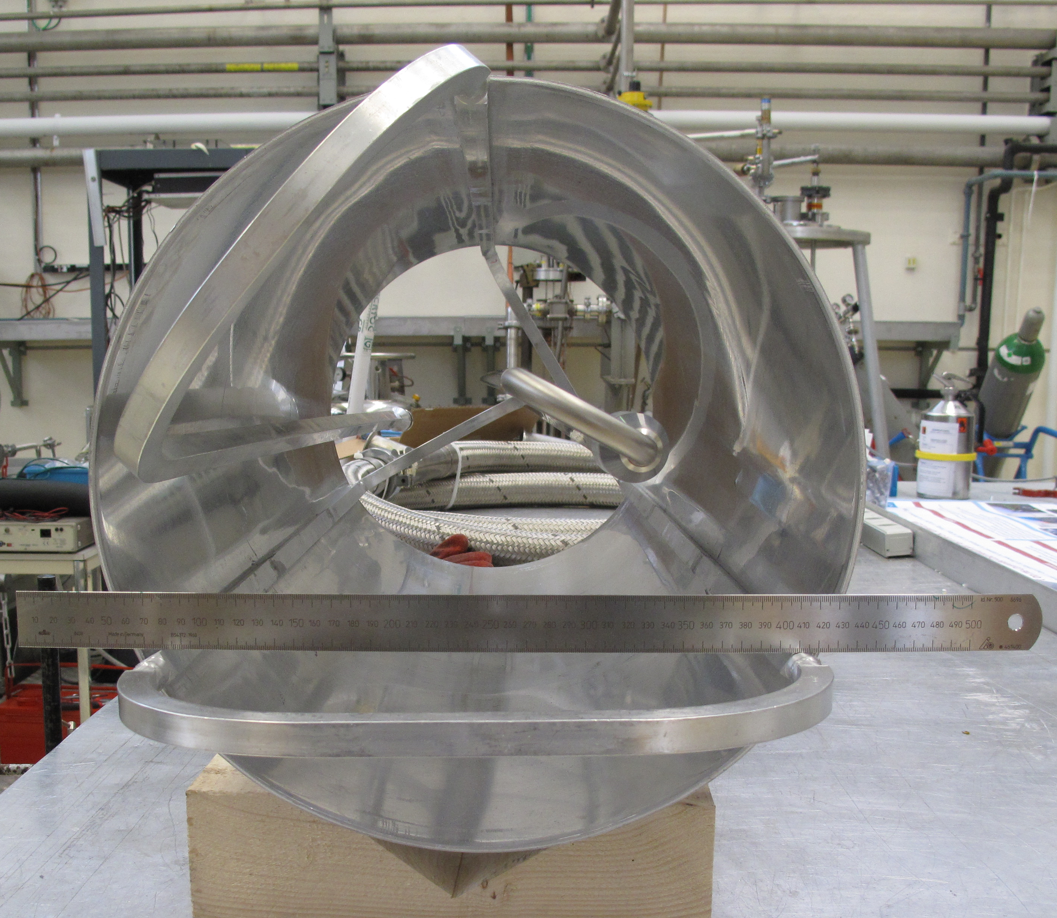
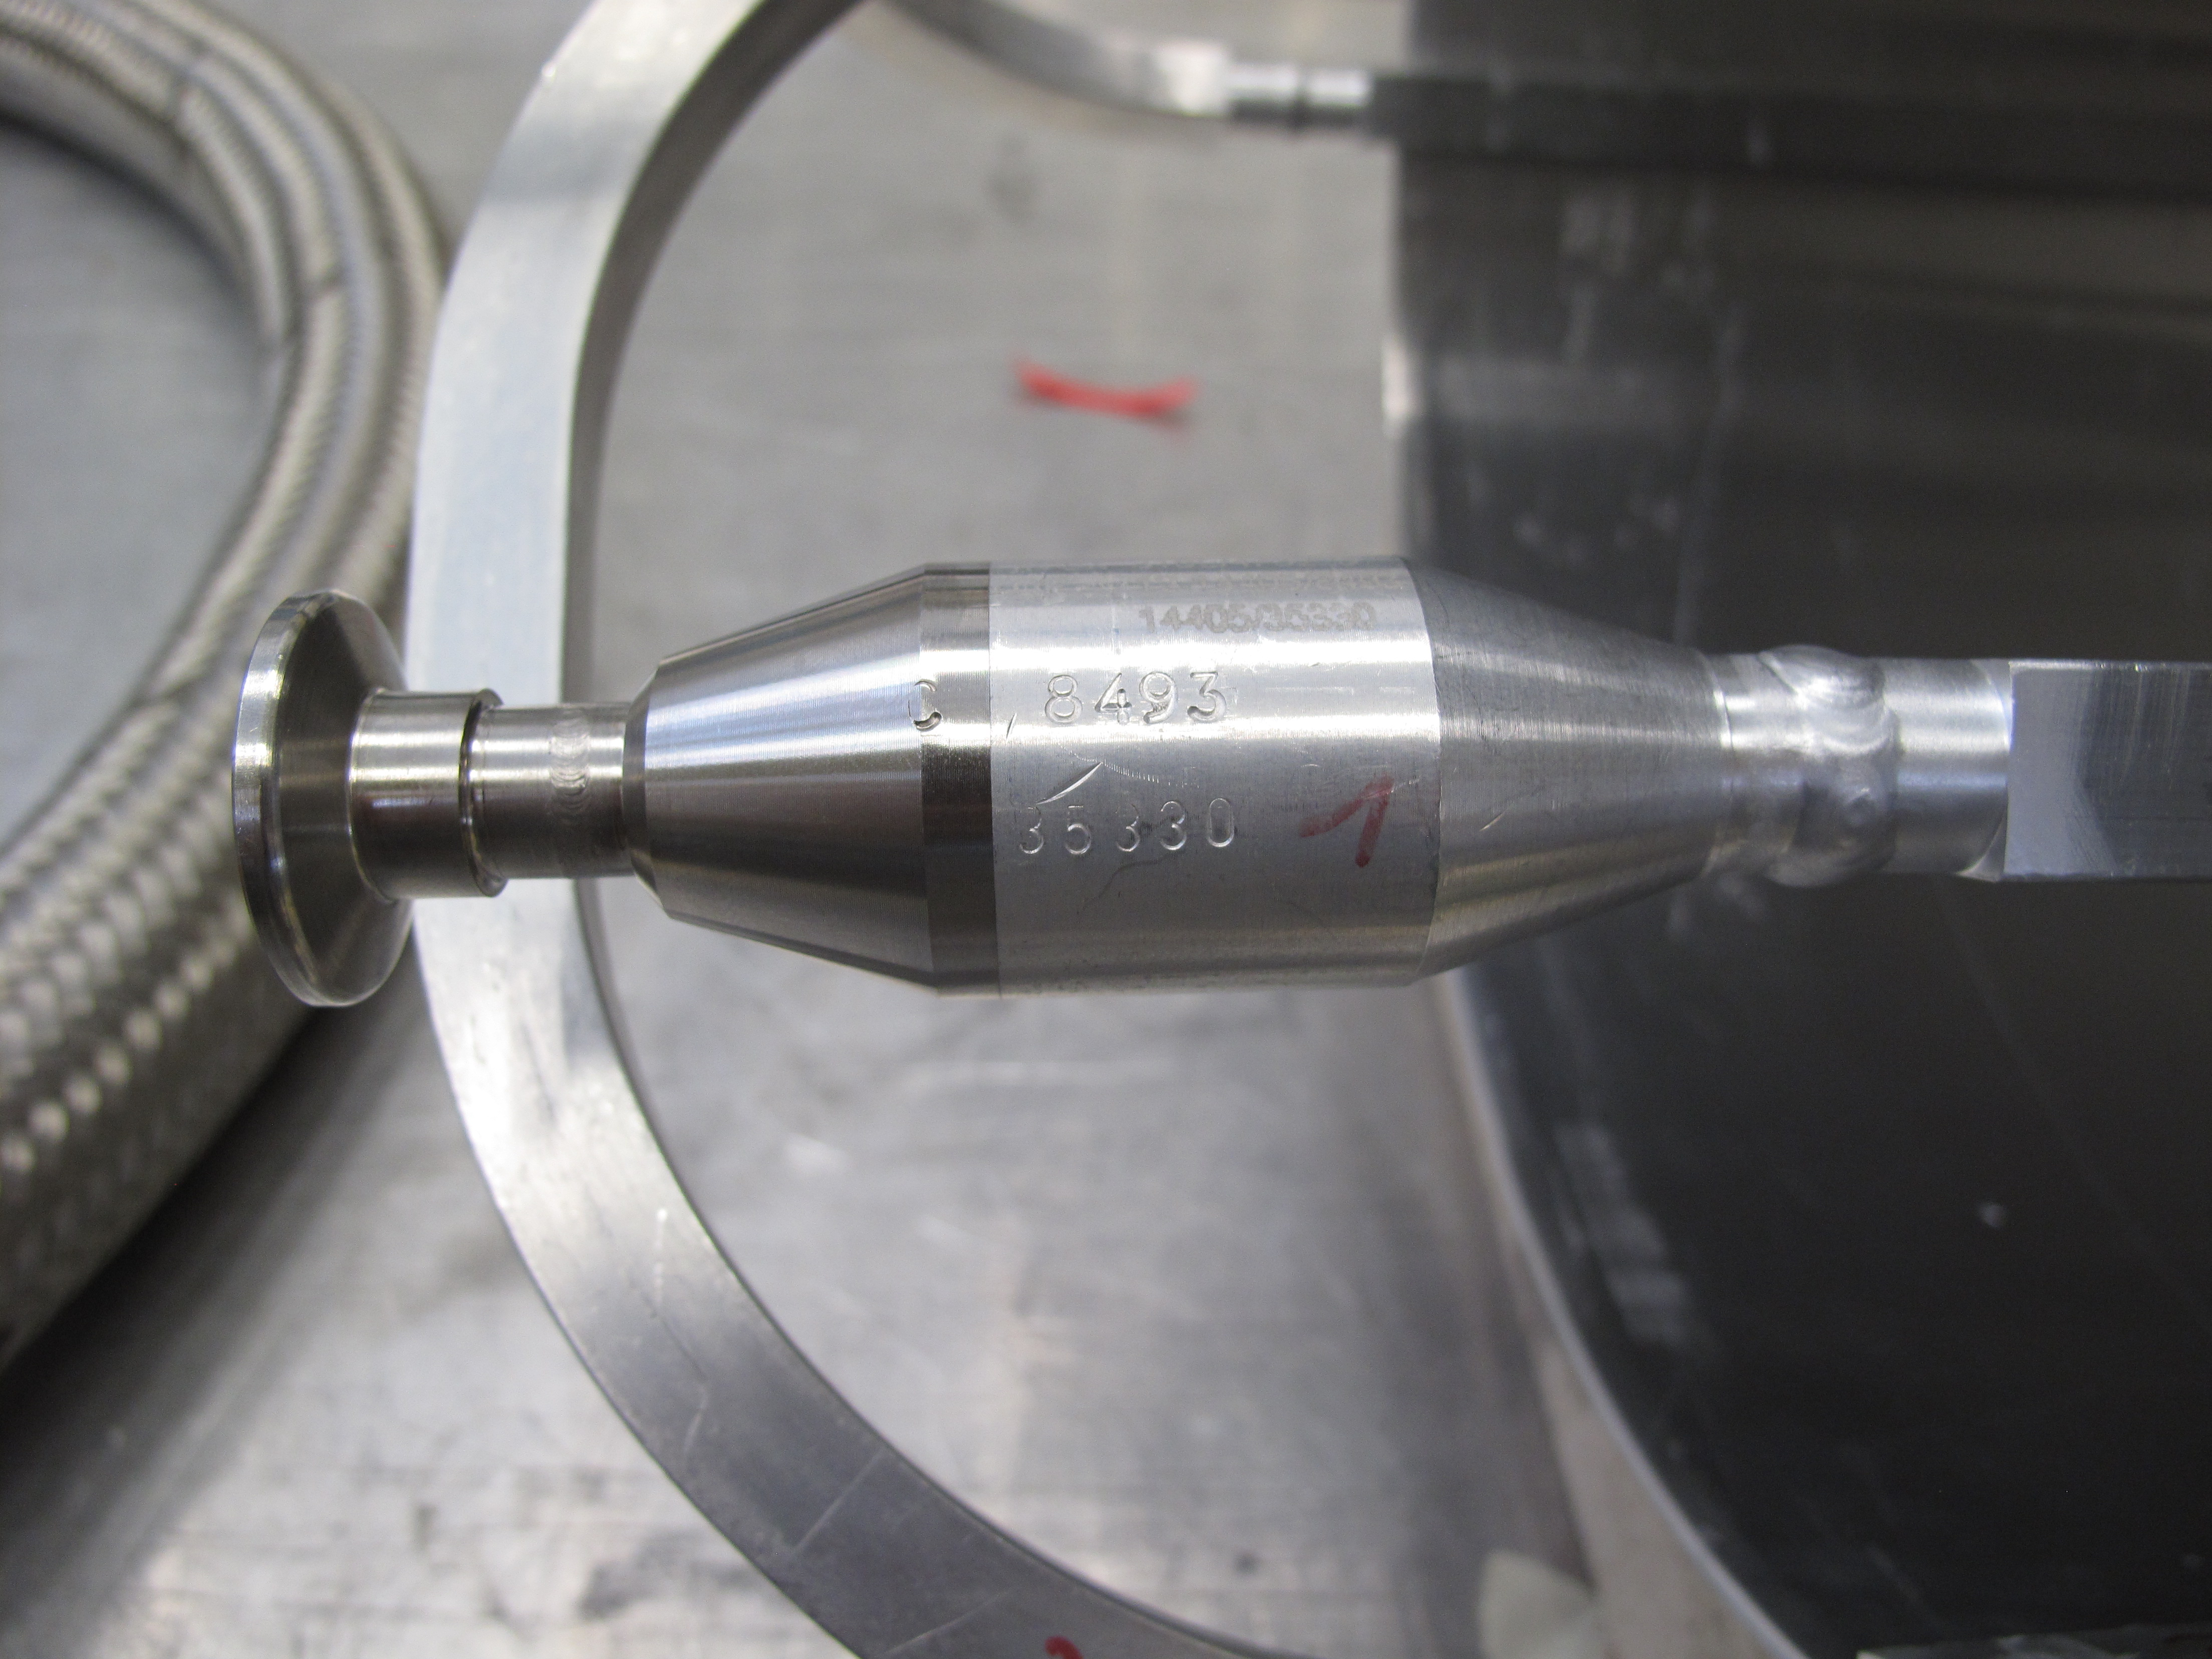
Thermal shielding strategy/heat intercepts
Examples of actively cooled LN₂ shields
Al1100 welded rectangular tubes in the plate
with transition to stainless steel connection tubing
Inox double wall LN₂ shield

Slide 21
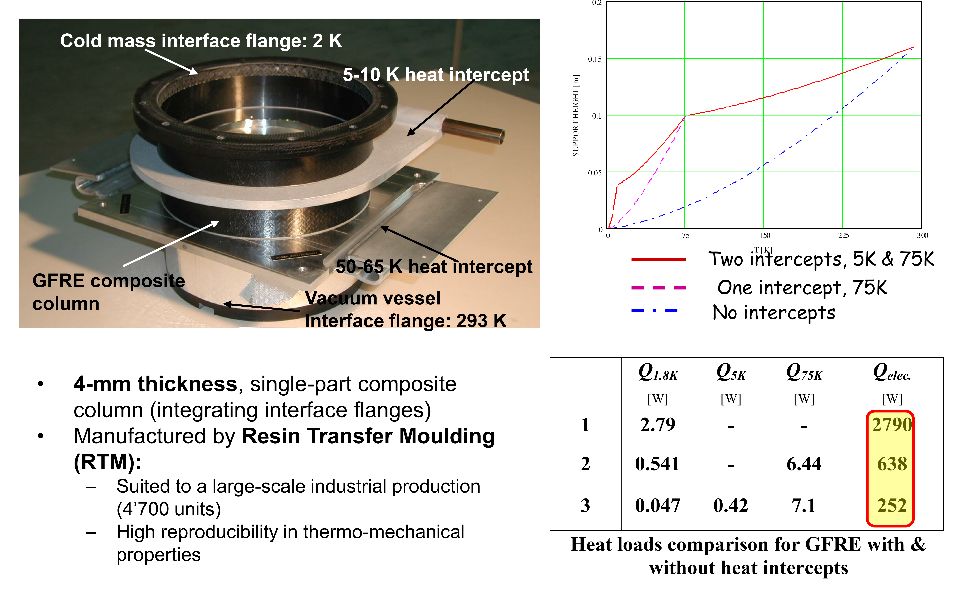
Support posts e.g. magnet of the LHC
From: V. Parma, Cryostat Design, CAS Superconductivity for Accelerators, Erice 2013

Slide 22
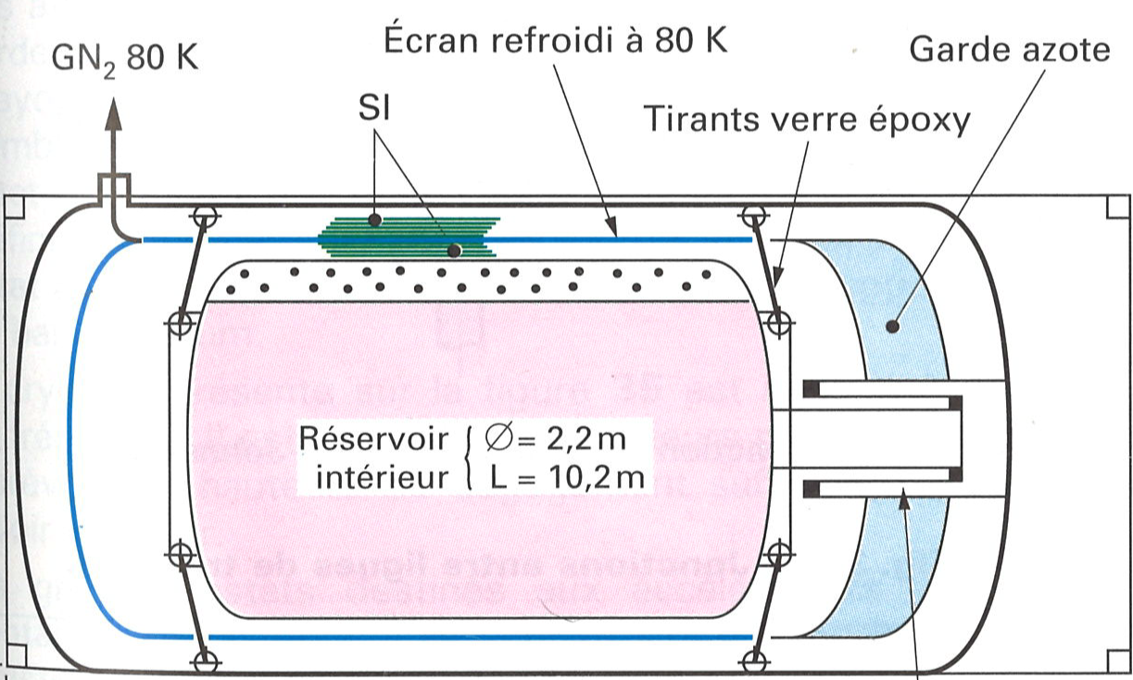
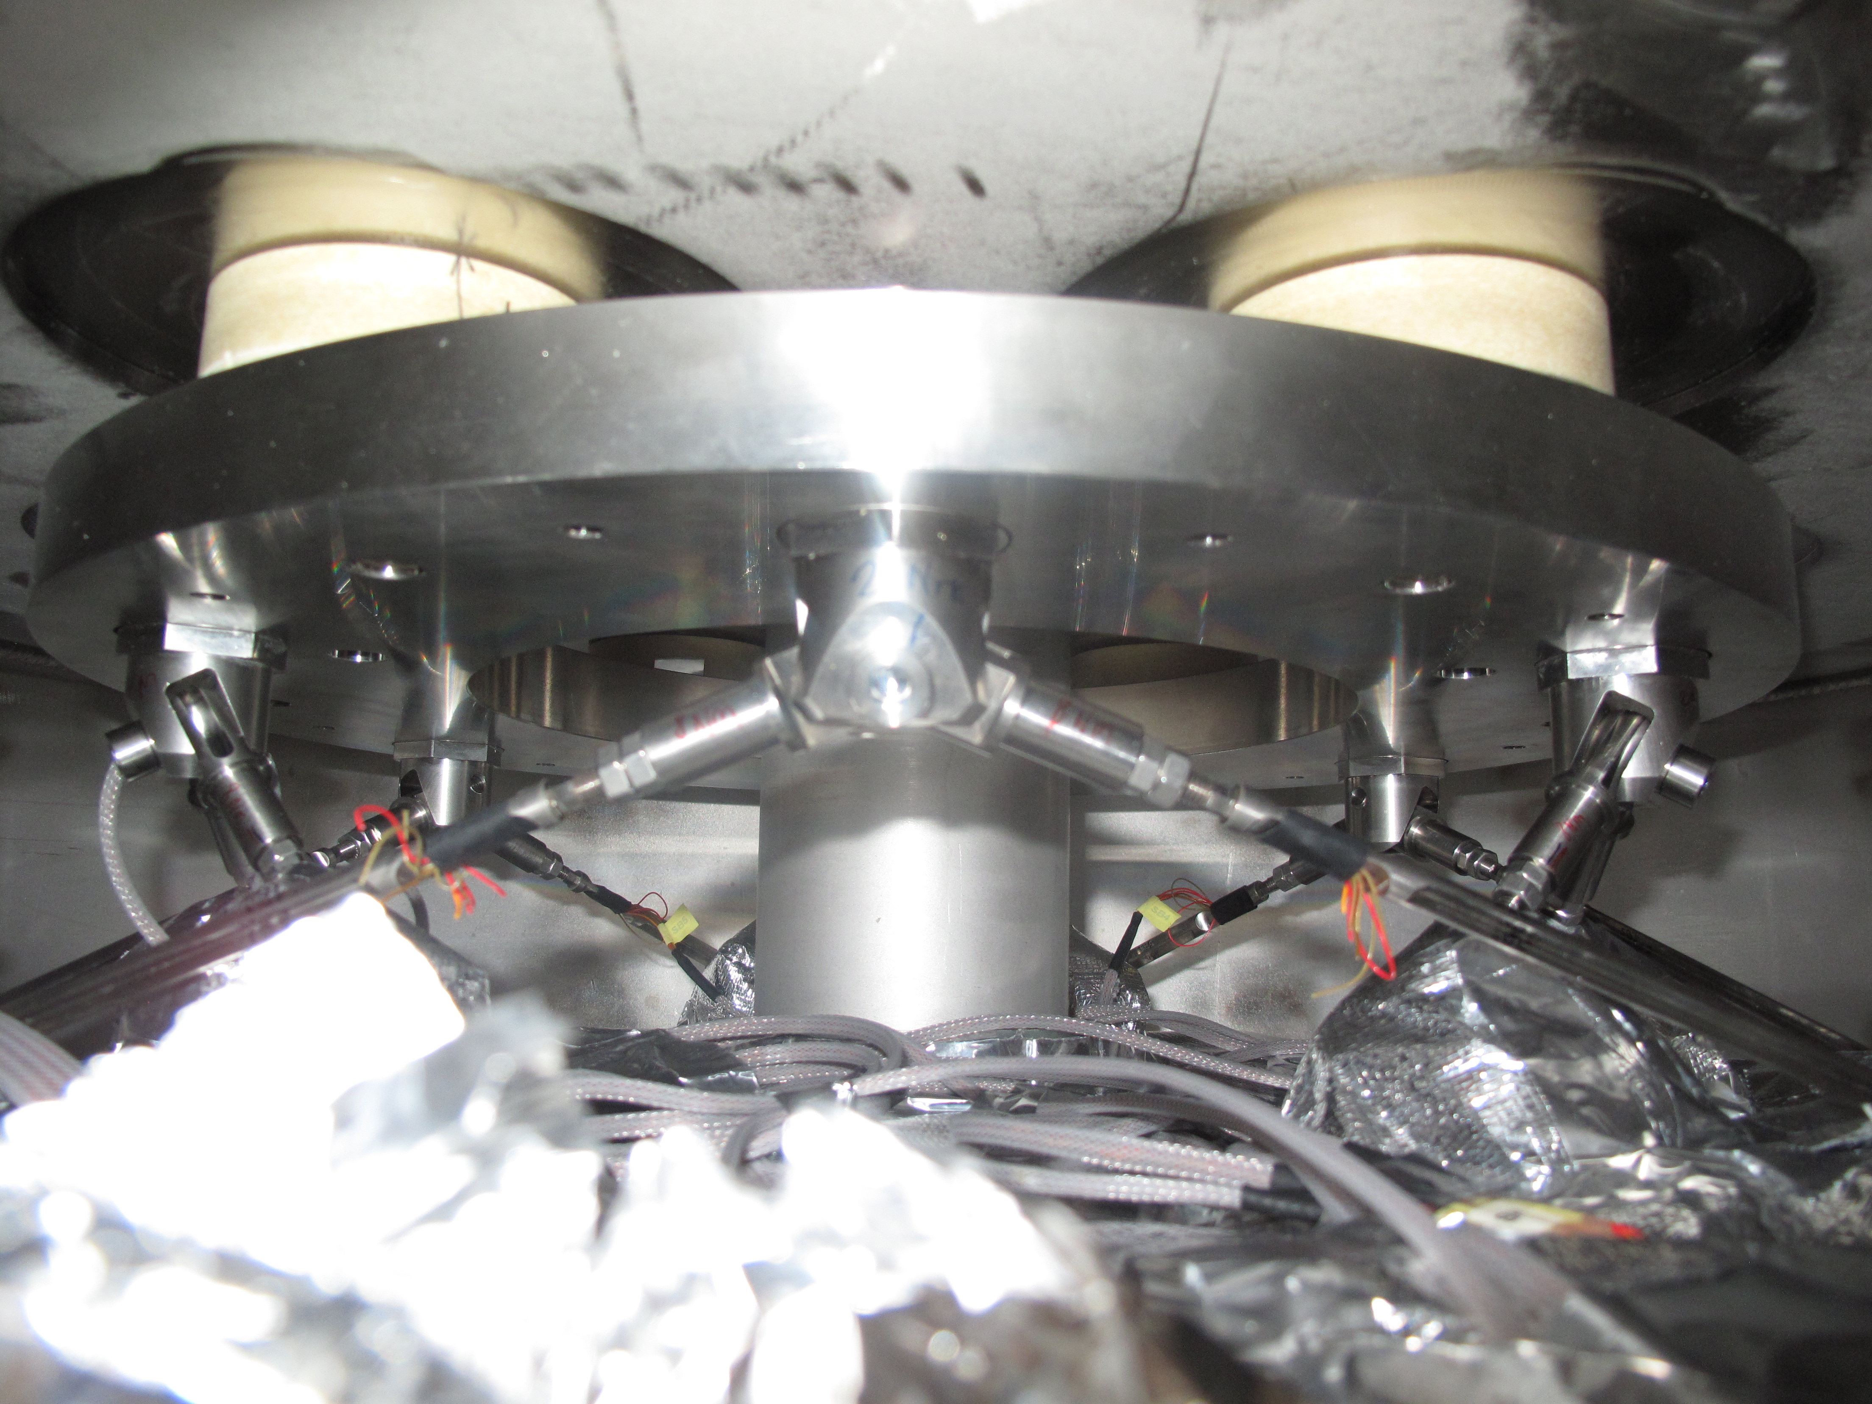
Cryostat support structures examples
Horizontal, large volume storage vessel for H₂ or He
Ti gr.5 support rods with interface plate on G10 supports
Thermal screen at 80 K
LN2 guard
MLI
Support rods G10
Axial support structure
BCCCA inner He vessel with thermal shield
What is the reason for the inclination/orientation of the support rods? Why not the red orientation?
Adapted from: Cryogenie, Institute International du Froid, 2019

Slide 23
Cryogenic valves, transfer lines and components

Slide 24
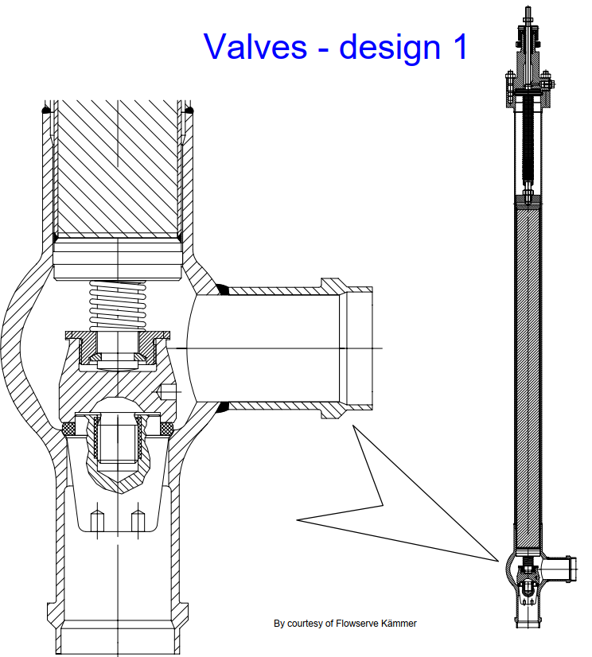
Cryogenic valves
Control or on/off valves
Stem between actuator and valve seat to operate at RT and reduce heat loads to cryo
Valve specs:
Valve size in DN
Nominal pressure PN
Normally closed or open (remember power cuts etc. => fail safe position)
K_{v} (C_{v}) value, flow coefficient
Plug profile for flow characteristic (linked to the controlled pipework)
Rangeability e.g. 1:100
Cryogenic length
Cu thermal interface along the stem to connect to intercepts/thermal shields
Valve actuator (manual, pneumatic 6 bar, electric)
Leak tightness to air and across the seat
Connection for possible He guard (subatmospheric operation in the circuit)
Positioner
TS
Courtesy: G. Perinic, VDI course, Konstruktion und Spezifikation von Kryosystemen, Valve picture courtesy of Flowserve Kaemmer.

Slide 25



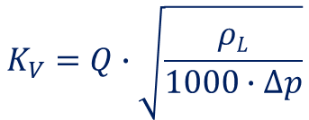


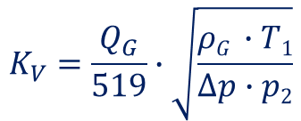
Cryogenic valves
$K_{V}$
$ρ$_{L}
$ρ$_{G}
Q
Q_{G}
$$∆p$$
T₁
p₁
p₂
- Value in m³/h
- Density liquids in kg/m³
- Density gas @ 273 K and 1.013 bar in kg/m³
- Flow of liquids in m³/h
- Flow of gas @ 273 K and 1.013 bar in m³/h
- Pressure drop in bar
- Temperature upstream in K
- Upstream pressure in bar(a)
- Downstream pressure in bar(a)
K_{v} (C_{v}) value calculation following DIN/IEC534
$$K_{V}=Q∙\sqrt{\frac{ρL}{1000∙∆p}}$$
Liquid op.
Gas operation
Subcritical flow p₂>p₁/2 and $∆$p<p₁/2
Critical flow p₂<p₁/2 and $∆$p>p₁/2
$$K_{V}=\frac{Q_{G}}{519}∙\sqrt{\frac{ρG ∙T1}{∆p∙p2}}$$
$$K_{V}=\frac{Q_{G}}{259.5∙p1}∙\sqrt{ρG∙T1}$$
$$Zeta value: ζ=\frac{d4}{626.3∙KV2}$$
Attention: C_{V} in USA 1.1561 * K_{V} [gal_{US}/min]; C_{V} in UK 0.9626 * K_{V} [gal_{UK}/min]

Slide 26
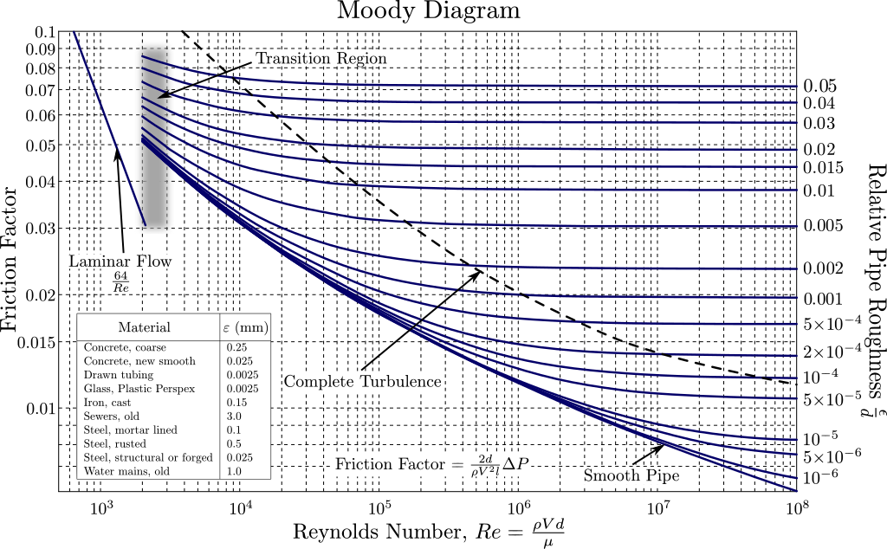

Transfer line pressure drop
https://en.wikipedia.org/wiki/Moody_chart
Common confusion between Fanning and Moody (aka Darcy-Weisbach) friction factors. If wrongly used, factor 4 difference in pressure drop calculations.
Recommendation: use Fanning for Navier-Stokes equations and Moody for an isolated pressure drop calculation.

Slide 27
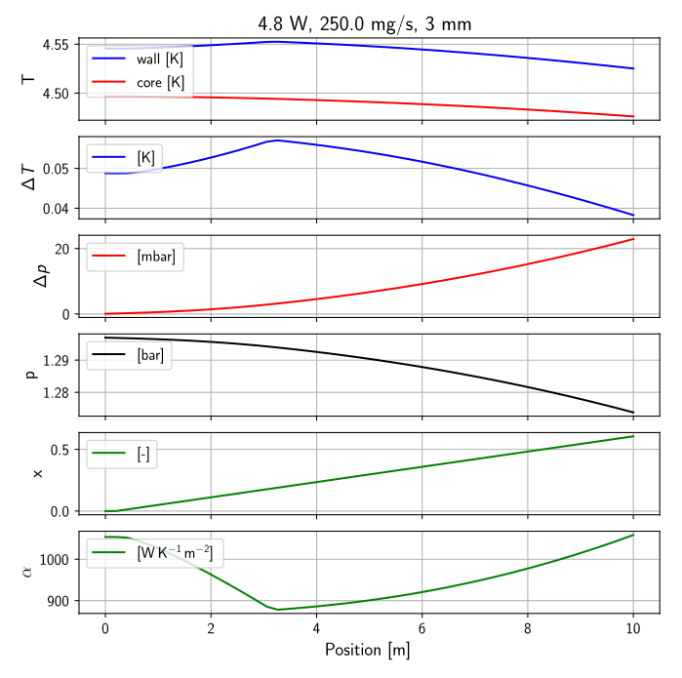
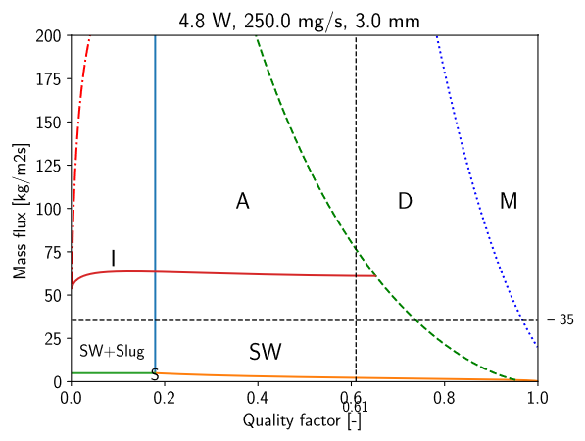
Two-phase flow – flow pattern map
Heat loads and mass flow

Slide 28
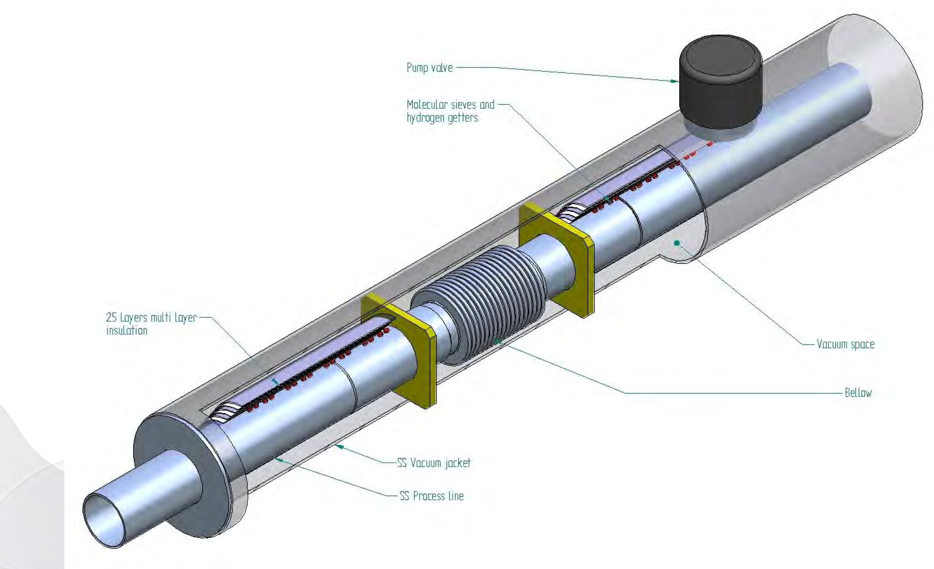
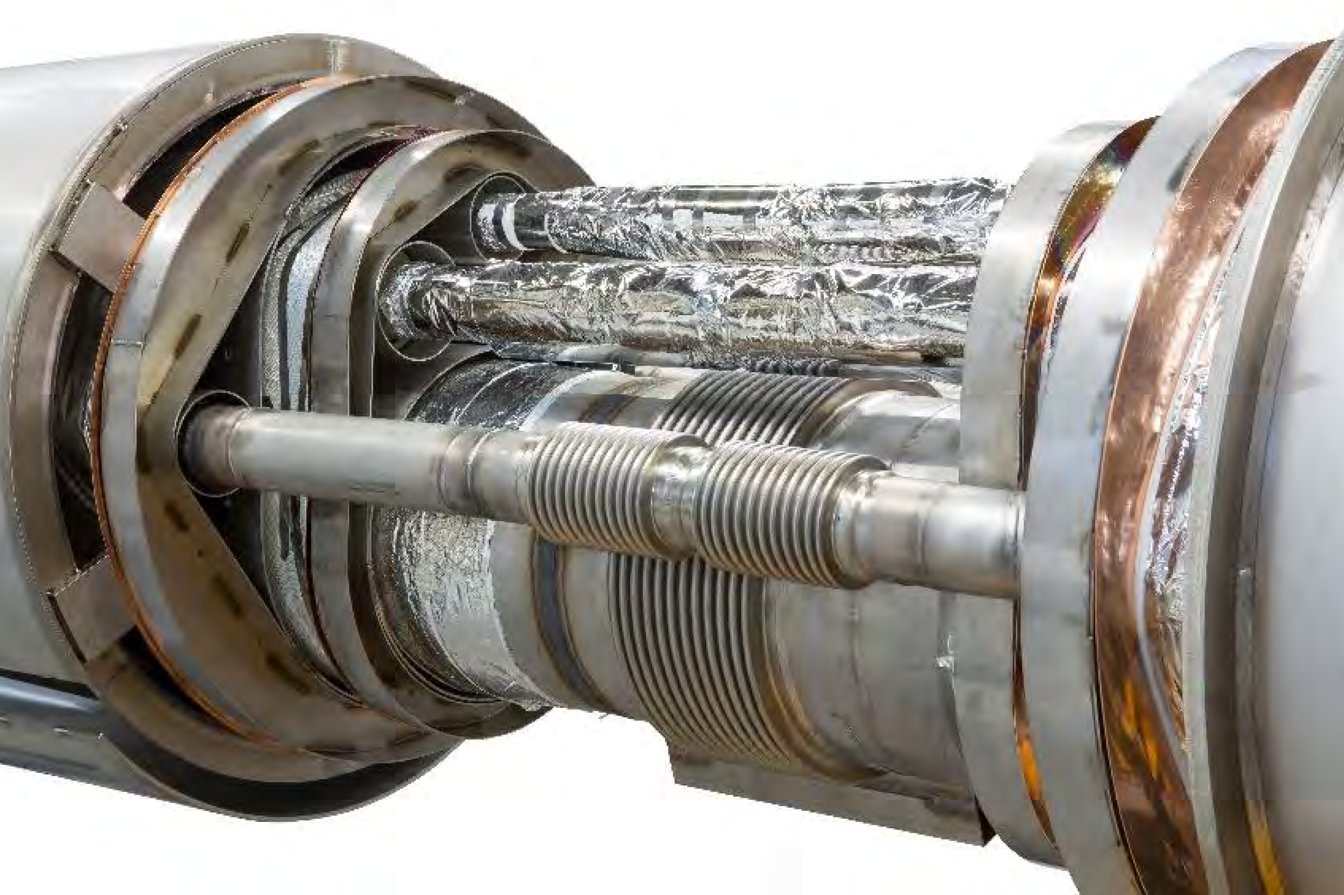
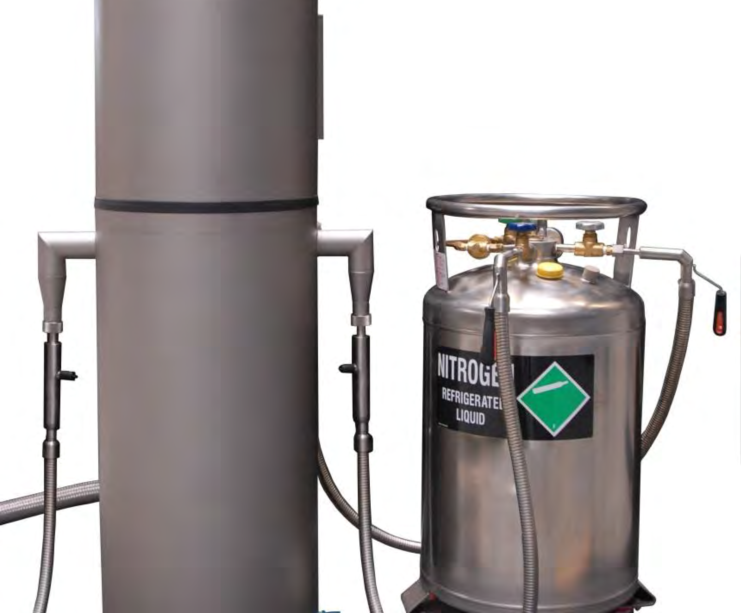
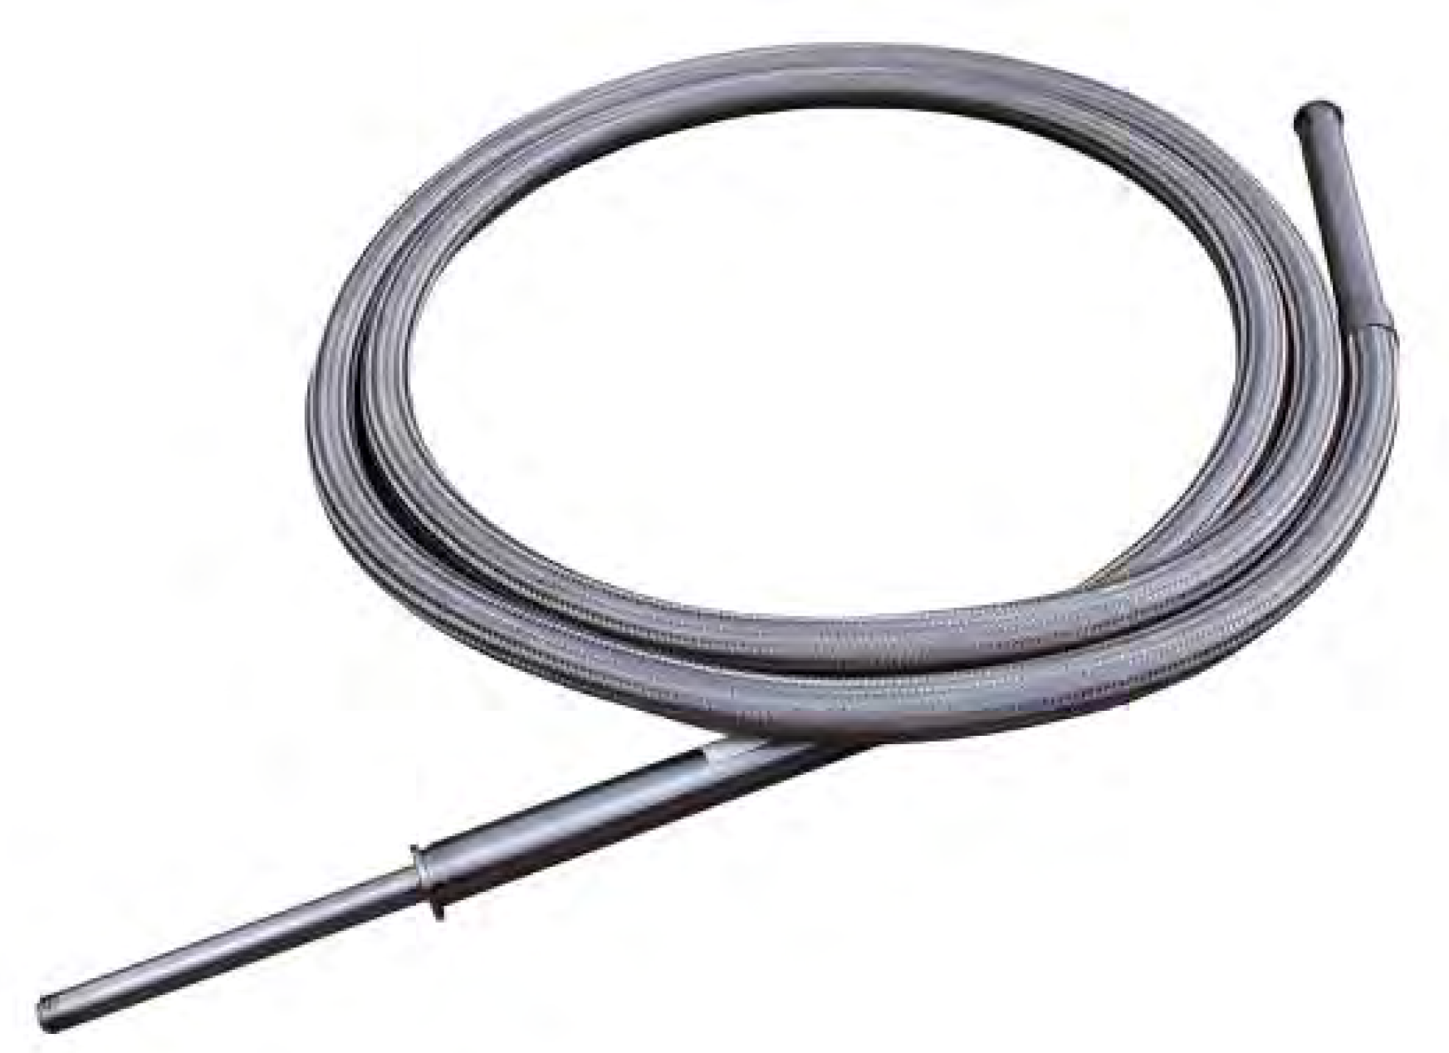
Cryogenic Transfer Lines
Multiple LHe transfer line
Schematic TL
Flexible TL for “temporary”
connections
Source: DEMACO, VDI course cryogenics, cryostat design, 2023

Slide 29
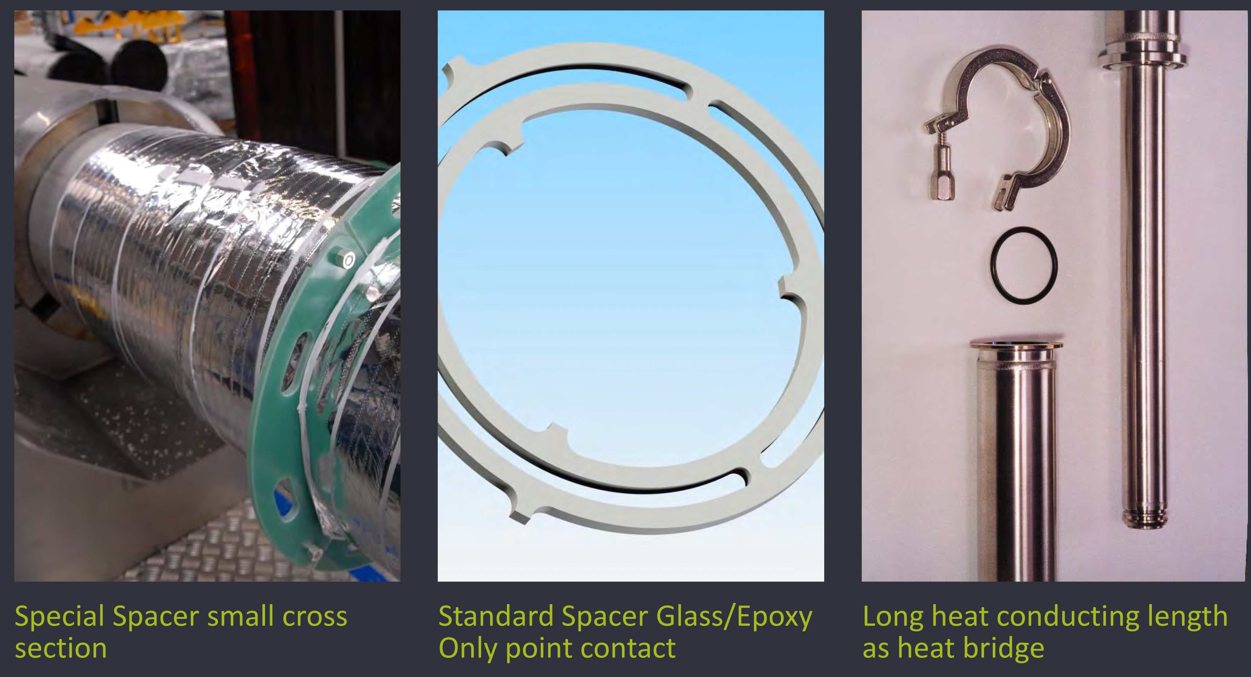
Cryogenic Transfer Lines
Thermal contact depends on force
not on pressure!
Source: DEMACO, VDI course cryogenics, cryostat design, 2023

Slide 30
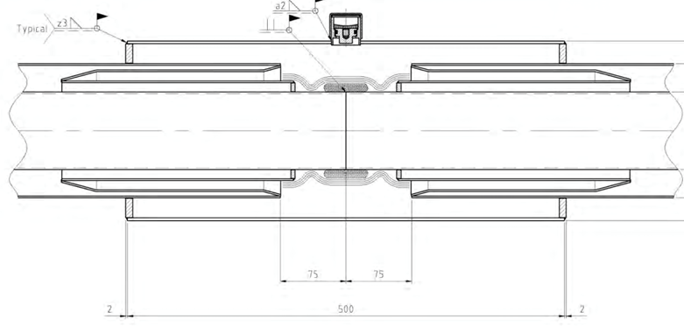
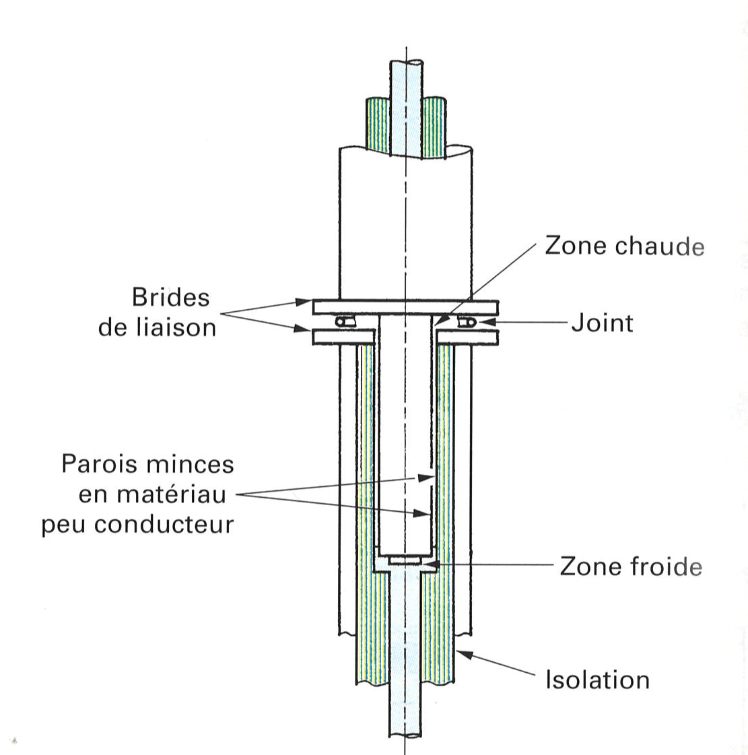
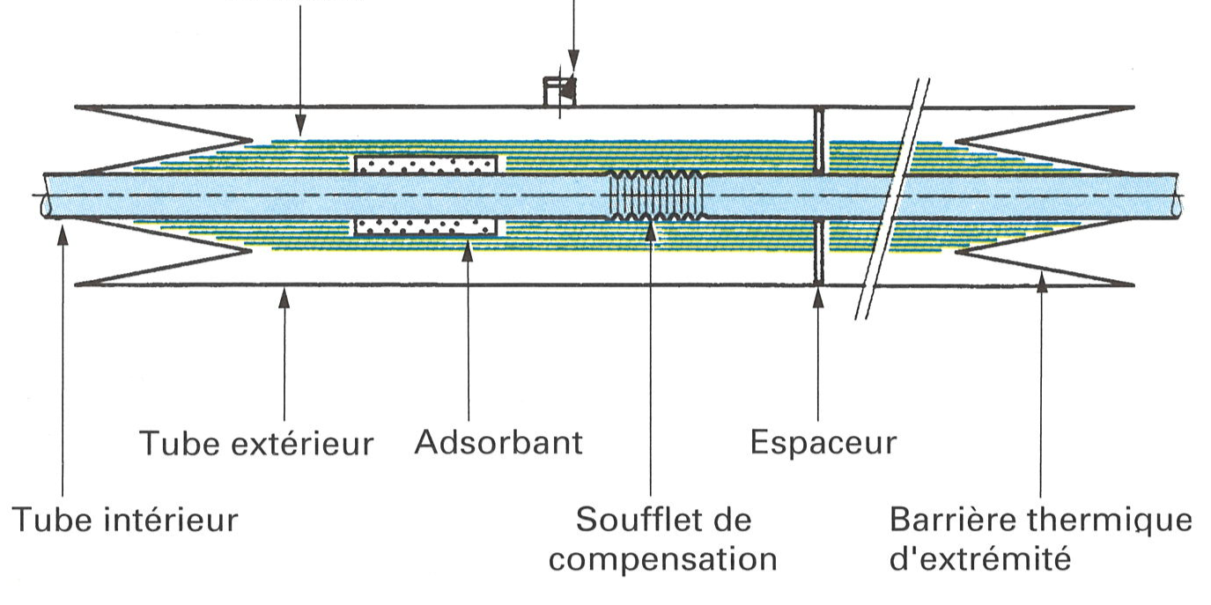
Transfer line examples
Rigid transfer line connection (DEMACO)
Bayonet Johnston connection
Warm zone
Connection flanges
Joint, O-ring or gasket (Al, Cu, In)
Annular gap of 50 to 100 micron possible cold Teflon seal to reduce convection but not sealing! => intermediate space pressure build up!
MLI
Pumping port
Cold zone
MLI
Ext. tube
Adsorbent
Support, spacer
Internal tube
Bellow
Thermal barrier
Adapted from: Cryogenie, Institute International du Froid, 2019

Slide 31
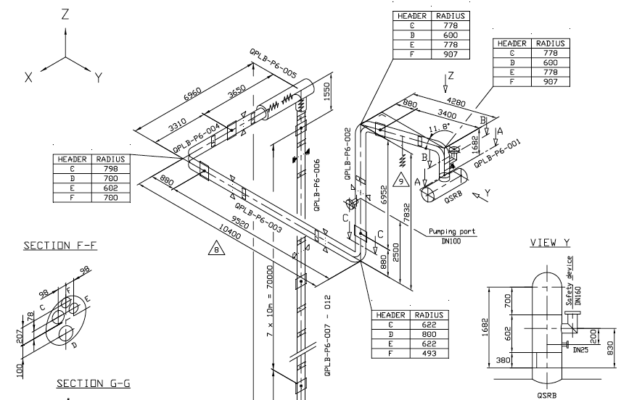
LHC vertical transfer lines (100 m vertical shaft)
Specified “bellows free” in vertical shaft,
With relaxed thermal requirements
Very important cross-section control for 3D lines

Slide 32
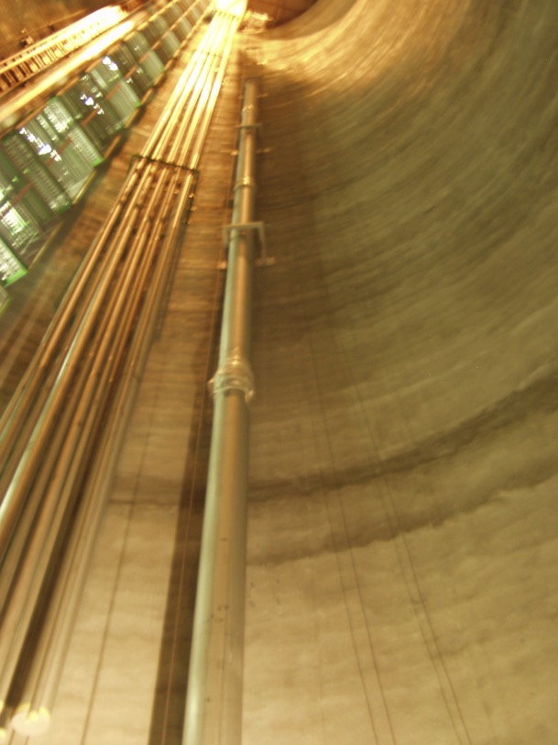
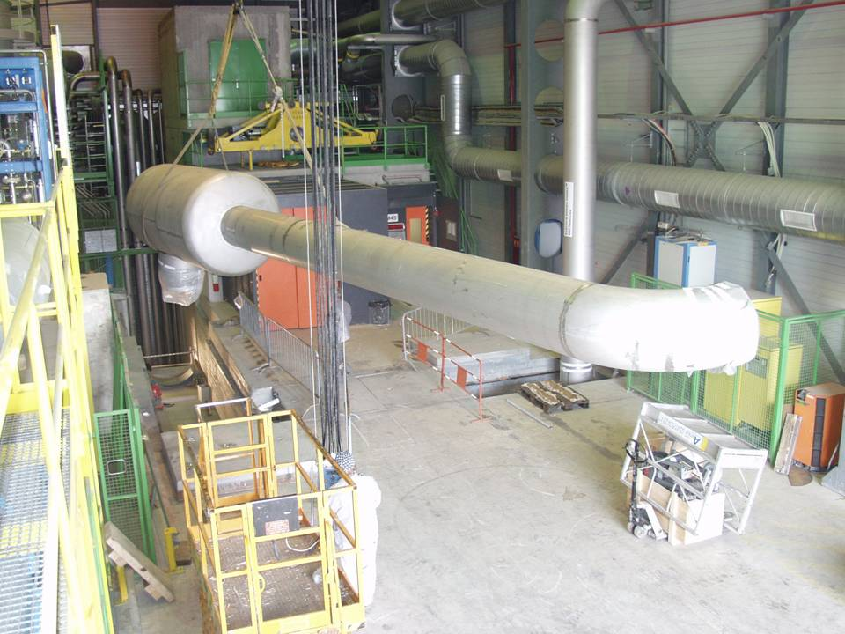
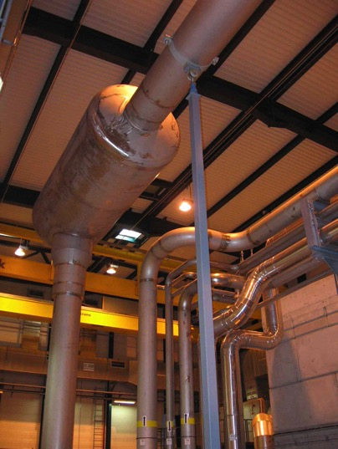
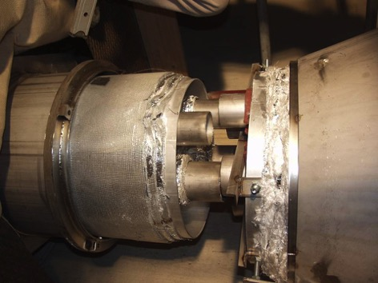
LHC vertical transfer lines (100 m vertical shaft)
Strategy and tooling for installation: a must !

Slide 33
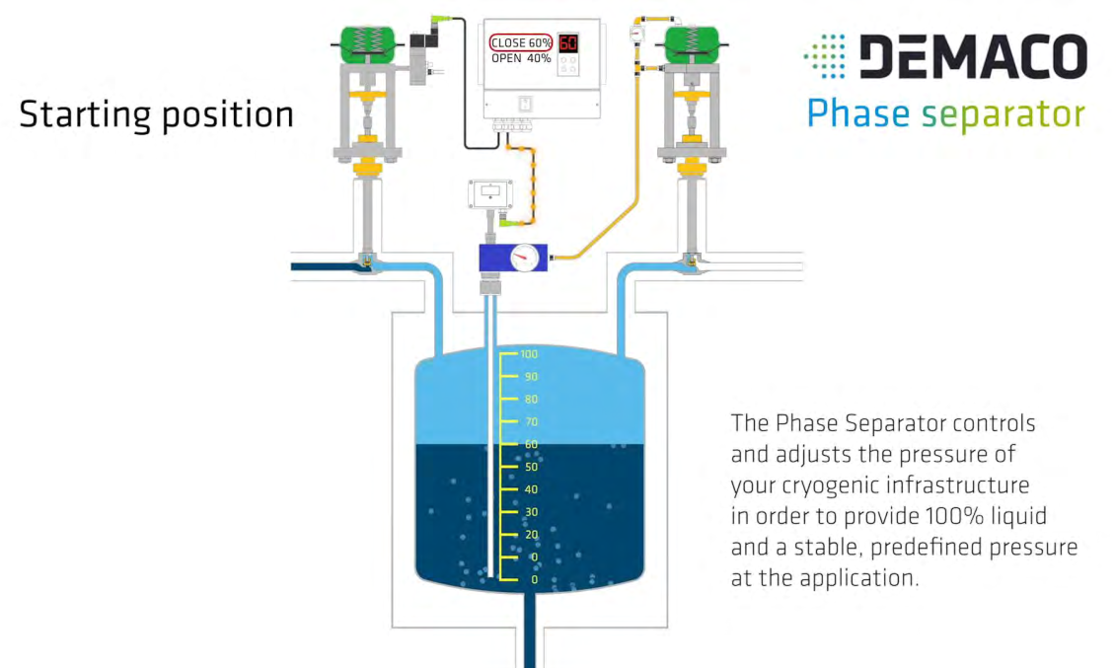
Phase separator and subcooler

Slide 34
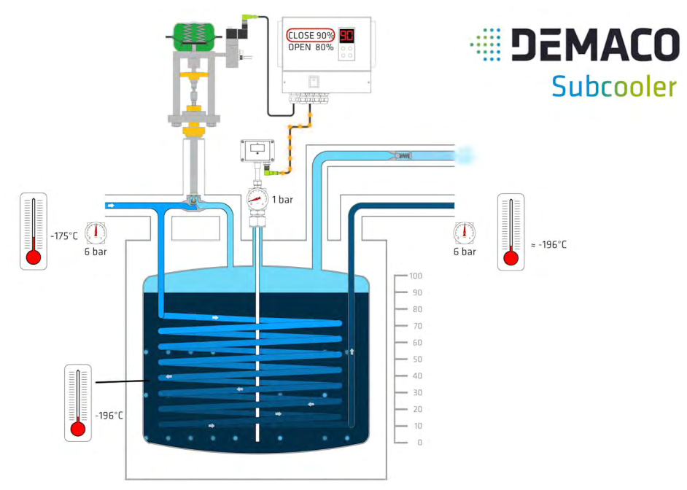
Transfer lines and pressure drop
Inlet pressure = outlet pressure
Provides 100 % liquid at the outlet in subcooled conditions

Slide 35
Transfer lines and pressure drop an example setup
LN₂
1 bar
TT
PT
PT
TT
FT
EH 1
EH 2
EH 3
2
3
4
5
6
Sample
Precooler
Joule-Thomson expansion
Cryostat with thermal shield
p
1
LN₂ Dewar
4 bar
EH 1
System provides two-phase flow with controlled pressure, mass flow and vapor quality.
Attention:
Exit CV is regulating the sample section pressure
Inlet CV is regulating the mass flow
1
EH 2
3
4
2
Test
5
6
h

Slide 36
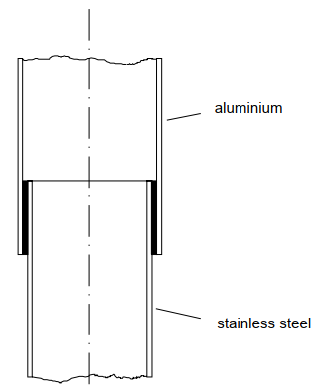
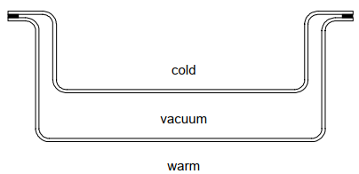
Cooldown speed and thermal gradients
Limits to be defined by the user:
Limiting max. stress in magnets with Nb₃Sn impregnated coil components:
50 K/h cooldown speed, e.g. 30 K gradient along a 9 m magnet structure
Fast cooldown of Nb cavities between 170 K and 75 K to avoid hydrogen disease => degradation of cavity performance in operation
(not required if there was a high-temperature bakeout in the procedure)
Fast cooldown of SC cavities passing T_{c}, typically in the range 9 K to 18 K to expel magnetic flux
Limits to be defined by the cryogenic engineer:
Due to material combinations or designs => mechanical deformation even for the same material if dT is too large during transients
Stress build up at material transitions e.g. brazed tube connections
Avoid shear stress etc.
Courtesy: G. Perinic, Introduction to Cryogenic Engineering, CERN 2005

Slide 37
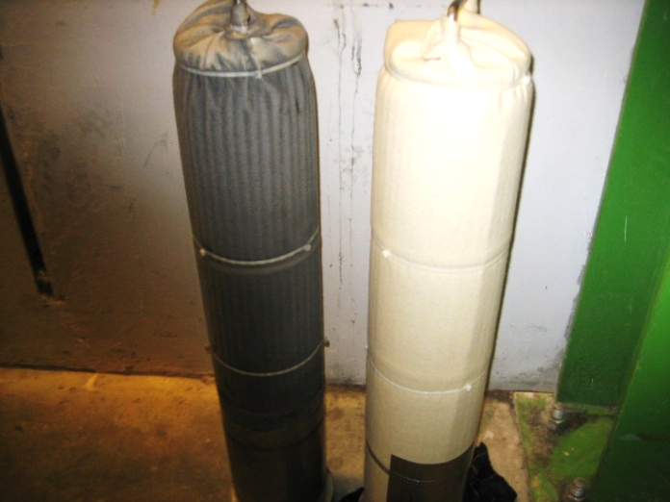
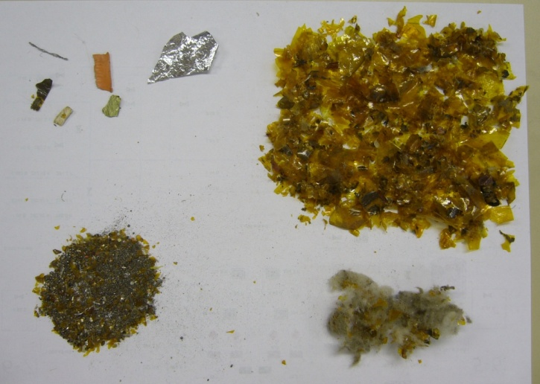
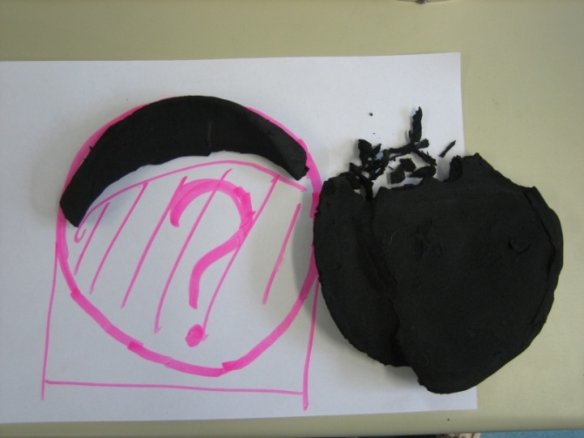
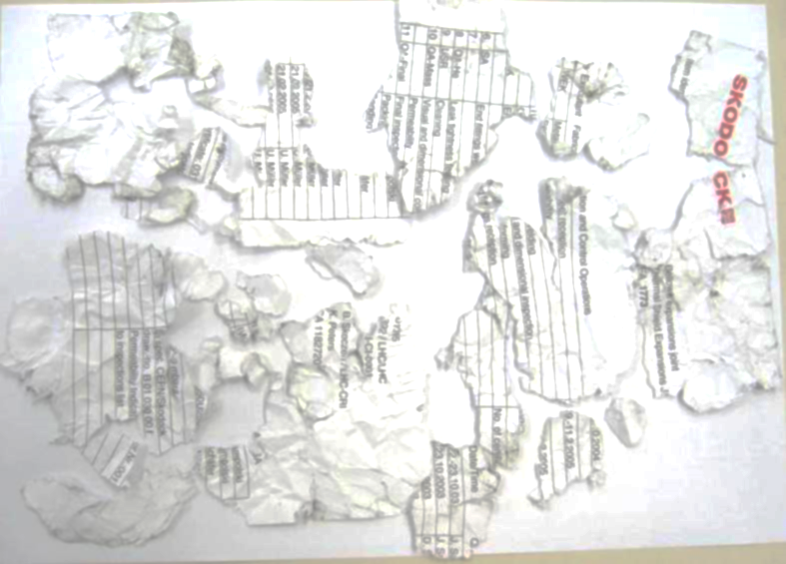
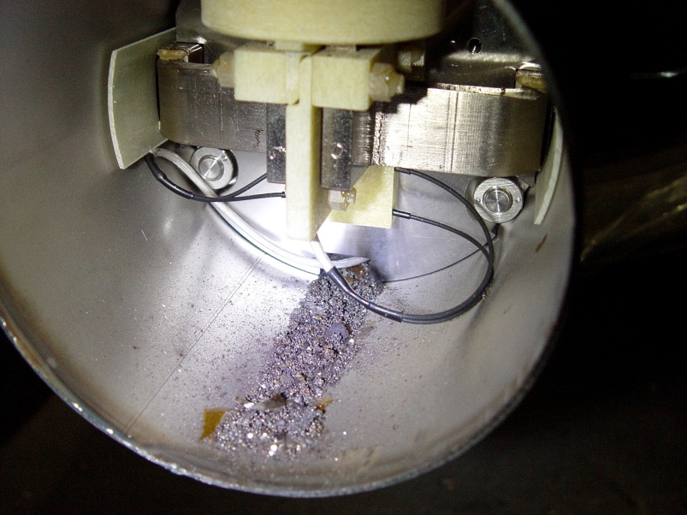
Cleanliness during installation
Watch out for oil pollution from cutting etc. or the cryoplant compressor oil propagation
Pollution in the cryogenic process e.g. water, CO₂ or O₂ in commercial LN₂
Soldering and brazing agents, problem of corrosion (ITER thermal shield cooling pipes)
Installation of filter cartridges to collect:
Foam (welding plug)
Debris
& Kapton
Dust
Courtesy: L. Tavian, The challenges for getting the nominal cryogenic conditions, Academic Training lectures CERN, 2008.
Paperwork
Possible short in magnet diodes

Slide 38
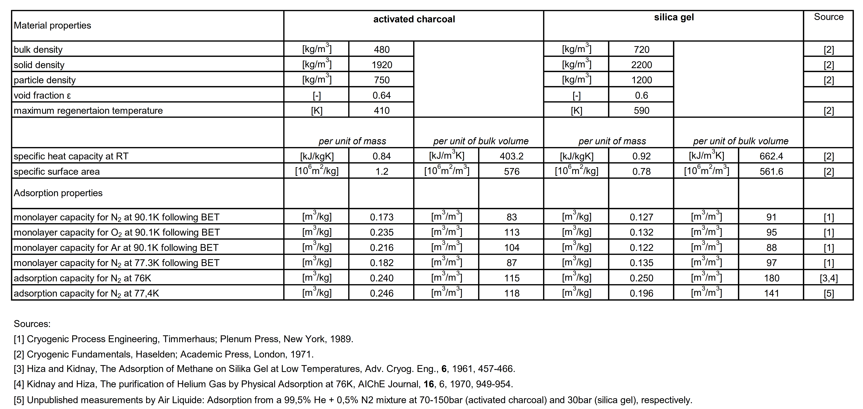
Improving vacuum “lifetime” – Adsorber material
Courtesy: G. Perinic, Introduction to Cryogenic Engineering, CERN 2005

Slide 39
Summary
Collection of requirements for the design
PID
Thermal shields, supports with active cooling
Valves (incl KV) and transfer line equipment
Phase separators subcoolers
Cleanliness

