Slide 2
Liquid Argon Cryogenics and Cooling Options
T. Koettig
with contributions from: J. Bremer, C. Fabre, J. Rutherford, D. Santandrea, F. Cacherat

Slide 3
Content
Applications of liquid Argon (LAr) in particle detectors
Introduction to Argon as a cryogenic fluid
Thermodynamics of LAr
Cooling options for LAr
Remarks

Slide 4
Applications of LAr in Particle Detectors
J. Bremer

Slide 5
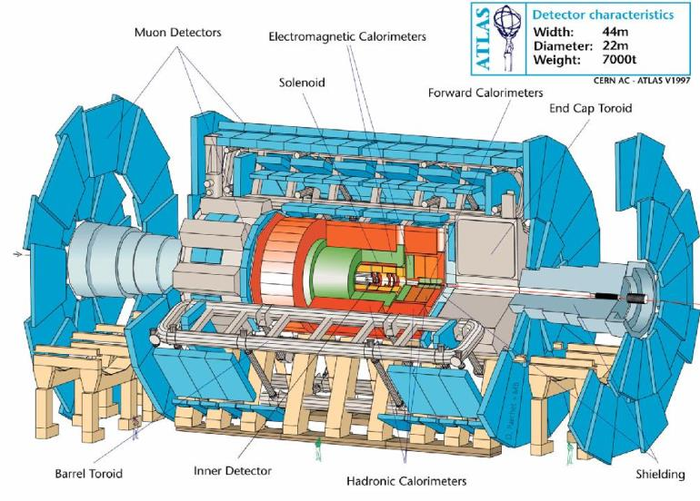
Cryogenics for ATLAS Liquid Argon Calorimeters

Slide 6
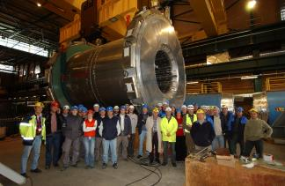
Liquid Argon Cryostats and Cryogenics at CERN
Picture of the ATLAS barrel calorimeter cryostat before lowering into UX15 cavern.
Total liquid argon volume about 50 m³.
Advantages:
Vacuum insulated cryostat, very low heat input (< 6 W/m²)
Cold vessel can be purged before start of cool-down (very pure liquid needed)
Disadvantages:
Quite heavy structure
Large heat load when vacuum is broken
Getting to the limit of what’s reasonable possible for vacuum insulated cryostats

Slide 7
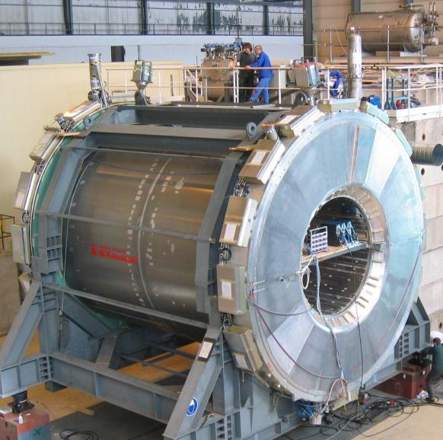
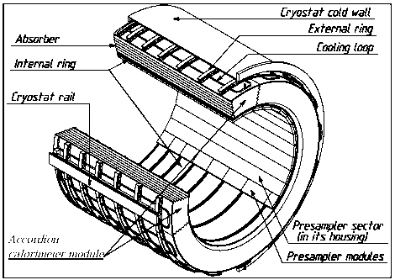
ATLAS Liquid Argon Calorimeters
Barrel Calorimeter:
  D: 4.3 m; L: 6.5 m
  Weight: 120 t
  Argon volume: 40 m³
Electromagnetic barrel half-wheel
Courtesy of Caroline Fabre

Slide 8
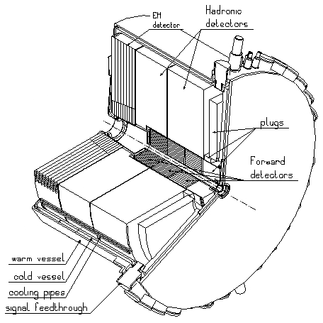
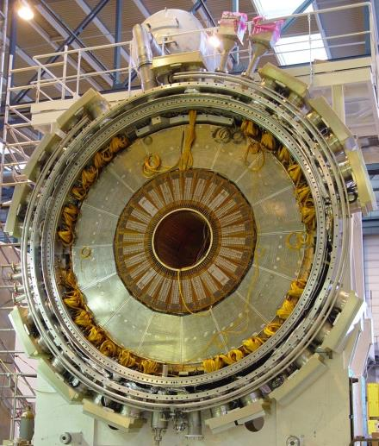
ATLAS Liquid Argon Calorimeters
End-cap Calorimeter:
  D: 4.3 m; L: 3 m
  Weight: 219 t
  Ar volume: 19 m³
Calorimeters are highly complicated composite structures made of copper, lead, stainless-steel and glass-epoxy… placed in aluminium cryostats
Courtesy of Caroline Fabre

Slide 9
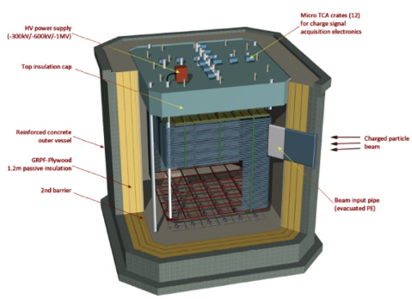
LAr Neutrino Detectors => Programs at CERN II
2 cryostats in EHN1 => NP02 and NP04
Design, installation and operation of 8x8x8 m³ sensitive volume cryostat and cryogenics system
Total liquid argon volume: 510 m³
Total argon weight: 705 ton
Cryogenics will be supplied via central system, to be designed and installed for this area
11.2 m
12.5 m
Continuous circulation and purification
=> LAr impurity level ≤ 30 ppt (O₂ equiv.)
12.5 m

Slide 10
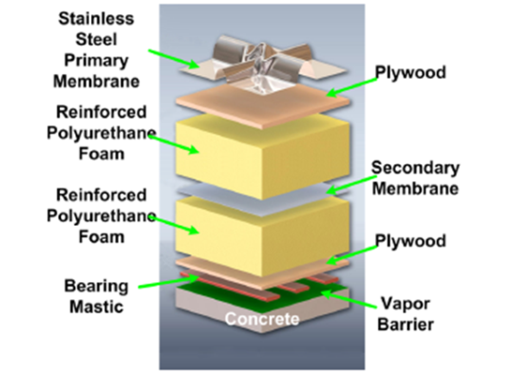
How could we construct these real large cryostats?
Could we use the membrane technology as already in use for liquefied natural gas storage and ship transport:
Primary membrane: To contain the liquid
Polyurethane foam: to diminish the heat-load ( 1 meter thickness: < 10 W/m)
Secondary membrane: to contain liquid in case of leak primary membrane
Vapour barrier: no condensation of air on cold surface
Support of cryostat on concrete of metallic structure
Example

Slide 11
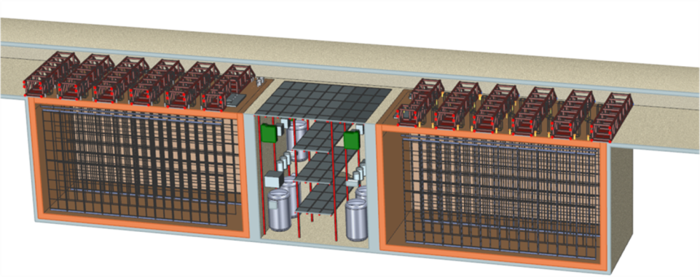

Eventual Future LAr Neutrino Detectors
LBN at Homestake, South-Dakota
15.6 m
16.0 m
28.6 m
Two cryostats, with about 10 kton liquid argon each
Argon purity < 200 ppt oxygen equivalent (electron life-time > 1.4 ms)
To be installed and operated in a cavern at 1.6 km below ground level
Ready for operation: 2021
Courtesy: Dune collaboration

Slide 12
LAr Neutrino Detectors => with CERN Team Contribution
Short Base Line Far Detector
The “upgraded ICARUS” will be installed as Far Detector at Fermilab
600 ton of liquid Argon
Courtesy: Icarus collaboration

Slide 13
Argon – Cryogenic Properties
T. Koettig

Slide 14
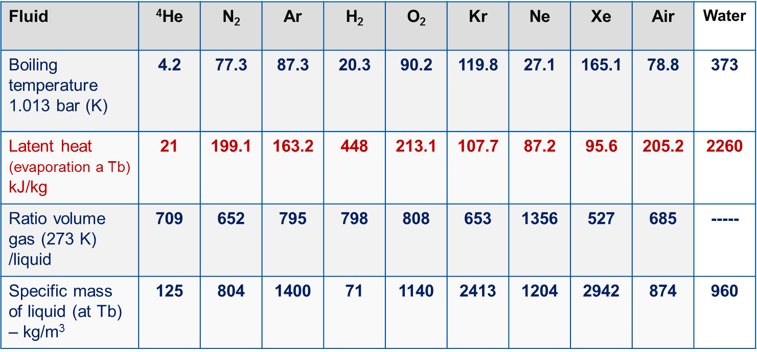
Cryogenic Fluids
THERMOPHYSICAL PROPERTIES

Slide 15
Argon as a Cryogenic Fluid
T_{c}=150.7 K
T_{TrP}=83.8 K
From: Haefer, Kryovakuumtechnik

Slide 16
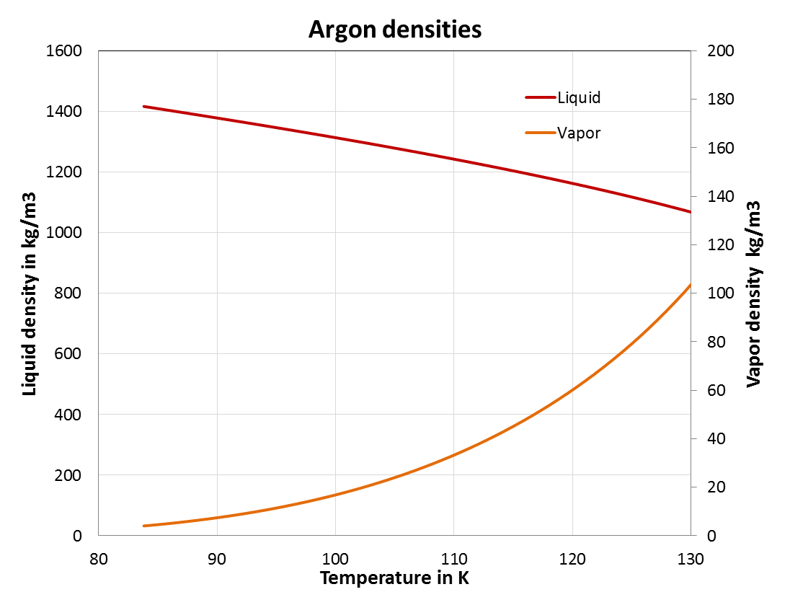
Argon as a Cryogenic Fluid
Data source: Refprop, NIST

Slide 17
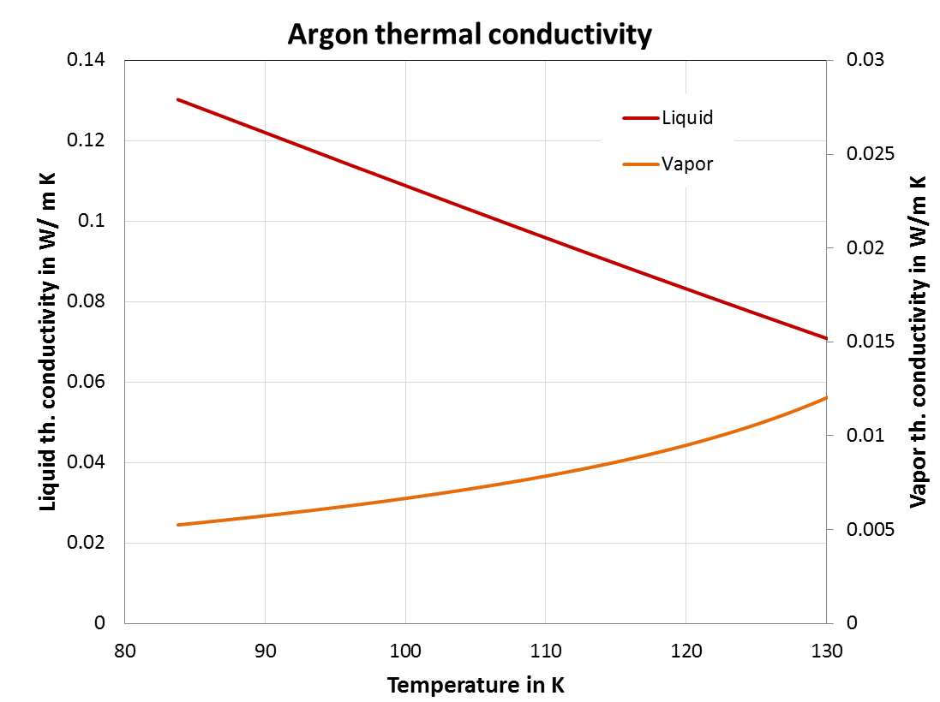
Argon as a Cryogenic Fluid
Data source: Refprop, NIST

Slide 18
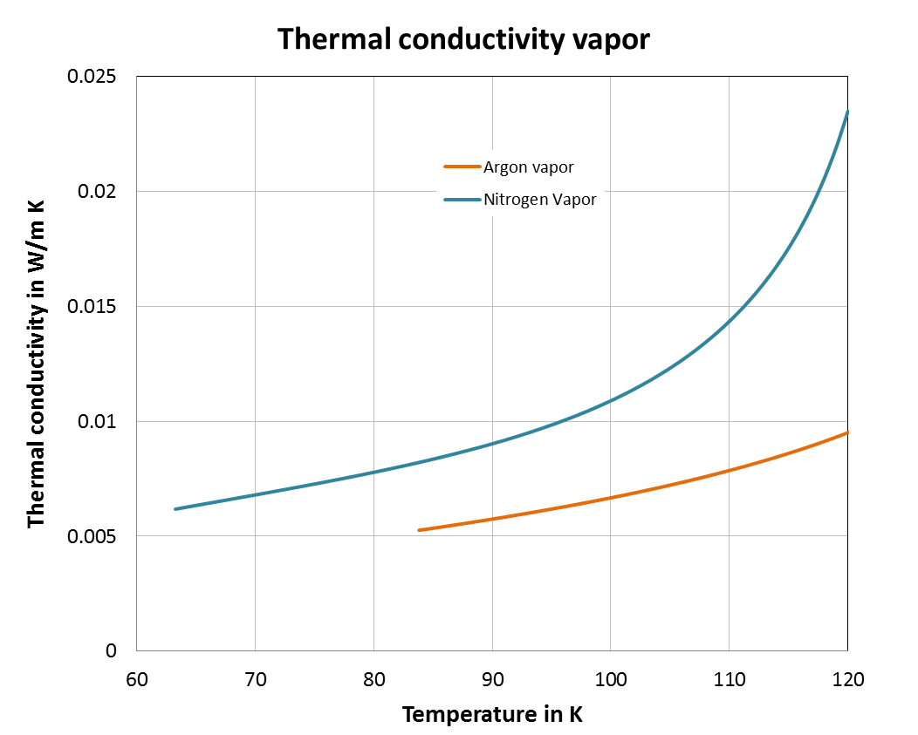
Argon as a Cryogenic Fluid
Data source: Refprop, NIST

Slide 19
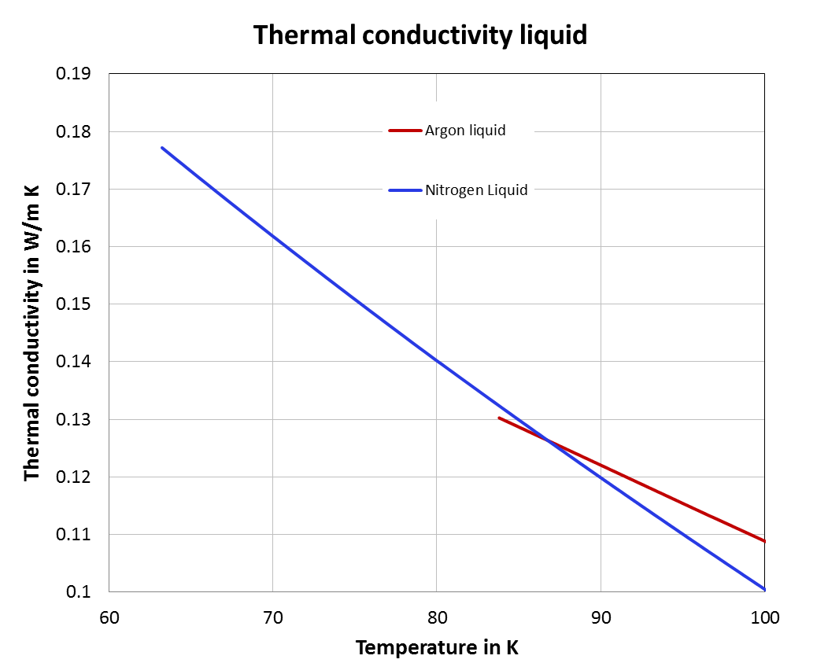
Argon as a Cryogenic Fluid
Data source: Refprop, NIST

Slide 20
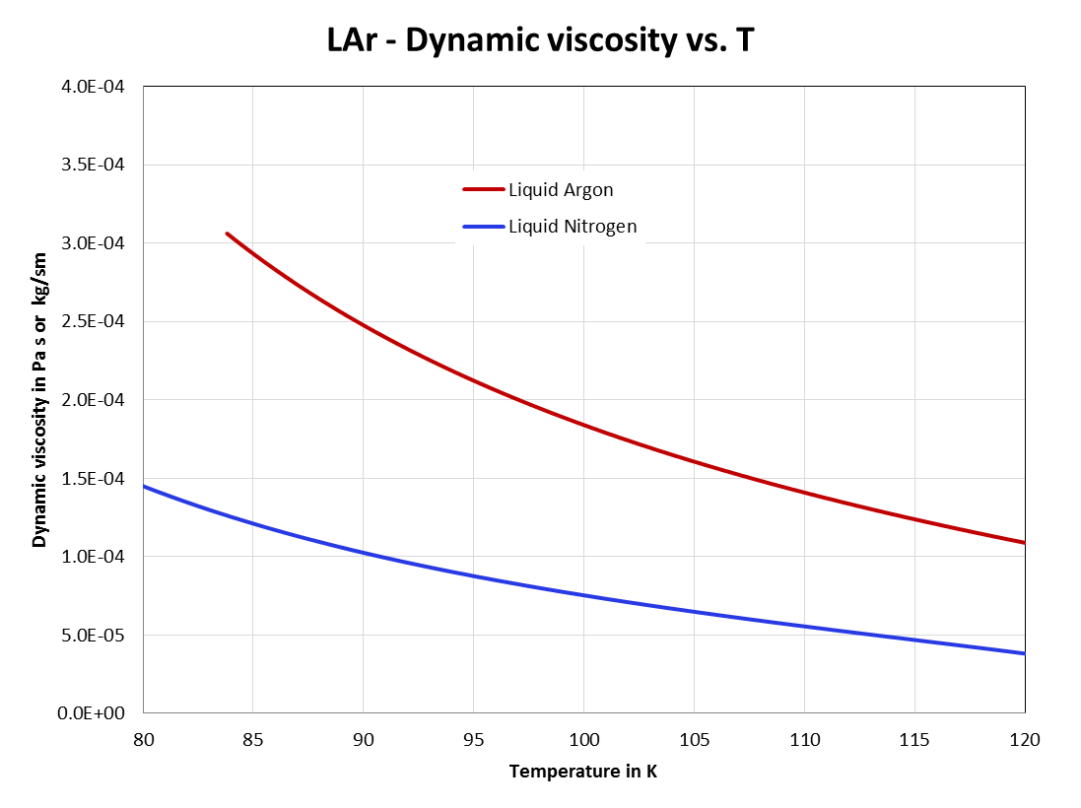
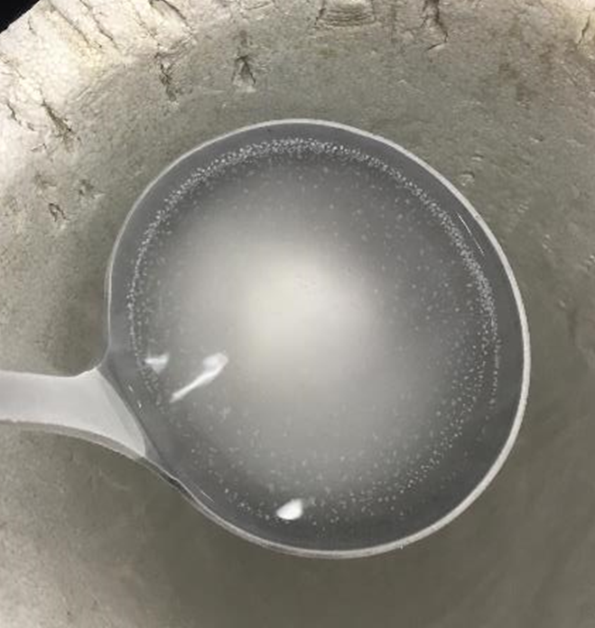
Argon as a Cryogenic Fluid
Dynamic Viscosity of Liquid Argon and Nitrogen
Data source: Refprop, NIST

Slide 21
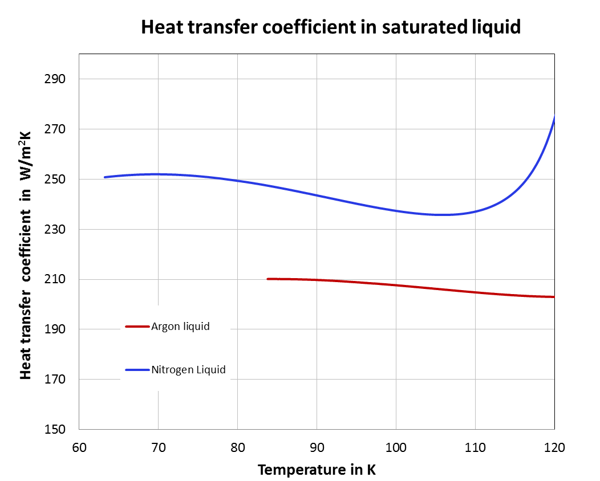
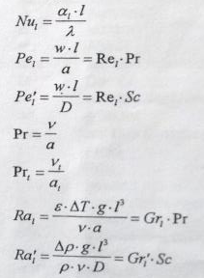
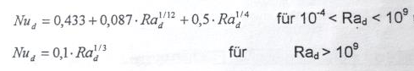
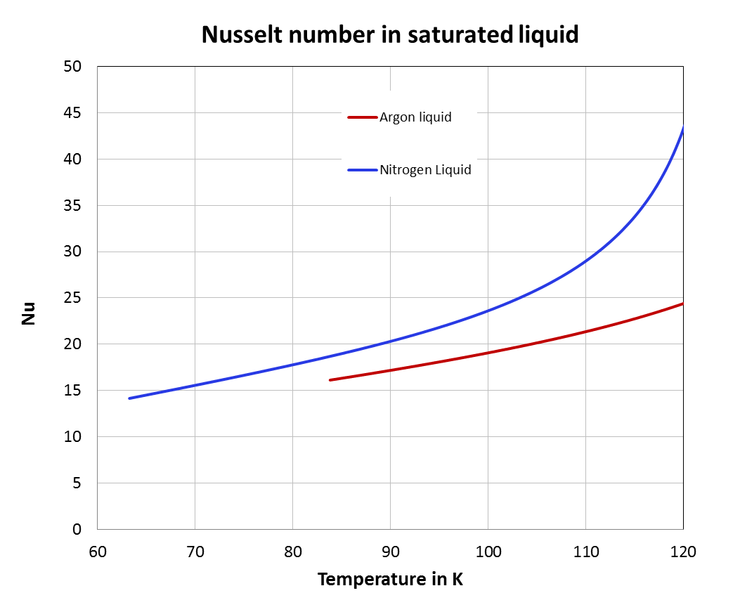
LAr vs. LN₂ natural convection heat transfer
Nusselt number
Free convection heat transfer at horizontal cylinder
Rayleigh number
Parameters:
ε vol. expansion coeff.
ν kinematic viscosity
a therm. diffisivity
l => d_{Tube,outer}=10 mm
ΔT_{transfer} =0.2 K
Data source: Refprop, NIST

Slide 22
Liquid Argon - Cooling Options

Slide 23
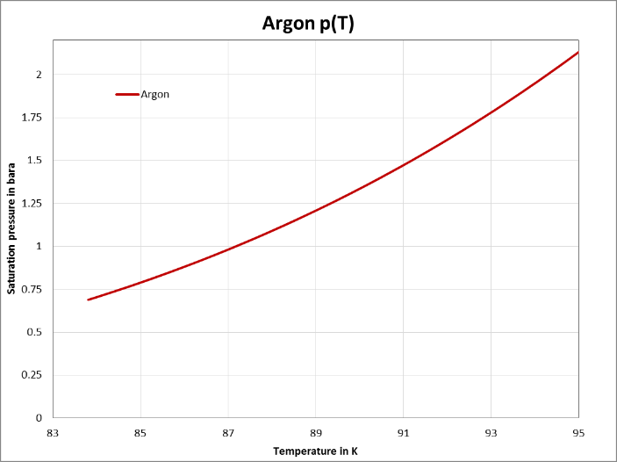
Argon as a Cryogenic Fluid
Tripel point
p=0.689 bar
T=83.81 K
Data source: Refprop, NIST
87.3 K
94.4 K

Slide 24
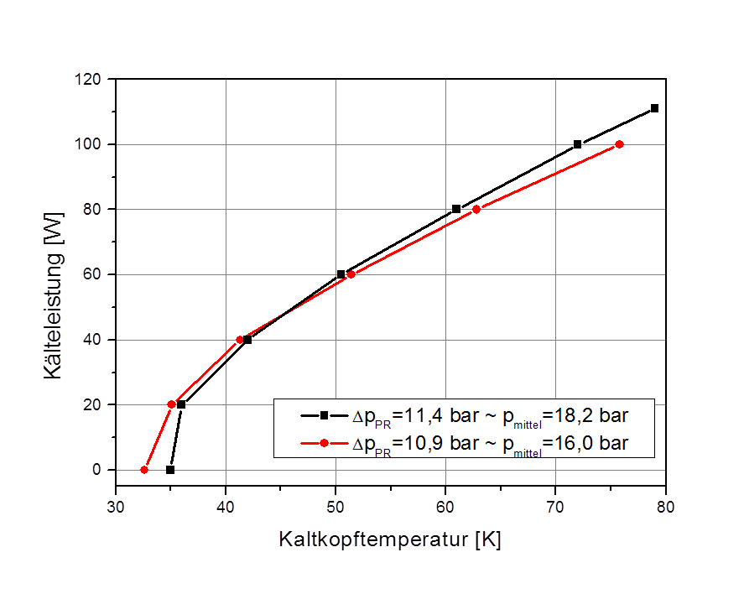
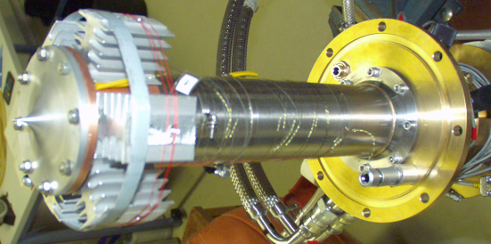
Reliquefection of Evaporated Liquid – Small scale
Single stage Pulse Rube Refrigerator (PTR)
300 K vacuum flange
Regenerator with internal pulse tube (coaxial design)
Liquefaction rate
for nitrogen 1 l/h
Cooling power in W
Cold tip
Cold tip temperature in K

Slide 25
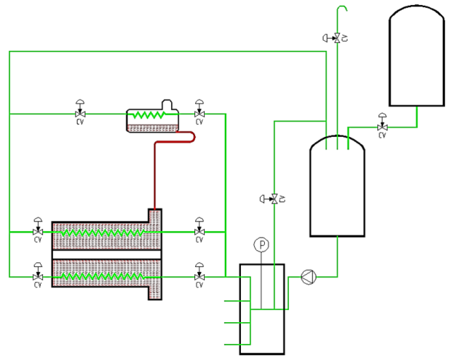
ATLAS Liquid Argon Calorimeters – Large scale cooling
LN₂
tank
Expansion vessel 1.25 bar
2.1 bar
LN₂ phase separator
5.3 bar
End-cap
Barrel
LN₂ pump
Nitrogen
End-Caps
Argon
LAr Tanks
Courtesy of Caroline Fabre

Slide 26
ATLAS Liquid Argon Calorimeters - Cooling
Heat loads
PT
001
p
Outlet valve controls the system pressure
Inlet valve controls
mass flow
Enter two-phase area by expansion
Why control loop like that?
- Pressure release in emergency
h
- Cooldown: having the possibility to keep the system at the required T(p) level

Slide 27
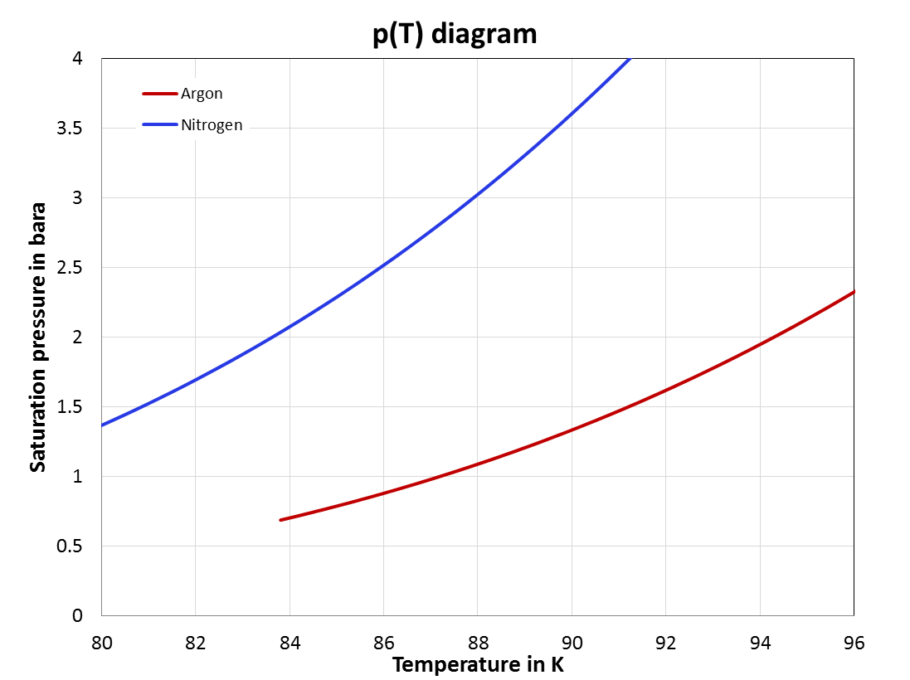
Cooling options for liquid Argon
2.8 bar
6 K
2.1 bar
2.5 K
1.25 bar
Tripel point
p=0.689 bar
T=83.81 K
89.3 K

Slide 28
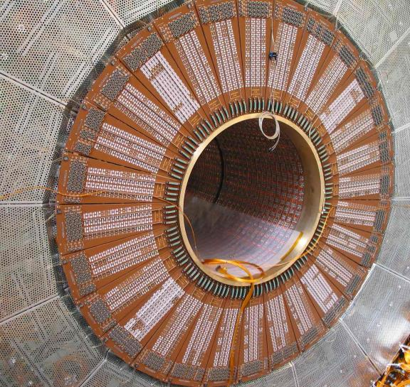
ATLAS – FCAL heat transfer study
Pressurized liquid Argon
in the ATLAS - FCAL
p=2 bara, T=87.3 K
1.25 bar
Courtesy of Caroline Fabre

Slide 29
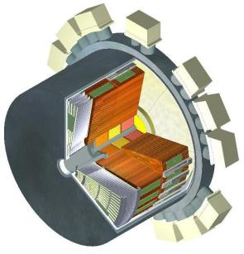
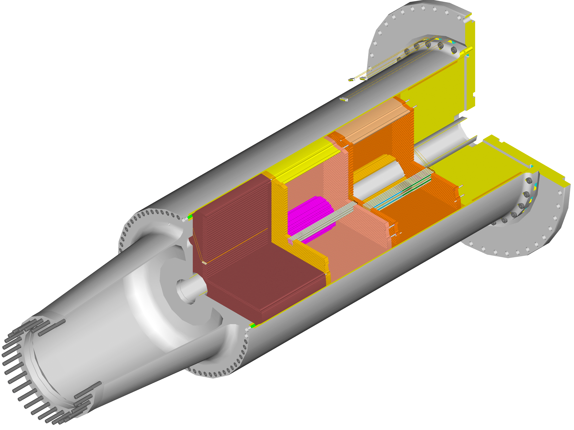
ATLAS FCAL Heat load generation
Heat flows outwards to HEC, crossing a 12 mm clearance gap between FCal and HEC
LAr is an excellent thermal insulator
Hottest spot at EM shower
Courtesy of John Rutherford

Slide 30

ATLAS FCAL LAr Gap Convection
Clearance gap 6 to 12 mm
HEC
Heat flows radially outwards
The 12 mm clearance gap is the biggest obstacle to radial heat flow from the FCAL to the HEC.
Convection improves the transport of heat across the 12 mm clearance gap.
FCal
Courtesy of John Rutherford

Slide 31
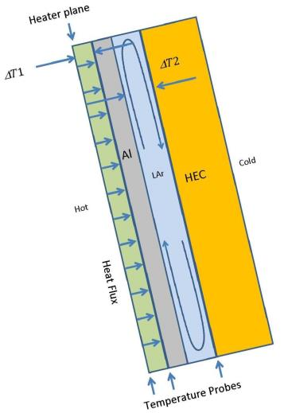

FCAL Mock-up => Principle of Operation
Drive heat across a layer of known thermal conductivity
Measure temperature drop
The same amount of heat must cross the liquid argon layer
Measure temperature difference across this layer
$$\dot{Q}=λ∙\frac{A}{d}dT ⇒ \dot{q}=λ\frac{dT}{d} ⇒ \dot{q}=λ ∇T$$
Courtesy of Prof. John Rutherford

Slide 32
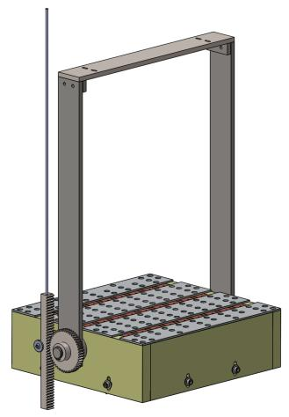
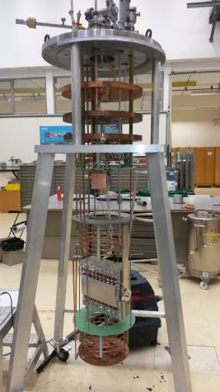
ATLAS FCAL Mock-up in the Cryolab
Sample from Univ. of Arizona and components from TU Dresden
Test of the thermal performance of a FCAL mock-up in subcooled LAr bath
Vapor pressure
regulation
Constant LAr level
in the cryostat
Rotatable
sample support
to simulate all FCAL orientations
Subcooling
Loops using
pressur. LN₂
α

Slide 33
ATLAS FCAL Mock-up in the Cryolab
Subcooled LAr bath
Depending on the heat input by the cryostat one needs to cool or heat there.
Setting the
saturation
pressure
ΔT ≤ 6 K
Uniform
subcooling

Slide 34
ATLAS FCAL Measurement Results
12 mm LAr gap size in the sample, total heat load 25 W => Q= 22 W equivalent , expected for LHC Run 2
Vertical position
Horizontal position
T=86.5 K

Slide 35

ATLAS Forward Calorimeter Heat Transfer Study
In case of a
6 mm LAr gap
Total
thermal heat transport capability
$$\dot{q}=\frac{\dot{Q}}{A}=\frac{λ}{l}∗ΔT$$
is almost independent of
gap size in vertical
and horizontal orientation
In case of a
12 mm LAr gap
Ratio 0.402
Ratio 0.423

Slide 36
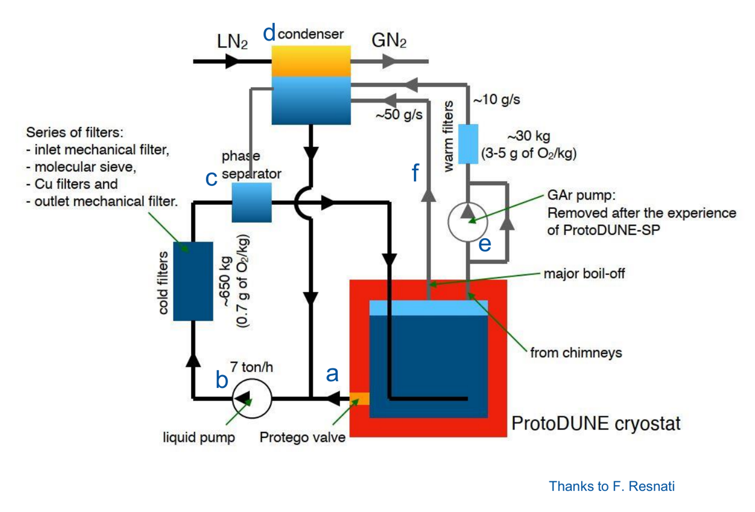
Full Large scale LAr cooling for a TPC

Slide 37
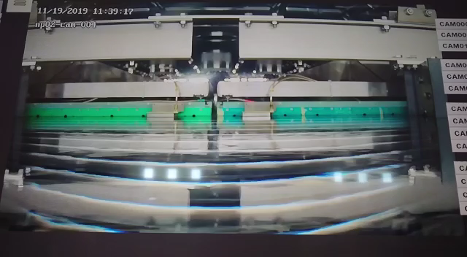
Large scale LAr TPC – Vortex in LAr???

Slide 38
Conclusion
Argon as a cryogenic fluid gets more and more used for particle physics
Large LAr volume => necessity of non-vacuum insulated vessels operating at atmospheric pressure
Cooling source needs to guarantee LAr saturation pressure of -5 mbarg <p_{LAr}< 20 mbarg
Pressure safety equipment with low set points in respect to ambient
Cooling of LAr by using LN₂ => requires relative high pressures p_{LN2}>2.8 bara (p_{LN2}>2.1 bara => TP of Argon) => CERN approach
ODH problematic in pits, underground etc.

Slide 40
LAr Neutrino Detectors - LN₂ Cooled Thermal Shield
Icarus upgrade
Cryolab R&D
=> cooling performance of
thermal shield panels
=> LN₂ cooling infrastructure +
two-phase flow distribution

Slide 41
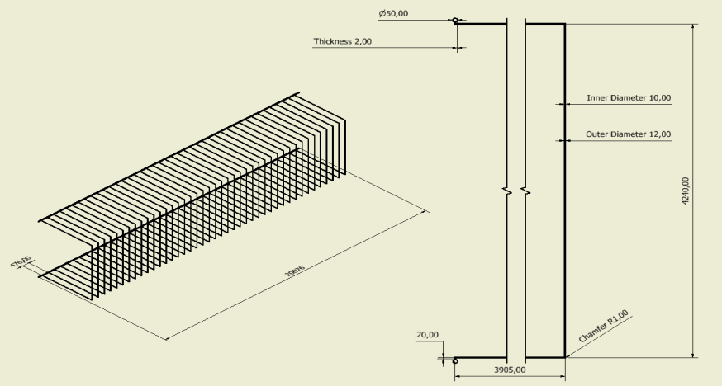
LAr Neutrino Detectors - LN₂ Cooled Thermal Shield
Lateral collector cooling loop: half view
AB: bottom collector
CD: top collector
Cryostat width 20 m
Length of the panels 472 mm
Number of panels = 42
Mass flow total = 84 g/s
Pressure inlet 3.5 bar
Temperature inlet 84 K
D
B
C
A
Goal:
Expansion at each lateral loop inlet -> after JT exp. 87 K, 2.76 bar, 10% quality

Slide 42
LAr Neutrino Detectors - LN₂ Cooled Thermal Shield
Required cooling power and mass flow rates
Heat flux = 20 W/m²
Heat Load per meter panel = 9.4 W/m
Total Cooling power = 10.2 kW/cryostat
LN₂ two-phase flow, vapor quality 10% < x < 40 %
Mass flow in one lateral loop = 2.0 g/s
Mass flow in one vertical loop = 0.7 g/s ( end caps )
Total Mass flow lateral cooling = 2.0 g/s x 42 x 2 = 168 g/s
Total Mass flow vertical cooling = 0.7 g/s x 8 x 2 = 11.2 g/s
Total mass flow = 179.2 g/s = 0.179 kg/s = 644 kg/h/cryostat

