Slide 1
Plasma Astrophysics Experiments and
Machine Learning-Driven BPM Calibration
61st BI R&D Workshop
V. Stergiou (U. Oxford/CERN), A. Boccardi (CERN), N. Charitonidis (CERN)
Acknowledgements: G. Gregori (U. Oxford), M. Gonzalez Berges (CERN), M. Schenk (CERN), V. Kain (CERN)
Friday 14.03.2025
1

Slide 2
Outline of this talk
Introduction
Plasma Astrophysics Experiments at HiRadMat
    Goals & Experimental Layout
    Beam Focusing Quadrupoles – Simulations, Measurements, Image Analysis & Managing Uncertainty
Machine Learning-Driven Calibration of Beam Position Monitors (BPMs)
    BPMs in the SPS & ALPS: Principle of Operation and Role for the Complex
    Current Limitations – What if we used Machine Learning
    Neural Networks to Minimize Systematic Errors
Future Plans and Next Steps

Slide 3
Outline of this talk
Introduction
Plasma Astrophysics Experiments at HiRadMat
    Goals & Experimental Layout
    Beam Focusing Quadrupoles – Simulations, Measurements, Image Analysis & Managing Uncertainty
Machine Learning-Driven Calibration of Beam Position Monitors (BPMs)
    BPMs in the SPS & ALPS: Principle of Operation and Role for the Complex
    Current Limitations – What if we used Machine Learning
    Neural Networks to Minimize Systematic Errors
Future Plans and Next Steps

Slide 4
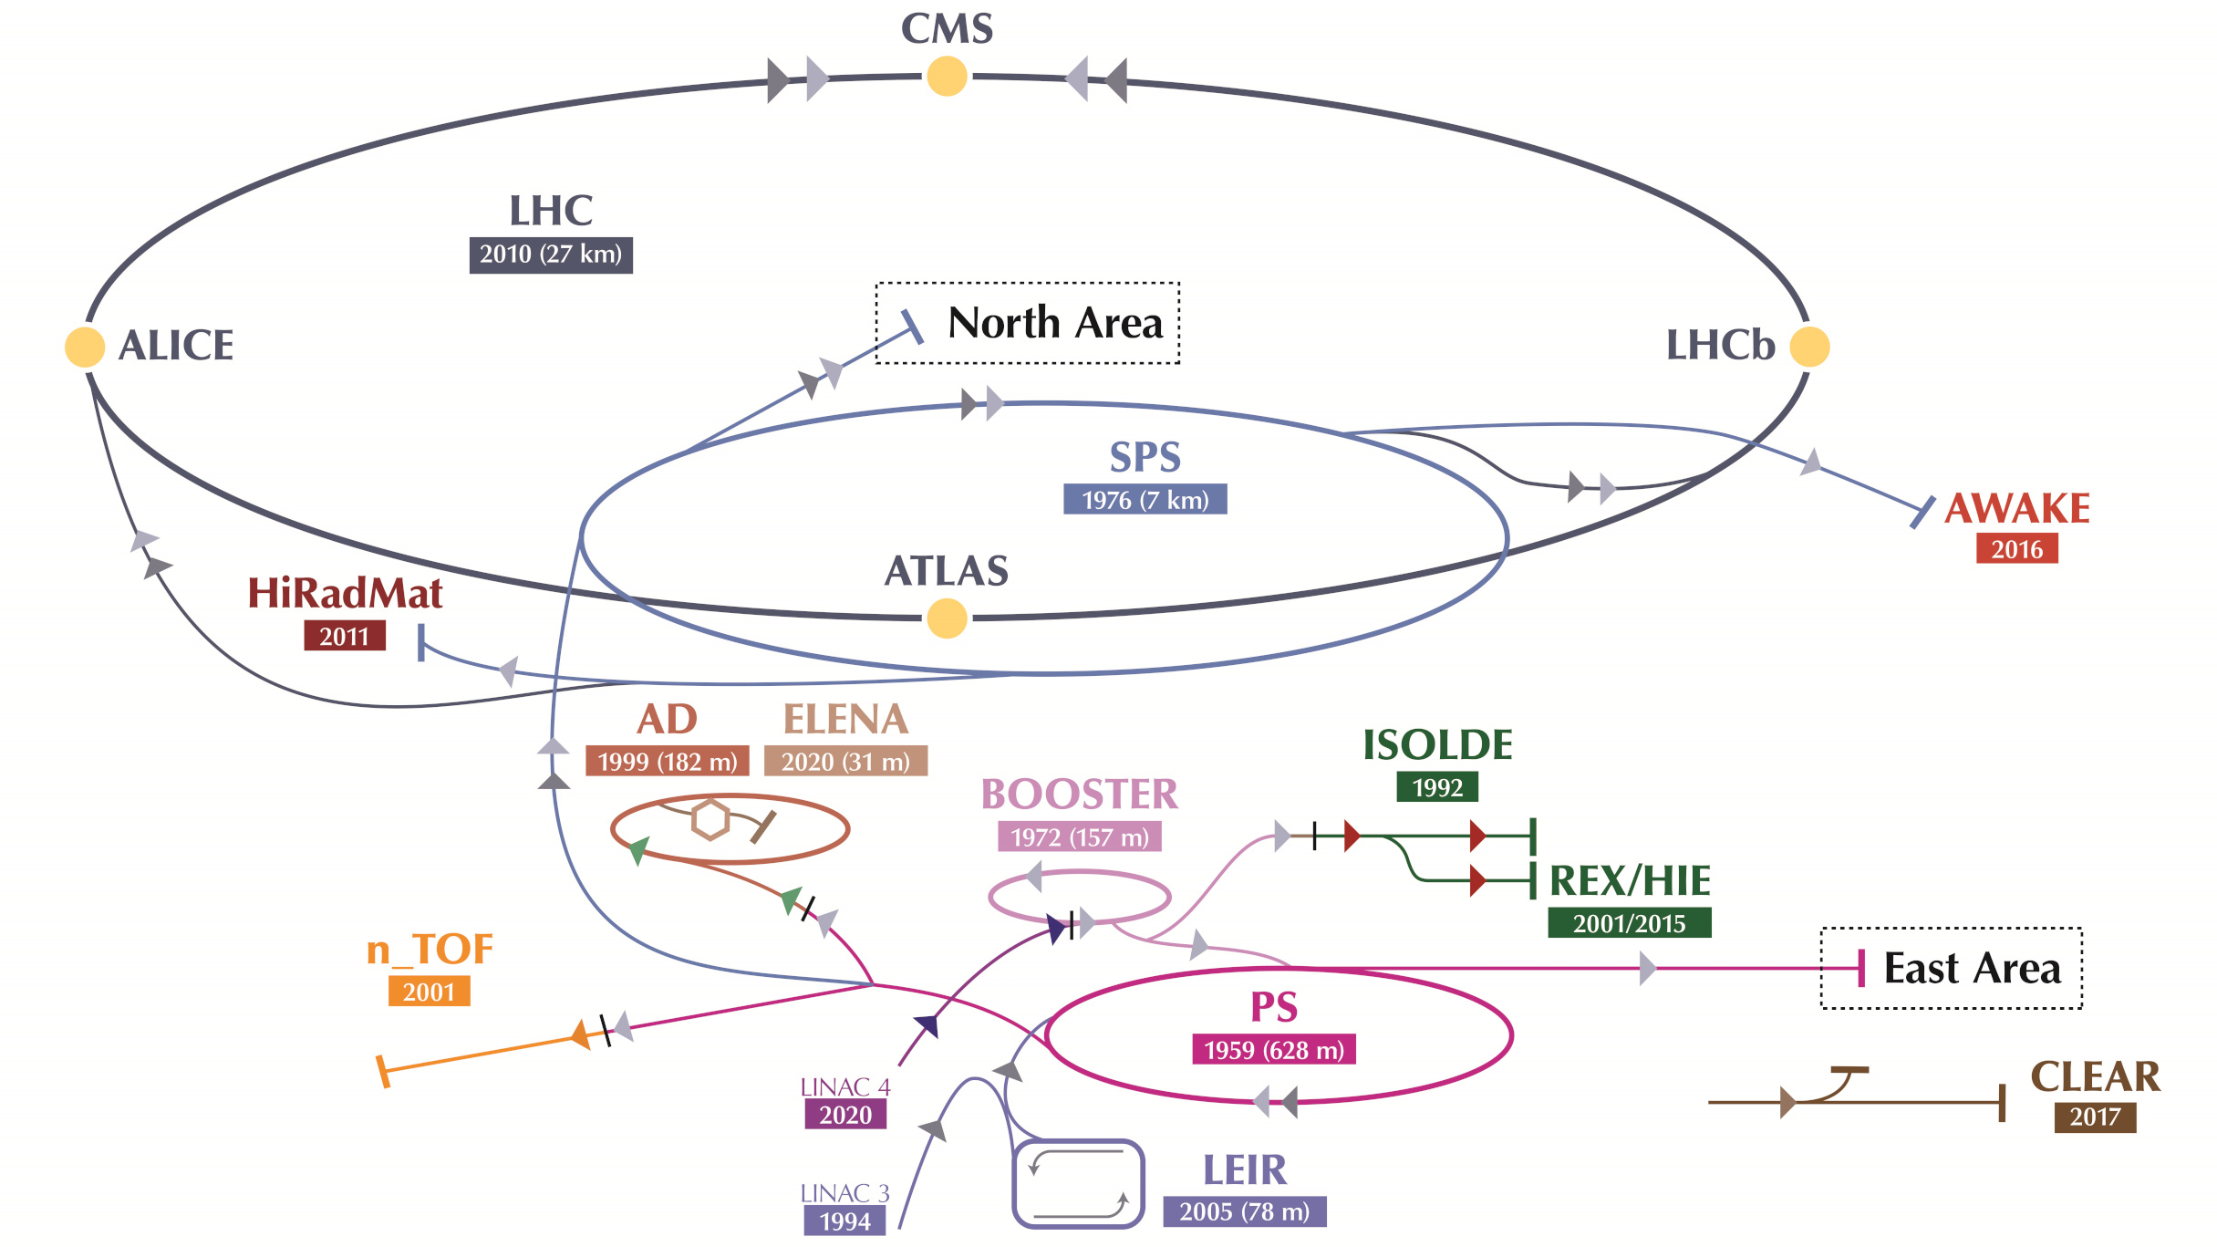
Introduction – CERN Accelerator Complex
Notes:
Something we’re all familiar with

Slide 5
Introduction – CERN Accelerator Complex

Slide 6
Introduction – CERN Accelerator Complex
SPS extracted beam
Notes:
Beam from SPS to do fixed target experiments

Slide 7
Introduction – CERN Accelerator Complex
Fireball
Experiments
SPS extracted beam

Slide 8
Introduction – CERN Accelerator Complex
1. Fireball
Experiments
2. SPS extracted beam
→ My PhD topic!
Notes:
Quality and characteristics of extracted beam directly affects the conditions of the experiments. My thesis is 2-fold: focusing on these two very important elements

Slide 9
Outline of this talk
Introduction
Plasma Astrophysics Experiments at HiRadMat
    Goals & Experimental Layout
    Beam Focusing Quadrupoles – Simulations, Measurements, Image Analysis & Managing Uncertainty
Machine Learning-Driven Calibration of Beam Position Monitors (BPMs)
    BPMs in the SPS & ALPS: Principle of Operation and Role for the Complex
    Current Limitations – What if we used Machine Learning
    Neural Networks to Minimize Systematic Errors
Future Plans and Next Steps

Slide 10
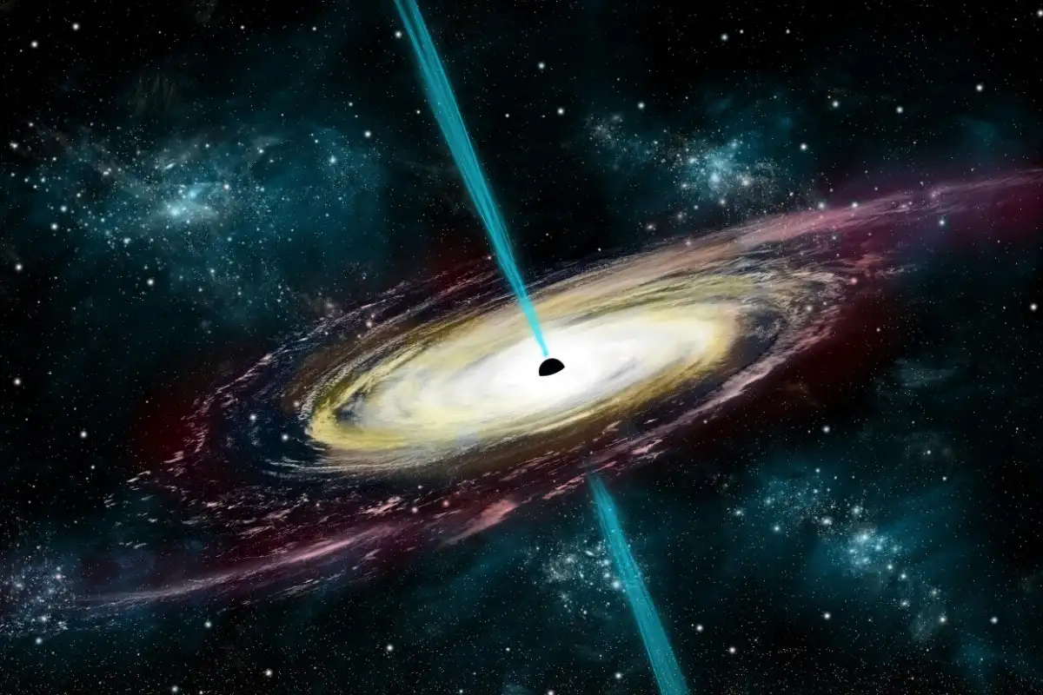
Fireball Experiments at HiRadMat
HiRadMat – High Radiation to Materials: facility at the SPS/CERN
High intensity (3e11), high momentum (440 GeV/c) LHC-type (1.2 ns 4σ) proton beam, interacting with a target material
Generation of high intensity, high density, quasi-neutral, relativistic electron/positron pair beams^{1,2}, which can be used to study astrophysics related processes
Illustration of a blazar jet. Source: Stocktrek Images, Inc. / Alamy Stock Photo
Notes:
Phenomena such as the one illustrated here

Slide 11
Fireball Experiments at HiRadMat
HiRadMat – High Radiation to Materials: facility at the SPS/CERN
High intensity (3e11), high momentum (440 GeV/c) LHC-type (1.2 ns 4σ) proton beam, interacting with a target material
Generation of high intensity, high density, quasi-neutral, relativistic electron/positron pair beams^{1,2}, which can be used to study astrophysics related processes
Illustration of a blazar jet. Source: Stocktrek Images, Inc. / Alamy Stock Photo
3 experiments so far: HRMT-62 (2023), HRMT-64 (2024), HRMT-68 (2025 - soon)
Notes:
Phenomena such as the one illustrated here.

Slide 12
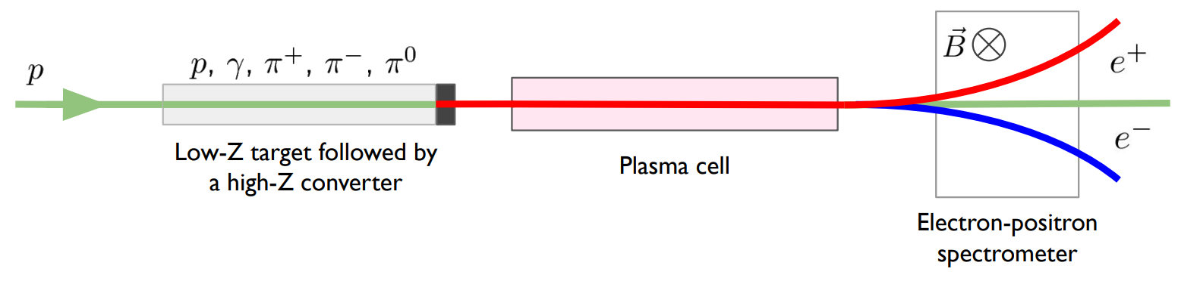
Fireball Experiments – Layout
Source: 1. C. D. Arrowsmith et al. Phys. Rev.Res. doi: 10.1103/PhysRevResearch.3.023103

Slide 13
Fireball Experiments – Layout
440 GeV/c protons impinging on a composite target,
Graphite and Tantalum
Source: 1. C. D. Arrowsmith et al. Phys. Rev.Res. doi: 10.1103/PhysRevResearch.3.023103

Slide 14

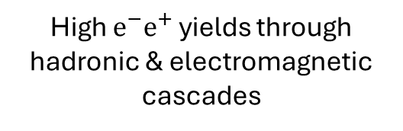
Fireball Experiments – Layout
440 GeV/c protons impinging on a composite target,
Graphite and Tantalum
High $e^{−}e^{+}$ yields through hadronic & electromagnetic cascades
($π^{0}$ → 2γ and subsequent pair production)
Source: 1. C. D. Arrowsmith et al. Phys. Rev.Res. doi: 10.1103/PhysRevResearch.3.023103

Slide 15
Fireball Experiments – Layout
440 GeV/c protons impinging on a composite target,
Graphite and Tantalum
High $e^{−}e^{+}$ yields through hadronic & electromagnetic cascades
Pair beam propagating through 1m long plasma
($π^{0}$ → 2γ and subsequent pair production)
Source: 1. C. D. Arrowsmith et al. Phys. Rev.Res. doi: 10.1103/PhysRevResearch.3.023103

Slide 16
Fireball Experiments – Layout
440 GeV/c protons impinging on a composite target,
Graphite and Tantalum
High $e^{−}e^{+}$ yields through hadronic & electromagnetic cascades
Pair beam propagating through 1m long plasma
Charge separation using an electromagnet
($π^{0}$ → 2γ and subsequent pair production)
Source: 1. C. D. Arrowsmith et al. Phys. Rev.Res. doi: 10.1103/PhysRevResearch.3.023103
Notes:
A very good question would be why are we doing this

Slide 17
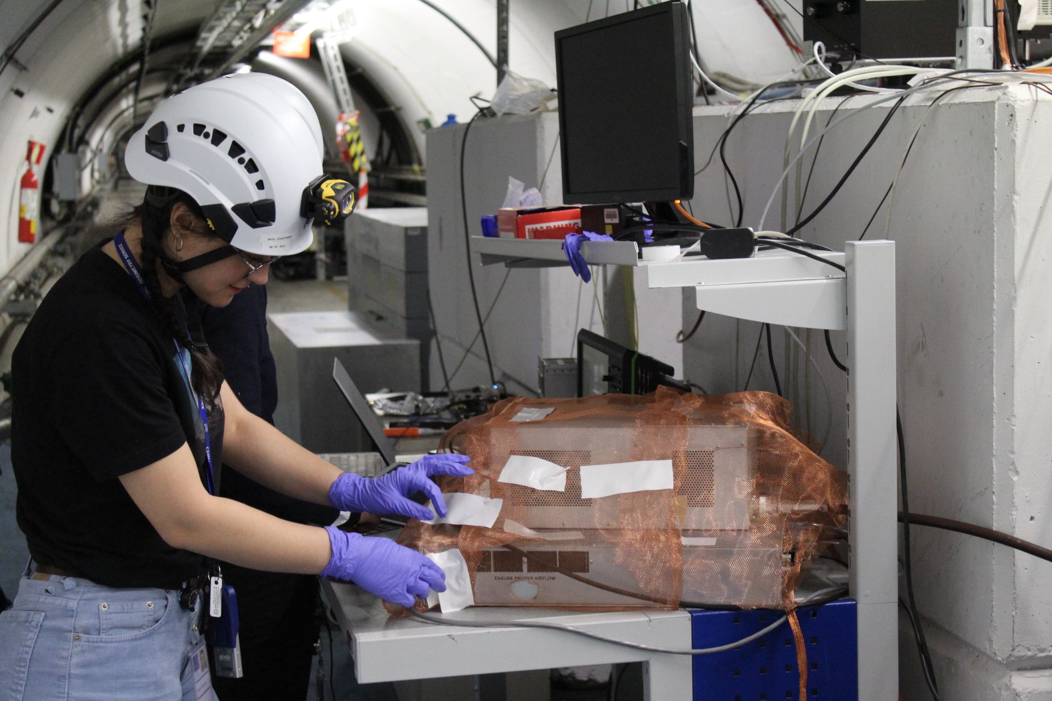
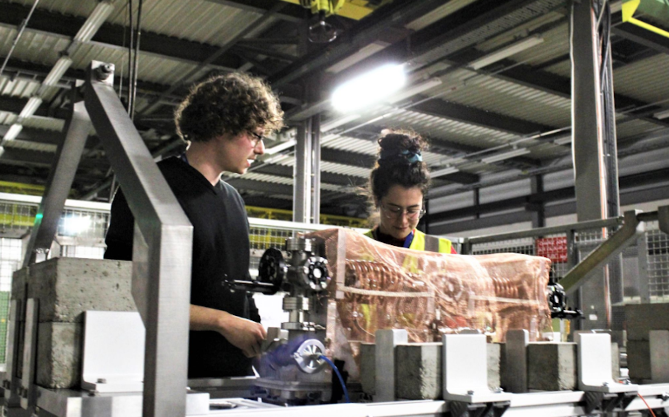
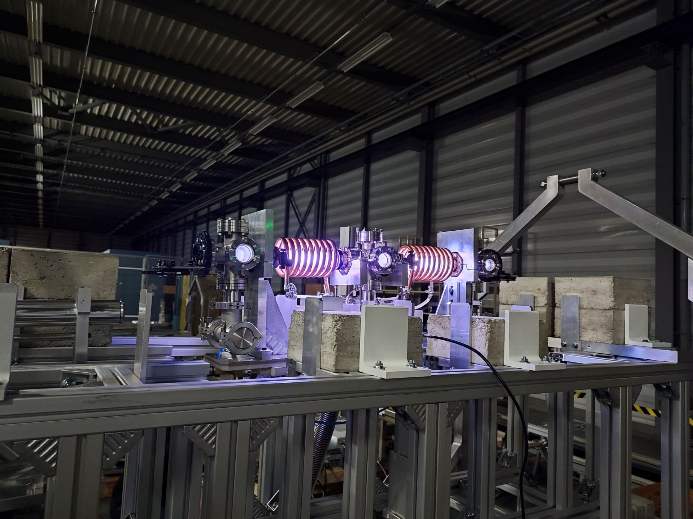
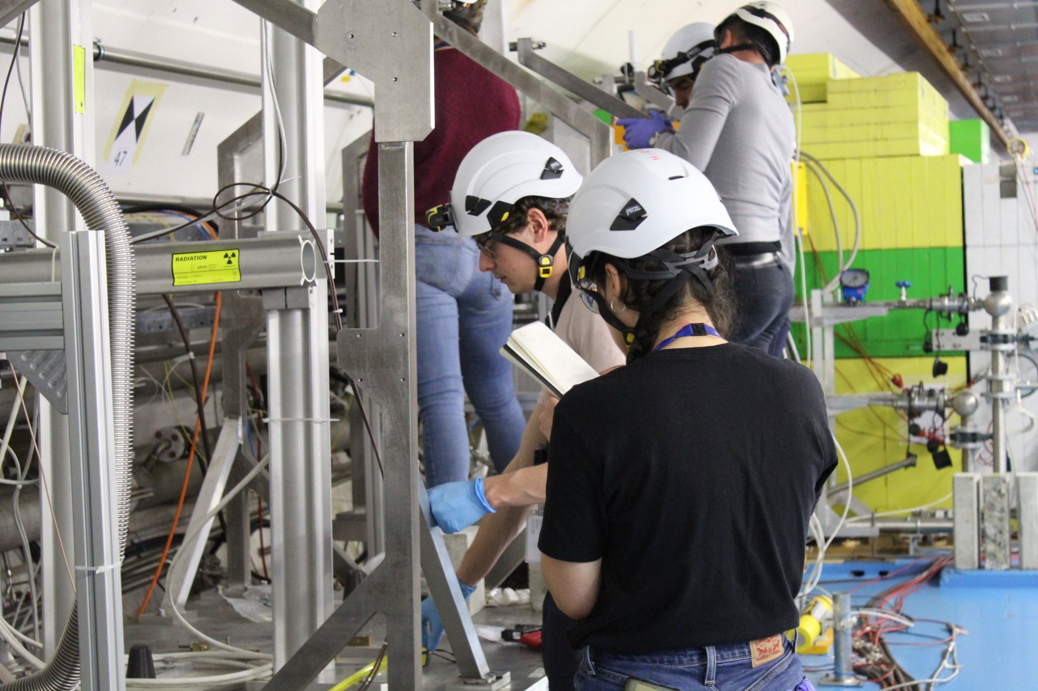
Hands-on Involvement
Assembly in the lab
Setting up in TT61 and TNC
Plasma cell on
Notes:
Happy to have been hands-on involved in the preparations of these experiments, opportunity to really understand what’s happenin

Slide 18
Fireball Experiments – Layout
440 GeV/c protons impinging on a composite target,
Graphite and Tantalum
High $e^{−}e^{+}$ yields through hadronic & electromagnetic cascades
Pair beam propagating through 1m long plasma
Charge separation using an electromagnet
($π^{0}$ → 2γ and subsequent pair production)
Source: 1. C. D. Arrowsmith et al. Phys. Rev.Res. doi: 10.1103/PhysRevResearch.3.023103
Notes:
A very good question would be why are we doing this

Slide 19
Fireball Experiments – Layout
440 GeV/c protons impinging on a composite target,
Graphite and Tantalum
High $e^{−}e^{+}$ yields through hadronic & electromagnetic cascades
Pair beam propagating through 1m long plasma
Charge separation using an electromagnet
($π^{0}$ → 2γ and subsequent pair production)
Okay… but why?
Source: 1. C. D. Arrowsmith et al. Phys. Rev.Res. doi: 10.1103/PhysRevResearch.3.023103
Notes:
A very good question would be why are we doing this

Slide 20
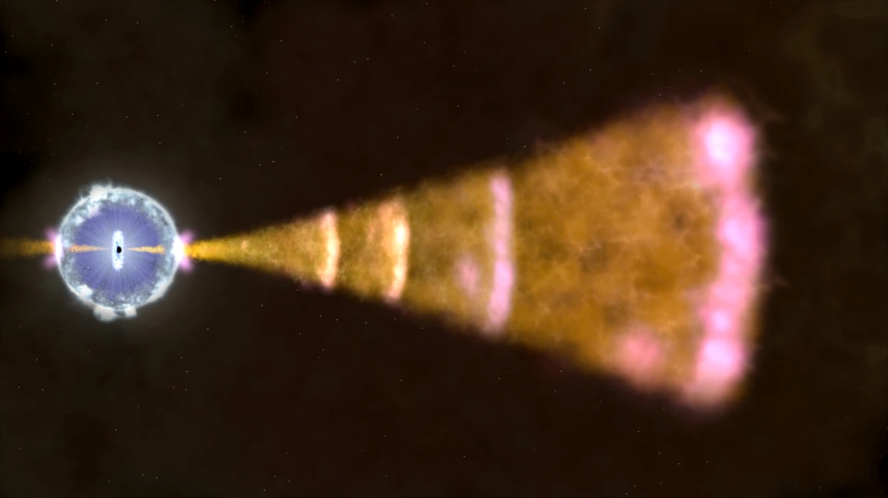

Why Are We Doing This
Studies of $e^{−}e^{+}$ plasmas are of great interest (really)
  Black holes, gamma ray bursts (GRBs), blazar jets etc^{3,4,5}
Illustration of a GRB. Source: NASA's Goddard Space Flight Center
Illustration of a blazar jet. Source: Stocktrek Images, Inc. / Alamy Stock Photo
Notes:
e-e+ all over the universe. Experimental studies could improve our understanding of such radiative signatures observed on Earth. Create an electron positron beam that propagates through plasma to reproduce astrophysical jet propagation

Slide 21

Why Are We Doing This
Studies of $e^{−}e^{+}$ plasmas are of great interest (really)
  Black holes, gamma ray bursts (GRBs), blazar jets etc^{3,4,5}
Plasma instabilities are theorized to develop during propagation through intergalactic medium – but the mechanisms involved still not well understood⁴
Illustration of a GRB. Source: NASA's Goddard Space Flight Center
Illustration of a blazar jet. Source: Stocktrek Images, Inc. / Alamy Stock Photo
Notes:
e-e+ all over the universe. Experimental studies could improve our understanding of such radiative signatures observed on Earth. Create an electron positron beam that propagates through plasma to reproduce astrophysical jet propagation

Slide 22
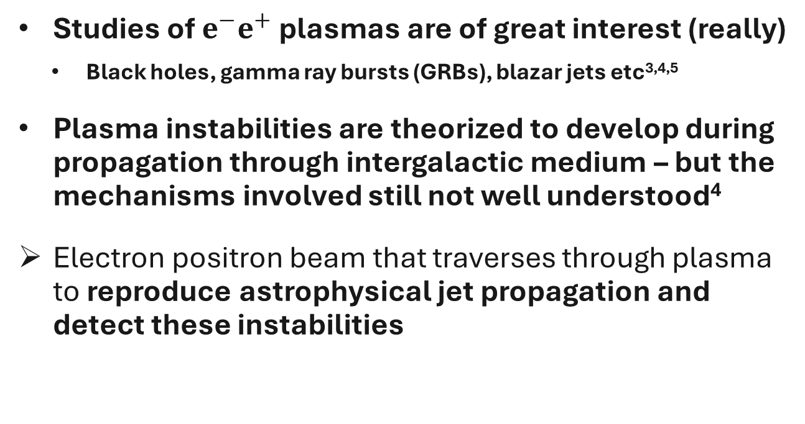
Why Are We Doing This
Studies of $e^{−}e^{+}$ plasmas are of great interest (really)
  Black holes, gamma ray bursts (GRBs), blazar jets etc^{3,4,5}
Plasma instabilities are theorized to develop during propagation through intergalactic medium – but the mechanisms involved still not well understood⁴
Electron positron beam that traverses through plasma to reproduce astrophysical jet propagation and detect these instabilities
Illustration of a GRB. Source: NASA's Goddard Space Flight Center
Illustration of a blazar jet. Source: Stocktrek Images, Inc. / Alamy Stock Photo
Notes:
e-e+ all over the universe. Experimental studies could improve our understanding of such radiative signatures observed on Earth. Create an electron positron beam that propagates through plasma to reproduce astrophysical jet propagation

Slide 23
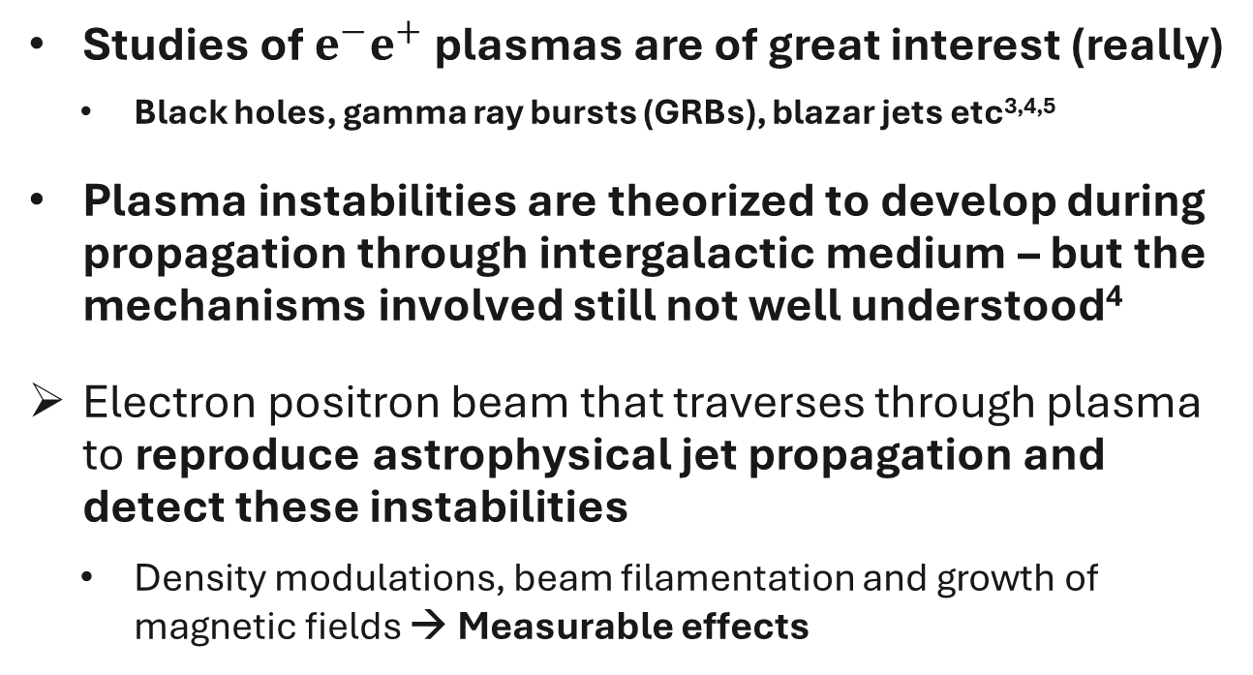
Why Are We Doing This
Studies of $e^{−}e^{+}$ plasmas are of great interest (really)
  Black holes, gamma ray bursts (GRBs), blazar jets etc^{3,4,5}
Plasma instabilities are theorized to develop during propagation through intergalactic medium – but the mechanisms involved still not well understood⁴
Electron positron beam that traverses through plasma to reproduce astrophysical jet propagation and detect these instabilities
  Density modulations, beam filamentation and growth of magnetic fields → Measurable effects
Illustration of a GRB. Source: NASA's Goddard Space Flight Center
Illustration of a blazar jet. Source: Stocktrek Images, Inc. / Alamy Stock Photo
Notes:
e-e+ all over the universe. Experimental studies could improve our understanding of such radiative signatures observed on Earth. Create an electron positron beam that propagates through plasma to reproduce astrophysical jet propagation

Slide 24
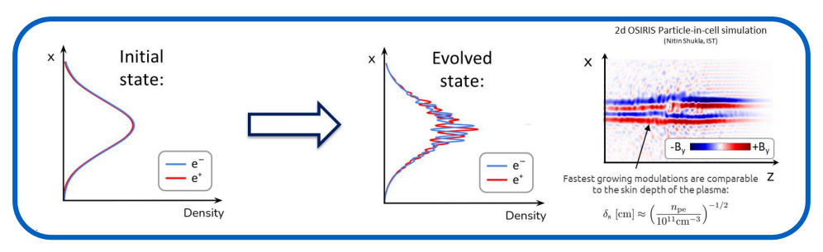

Why Are We Doing This
Studies of $e^{−}e^{+}$ plasmas are of great interest (really)
  Black holes, gamma ray bursts (GRBs), blazar jets etc^{3,4,5}
Plasma instabilities are thought to develop during propagation through intergalactic medium – but the mechanisms involved still not well understood⁴
Electron positron beam that propagates through plasma to reproduce astrophysical jet propagation and detect these instabilities
  Density modulations, beam filamentation and growth of magnetic fields → Measurable effects
Illustration of a GRB. Source: NASA's Goddard Space Flight Center
Illustration of a blazar jet. Source: Stocktrek Images, Inc. / Alamy Stock Photo
Notes:
e-e+ all over the universe. Experimental studies could improve our understanding of such radiative signatures observed on Earth. Create an electron positron beam that propagates through plasma to reproduce astrophysical jet propagation

Slide 25

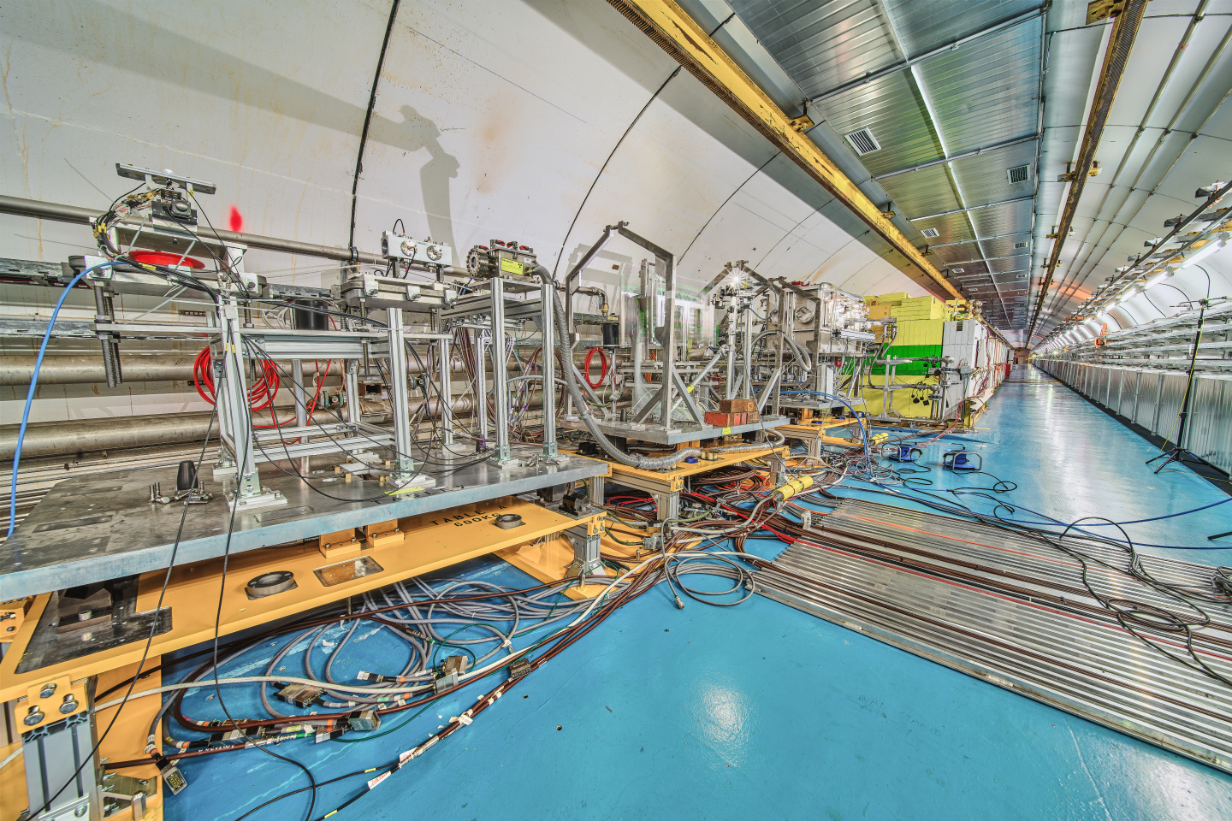
We can do this here on Earth at HiRadMat 😊
>2M light years away…
500 m away !

Slide 26
Challenging Beam Requirements
We need a beam.

Slide 27
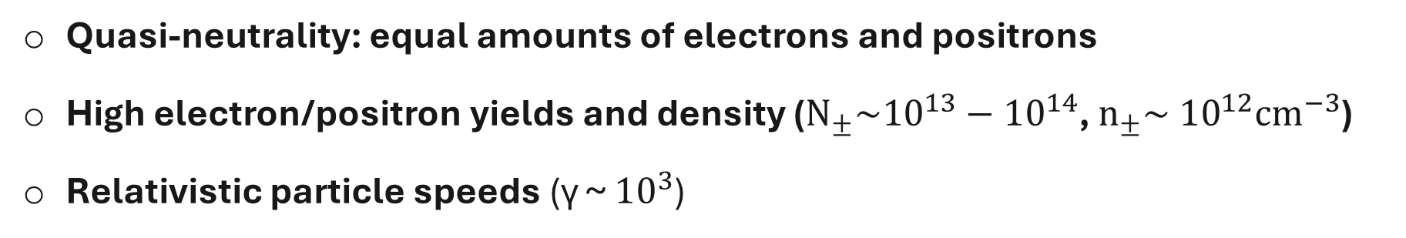
Challenging Beam Requirements
Quasi-neutrality: equal amounts of electrons and positrons
High electron/positron yields and density (${Ν_{±}\sim {10}^{13}−10}^{14}$, $n_{±}\sim {10}^{12}cm^{−3}$)
Relativistic particle speeds (γ ~ ${10}^{3}$)
  Also: control e-e+ beam divergence and momentum spread as much as possible, and proton properties (primary beam position and spot size) known with high certainty

Slide 28
Challenging Beam Requirements
Quasi-neutrality: equal amounts of electrons and positrons
High electron/positron yields and density (${Ν_{±}\sim {10}^{13}−10}^{14}$, $n_{±}\sim {10}^{12}cm^{−3}$)
Relativistic particle speeds (γ ~ ${10}^{3}$)
  Also: control e-e+ beam divergence and momentum spread as much as possible, and proton properties (primary beam position and spot size) known with high certainty
My work: optimize e-e+ beam divergence and improve control of primary beam position → serving better the physics scope of the experiment and the CERN accelerator complex in general

Slide 29
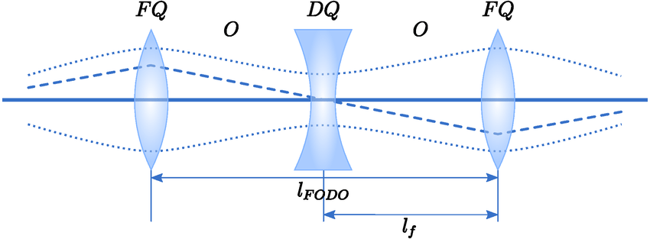
Beam Focusing Using Quadrupoles
In particle accelerators: quadrupoles used to focus the beam, in triplets
We decided to apply the same principle, using permanent magnets
Notes:
Fodo cells

Slide 30
Beam Focusing Using Quadrupoles
In particle accelerators: quadrupoles used to focus the beam, in triplets
We decided to apply the same principle, using permanent magnets
However:
  Mixed particle beam
  Very wide band momenta
  Unknown exact field of permanent magnets arrangement (design inspired by Halbach arrays)
  Challenging implementation with uncertain performance
My role: I performed simulations to understand the material properties and the focusing effect of the magnetic setup on our beam

Slide 31
Beam Focusing Using Quadrupoles
Quadrupole triplet was placed between target and plasma cell
Source: 4. C. D. Arrowsmith et al. Phys. Rev.Res. doi: 10.1103/PhysRevResearch.3.023103

Slide 32
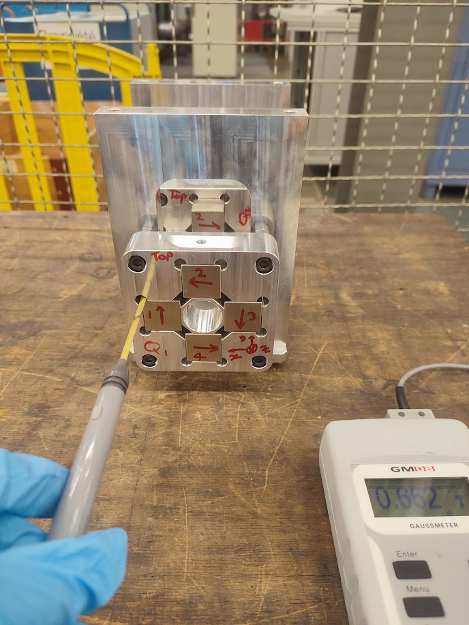
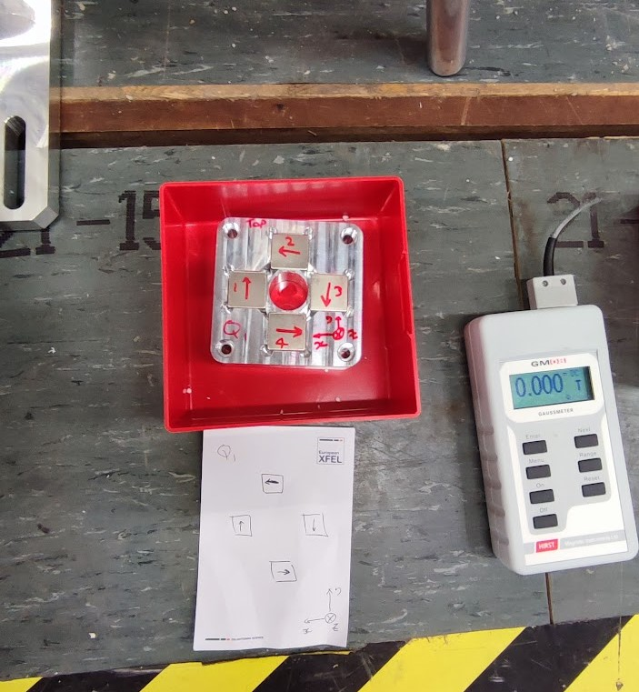
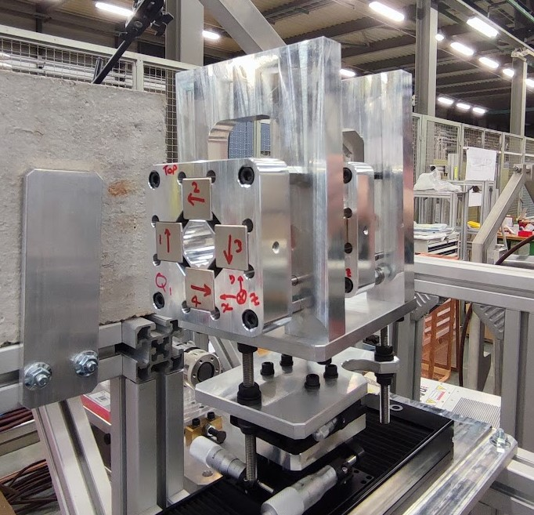
Quadrupoles
Assembly & installation
Post-irradiation field measurements

Slide 33
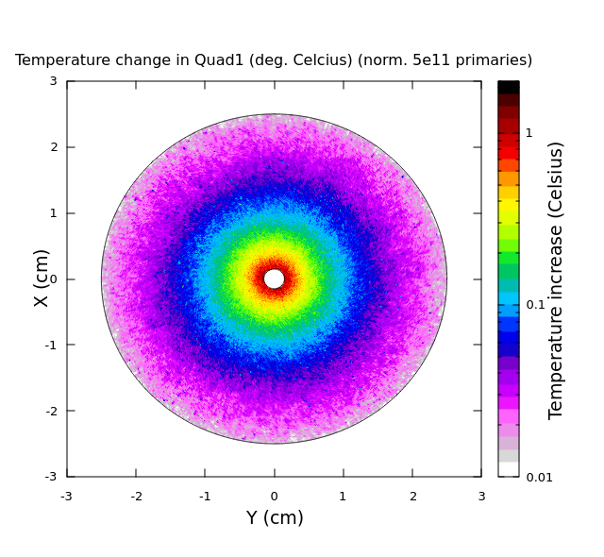
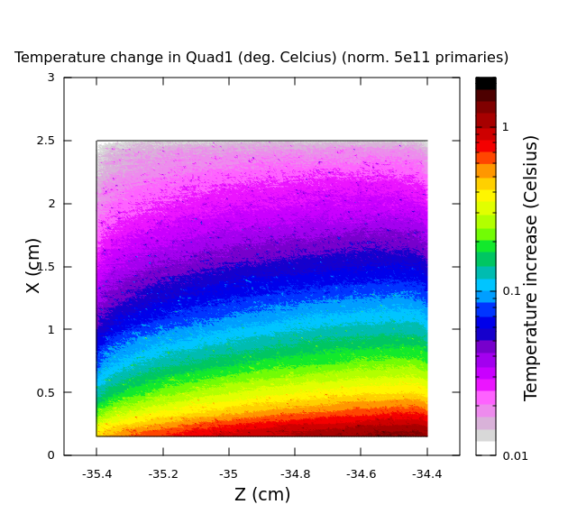
Quadrupole Studies (FLUKA) – Temperature Increase
Beam
Temperature increase due to energy deposition: Δθ ~ 1-2 ºC
Curie temperature for NdFeB ~ 300 ºC (demagnetization)
Maximum operating temperature ~100 ºC (beginning of losses)
Temperature changes don’t affect the performance of the magnet
Notes:
This is simulation I performed

Slide 34
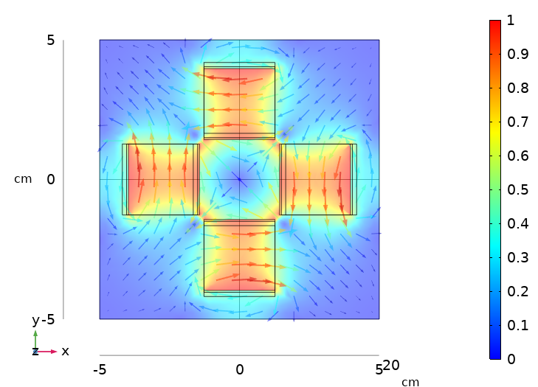
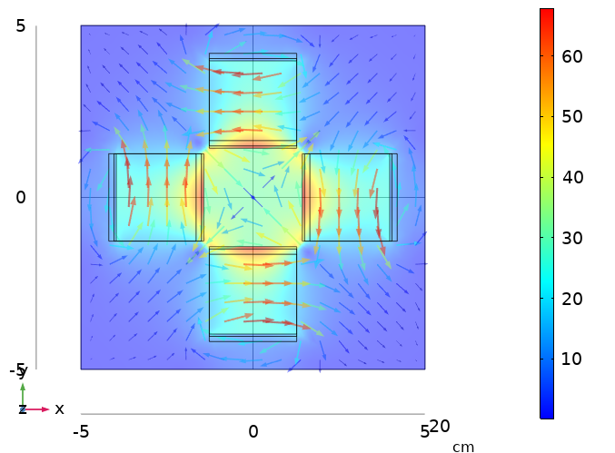
Quadrupole Studies (COMSOL)
Magnetic Flux Density B (T)
Magnetic Flux Density Gradient (T/m)
Notes:
What we’re looking for in a quadrupole field: zero B in the center, increasing linearly, conctant gradient in the central region, focusing on one plane & defocusing on the other

Slide 35
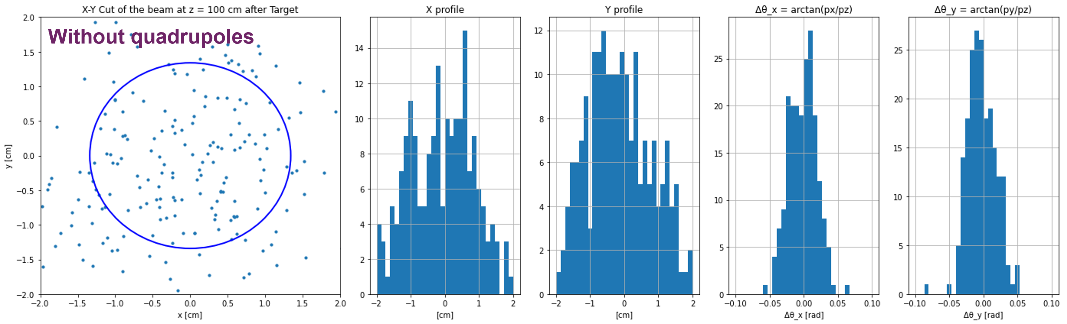
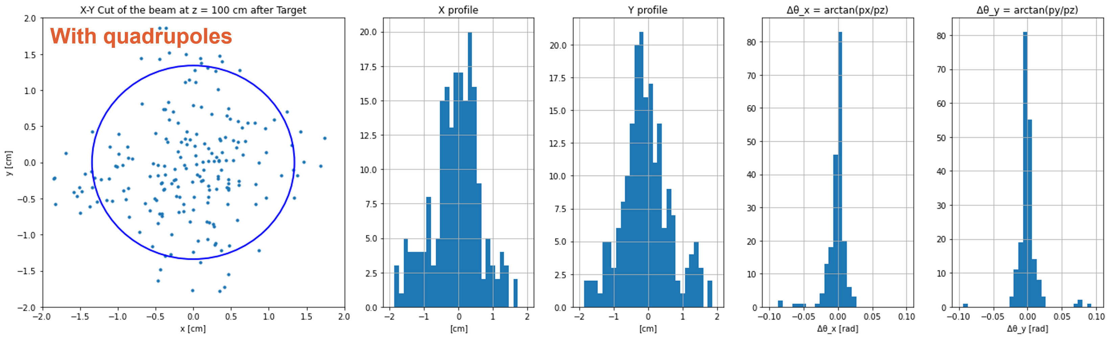
Quadrupole Studies – Divergence and p-spread
Transverse beam profile
X profile
Y profile
Δθ_{x} = atan(px/pz)
Δθ_{y} = atan(py/pz)
Beam profile & momentum spread Δθ, 1 m after the Target (~80 cm after quadrupole triplet)
With quadrupoles:
More narrow beam profiles and momentum spreads, for energies around 75 MeV
- Particles concentrated in the center
Transverse beam profile
X profile
Y profile
Δθ_{x} = atan(px/pz)
Δθ_{y} = atan(py/pz)
Aperture of last quadrupole
Notes:
We are interested in beam properties in the plasma cell – we want small divergence and p-spread to hopefully seed the instabilities

Slide 36
Diagnostics – Luminescence Screens & Cameras
Luminescence screens before and after the plasma cell to monitor beam profile
Source: 1. C. D. Arrowsmith et al. Phys. Rev.Res. doi: 10.1103/PhysRevResearch.3.023103

Slide 37
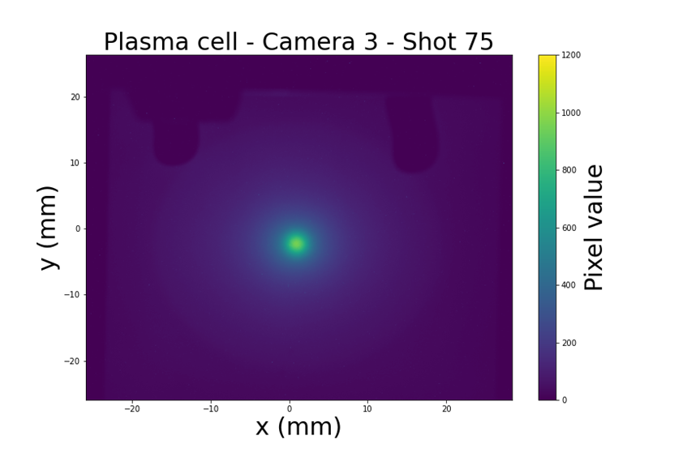
Diagnostics – Luminescence Screens & Cameras
Luminescence screens before and after the plasma cell to monitor beam profile
Source: 1. C. D. Arrowsmith et al. Phys. Rev.Res. doi: 10.1103/PhysRevResearch.3.023103

Slide 38
Diagnostics – Luminescence Screens & Cameras
Luminescence screens before and after the plasma cell to monitor beam profile
Luminescence screens after the electromagnet, to get the energy spread of the charges
Source: 1. C. D. Arrowsmith et al. Phys. Rev.Res. doi: 10.1103/PhysRevResearch.3.023103

Slide 39
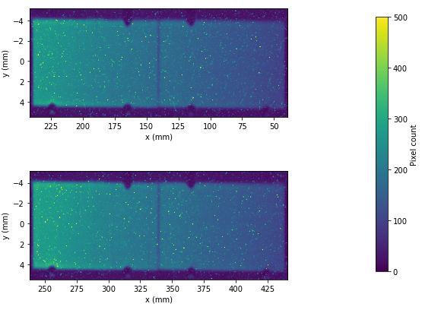
Diagnostics – Luminescence Screens & Cameras
Luminescence screens after the electromagnet, to get the energy spread of the charges
Source: 1. C. D. Arrowsmith et al. Phys. Rev.Res. doi: 10.1103/PhysRevResearch.3.023103

Slide 40
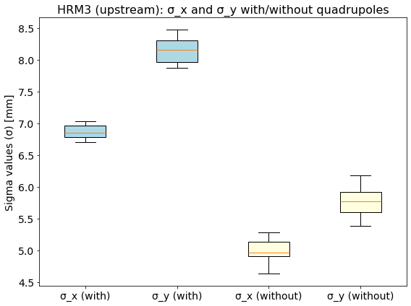
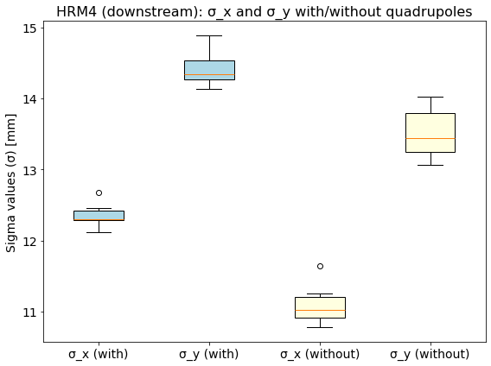
Preliminary Image Analysis
Image analysis based on data from Chromox luminescence screens -- Οngoing
It appears that beam divergence is indeed controlled
Data analysis of the spectrometer screens will shed light into the effect on the particle energies

Slide 41
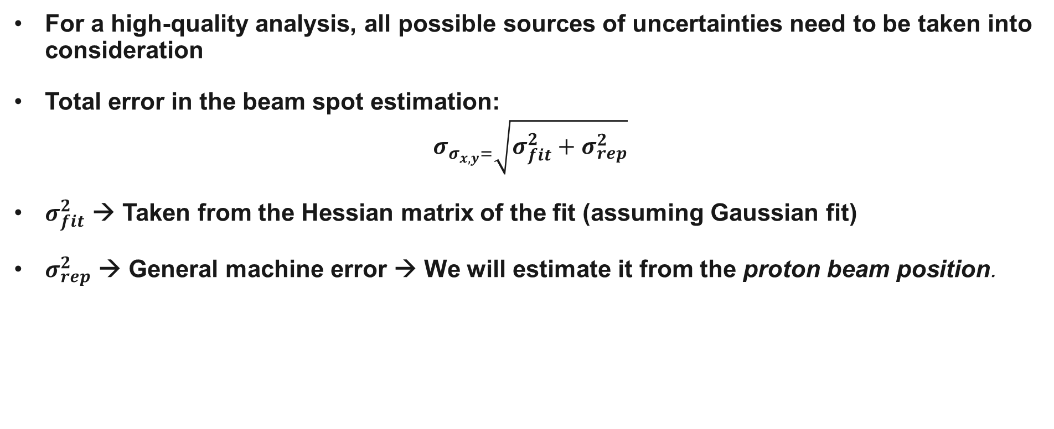
Estimating the Uncertainty
For a high-quality analysis, all possible sources of uncertainties need to be taken into consideration
Total error in the beam spot estimation:
$$σ_{σ_{x,y}=}\sqrt{σ_{fit}^{2}+σ_{rep}^{2}}$$
$σ_{fit}^{2}$ → Taken from the Hessian matrix of the fit (assuming Gaussian fit)
$σ_{rep}^{2}$ → General machine error → We will estimate it from the proton beam position.

Slide 42
Estimating the Uncertainty
For a high-quality analysis, all possible sources of uncertainties need to be taken into consideration
Total error in the beam spot estimation:
$$σ_{σ_{x,y}=}\sqrt{σ_{fit}^{2}+σ_{rep}^{2}}$$
$σ_{fit}^{2}$ → Taken from the Hessian matrix of the fit (assuming Gaussian fit)
$σ_{rep}^{2}$ → General machine error → We will estimate it from the proton beam position.
This error is dependent on the extraction angle from the SPS
→ directly linked to the precision of the beam position measurements at the extraction points
How can we minimize this ?

Slide 43
Outline of this talk
Introduction
Plasma Astrophysics Experiments at HiRadMat
    Goals & Experimental Layout
    Beam Focusing Quadrupoles – Simulations, Measurements, Image Analysis & Managing Uncertainty
Machine Learning-Driven Calibration of Beam Position Monitors (BPMs)
    BPMs in the SPS & ALPS: Principle of Operation and Role for the Complex
    Current Limitations – What if we used Machine Learning
    Neural Networks to Minimize Systematic Errors
Future Plans and Next Steps

Slide 44
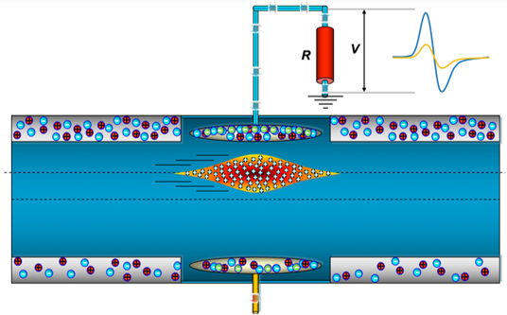
Beam Position Monitors
Non-intercepting devices allowing for transverse beam position measurements, with minimal interaction with the passing beam⁶
  Consisting of the pick-up sensor and read-out electronics
  Critical role in monitoring the transverse betatron oscillations along the ring
Schematic diagram of a BPM and image current induced as a bunch passes through a beam pipe [6]
Notes:
BPM principle, importance for the accelerator system
ALPS

Slide 45
Beam Position Monitors
Non-intercepting devices allowing for transverse beam position measurements, with minimal interaction with the passing beam⁶
  Consisting of the pick-up sensor and read-out electronics
  Critical role in monitoring the transverse betatron oscillations along the ring
Principle of operation:
  The passing beam induces voltages on each of the symmetrically arranged electrodes
  The voltage difference indicates the center of mass on the transverse plane at the location of the BPM
Schematic diagram of a BPM and image current induced as a bunch passes through a beam pipe [6]
Notes:
BPM principle, importance for the accelerator system
ALPS

Slide 46
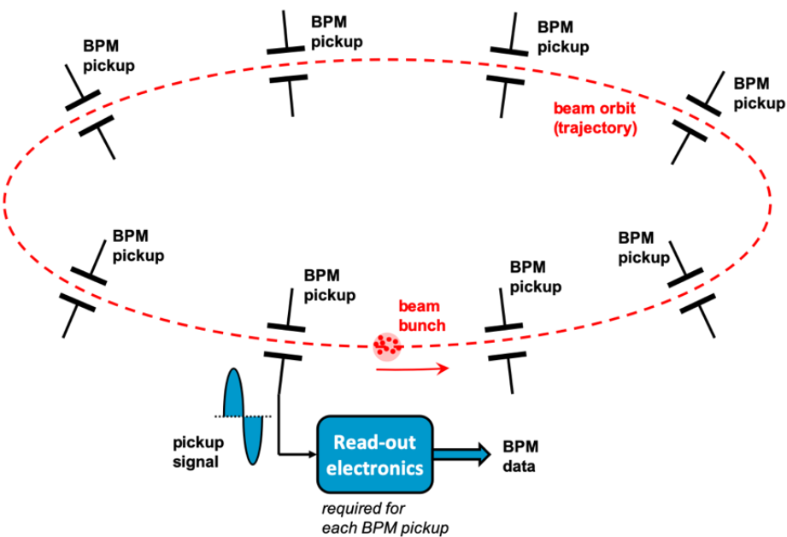
ALPS – A Logarithmic Position System
Beam position monitoring system of the SPS^{7,8,9}
  ~ 250 BPMs (pick-ups & electronics), placed along the accelerator beamline and the transfer lines
Logarithmic amplifiers used to compress the SPS beam signal, to accommodate 90 dB of dynamic range
  Subsequently the processed signal gets digitized in the ADC
Schematic representation of a beam position monitoring system like ALPS and its components, implemented on a circular accelerating system [6]

Slide 47
Block Diagram of ALPS Electronics
Courtesy of A. Boccardi
Notes:
Block diagram of the electronics

Slide 48
Block Diagram of ALPS Electronics
Digital output of each electrode
Electrodes A & B of a BPM
Logarithmic Amplifiers, for each electrode…
ADC – Analog Digital Converters
Courtesy of A. Boccardi
Notes:
Block diagram of the electronics

Slide 49
Block Diagram of ALPS Electronics
Low intensities
Mid intensities
Signal split in 3 sensitivity channels to accommodate the dynamic range
→ in total: 6 calibration datasets per BPM
High intensities
Notes:
6 calibration datasets to work with and optimize on

Slide 50
How Beam Position is Measured
During operation:
  ADC digital output → analog amplified input signals from the electrodes, which, combined, give the transverse position of the beam (position measurement)
Notes:
Current errors, room for improvement, what this means for the extraction points

Slide 51
How Beam Position is Measured
During operation:
  ADC digital output → analog amplified input signals from the electrodes, which, combined, give the transverse position of the beam (position measurement)
To achieve measurements as precise as possible: off-line calibration of each BPM device
  For known input signal: measurements and mapping of the ADC response
Notes:
Current errors, room for improvement, what this means for the extraction points

Slide 52
How Beam Position is Measured
During operation:
  ADC digital output → analog amplified input signals from the electrodes, which, combined, give the transverse position of the beam (position measurement)
To achieve measurements as precise as possible: off-line calibration of each BPM device
  For known input signal: measurements and mapping of the ADC response
Theoretically: logarithmic amplifier has linear response with respect to the input power (in dB)
Notes:
Current errors, room for improvement, what this means for the extraction points

Slide 53
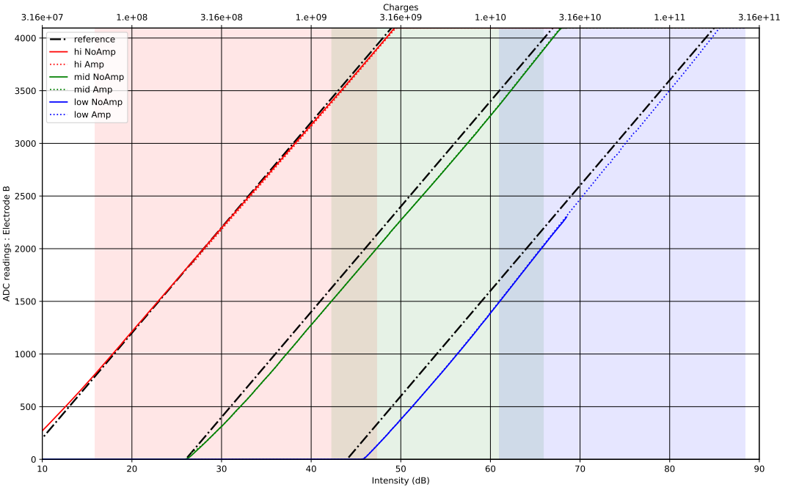
BPM Calibration
In practice, due to technological limitations and production imperfections, the actual curve is not perfectly linear
  Currently approximated using polynomial functions
ADC counts
Intensity (dB)

Slide 54
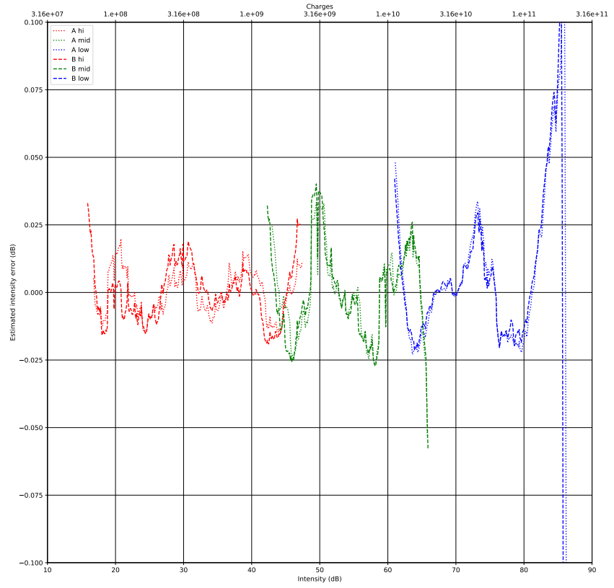
BPM Calibration
In practice, due to technological limitations and production imperfections, the actual curve is not perfectly linear
  Currently approximated using polynomial functions
~0.05 dB
ADC counts
Estimated intensity error (dB)
Intensity (dB)
Intensity (dB)

Slide 55
BPM Calibration
In practice, due to technological limitations and production imperfections, the actual curve is not perfectly linear
  Currently approximated using polynomial functions
This approach introduces systematic errors
  System very sensitive to small variations – even small errors translate to change in position
  Larger errors for actual beam positions deviating significantly from the center of the vacuum chamber (e.g. at the extraction points)

Slide 56
BPM Calibration
In practice, due to technological limitations and production imperfections, the actual curve is not perfectly linear
  Currently approximated using polynomial functions
This approach introduces systematic errors
  System very sensitive to small variations – even small errors translate to change in position
  Larger errors for actual beam positions deviating significantly from the center of the vacuum chamber (e.g. at the extraction points)
  → Minimizing these calibration-introduced systematics would ensure better control of the extraction angle and higher beam stability in terms of position

Slide 57
BPM Calibration
In practice, due to technological limitations and production imperfections, the actual curve is not perfectly linear
  Currently approximated using polynomial functions
This approach introduces systematic errors
  System very sensitive to small variations – even small errors translate to change in position
  Larger errors for actual beam positions deviating significantly from the center of the vacuum chamber (e.g. at the extraction points)
  → Minimizing these calibration-introduced systematics would ensure better control of the extraction angle and higher beam stability in terms of position
To calibrate the BPMs and get curves that smoothly follow the natural and complex of the data, we can use machine learning instead

Slide 58






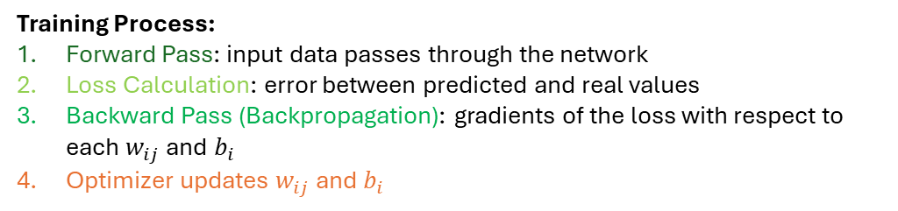











Processing the Calibration Data using Neural Networks
Layer 1
Layer 2
(…)
Last Layer
Input data: ADC counts (split into Training & Test sets)
Output data (predicted values): power in dB
$$N_{21}$$
$$N_{31}$$
Input x
$$N_{22}$$
$$N_{32}$$
Output y
$$N_{23}$$
$$N_{33}$$
$$N_{11}$$
$$N_{24}$$
$$N_{34}$$
$$N_{41}$$
Training Process:
Forward Pass: input data passes through the network
Loss Calculation: error between predicted and real values
Backward Pass (Backpropagation): gradients of the loss with respect to each $w_{ij}$ and $b_{i}$
Optimizer updates $w_{ij}$ and $b_{i}$
$$N_{2,63}$$
$$N_{3,63}$$
$$N_{2,64}$$
$$N_{3,64}$$
L1 → L2
Activation function f: $y_{ij}$ = ${f(\tilde{x}}_{ij})$
L2 → L3
Activation function f:
$y_{ij}$ = ${f(\tilde{x}}_{ij})$
L(N-1) → L(N)
Activation function f:
$y_{ij}$ = ${f(\tilde{x}}_{ij})$
Notes:
Explain how network works and calculates predictions

Slide 59
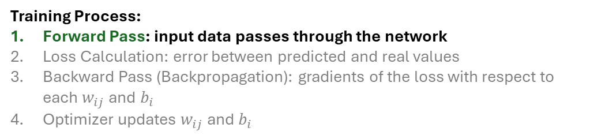
Processing the Calibration Data using Neural Networks
Forward Pass
$$N_{21}$$
$$N_{31}$$
Training Process:
Forward Pass: input data passes through the network
Loss Calculation: error between predicted and real values
Backward Pass (Backpropagation): gradients of the loss with respect to each $w_{ij}$ and $b_{i}$
Optimizer updates $w_{ij}$ and $b_{i}$
Input x
$$N_{22}$$
$$N_{32}$$
$$N_{23}$$
$$N_{33}$$
$$N_{11}$$
$$N_{24}$$
$$N_{34}$$
$$N_{41}$$
$$N_{2,63}$$
$$N_{3,63}$$
$$N_{2,64}$$
$$N_{3,64}$$
Notes:
Explain how network works and calculates predictions

Slide 60
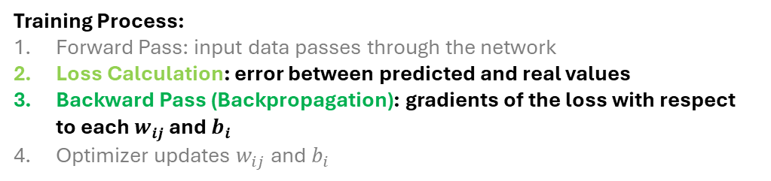

Processing the Calibration Data using Neural Networks
Forward Pass
$$N_{21}$$
$$N_{31}$$
Predicted y output of $N_{41}$
Training Process:
Forward Pass: input data passes through the network
Loss Calculation: error between predicted and real values
Backward Pass (Backpropagation): gradients of the loss with respect to each $w_{ij}$ and $b_{i}$
Optimizer updates $w_{ij}$ and $b_{i}$
Input x
$$N_{22}$$
$$N_{32}$$
$$N_{23}$$
$$N_{33}$$
$$N_{11}$$
$$N_{24}$$
$$N_{34}$$
$$N_{41}$$
Loss & Gradients Calculation
$$N_{2,63}$$
$$N_{3,63}$$
$$N_{2,64}$$
$$N_{3,64}$$
Notes:
Explain how network works and calculates predictions

Slide 61
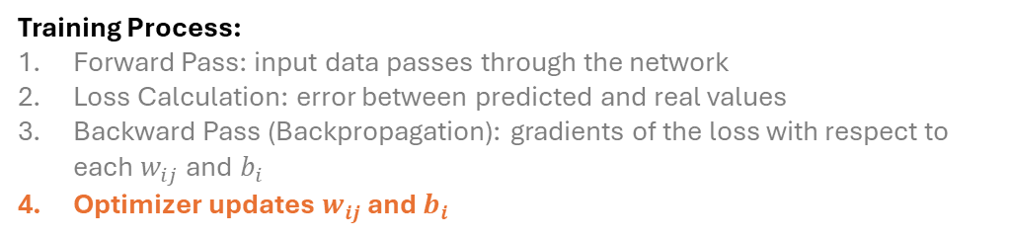
Processing the Calibration Data using Neural Networks
Forward Pass
$$N_{21}$$
$$N_{31}$$
Predicted y output of $N_{41}$
Training Process:
Forward Pass: input data passes through the network
Loss Calculation: error between predicted and real values
Backward Pass (Backpropagation): gradients of the loss with respect to each $w_{ij}$ and $b_{i}$
Optimizer updates $w_{ij}$ and $b_{i}$
Input x
$$N_{22}$$
$$N_{32}$$
$$N_{23}$$
$$N_{33}$$
$$N_{11}$$
$$N_{24}$$
$$N_{34}$$
$$N_{41}$$
Loss & Gradients Calculation
$$N_{2,63}$$
$$N_{3,63}$$
Updating the parameters of all neurons
$$N_{2,64}$$
$$N_{3,64}$$
Notes:
Explain how network works and calculates predictions

Slide 62
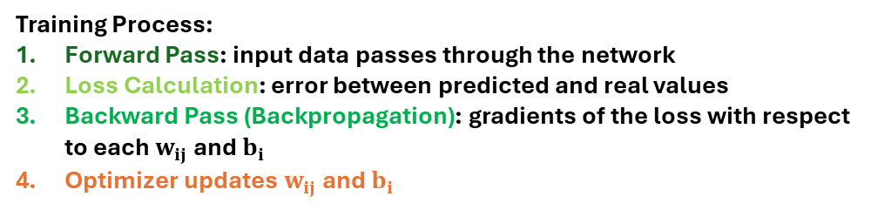
Processing the Calibration Data using Neural Networks
Forward Pass
$$N_{21}$$
$$N_{31}$$
Predicted y output of $N_{41}$
Training Process:
Forward Pass: input data passes through the network
Loss Calculation: error between predicted and real values
Backward Pass (Backpropagation): gradients of the loss with respect to each $w_{ij}$ and $b_{i}$
Optimizer updates $w_{ij}$ and $b_{i}$
Input x
$$N_{22}$$
$$N_{32}$$
$$N_{23}$$
$$N_{33}$$
$$N_{11}$$
$$N_{24}$$
$$N_{34}$$
$$N_{41}$$
Loss & Gradients Calculation
$$N_{2,63}$$
$$N_{3,63}$$
Updating the parameters of all neurons
The above steps are completed once for each epoch.
Every time, the data propagate through the network and the weights and biases get updated by the optimizer algorithm.
Repeat for next epoch
$$N_{2,64}$$
$$N_{3,64}$$
End of 1 epoch
Notes:
Explain how network works and calculates predictions

Slide 63
Processing the Calibration Data using Neural Networks
Forward Pass
$$N_{21}$$
$$N_{31}$$
Predicted y output of $N_{41}$
Training Process:
Forward Pass: input data passes through the network
Loss Calculation: error between predicted and real values
Backward Pass (Backpropagation): gradients of the loss with respect to each $w_{ij}$ and $b_{i}$
Optimizer updates $w_{ij}$ and $b_{i}$
Input x
$$N_{22}$$
$$N_{32}$$
$$N_{23}$$
$$N_{33}$$
$$N_{11}$$
$$N_{24}$$
$$N_{34}$$
$$N_{41}$$
Loss & Gradients Calculation
$$N_{2,63}$$
$$N_{3,63}$$
Updating the parameters of all neurons
The above steps are completed once for each epoch.
Every time, the data propagate through the network and the weights and biases get updated by the optimizer algorithm.
Also, before moving to the next epoch, the test data set is propagated through the network, to monitor the performance of the model dealing with data it has not been trained on (Testing Process)
Repeat for next epoch
$$N_{2,64}$$
$$N_{3,64}$$
End of 1 epoch
Notes:
Input ADC counts, output dB. First approach: optimize model for single sensitivity channel of a single electrode. End goal will be a model that incorporates all elements/electrodes/sensitivities and optimizes for position errors

Slide 64
Testing different architectures and schemes
Various parameters to optimize: learning rate, no. layers, no. neurons, initializer
From Tensorflow Keras, switched to PyTorch (more commonly used in accelerator sector)

Slide 65
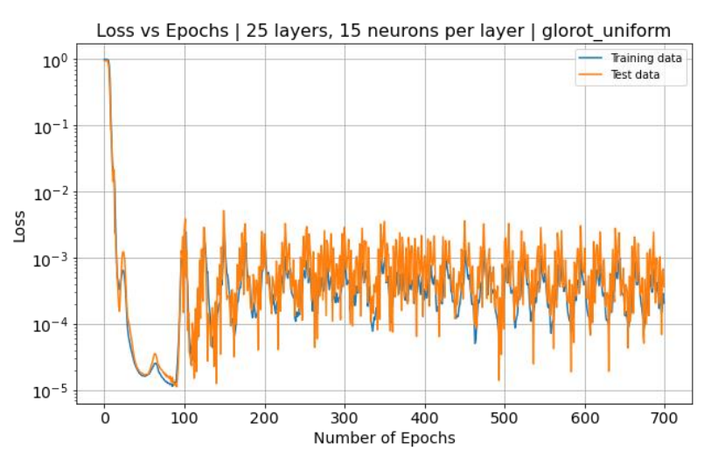
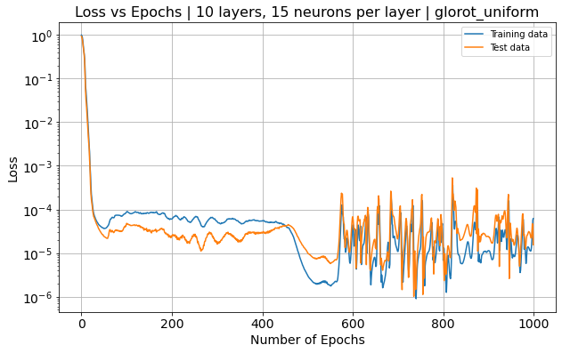
Testing different architectures and schemes
Various parameters to optimize: learning rate, no. layers, no. neurons, initializer
From Tensorflow Keras, switched to PyTorch (more commonly used in accelerator sector)
‘Manual’ initial parameter scan to identify an area of stability, to test ideas and experiment with workflow and optimization aspects – full parameter scan using specialized tools will be the final step

Slide 66
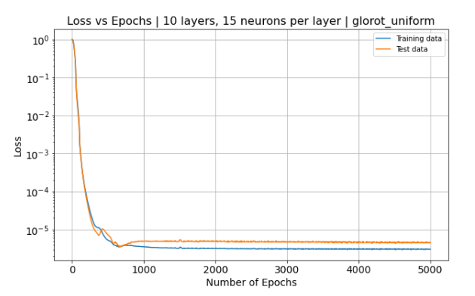
Testing different architectures and schemes
Various parameters to optimize: learning rate, no. layers, no. neurons, initializer
From Tensorflow Keras, switched to PyTorch (more commonly used in accelerator sector)
‘Manual’ initial parameter scan to identify an area of stability, to test ideas and experiment with workflow and optimization aspects – full parameter scan using specialized tools will be the final step
Learning rate =1e-3
Learning rate =1e-5

Slide 67
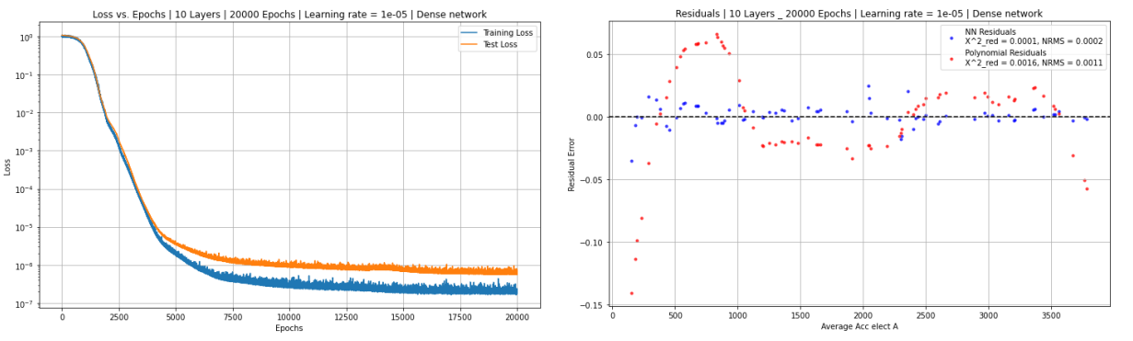
Performance Comparison with Polynomial Approach – Single Electrode of a Single BPM device
Train model on data from one electrode of a BPM device, and evaluate the performance on its response
Neural network appears to outperform the polynomial approach!

Slide 68
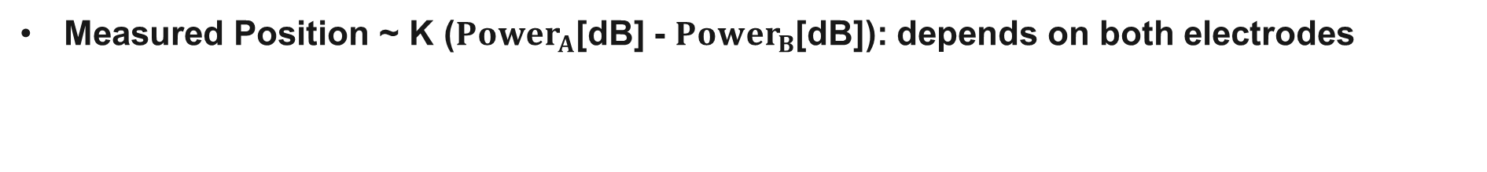
Next Steps Towards Minimizing Errors in Position
Measured Position ~ K (${Power}_{A}$[dB] - ${Power}_{B}$[dB]): depends on both electrodes

Slide 69

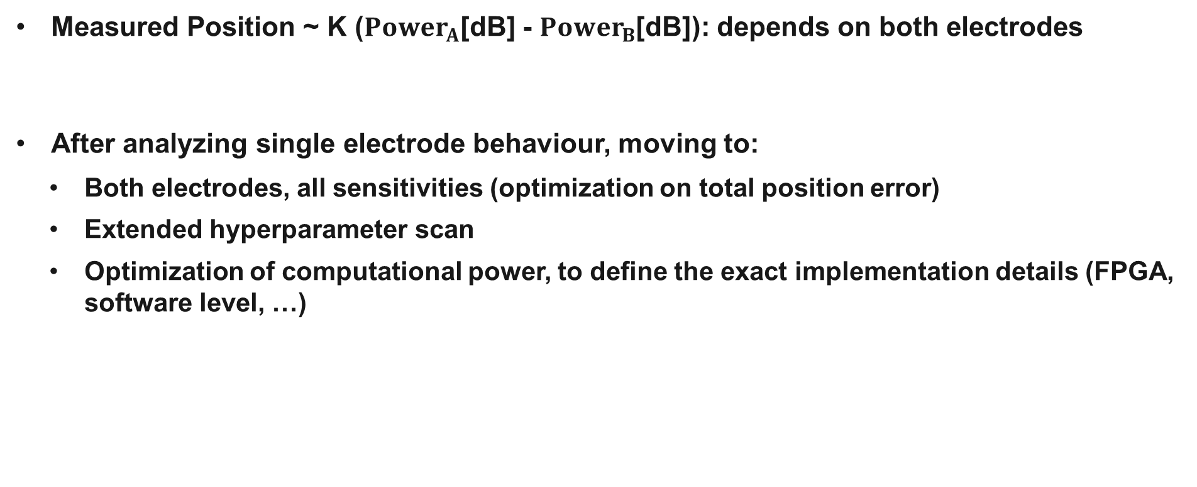
Next Steps Towards Minimizing Errors in Position
Measured Position ~ K (${Power}_{A}$[dB] - ${Power}_{B}$[dB]): depends on both electrodes
After analyzing single electrode behaviour, moving to:
  Both electrodes, all sensitivities (optimization on total position error)
  Extended hyperparameter scan
  Optimization of computational power, to define the exact implementation details (FPGA, software level, …)

Slide 70
Outline of this talk
Introduction
Plasma Astrophysics Experiments at HiRadMat
    Goals & Experimental Layout
    Beam Focusing Quadrupoles – Simulations, Measurements, Image Analysis & Managing Uncertainty
Machine Learning-Driven Calibration of Beam Position Monitors (BPMs)
    BPMs in the SPS & ALPS: Principle of Operation and Role for the Complex
    Current Limitations – What if we used Machine Learning
    Neural Networks to Minimize Systematic Errors
Future Plans and Next Steps

Slide 71
Future Plans and Next Steps
Fireball experiments:
  Image analysis to fully study the effect of the quadrupoles and the interplay between divergence and instabilities growth
  Installation/setup/data taking campaign of next experiment
BPM Calibration with ML:
  Multi-dimensional analysis including both electrodes, all sensitivities
  Longer term implementation: hyperparameter scan & optimization of computational power

Slide 72
References
C. D. Arrowsmith et al. Phys. Rev. Res. 3 (2 May 2021), p. 023103. doi: 10.1103/PhysRevResearch.3.023103.
C.D. Arrowsmith et al. Nat Commun 15 (2024), p. 5029. doi: 10.1038/s41467-024-49346-2.
R. D. Blandford and R. L. Znajek, Monthly Notices of the Royal Astronomical Society 179.3 (July 1977). doi: 10.1093/mnras/179.3.433.
Peter Goldreich and William H. Julian. “Pulsar Electrodynamics”. In: APJ 157 (Aug. 1969), p. 869. doi: 10.1086/150119.
Bing Zhang. The Physics of Gamma-Ray Bursts. Cambridge University Press, 2018.
Manfred Wendt. “A Brief Introduction to Beam Position Monitors for Charged Particle Accelerators”. In: IEEE Instrumentation & Measurement Magazine 24.9 (2021), pp. 21–32. doi: 10.1109/MIM.2021. 9620043.
Manoel Barros Marin. “Hardware & FPGA firmware development in the frame of the Beam Position Monitoring (BPM) system upgrade for the Super Proton Synchrotron (SPS)”. Presented 04 Oct 2021. UNED, 2021. url: https://cds.cern.ch/record/2783152.
Andrea Boccardi et al. “Commissioning of ALPS, the New Beam Position Monitor System of CERN’s Super Proton Synchrotron.” In: JACoW IBIC 2021 (2021), pp. 96–99. doi: 10 . 18429 / JACoW - IBIC2021-MOPP23. url: https://cds.cern.ch/record/2815318.
Manfred Wendt et al. “Technology and First Beam Tests of the New CERN-SPS Beam Position System”. In: JACoW IBIC (2019), WEPP046. doi: 10 . 18429 / JACoW - IBIC2019 - WEPP046. url: https://cds.cern.ch/record/2750956
C.D. Arrowsmith et al. “Suppression of pair beam instabilities in a laboratory analogue of blazar jets”, unpublished (2025).

Slide 73

Thank you for your attention!

Slide 75
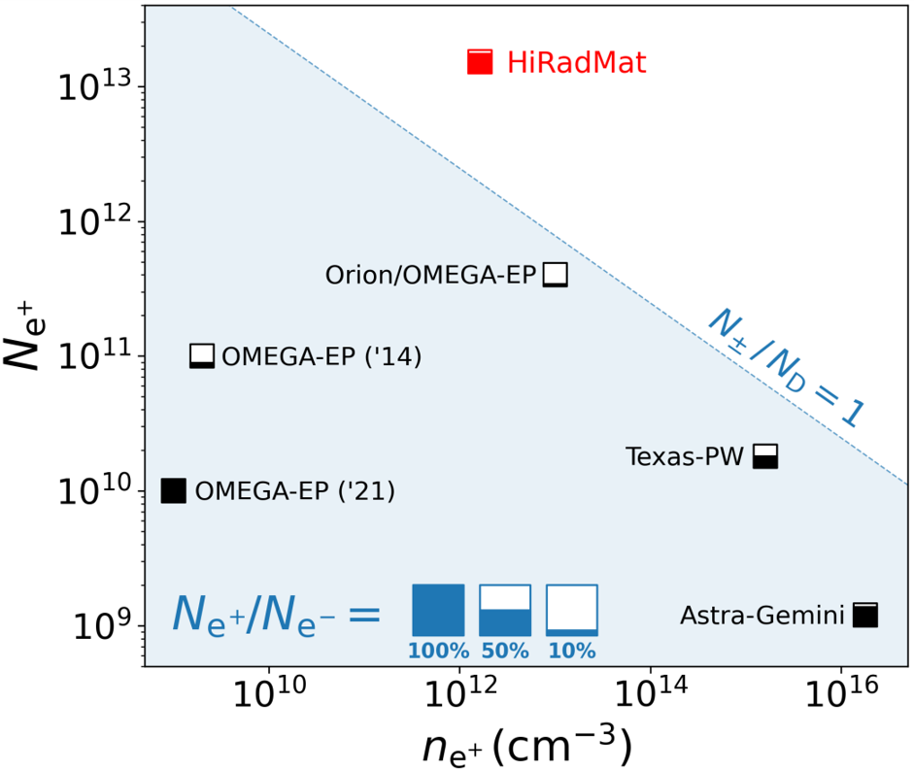
Fireball at HiRadMat vs Other Experiments

Slide 76
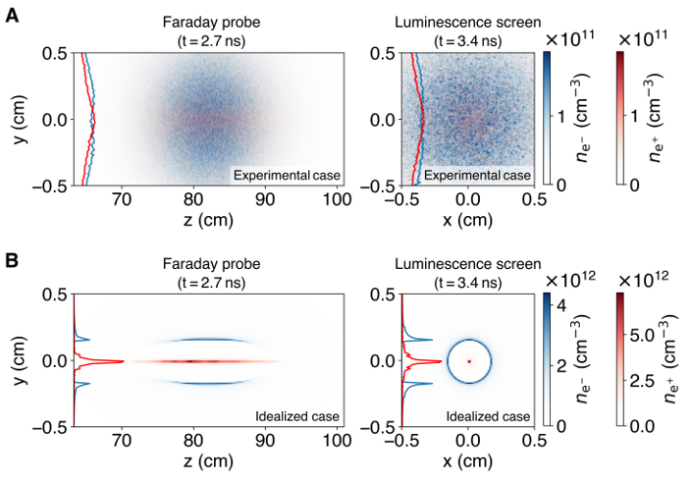
Suppression of Plasma Instabilities
Previously mentioned requirements: competing with low divergence & momentum spread → affecting growth rate of instabilities¹⁰
Focus of my work:
  To study the interplay between beam divergence, momentum spread and the growth of the instabilities
  How can we control these properties
Results from PIC simulation. A. Realistic experimental conditions. B. Idealized conditions, collimated and monoenergetic beam.
Source: 10. C.D. Arrowsmith et al. “Suppression of pair beam instabilities in a laboratory analogue of blazar jets”, unpublished (2025).

Slide 77
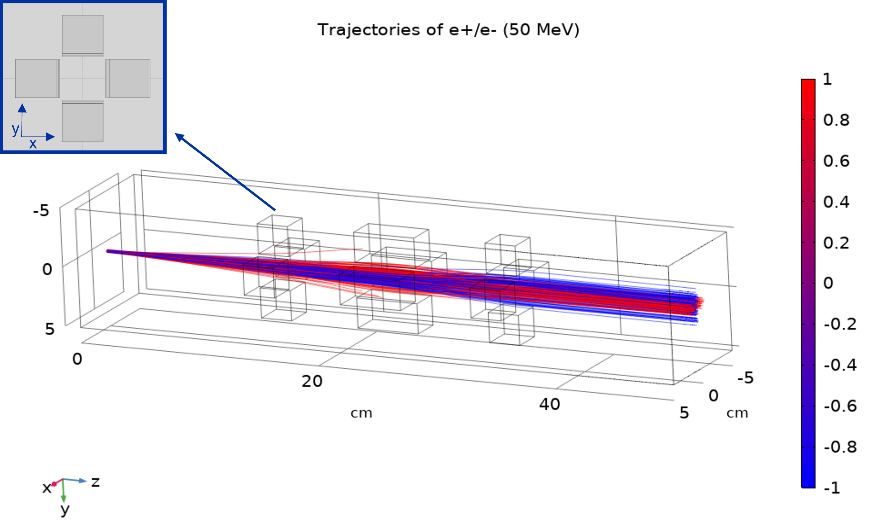
Quadrupole Studies - COMSOL
Quadrupole triplet modelled in detail in COMSOL
Study quadrupole arrangement and effect on beam propagation

Slide 78
Diagnostics
Luminescence screens before and after the plasma cell to monitor beam profile
Luminescence screens after the electromagnet, to get the energy spread of the charges
Other diagnostics: Optical spectrometer, Faraday rotation probe
Source: 4. C. D. Arrowsmith et al. Phys. Rev.Res. doi: 10.1103/PhysRevResearch.3.023103

Slide 79


Fireball Experiments – Pair Beam Production
First experiment: results in excellent agreement with FLUKA Monte Carlo simulations²
Transverse beam profile post-target.
Electron/positron spectra after the electromagnet.
Source: 2. C.D. Arrowsmith et al., Nat Commun15 (2024), doi: https://doi.org/10.1038/s41467-024-49346-2

Slide 80

Incorporating Set of Devices to Train a Joint Model
Train a model on data from multiple devices, instead of training one model for each device, and evaluate performance

