Slide 1
IV Ergebnisse CLT-01, v02
Competence in Silicon
Kevin Lauer
01.04.25

Slide 2
Waferüberblick
 | Ioanas porposal | Wafernumber | Type | Res [Ohmcm] | DOFZ | P Plateau | C Dose [1/cm²]
1 | G-FZ-A | 440598_01 | FZ | 1-3 | no | no | 5E+12
2 | G-FZ-A | 440598_02 | FZ | 1-3 | no | no | 5E+13
3 | G-FZ-A | 440598_03 | FZ | 1-3 | no | no | 5E+13
4 | G-FZ-A | 440598_04 | FZ | 1-3 | no | no | 5E+13
5 | G-FZ-A | 440598_05 | FZ | 1-3 | no | no | 5E+14
6 | G-FZ-A-P | 440598_06 | FZ | 1-3 | no | yes | 5E+12
7 | G-FZ-A-P | 440598_07 | FZ | 1-3 | no | yes | 5E+13
8 | G-FZ-A-P | 440598_08 | FZ | 1-3 | no | yes | 5E+13
9 | G-FZ-A-P | 440598_09 | FZ | 1-3 | no | yes | 5E+14
10 | G-DOFZ-A | 440598_10 | FZ | 1-3 | yes | no | 5E+12
11 | G-DOFZ-A | 440598_11 | FZ | 1-3 | yes | no | 5E+13
12 | G-DOFZ-A | 440598_12 | FZ | 1-3 | yes | no | 5E+13
13 | G-DOFZ-A | 440598_13 | FZ | 1-3 | yes | no | 5E+14
14 | G-DOFZ-A-P | 440598_14 | FZ | 1-3 | yes | yes | 5E+12
15 | G-DOFZ-A-P | 440598_15 | FZ | 1-3 | yes | yes | 5E+13
16 | G-DOFZ-A-P | 440598_16 | FZ | 1-3 | yes | yes | 5E+13
17 | G-DOFZ-A-P | 440598_17 | FZ | 1-3 | yes | yes | 5E+14
1 | G-FZ-B | 440603_01 | FZ | 10.2 | no | no | 5E+12
2 | G-FZ-B | 440603_02 | FZ | 10.2 | no | no | 5E+13
3 | G-FZ-B | 440603_03 | FZ | 10.2 | no | no | 5E+13
4 | G-FZ-B | 440603_04 | FZ | 10.2 | no | no | 5E+14
5 | G-DOFZ-B | 440603_05 | FZ | 10.2 | yes | no | 5E+12
6 | G-DOFZ-B | 440603_06 | FZ | 10.2 | yes | no | 5E+13
7 | G-DOFZ-B | 440603_07 | FZ | 10.2 | yes | no | 5E+13
8 | G-DOFZ-B | 440603_08 | FZ | 10.2 | yes | no | 5E+14

Slide 3
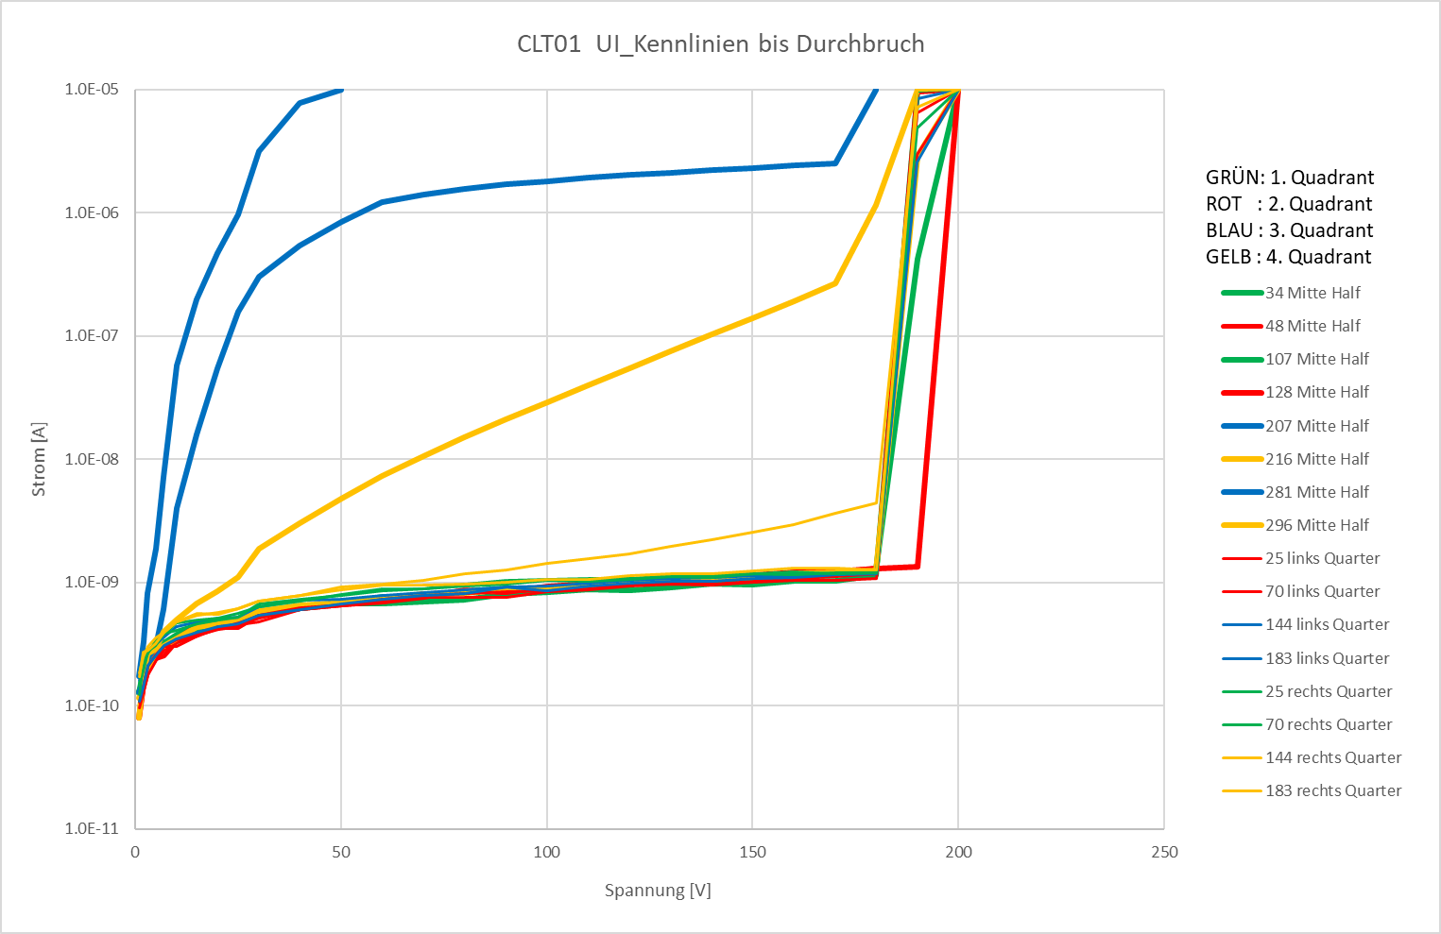
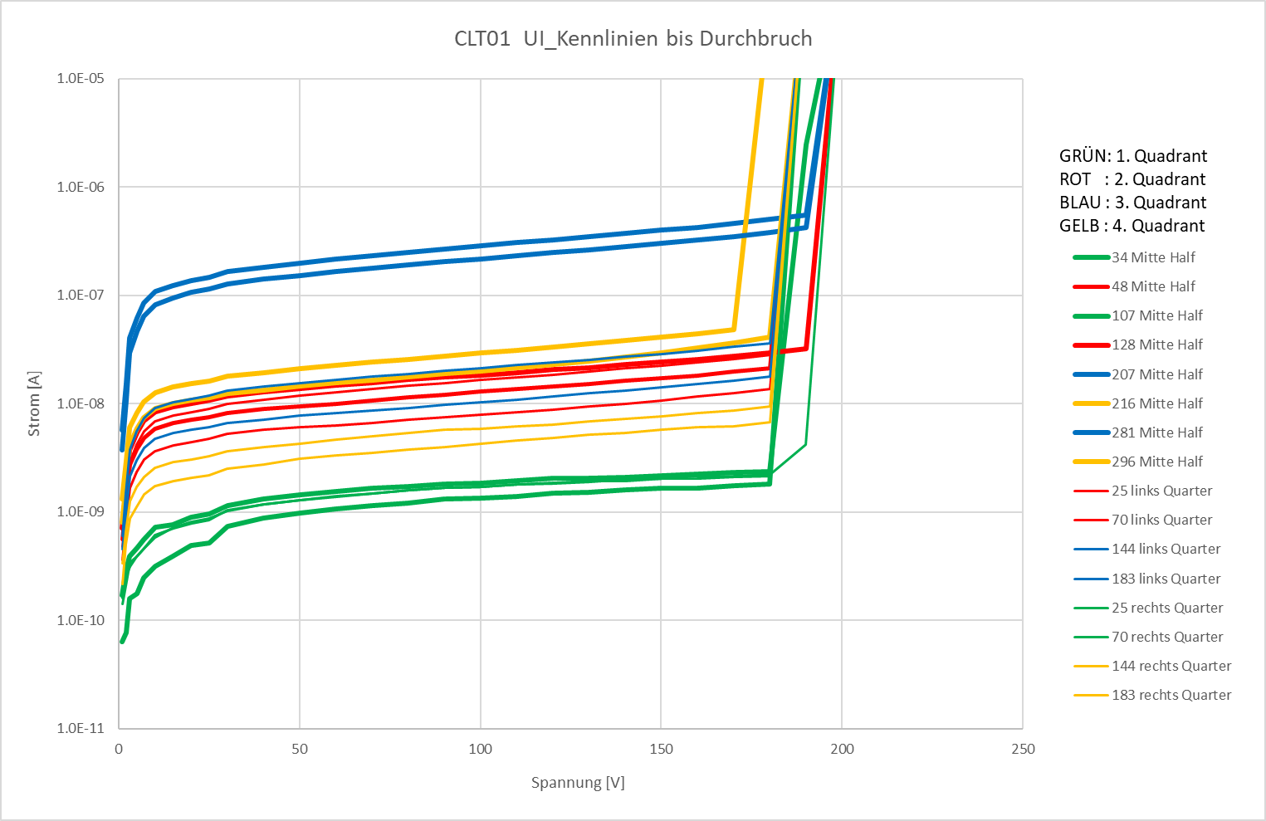
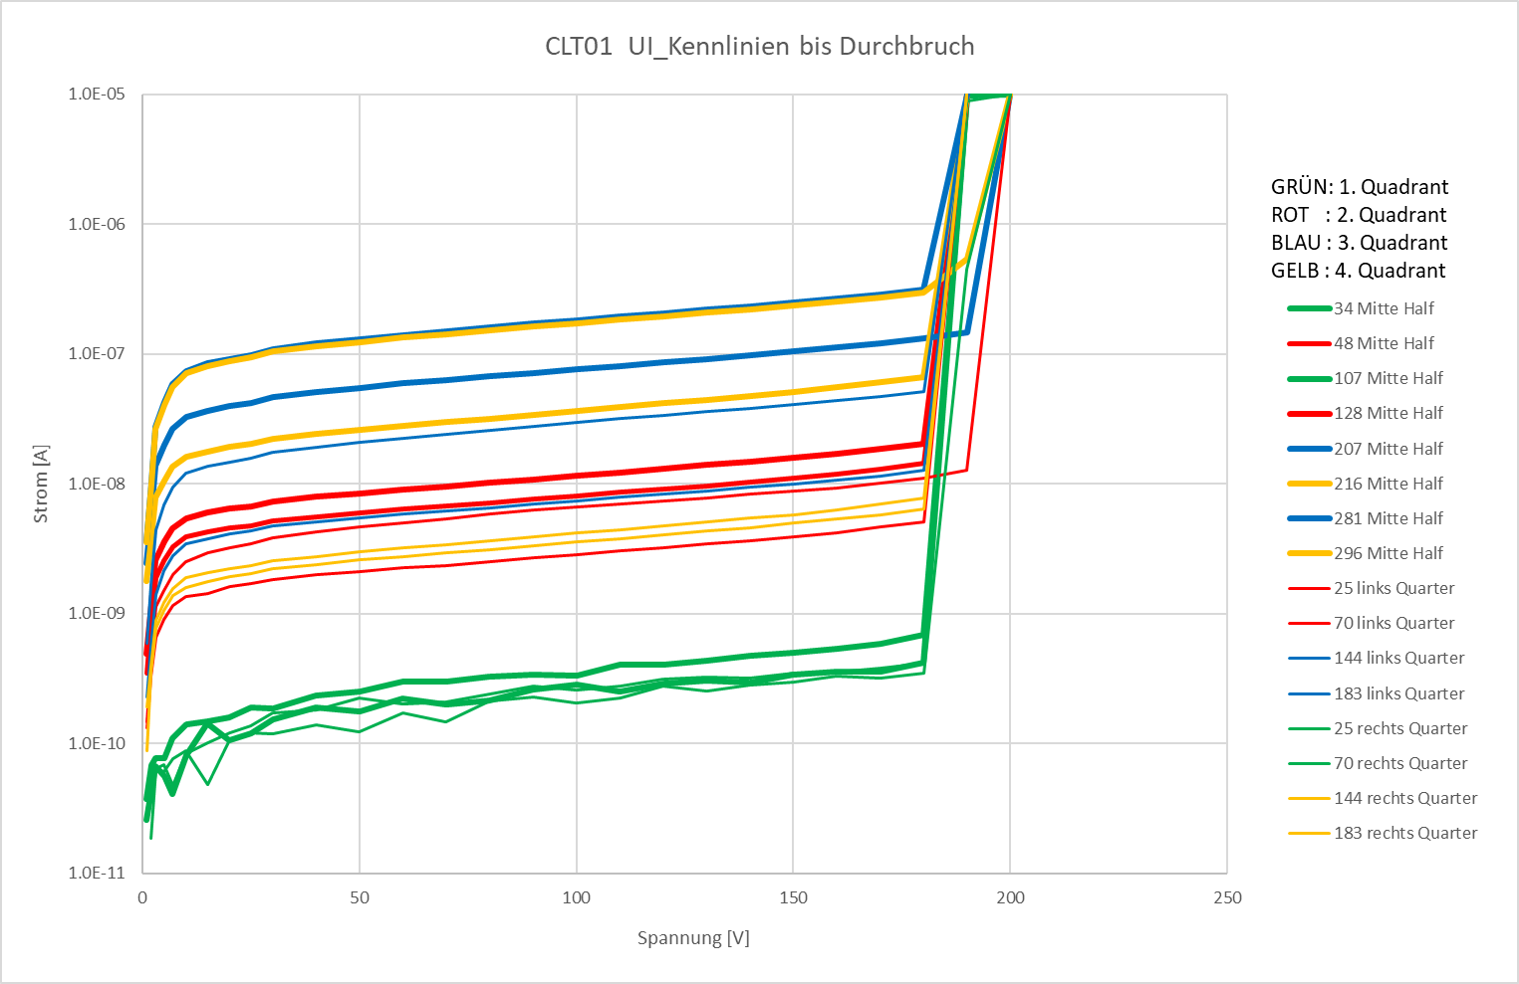
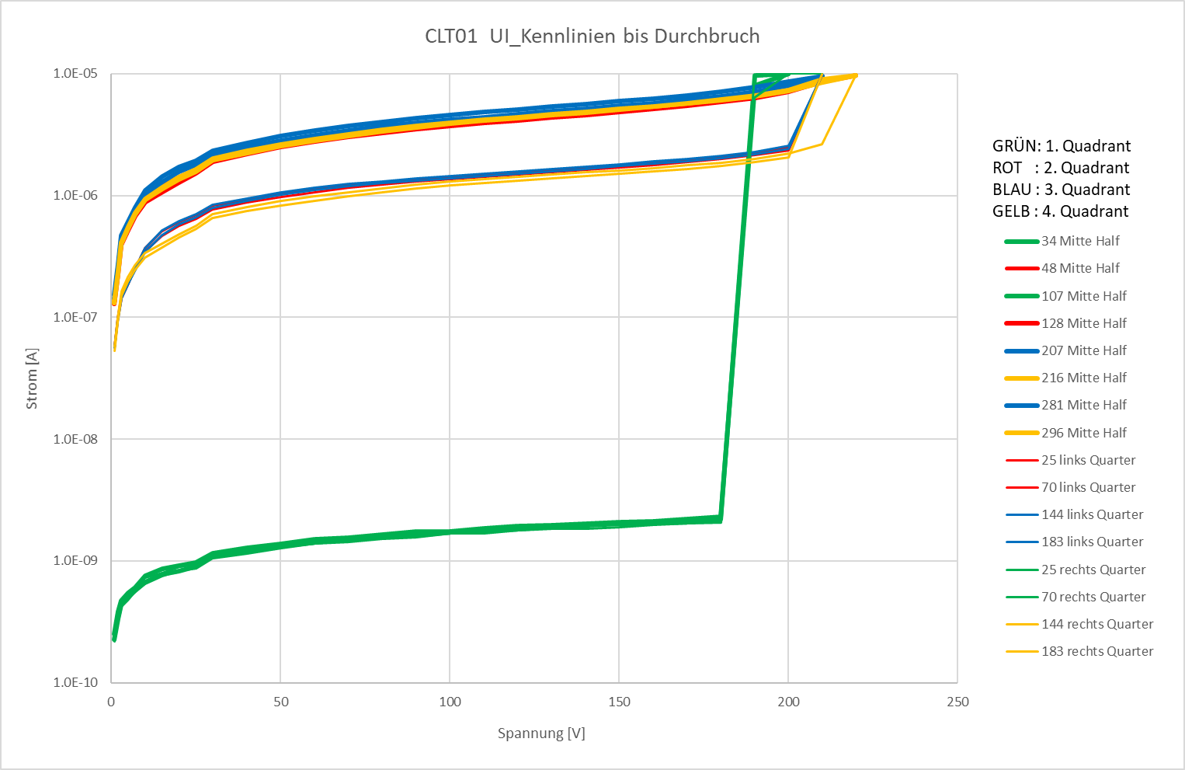
IV, Wafer 01-04, 440603, G-FZ-B
IV curve, selected diodes
Green curves: quarter shielded from carbon
Carbon dose: 5e12cm^-2
5e13cm^-2
5e13cm^-2
5e14cm^-2

Slide 4
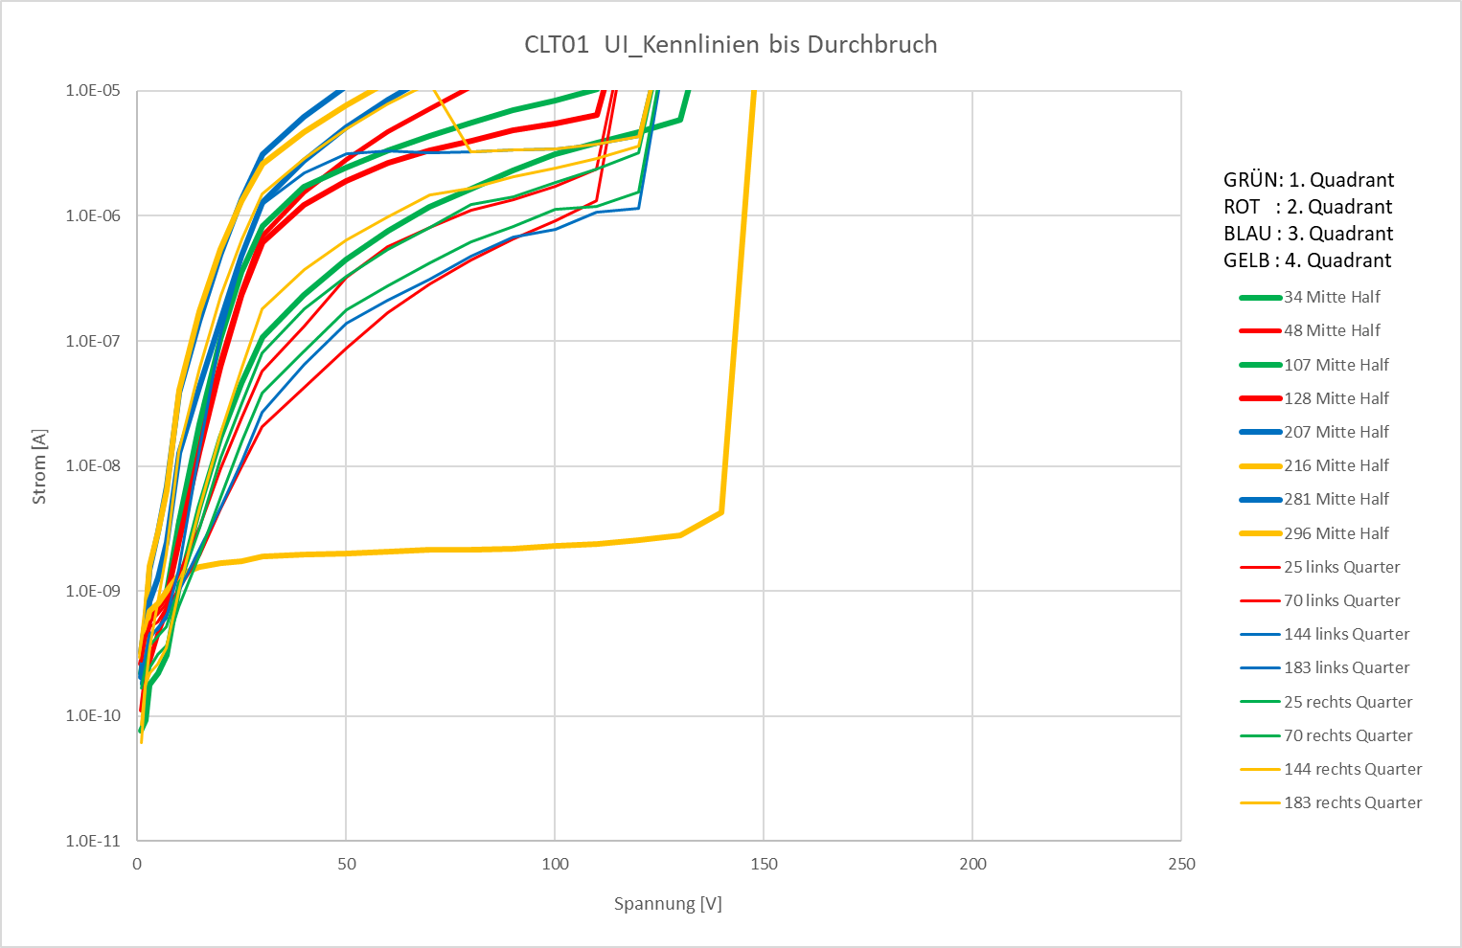
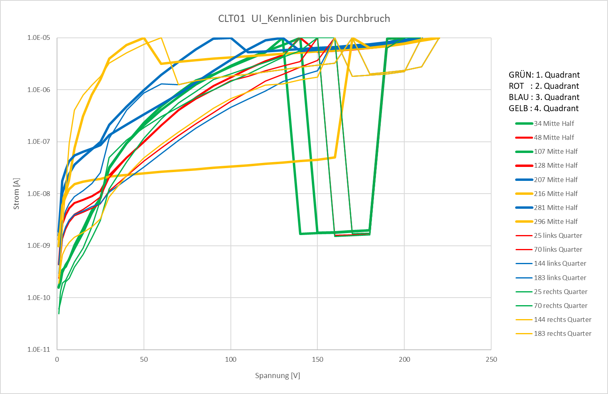
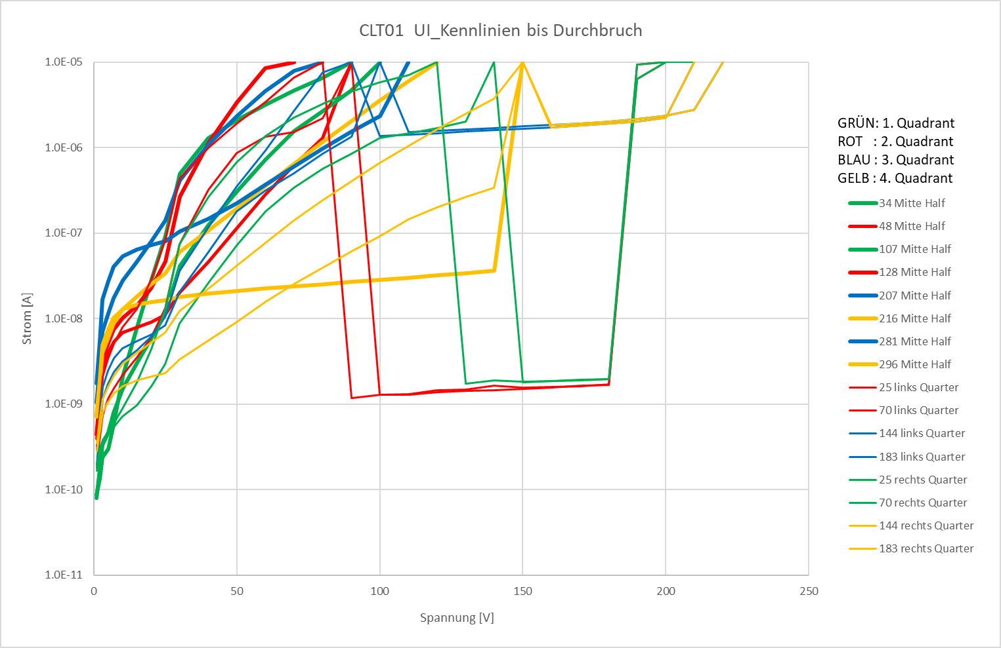
IV, Wafer 05-08, 440603, G-DOFZ-B
IV curve, selected diodes
Green curves: quarter shielded from carbon
Carbon dose: 5e12cm^-2
5e13cm^-2
5e13cm^-2
5e14cm^-2

Slide 5
V_br>150V: green
IV, Wafer 01-07, 440603

Slide 6
Remarks
More to come
Impact of carbon dose visible
DO-step reduces breakdown voltage and increases dark current

Slide 7
Thank you for your kind attention!
  Dr. Kevin Lauer
  klauer@cismst.de

Slide 8
Simulationen P und C Implantation
Oxidschichtdicke in aktiver Region (I) =50nm
Sonst 200nm
P Implantation
C Implantation
Dosis [cm^2] | Energie [keV]
1.48E+15 | 104
1.19E+11 | 560
1.58E+11 | 948
1.61E+11 | 1282
1.60E+11 | 1531
1.70E+11 | 1929
1.72E+11 | 2325
Wafer | Energie [keV] | Dosis [1/cm²]
6 | 500 | 1E+12
6 | 500 | 1E+13
6 | 500 | 1E+14

Slide 9
Planned high energy P and C implantations
P implantations (8 Wafer)
C implantations (18 Wafer)
Dosis [cm^2] | Energie [keV]
1.2E+11 | 500
1.6E+11 | 1000
1.6E+11 | 1250
1.6E+11 | 1500
Wafer | Energie [keV] | Dosis [1/cm²]
6 | 500 | 5E+12
13 | 500 | 5E+13
6 | 500 | 5E+14

Slide 10
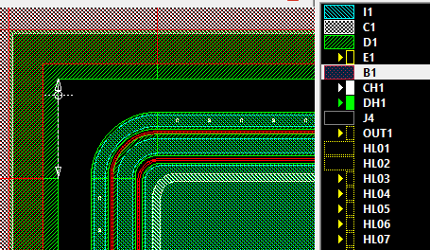
Prozessparameter, CLT-01, Update 240903
Wafer: 16 FZ, p-Typ, Bor, 1-3Ohmcm, 9 FZ, p-Typ, Bor, 10.2Ohmcm
DOFZ-Schritt für 12 Wafer
(J) Oxidation 200nm
(B1) Bor-Implantation (p-Stop) 8e11cm-2 130keV
(B1) Tempern 1100°C 60min
(I1) Oxid Zielätzen im aktiven Bereich auf 50nm
(I1) Phosphor-Implantation 1.5e15cm-2 100keV
Rückseite: ganzflächig Bor-Impl. 1e15cm-2 100keV
(I1) 4 Hochenergie P-Implantationen vollflächig,
(I1) 1000°C 5min
(I1) Hochenergie C-Implantation in 3 Quadranten des Wafers,
(I1) Tempern 1000°C 10s, RTP Unitemp
(CV), (CH), (DV), (DH) bei Prozessentwicklung

Slide 11
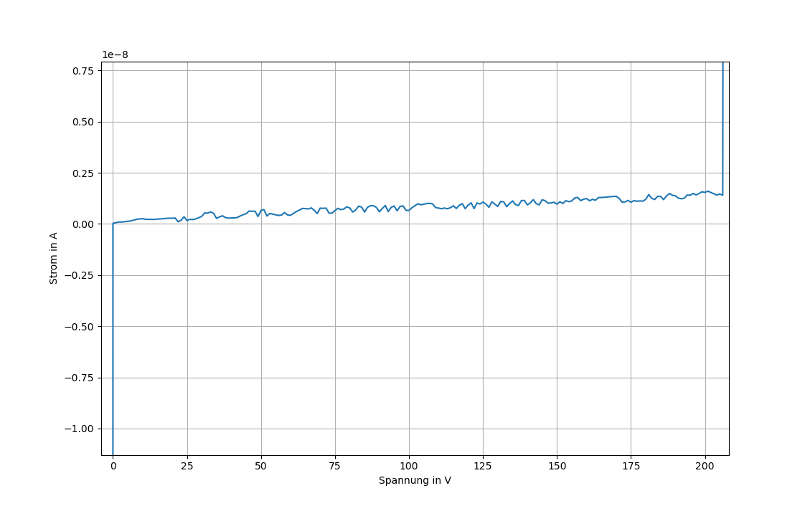
IV, Wafer 01, 440603
First IV curve
I @ 200V < 2.5nA
I_{Br} ~ 200V

Slide 12
IV, Wafer 05, 440603
First full IV Map (duration ca. 2d)

