Slide 1
FCC-ee: The Availability Challenge
Hannah Dostmann, Jack Heron, Lukas Felsberger, Daniel Wollmann, Jan Uythoven
17th March 2025

Slide 2

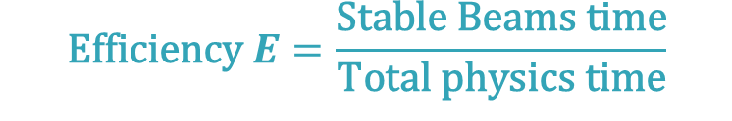
Availability and Efficiency
$$\text{Efficiency} E=\frac{\text{Stable} \text{Beams} \text{time}}{\text{Total} \text{physics} \text{time}}$$
FCC-ee:
365 days
−120 (extended shutdowns)
− 30 (annual commissioning)
− 20 (machine development)
− 10 (technical stops)
185 days for physics
min 75% !
$$\text{Availability} A=\frac{\text{Up} \text{time}}{\text{Total} \text{physics} \text{time}}$$
Operation
Stable Beams
Down Time

Slide 3
Simulation Model

Slide 4
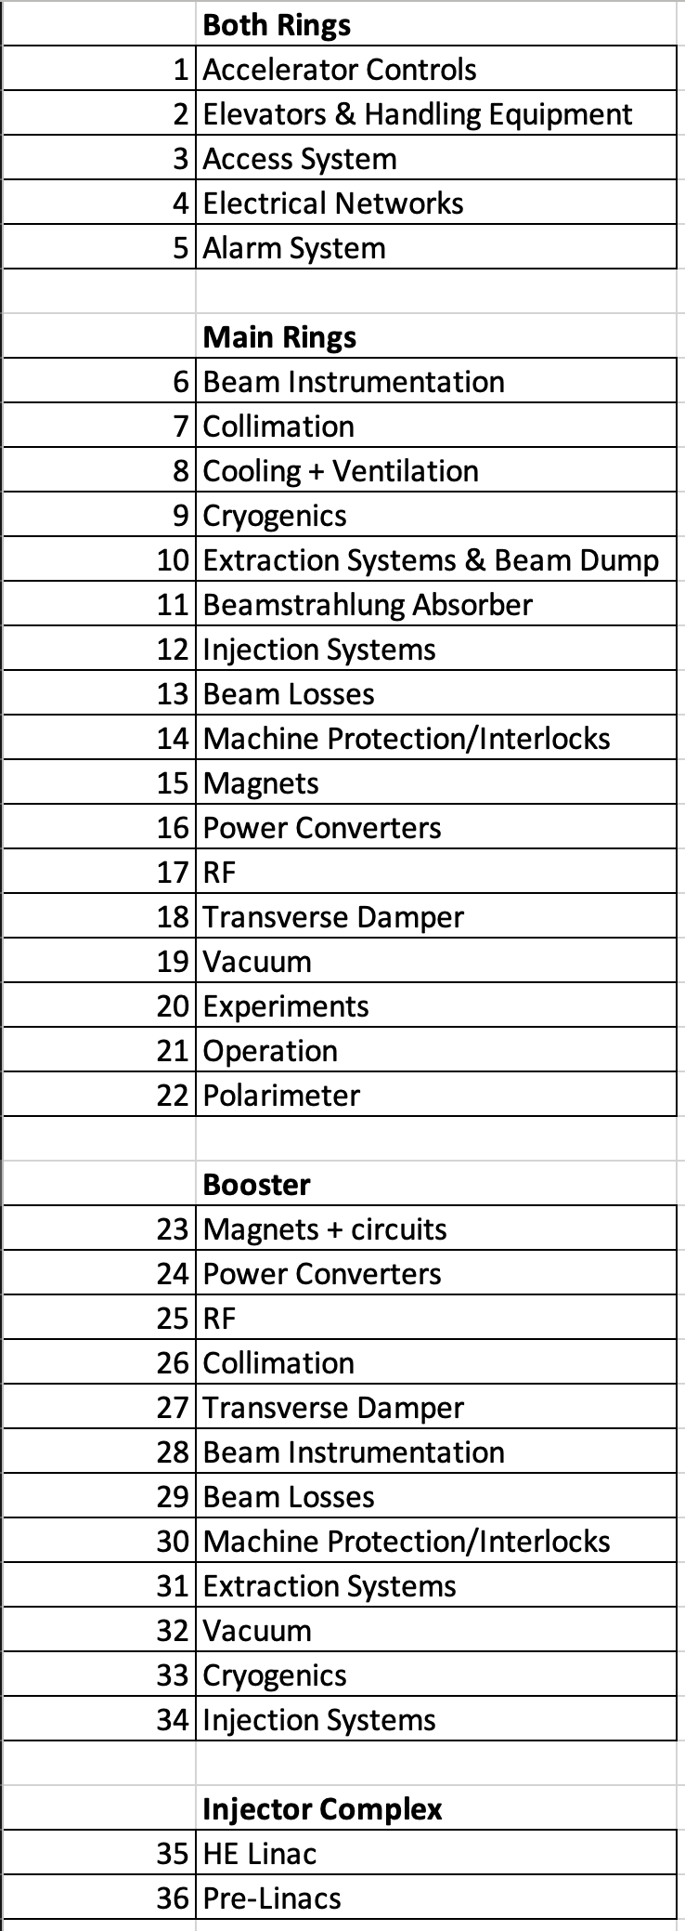
From Subsystems to Luminosity
Failure Distribution
FCC-ee
Availability
Luminosity
Repair Distribution

Slide 5
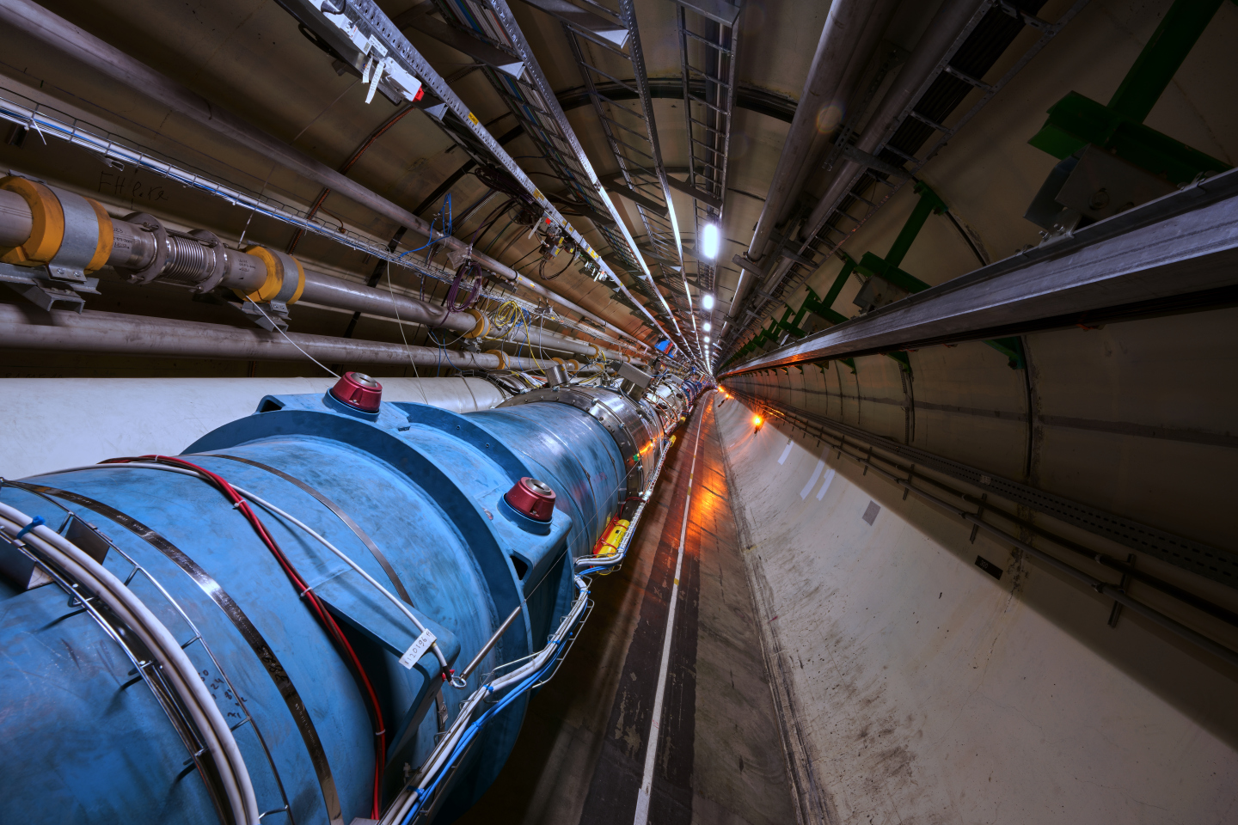
Failure Distribution (showcased by RF system)
Identifying comparable system
  From other accelerators that provide fault data
LHC
https://home.cern/science/accelerators/large-hadron-collider

Slide 6
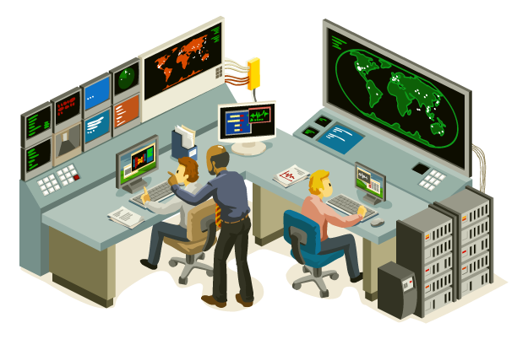

Failure Distribution (showcased by RF system)
LHC
Identifying a comparable system
  From other accelerators that provide fault data
Breaking down fault data
  Subcategories (if possible)
  Short/long faults (remote/human faults)
Repair from control room
Repair on site
https://www.istockphoto.com/vector/isometric-control-center-gm164401684-15526568
https://www.flaticon.com/free-icon/technician_6342684
https://home.cern/science/accelerators/large-hadron-collider
Notes:
Warum das unter anderem wichtig ist wird spaeter klar

Slide 7
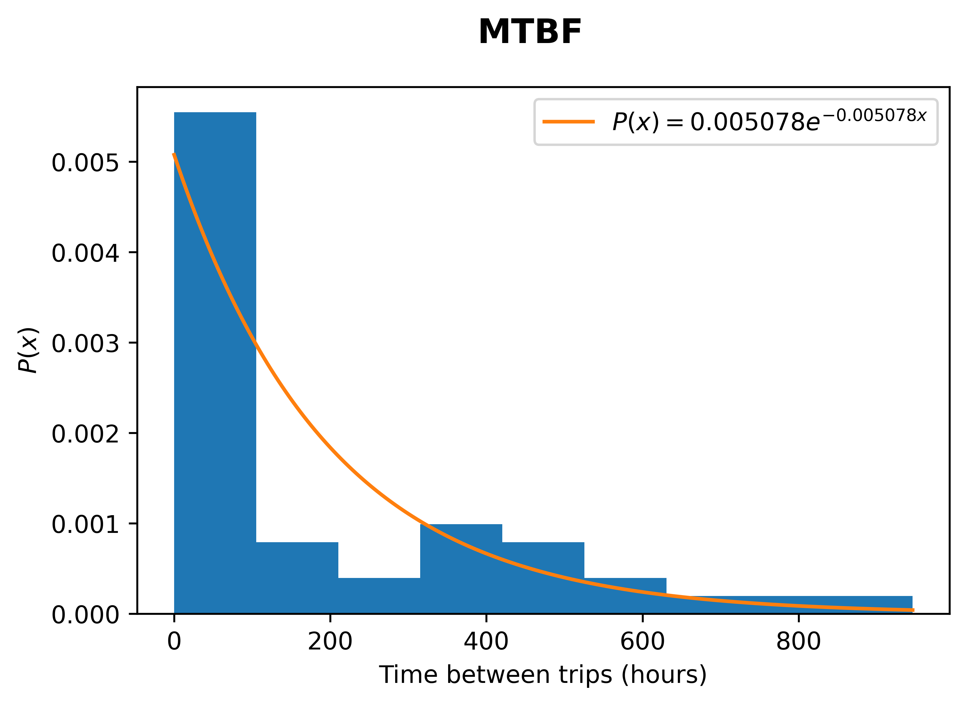
Failure Distribution (showcased by RF system)
LHC
Identifying comparable system
  From other accelerators that provide fault data
Breaking down fault data
  Subcategories (if possible)
  Short/long faults (remote/human faults)
Fitting distribution function to each group
Failure Distribution
https://www.istockphoto.com/vector/isometric-control-center-gm164401684-15526568
https://www.flaticon.com/free-icon/technician_6342684
https://home.cern/science/accelerators/large-hadron-collider

Slide 8
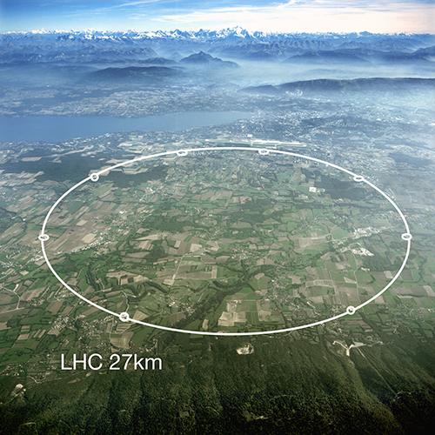
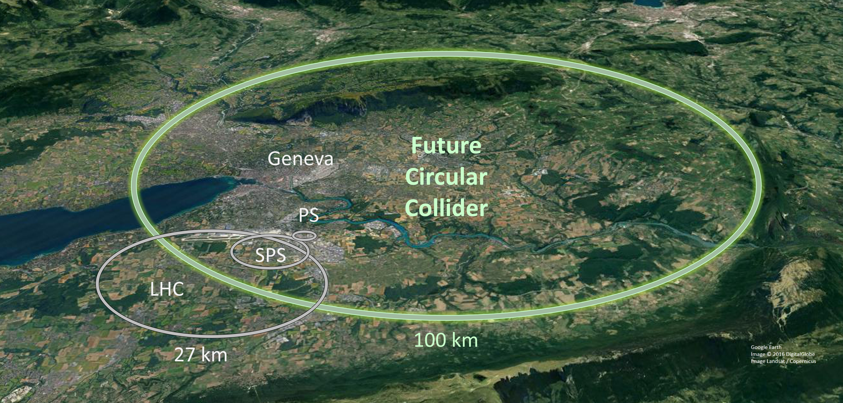
Failure Distribution (showcased by RF system)
LHC
Identifying comparable system
  From other accelerators that provide fault data
Breaking down fault data
  Subcategories (if possible)
  Short/long faults (remote/human faults)
Fitting distribution function to each group
Scaling distribution function
Failure Distribution
number of cavities
https://www.istockphoto.com/vector/isometric-control-center-gm164401684-15526568
https://www.flaticon.com/free-icon/technician_6342684
https://home.cern/science/accelerators/large-hadron-collider
https://hep.hamamatsu.com/eu/en/behind-the-science/cern.html
https://cds.cern.ch/record/2653532

Slide 9
Failure Distribution (showcased by RF system)
LHC
Identifying comparable system
  From other accelerators that provide fault data
Breaking down fault data
  Subcategories (if possible)
  Short/long faults (remote/human faults)
Fitting Distribution Function to each group
Scaling distribution function
Defining Redundancy
Failure Distribution
Number of cavities
Collider | Z | W | ZH | tt
cavities | 132* | 132* | 264 | 752
Redundancy [%] | 0.75 | 4.5 | 10 | 10
*per ring
Booster | Z | W | ZH | tt
cavities | 112 | 112 | 112 | 600
Redundancy [%] | 0 | 0 | 10 | 10
https://www.istockphoto.com/vector/isometric-control-center-gm164401684-15526568
https://www.flaticon.com/free-icon/technician_6342684
https://home.cern/science/accelerators/large-hadron-collider
https://hep.hamamatsu.com/eu/en/behind-the-science/cern.html
https://cds.cern.ch/record/2653532

Slide 10
From Subsystems to Luminosity
Failure Distribution
FCC-ee
Availability
Luminosity
Repair Distribution

Slide 11
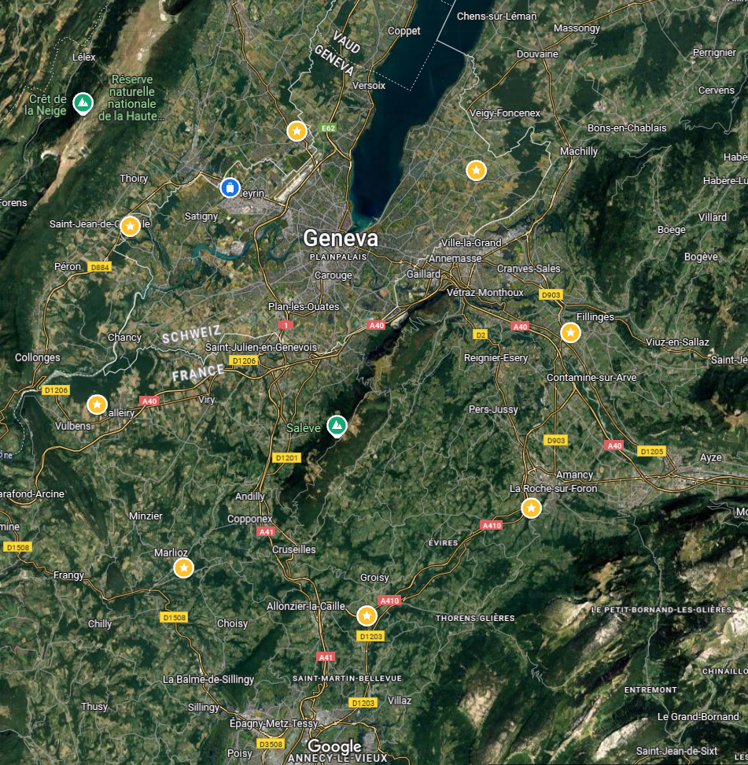
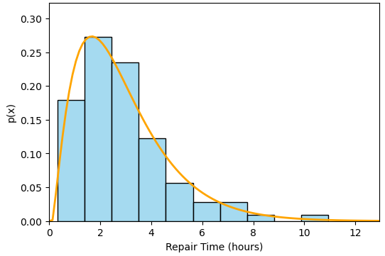
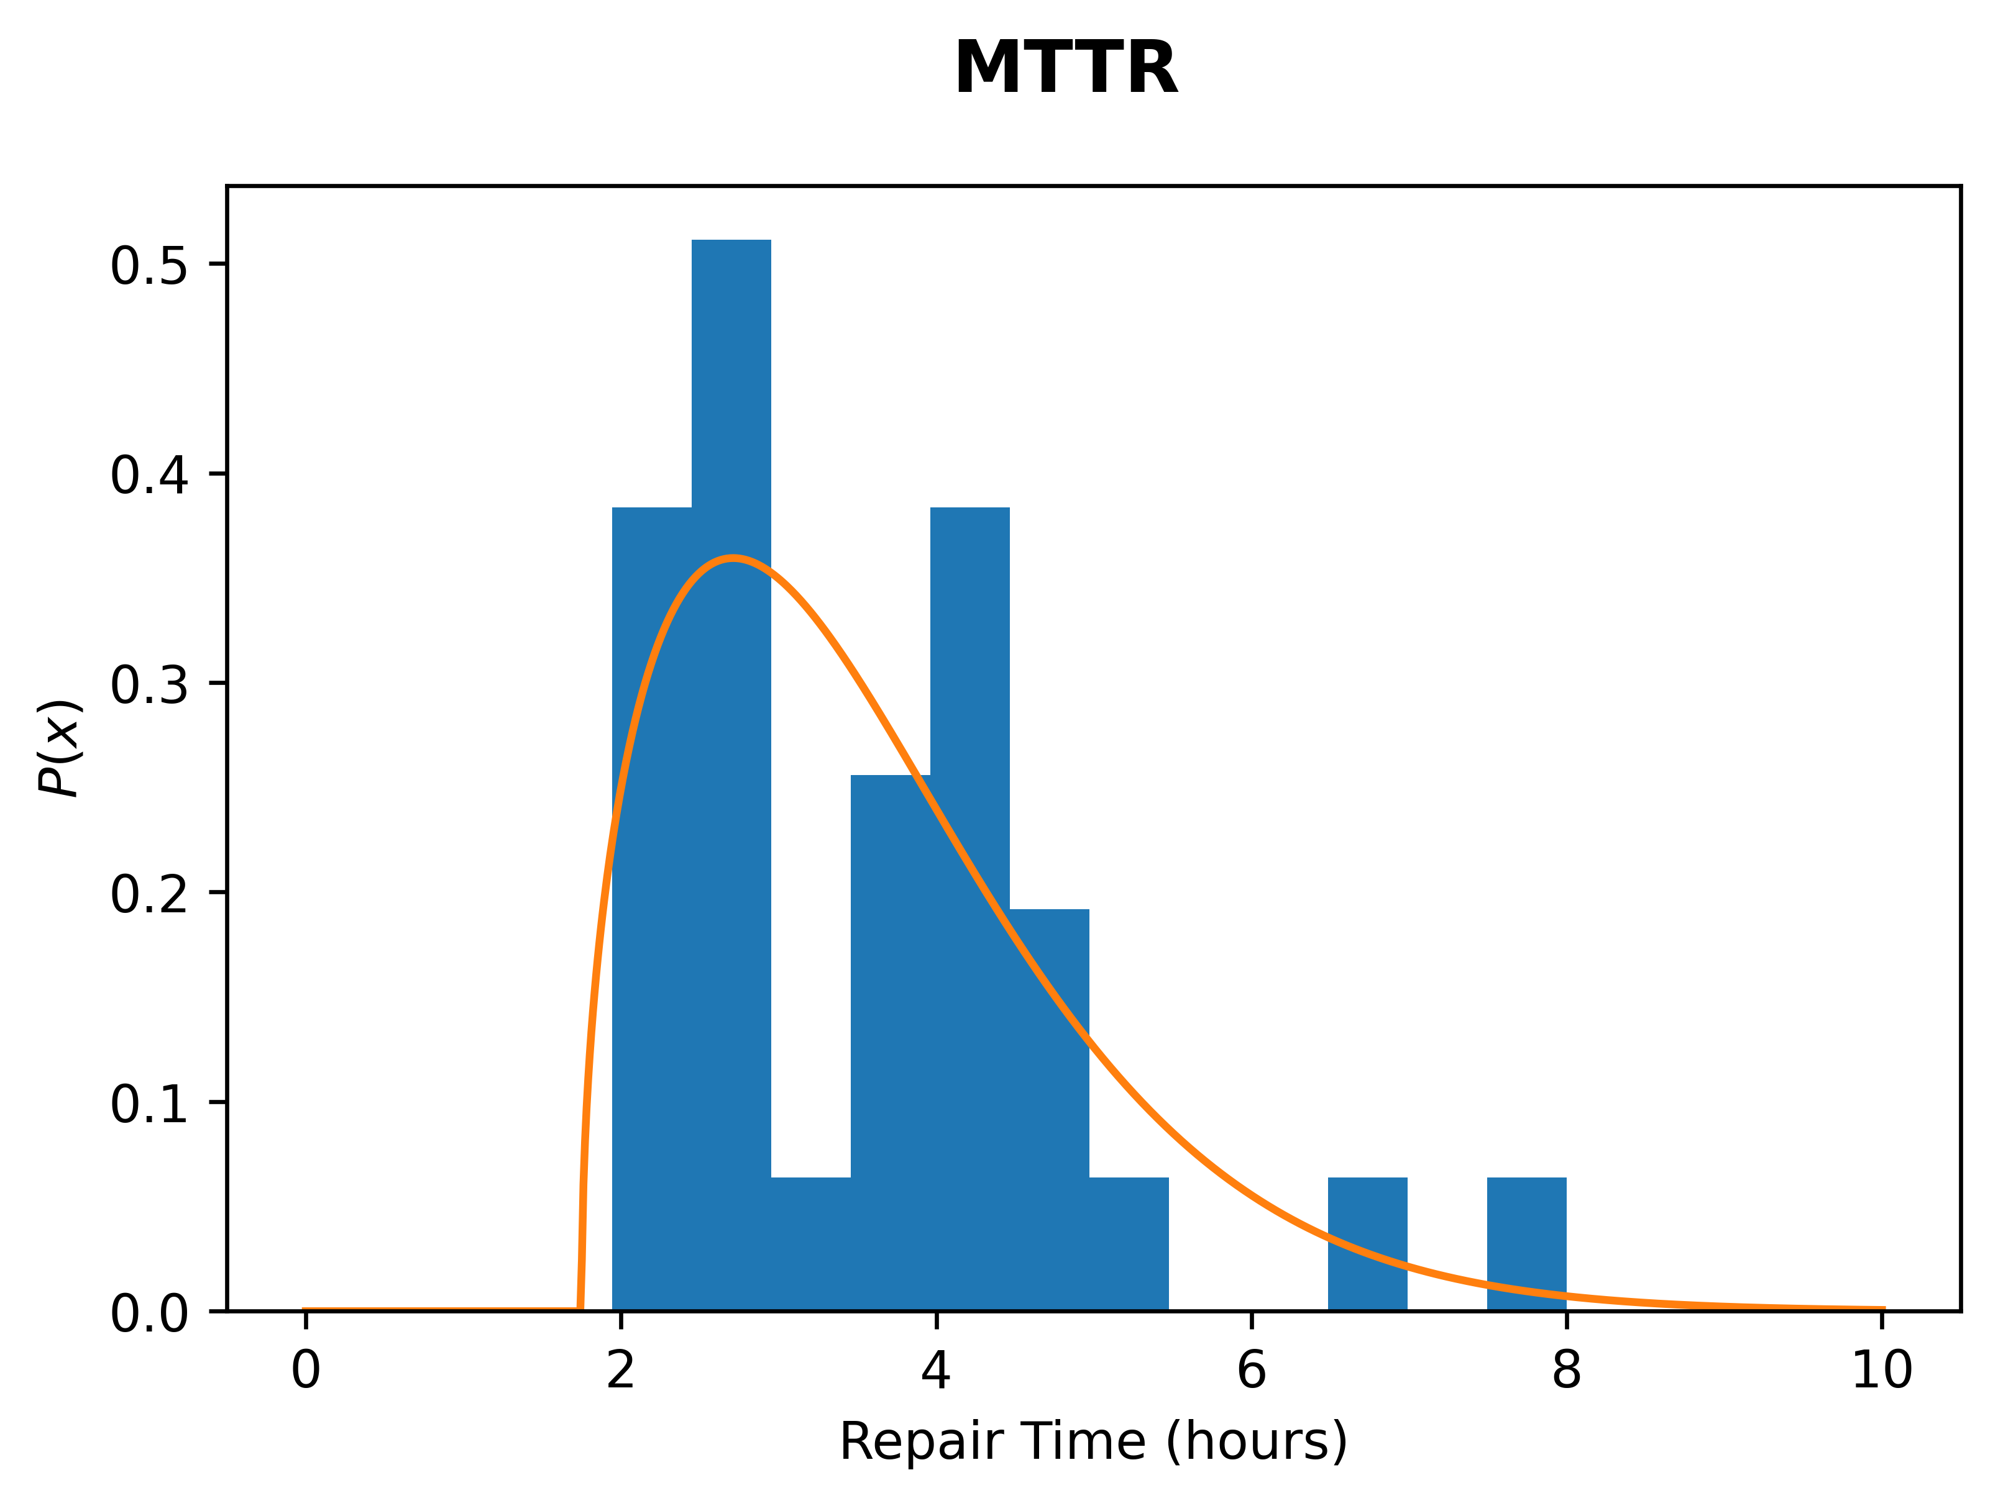
Repair Distribution
PA
Fitting Distribution
  to downtime durations caused by the faults
Shifting Distribution Function
  Only for human fault type (long faults)
  Drive Time: 0.3-2 h (with traffic)
  Cool Down Time: 0.7-24h
0.3 h
PB
PL
1.5 h
0.75 h
0.3 h
1.7 h
Remote Repair Distribution
0.7 h
PD
0.55 h
arc
1.5 h
PJ
1.7 h
0.4 h
1.5 h
Human Repair Distribution
PF
PH
0.8 h
0.6 h
24 h
PG
0.7 h
0.6 h
Approach time
1.5 h
https://www.istockphoto.com/vector/isometric-control-center-gm164401684-15526568
https://www.flaticon.com/free-icon/technician_6342684

Slide 12


“Realistic” Repair Timeline:
2. Forecasts
Operation resumes if possible before humans are in the tunnel
Once human repairs start, they will finish.
Operation
resumes here
Fault
Remote repairs begin immediately
1 h
Diagnosis + attempts to reset from control room
We can’t fix it from here. Get someone out there!
Remote repairs
20 min - 1 h
Repair
Human repairs
Approach time
Humans in tunnel
Cool-Down time
45 min - 24 h

Slide 13
From Subsystems to Luminosity
Failure Distribution
FCC-ee
Availability
Luminosity
Repair Distribution

Slide 14





FCC-ee Operation Cycle
  Z,W
Resonant depolarization is impossible
  $H$,$t\overline{t}$
Dump
Pilot bunch injection
Set Up
Physics
Polarisation
Fill
Adjust
Burn Off
10 min
10 min
1.5 h
$$t_{f}$$
10 min
20 h
$$τ$$
Down for Repair
$$t_{repair}$$
Default
 | Z | W | H | tt
Fill time $t_{f}$ (min) | 7.7 | 2.5 | 1.52 | 1.45
Lifetime $τ$ (min) | 15 | 12 | 12 | 11
Repair completed
Main ring failure
Injector Complex failure
Notes:
Polarization erklären

Slide 15
Results
FCC-ee Baseline

Slide 16

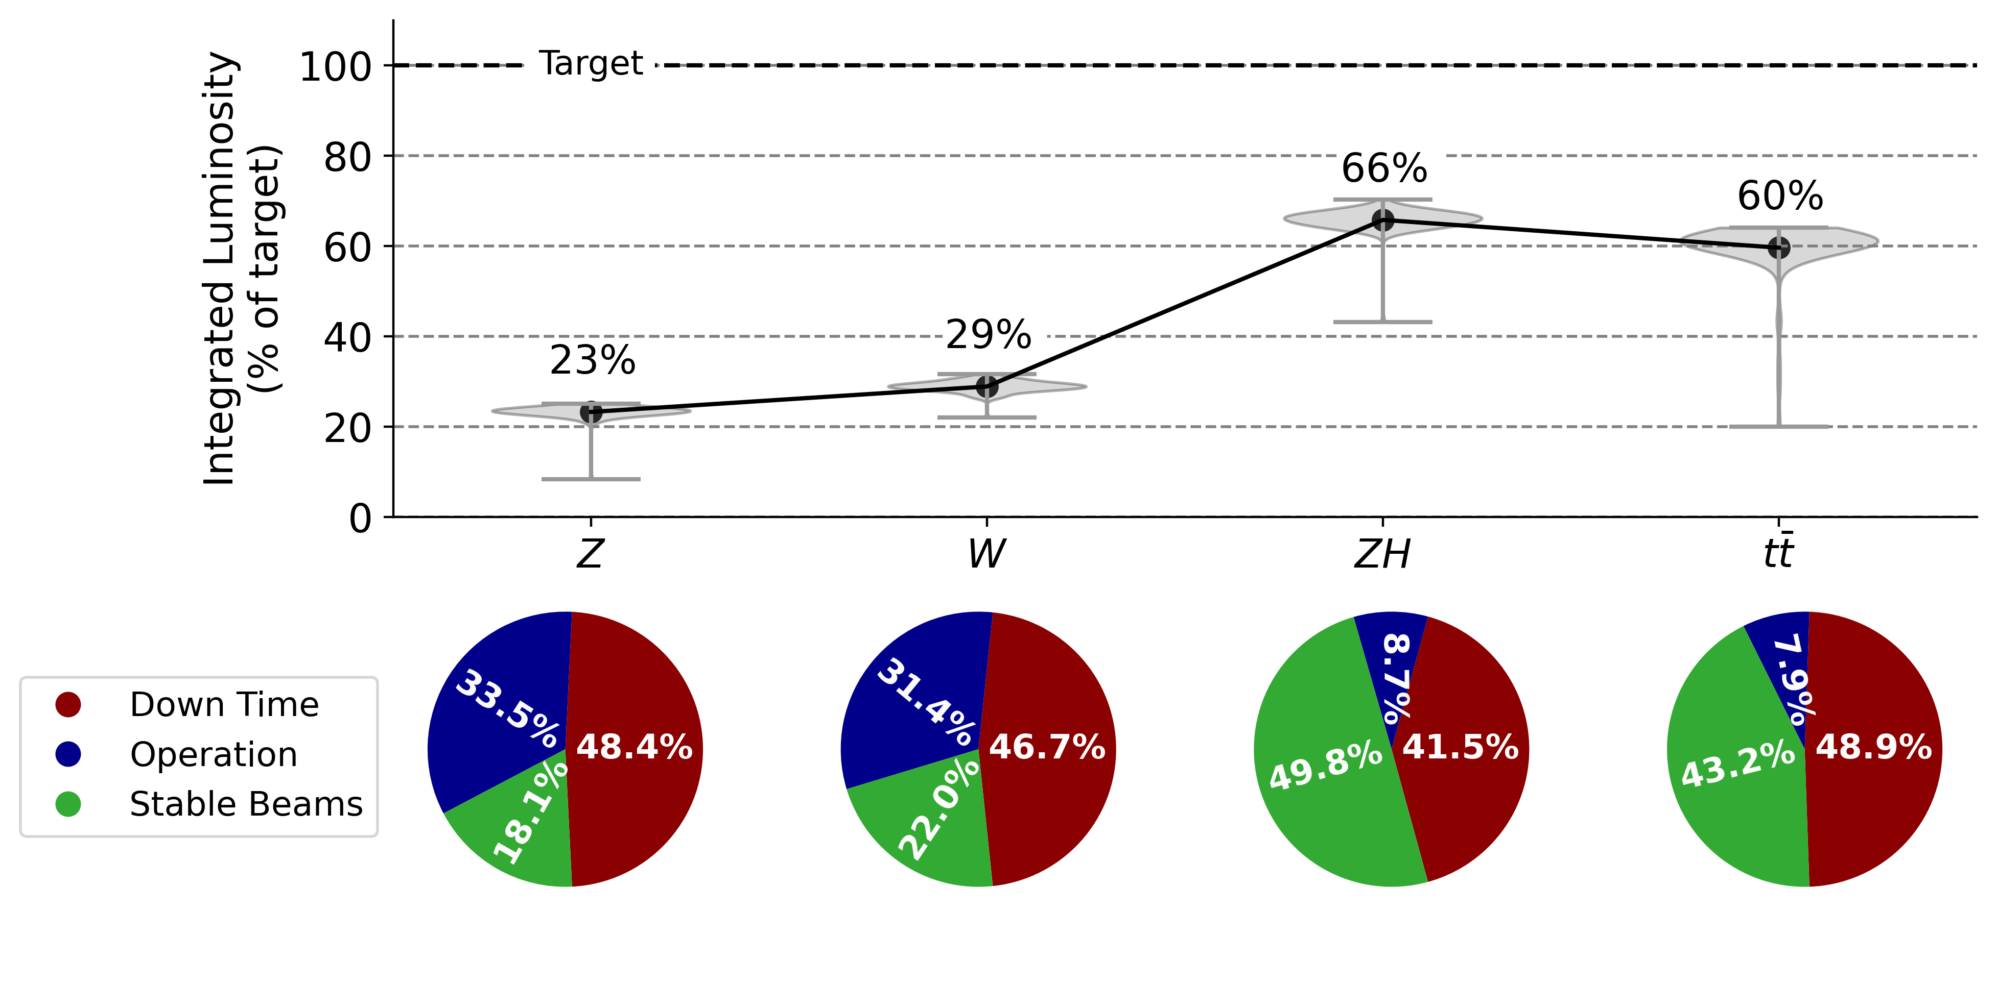
Forecast of Overall Performance
Low availability in all energy modes
  low integrated luminosity
Particularly in Z and W due to additional polarisation phase
 | Z | W | H | tt
Integrated luminosity target [ab-1] | 205 | 19.5 | 10.8 | 3.12
Notes:
Availsim4 logo, gitlab link

Slide 17
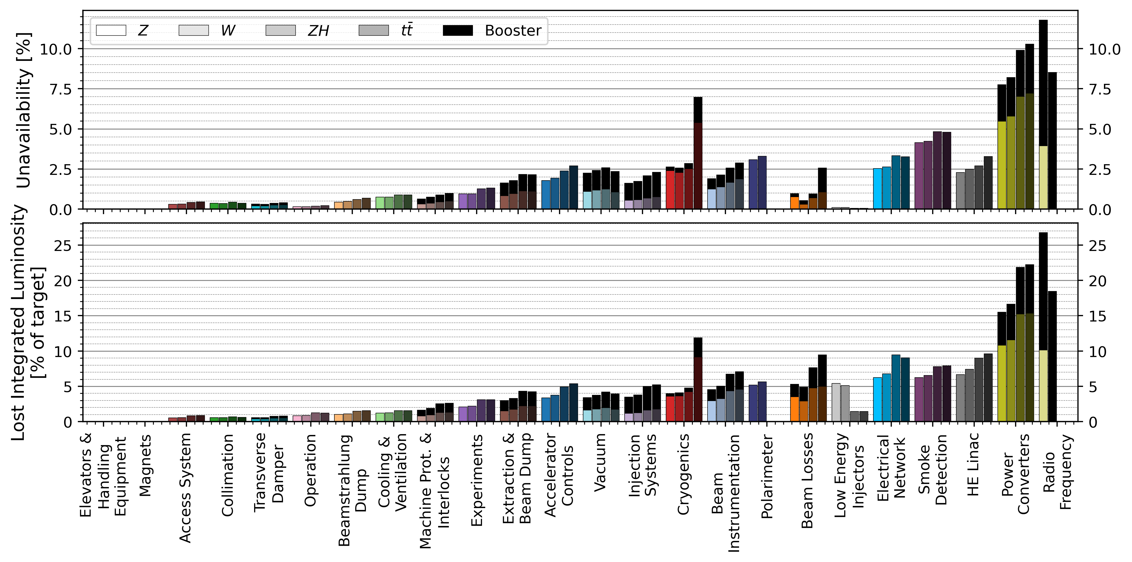
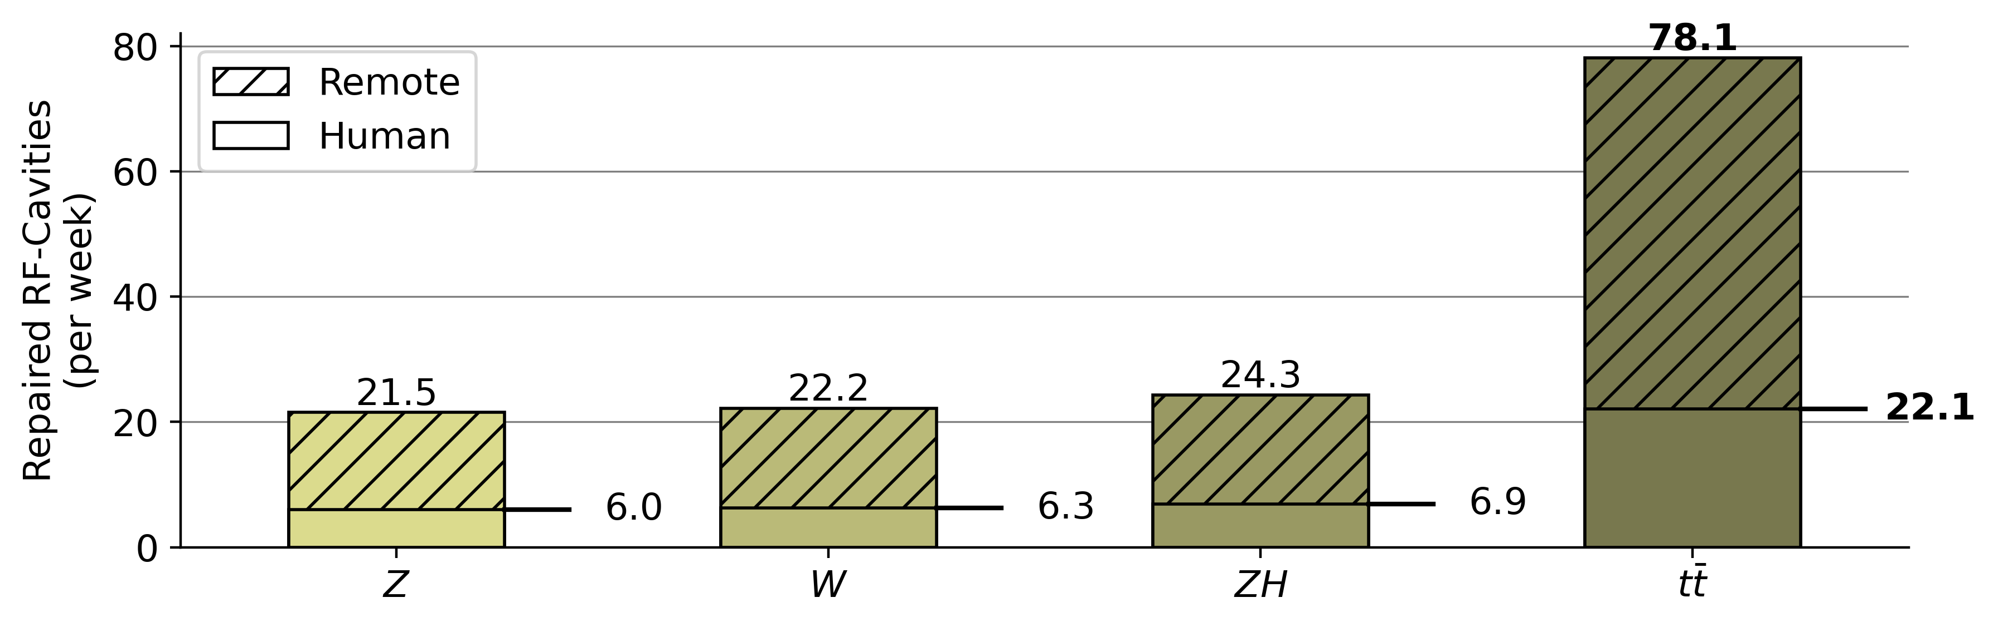
Unavailability & Lost Luminosity
Radio Frequency (RF):
Highest contribution in Z and W mode due to high number of cavities
Already 4.5% redundancy eliminates downtime due to RF system
High repair rate
Collider | Z | W | ZH | tt
cavities | 132* | 132* | 264 | 752
Redundancy [%] | 0.75 | 4.5 | 10 | 10
Booster | Z | W | ZH | tt
cavities | 112 | 112 | 112 | 600
Redundancy [%] | 0 | 0 | 10 | 10
*per ring
Number of RF cavities failing each week
Of which require human access to the tunnel

Slide 18
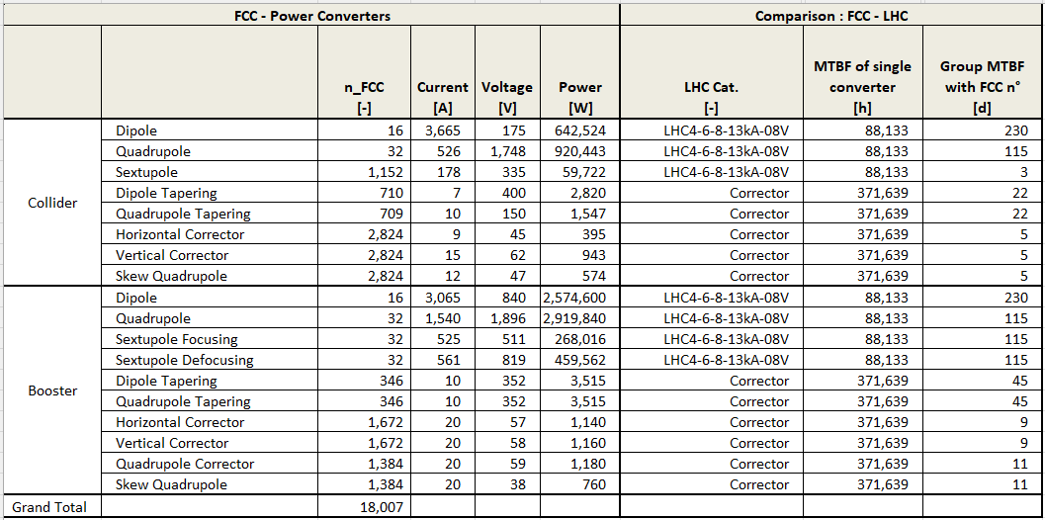
Unavailability & Lost Luminosity
Power Converters:
Highest contribution in ZH and tt
Some converter groups are expected to fail every
    3-5 days

Slide 19
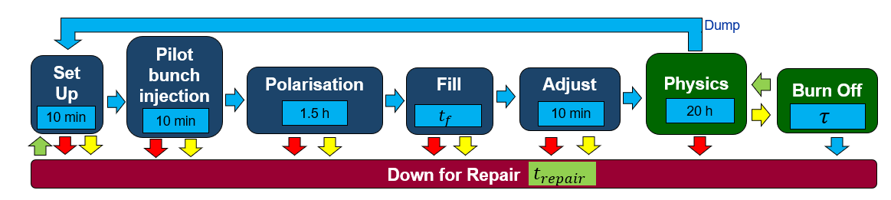
Unavailability & Lost Luminosity
Injector Complex:
sums up to very high contribution
Low Energy Injectors have very short downtime but high fault rate
Due to Turnaround Penalty high lost luminosity
    (Beam Losses shows same effect)
ZH and tt can profit of the Burn Off phase more often
Turnaround Penalty

Slide 20
Unavailability & Lost Luminosity
Technical Infrastructure:
sums up to very high contribution
Cryogenics especially high in tt
due to upgrade of cryoplants after between ZH and tt

Slide 21
Solutions

Slide 22
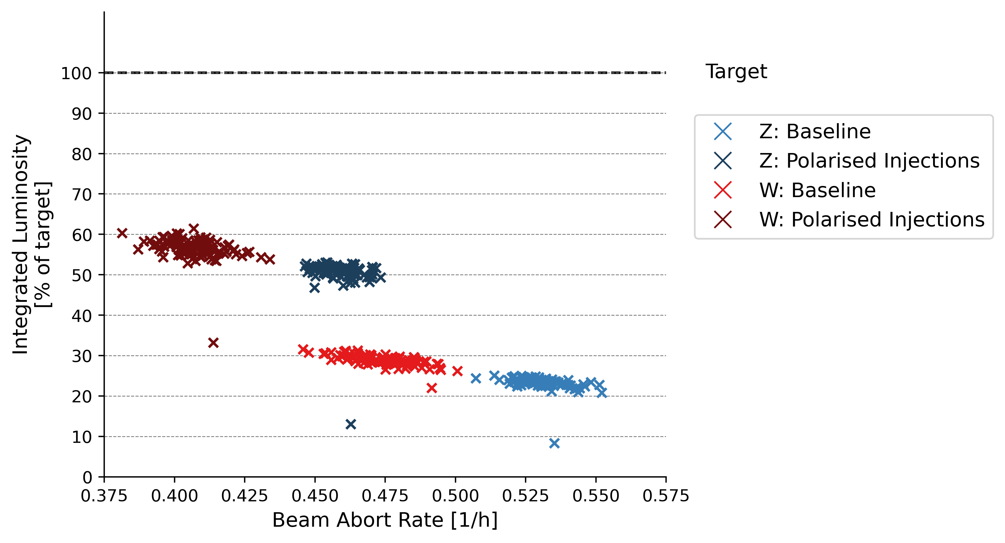
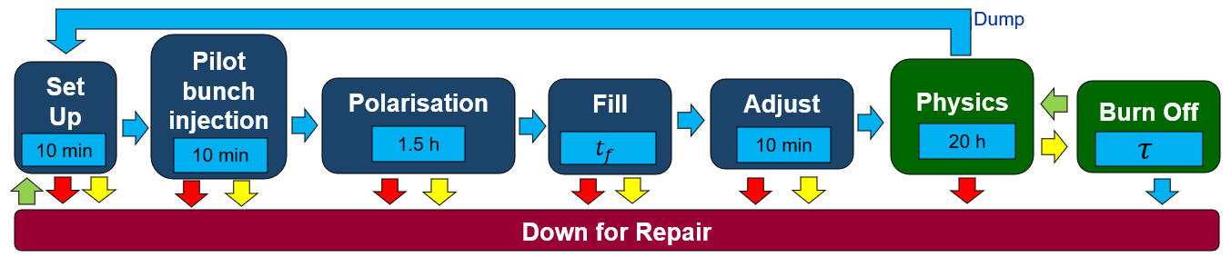
Pre-Polarised Injections
Inject already-polarised bunches:
    Separate polarisation ring in injector complex
doubles the achieved integrated luminosity
Similar results can be achieved with a reliability improvement of 1.2-6.2 of the most failing systems
Polarised Injections Z
Polarised Injections W
  Z,W

Slide 23
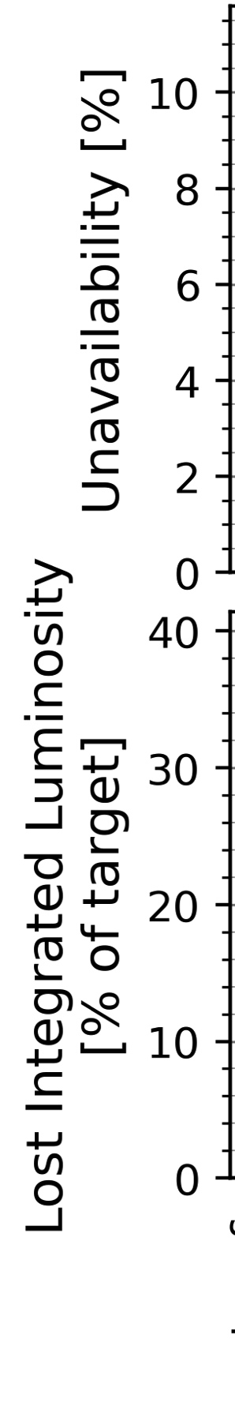
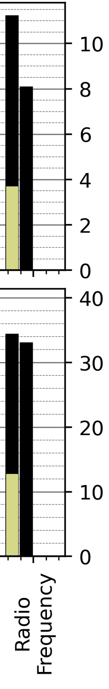
Radio Frequency
RF-Redundancy in Booster might be possible for Z and W (to be studied)
  increases overall achievements by 6-7%
High repair rate still stays problematic
The klystron gallery is accessible to personnel during beam operation
  Opportunity for modular and hot-swappable design of auxiliary systems
Radio Frequency
Collider
Booster
Z
Z
W
W
H
tt
H
tt

Slide 24
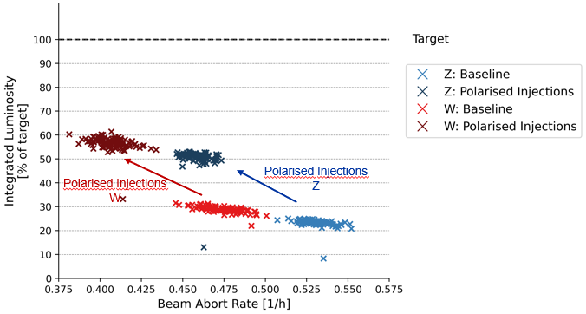
Conclusions
Integrated luminosity predictions extremely low
Systems of highest concern:
  Radio Frequency
  Power Converters
  Injector Complex
  Technical Infrastructure
Operational Cost Implications:
  High repair rate of RF cavities (up to 78 cavities per week)
R&D Opportunity:
  Injection of polarised bunches
  Redundancy / improved reliability for most frequently failing systems

Slide 25
Outlook
Success in FCC-ee requires machine-wide improvement in reliability
Next steps:
    More nuanced reliability models of high-contributing systems as design develops
    Support for modular / hot-swappable design paradigm
    Requirements and milestones
    Optimisation for performance and cost factors
    R&D opportunities evaluation
→ All of this must happen in parallel with design process

Slide 26
Acknowledgements
Jacqueline Keintzel
Franck Peauger
Olivier Brunner
Andy Butterworth
Ivan Karpov
Serge Pittet
David Nisbet
Davide Aguglia
Ben Todd
Byamba Wicki
Jean-Paul Burnet
Klaus Hanke
Chris Roderick
Ioan Kozsar
Alessandro Masi
Damien Lafarge
Tomasz Ladzinski
Verena Kain
Frank Zimmerman
Markus Zerlauth
Jesper Nielsen
Mario Parodi
Charline Marcel
Manfred Wendt
Roderik Bruce
Anton Lechner
Marco Calviani
Antonio Perillo Marcone
Guillermo Peon
Inigo Martin Melero
Laurent Delpraz
Yann Dutheil
Christoph Wiesner
Jan Uythoven
Jeremie Bauche
Wolfgang Hofle
Roberto Kersevan
Gregory Pigny
Rudiger Schmidt
Arjan Verweij
Benoit Salvant
Bernhard Holzer
Bettina Mikulec
Cedric Hernalsteens
Rama Calaga
Roberto Losito
Katsunobu Oide
Hannes Bartosik
Paolo Craievich (PSI)
Masanori Sato (KEK)
William Corocho (SLAC)
Ralph Boespflug (DESY)
Rainer Wanzenberg (DESY)
Michaela Schaumann (DESY)
Cristian Maccarrone (ESRF)
Laurent Hardy (ESRF)
Antoine Chance (CEA)
Jorg Wenninger
Gijs de Rijk
Daniel Valuch
Belen Maria Salvachua Ferrando
Matteo Solfaroli Camillocci
Alice Vanel
Luke Von Freeden
Robert Kieffer
Igor Syratchev
Helga Timko
Rafaele Tegas
Giacomo Lavezzari
Manuel Colmenero Moratalla
Milosz Blaszkiewicz

Slide 28



(2) Inject already-polarized bunches
  Separate polarisation ring in injector complex
(1) Indefinite physics
Pilot bunch lifetime > natural polarization time
  Z,W
Dump
Pilot bunch injection
Set Up
Physics
Polarisation
Fill
Adjust
Burn Off
10 min
10 min
2 h
$$t_{f}$$
10 min
20 h
$$τ$$
Down for Repair
$$t_{repair}$$

Slide 29
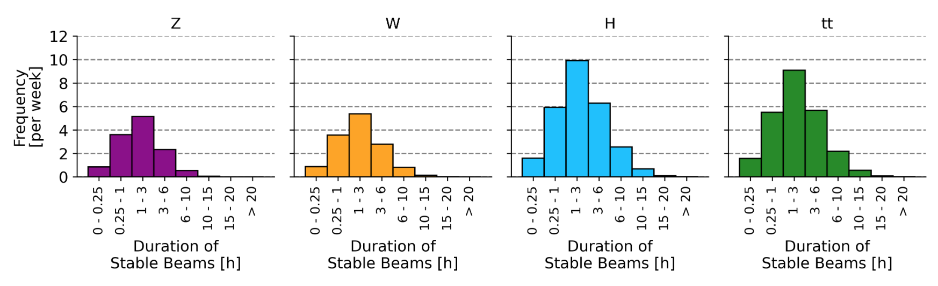
(1) Indefinite physics
Pilot bunch lifetime > natural polarization time
Ineffective without huge improvement in reliability

Slide 30

85-90 % Instantaneous Luminosity
50%
50%
CDR, 2019:
(2 IPs)
82%
44%
90%
43%
87%
89%
50%
luminosity
50%
100%
65%
Mid Term, 2024:
(4 IPs)
1
2
3
4
5
6
7
8
9
10
11
12
13
14
15
16
50%
luminosity
65%
Feasibility Study, 2025:
(4 IPs)
1
2
3
4
5
6
7
8
9
10
11
12
13
14
15
Z
W
H
tt

Slide 31
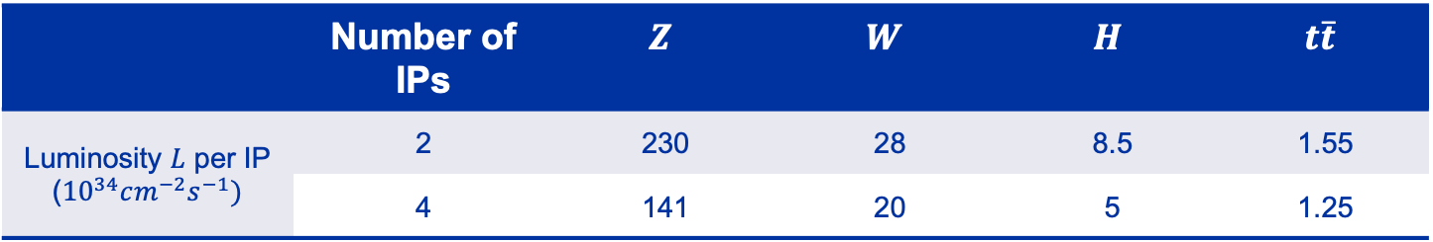
Instantaneous Luminosity
4IPs: Mid Term Configuration, 2024
2IPs: CDR Configuration, 2019
 | Number of IPs | $$Z$$ | $$W$$ | $$H$$ | $$t\overline{t}$$
Luminosity $L$ per IP (${10}^{34}cm^{−2}s^{−1})$ | 2 | 230 | 28 | 8.5 | 1.55
 | 4 | 141 | 20 | 5 | 1.25
These numbers were simulated

Slide 32
Beamstrahlung Dump
Scaled from SPS TIDVG using complexity allocation framework
Six scores:
  Repair Time
  Criticality
  Intricacy
  Technical Maturity
  Performance Time
  Environment
MTBF: 204 h
MTTR: ~1.5h
Placeholder for down time pending thorough availability analysis

Slide 33
Polarimeter
Assumed at target 95% availability
  MTTR: 4 h
  MTBF: 76 h
Full redundancy option (@ PA & PG)
Robert Kieffer, “ATDC FCC Polarimeter Update”, 21st November 2024
https://indico.cern.ch/event/1469279/contributions/6188403/attachments/2971794/5230168/2024_11_21_ATDC_FCC_Polarimeter.pdf

Slide 34
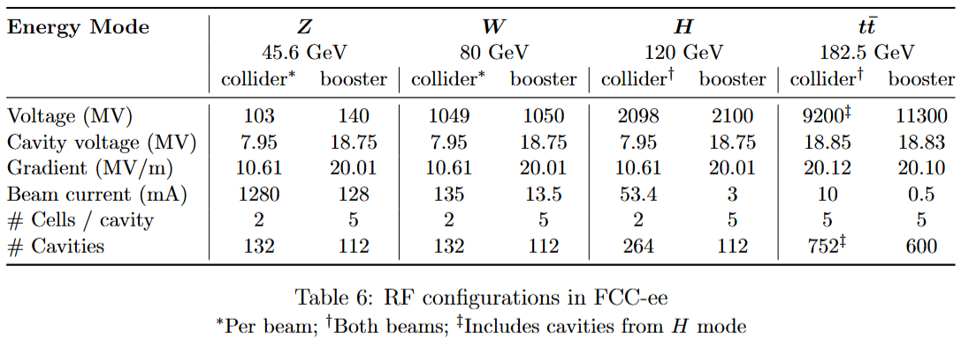


Redundancy (RF System)
Using LHC fault data for single cavity
$Z, W$
High current, beam loading
132 / 112 cavities in collider/booster
Previously:
RF trip => beam dump
(0% redundancy)
Latest analysis:
Redundancy in collider Z: 1 and W: 6 cavities
No redundancy in the booster
$H, t\overline{t}$
Low current, high voltage
132/112 or 752/600 cavities
10% voltage redundancy
J. W. Heron et al., “Machine protection and availability in the FCC-ee,” Engineering; Accelerators and Storage Rings, 2023, https://cds.cern.ch/record/2880188
Ivan Karpov, “Status of the RF study on the 2-cell cavity for Z operation”, 181st FCC-ee Optics Design Meeting & 52nd FCCIS WP2.2 Meeting, 21st March 2024, https://indico.cern.ch/event/1392548/

