Slide 1
Fast failures in fcc-ee
Layout and optics overview, tapering, powering failures
TE-MPE-CB section meeting 17-03-2025 Delphine Domange

Slide 2
Outline
Layout and optics overview
  FCC-ee layout
  Powering scheme
  Optics
  Synchrotron radiation
  Machine protection consideration
Tapering
  What is tapering ?
  Realistic tapering
  Algorithm and implementation
  Results
Powering failure
  Main dipole powering failure
  Simulation
  Results and criticality
  Next steps

Slide 3
Layout and optics overview

Slide 4
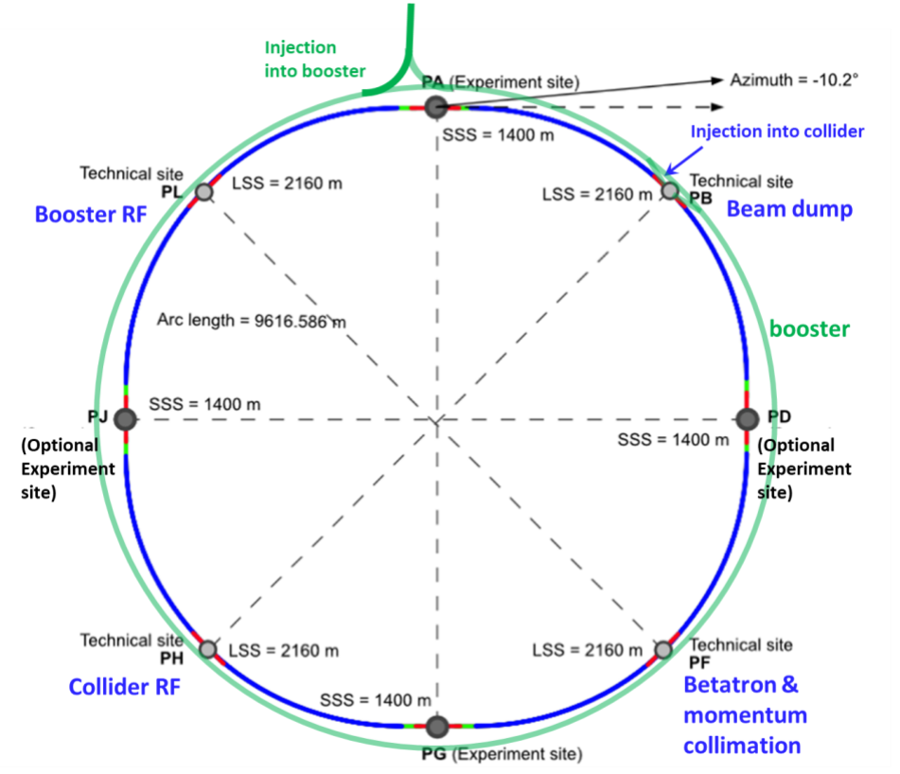
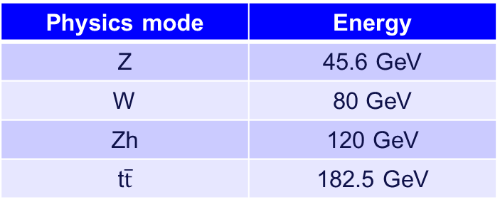
Layout and optics overview
Booster: acceleration from 20 GeV to collision energy
Electron – Positron collider
90.65 km circumference
4 technical insertions
  PB - Injection / Extraction to beam dump
  PF - Collimation
  PH - Collider RF
  PL - Booster RF
4 interaction points – experiments (PA, PD, PG and PJ)
Physics mode | Energy
Z | 45.6 GeV
W | 80 GeV
Zh | 120 GeV
t$\overline{t}$ | 182.5 GeV

Slide 5
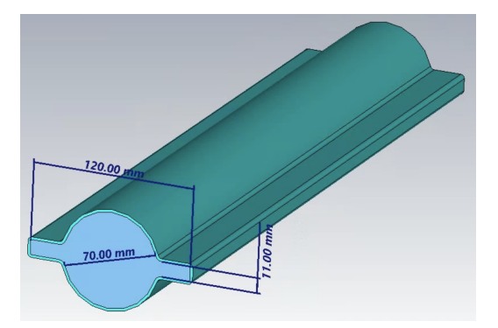
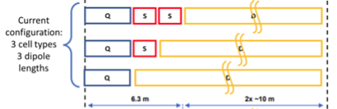
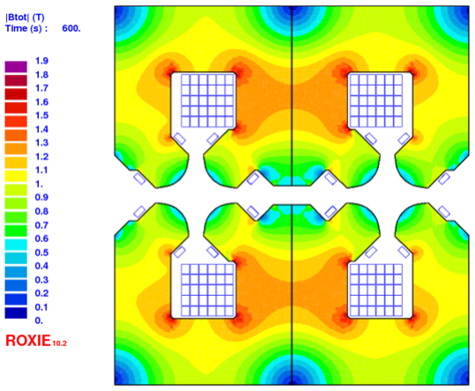
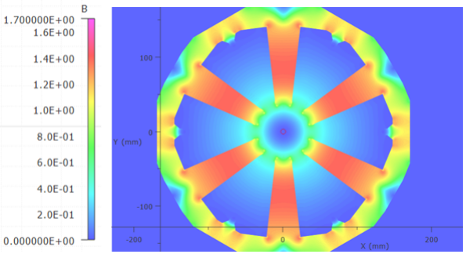
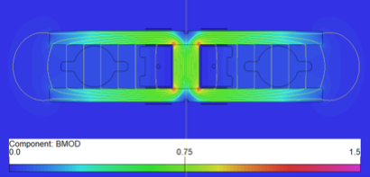
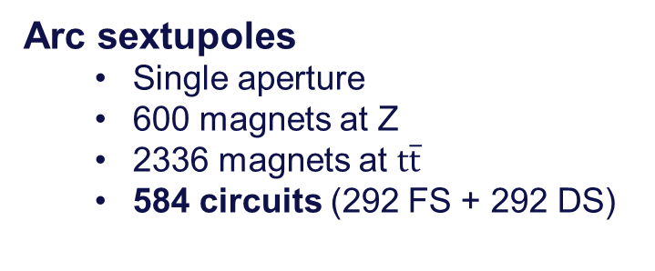
Layout and optics overview
V24.3 GHC layout
Normal conducting magnets (except for the final focusing insertion)
60 mm
Arc dipoles
  Twin aperture
  2840 units (of 2 magnets)
  Half-arc powering
  16 circuits in total
Arc quadrupoles
  Twin aperture
  2836 magnets
  Half-arc powering
  32 circuits (16 FQ + 16 DQ)
Arc sextupoles
  Single aperture
  600 magnets at Z
  2336 magnets at $t\overline{t}$
  584 circuits (292 FS + 292 DS)
Cell configuration and magnet cross-sections from the FCC midterm report May 2024.

Slide 6
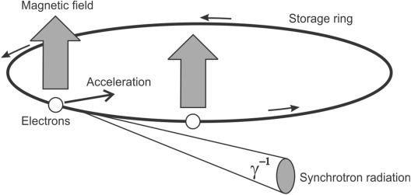
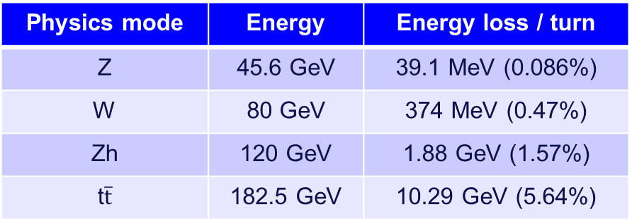
Layout and optics review
Synchrotron radiation
Particles lose energy via photon emission when (transversely) accelerated
  Particle energy varies along the machine
  RF cavities restore the energy but located in a single technical insertion
  Sawtooth shape of the closed orbit
  Damping of the beam
Physics mode | Energy | Energy loss / turn
Z | 45.6 GeV | 39.1 MeV (0.086%)
W | 80 GeV | 374 MeV (0.47%)
Zh | 120 GeV | 1.88 GeV (1.57%)
t$\overline{t}$ | 182.5 GeV | 10.29 GeV (5.64%)

Slide 7
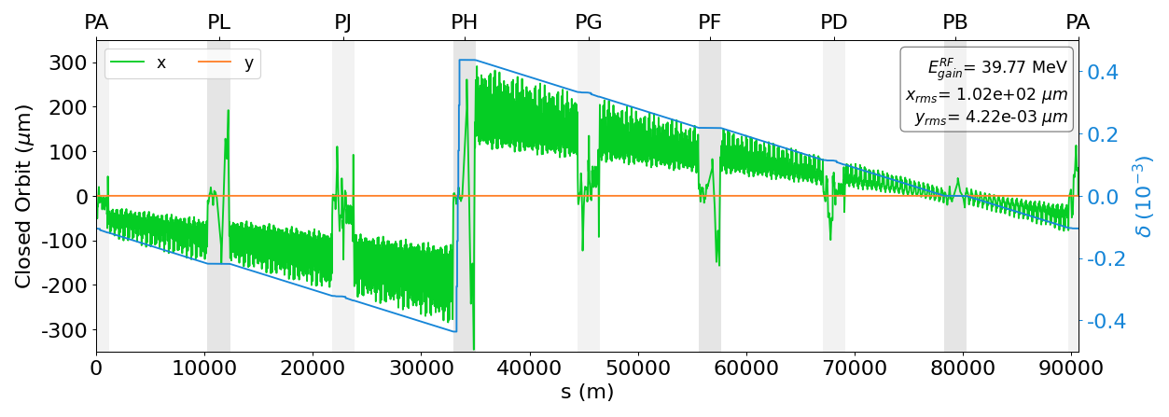
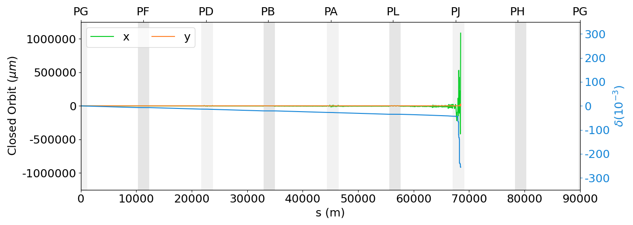
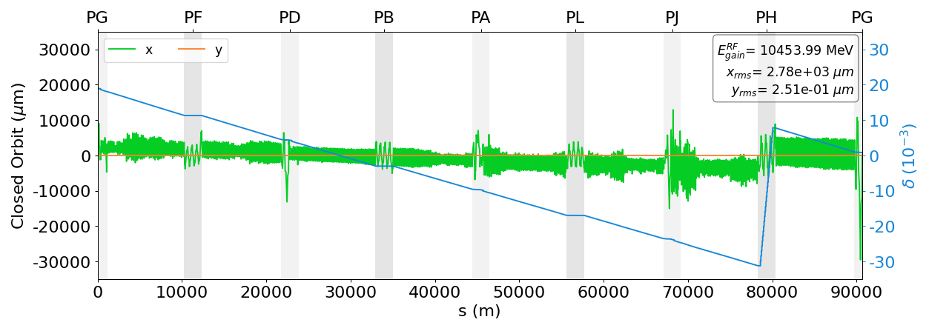

Layout an optics review
Sawtooth shape orbit
Z-pole energy
$t\overline{t}$ energy

Slide 8
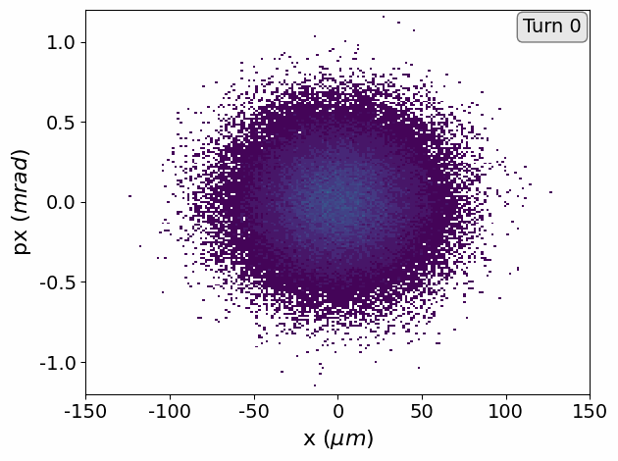
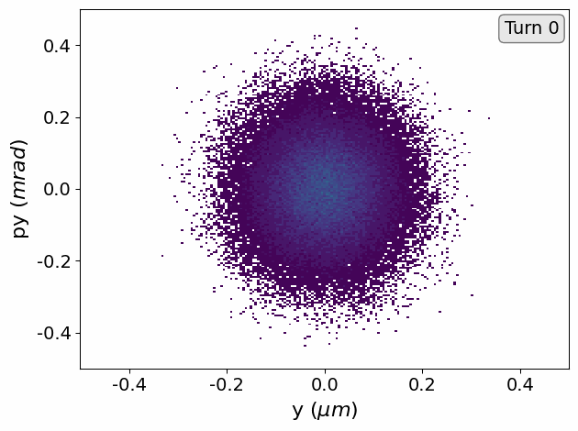
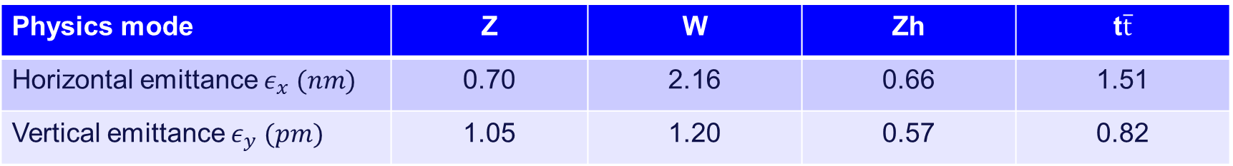
Layout and optics review
Damping (anti-damping) of the beam
Very small transverse beam size
Physics mode | Z | W | Zh | t$\overline{t}$
Horizontal emittance $ε_{x} (nm)$ | 0.70 | 2.16 | 0.66 | 1.51
Vertical emittance $ε_{y} (pm)$ | 1.05 | 1.20 | 0.57 | 0.82

Slide 9
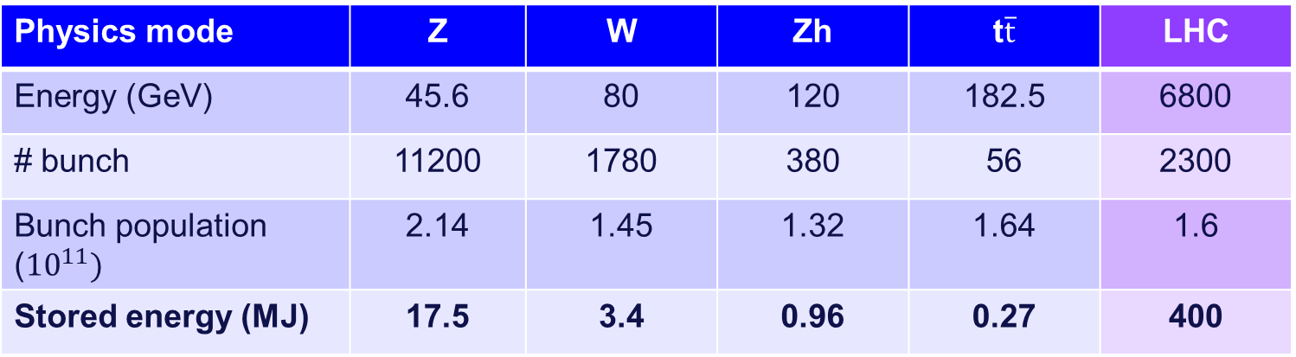
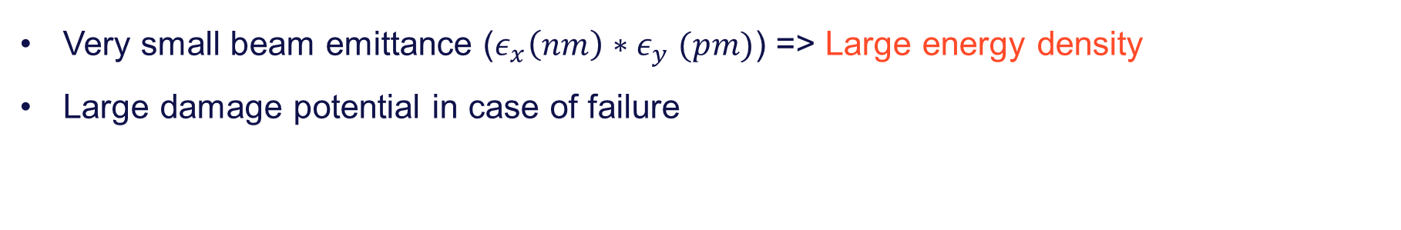
Layout and optics review
Motivations for machine protection
Physics mode | Z | W | Zh | t$\overline{t}$ | LHC
Energy (GeV) | 45.6 | 80 | 120 | 182.5 | 6800
# bunch | 11200 | 1780 | 380 | 56 | 2300
Bunch population (${10}^{11})$ | 2.14 | 1.45 | 1.32 | 1.64 | 1.6
Stored energy (MJ) | 17.5 | 3.4 | 0.96 | 0.27 | 400
Very small beam emittance ($ε_{x}\left(nm\right)∗ε_{y} (pm)$) => Large energy density
Large damage potential in case of failure

Slide 10
Tapering

Slide 11
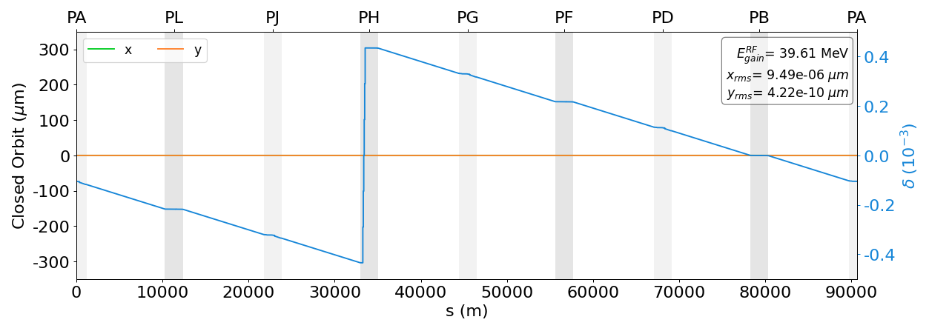
Tapering
Tapering: local correction of the magnet strength to compensate for variation in particle energy
Ideal tapering
  Individual correction for each magnet
  Minimise the closed orbit

Slide 12
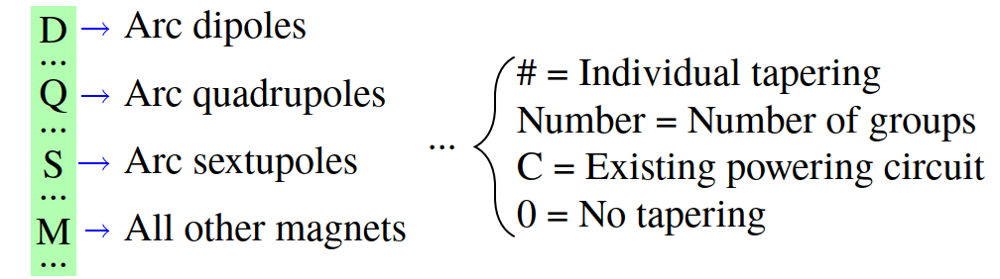
Tapering
Realistic tapering
  Mean correction for a group of magnets
  Different configurations studied
Example: D64Q32SCM#

Slide 13
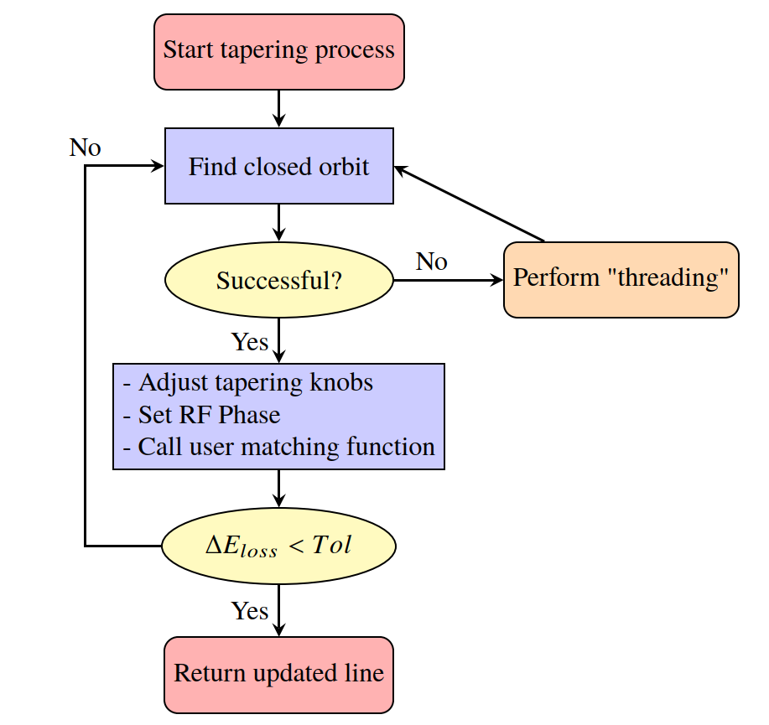
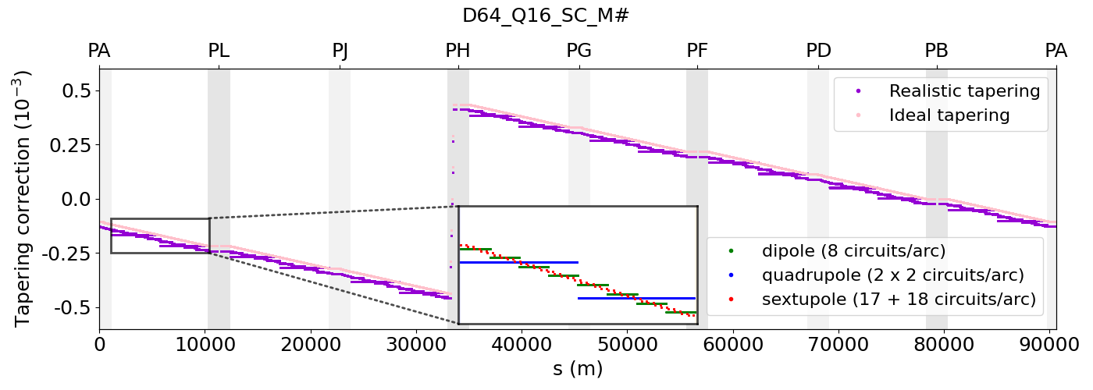

Tapering
Threading
i
j
Algorithm and implementation
i
j
*
i
j
*
i
j
*
*${k_{j} →k_{j}+p}_{τ_{ij}}$
*

Slide 14
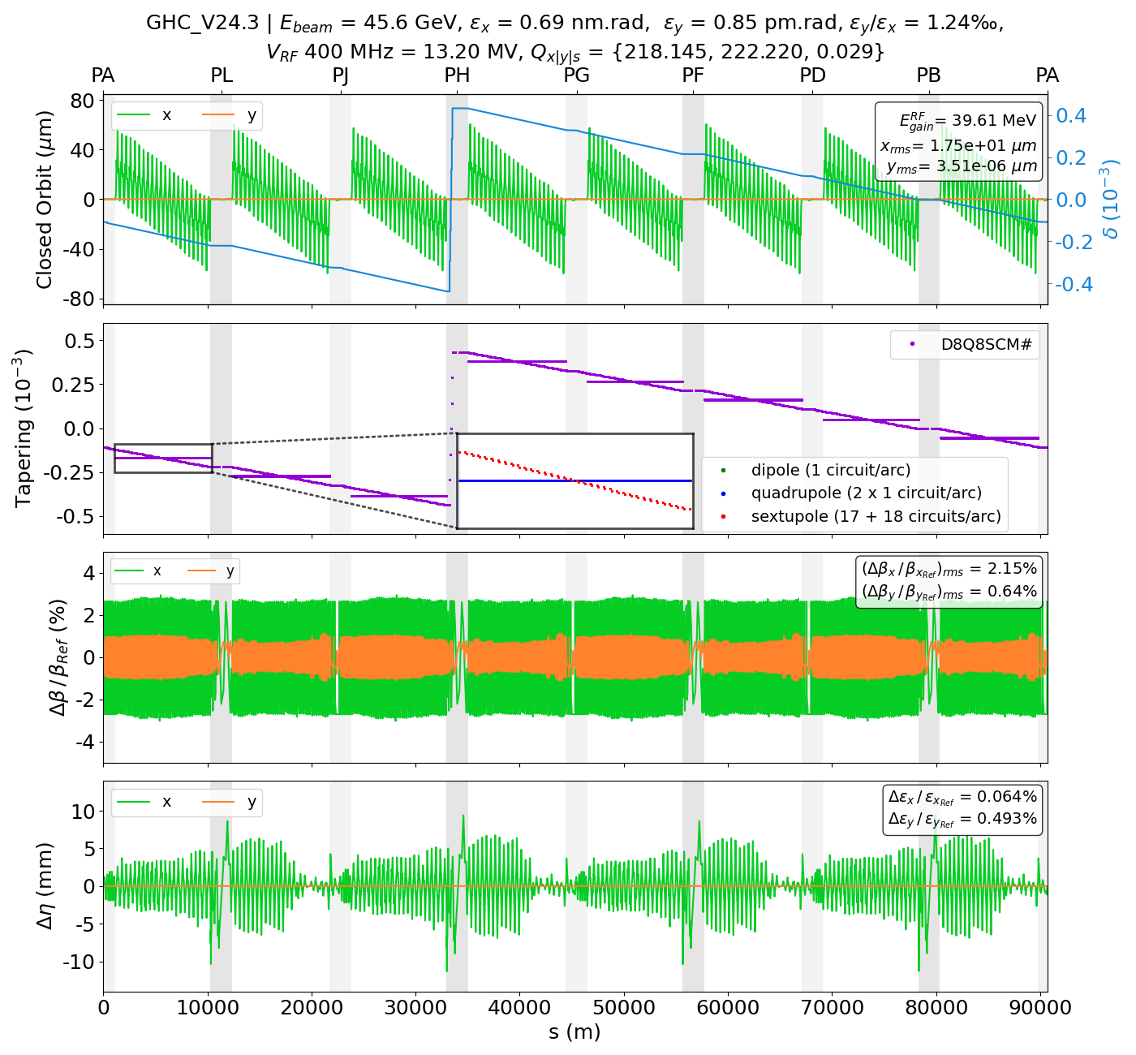
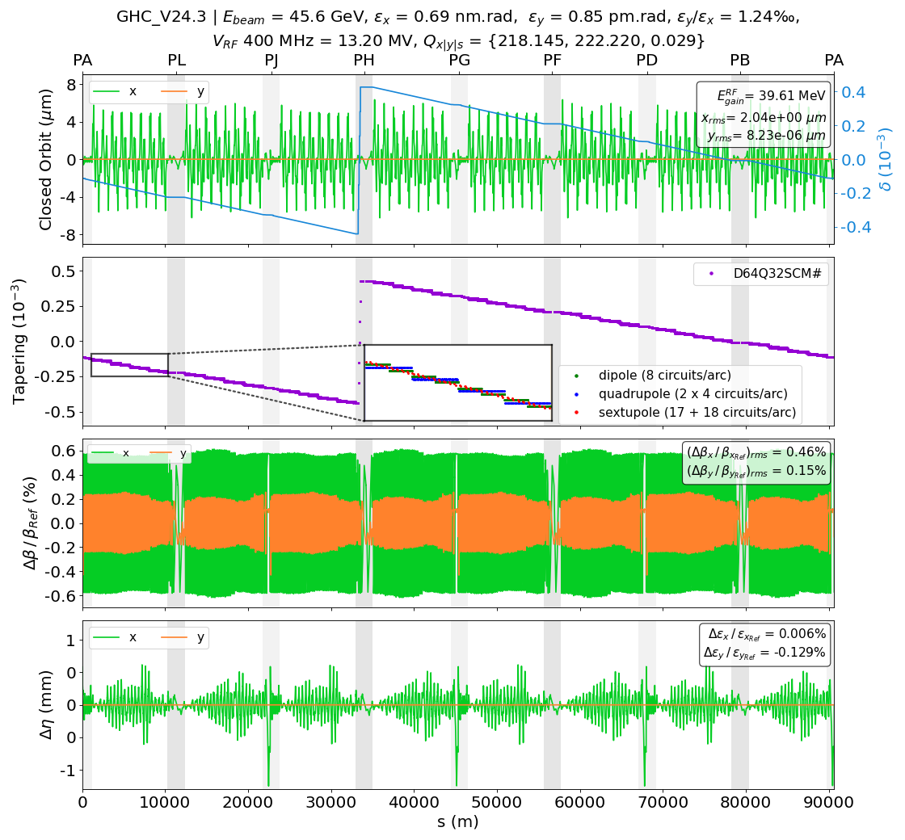
Realistic tapering Z-pole energy

Slide 15
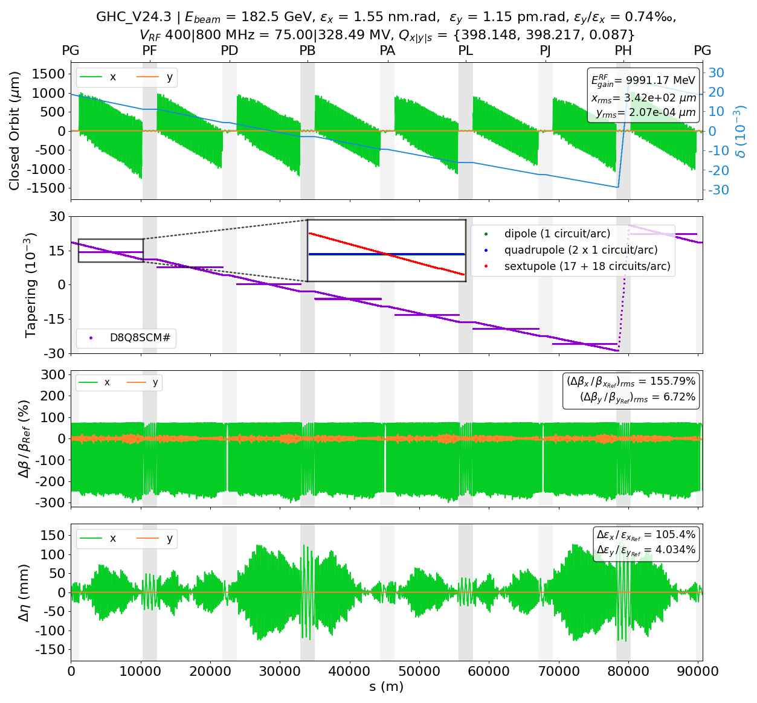
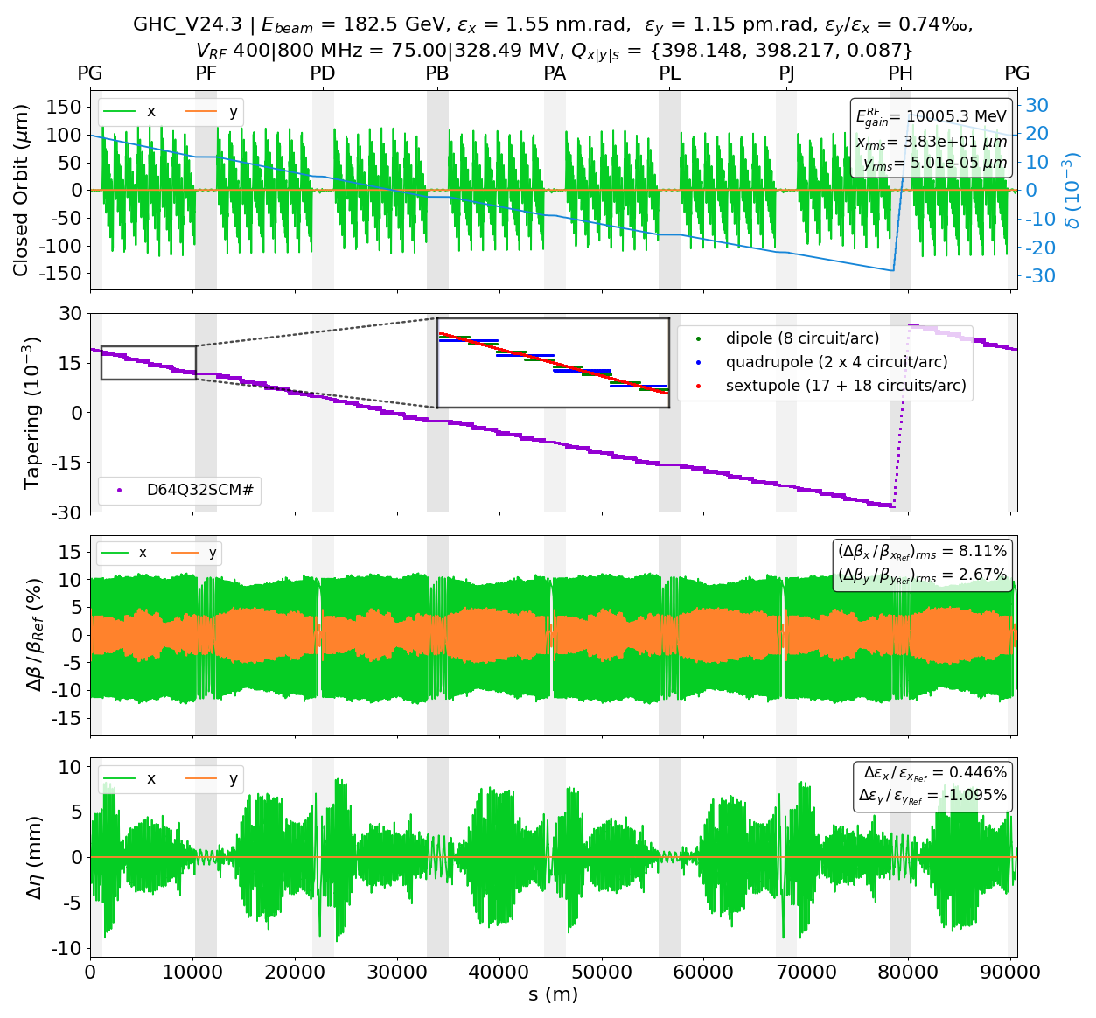
Realistic tapering $t\overline{t}$ energy

Slide 16
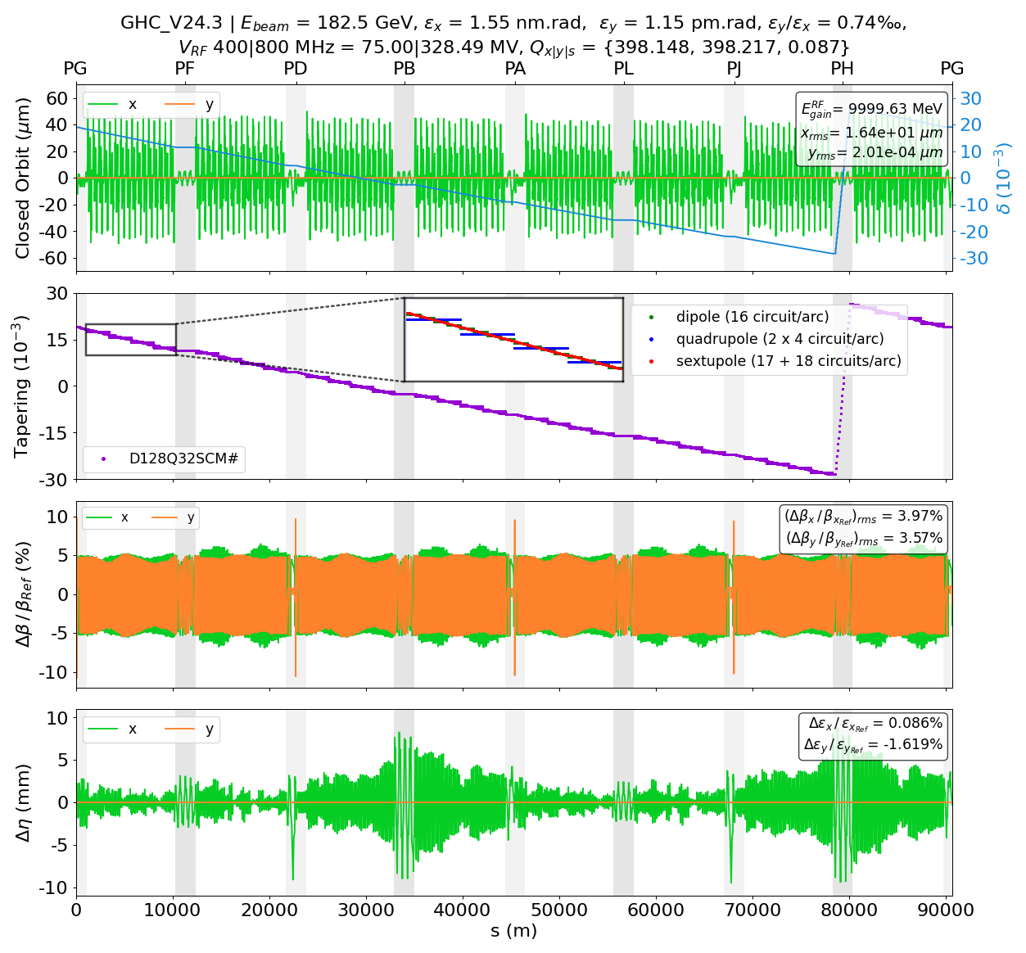
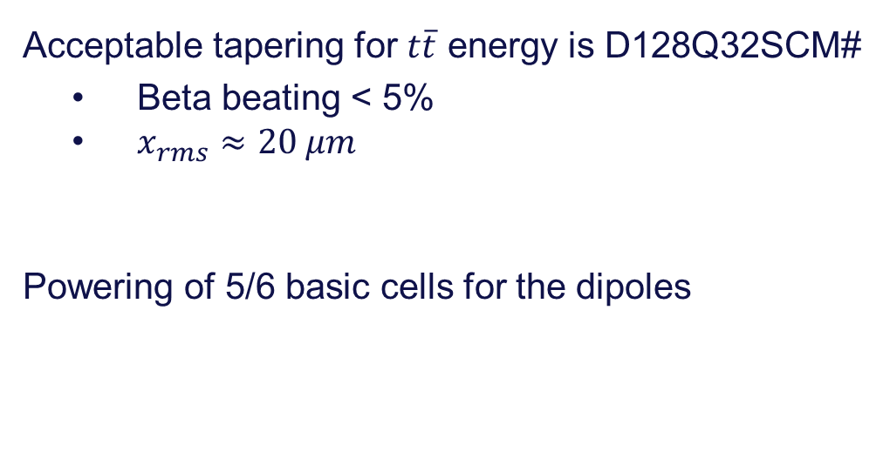
Realistic tapering $t\overline{t}$ energy
Acceptable tapering for $t\overline{t}$ energy is D128Q32SCM#
  Beta beating < 5%
  $x_{rms}≈20 μm$
Powering of 5/6 basic cells for the dipoles
Cell configuration from the FCC midterm report May 2024.

Slide 17
Powering failure

Slide 18
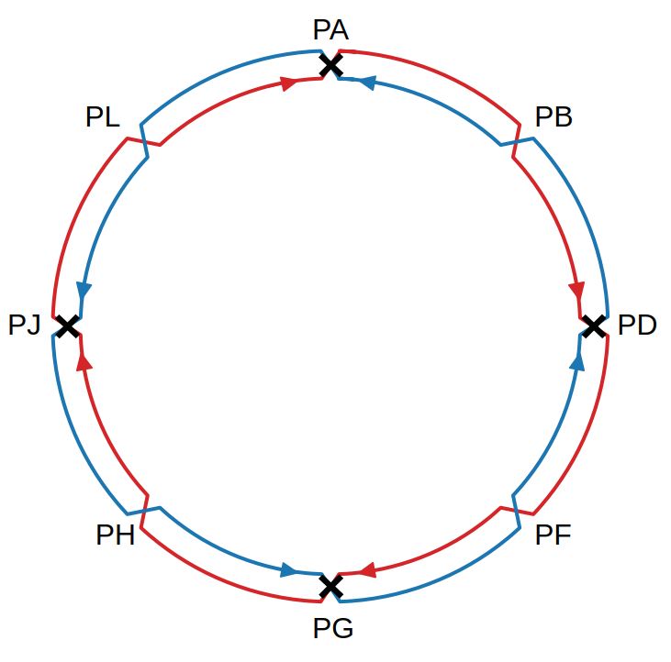
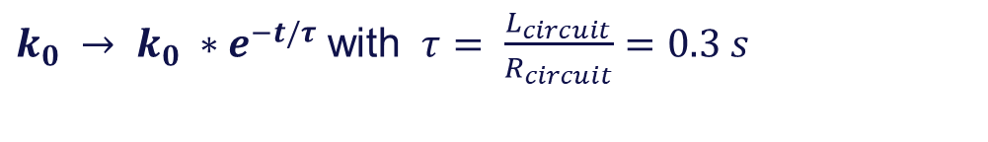

Powering failure
Main dipole power converter failure
Half-arc powering: 175/180 dipoles in series
Loss of a power converter => Fast decay of the bending magnetic field
~ 10 turns to lose 1% of the bending magnetic field
$k_{0} → k_{0} ∗e^{−t/τ}$ with $τ= \frac{L_{circuit}}{R_{circuit}}=0.3 s$
Failing circuit naming convention: Arc PA-PL.1
  $$L_{circuit}=L_{dip}=2∗0.092 mH$$
  $$R_{circuit}= R_{dip}=0.62 mΩ$$
FCC Xsuite model for simulation
  Synchrotron radiation
  Tapering
  Beamstrahlung
  Beam-beam
  Solenoid

Slide 19
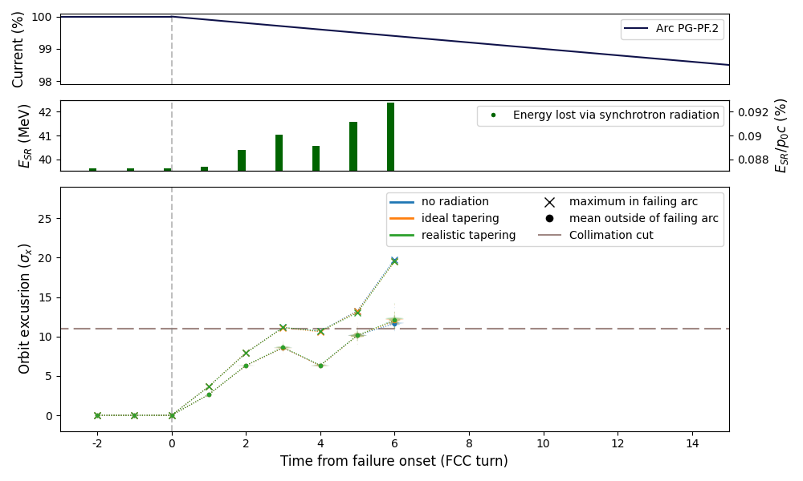


Main dipoles powering failure
Z-pole energy, Arc PG-PF.2
$$p_{x_{norm}}$$
$$x_{norm}$$
$$Orbit excursion=\sqrt{x_{norm}^{2}+p_{x_{norm}}^{2}}$$

Slide 20
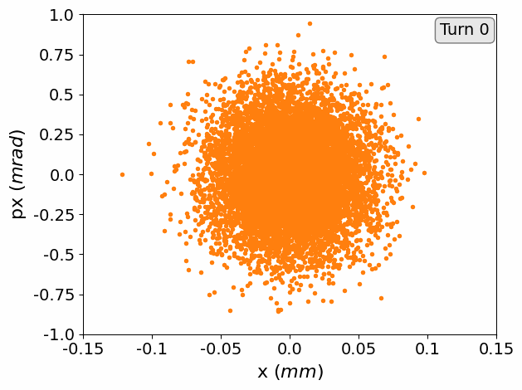
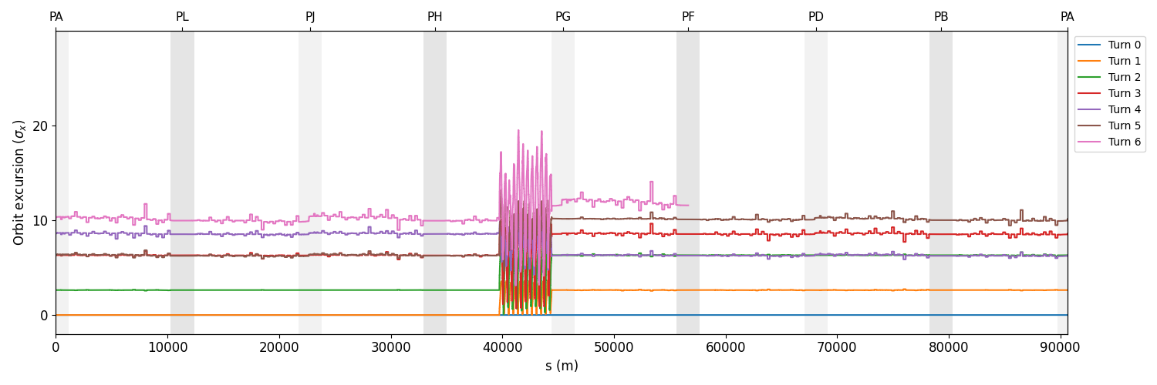
Main dipoles powering failure
Z-pole energy, Arc PG-PF.2
Single particle tracking along the machine

Slide 21
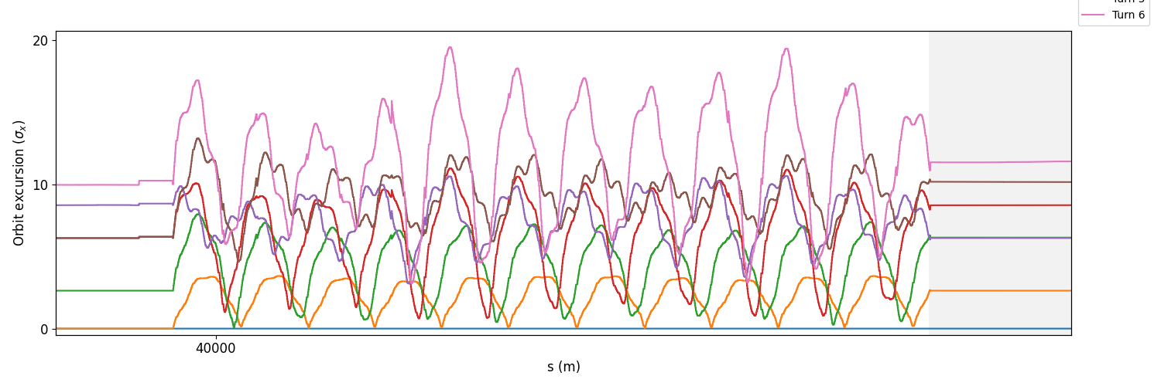
Main dipoles powering failure
Z-pole energy, Arc PG-PF.2
Single particle tracking along the machine

Slide 22
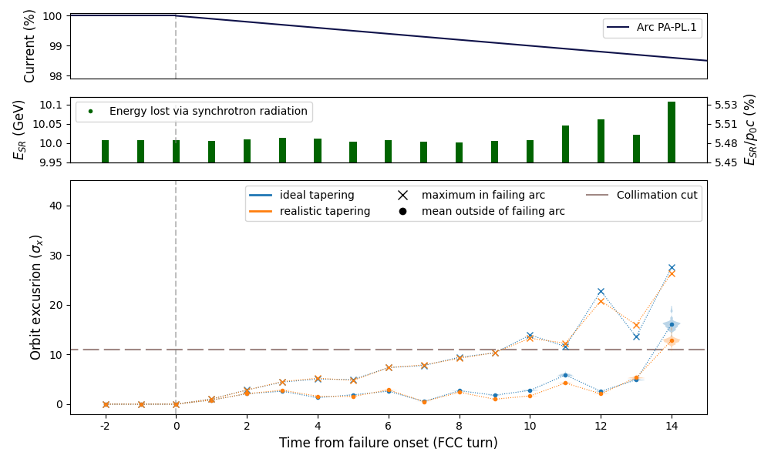
Main dipoles powering failure
ttbar energy, Arc PA-PL.1

Slide 23
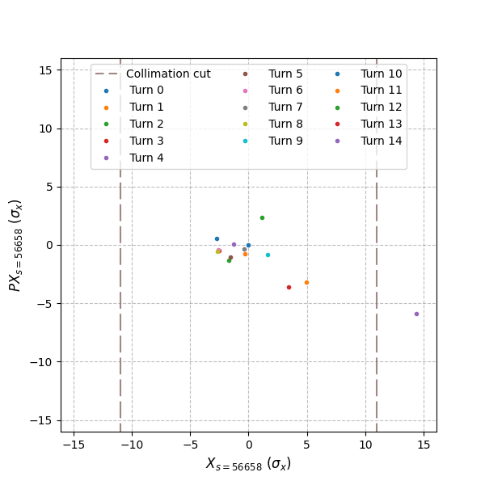
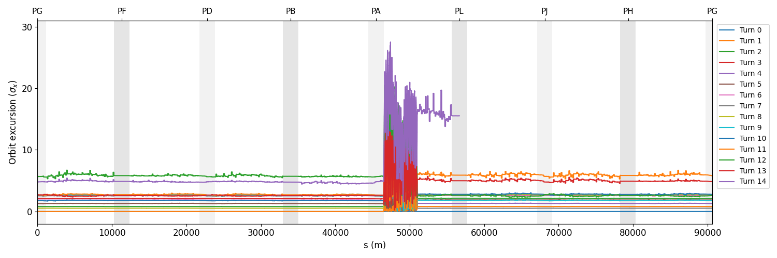
Main dipoles powering failure
ttbar energy, Arc PA-PL.1
Single particle tracking along the machine

Slide 24
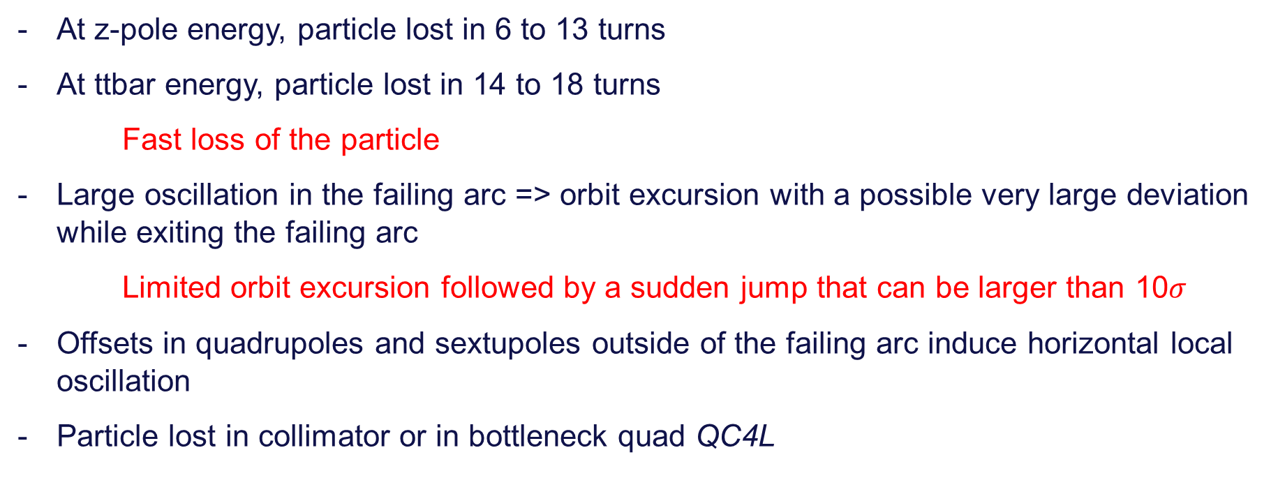
Main dipoles powering failure
Conclusions
At z-pole energy, particle lost in 6 to 13 turns
At ttbar energy, particle lost in 14 to 18 turns
Fast loss of the particle
Large oscillation in the failing arc => orbit excursion with a possible very large deviation while exiting the failing arc
  Limited orbit excursion followed by a sudden jump that can be larger than 10$σ$
Offsets in quadrupoles and sextupoles outside of the failing arc induce horizontal local oscillation
Particle lost in collimator or in bottleneck quad QC4L

Slide 25
Main dipoles powering failure
Next steps
Improve tracking simulations
  Bunch tracking
  Include beamstrahlung
  Include detailed collimation insertion (waiting input from BE-ABP)
Consider possible protection and mitigation system
Extend the powering failure study to the main quadrupoles and main sextupoles

Slide 26
Backup slides

Slide 27
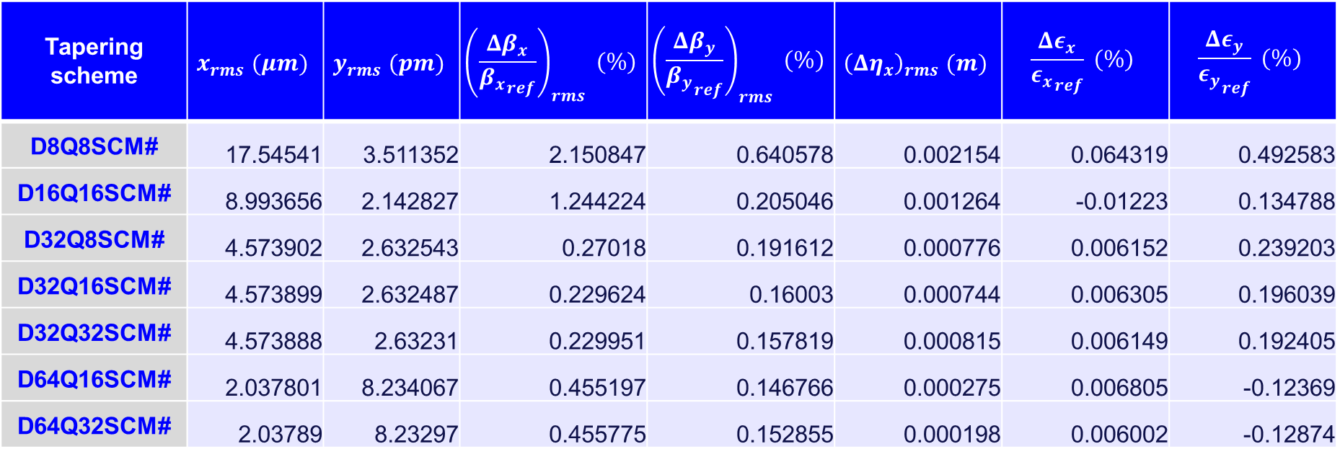
Tapering
Comparison of realistic tapering scheme – Z-pole energy
Tapering scheme | $$x_{rms} (μm)$$ | $$y_{rms} (pm)$$ | $${\left(\frac{Δβ_{x}}{{β_{x}}_{ref}}\right)}_{rms} (\%)$$ | $${\left(\frac{Δβ_{y}}{{β_{y}}_{ref}}\right)}_{rms} (\%)$$ | $${\left(Δη_{x}\right)}_{rms} (m)$$ | $$\frac{Δε_{x}}{{ε_{x}}_{ref}} (\%)$$ | $$\frac{Δε_{y}}{{ε_{y}}_{ref}} (\%)$$
D8Q8SCM# | 17.54541 | 3.511352 | 2.150847 | 0.640578 | 0.002154 | 0.064319 | 0.492583
D16Q16SCM# | 8.993656 | 2.142827 | 1.244224 | 0.205046 | 0.001264 | -0.01223 | 0.134788
D32Q8SCM# | 4.573902 | 2.632543 | 0.27018 | 0.191612 | 0.000776 | 0.006152 | 0.239203
D32Q16SCM# | 4.573899 | 2.632487 | 0.229624 | 0.16003 | 0.000744 | 0.006305 | 0.196039
D32Q32SCM# | 4.573888 | 2.63231 | 0.229951 | 0.157819 | 0.000815 | 0.006149 | 0.192405
D64Q16SCM# | 2.037801 | 8.234067 | 0.455197 | 0.146766 | 0.000275 | 0.006805 | -0.12369
D64Q32SCM# | 2.03789 | 8.23297 | 0.455775 | 0.152855 | 0.000198 | 0.006002 | -0.12874

Slide 28
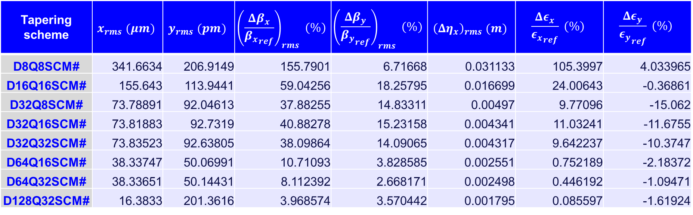
Tapering
Comparison of realistic tapering scheme – $t\overline{t}$ energy
Tapering scheme | $$x_{rms} (μm)$$ | $$y_{rms} (pm)$$ | $${\left(\frac{Δβ_{x}}{{β_{x}}_{ref}}\right)}_{rms} (\%)$$ | $${\left(\frac{Δβ_{y}}{{β_{y}}_{ref}}\right)}_{rms} (\%)$$ | $${\left(Δη_{x}\right)}_{rms} (m)$$ | $$\frac{Δε_{x}}{{ε_{x}}_{ref}} (\%)$$ | $$\frac{Δε_{y}}{{ε_{y}}_{ref}} (\%)$$
D8Q8SCM# | 341.6634 | 206.9149 | 155.7901 | 6.71668 | 0.031133 | 105.3997 | 4.033965
D16Q16SCM# | 155.643 | 113.9441 | 59.04256 | 18.25795 | 0.016699 | 24.00643 | -0.36861
D32Q8SCM# | 73.78891 | 92.04613 | 37.88255 | 14.83311 | 0.00497 | 9.77096 | -15.062
D32Q16SCM# | 73.81883 | 92.7319 | 40.88278 | 15.23158 | 0.004341 | 11.03241 | -11.6755
D32Q32SCM# | 73.83523 | 92.63805 | 38.09864 | 14.09065 | 0.004317 | 9.642237 | -10.3747
D64Q16SCM# | 38.33747 | 50.06991 | 10.71093 | 3.828585 | 0.002551 | 0.752189 | -2.18372
D64Q32SCM# | 38.33651 | 50.14431 | 8.112392 | 2.668171 | 0.002498 | 0.446192 | -1.09471
D128Q32SCM# | 16.3833 | 201.3616 | 3.968574 | 3.570442 | 0.001795 | 0.085597 | -1.61924

Slide 29
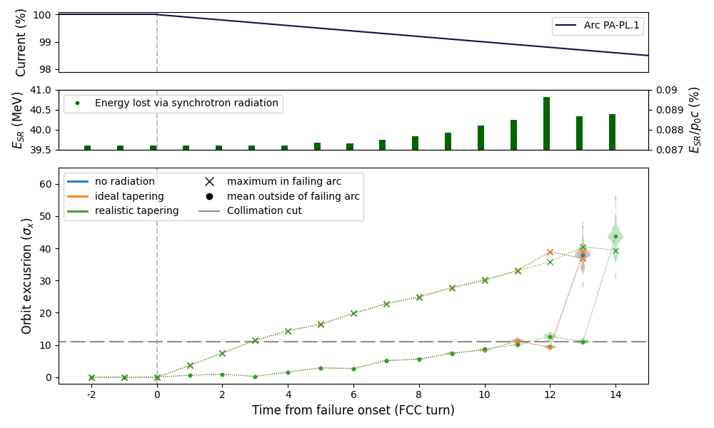
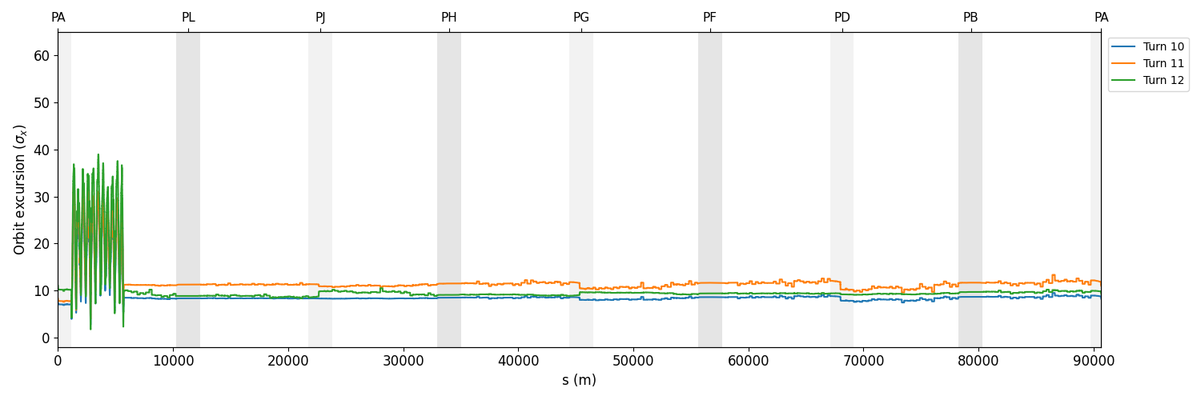
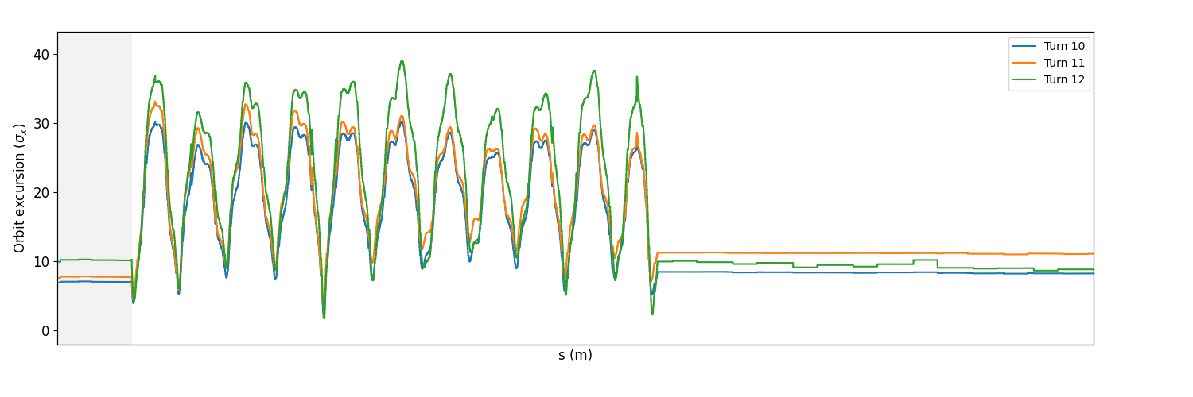
Main dipoles powering failure
Z-pole energy, Arc PA-PL.1 failing

