Slide 1
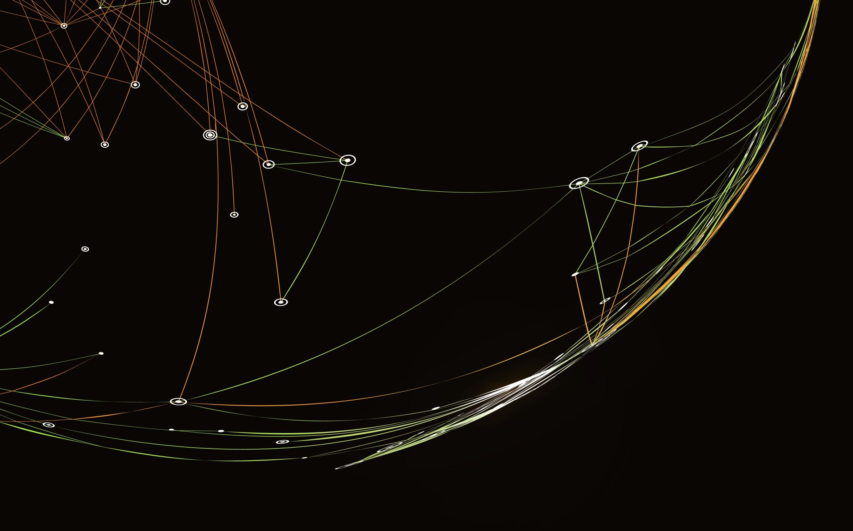


Artificial Intelligence techniques for space
experiments
F.Cuna, M.Bossa, F.Gargano, M.N.Mazziotta
Federica.cuna@ba.infn.it
Maria.bossa@na.infn.it

Slide 2
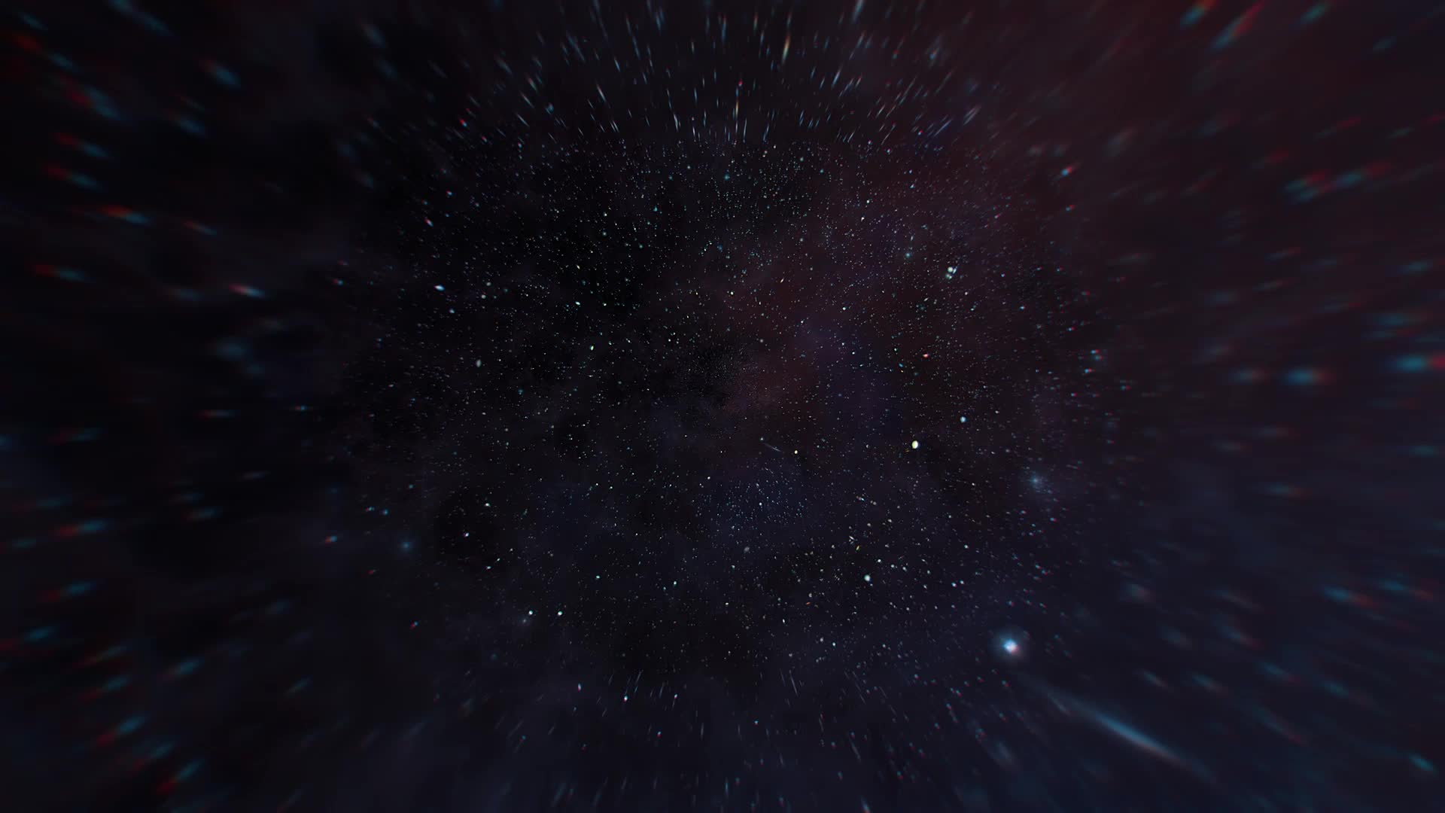
OUTLINE
Our work aims to develop robust AI- driven algorithms for space experiments capable of handling real-world experimental data.
The HERD experiment
Data simulation
Tracks reconstruction with Graph Neural Networks (GNNs)
Discrimination between hadronic and electromagnetic showers in a calorimeter with Transformers (M.Bossa from INFN-Napoli)

Slide 3
HERD as proof of concept for AI in space experiment
HERD is a future space mission for:
  the direct detection of cosmic rays up to 1 PeV
  the measurement of the electron and positron flux up to several tens of TeV
It consists of homogeneous, isotropic, and deeply segmented 3D calorimeter, surrounded by multiple sub-detectors for charge, timing, and tracking measurements.
Fiber Tracker (FIT)
Particle tracking and charge measurement.
It consists of 5 tracking sectors made of seven X-Y double layers of scintillating fibers
Calorimeter (CALO)
Particle energy measurement
Discrimination of electrons from protons and nuclei
It consists of 7500 LYSO cubic scintillating crystals of 3 cm side

Slide 4
Data simulation
The full dataset is generated using the custom HerdSoftware simulation framework
It consists of 4,300,000 events, equally divided into 2,150,000 electron events and 2,150,000 proton events.
Both events sets are simulated within a power-law energy spectrum E⁻¹, spanning an energy range from 100 GeV to 1 TeV
Tracks are distributed within a spherical region surrounding the HERD detector.

Slide 5
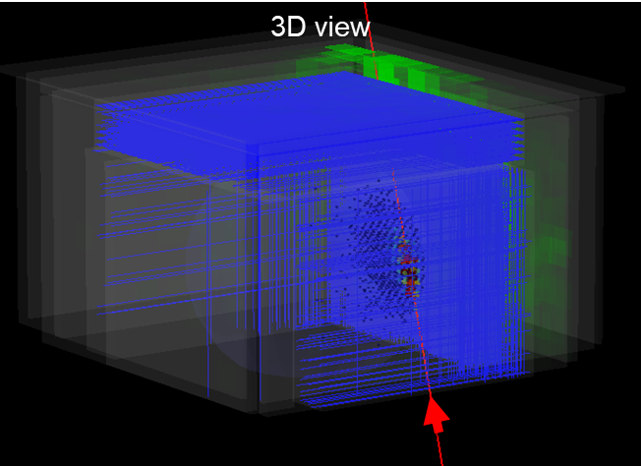
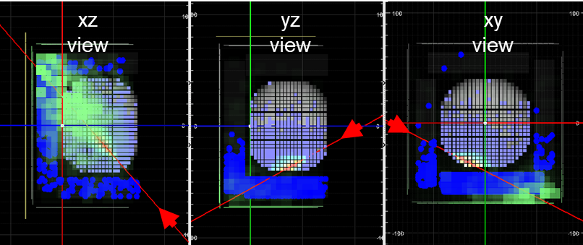
Graph Neural Network for tracks reconstruction
Challenge
Backscattering tracks originating from the calorimeter, which interfere with the correct identification of the primary particle’s trajectory
Solution methodology
Graph neural network for nodes classification.
Tracking data can be represented as graphs, which is a collection of nodes and links.
Nodes are the hits inside the tracker.
Links are the interlayer connections.

Slide 6
Graph Neural Network for tracks reconstruction: pipeline
HerdSoftware
simulations
Clustering
Graph construction
GNN
Simulation of the data set (with and without the calorimeter to balance the backscattering and signal hits)
Clustering
Graph construction
GNN-based tracking algorithm, which consists of a GNN classification of backscattering clusters from signal clusters and a final linear fit to retrieve the track parameter (angular coefficient and intercept)

Slide 7
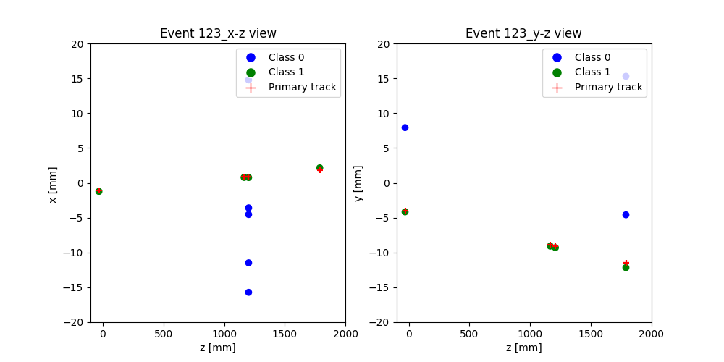
Graph Neural Network for tracks reconstruction: clustering and graph construction
The hits inside each side and layers of the FIT are clustered by applying a traditional clustering algorithm, where neighboring silicon strips with activated signals are grouped together and the barycenter of charge is calculated.
Starting by the clusters, data have been organized in a graph format, where nodes are represented by the clusters position and links by the inter layer connections between clusters.
The graphs are undirected to increase generality, as this approach captures a wider range of potential track interactions
Class 0: noise hits
Class 1: signal hits
Node
Link

Slide 8
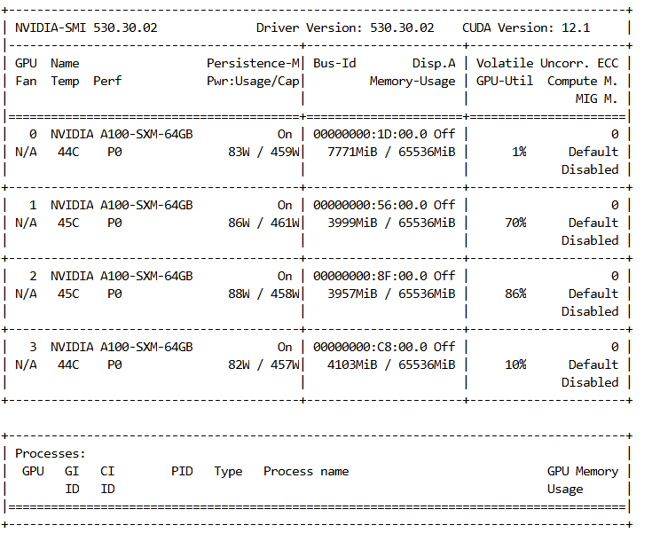
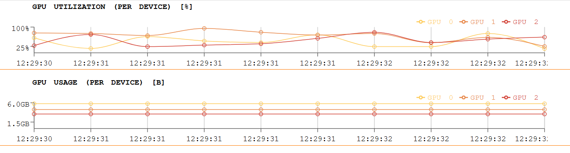
Graph Neural Network for tracks reconstruction: GNN algorithm
SageConv architecture
18 layers
Mean aggregation function
128 hidden size
Adam optimizer
Binary cross entropy loss function
4,5 million simulated electron tracks
75% train-15% validation-10% test
Distributed training
To enhance the time consuming we performed the distributing training by using:
the JupyterLab instance with 3 A100 NVIDIA GPUs
the Leonardo Hub instance with 4 A100 NVIDIA GPUs
Leonardo-HUB
RECAS-Bari

Slide 9
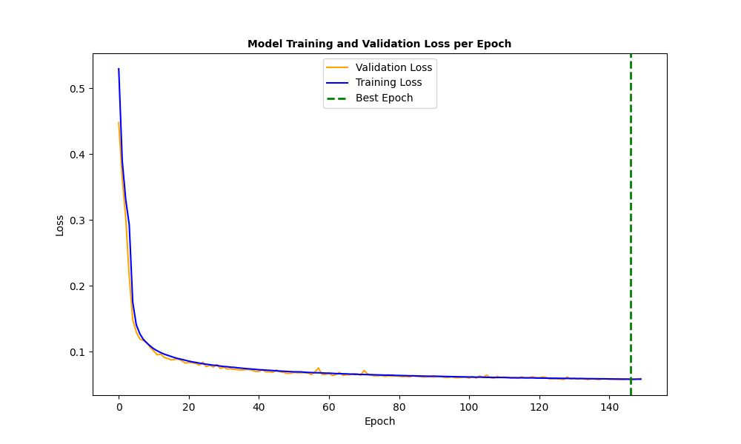
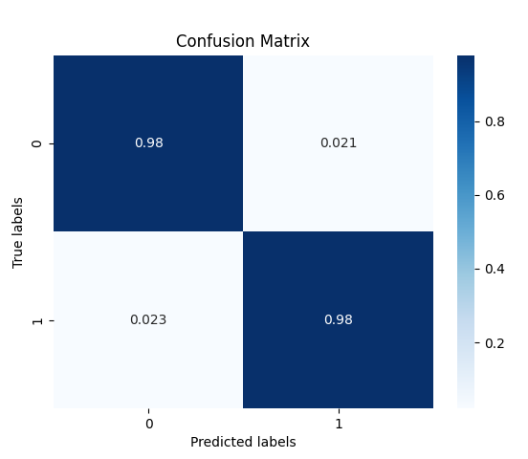
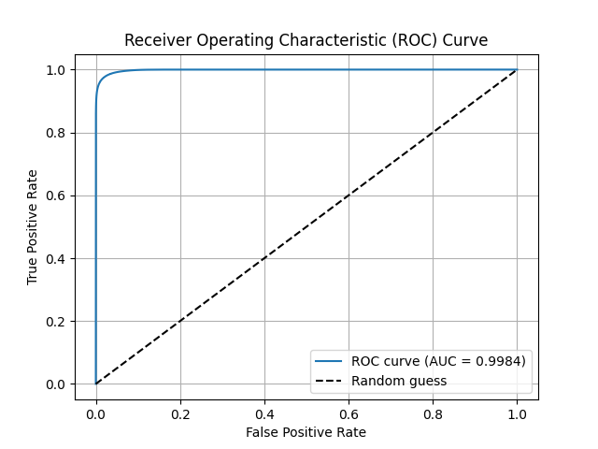
Graph Neural Network for tracks reconstruction: results
Metrics | Values
Accuracy | 97.80%
Recall | 97.65%
Precision | 97.81%
F1-score | 97.73%
ROC AUC | 99.84%

Slide 10
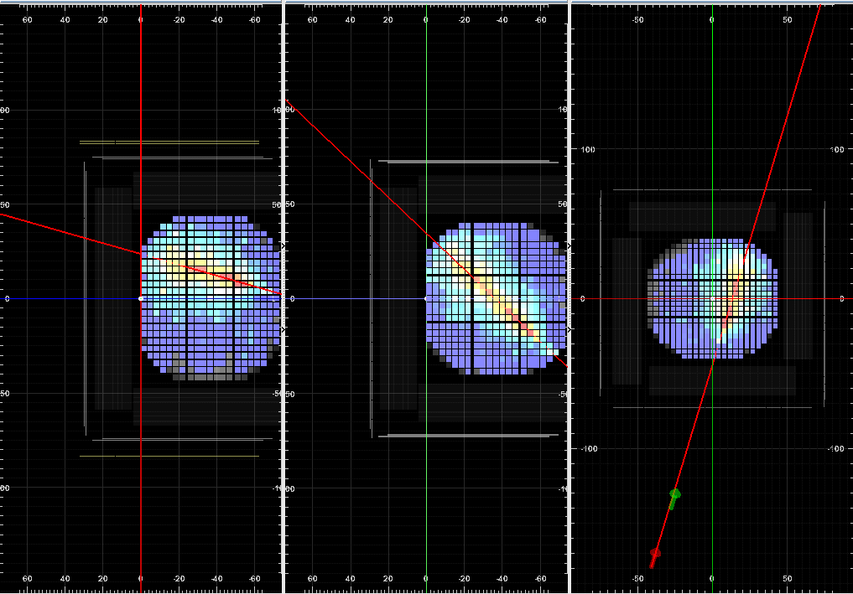
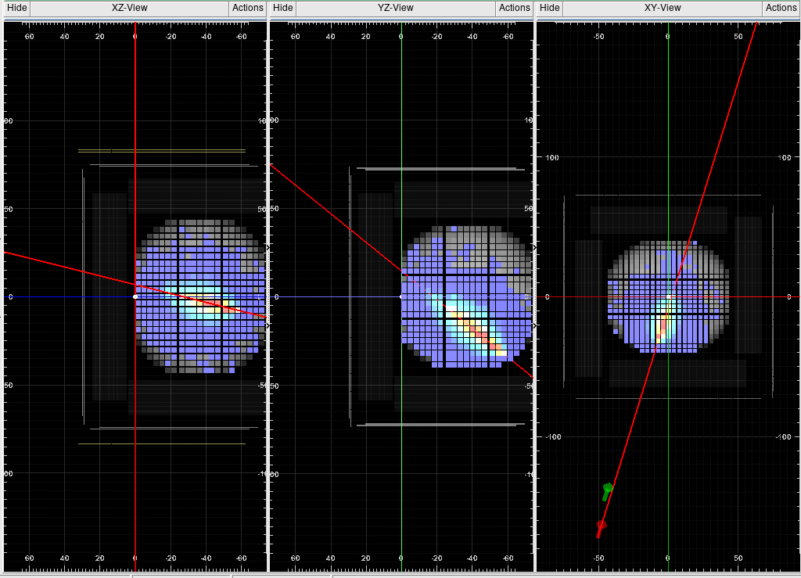
Discrimination between hadronic and electromagnetic showers in a calorimeter with Transformers
Challenge
Cosmic rays (CRs) are high-energy protons and nuclei (plus a minority electron component, less than 1%) produced in astrophysical environments, filling the galactic space and arriving on Earth.
The abundance of cosmic ray electrons above a few GeV is significantly lower-by a factor of 10⁻³ ∼ 10⁻² -compared to that of cosmic ray protons. This makes precise measurement of the electron spectrum a challenging task.
Electron event
Proton event
Solution methodology
Novel approach for classifying electron- and proton-induced events consists of a transformer model

Slide 11
Discrimination between hadronic and electromagnetic showers in a calorimeter with Transformers: pipeline
For each event, we record the following information: energy deposition and the X, Y, Z coordinates of the activated pixel​.
Embedding Layer: the input features are transformed through a linear embedding layer, which maps each input vector to a vector of larger size.
Positional Encoding: computes a fixed encoding based on sine and cosine functions, which is then added to the embedded input.
Transformer Encoder: consists of a stack of five identical layers. Each layer includes two sub-layers: the first is a multi-head self-attention mechanism that learns dependencies between sequence elements, while the second is a position-wise fully connected feed-forward network that allows the model to capture complex, high dimensional relationships inherent in physical events.
Add&Norm: includes residual connections and layer normalization after each sub-layer
Classification Layer: the encoder’s output is aggregated by computing the mean across the sequence dimension, producing a single feature vector.
Linear & Softmax: this vector is fed to a fully connected layer, which outputs a final prediction for the binary classification.

Slide 12
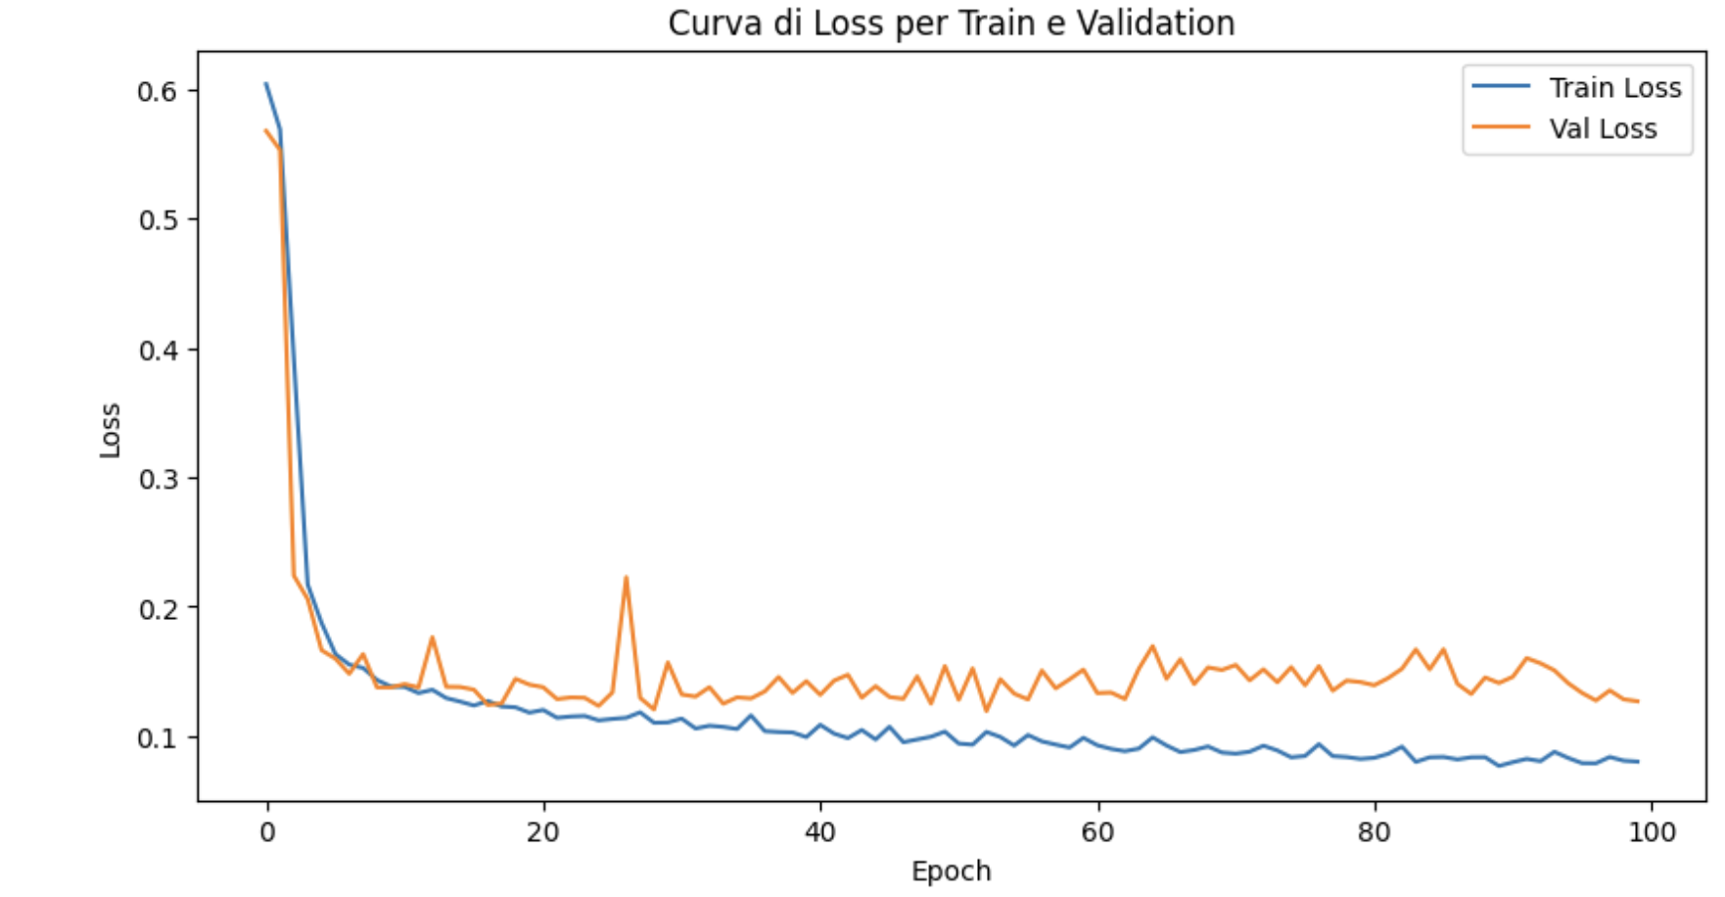
Discrimination between hadronic and electromagnetic showers in a calorimeter with Transformers: results
20000 events:
10000 electrons
10000 protons
80%-20% train-test
Model was trained for 100 epochs using the Adam optimizer to minimize the binary cross-entropy loss.
Metrics | Values
Accuracy | 94.55%
Recall | 96.81%
Precision | 92.58%
The observed overfitting and fluctuations in the curves are due to the small size of the dataset.

Slide 13
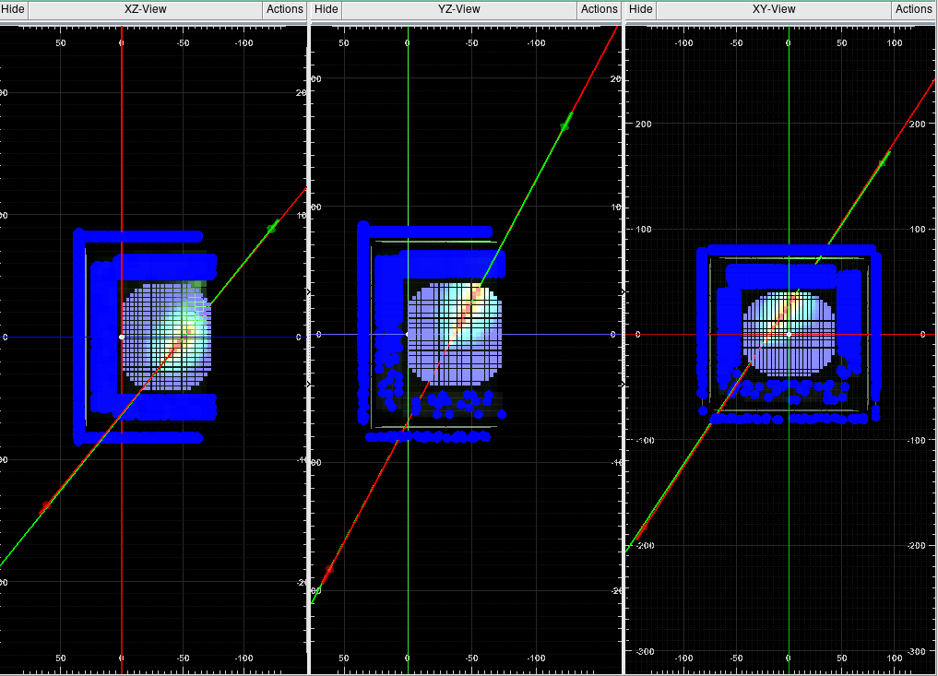
Some news!!!
GNN for FIT
The GNN algorithm gives quite promising results, but the very challenge starts when we look at the protons tracks for 100TeV 1PeV!
We perform a dedicated preprocessing step guided by the calorimeter shower axis, where we select all clusters within a cylinder of radius of 2 interaction lambdas around the reconstructed shower axis. This process ensures an initial ‘cleaning’ of the dataset.
Then we add a “pruning” layer inside the GNN, based on transformer architecture, to cut some of the noise edges.
The new algorithm is currently undergoing training with hyperparameter optimization!

Slide 14
Some news!!!
Transformer for CALO
The results obtained by applying the transformer algorithm are quite promising, besides the overfitting due to the low amount of data.
New features related to the calorimeter showers have been extracted (e.g. shower longitudinal profile).
These feature have been fed to the transformer model which is currently undergoing training with hyperparameter optimization.
This “high level features analysis” could improve the classification task between electrons and protons

Slide 15
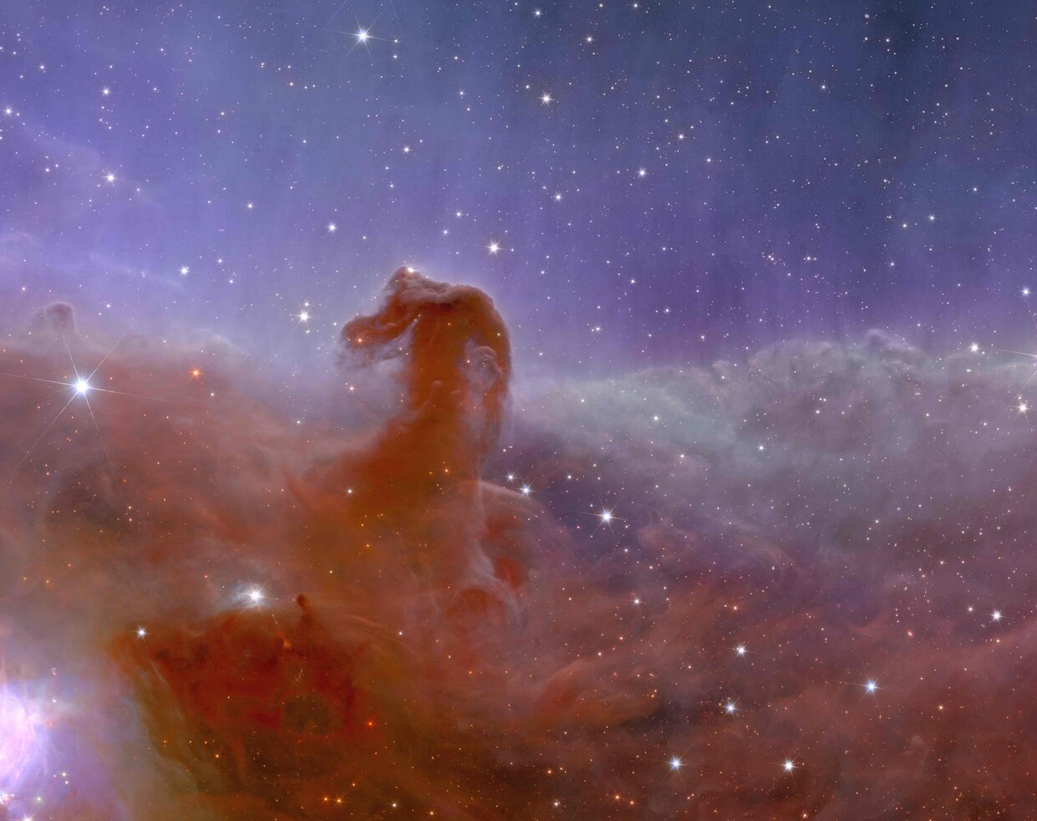
Thank you!

Slide 16
Conclusion
Two distinct approaches for handling two different tasks in space experiments:
charge particle track reconstruction
discrimination between hadronic and electromagnetic showers in calorimeters.
The results obtained are promising, indicating that the AI algorithm can be effectively applied to real-world experiments.
Next steps
A linear fit will be inserted after the GNN classification of backscattering and signal clusters to retrieve the track parameter of intercept and angular coefficient.
Other GNN architectures are currently being tested to compare their results with the ones obtained by applying the SageConv model.
Trasformer model is under testing on big size dataset.
New Transformer architectures featuring an autoencoder as the initial layer are being explored to reduce the dataset’s dimensionality.

Slide 17
Backup slides

Slide 18
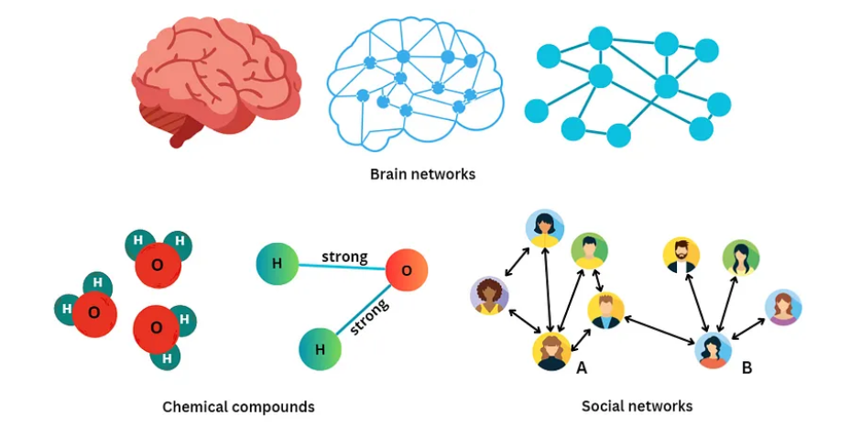
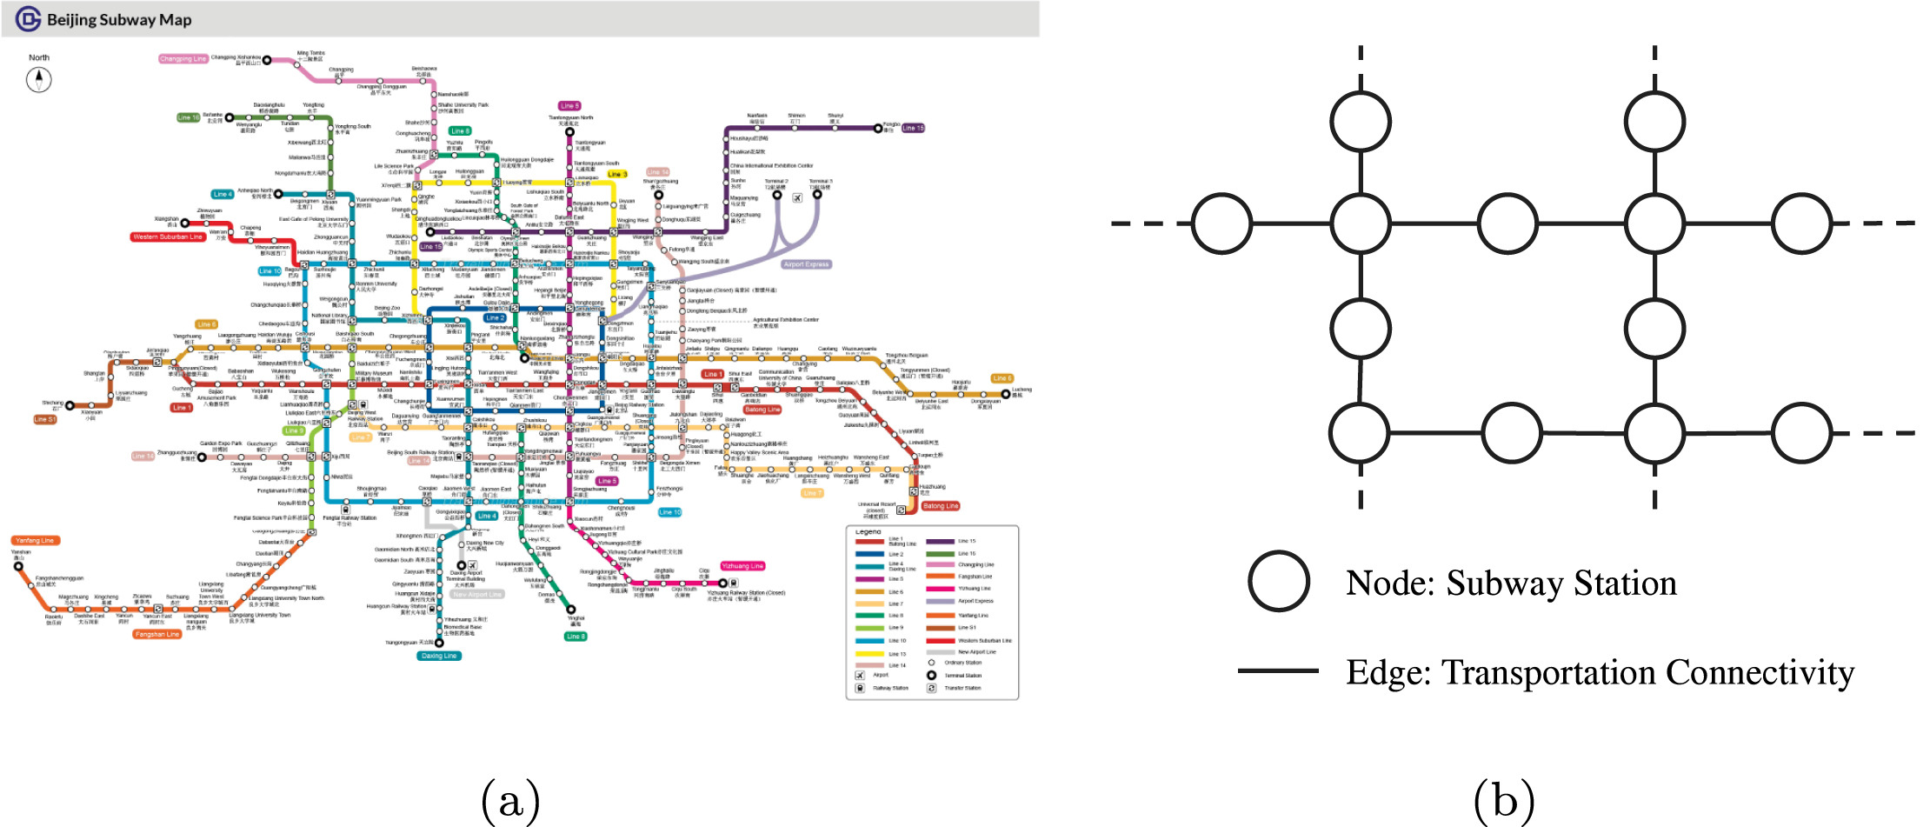
Graph neural networks
A graph represents the relations (edges or links) between a collection of entities (nodes).
Graph Neural Networks (GNNs) are a class of deep learning models that are designed to operate on graph-structured data.
They have shown remarkable success in tasks such as node classification, link prediction, and graph classification.
The key idea behind GNNs is to learn representations for nodes and edges in a graph by aggregating information from their local neighborhood.
A GNN consists of a number of layers, each of which updates the representation of each node based on its local neighborhood.
The representation of each node is typically a low-dimensional vector that encodes the node’s properties and its relationships with other nodes.
The layers of a GNN are designed to capture increasingly complex features of the graph by aggregating information from the neighborhood of each node.
The key component of a GNN layer is the aggregation function, which takes as input the representations of a node’s neighbors and produces a new representation for the node.
A Gentle Introduction to Graph Neural Networks, https://distill.pub/2021/gnn-intro/
Hands-On Graph Neural Networks Using Python, M.Labonne, Packt Publishing Ltd.

Slide 19
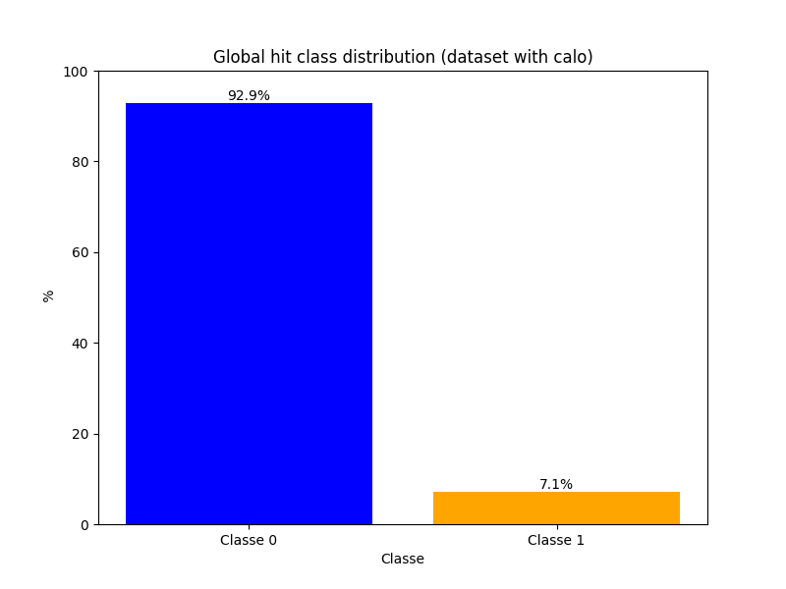
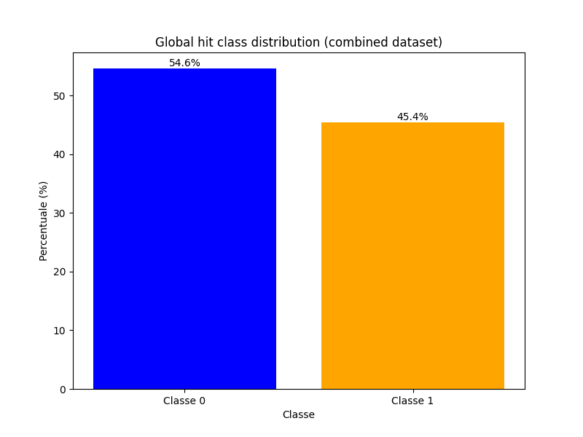
Balancing FIT dataset
Data are highly imbalanced, since there are many bacskattering tracks originating from the calorimeter, which interfere with the correct identification of the primary particle's trajectory
To mitigate the imbalance:
Clustering algorithm
Cut of noise clusters “far away” from the primary track
Adding simulated events without calorimeter

