Slide 1
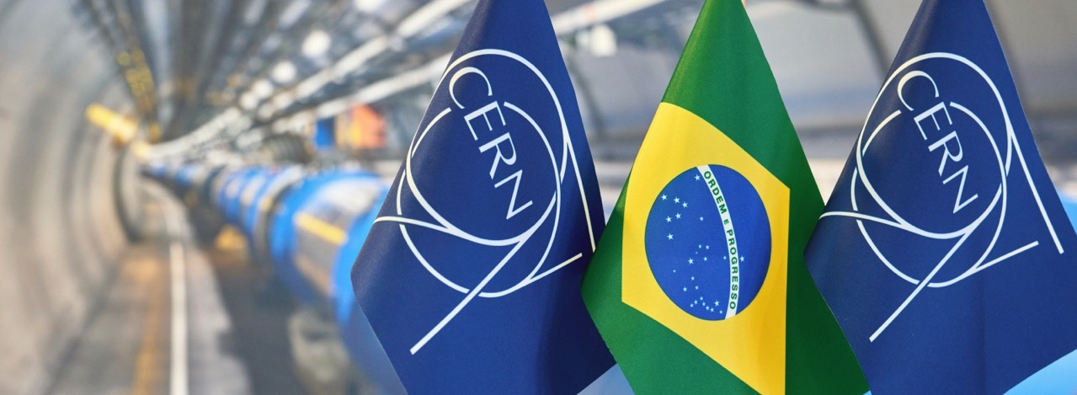
Recent steps in the integration of Brazil in CERN’s activities
Salvatore Mele
Notes:
THE WELCOME SLIDE
With this slide the speaker:
Introduces him/herself
Describes how this brief presentation aims to give an overview of CERN, as an introduction to the visit that will follow.

Slide 2
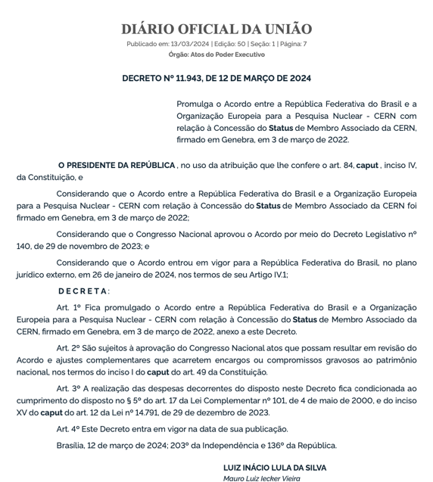
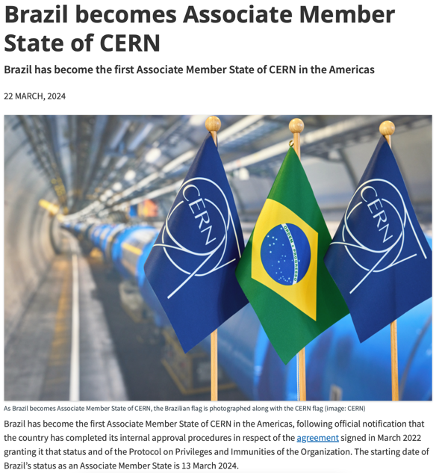

Slide 3
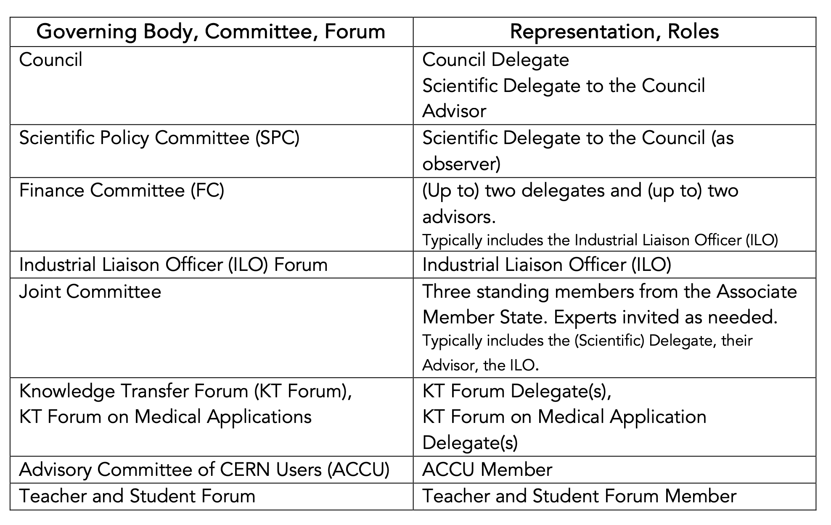
Appointments received for all but one role
Request for Nomination to ACCU pending with MCTI/SEPPE

Slide 4
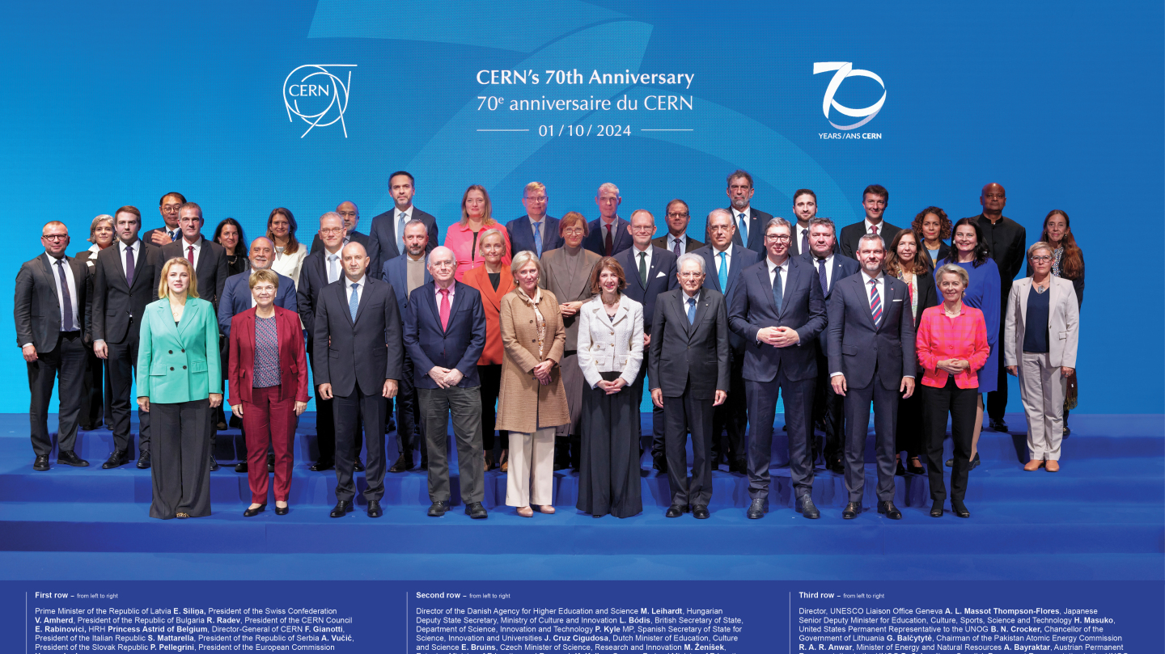

Slide 5
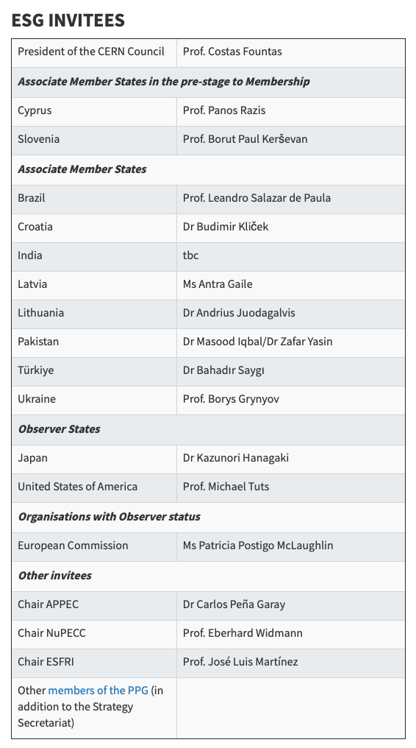
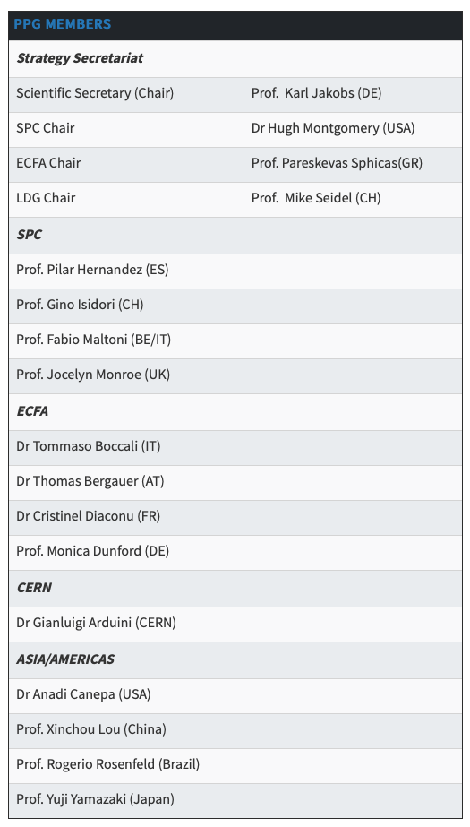

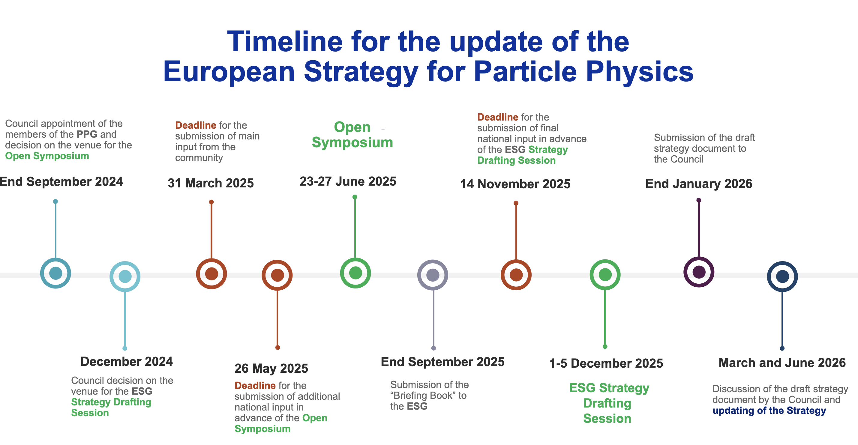

Slide 6
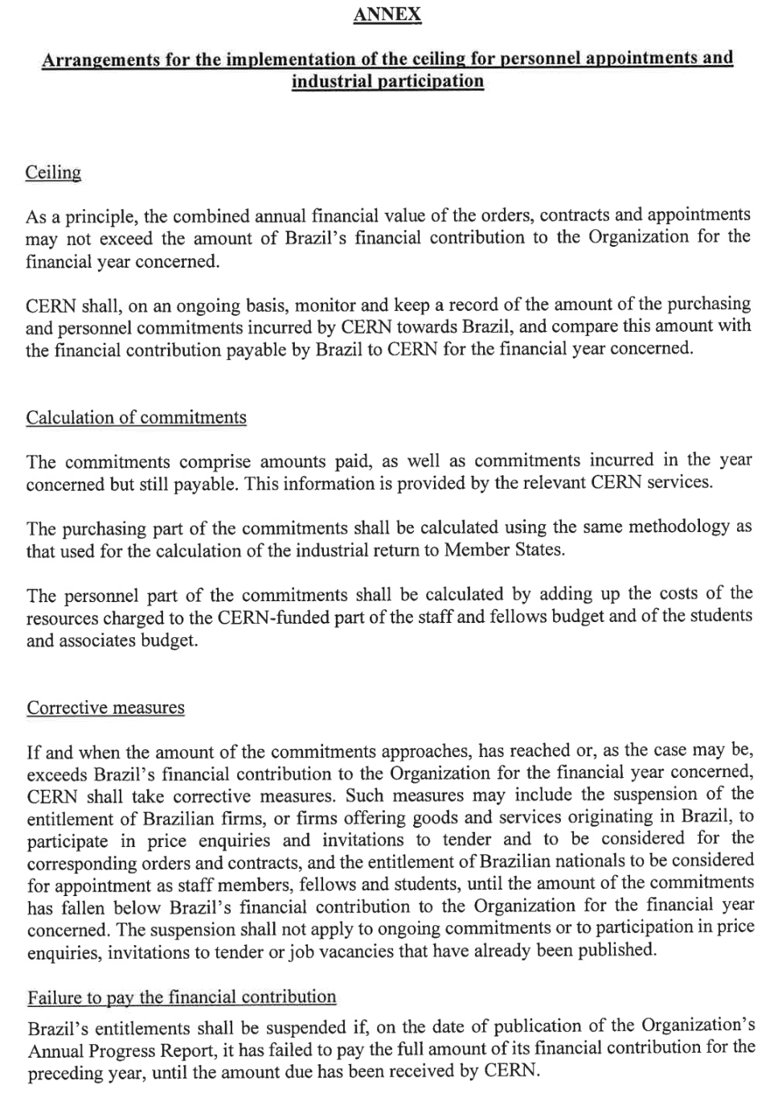
Contribution to CERN Budget
 | Total called | Due | Outstanding
2024 | 10’381’700 CHF | June 2024 | 10’381’700 CHF
2025 | 10’232’950 CHF | ½ February 2025 ½ June 2025 | 10’232’950 CHF
 |  | Total Outstanding | 20’614’650 CHF
N.B. (1) Annual Progress Report normally published 2 weeks ahead of June Council session (scheduled for the week of June 16th, 2025)
N.B. (2) CERN accounts funds received in respect to the contribution against the entire outstanding total (e.g. if the contribution for 2025 is settled before that of 2024, these funds are in any case accounted for 2024)

