Slide 1
Brazil at CERN
Talent Acquisition – recruitment results

Slide 2
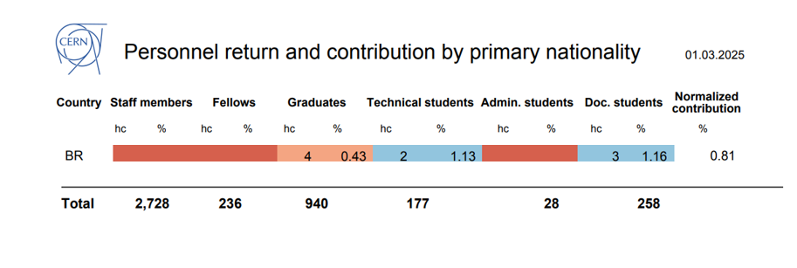
1 March 2025 – Personnel Return report
All graduates are university level early careers.

Slide 3
Brazilians (as primary nationality) status distribution
Primary Nationality | BR
Programme Status | Application Count
USER | 165
ENTC | 25
EXTN | 15
DOCT | 3
GRAE | 3
TECH | 2
CASS | 1
TEMC | 1
PJAS | 1
GRAP | 1
Grand Total | 217
However, 272 people in total at CERN hold a BR nationality.

Slide 4
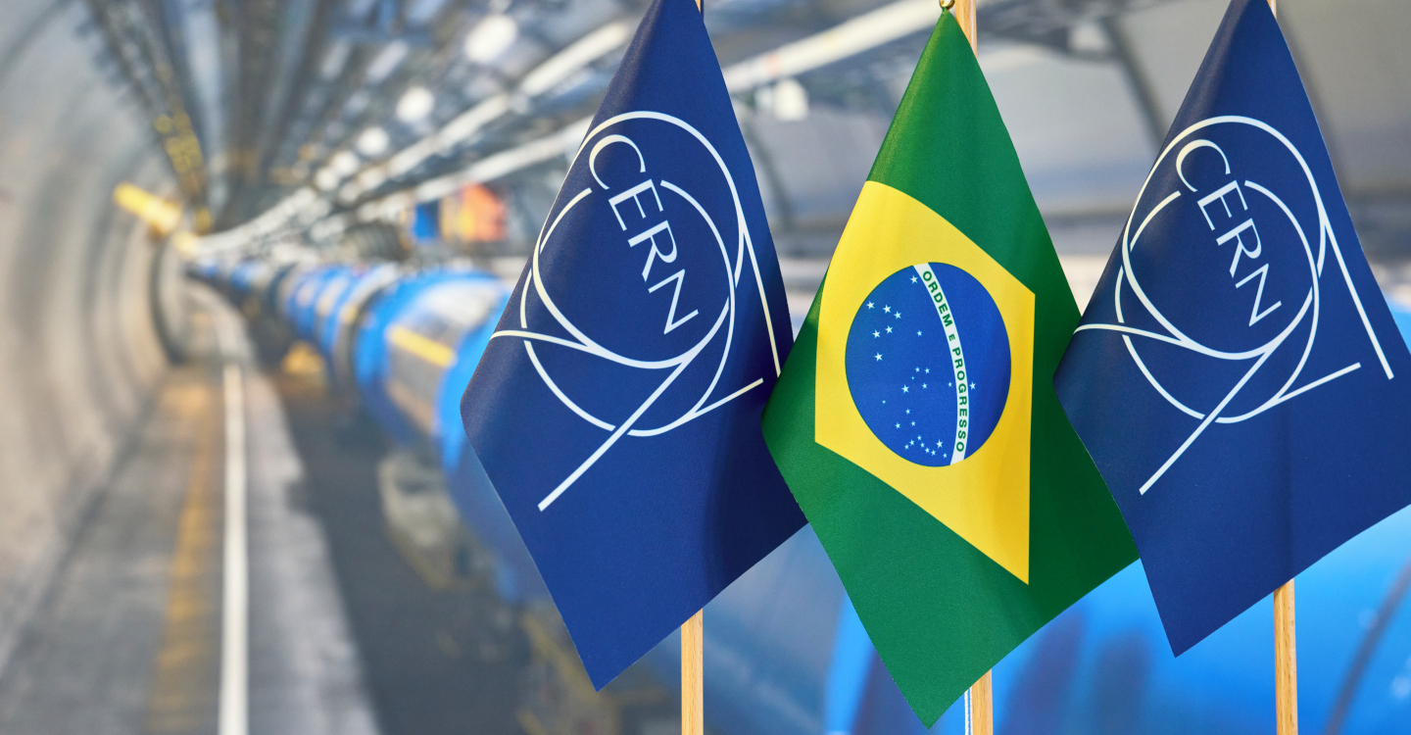
2024 Recruitment Results (13 Mar – 31 Dec)

Slide 5
Application Count
Job REF Code: 2024
Programme | Count of Application
Administrative Students | 17
Corresponding Associates | 1
Doctoral Students | 10
Early Career Professionals | 327
Experienced Project Graduates | 182
Limited Duration - Staff | 212
Research Fellows | 17
Scientific Associates | 1
Technical Students | 109
Trainees | 156
Grand Total | 1033

Slide 6
2024 Application Results
Programme /Application Status | HIRED | IN_REVIEW/ For Manager Review | IN_REVIEW/Not For Manager Review | IN_REVIEW/ Pre-Screening | INTERVIEW/ Video Interview | NEW | REJECTED | WITHDRAWN | Total
Administrative Students |  |  |  |  |  |  | 17 |  | 17
Corresponding Associates | 1 |  |  |  |  |  |  |  | 1
Doctoral Students | 1 |  |  |  |  |  | 9 |  | 10
Early Career Professionals | 3 | 8 | 2 | 2 |  | 1 | 308 | 3 | 327
Experienced Project Graduates | 3 | 6 |  |  |  | 1 | 168 | 4 | 182
Limited duration Staff |  | 3 | 3 | 1 | 1 |  | 203 | 1 | 212
Research Fellows |  | 8 |  |  |  |  | 9 |  | 17
Scientific Associates |  |  |  |  |  |  | 1 |  | 1
Technical Students | 2 |  |  |  |  |  | 106 | 1 | 109
Trainees |  |  |  |  |  |  | 154 | 2 | 156
Grand Total | 10 | 25 | 5 | 3 | 1 | 2 | 976 | 11 | 1033

Slide 7
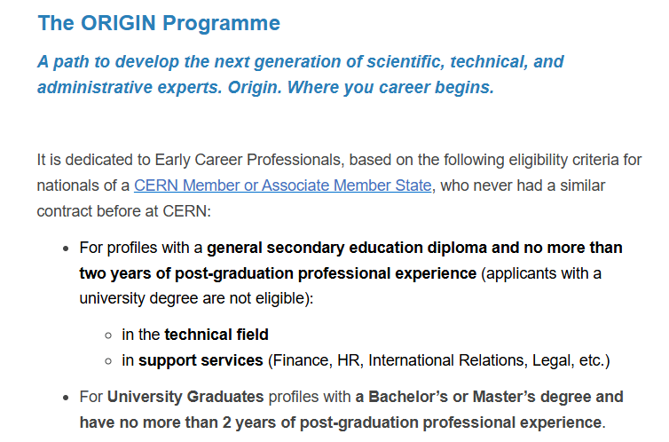

Initial discussions to promote Early Careers – Technicians
(Rafael Navarro)

Slide 9
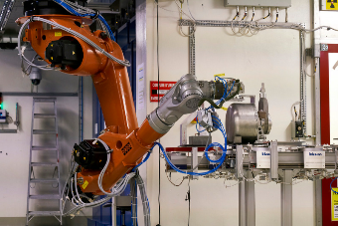

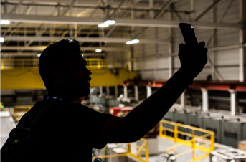
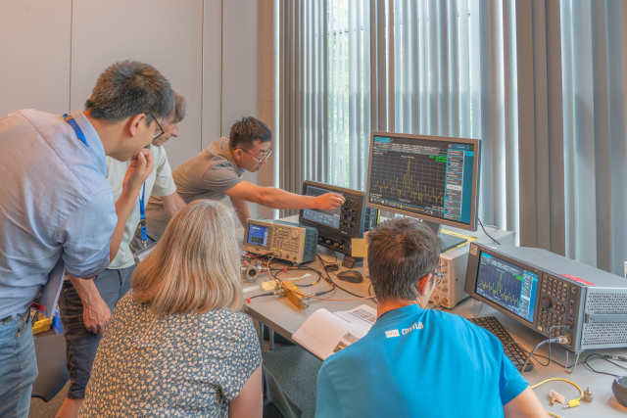
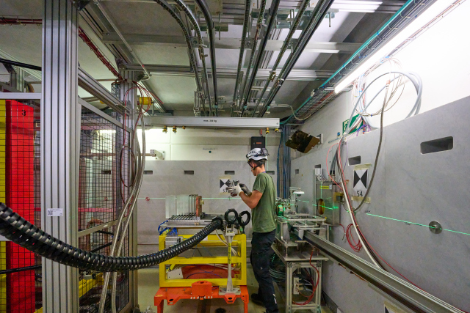
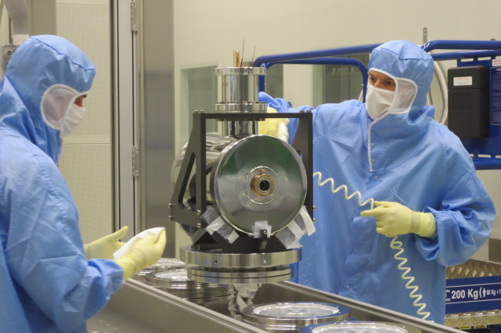
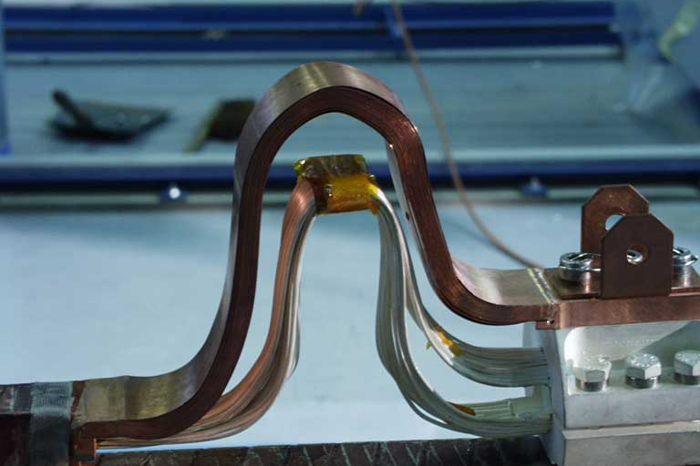
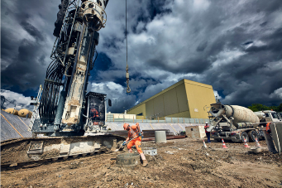
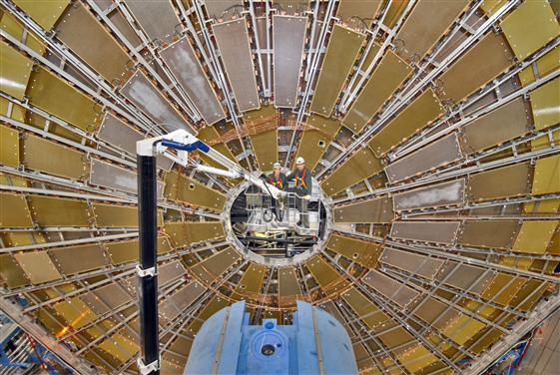
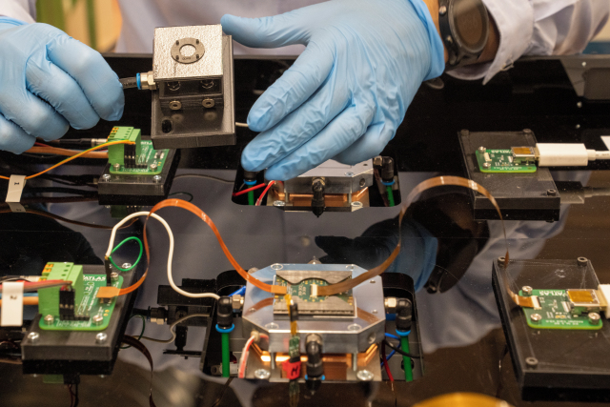
Various areas besides physics..
ROBOTICS
COMPUTING
COMMUNICATION
RADIO FREQUENCY
ELECTRONICS
VACUUMS AND CRYOGENICS
ELECTRICAL ENGINEERING
CIVIL ENGINEERING
MECHANICAL ENGINEERING
MATERIALS SCIENCE

Slide 10
Your opportunities
PROFESSIONALS & GRADUATES
STUDENTS
ORIGIN
Early Career Professionals
STAFF MEMBERS
TECHNICAL & ADMINISTRATIVE STUDENTS
DOCTORAL
STUDENTS
QUEST
Experienced Project Graduates
SUMMER STUDENTS
RESEARCH FELLOWS
Post-docs
SHORT-TERM INTERNS

Slide 11
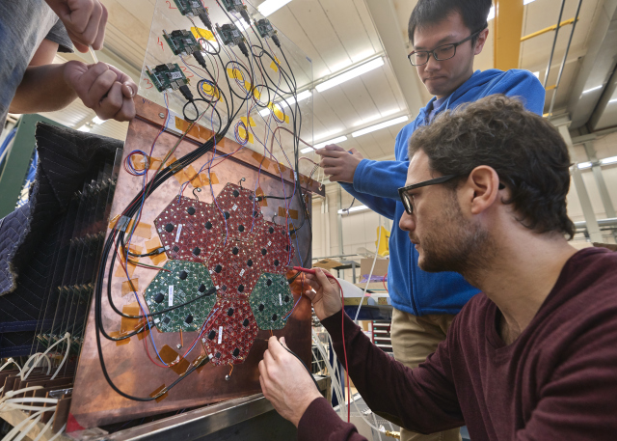
Technical Student Programme
~ 250 positions/year
“A great place to start a career,
learn new skills, make new friends…”
- technical student in electronics
Applied physics, electrical or electronics engineering, general or civil engineering, IT, mathematics and robotics, material and surface science, mechanical engineering…
A project with a CERN supervisor
An allowance of 3452 Swiss Francs per month (net of tax)
A travel allowance
A supplement if you have a spouse and/or have children
Comprehensive health insurance
2.5 days of paid leave per month
Eligibility: Minimum of 18 months of undergraduate studies
Length: 4 to 12 months
Application Periods: Open for applications 3 times per year - Dec-Mar, May-Jul, Aug-Nov

Slide 12

Administrative Student Programme
~ 30 positions/year
“An enriching experience – I had exposure to more activities than I could have imagined,”
Administrative student in legal
Translation, human resources, business administration, law, finance, science communication, public relations…
A project with a CERN supervisor
An allowance of 3452 Swiss Francs per month (net of tax)
A travel allowance
A supplement if you have a spouse/partner and/or have children
Comprehensive health insurance
2.5 days of paid leave per month
Eligibility: minimum of 18 months of undergraduate studies
Length: 2 to 12 months
Application Periods: Open for applications 3 times per year - Dec-Mar, May-Jul, Aug-Nov

Slide 13
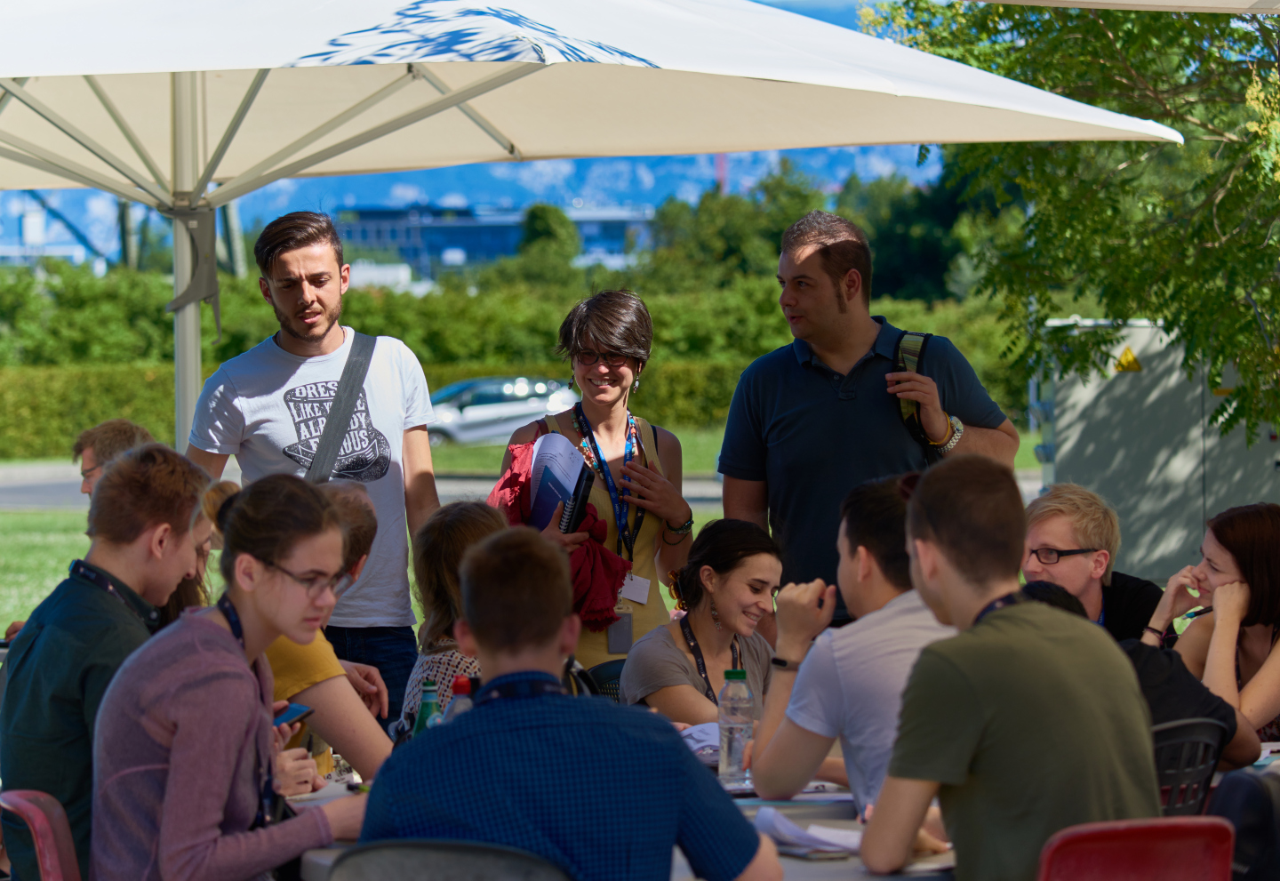
Doctoral Student Programme
~ 80 positions/year
“An opportunity to meet important people, especially in the research field”
Doctoral student in Physics
Applied physics, electrical or electronics engineering, general or civil engineering, IT, mathematics and robotics, material and surface science, mechanical engineering…
A research topic/project, leading to a PhD thesis co-supervised by the university thesis advisor and a CERN staff member
An allowance of 3868 Swiss Francs per month (net of tax)
A travel allowance
A supplement if you have a spouse/partner and/or have children
Comprehensive health insurance
2.5 days of paid leave per month
Eligibility: Enrolled in a doctoral programme in a university
Length: 36 months and 12 months of unpaid leave
Application Periods: Open for applications 3 times per year - Dec-Mar, May-Jul, Aug-Nov

Slide 14
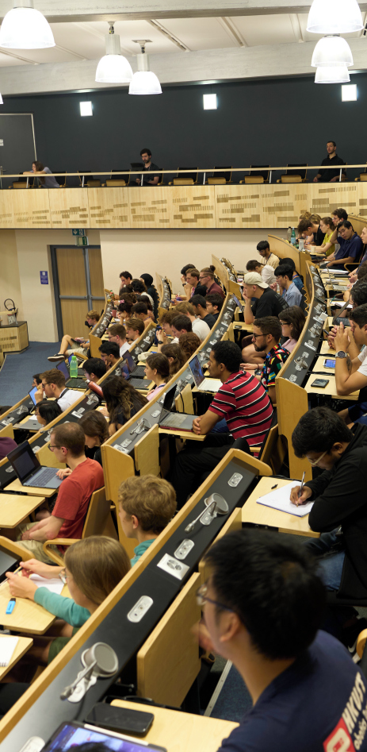
Summer Student Programme
~ 300 positions/year
“Can’t imagine a better way to spend
my summer”
Summer student in computing
Applied physics, electrical or electronics engineering, general or civil engineering, IT, mathematics and robotics, material and surface science, mechanical engineering…
Series of lectures delivered by world-wide renowned scientists, visits and workshops.
A project with a CERN supervisor.
A 93 CHF per calendar day (net of tax) subsistence allowance to cover the cost of accommodation and meals in the Geneva area for a single person for the whole contract duration.
A travel allowance on a lump sum basis paid at the end of your stay to help you with the cost of travel between Geneva and your residence at the time of the selection committee.
Coverage by CERN’s comprehensive Health Insurance scheme (contribution already deducted from allowance).
Assistance to find accommodation on the CERN site or nearby.
Eligibility: 3 years of full-time studies at university level
Length: 8 to 13 weeks over summer
Application Period: November – January

Slide 15
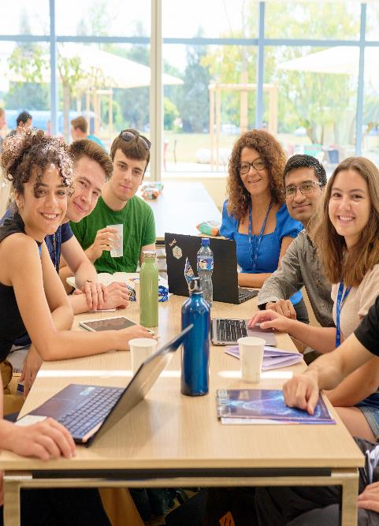
Short Term Internship Programme
~ 250 positions/year
“A great opportunity for your career and also a very rewarding life experience”
Short-term intern in mechanical engineering
All disciplines in science, engineering, technical and administrative fields
A project with a CERN supervisor
A living allowance of 1577 CHF per month
Eligibility: Be a full-time student at undergraduate level (post-secondary)
Length: 1 to 6 months
Application Period: Open for applications all year round

Slide 16
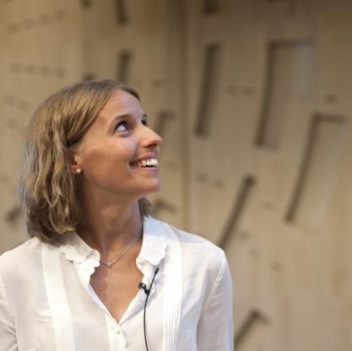

Early Career Professionals
~ 300 positions/year
“The smartest way to kick-start your
career and give it real momentum.”
All disciplines in science, engineering, technical and administrative fields
On-the-job learning by full immersion in a CERN team and their activities
A stipend ranging from 4569 to 5647 Swiss Francs per month (net of tax)
Comprehensive health insurance (for yourself, your spouse/partner, and children)
Membership of the CERN Pension Fund
Other benefits may include: Installation grant, family, child and infant allowances; payment of travel expenses at the beginning and end of contract
2.5 days of paid leave per month.
Eligibility: From general secondary education to Master level, with max. 2 years of relevant experience after your highest degree
Length: From 6 to 36 months, in principle duration of 24 months
Publication/Application Period: Continuous hiring throughout the year, publication of positions on demand

Slide 17
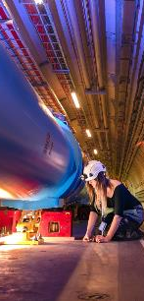

Experience Project Graduates
~ 100 positions/year
“Deepen your knowledge and expertise faster than anywhere else on earth.”
Applied physics, electrical or electronics engineering, general or civil engineering, IT, mathematics and robotics, material and surface science, mechanical engineering…
Work on well-defined project from A to Z with clear deliverables
Deepen your expertise and expand your professional network by working with the best experts
Opportunity to supervise student
A stipend ranging from 6212 to 6828 Swiss Francs per month (net of tax)
Comprehensive health insurance (for yourself, your spouse/partner, and children)
Membership of the CERN Pension Fund
Other benefits may include: installation grant, family, child and infant allowances; payment of travel expenses at the beginning and end of contract
2.5 days of paid leave per month
Eligibility: Master’s with 2 to 6 years of relevant experience or PhD with up to 3 years of relevant experience
Length: From 6 to 36 months, in principle duration of 24 months
Publication/Application Period: Continuous hiring throughout the year, publication of positions on demand

Slide 18
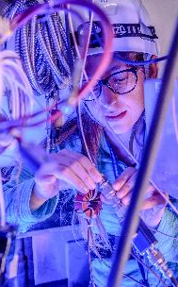
Research fellows
~ 40 positions/year
“Make your mark and hone your skills at a place like no other.”
Applied physics, theoretical physics, experimental physics, electrical or electronics engineering, mathematics and robotics, material and surface science, mechanical engineering…
Define your own research project and benefit from international exposure
A stipend ranging from 6828 to 7239 Swiss Francs per month (net of tax)
Comprehensive health insurance (for yourself, your spouse/partner, and children)
Membership of the CERN Pension Fund
Other benefits may include: Installation grant, family, child and infant allowances; payment of travel expenses at the beginning and end of appointment
2.5 days of paid leave per month
Eligibility:
Theoretical and Experimental Physics: PhD with up to 6 years of relevant experience
Applied Sciences and Engineering: PhD with up to 3 years of relevant experience
Length: From 6 to 36 months, in principle duration of 24 months
Application Periods: Open for applications twice per year – December-February + June-August

Slide 19
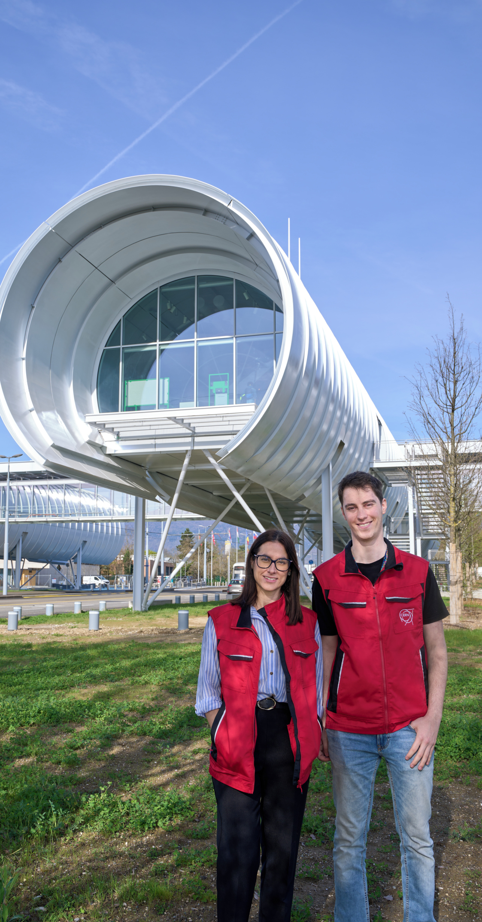
Staff Positions
~ 150 positions/year
“It’s the chance to focus on being the very best at what you do.”
All disciplines in science, engineering, technical and administrative fields
Attractive compensation package
Comprehensive health insurance (for yourself, your spouse/partner, and children)
Membership of the CERN Pension Fund;
Other benefits may include: (re)installation grant, family, child and infant allowances; payment of travel
and removal expenses at the beginning and end of contract; unemployment coverage.
2.5 days of paid leave per month.
Eligibility: From general secondary education to PhD
Length: Limited duration contract (5 years). Subject to certain conditions, holders of limited-duration contracts may apply for an indefinite position

