Slide 1
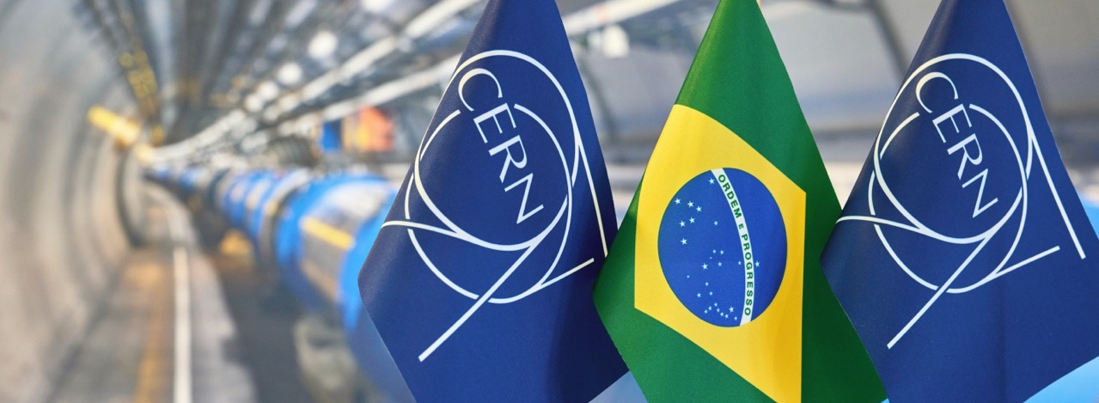
Collaboration with FAPESP and INPE
Salvatore Mele
Notes:
THE WELCOME SLIDE
With this slide the speaker:
Introduces him/herself
Describes how this brief presentation aims to give an overview of CERN, as an introduction to the visit that will follow.

Slide 2
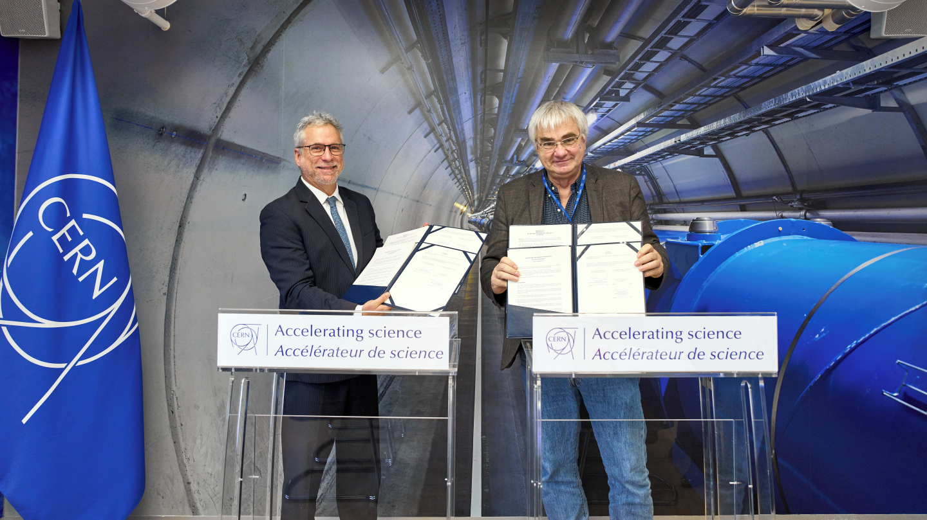

Slide 3
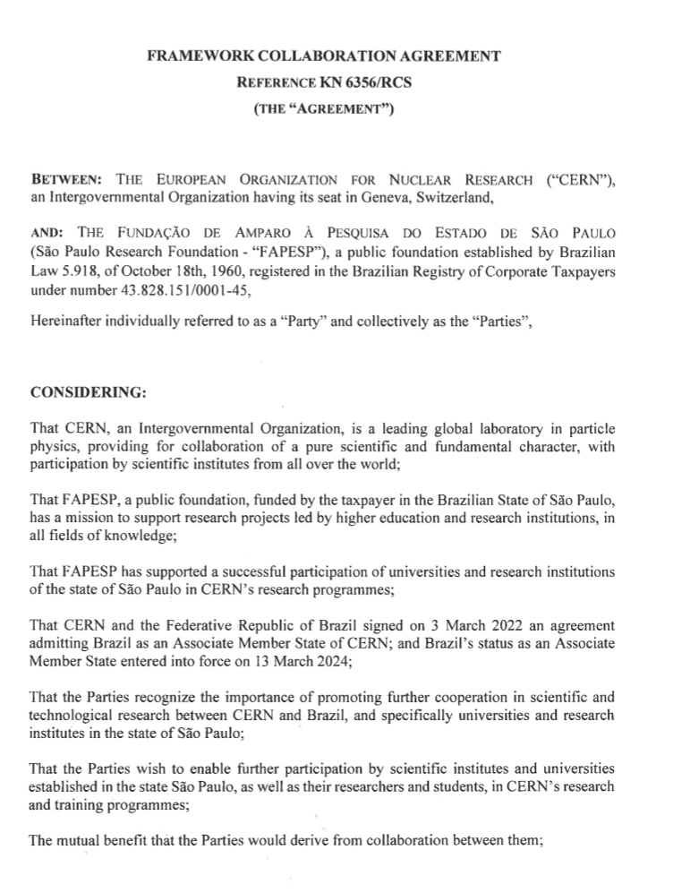
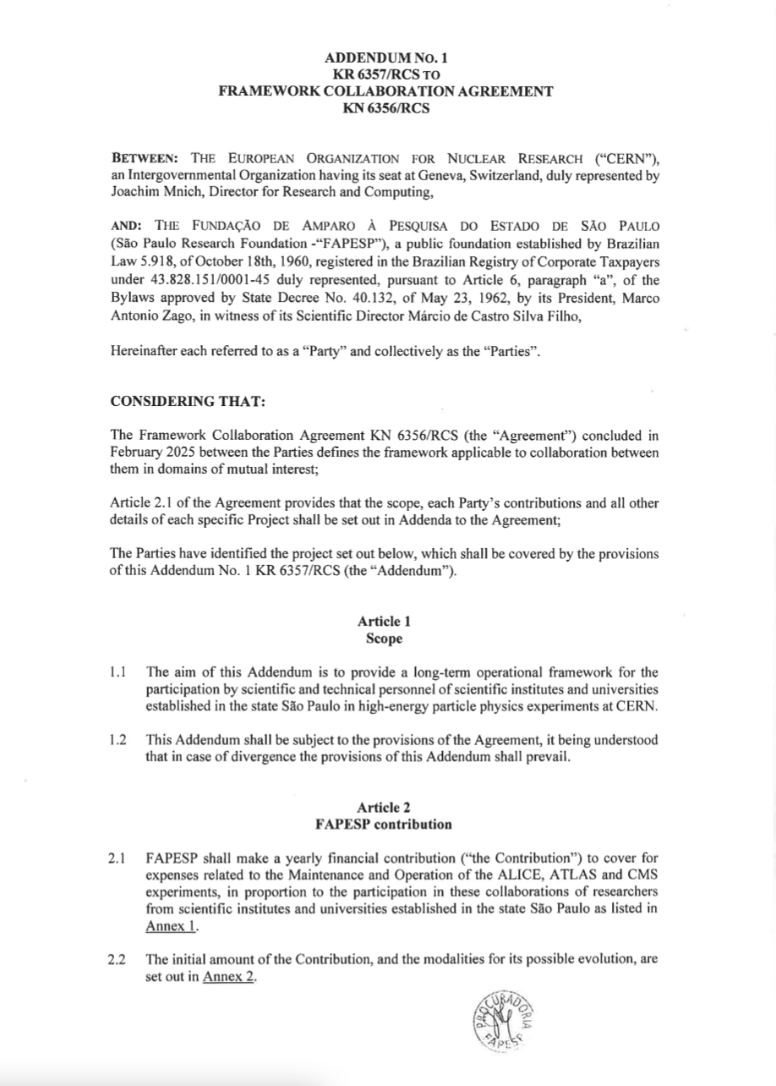
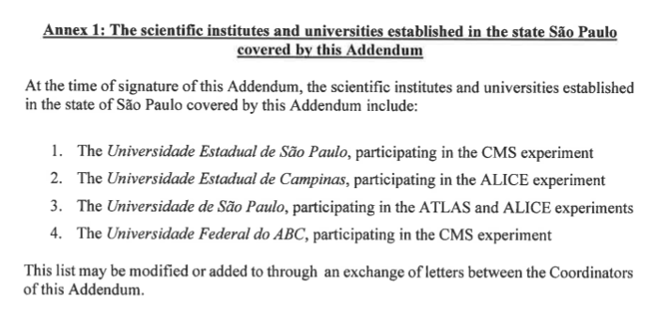
  Framework Collaboration Agreement to enable further participation by scientific institutes and universities established in the state of São Paulo, as well as their researchers and students, in CERN’s research and training programmes and in any other area of mutual interest.
  First Addendum covering M&O A costs for UNESP, UNICAMP, USP and UFABC participation in ALICE, ATLAS, CMS.

Slide 4

  Framework Collaboration Agreement under discussion: collaboration in applications of CERN data storage solutions for large-scale data sharing in environmental sciences and in any other area of mutual interest
  First Addendum: secondment of two senior researchers at CERN (1 FTE-year) to support large-scale data sharing in space science. Participate in day-to-day operations of CERN Storage Operations Team.
  Project objective: build capacity towards establishing a large-scale data federation in Brazil, based on CERN’s advanced distributed storage system (EOS), enabling large-scale data sharing for research in environmental sciences, pollution monitoring and climate change.
  Signature expected over the coming weeks
Instituto Nacional de Pesquisas Espaciais
National Institute for Space Research

