Slide 1
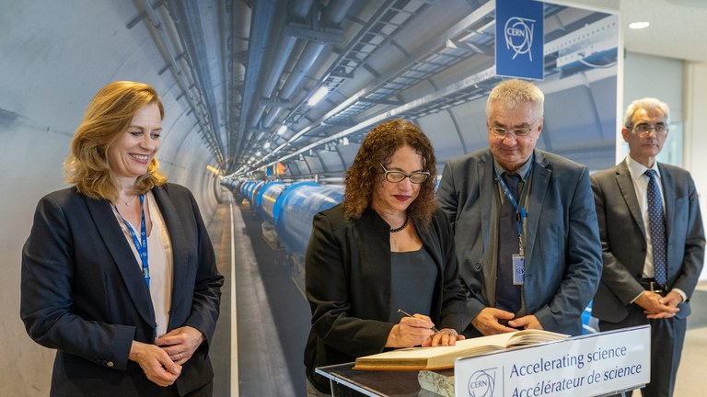
Brazil has become the first Associate Member State of CERN in the Americas

Slide 2
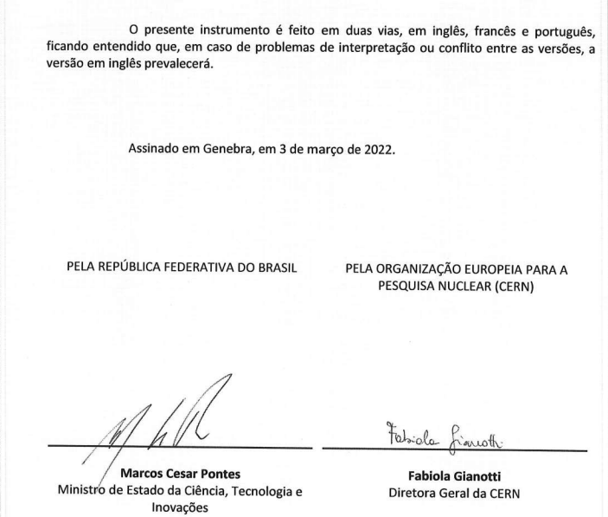
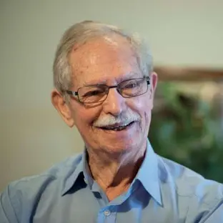
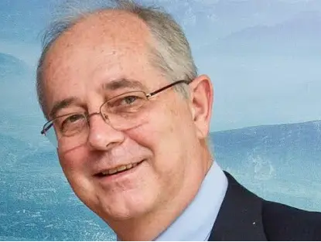
Roberto Salmeron
Ronald Shellard
Initial Annual Contribution CHF 10,300,000.00

Slide 3
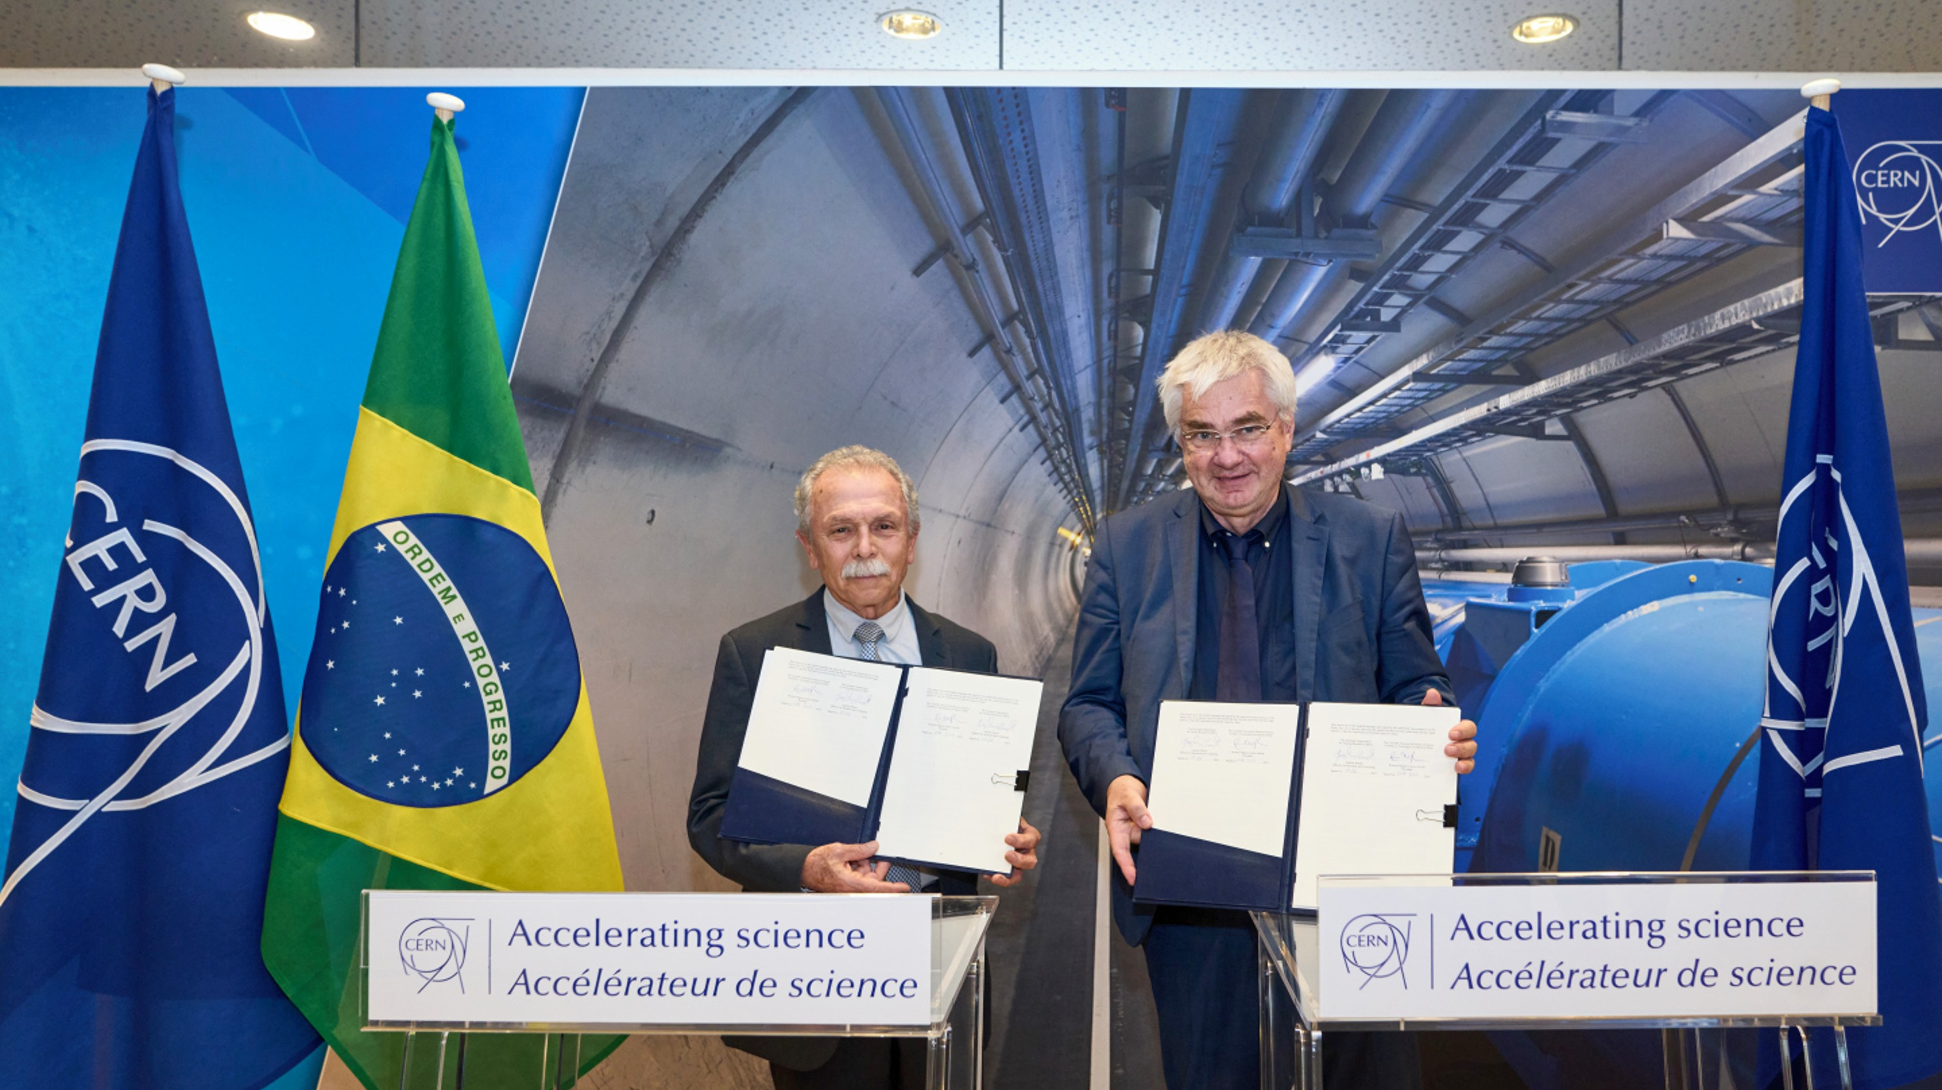
Renovation of the Framework Agreement CERN-CNPq June 2024
CNPq Annual Contribution – US$ 180,000.00
Ricardo Galvão
Joachim Mnich

Slide 4
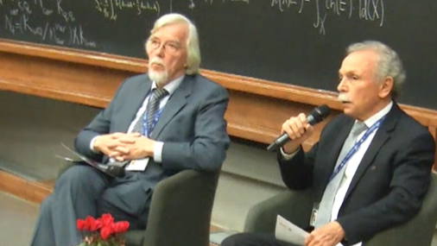
ICTP November 2024
Rolf-Dieter Heuer
Ricardo Galvão

