Slide 1





Proton extraction studies
13th March 2025
J. Mańczak, D. Calzolari, S.Candido R. Franqueira Ximenes, A.Lechner, G. Lerner

Slide 2
Outline
For the moment, we are focusing solely on the proton extraction – the impact on the muon yield to be understood later when a vaiable solution is established.
The idea is to stick to a solenoid-based chicane trying to fine tune several parameters: horizontal shift, curvature, target length and the tapering length.
New chicane geometries are tested without additional shielding – the goal is first to understaind the impact of changing geometry.

Slide 3
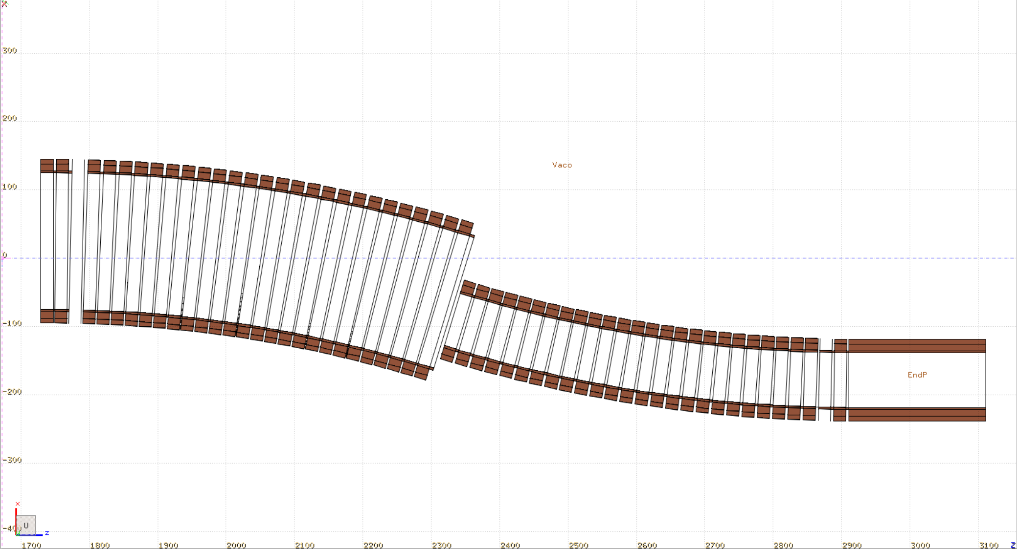
Chicane with shifted axis
PRELIMINARY
This configuration with a shorter chicane could be able to extract a big part of the spent proton beam halo – more studies are needed
Target and primary beam axis
+/- 30 cm aperture
First tests will be conducted with ideal field following the chicane axis, not yet clear to me if this is realistic to achieve (?)

Slide 4
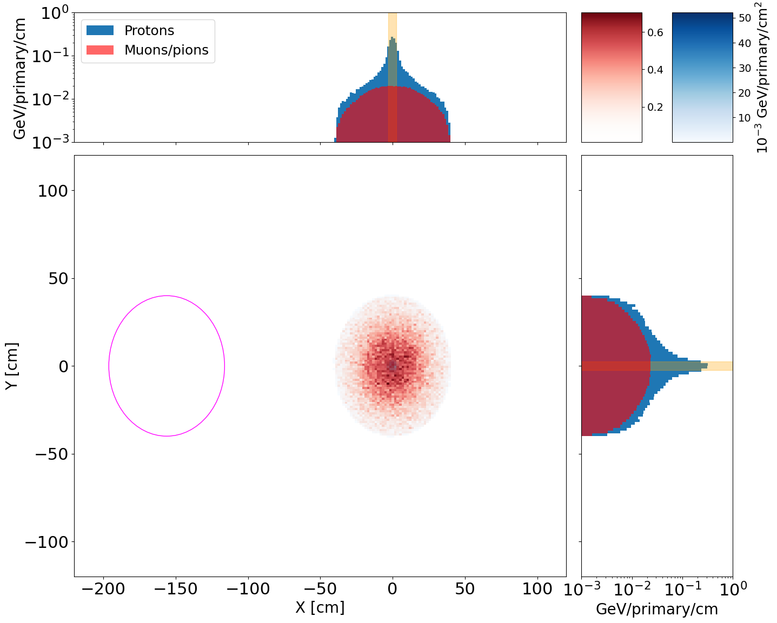
Short tapering
Shortening the tapering does not reduce the radiation load to the chicane magnets – the proton halo is still present
If we want to keep the solenoid chicane, we may have to search for viable solutions to expand the extraction window size.
The spent beam size is mostly driven by the
size of the tapering
Current window size is ~+/- 20 cm
Doubling this size would be ideal.
~+/- 40 cm

Slide 5
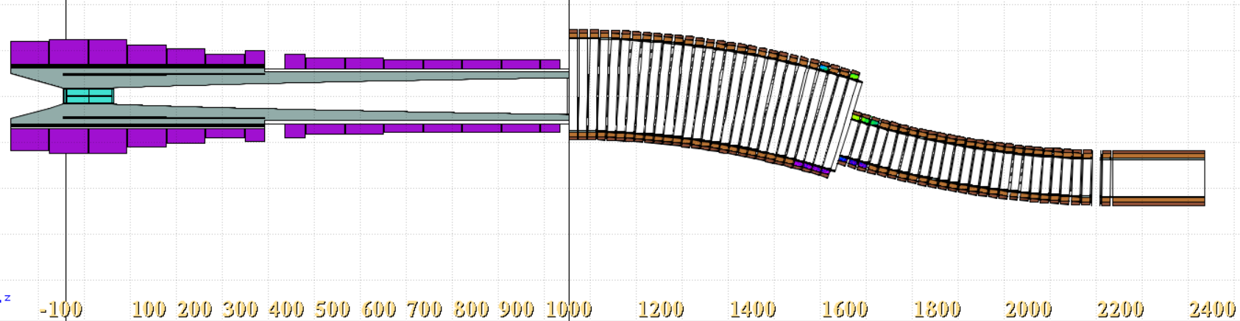
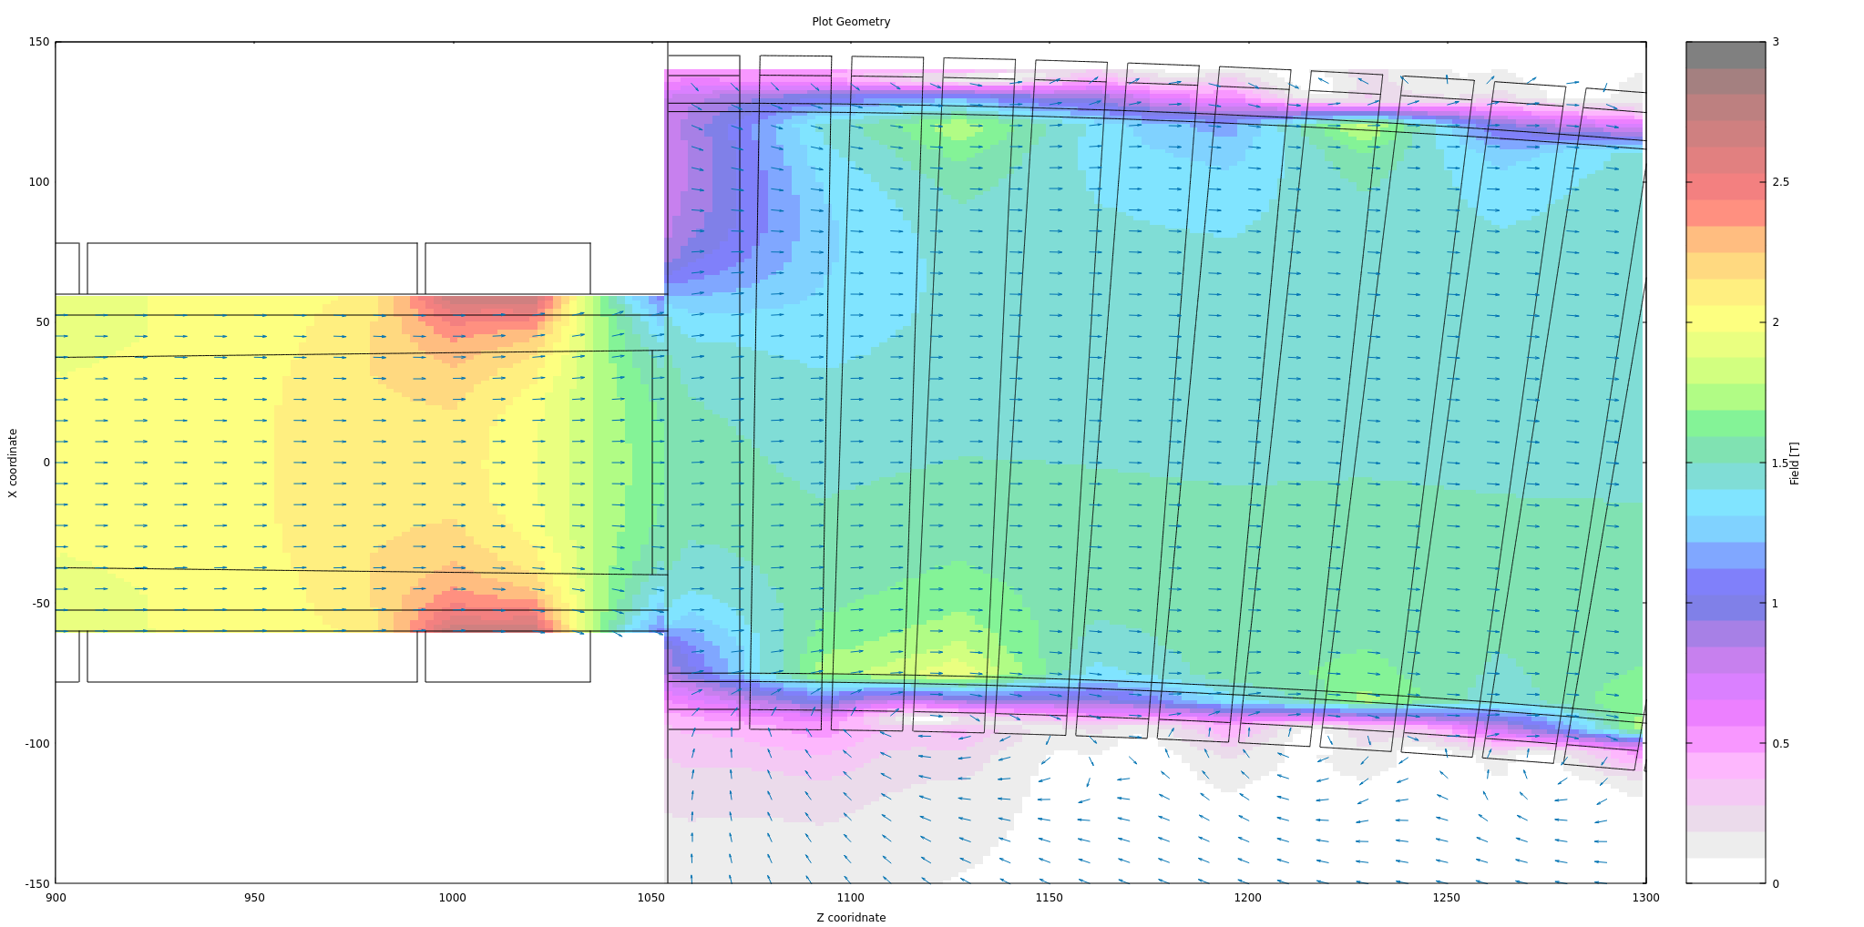
10 m Tapering
The 23 coil design of the tapering region is reduced to 15 coils and connected to the chiane
The field is fairly smooth at the connection between tapering and the chicane

Slide 6
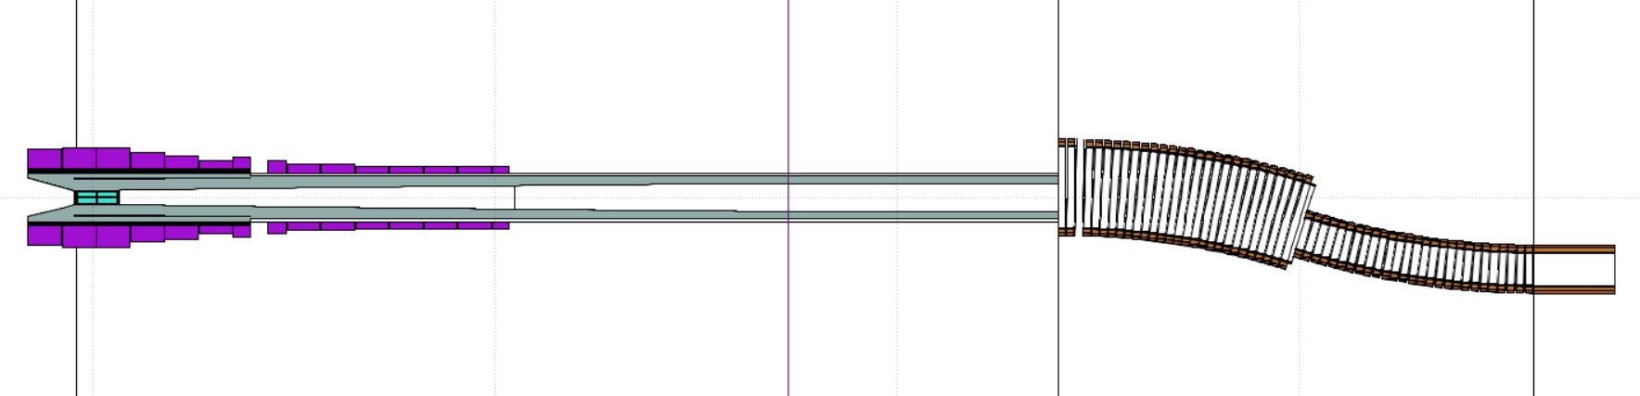
Long tapering 24 meters
Consant radius of 25 cm
Area of contant solenoid field of 1.5 T (the magnet not visible)
The idea here was to keep the shielding inner radius at 35 cm (equal to the final aperture of the baseline tapering of 17 m) to dissipate secondary protons travelling at a small angle with respect to the beam axis

Slide 7
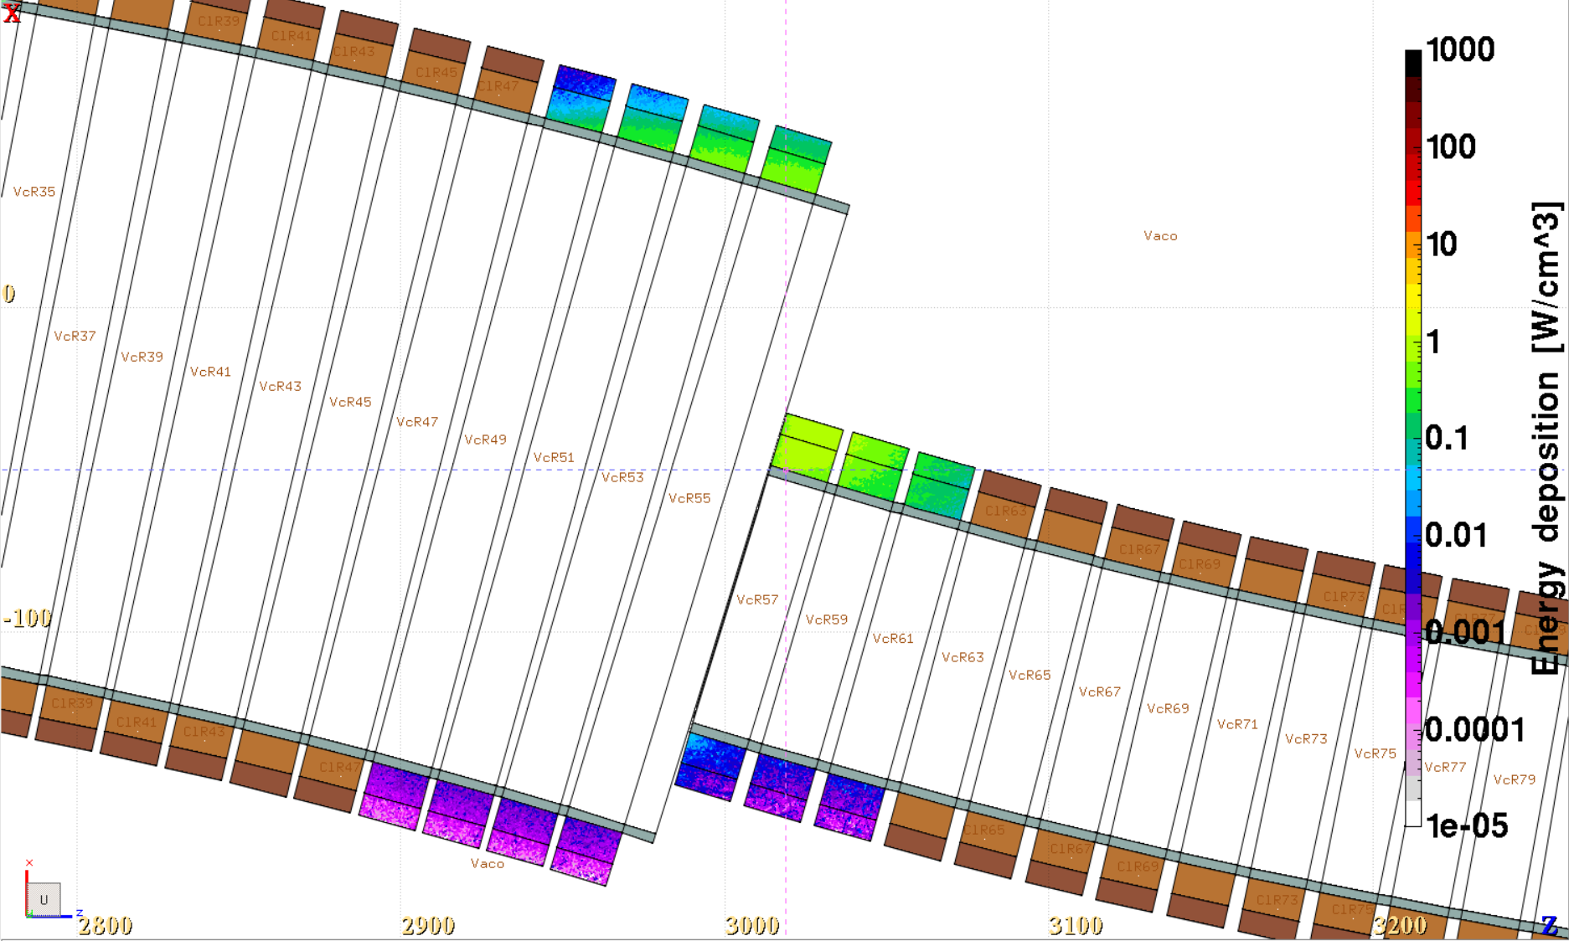
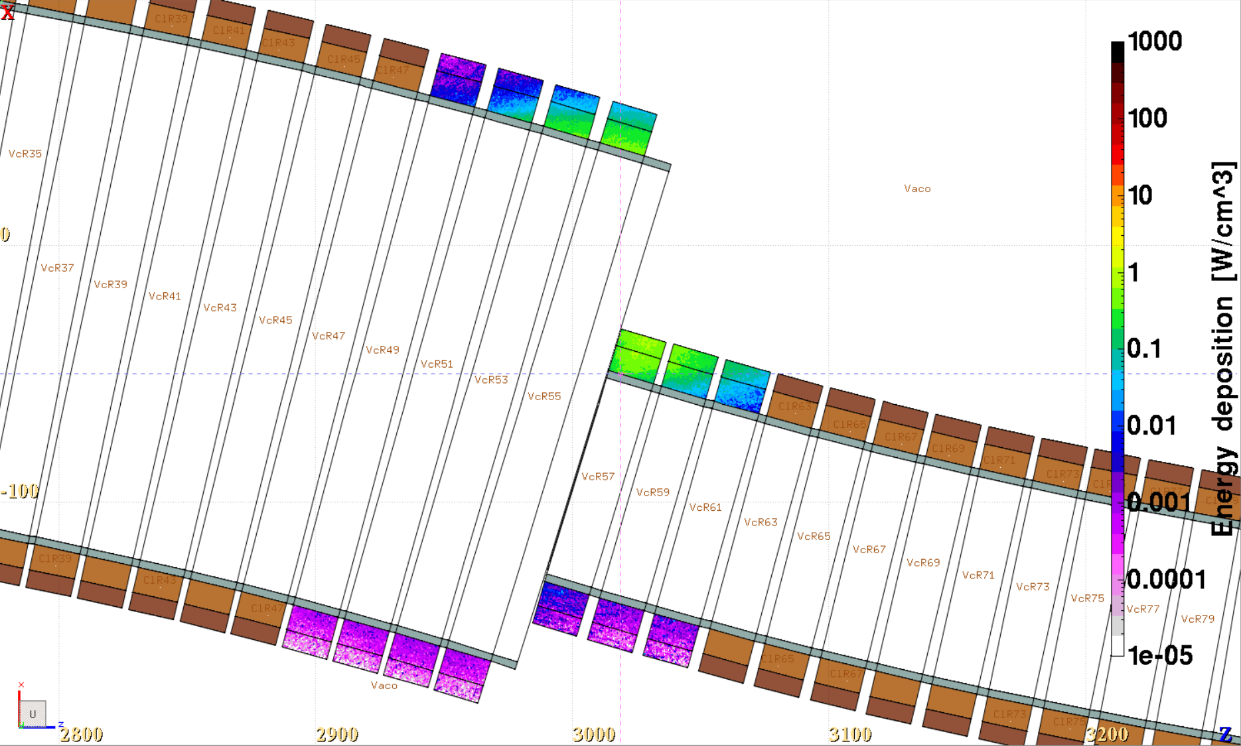
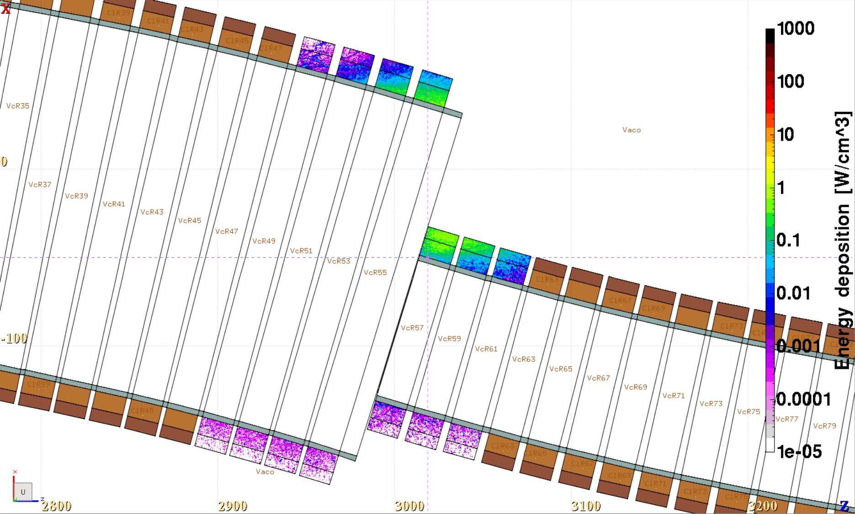

Tapering length – shifted chicane
10 m
17 m
(baseline)
~+/- 60 cm
~+/- 50 cm
24m + cylinder trimmed shielding
24 m
~ +40 cm
-45 cm
~ +45 cm
-50 cm

Slide 8
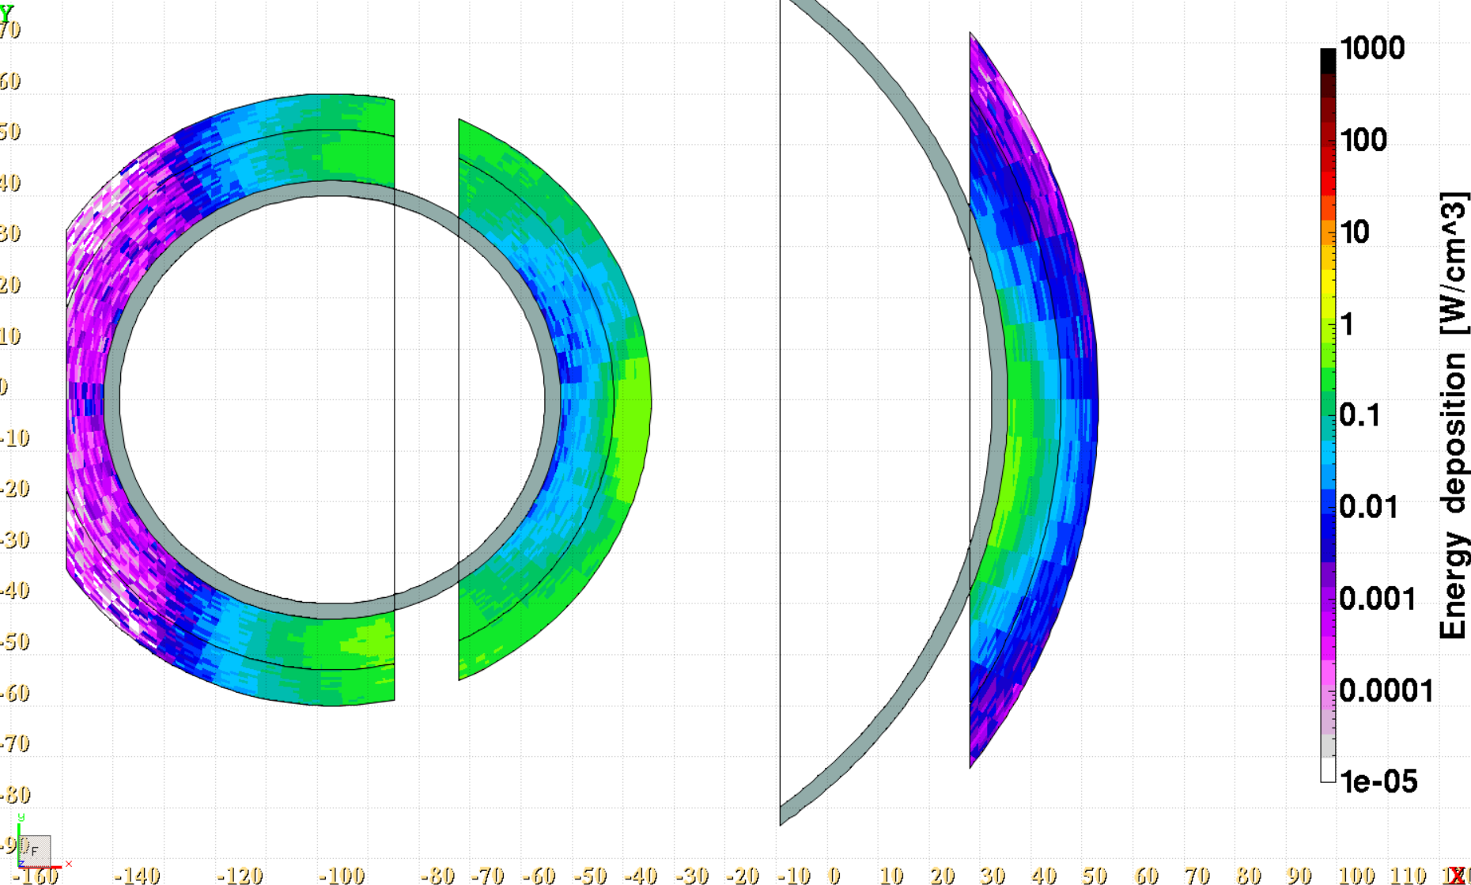
Horizontal view, additional hot spots
The problem was already indentified in the past with the alligned chicane
Hotspots due to charged pions and low energy protons, most likely can be shielded!
Caused by high energy protons, shielding was not very effective so far

Slide 9
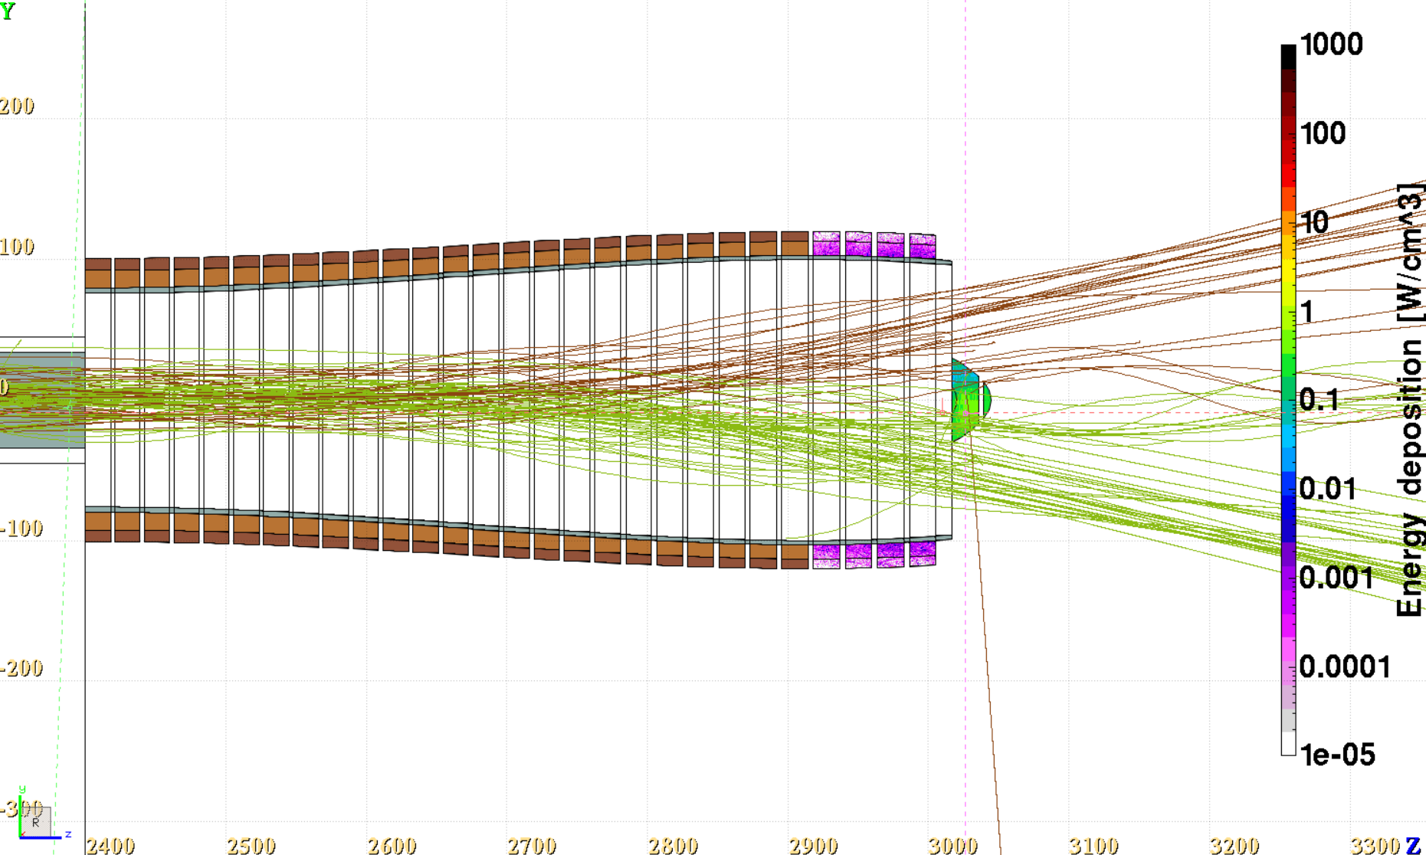
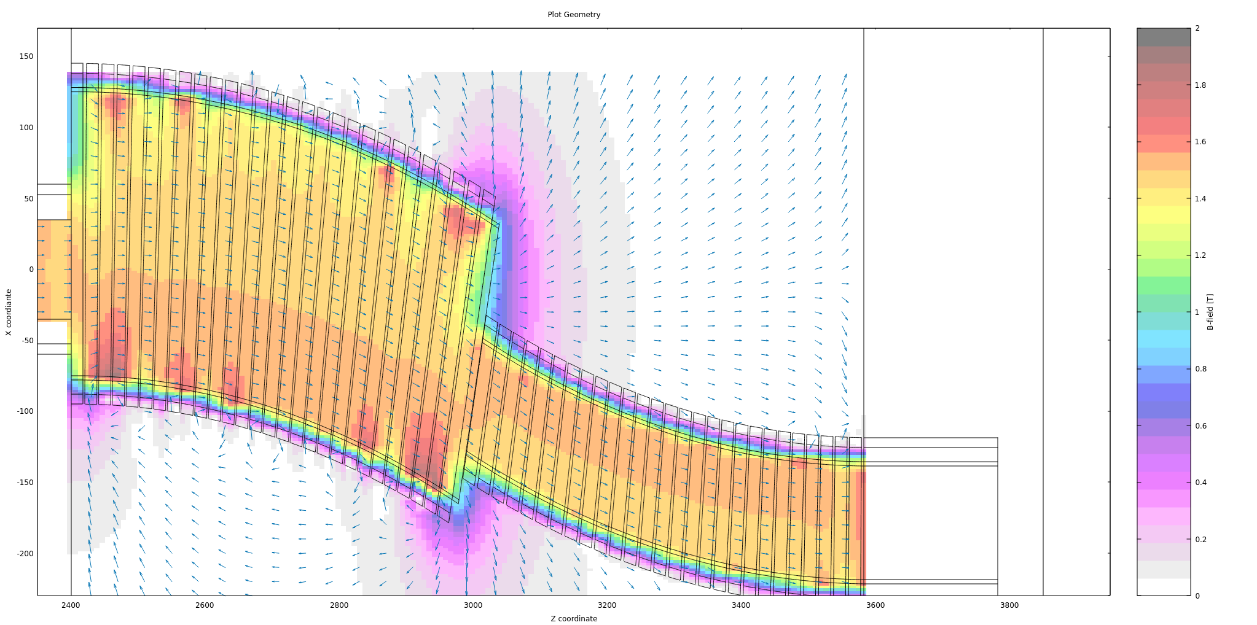
Charge separation and the radial component
π ⁻
π ⁺
Low energy protons are also bent down (not shown)
More or less here the pion charges start to separate. In a chicane with smaller aperture the pions would be impacting the shielding walls along the full length effectively dissipating the radiation load

Slide 10
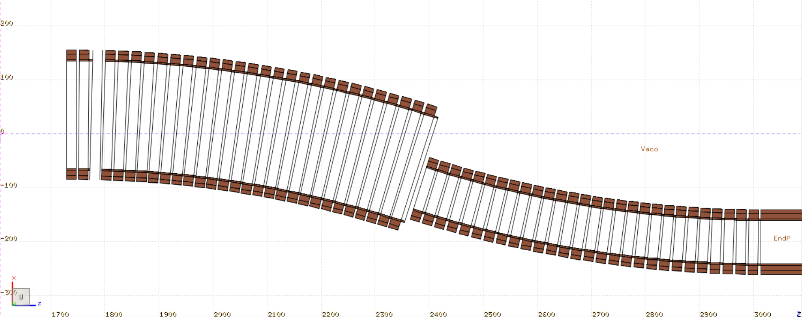
Next steps?
Include a bigger shielding in the upper part
Aperture
+30 cm
-45 cm
Introduce a new chicane with even bigger separation to get more clearance for the second half
Introduce a linear increase in the aperture + shift of the chicane coils

Slide 11
Conclusions
Instead of shortening the tapering region, it might be more beneficial to extend it by adding a few extra meters of drift in a constant solenoid field. More pions will decay and the secondary protons with small incident angle will be dissipated in the shielding walls before entering the chicane.
Introducing a shift in the second part of the chicane can in fact be beneficial for reducing the radiation load from high energy protons.
It seems that the with any chicane design, due to the curvature introducing a radial field component, we will have to deal with low energy protons and pions impactng the upper and lower part of the first smaller coil. However, the effect can be mitigated with proper shielding.

