Slide 1
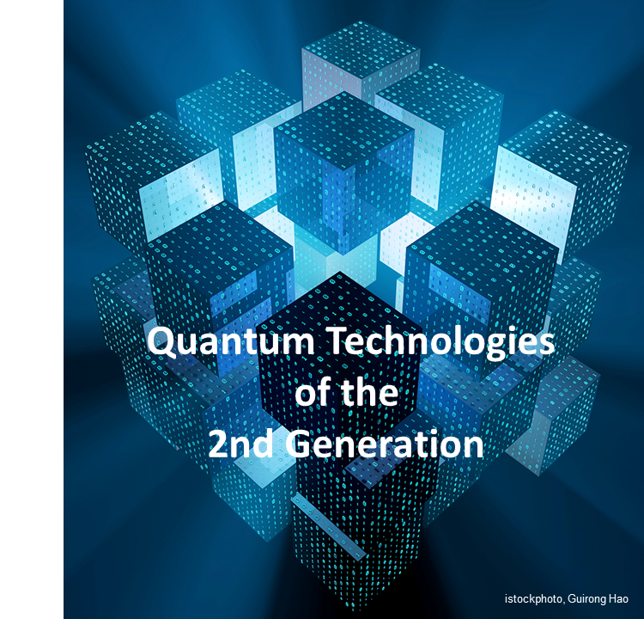

Quantum Machine Learning
for Generating Precise Images in the NISQ Era
Hamburg
Zeuthen
Prof. Dr. Kerstin Borras kerstin.borras@desy.de
Deutsches Elektronen-Synchrotron DESY and RWTH Aachen University
DESY Quantum Technology Task Force qt-task-force@desy.de

Slide 2
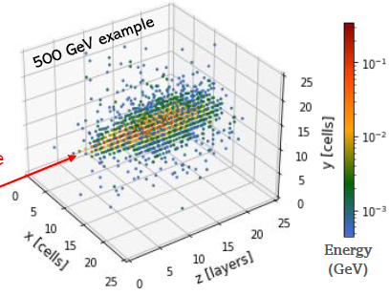
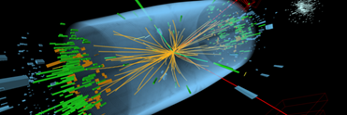
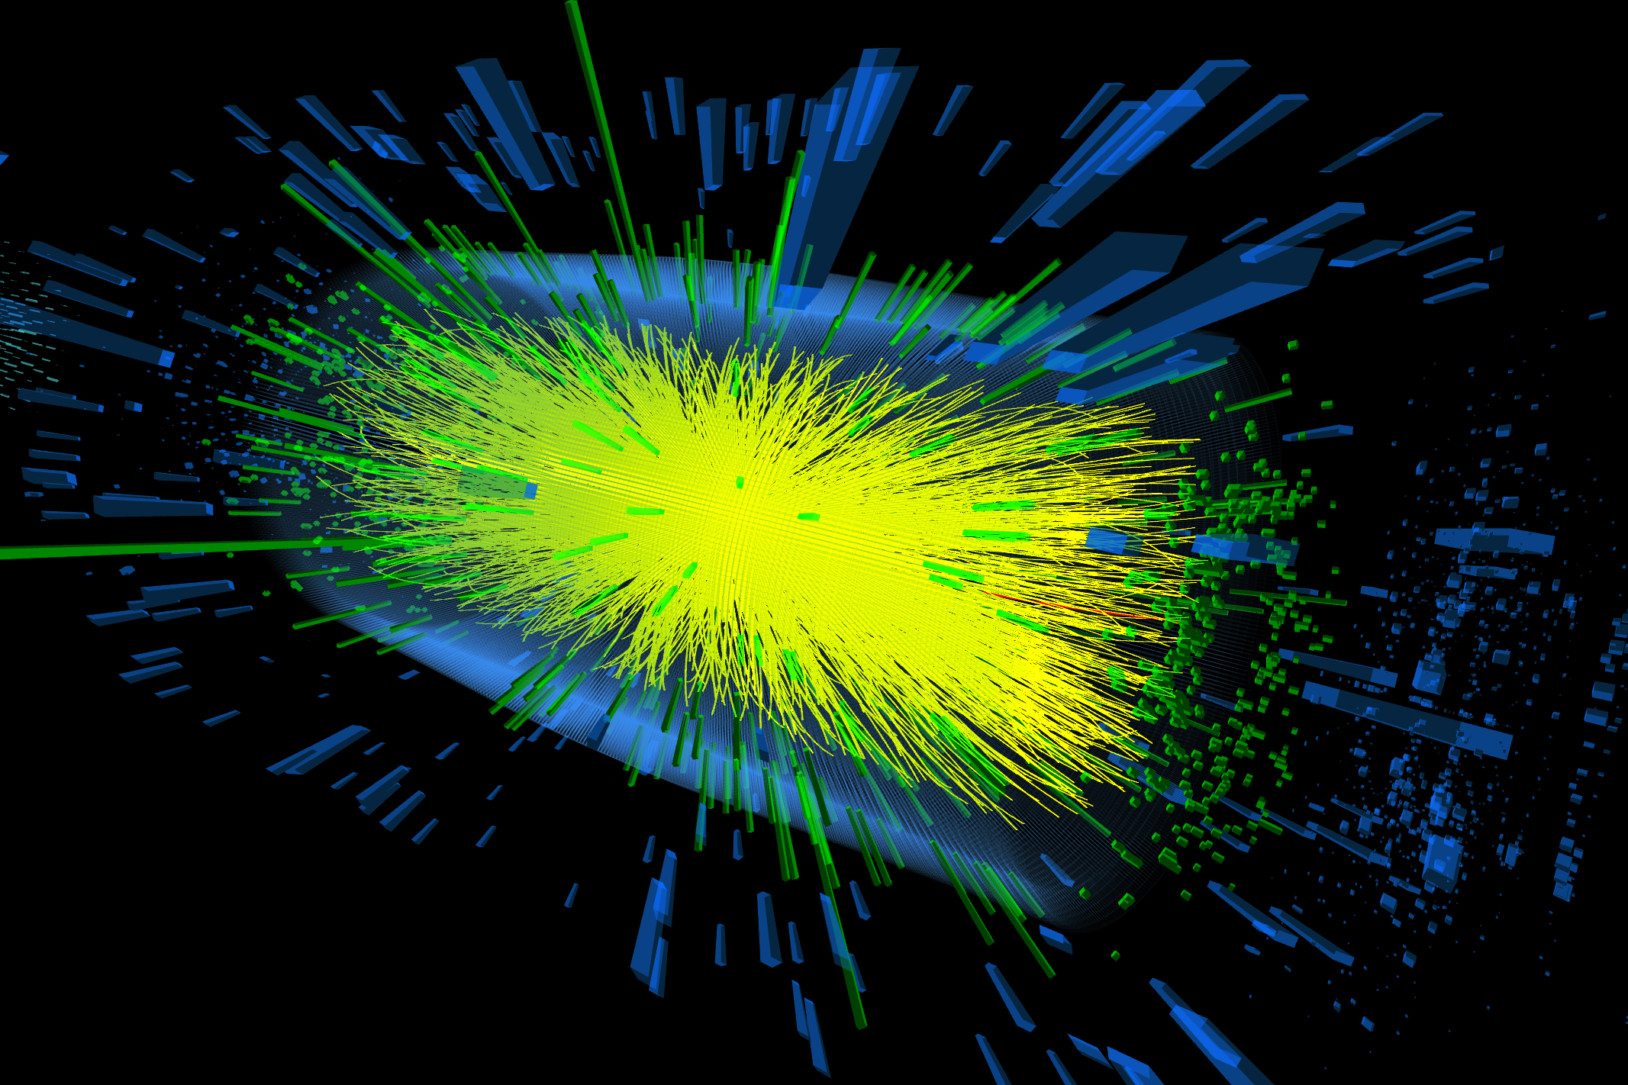


Quantum Machine Learning for Particle Physics
Early examples in Experimental Particle Physics
Quantum Machine Learning lies at the intersection of
Quantum Computing and Machine Learning
High Luminosity LHC (>2029) needs vast amount of simulations with 200 pile-up events,
GRID Computing, Big Data Analysis
LHC (~20 pile-up events)
Develop machine learning methods for Quantum Computing
Q-GAN (Quantum Generative Adversarial Network) simulations for detectors
(CERN Openlab with joint BMBF Gentner PhD Student)
HL LHC (~200 pile-up events)

Slide 3



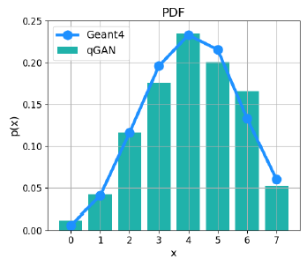
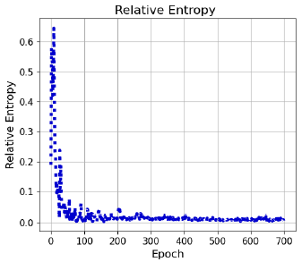
Hybrid Q-GAN in One Dimension
BMBF
NiQ
Down sample 3D shower image → 8 pixels → 3 qubits
Use hybrid approach: quantum + classical
Employ a Qiskit Q-GAN model developed by IBM*
* https://qiskit.org/documentation/machine-learning/tutorials/04_qgans_for_loading_random_distributions.html
Quantum Generative Adversarial Network
8 quantum states:
|000⟩, |001⟩, |010⟩, |011⟩,
|100⟩, |101⟩, |110⟩, |111⟩
Q-GAN simulations in one dimension (with noise)
← readout
noise
full noise
real hardware →

Slide 4

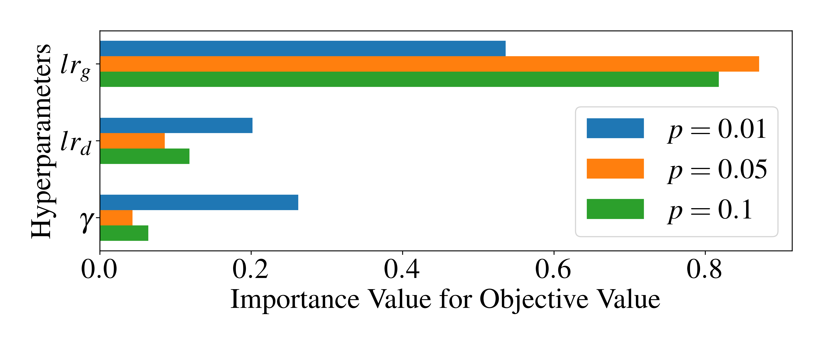
Impact of quantum noise on the training of Q-GANs
K.Borras,S.Y.Chang,L.Funcke,M.Grossi,T.Hartung,K.Jansen, D.Kruecker,S.Kühn,F.Rehm,
C.Tüysüz,S.Vallecorsa https://arxiv.org/abs/2203.01007
Detailed studies with noise and noise mitigation
Importance of hyperparameters for different values of the bit-flip probability, p = {0.01, 0.05, 0.1}
generator learning rate lrg,
discriminator learning rate lrd,
exponential decay rate γ
for the learning layers
→ generator learning rate lrg has the highest impact
→ demonstrates the difficulty of training the quantum generator

Slide 5
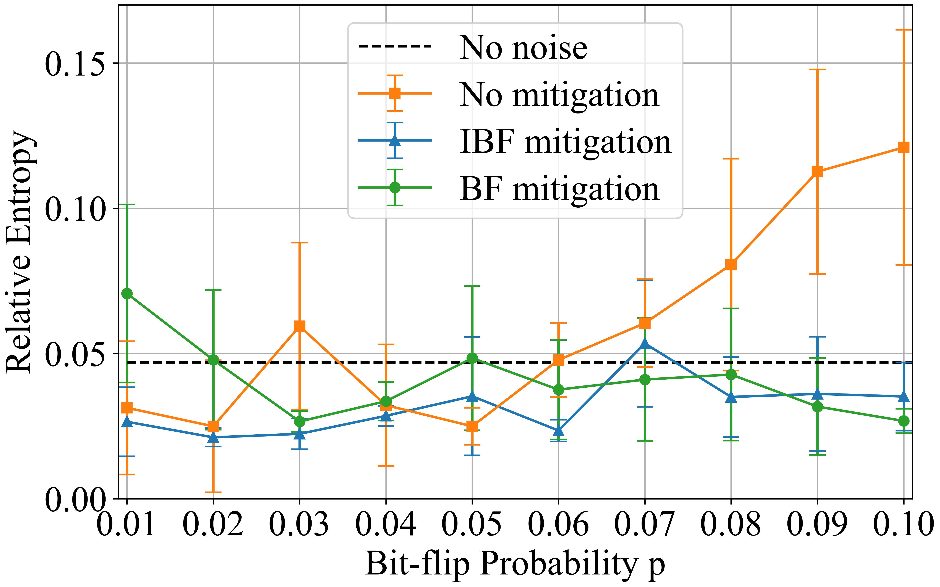
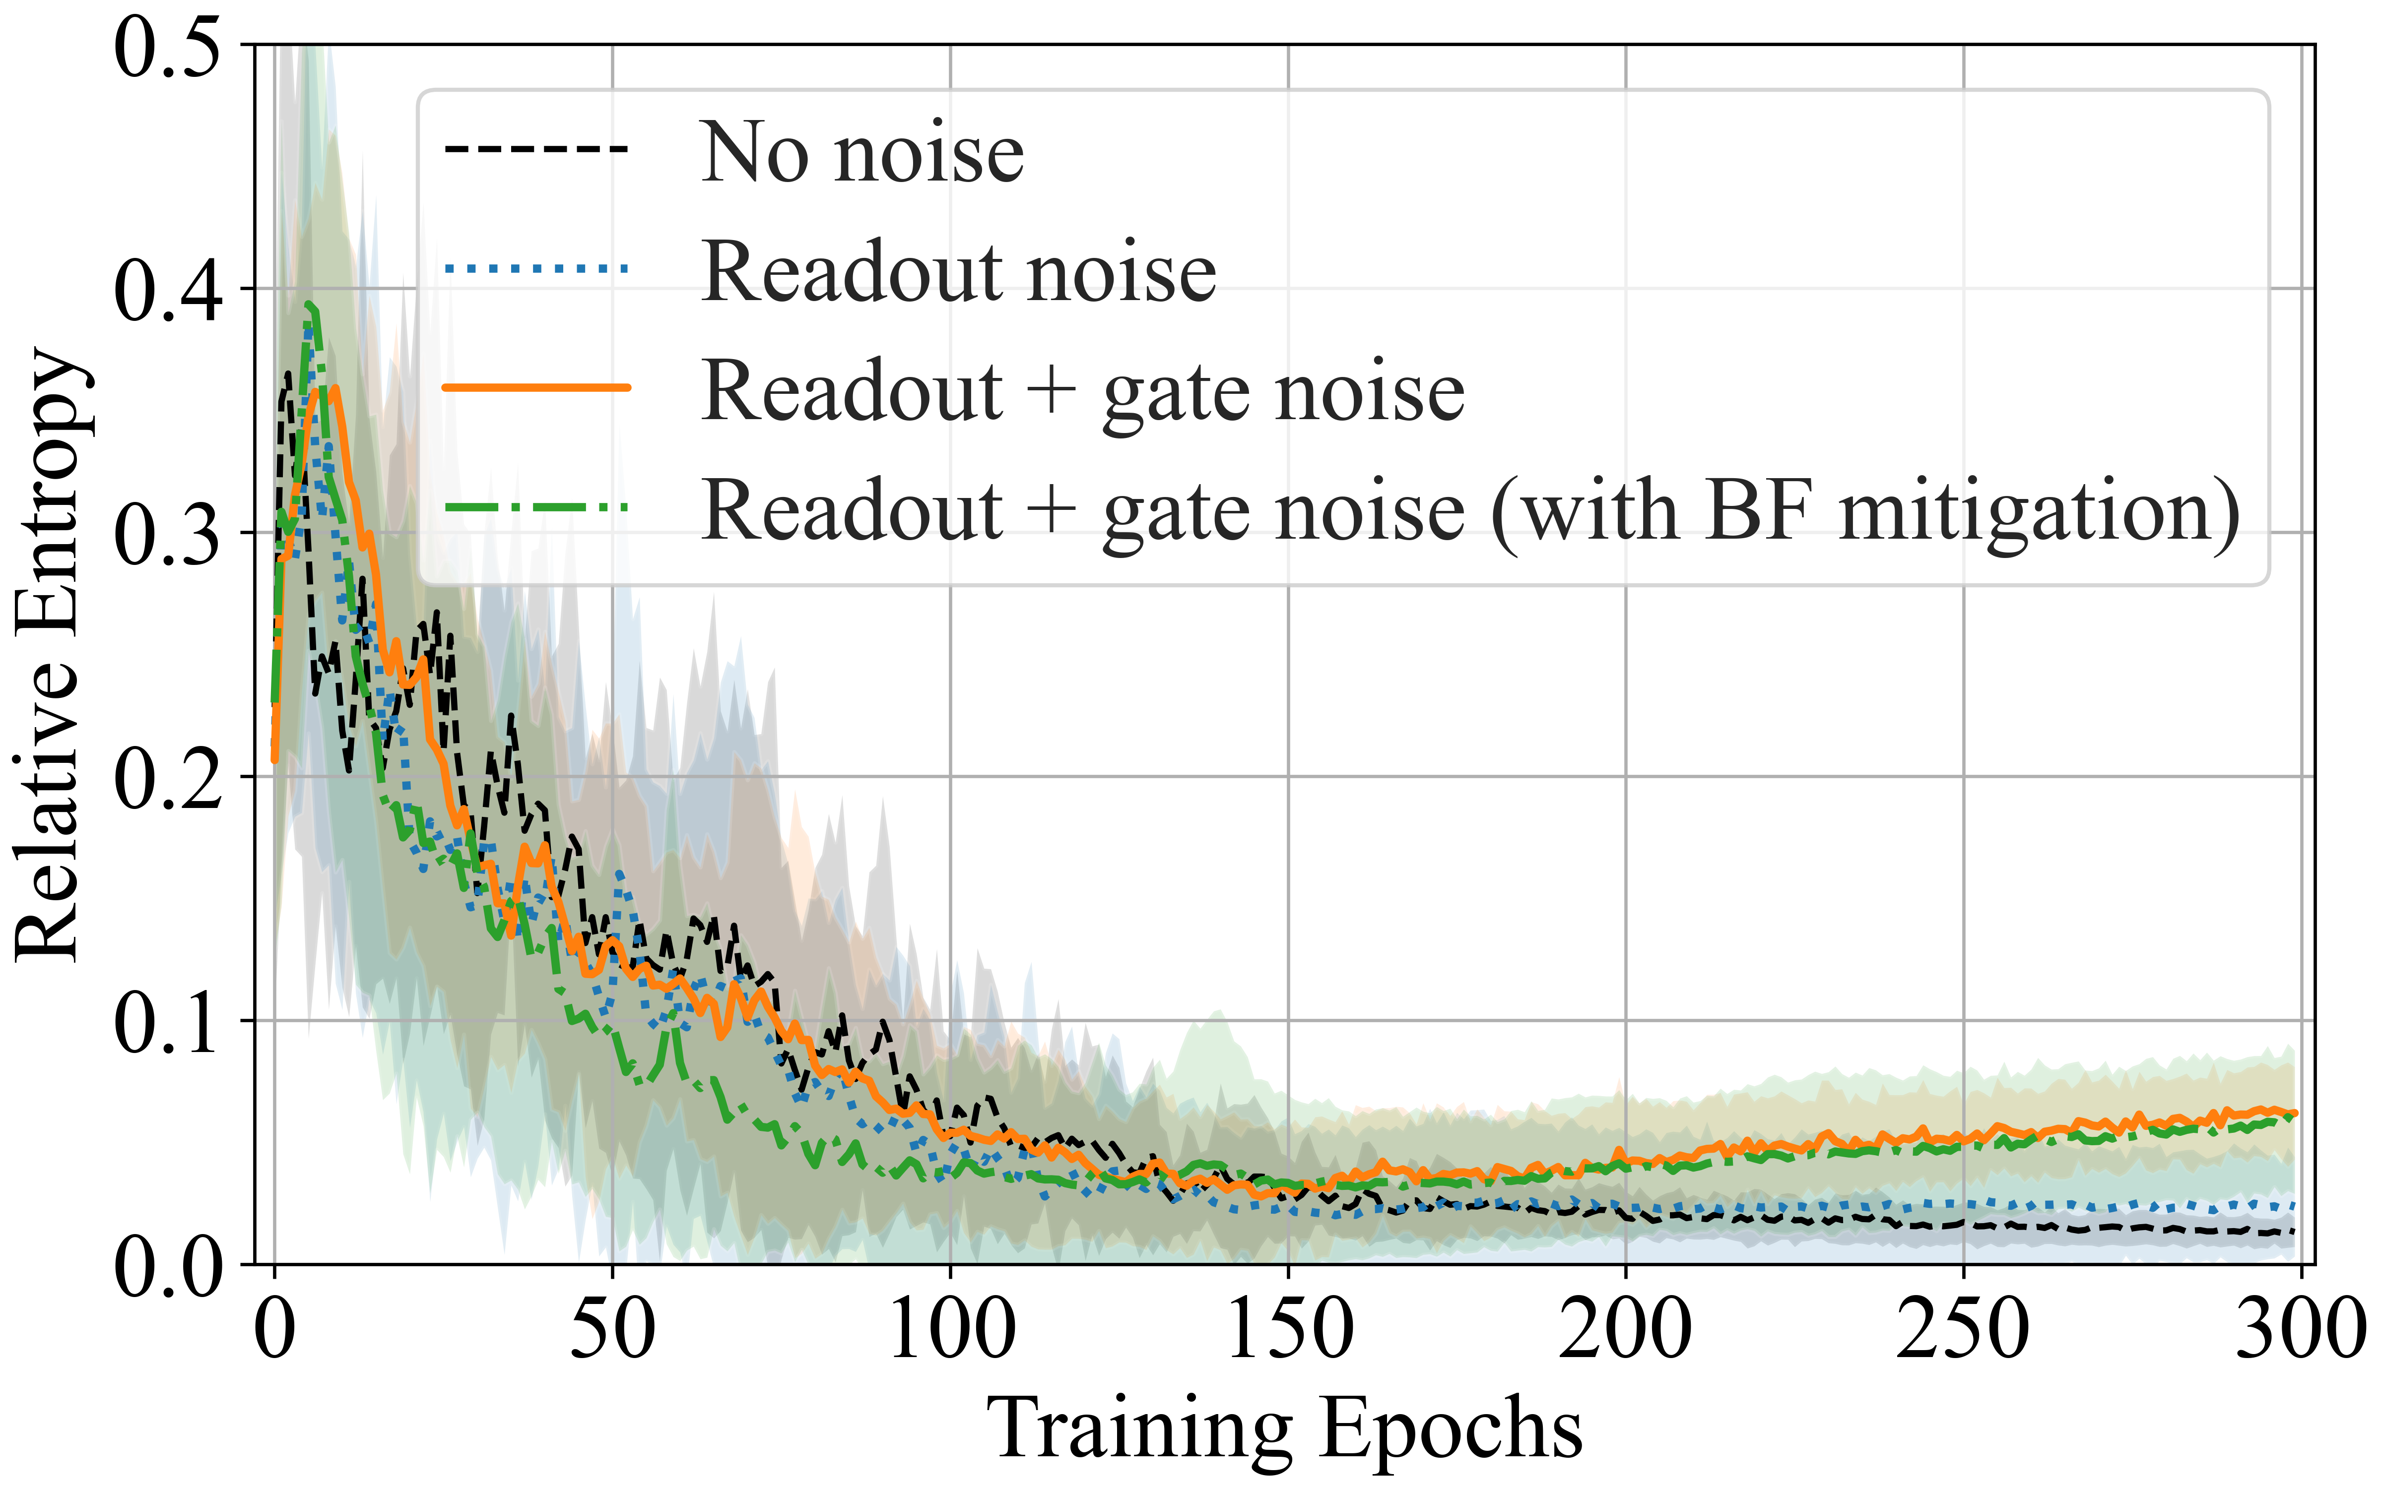
Impact of quantum noise on the training of Q-GANs
K.Borras,S.Y.Chang,L.Funcke,M.Grossi,T.Hartung,K.Jansen,D.Kruecker,S.Kühn,F.Rehm,
C.Tüysüz,S.Vallecorsa https://arxiv.org/abs/2203.01007
Results without and with two different error mitigation methods
Error mitigation plays a crucial role for qGAN training in the presence of the large readout errors on current NISQ devices
Average values quickly converge in the noise-free and readout-error only cases, but do not seem to converge when including two-qubit gate errors → reveal the critical effect of two-qubit gate errors on qGAN training with current NISQ devices.

Slide 6
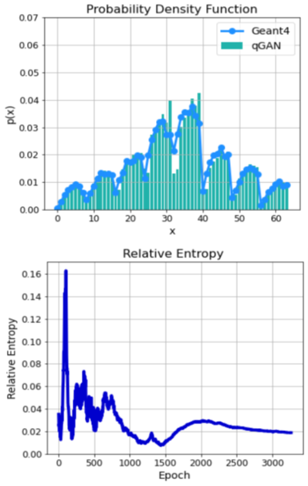
Hybrid Q-GAN in Two Dimensions
BMBF
NiQ
Early examples in Experimental Particle Physics
Down sample → 8x8 pixels → 6 qubits
Adapt Tree Tensor Network
Grant, E., Benedetti, M., Cao, S.et al.
Hierarchical quantum classifiers.
npjQuantum Inf4,65 (2018). https://doi.org/10.1038/s41534-018-0116-9
Model generates only averaged probability distributions
→ only average image no individual images
Hardware expensive training: 2D model training ~1 week
Unstable training with large fluctuations.

Slide 7
Full Quantum Angle Generator - QAG
→ Correlations & Noise Robustness
BMBF
NiQ
Less parameters for complex data and sufficient accuracy albeit noise
Angle Encoding
Best Circuit
Training with Loss-functions
Good Accuracy
Correlations reproduced
Noise in Training
Readout + Gate Noise
Gate Noise
Readout Noise
▼ HW Sim M
▲ HW M
▼ HW Sim M
▲ HW C
Rehm, F. et al. Precise Image Generation on Current Noisy Quantum Computing Devices.
IOP Quantum Science and Technology https://doi.org/10.1088/2058-9565/ad0389. PhD Thesis RWTH Aachen more details http://doi.org/10.18154/RWTH-2023-09302

Slide 8
Quantum Angle Generator: Learning Noise !
BMBF
NiQ
Less parameters for complex data and robustness against noise
8%
Noise in Trainng
2%
Calibration change from
2% to 8% during training
Noise in training + inference → better accuracy
Quantum Neural Networks can adapt and learn changing noise conditions
→ robustness against and employing noise !
QAG needs 20x less parameters to be trained than comparable hybrid GAN → sustainability
Under scrutiny right now
Rehm, F. et al. Precise Image Generation on Current Noisy Quantum Computing Devices.
IOP Quantum Science and Technology https://doi.org/10.1088/2058-9565/ad0389. PhD Thesis RWTH Aachen more details http://doi.org/10.18154/RWTH-2023-09302

Slide 9
Full Quantum GAN
BMBF
NiQ
Generator and Discriminator in Quantum
Why a quantum GAN ?
  Objective functions better at small image sizes.
  (q)GAN better at larger image sizes (in future)
QAG generator and quantum discriminator
→ full quantum
Good accuracy for the average shower images
Rehm, F. et al. Precise Image Generation on Current Noisy Quantum Computing Devices.
IOP Quantum Science and Technology https://doi.org/10.1088/2058-9565/ad0389. PhD Thesis RWTH Aachen more details http://doi.org/10.18154/RWTH-2023-09302

Slide 10
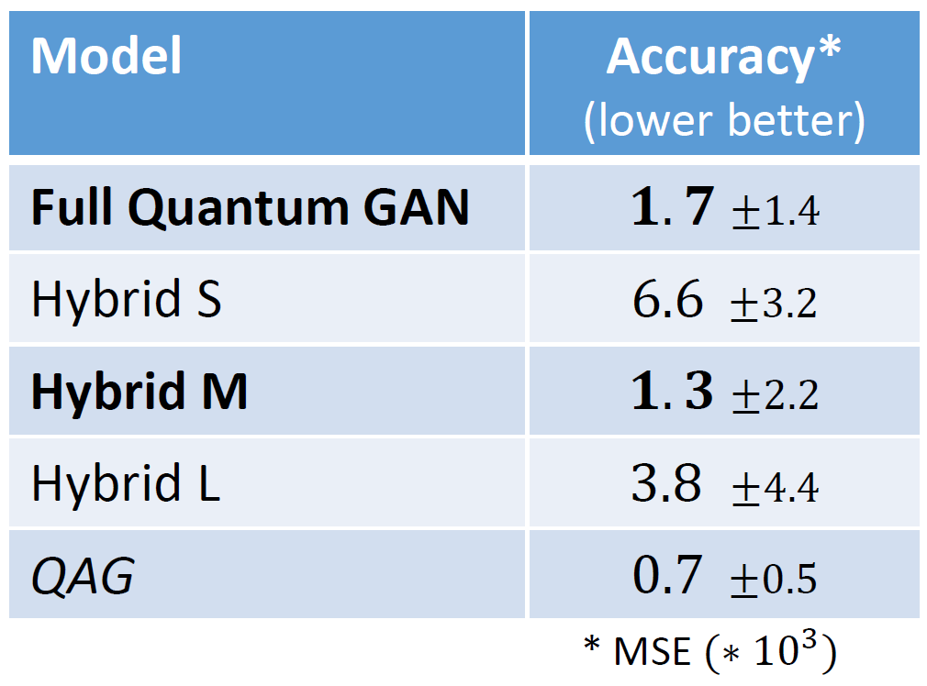
Hybrid Quantum GAN
BMBF
NiQ
Quantum Generator and Classical Discriminator
QAG generator + a classical discriminator → hybrid ansatz
Goal: Compare the power of quantum circuits to classical neural networks.
Three classical discriminator sizes S: 153, M: 433, L: 1889 parameters.
Accuracy of Hybrid M matches best the Full Q-GAN.
  both models exhibit an ~equal expressive power
  quantum discriminator circuit with 20 parameters performs similar to the neural network with 433 parameters
  The quantum circuit retains a higher expressive power than the classical neural network (confirms the findings of Ref *)
To be investigated:
Statistics not sufficient for significant results
Full Quantum and hybrid GANs cannot reproduce the pixel-wise image correlations
Necessary number of parameters in classical Gen-ML under scrutiny with a small model for condensed shower profile.
* Zhao, Chen, and Xiao-Shan Gao. "QDNN: DNN with quantum neural network layers."
arXiv preprint arXiv:1912.12660 (2019).

Slide 11
Outlook.
The next immediate steps.
Upscale and improve the present best model
- more pixels
- different particle showers, energy, incident angle, …
- look at real testbeam data
Improve statistics to obtain significant results
Investigate the missing correlation in Q- and hybrid GANs
Investigate the minimum number of parameters in classical model
Connect to Industry:
New funding from City of Hamburg:
collaborate with the companies eleQtron, ParityQC and DLR-QCI
→ different Quantum Computing Platform, optimizing running conditions, optimizing algorithms, …
Initial connections made with company IQM
→ different architecture, different connectivity and more other aspects
Exciting times with exploratorive projects for
novel technologies

Slide 12


Any
Questions ?
Prof. Dr. Kerstin Borras kerstin.borras@desy.de
DESY Quantum Technology Task Force: qt-task-force@desy.de

