Slide 1
CLIC Injector Linacs Summary
A. Kurtulus, A. Grudiev, S. Doebert, A. Latina, Y. Zhao
CLIC MB injector design meeting: 10
14/03/2025

Slide 2
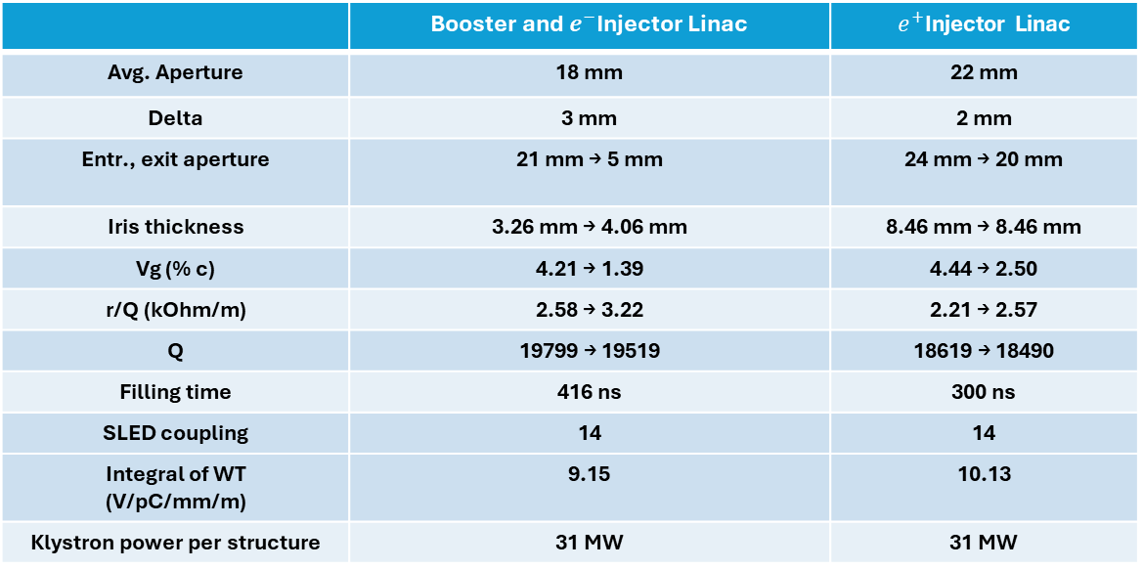
CLIC Booster, $e^{−}$ and $e^{+}$ Injector Linac Structure Parameters
Summary Table
f = 2 GHz, Length = 3m, Phase advance = 2π/3, Q_{0,SLED} = 2e5, T_{klystron} = 5 us
 | Booster and $e^{−}$Injector Linac | $e^{+}$Injector Linac
Avg. Aperture | 18 mm | 22 mm
Delta | 3 mm | 2 mm
Entr., exit aperture | 21 mm → 5 mm | 24 mm → 20 mm
Iris thickness | 3.26 mm → 4.06 mm | 8.46 mm → 8.46 mm
Vg (% c) | 4.21 → 1.39 | 4.44 → 2.50
r/Q (kOhm/m) | 2.58 → 3.22 | 2.21 → 2.57
Q | 19799 → 19519 | 18619 → 18490
Filling time | 416 ns | 300 ns
SLED coupling | 14 | 14
Integral of WT (V/pC/mm/m) | 9.15 | 10.13
Klystron power per structure | 31 MW | 31 MW

Slide 3
No BLC applied input RF pulse

Slide 4
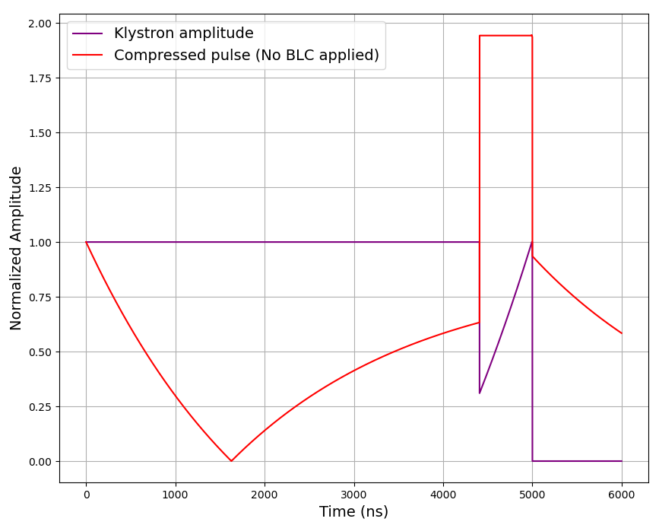

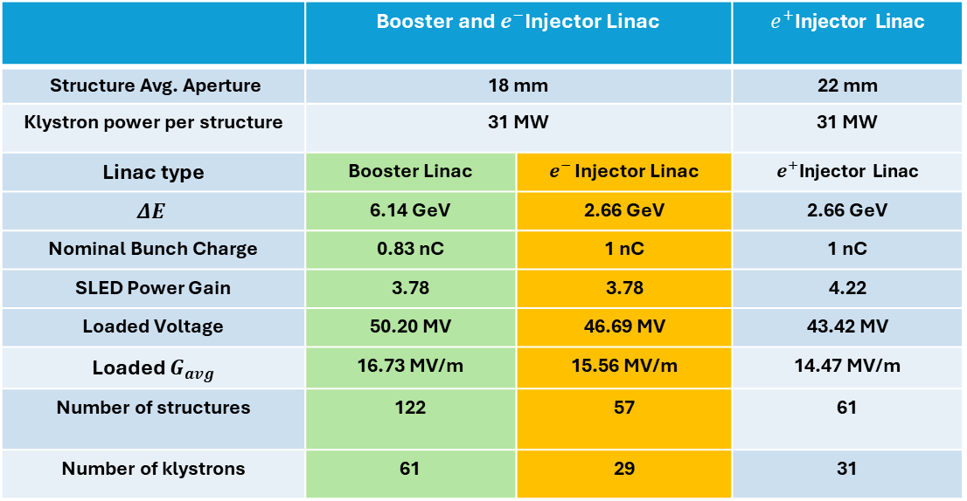


CLIC Booster, $e^{−}$ and $e^{+}$ Injector Linac RF Module
 | Booster and $e^{−}$Injector Linac |  | $e^{+}$Injector Linac
Structure Avg. Aperture | 18 mm |  | 22 mm
Klystron power per structure | 31 MW |  | 31 MW
Linac type | Booster Linac | $e^{− }$Injector Linac | $e^{+}$Injector Linac
$$ΔE$$ | 6.14 GeV | 2.66 GeV | 2.66 GeV
Nominal Bunch Charge | 0.83 nC | 1 nC | 1 nC
SLED Power Gain | 3.78 | 3.78 | 4.22
Loaded Voltage | 50.20 MV | 46.69 MV | 43.42 MV
Loaded $G_{avg}$ | 16.73 MV/m | 15.56 MV/m | 14.47 MV/m
Number of structures | 122 | 57 | 61
Number of klystrons | 61 | 29 | 31
Klystron
$P_{k}$
RF Pulse Compressor
$P_{gain}$
Accelerating Structure
Accelerating Structure

Slide 5
BLC applied input RF pulse

Slide 6
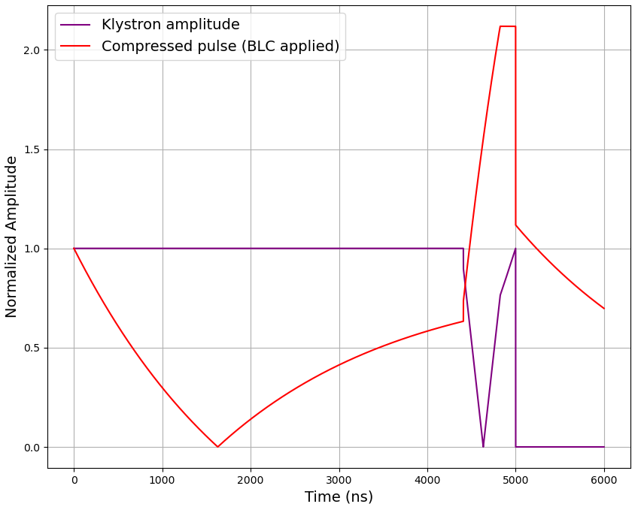
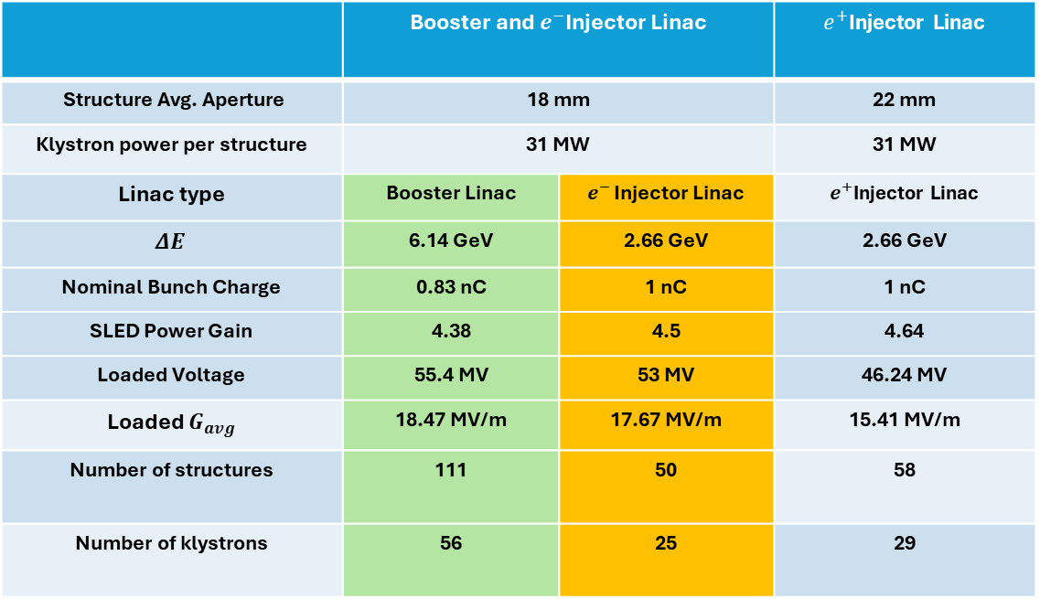
CLIC Booster, $e^{−}$ and $e^{+}$ Injector Linac RF Module
Beam-loading ramp applied.
 | Booster and $e^{−}$Injector Linac |  | $e^{+}$Injector Linac
Structure Avg. Aperture | 18 mm |  | 22 mm
Klystron power per structure | 31 MW |  | 31 MW
Linac type | Booster Linac | $e^{− }$Injector Linac | $e^{+}$Injector Linac
$$ΔE$$ | 6.14 GeV | 2.66 GeV | 2.66 GeV
Nominal Bunch Charge | 0.83 nC | 1 nC | 1 nC
SLED Power Gain | 4.38 | 4.5 | 4.64
Loaded Voltage | 55.4 MV | 53 MV | 46.24 MV
Loaded $G_{avg}$ | 18.47 MV/m | 17.67 MV/m | 15.41 MV/m
Number of structures | 111 | 50 | 58
Number of klystrons | 56 | 25 | 29
Klystron
$P_{k}$
RF Pulse Compressor
$P_{gain}$
Accelerating Structure
Accelerating Structure

Slide 7
Double compressed-BLC applied input RF pulse

Slide 8
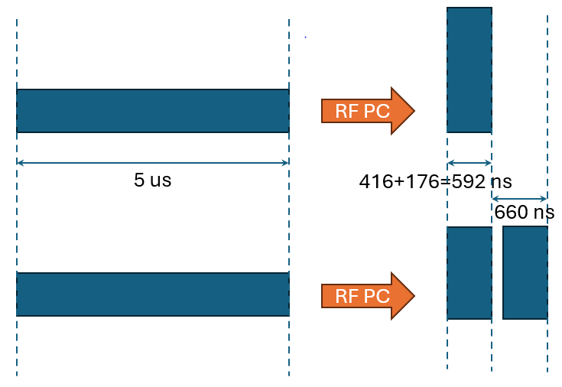
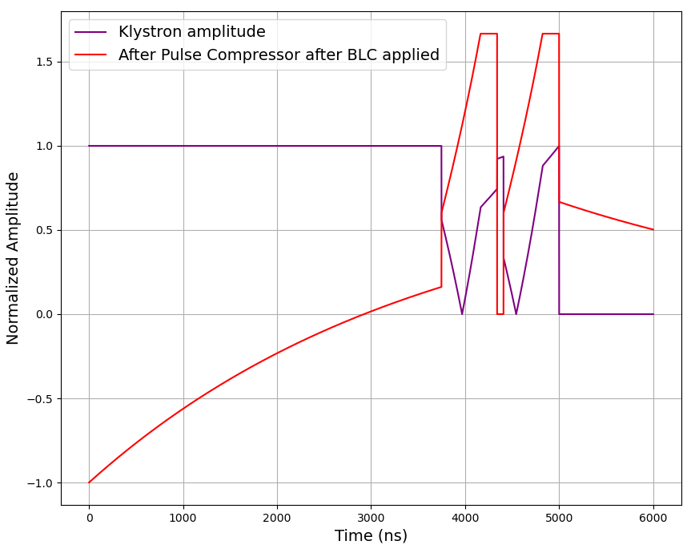
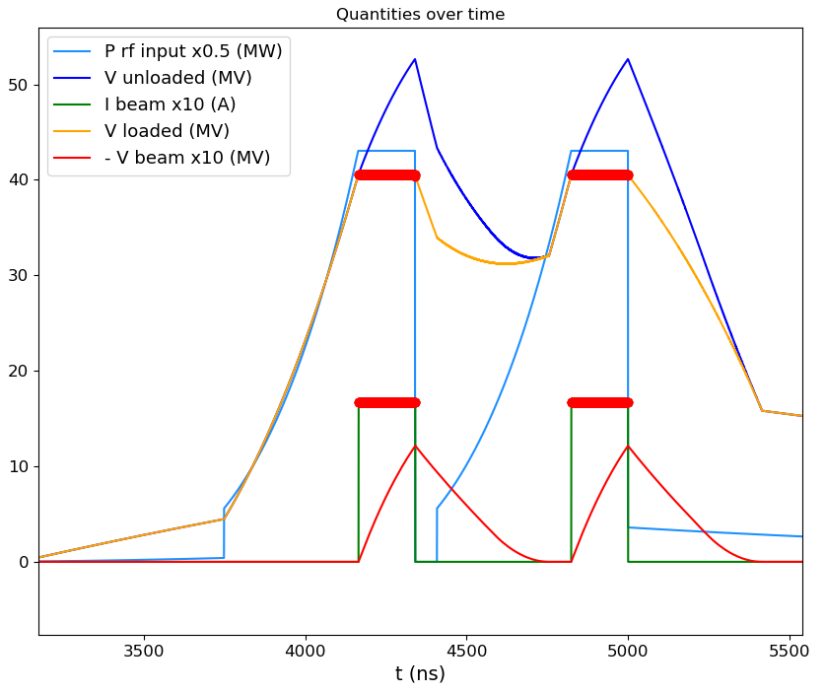

CLIC $Booster$Linac
Double compressed pulse:
0.5% energy spread
0.06% energy spread
40.58 MV unloaded V
40.52 MV unloaded V

Slide 9
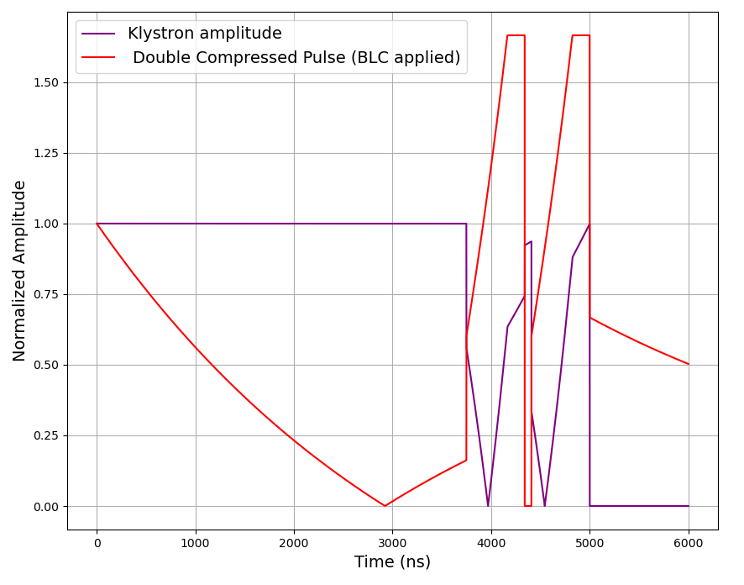
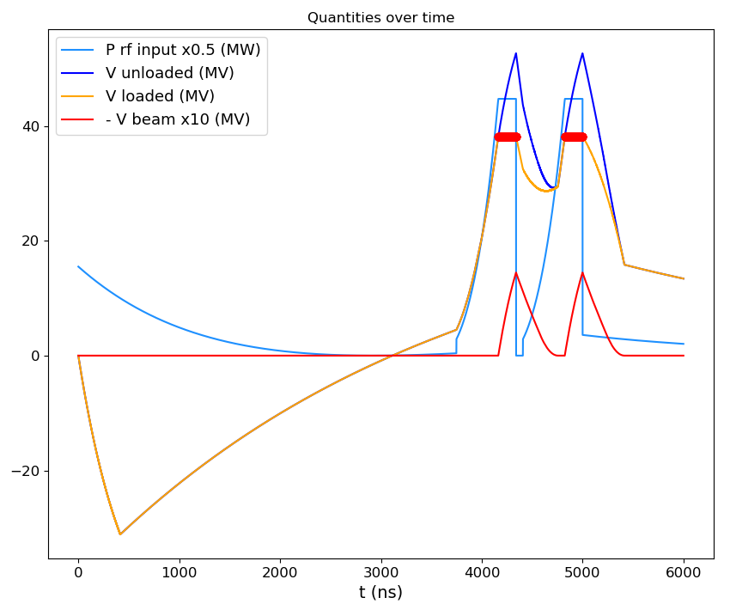

CLIC $e^{−}$ Injector Linac
Double compressed pulse:
0.6% energy spread
0.07% energy spead
38.18 MV unloaded V
38.35 MV unloaded V

Slide 10


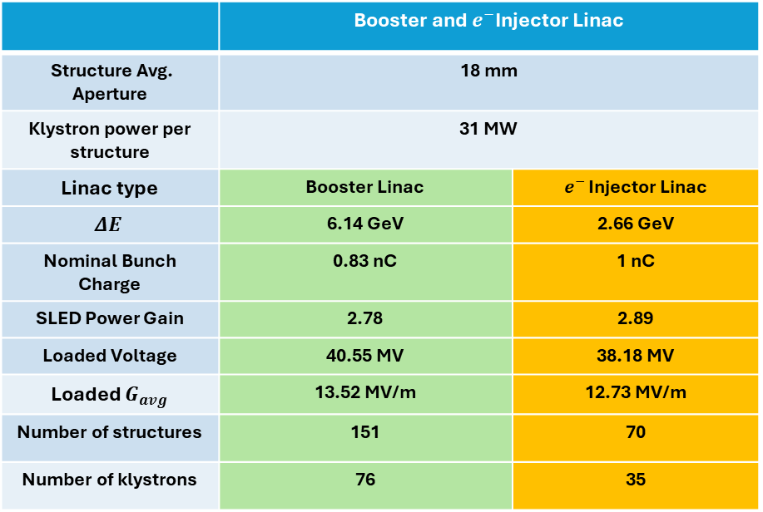
CLIC Booster, $e^{−}$ and $e^{+}$ Injector Linac RF Module
Double Compressed pulse beam-loading ramp applied.
 | Booster and $e^{−}$Injector Linac
Structure Avg. Aperture | 18 mm
Klystron power per structure | 31 MW
Linac type | Booster Linac | $e^{− }$Injector Linac
$$ΔE$$ | 6.14 GeV | 2.66 GeV
Nominal Bunch Charge | 0.83 nC | 1 nC
SLED Power Gain | 2.78 | 2.89
Loaded Voltage | 40.55 MV | 38.18 MV
Loaded $G_{avg}$ | 13.52 MV/m | 12.73 MV/m
Number of structures | 151 | 70
Number of klystrons | 76 | 35
Klystron
$P_{k}$
RF Pulse Compressor
$P_{gain}$
Accelerating Structure
Accelerating Structure

Slide 11


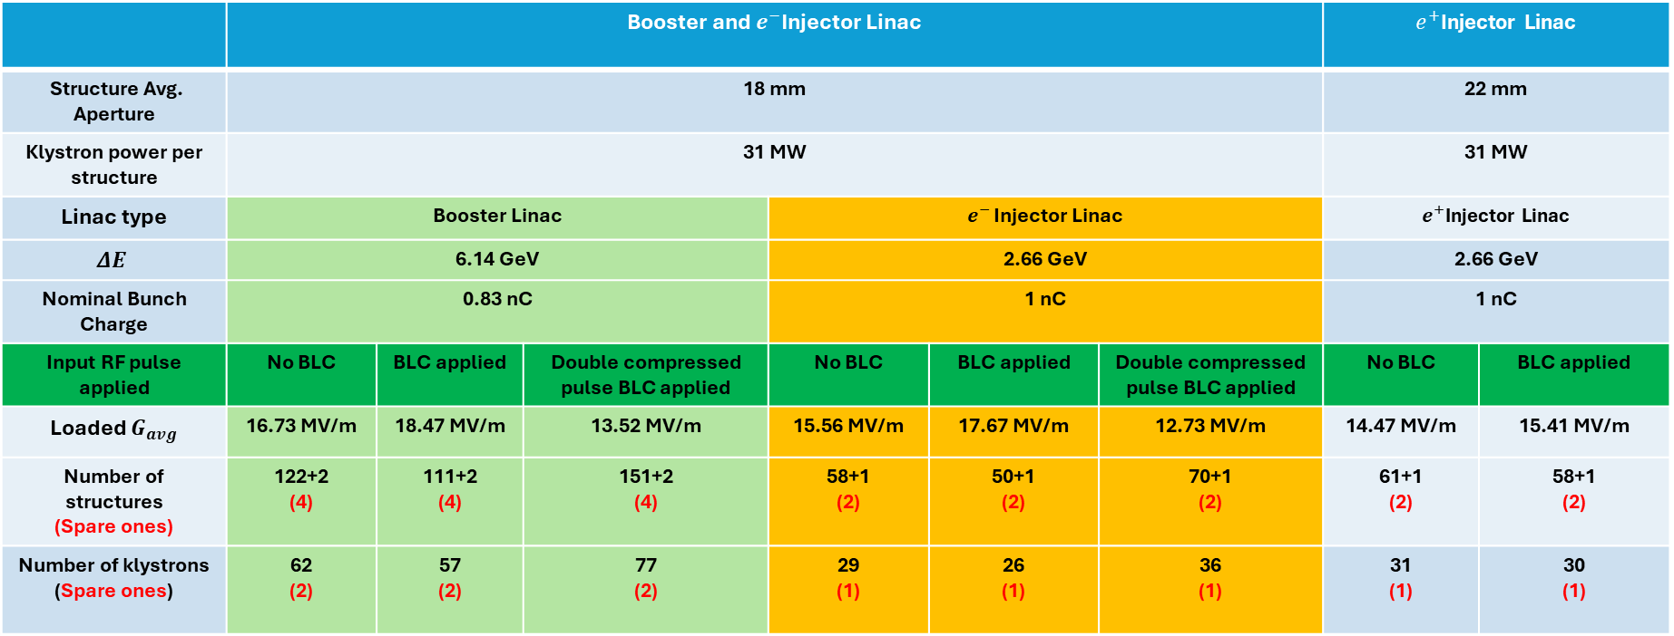



CLIC Booster, $e^{−}$ and $e^{+}$ Injector Linac RF Module
Summary Table
 | Booster and $e^{−}$Injector Linac |  |  |  |  |  | $e^{+}$Injector Linac
Structure Avg. Aperture | 18 mm |  |  |  |  |  | 22 mm
Klystron power per structure | 31 MW |  |  |  |  |  | 31 MW
Linac type | Booster Linac |  |  | $e^{− }$Injector Linac |  |  | $e^{+}$Injector Linac
$$ΔE$$ | 6.14 GeV |  |  | 2.66 GeV |  |  | 2.66 GeV
Nominal Bunch Charge | 0.83 nC |  |  | 1 nC |  |  | 1 nC
Input RF pulse applied | No BLC | BLC applied | Double compressed pulse BLC applied | No BLC | BLC applied | Double compressed pulse BLC applied | No BLC | BLC applied
Loaded $G_{avg}$ | 16.73 MV/m | 18.47 MV/m | 13.52 MV/m | 15.56 MV/m | 17.67 MV/m | 12.73 MV/m | 14.47 MV/m | 15.41 MV/m
Number of structures (Spare ones) | 122+2 (4) | 111+2 (4) | 151+2 (4) | 58+1 (2) | 50+1 (2) | 70+1 (2) | 61+1 (2) | 58+1 (2)
Number of klystrons (Spare ones) | 62 (2) | 57 (2) | 77 (2) | 29 (1) | 26 (1) | 36 (1) | 31 (1) | 30 (1)
+10.4% in $G_{avg}$
-19.2% in $G_{avg}$
+13.6% in $G_{avg}$
-18.2% in $G_{avg}$
+6.5% in $G_{avg}$

