Slide 2
SIS status and updates for 2025
J. Wenninger, A. Calia

Slide 3
SIS1 in 1 slide
SIS1 development started in 2005 (CO: J. Wozniak, V. Baggiolini, OP: J. Wenninger; EDMS no. 3268007) to replace the obsolete SSIS (SPS Software Interlock System).
SSIS was developed by a company, as usual problems appeared as soon as extensions were required !
The SIS1 design was generic, although the initial target machines were SPS and LHC.
SIS1 configuration is in the form of an XML file with the definitions of the tests and of the interlock tree.
To gain efficiency for definitions, a velocity engine was introduced. With a simple DSL it is possible to define macros, loop and lists to generate series of tests for groups of devices (typical case: LHC circuits).
The configuration was later extended to Groovy (not used at SPS and LHC) and to custom JAVA classes (used mainly @ LHC) to code complex tests.
Positive aspect of XML: even non-programmers can easily configure a SIS tree.
The negative aspect of the XML configuration (+velocity, +Groovy): mistakes are only detected at runtime.
Another legacy aspect: as a powerful and reliable server, SIS was (ab-)used for non-interlocking actions.
  Hysteresis corrections in the CPS.
  Optics ID and beta* reconstruction for LHC (~borderline).
  AFT management (SPS).
UCAP world

Slide 4
From SIS1 to SIS2
In 2024 BE-CSS started development work for a new version of SIS: SIS2.
Jean-Baptiste de Martel is the main developer. Excellent and very close collaboration with BE-OP.
Key changes from the OP-configurer’s perspective:
The test description and interlock tree construction is now in JAVA – much less error prone.
  SIS internal fluent API to define tests.
The test descriptions and interlock trees are saved in a yaml file that must be generated before committing the code. The committed yaml file is used by the server as configuration at startup time.
  To ease rollback to a previous configuration.
The validity of parameters used in tests (device/property/field) are/can be checked against CCDE definitions at deployment time.
It is possible to define “SIS internal” UCAP nodes for local data transformations. Those UCAP nodes are deployed at the same time than the SIS server.
No internal JAVA code interlock tests → UCAP transformations.
  To migrate to SIS2, all the SIS1 JAVA interlock logic must move to UCAP transformations.

Slide 5
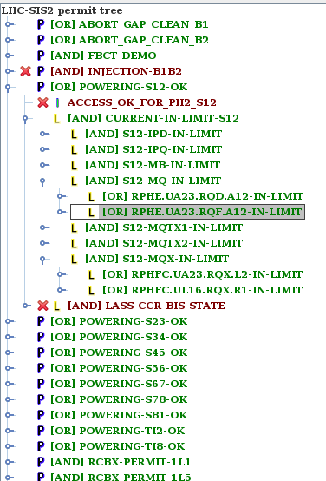
Initial work on LHC SIS2
As a test case, the configurations for POWERING-ACCESS and the QPS-OK test trees have been re-implemented in SIS2 to explore the advantage of JAVA definition for huge interlock groups.
Very efficient to build the large trees with LSA equipment group definition.
  Definition much more readable than endless XML.
First experience very positive.
While SPS is partly switching trees to SIS2 in operation, for LHC we will remain in development mode – no operational deployment in 2025.
We will however deploy a LHC BIGSISTER SIS2 production version and start migrating tests.

Slide 6
JAVA in SIS1 to JAVA in UCAP
Started migration of internal SIS JAVA interlock logic towards UCAP transformations.
UCAP transformations publish all input/output information required to reconstruct the interlock result.
To be logged in nxcals by ~ end of April.
Standard property: InterlockState
Two standard fields: interlock (true/false) and message (text message describing interlock logic/decisions).
SIS uses the interlock field for decisions.
Logic moved from JAVA inside SIS1 to UCAP transformations (node UCAP-NODE-LHC-SIS):
MKI settings checks
MKI FIB settings checks
MKI AGK settings checks
SPS BQM checks
LHC BQM checks
TI2/8 collimator gap interlocks
TDIS gap interlocks
ALICE/LHCb spectrometer bump checks
SPS BCT derived flags
Bunch length interlocks
Collimator BPM position interlocks → complemented by new GUI
Beam energy tracking interlocks of Q4s and MSDs in point 6
Beta* reconstruction
Already active since 2024
Already active since 2024
JAVA logic remains in SIS, UCAP runs in //

Slide 7
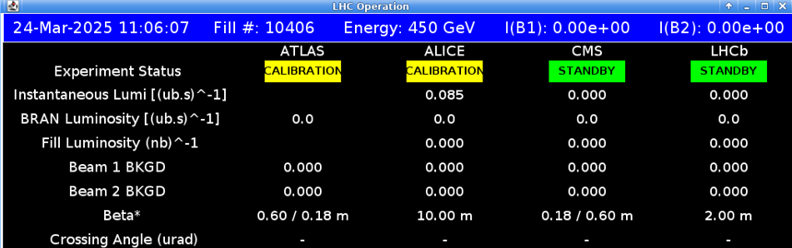
Beta* reconstructions and publications in 2025
The existing beta* reconstruction within SIS remains the baseline for the SMP beta* distributed over the timing system.
When the optics becomes flat, beta*_x ≠ beta*_y, the smaller beta* is published by SIS to SMP/timing.
At 60cm/18cm → publish 18 cm !
To prepare a future SIS1 → SIS2 migration, the same beta* reconstruction is now running in parallel in a UCAP transformation on node UCAP-NODE-LHC-SIS.
Device/property names: LHC.BETASTARk.RECO/Betastar with k = 1,2,5,8.
Bonus:
  All input data (selected PCs, currents, simulation state, etc) and all results are published and logged in nxcals.
  beta*x and beta*y are published separately → used in lumi server, OP pages.

Slide 8
Collimator BPM interlocks
The collimator BPM interlocks are migrated to UCAP.
One device per collimator which groups 2-4 DOROS BPMs (4 BPMs if spare DOROS).
SIS subscribes to the devices, used the interlock field in the interlock tree.
  Automatically masked when SBF = TRUE.
The UCAP devices publish interlock thresholds, raw and normalized positions, beta* etc → much better diagnostics.
Logging in nxcals will be activated during beam commissioning.
Complemented by a new JAVA UI.
For the TCTs in IR1 and IR5, the tightest interlock thresholds range between 0.8 and 1.4 sigma (min. tolerance window set to ~±0.8 mm). The thresholds for the TCSP6 are 1.5 sigma.
The tightest retractions TCT-TCDQ of 1.2 sigma are not protected – missing a factor ~ 2. Be aware !!
  Favorable phase advance TCDQ-TCTH adds protection, retraction not the full story.
  Proposal to lower TCSP6 to 1 sigma after commissioning if the stability is good.
It may be possible to tighten limits, but at the risk of interlocks: need a plan what to do in that case !

Slide 9
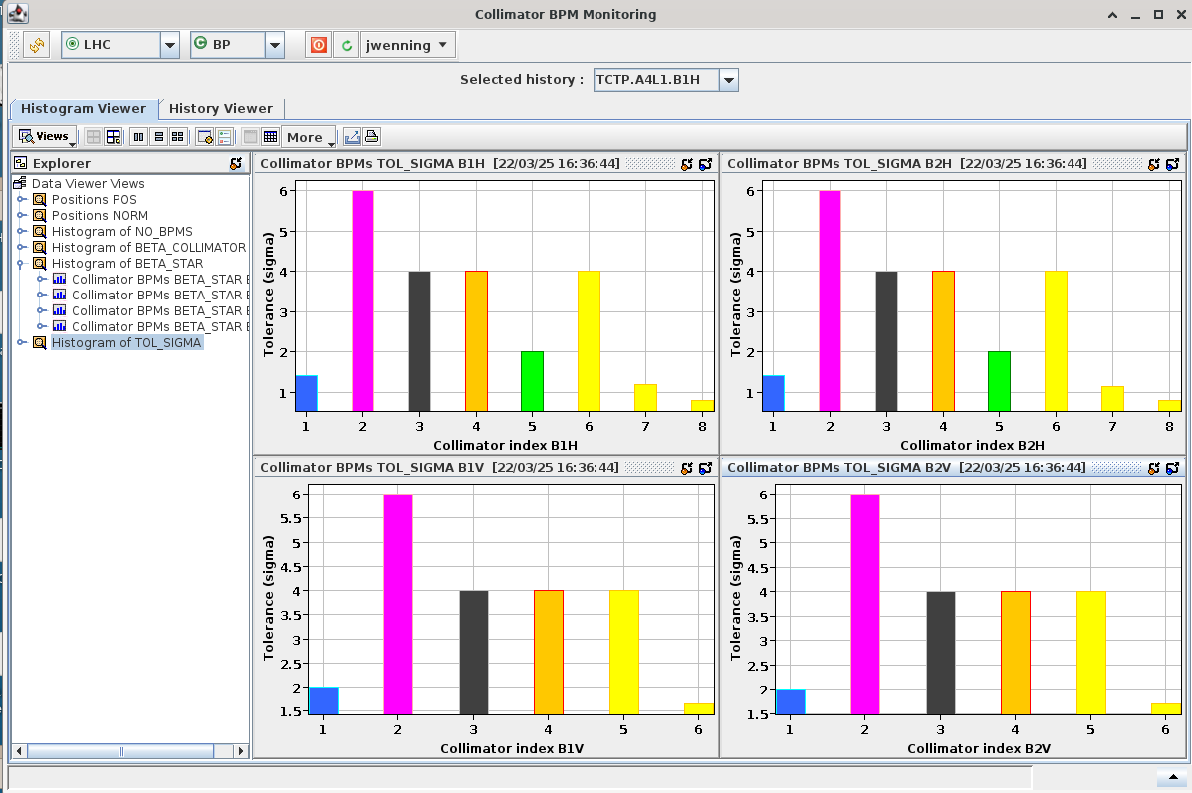
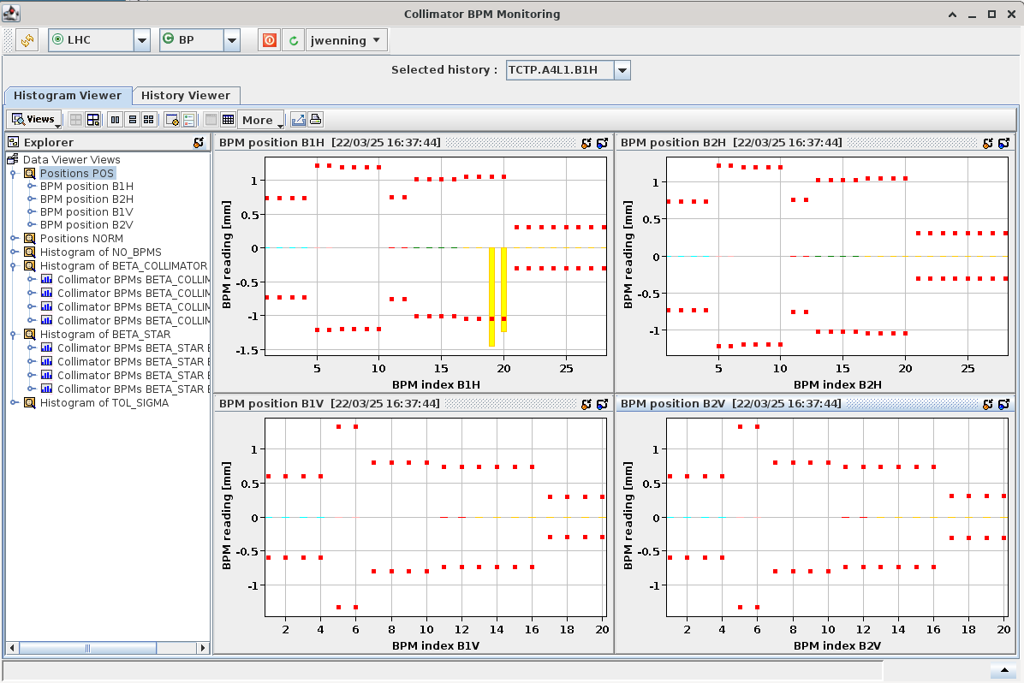
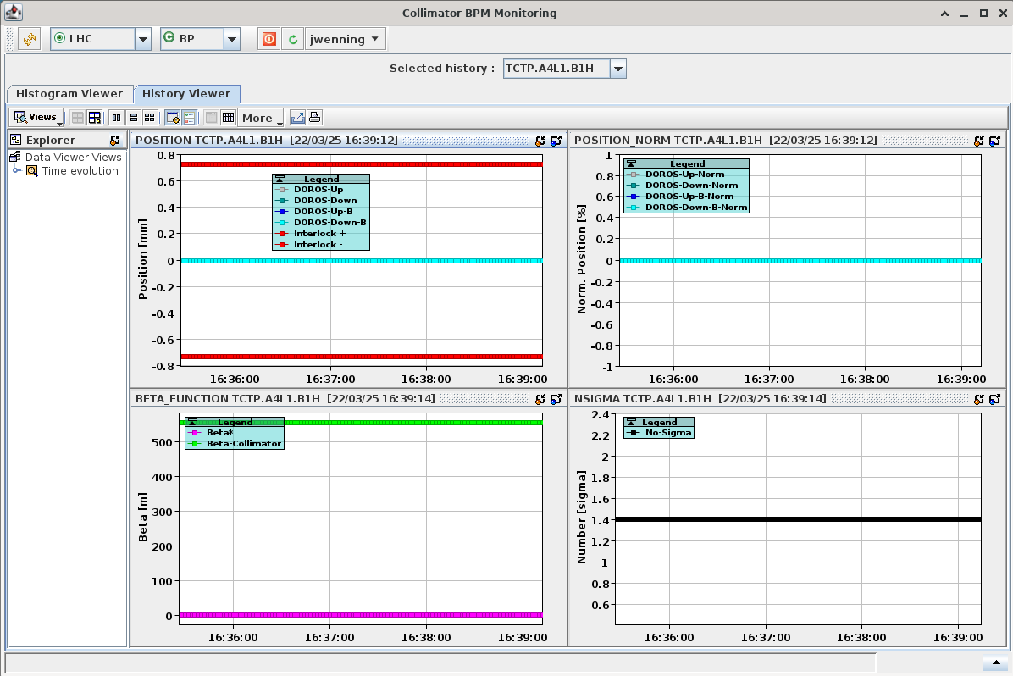
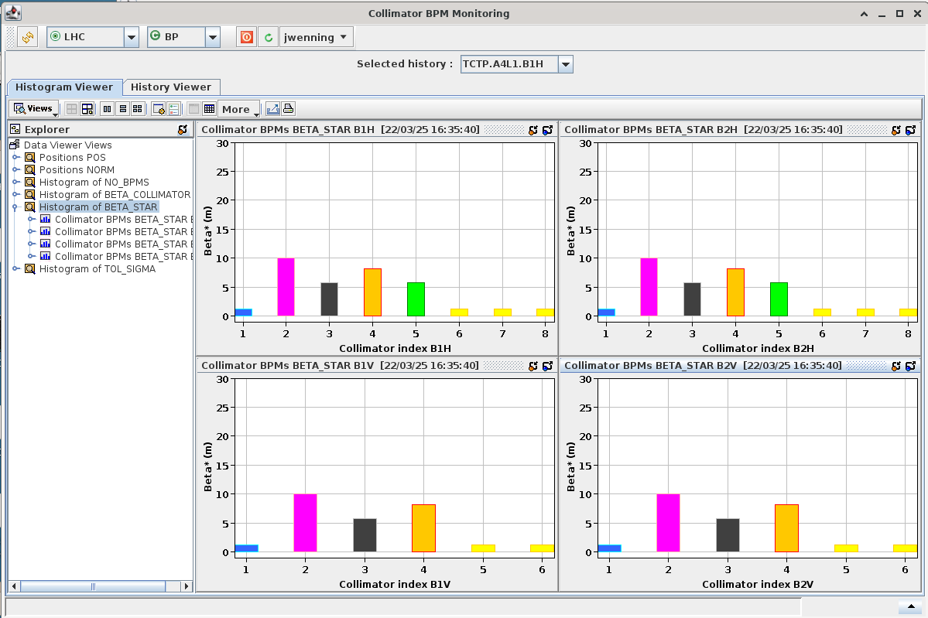
Collimator BPM interlocks (2)
New GUI to be ‘commissioned’ !

Slide 10
SIS orbit interlocks
SIS has currently 3 orbit interlocks (settings by hypercycle):
Orbit at injection – INJ.
Orbit across the cycle – CYCLE.
Orbit in stable beams – SB.
For each interlock, there is one reference and tolerance value for each BPM.
As the machine setup became more and more involved, the orbit interlocks CYCLE and SB must cover non-trivial orbit changes:
Dispersion correction bumps (‘ON_DISP’).
OMC bumps for optics corrections.
Xing plane rotations in pt 1, 5 and 8.
Etc…
Even the orbit in SB is no longer really ‘constant’ (ON_DISP, OMC bumps).
Changes can only be covered by enlarged tolerance windows.

Slide 11
SIS orbit interlocks (2)
A proper interlocking of the orbit over the cycle would require a PC_INTERLOCK-like server to survey the orbit.
Track orbit details through every phase of a cycle.
Issue was already raised at an MPP meeting in November 2019.
Not enough resources in OP during LS2 for such a task. LS3 ?
The CYCLE orbit interlock requires now wide windows ( ~ ±10 mm in many LSS !) over large fractions of the machines:
Error prone to cover all cases during setup.
Usefulness of the interlock is questionable.
DOROS BPM interlock provide better and more reliable protection for GLOBAL orbit changes.
Proposal: suppress the CYCLE orbit interlock in 2025. Keep only the interlock on the injection and stable beam orbits.

Slide 12

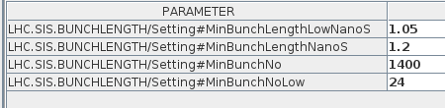
“Standard” bunch length interlock - update
The bunch length interlock for the ramp was revisited.
The logic was moved to UCAP node UCAP-NODE-LHC-SIS in 2024, one device per beam.
The LSA setting was extended to cover 3 regimes with different BL thresholds:
High intensity (production type beam power),
Medium intensity (between few 10’s bunch to production level),
Low intensity (< few 10’s bunches) – no interlock.
The interlock will be active in RAMP, FT and SQUEEZE.
Stable beams excluded (automatic blow up, intensity decay).
ADJUST excluded - tricky: end of fill ADJUST tests !
But could move to another logic → next slide !

Slide 13
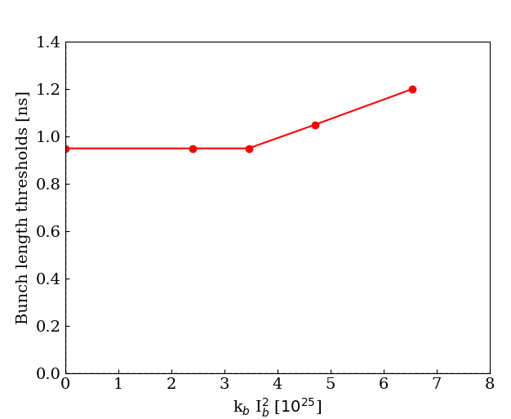
Towards a better bunch length interlock
Since the relevant parameter is the power P_{h} ~ KI2 = k_{b} × I_{b}² , it may make sense to interlock on KI2.
Tentative interlock table (to be interpolated, values indicative):
KI2 ≥ 2400 x (1.65 x 10¹¹)² = 6.5 x 10²⁵ → Minimum bunch length = 1.2 ns.
KI2 = 2400 x (1.4 x 10¹¹)² = 4.7 x 10²⁵ → Minimum bunch length = 1.05 ns.
KI2 = 2400 x (1.2 x 10¹¹)² = 3.5 x 10²⁵ → Minimum bunch length = 0.95 ns (or 1 ns).
For lower KI2 → Minimum bunch length = 0.95 ns (or 1 ns).
For k_{b} < ~20 → no interlock.
Advantage:
This logic covers MD cases with various filling schemes and bunch currents without having to change limits etc.
It can be used in all beam modes → interlock can be ALWAYS active (if we want), add at least ADJUST mode.
1.65
1.4
1.2
Propose to test this logic (already implemented and deployed as UCAP node), we can decide to swap logic later.
k_{b} from BQM
I_{b} from SMP intensity/k_{b}

Slide 14
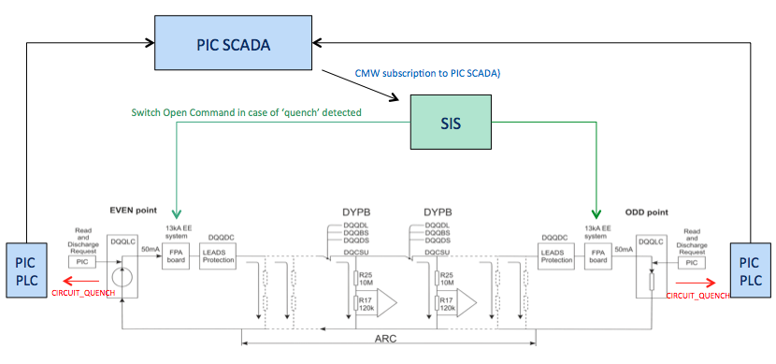
SIS FPA interlock tree
During Run 2, a special SIS logic tree was introduced to cover a failure case where the energy extraction switches were not opened in the odd point during a fast power abort (LHC-MPP-FS-0002-10).
SIS surveys all RB and RQ circuits listening to a PIC SCADA signal indicating that a FPA has been triggered.
Action: send an open switch command to both even and odd side EE switches.
In Run 3, it was discovered that the MACRO to open the switches did not work anymore. While “repair” work was (is) in progress, recent worry that an opening of the second switch just after the QPS sunglass period could trigger massive QH firings.
While the situation is being (re-)assessed, the permit tree was removed (but not all the code and configuration).
Wait for follow up by MP3 / TE-MPE.

Slide 15
60A/FGClite communication check
With the deployment of FGClite on the ~750 60A orbit correctors in 2016/7, a special SIS test was deployed to dump the beam in case of loss of communication.
Reason: the FGClite in the tunnel crate have no control logic (→ makes them more rad-hard), all control signals transit over the WorldFIP bus. If the FGClite looses communication with the gateway for more than 10 seconds, the FGClite ramps down the converter.
SIS continuously monitors the communication with all 60A CODs to intercept WorldFip interruptions, if a delay of more than 6 seconds is observed (= no data), the beam is dumped.
There is a 4 sec margin for the 2 sec SIS update period and delays.
This is most critical timeout in SIS: generally, timeouts are ≥ 15-20 sec.
This interlock never triggered in Run 2, but then two quasi-consecutive events occurred on Aug 3rd 2024 and on Aug 5th 2024 on the same gateway: two fills dumped during stable beams.
The root cause was the communication of SIS with the FGC gateway, not between gateway and FGClite devices.
SIS cannot easily distinguish the two cases.

Slide 16
60A/FGClite communication check (2)
Cause of the first event (Aug 3rd):
Fault on a network router interrupted communication with point 7 devices for a few second before the backup router restored communication. According to IT the timeout was ~ 3 seconds.
Cause of the second event (Aug 5th):
IT intervention on the same network router during stable beams (not announced) to investigate the issue (re)produced a similar network disruption.
On the SIS side, both events had similar signature in the logfiles:
A 4 sec long data interruption (1 or 2 samples @ 2 sec period). Loss due to the network router switch over?
Data back for 1-2 samples.
CMW exception with an interruption of the data of ~8 seconds (4 samples) → triggered SIS dump.
This signature may indicate that CMW “amplified” the data interruption (not proven/confirmed).
IT seemed very surprised that we depend so critically on the network - itself a surprise. The event spawned long email threads.
Not just SIS, the orbit/tune FBs can be affected significantly by such interruption in critical phases…

Slide 17
60A/FGClite communication check (3)
Looking back, those are rare events, we should not get over-exited about them.
I suggest to increase the timeout from 6 sec to 8 sec, this would have avoided one unnecessary dump.
Adding those 2 sec will still provide a timely response.
A delay of 10 sec would have avoided both.

