Slide 1
Intensity Ramp-Up 2025
C. Wiesner, M. Solfaroli Camillocci, C. Hernalsteens, J. Uythoven, J. Wenninger, D. Wollmann
258th Machine Protection Panel Meeting, March 28th, 2025
Acknowledgments: rMPP members, intensity checklist experts, OP teams, Machine Coordinators and LPCs

Slide 2
Outline
Introduction and general ramp-up strategy
Proton intensity ramp-up 2024
  Overview and duration
  Observations and issues
  Machine-protection checklists 2024
Proposal for 2025 proton intensity ramp-up
Conclusions

Slide 3
Introduction and general strategy
Intensity ramp-up is based on step-wise increase of injected and stored beam energy after YETS/LS to:
  establish operational cycle
  identify and mitigate issues in machine-protection-relevant systems that are remaining after individual system tests and hardware and beam commissioning with as low as possible stored beam energy
  identify issues related to stored beam intensity and other beam related parameters and establish mitigation measures
Monitor behaviour and validate correct functioning of the machine-protection system using formalised check process before advancing to the next intensity step
  Centralising and formalising the check process via checklists reduces the risk to overlook a check task and provides a common holding point, where the state of all systems is evaluated simultaneously, allowing for an efficient decision taking on the readiness to advance to the next intensity step
For more details see LMC, 9.11.2022, 217th MPP and 10th “Evian” workshop

Slide 4
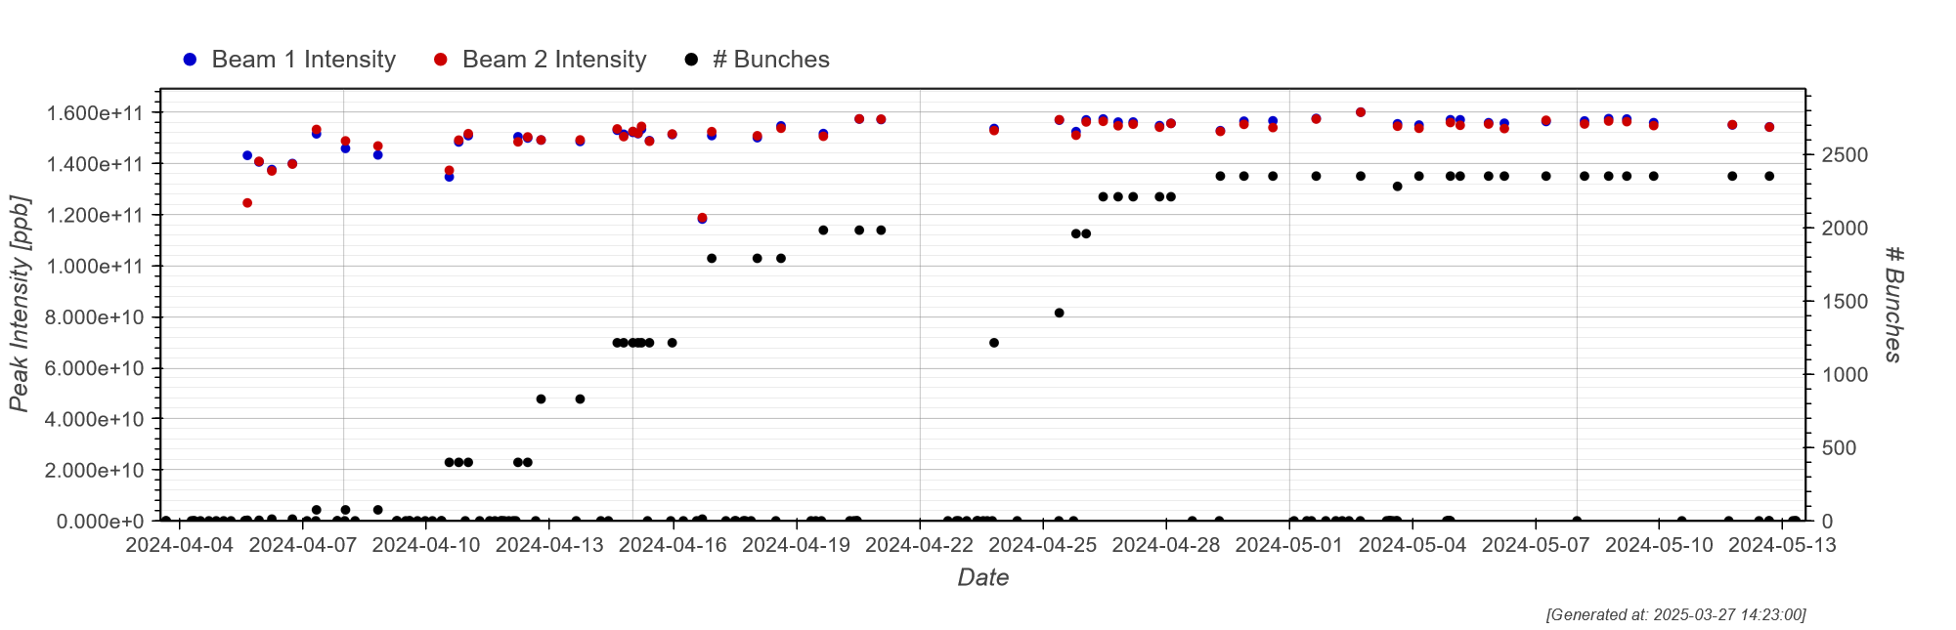
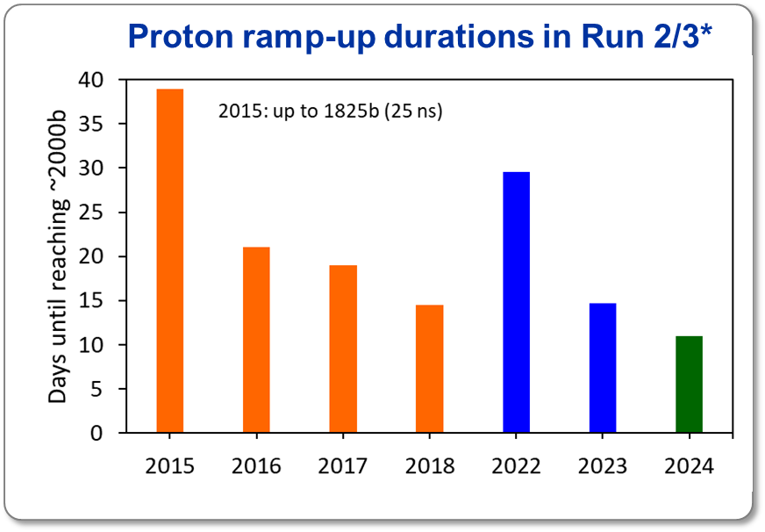
Proton intensity ramp-up 2024 (1/2)
First Stable Beams at 6.8 TeV on April 5th
  3 days ahead of schedule
Reached 1200 bunches on
April 14th
  10 days ahead of schedule
  Achieved in 6 ramp-up days* – compared to 10d in 2023 and 18d in 2022
Completed 1800b step on
April 19th
  Observed collimation hierarchy issue at smallest β* values → Required that a minimum β*=36 cm is kept
  Decision to take intermediate intensity steps due to the heat load situation
Reached physics operation with ~2000 bunches on April 19th
  Achieved in 11 ramp-up days* -compared to 15 days in 2023 and 30 days in 2022
Bunch intensity: 1.6x10¹¹ ppb
1800b
2000b
Start of ramp-up
1200b
3x48b
3x36b
2024
*Excludes time for scrubbing, commissioning left-overs, cryo reconditioning, long faults, …

Slide 5
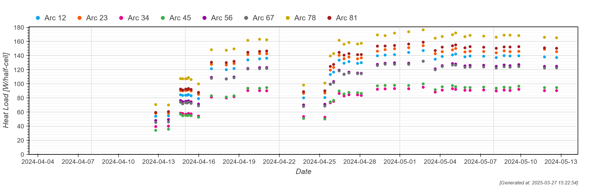
Proton intensity ramp-up 2024 (2/2)
Heat load in Sector 78 approaching the limit
  Switched to trains of 3x36 bunches on April 25th
  Performed intermediate fills with 1400b, 2000b, 2200b
Full machine with 2350 bunches reached on April 29th
  Would have been 2550 bunches with 3x48b
Stable operation during the year with intensities of 1.6x10¹¹ protons per bunch
  Routine operation with stored energy of 420 MJ per beam
  Record integrated luminosity of 124 fb⁻¹ (for ATLAS/CMS)
No beam-induced damage occurred in 2024
Bunch intensity: 1.6x10¹¹ ppb
1800b
2000b
2350b
Start of ramp-up
1200b
3x48b
3x36b
2024
3x48b
3x36b

Slide 6
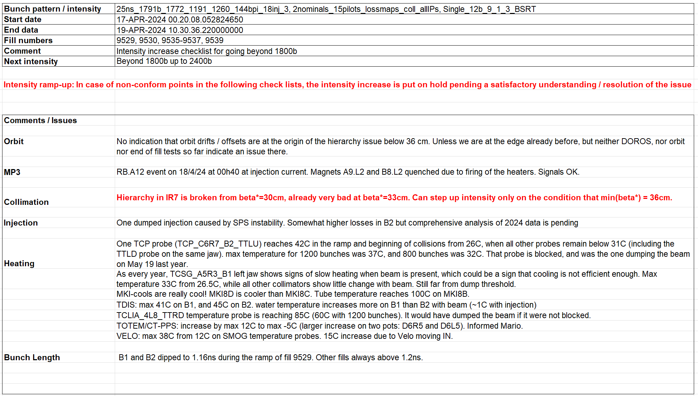
Intensity ramp-up 2024: Issues and observations
Important number of issues found and followed up, e.g.:
  Spurious dumps on SIS DOROS interlocks → solved by improved handling of NULL exception for data reception exceptions (4b step)
  QH-firing of RQ10.L8, following an electrical perturbation → Increased QPS threshold, which had remained at 40 mV since the ion run, back to 100 mV (75b step)
  Closed loophole of injecting with a separation dipole in OFF state (not covered by either WIC nor PC-INTERLOCK) by restoring a state interlock on all circuits except orbit correctors in SIS for injection (400b step)
  Incorrect energy interlock of the TCTPV.4L1.B1 → found and fixed (400b step)
  High losses observed in IR6 (higher than IR7 steady-state) due to vacuum-induced losses in the newly installed LESS chamber in IR6 → quick conditioning (Scrubbing >500b)
  Introduced bunch length interlock in the ramp and re-commissioned longitudinal blow-up during stable beams (800b step)
  Observed VELO vacuum spikes linked to certain positions → modified intermediate steps to exclude stopping close to those positions (1200b step)
  Observed breakage of collimation hierarchy in IR7 for lowest β*, requiring minimum β* of 36 cm (1800b step) → cured after TS1 (June 2024) by adapting dispersion and lowering chromaticity
In general, injections cleaner than in 2023
Example: Checklist for going beyond 1800b
All intensity checklists on EDMS

Slide 7
Machine-protection checklists 2024
Proton operation
  14 checklists issued in 2024 (17 in 2023 and 11 in 2022)
    Includes checklists for pp ref and Pb ion operation
  Important tool to analyse and document correct functionality and performance of machine protection critical systems
  Includes ~100 check tasks for ten relevant systems
Checklist type | Intensity step | Checklist (EDMS)
Intensity ramp-up | From 3/12b to 75b | #3073790
 | From 75b to 400b | #2887282
 | From 400b to 800b | #3075597
 | From 800b to 1200b | #3075654
 | From 1200b to 1800b | #3076702
 | From 1800b to 2400b | #3078273
Scrubbing | Beyond 500b | #3074234
 | End of scrubbing | #3230886
Intensity cruise | Cruise April/May
 | Cruise June/July | #3230892
 | Cruise Aug.–Oct. | #3230903
Pb ion operation
Checklist type | Intensity step | Checklist (EDMS)
Intensity ramp-up | From 80b to 250b | #3190465
 | From 250b to 450b | #2887282
 | From 450b to 850b
 | From 850b to 1240b | #3230911
Intensity cruise | Cruise Nov.
pp ref. run
Checklist type | Intensity step | Checklist (EDMS)
Intensity ramp-up | Beyond 400b | #3182696
 | 1200b/2400b | #3182697
Intensity cruise | Cruise Nov. | #3230908

Slide 8
Proposal for 2025 intensity ramp-up (1/2)
Maintain successful strategy applied in 2023/2024 with adaptation to the 2025 operational scenario
Intensity steps:
  Use steps of 4/12 - 75 - 400 - 800 - 1200 - 1800 - 2400 - full machine* (≥2 fills with ≥15h in SB)
For each step:
  Monitor behavior during >15h in stable beams with at least 2 fills that go through the full luminosity levelling process (reaching the smallest β* and smallest crossing angle) using the operational tool
  Validate correct functioning of machine-protection systems via checklist
    Before going from 12 to 75 bunches: verbal verification with all concerned teams and combined checklist for 4/12/75b fills after the 75b step
  CT-PPS, AFP roman pots to be inserted to agreed settings before the first levelling step for all fills at each intensity step
  VELO to be moved to its nominal position during ramp-up steps
  No simultaneous increase in the total number of bunches and the injected train length in the same fill
*exact number of bunches depends on agreed filling schemes

Slide 9
Proposal for 2025 intensity ramp-up (2/2)
Bunch intensity
  Perform ramp-up with bunch intensities of 1.6e11 ppb (beginning of Stable Beams)
Scrubbing:
  Verify heating of critical elements before going to next intensity step
  Intermediate scrubbing checklist after ~500 bunches
  Final checklist at the end of scrubbing to be integrated into the first proton cruise checklist
During the Run
  Issue Cruise Checklists covering ~8 weeks (e.g. between TS) to verify and document behaviour of machine-protection systems

Slide 10
Update of checklist tasks and responsibilities
System | Responsible person(s)
Magnet powering (MP3) | Arjan Verweij, Agnieszka Chmielinska
Interlocks | Ivan Romera Ramirez, Raffaello Secondo
RF | Wolfgang Hofle, Andy Butterworth, Helga Timko
Beam Instrumentation | Belen Salvachua Ferrando, Christos Zamantzas (BLM), Stefano Mazzoni (BSRA), Marek Gasior, Tom Levens (BCCM)
Collimation | Stefano Redaelli, Roderik Bruce, Frederik Van Der Veken, Björn Lindström, Natalia Triantafyllou
Operation, orbit and feedbacks | Jörg Wenninger, Matteo Solfaroli Camillocci
Beam dump | Yann Dutheil, Chiara Bracco
Injection | Yann Dutheil, Chiara Bracco
Heating of Equipment | Benoit Salvant
VELO | Victor Coco
Check tasks:
  Added: “Heating of TWOCRYST”
  Modified: “Luminosity levelling (beta* and crossing angle)”
  Removed: check for BBCW
For all system responsibles: Please contact us in case of any proposed changes of the check tasks and/or a change of responsibility
Great thank you to all the system experts for their commitment, dedication and flexibility!

Slide 11
Conclusions
Intensity ramp-up 2024
  Reached 1200b in 6 ramp-up days
  Reached 2000b in 11 ramp-up days
    Encountered limitations due to heat load situation and collimation hierarchy breakage
      Switched to trains of 3x36 bunches (April 25th) and operated with min. β* of 36 cm (until TS1)
  Important number of issues identified and tackled at the different intensity steps
  No beam-induced damage occurred
Proposal for 2025 intensity ramp-up
    Bunch steps of 4/12 - 75 - 400 - 800 - 1200 - 1800 - 2400 – full machine
    For each step: ≥15h in Stable Beams with ≥2 fills that go through the full luminosity levelling (β* and crossing angle), to be validated with checklist
    Perform ramp-up with bunch intensity of 1.6x10¹¹ ppb
  Considers the operational scenario, the maturity of the systems and the balance between machine efficiency and risks

Slide 12
Thank you for your attention!

Slide 13
Backup slides

Slide 14
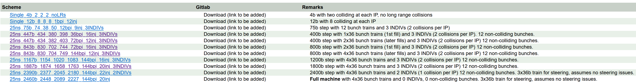
Filling schemes (LPC)
Injected train lengths
  4b/12b: 1bpi
  75b: 12bpi
  400b: 36 bpi → 72 bpi
  800b: 72 bpi → 144 bpi
  1200b/1800b/2400b: 144 bpi
https://lpc.web.cern.ch/Run3/RampUpConditions_2025.html

Slide 15
Ramp-up scenarios after stops of nominal operation
Stop >48 h with massive HW + SW interventions | Stop >48 h without massive HW + SW interventions | Triplet events with non-reversible position changes**
One fill with either pilot bunches or max. 2-3 nominal bunches into SB (cycle revalidation, etc.) | One fill with 2-3 nominal bunches into SB (cycle revalidation, etc.) | One fill with 2-3 nominal bunches into SB (re-adjust orbit in IP)
One fill with ~50 bunches and about 1-2 hours of stable beams
One fill with 400 bunches and min. 2 hours of stable beams* | One fill with 400 bunches and min. 2 hours of stable beams*
If > 2000 bunches have been reached, one fill with about half max. number of bunches and about 5 hours of stable beams
Back to pre-stop intensities | Back to pre-stop intensities | Back to pre-stop intensity
In total, 3-4 fills for ramp-up | In total, 2 fills for ramp-up | In total, 1 fill for ramp-up
Note: All fills need to go through the full luminosity levelling.
*known intensity step to disentangle wrong settings, de-conditioning, etc. from intensity dominated effects at full intensity
LMC #460, 2023-04-05
**E.g. triplet quench, warm up of triplet region, cryo stop in triplet region, …

Slide 16
Evolution of ramp-up steps requirements
Intensity steps (number of bunches)*:
  2025: Steps of 4/12 - 75 - 400 - 800 - 1200 - 1800 - 2400 - full machine (≥2 fills with ≥15h in SB)
  2024: Steps of 3/12 - 75 - 400 - 800 - 1200 - 1800 - 2400 (≥2 fills with ≥15h in SB)
  2023: Steps of 3/12 - 75 - 400 - 900 - 1200 - 1800 - 2400 bunches (≥2 fills with ≥15h in SB)
  2022: Steps of 3/12 - 75 - 300 - 600 - 900 - 1200 - 1800 - 2400 bunches (≥3 fills with ≥20h in SB)
*exact number of bunches depends on agreed filling schemes

Slide 17
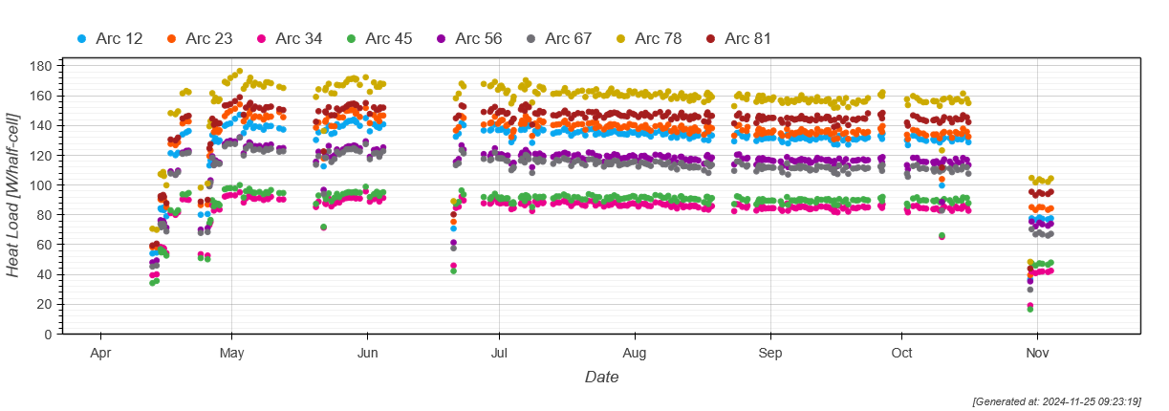
Heat Load Evolution

Slide 18
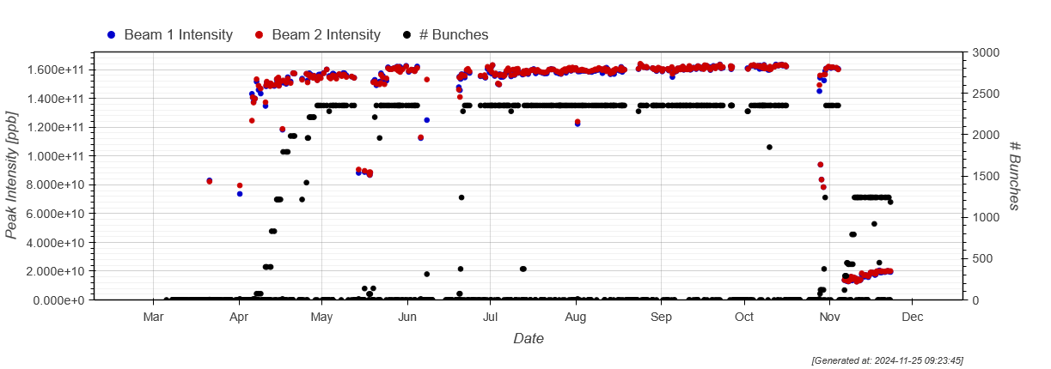
Bunch Intensity Evolution

Slide 19
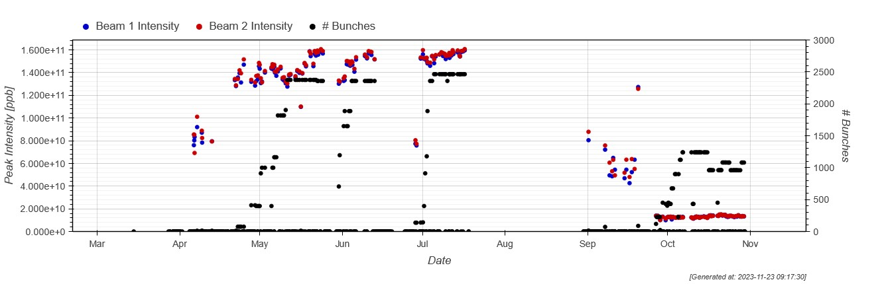
Intensity ramp-up(s) 2023: overview
Intensity ramp-ups 2023
  Main proton ramp-up performed in April/May 2023
  Additional ramp-ups required after 4L1 intervention, after TS1 with VELO partial insertion, and for Pb ion operation
Bunch intensity
  Kept around 1.3-1.4x10¹¹ ppb during ramp-up
  Then slowly ramped up to 1.6x10¹¹ ppb
  Reached record stored energy of
  ~430 MJ per beam
No beam-loss induced damage occurred in 2023
  However, bunch intensity limited to 1.6x10¹¹ ppb after 4L1 event
Main proton ramp-up
Ramp-up after 4L1 intervention
Ramp-up after TS1 with VELO partial insertion
Pb ion ramp-up
1.4x10¹¹ ppb during ramp-up
Operation with 1.6x10¹¹ ppb

Slide 20
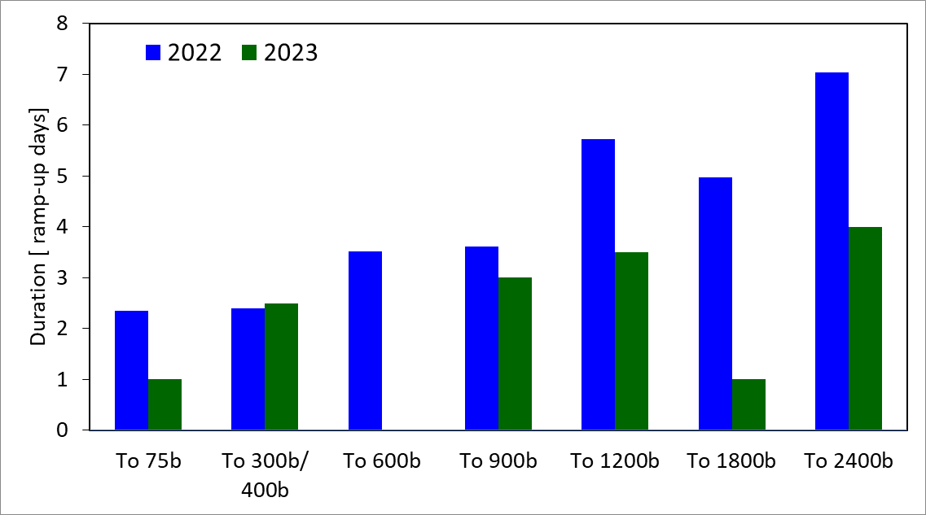
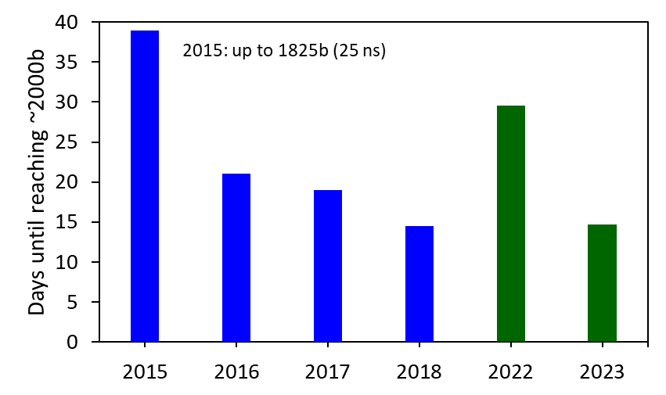
Ramp-up duration 2023
Ramp-up time
  Reached 1200b in 10 ramp-up days*
    Compared to 18 ramp-up days* in 2022
  Reached full machine in ~15 ramp-up days*
    Compared to ~30 ramp-up days* in 2022
  Average duration per step decreased from 4.2d (2022) to 2.5d (2023)
  De-facto duration of steps largely influenced by machine status and encountered issues
Calculated ramp-up duration per step in 2022**: 2.1d
Calculated ramp-up duration per step in 2023**: 1.6d
Ramp-up duration*
*Excludes time for scrubbing, commissioning left-overs, crossing-angle change (2023), long faults
**Assuming 60% availability, 3h turn-around time, and 10h to fill and validate the checklist

Slide 21
Machine-protection checklists 2023
Proton operation
Checklist type | Intensity step | Checklist (EDMS)
Intensity ramp-up | From 3/12b to 75b | #2887282
 | From 75b to 400b | #2887282
 | From 400b to 900b | #2888331
 | From 900b to 1200b | #2891262
 | From 1200b to 1800b | #2892600
 | From 1800b to 2400b | #2893111
Scrubbing | Beyond 500 bunches | #2887415
 | End of scrubbing | #2933511
Bunch intensity | Beyond 1.6x10¹¹ ppb | #2897728
Cruise May/June | Intensity cruise | #2933512
Ramp-up after TS1 (dedicated checklists for VELO partial insertion) | From 75b to 400b | #2911909
 | From 400b to 900b
 | From 900b to 1200b | #2911910
 | From 1200b to 1800b | #2911912
 | From 1800b to 2400b | #2911913
Cruise June/July | Intensity cruise | #2975994
Pb ion operation
Checklist type | Intensity step | Checklist (EDMS)
Intensity ramp-up | From 80b to 250b | #2956830
 | From 250b to 450b | #2887282
 | From 450b to 850b
Cruise Oct. I | Intensity cruise | #2975964
Cruise Oct. II | Intensity cruise | #2975967

Slide 22
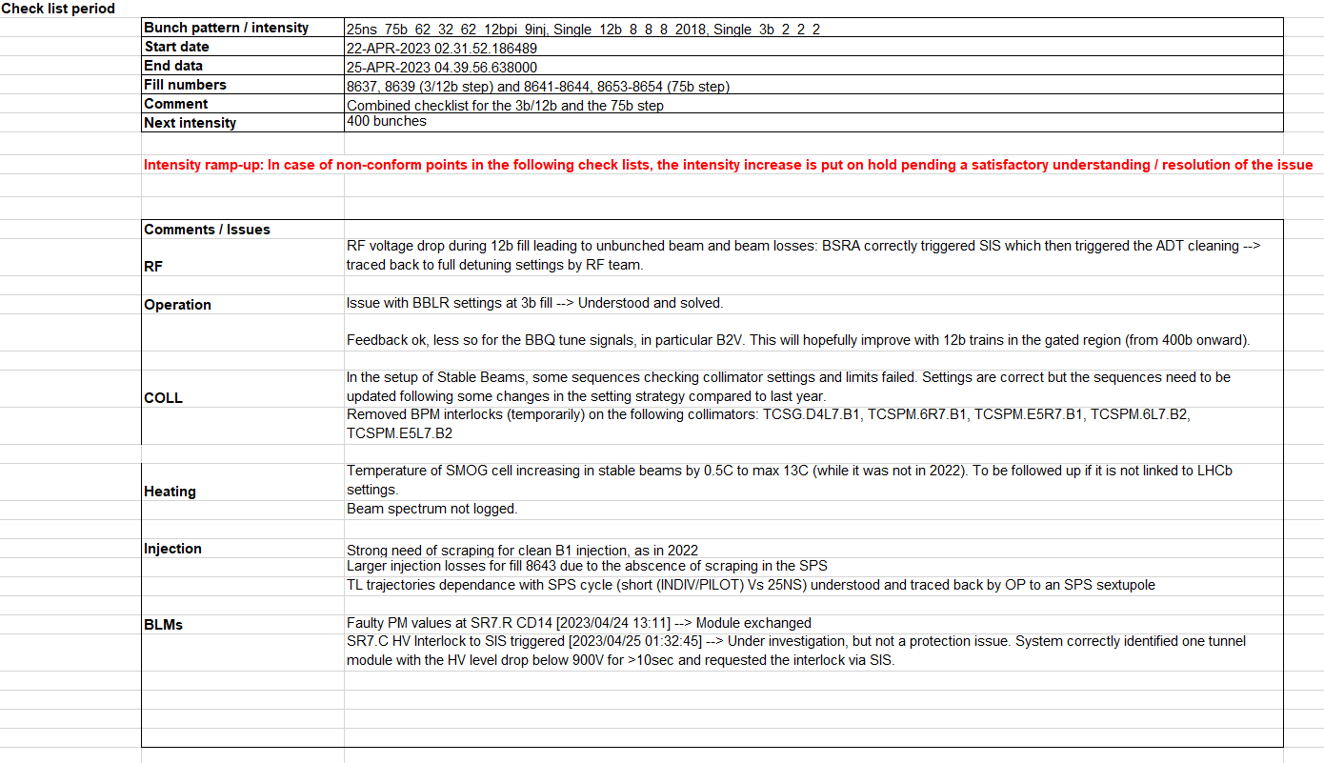
Intensity ramp-up 2023: Observations
Issues distributed over all intensity steps, e.g.:
  RF voltage drop leading to unbunched beam and beam losses → solved by adjusting RF settings (12b)
  High injection losses → limited injection to 144 bpi for B1→ realignment of transfer line collimator (scrubbing, 500b)
  BTVDD image saturated → followed up by BI (400b)
  Higher leakage from collimation losses in Beam 1 → retraction of TCSPM.E5R7.B1 to 8.2 sigma and revalidation (900b)
  BPM calibration for trains not correctly applied (not new…)
  → SIS interlock implemented (1800b)
Example: combined checklist for the 3b/12b and 75b steps

Slide 23
Issues encountered during 2022 intensity ramp-up
  Examples:
    Unexpected high beam losses at TDIS*
    Unexpected high beam losses at TCLIA**
    Issue with creation of PM event causing XPOC to latch
    Sporadic missing of BLM data in XPOC and PM
    Intermittently missing BBQ data in PM event
    BLMLHC FESA server exiting due to low memory
    Need to adapt BLM thresholds
    Miscalibration of BSRA B2 by factor 4
    Intermittent issues with BQM and FBCT that prevented IQC from confirming that an injection took place
    One MKI2 main switch showing higher erratic rate
    Dumps on TCLIA temperature probe leading to threshold adaption
    LVDT reading of TCTPV.4R1.B2 drifting and reaching the dump limit
    Difficulties in using the QFB due to working point with high Q' and octupoles
*See D. Wollmann, LMC,#450, 12.10.2022
** See C. Bracco, LBOC #142, 1.11.2022
Note that the 2022 ramp-up could profit from issues found and solved during the beam test in Oct 2021, in particular the aperture restriction in 21L3.
    See checklists for details

Slide 24
Issues discovered during ramp-ups (Run 2) - Selection
Establish cycle/beam commissioning:
  PM/XPOC: data missing or misaligned
  BIS timing mis-aligned
  Direct dump BLMs (IR6) – connected to LBDS of wrong beam
MP dominated:
  Orbit feedback: offsets due to BPM calibrations
  UFO – 16L2 events causing beam dumps & quenches
  Abort Gap cleaning not properly functioning
  Screen unintentionally left in dumpline
Intensity dominated:
  TDI – vacuum issues and heating
  Insufficient cooling of a collimator
  Instabilities
Random occurrence:
  MKD and MKB erratics
  Un-physical BLM readings in PM
  PM event builder stuck
For full list: see D. Wollmann, Evian’19 and checklists for intensity ramp-up

