Slide 1
TWOCRYST Validation :
Machine Protection
Eloise Matheson [BE-CEM], Pascal Hermes [BE-ABP], Daniele Mirarchi [BE-OP]

Slide 2
Contents
TWOCRYST Installation
TWOCRYST Interlocks
TWOCRYST Machine Protection Test Plan

Slide 3
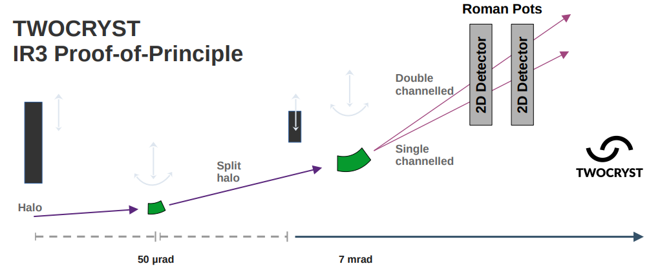
TWOCRYST Installation
TCCS.5R3.B2
DCUM: 6773.9
TCCP.4L3.B2
DCUM: 6653.25
XRPV.A4L3.B2
DCUM: 6652.6
XRPV.B4L3.B2
DCUM: 6651.9

Slide 4
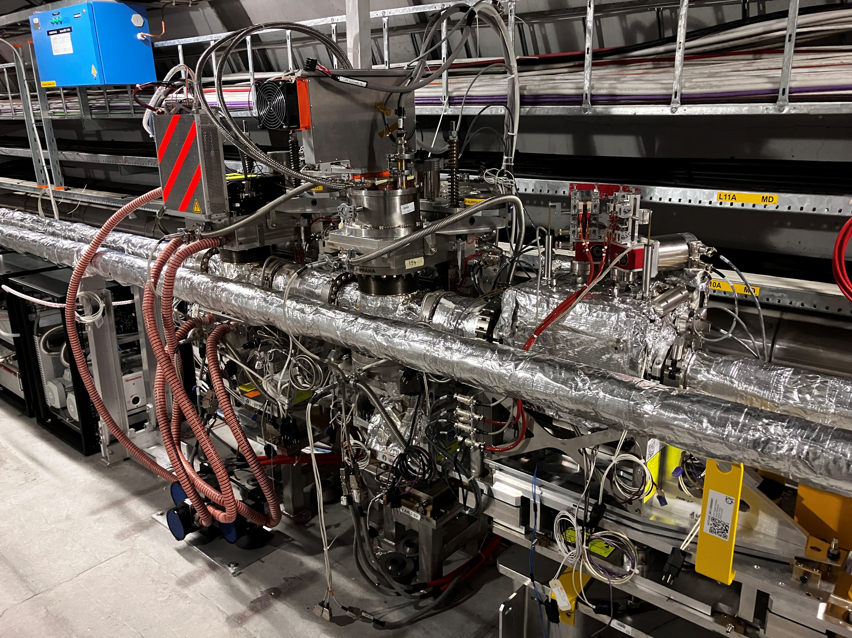
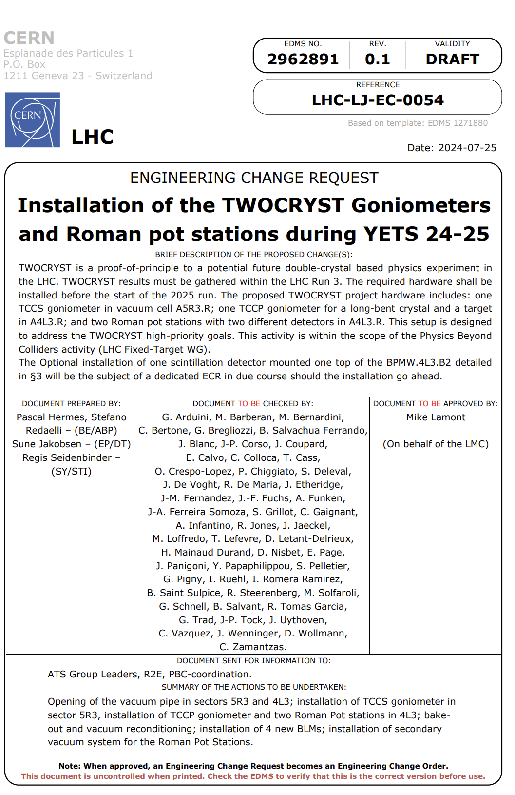
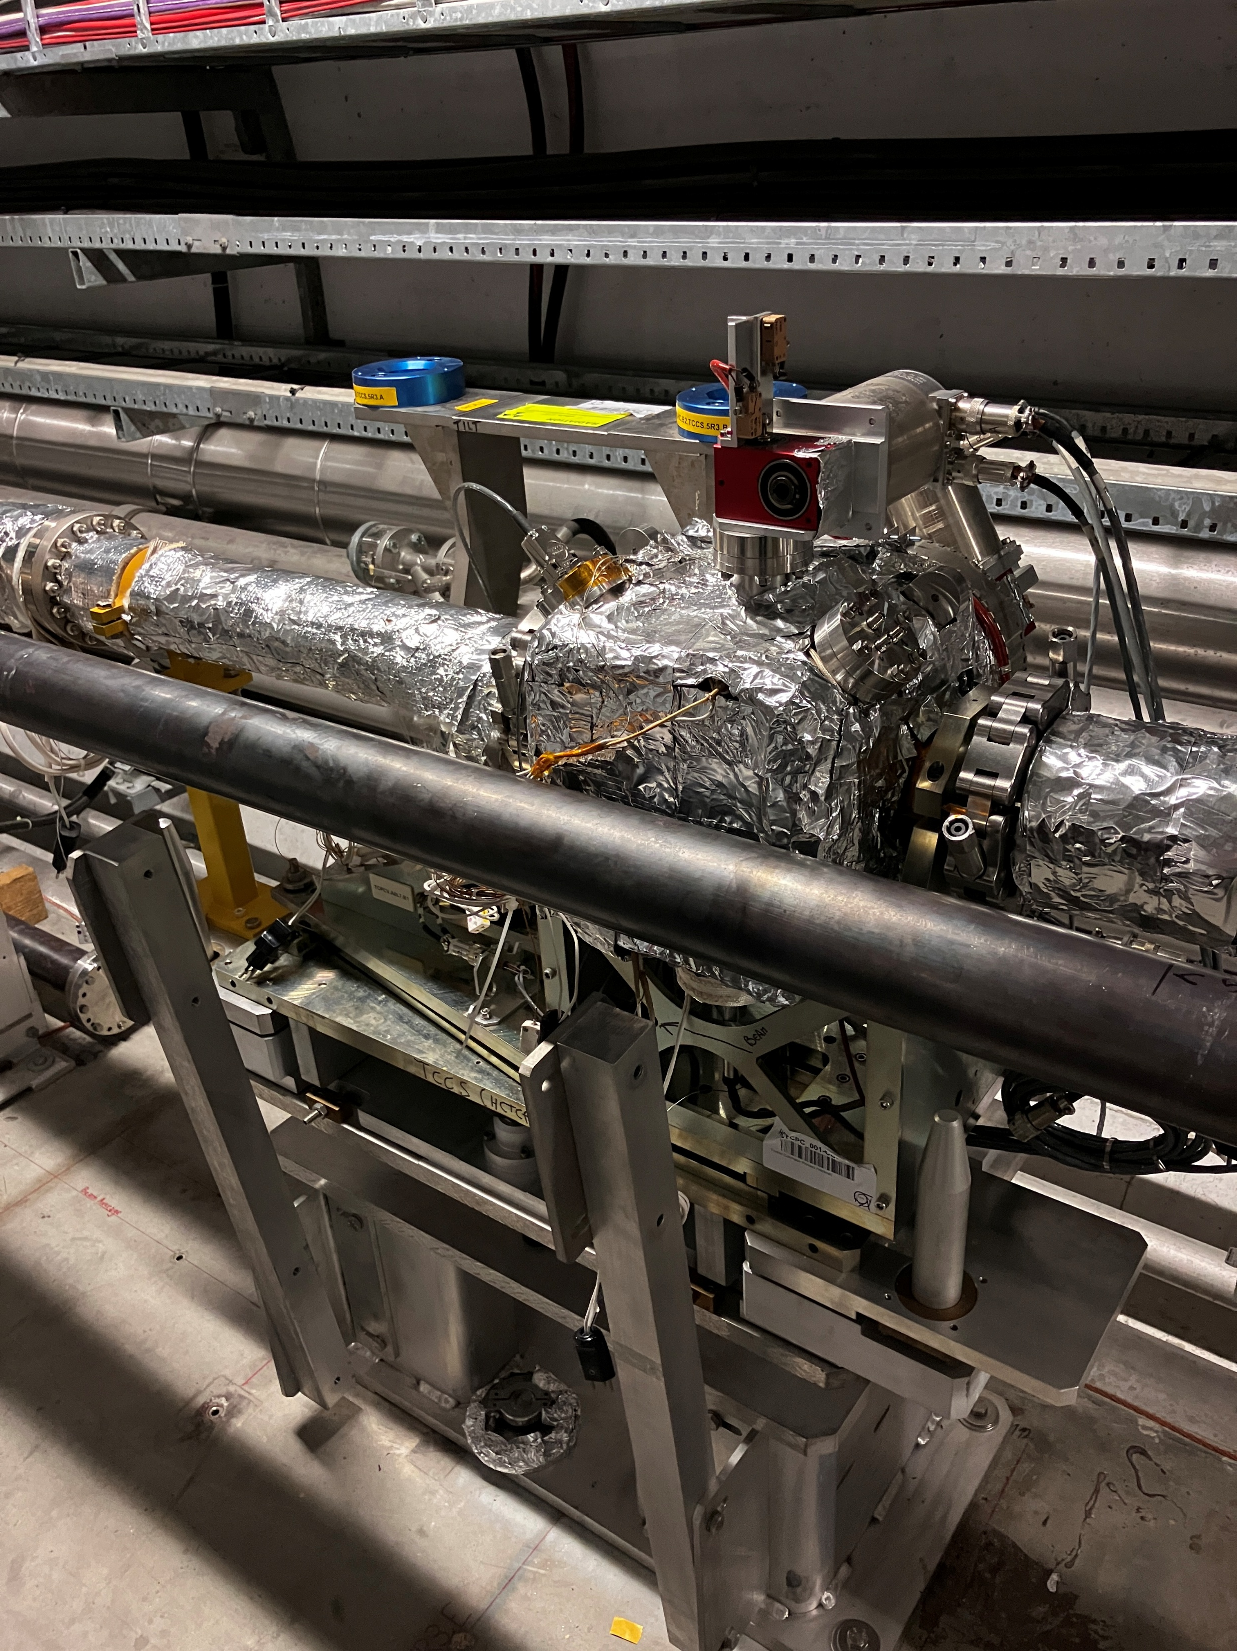
TWOCRYST Installation
ECR: EDMS #2962891
XRPV.B4L3.B2, XRPV.A4L3.B2, TCCP.4L3.B2
TCCS.5R3.B2

Slide 5
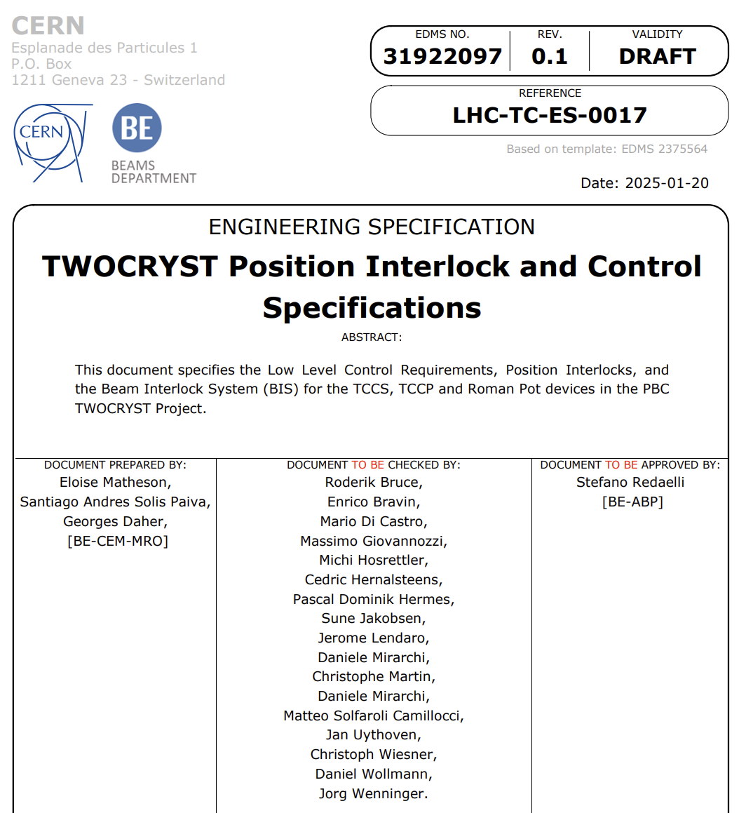
TWOCRYST Interlocks
EDMS Document #3192097
(will be released pending any feedback from this meeting)
There is one dedicated channel available on the BIC (CIB.UJ33.U3 – Maskable Both Beam input 11) to read the USER_PERMIT from the daisy-chained TCCS, TCCP and Roman Pot device signals

Slide 6
TWOCRYST Device Status
Approximate beam position
Non-MD Status
TCCS: Beam Pipe IN, Crystal OUT
TCCP: Crystal OUT, Target OUT
XRPVs: Detectors OUT
MD Status
TCCS: Beam Pipe OUT, crystal can move within limits
TCCP: crystal and target can move within limits
XRPVs: Detectors can move within limits

Slide 7
TWOCRYST BIS Interlocks: TCCS & TCCP
TCCS has same setup as per the TCPC devices. Interlock on:
  Position limits on crystal moveable stage
  Single sided energy limit on crystal moveable stage (minimum/outer position)
  Replacement beam pipe and crystal moveable stages switches
  Note: As the TCCS is a refurbished version 1 TCPC device, there is only 1 switch indicating each extreme position of the crystal linear stage. The beam pipe chamber has 2 switches
TCCP has similar setup as per the TCPC devices. Interlock on:
  Position limits on crystal moveable stage and target moveable stage
  Single sided energy limits on crystal moveable stage and target moveable stage (minimum/outer position)

Slide 8
TWOCRYST BIS Interlocks: Roman Pot
Each Roman Pot upper jaw has the following interlocks
  Position limits on upper roman pot linear stage based on one* LVDT reading
  Energy limits on upper roman Pot linear stage based on one* LVDT reading
  *This primary LVDT input signal could be swapped to the redundant secondary LVDT signal after remote intervention by a BE-CEM expert

Slide 9
TWOCRYST SIS Interlocks
  TCCS, switchIn_beampipe == True AND switchOut_beampipe == False (to avoid injecting high intensity beams with pipe open)
  TCCP, switchOut_linear == True, switchOut_target == True (to be sure devices are not on the beam path)
  XRPVs, switchOut == True (to be sure devices are not on the beam path)

Slide 10
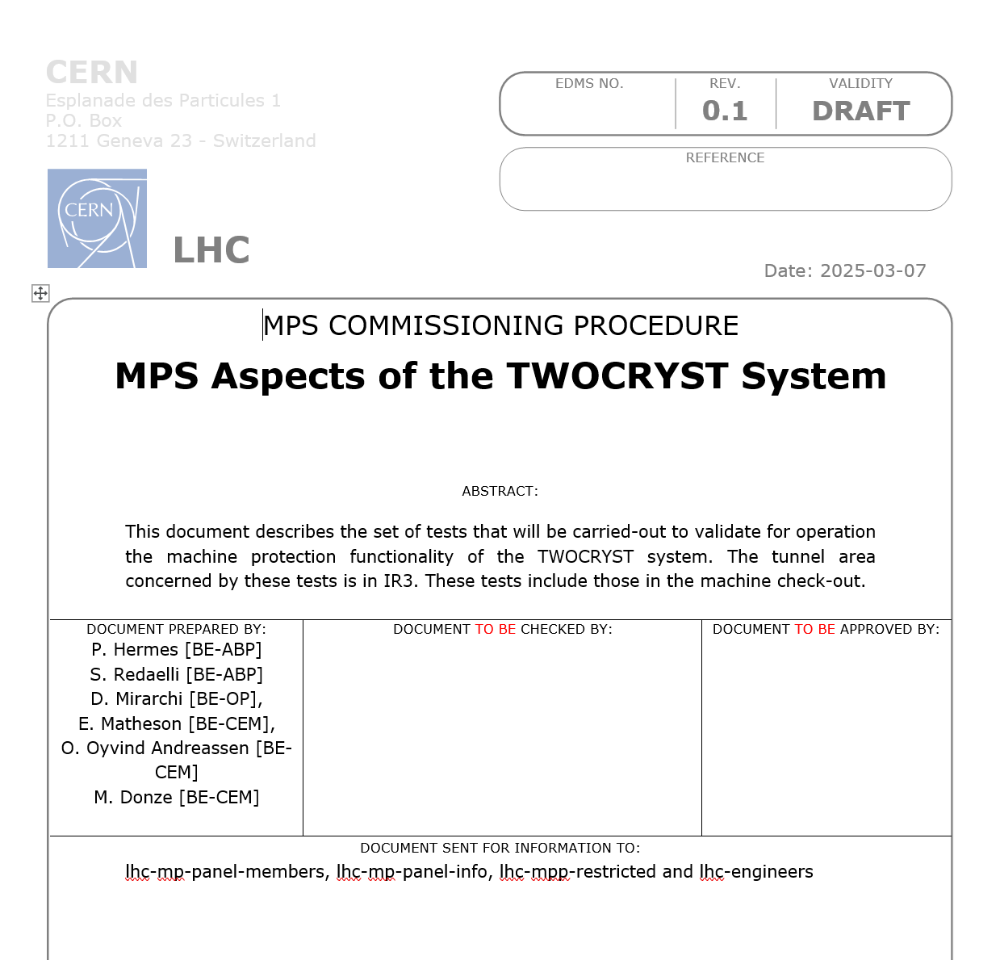
TWOCRYST MP Test Plan
Position Interlock Tests – BIS
Position Interlock Tests – SIS

Slide 11
TWOCRYST MP Test Plan
Power Cut & PRS Reboot Interlock
Check the access map and protected set (RBAC roles checks)

