Slide 1
MPS checklist for 2025 re-commissioning
Cédric Hernalsteens
258th Machine Protection Panel

Slide 2

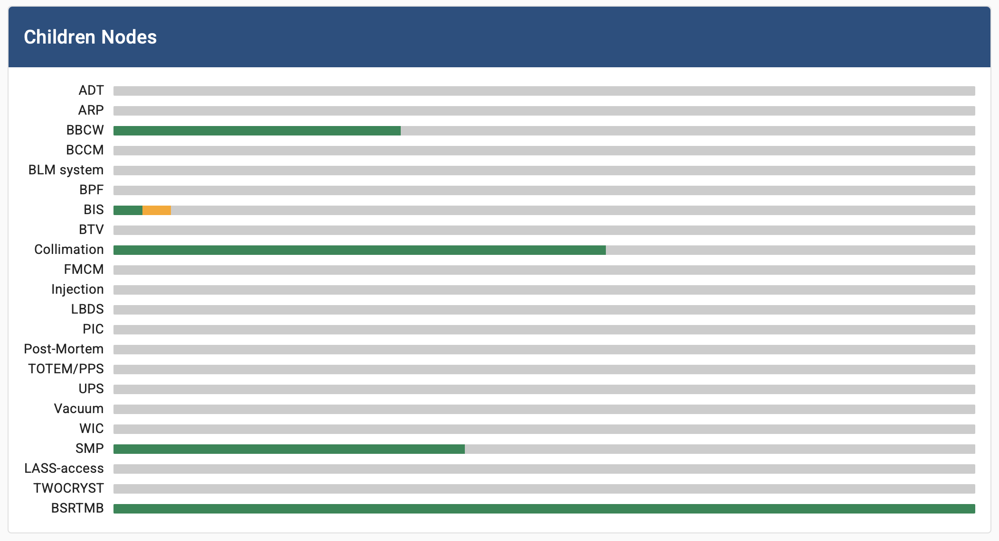
Status for 2025
MPS tree in the LHC machine checklist
Reset for 2025
  MPS tree has been reset (all history is kept, status reset only)
Changes and additions
    BSRTMB (B1 mirror for the light coming from D3)
    PIC additional actions for polarity reversal
    SMP (no testing of the “restricted” and “ion” SMP equation at injection nor flat-top)
    ADT (additional details)
    BCCM
    TWOCRYST
    BLM blinding functionality
https://checklist.cern.ch

Slide 3
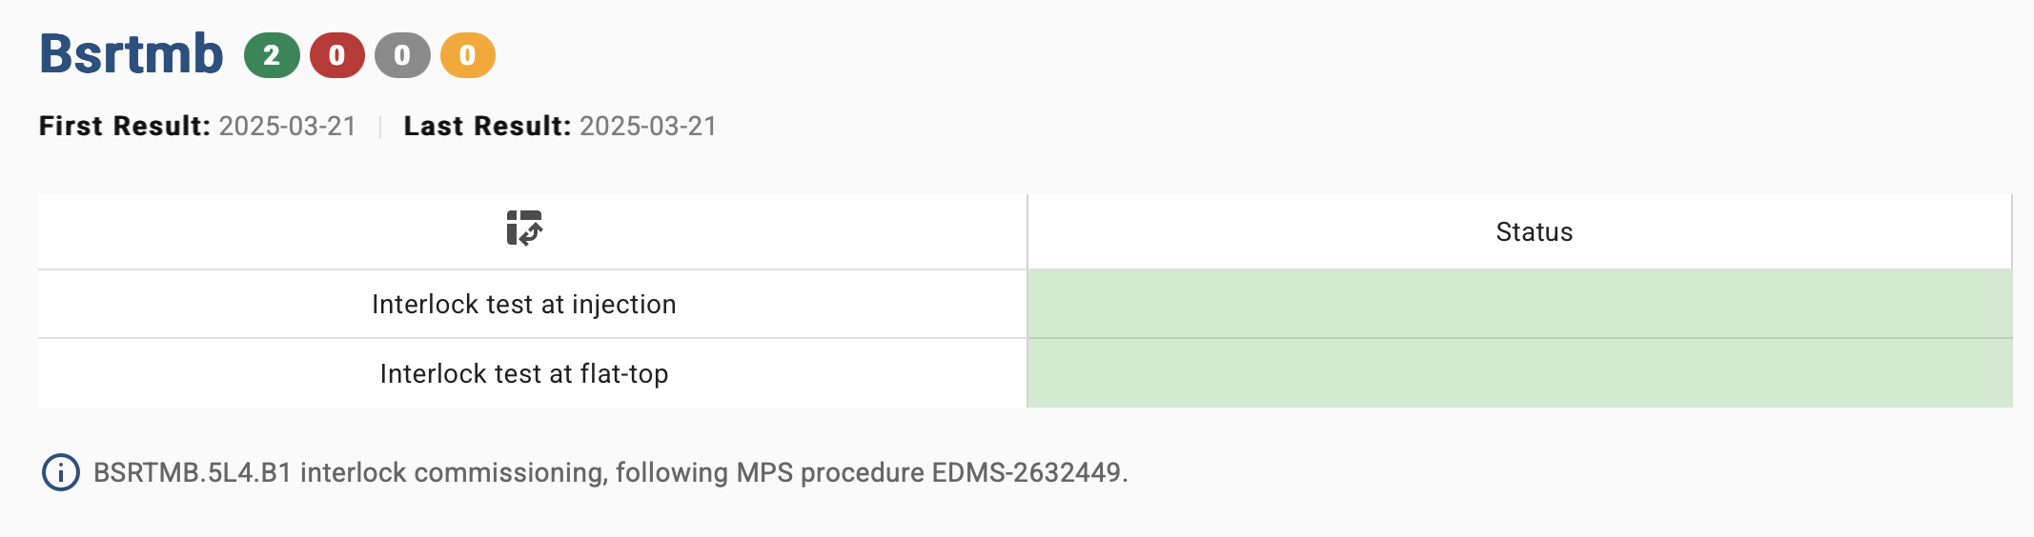
BSRTMB
Checklist added, following MPS procedure EDMS-2632449. Thanks a lot to Daniele B. (and M.) for the follow-up and for already filling in the checklist.

Slide 4
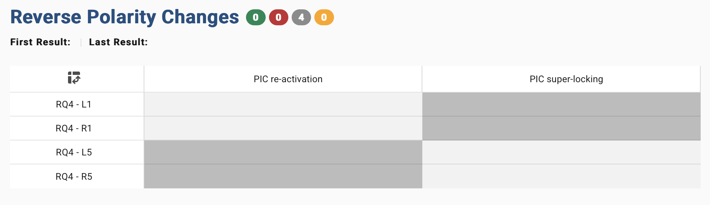
PIC
No change to the existing procedure or tests. Addition of dedicated checks for the polarity reversal.

Slide 5
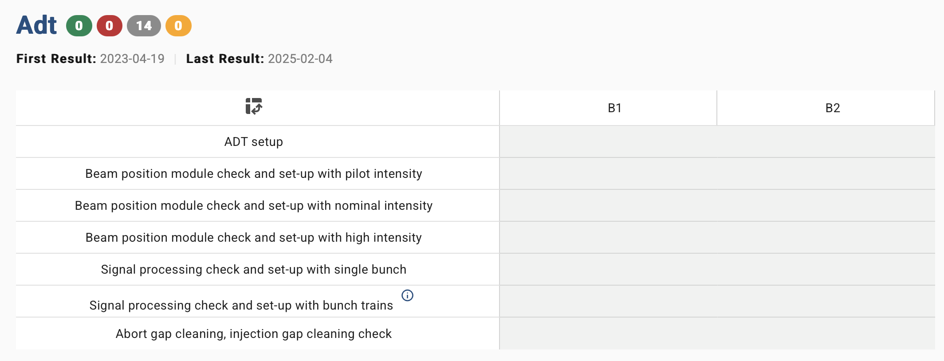
ADT
Thanks to Daniel V. for providing step-by-step checks (replacing the monolithic checklist from previous years)!

Slide 6
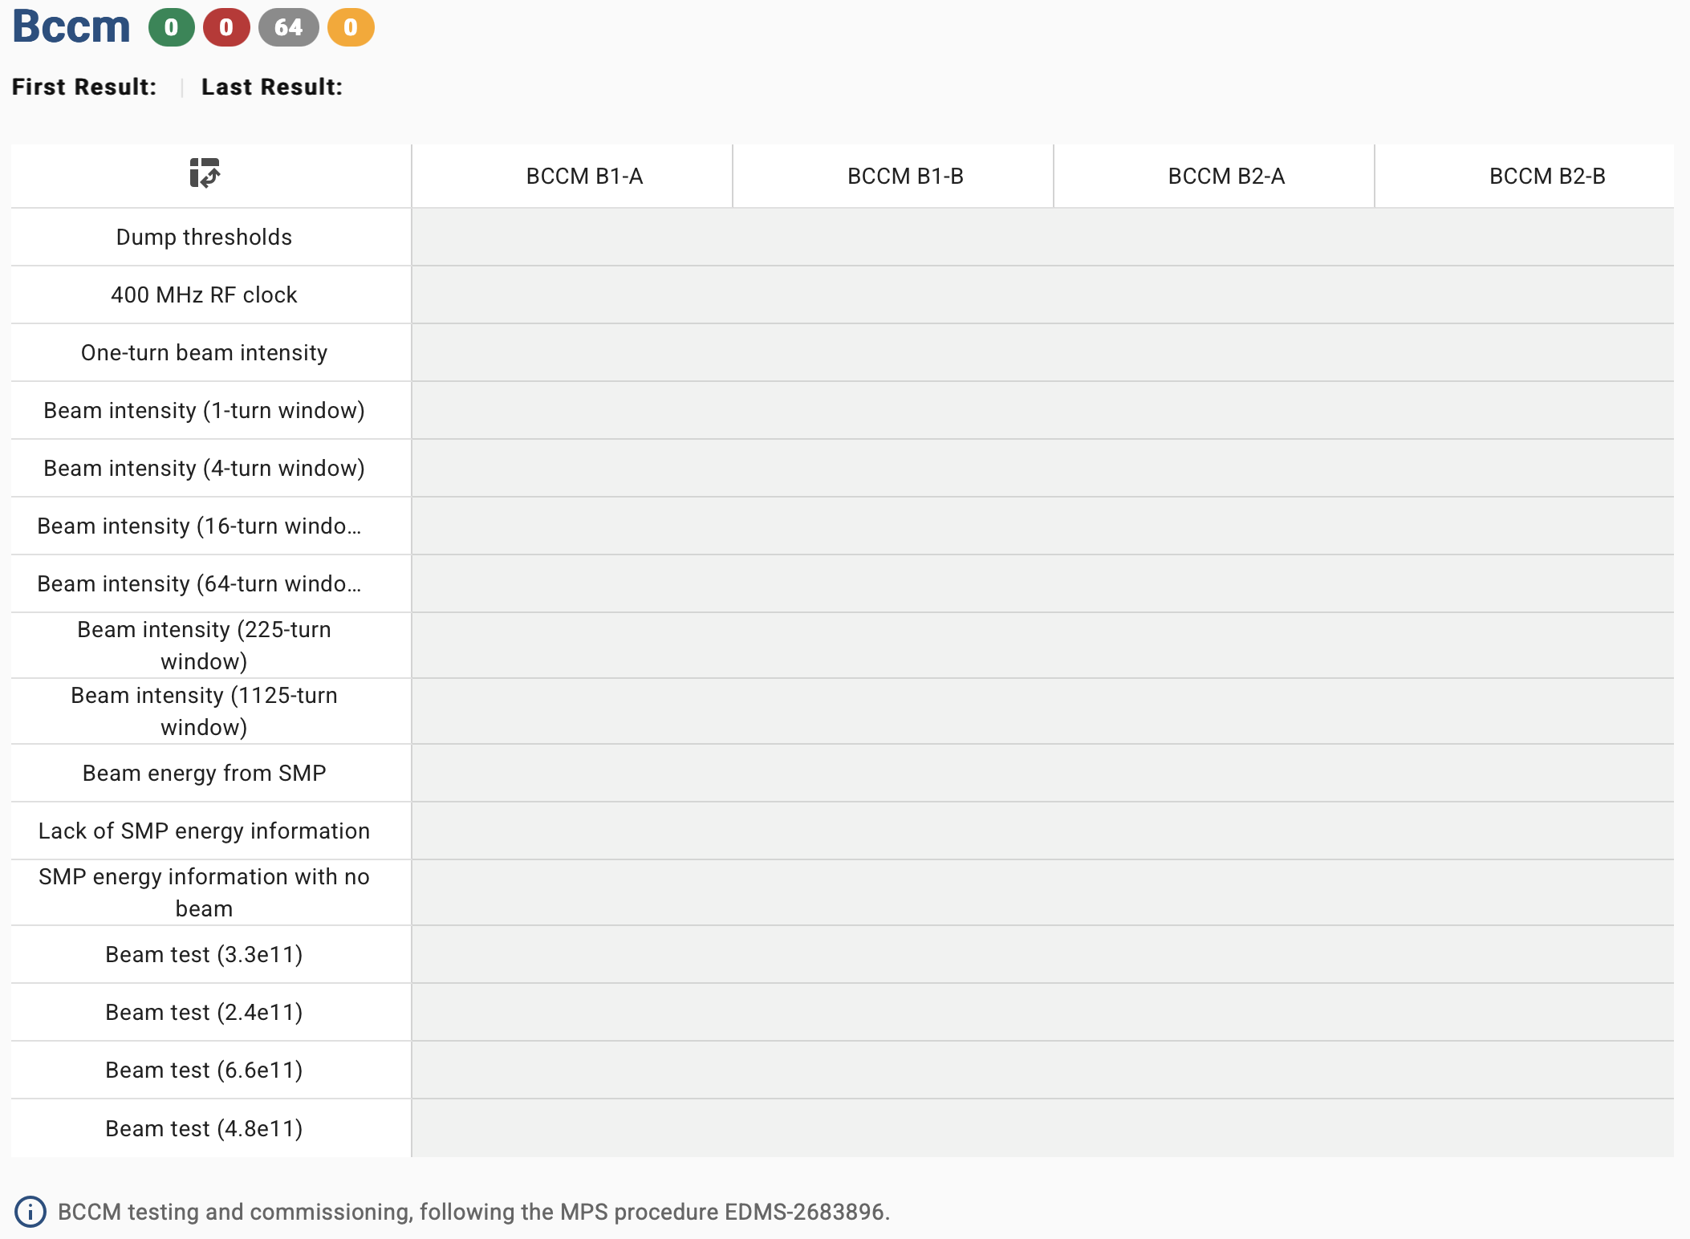
BCCM
Full MPS procedure EDMS-2683896 present in the checklist tool.
Commissioning strategy to be defined and planned.

Slide 7
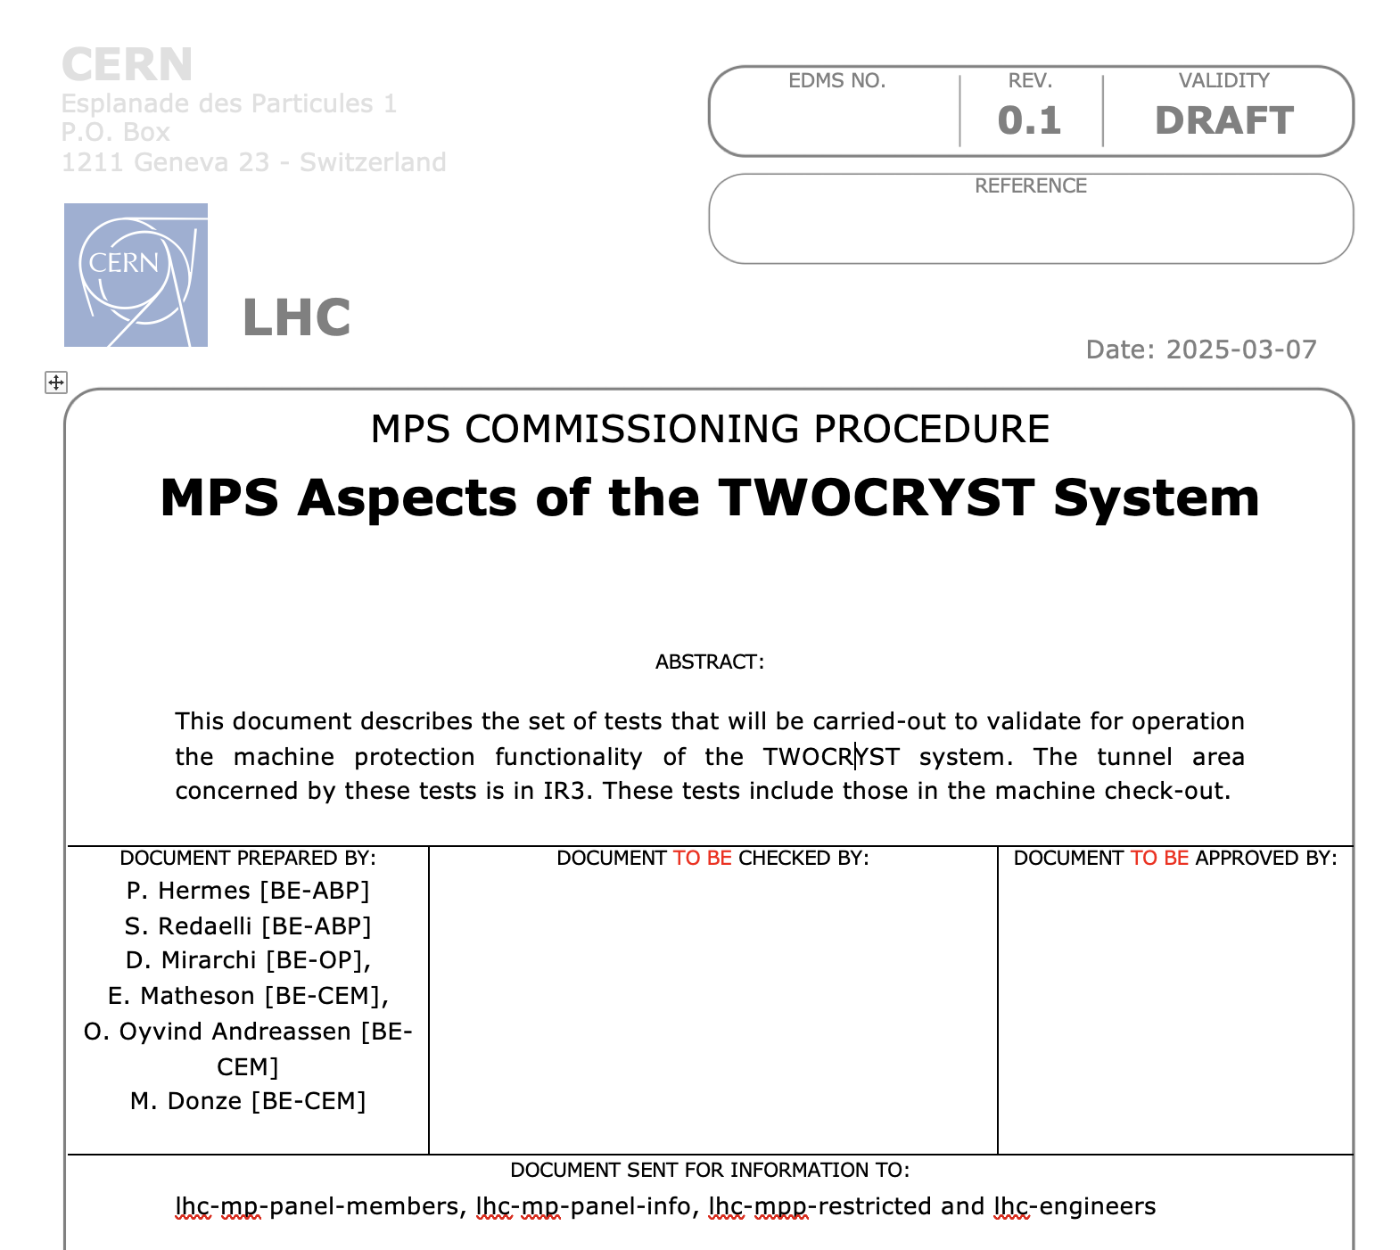
TWOCRYST
Full MPS procedure presented in this meeting will be added to the tool swiftly.
Crystal goniometers connection to the BIS also checked in the BIS checklist, under “User Link Connections“

