Slide 1
Machine Learning
and Radiological Characterization
M. Magistris, A. Gomes, R. Neugebauer, J.B. Potoine, E. Stamati
RP Seminar 17/04/2025 EDMS 3291657

Slide 2
Outline
Machine learning
Data and tools
Application:
  Scaling factors
  Principal component analysis (PCA)
  Clearance
Conclusions

Slide 3

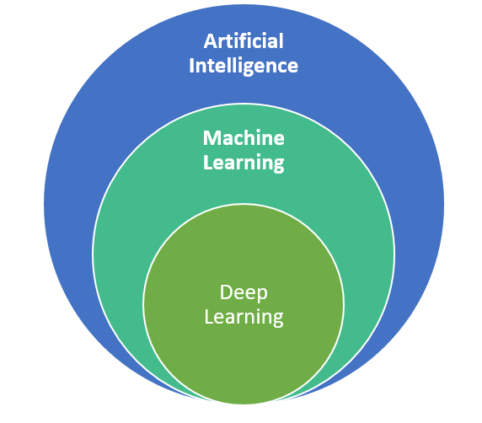
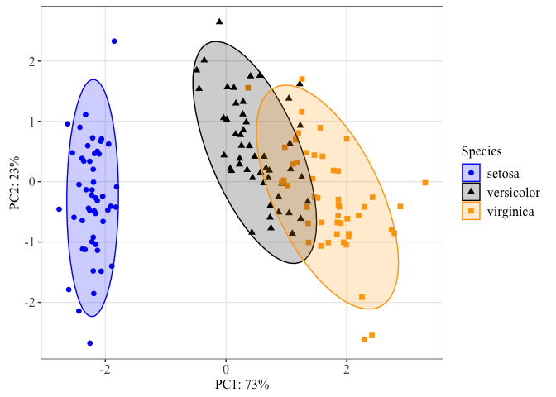
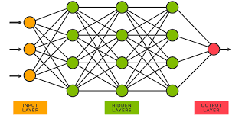
Machine learning
Machines mimicking humans
Machines learning from data
Machines using multilayer networks

Slide 4
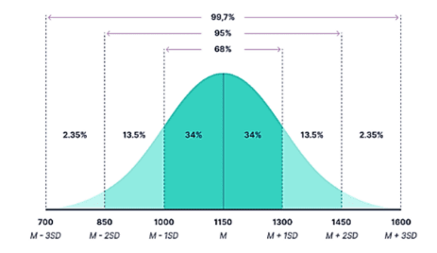
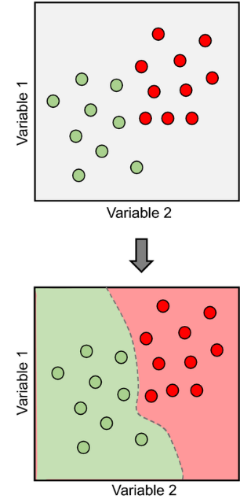
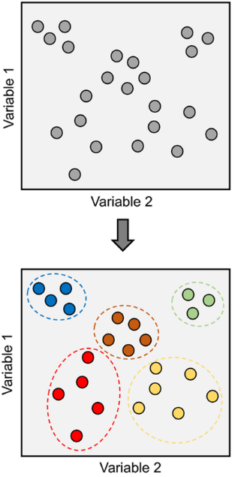
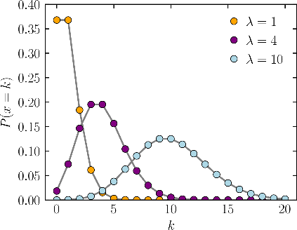
Statistics Machine learning
Statistics
Set the model
Use data to set parameters
Deal with outliers
=> describe the population
Machine learning
Set the data
Identify patterns
Deal with parameters
=> predict individuals
Description from an a-priori model Predictions from (un)labeled data

Slide 5
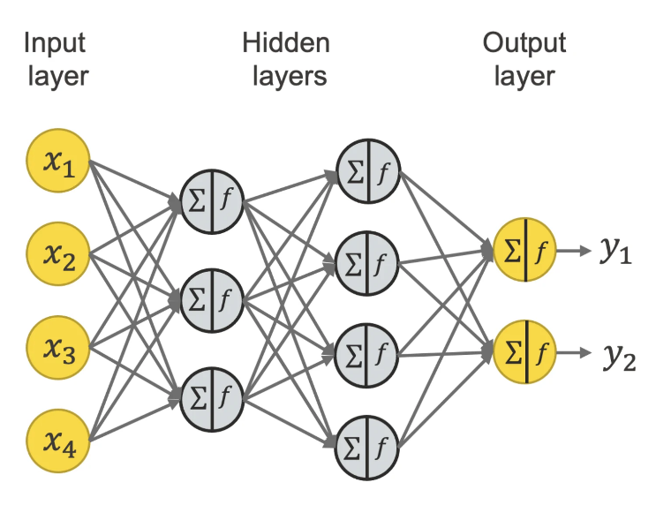

Machine learning: Deep learning
Interconnected nodes, trained to identify patterns
From many simple inputs to few complex outputs
What is the activity of Ni-63 given the chemical composition and radiological history?
No need for deep learning, ActiWiz can answer!
What is the radiological history given a spectrometry measurement and the type of material?
With deep learning you can swap inputs and outputs

Slide 6
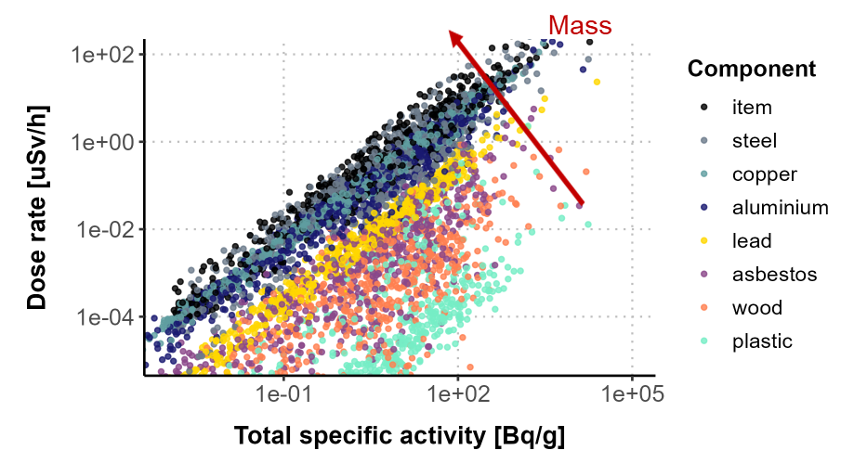
Machine learning: visualization is king!
Recipe (serves 1-2 plots)
Clean the data
Code (R/Python)
Identify message
Reveal message visually

Slide 7
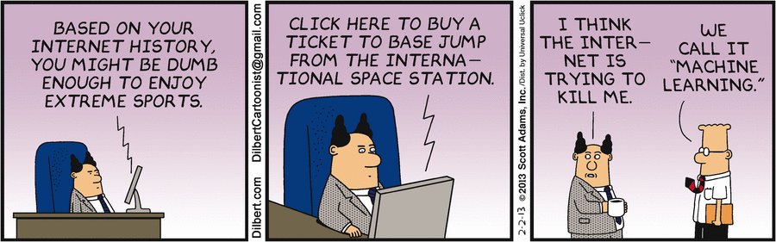

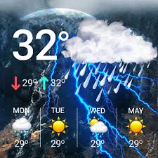

Machine learning: Applications
Targeted advertising
Weather forecast
Stock market

Slide 8

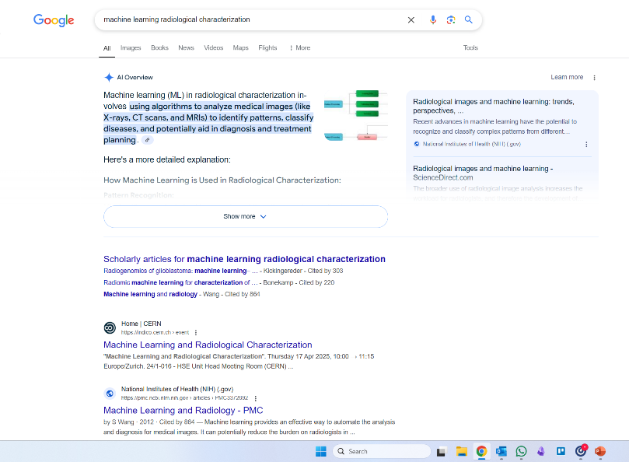
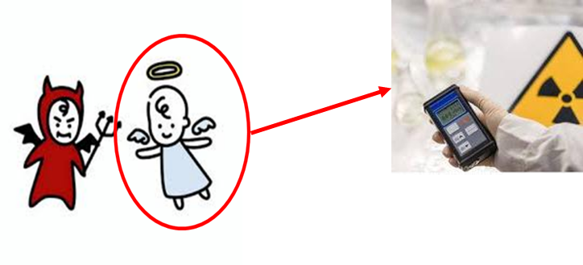

Machine learning: and radiological characterization?
Google search
“machine learning radiological characterization”
Top result
...this seminar!!

Slide 9

Machine learning: radiological characterization
Until today: slow progress, ML needs:
  Large datasets...
  ...a lot of data...
  ... even more data.
Data from
  gamma-spectrometry: time-consuming
  radiochemical analysis: expensive
  chemical composition: wishful thinking
  radiological history: what did you just say?
More data, please!!

Slide 10
Outline
Machine learning
Data and tools
Application:
  Scaling factors
  Principal component analysis (PCA)
  Clearance
Conclusions

Slide 11
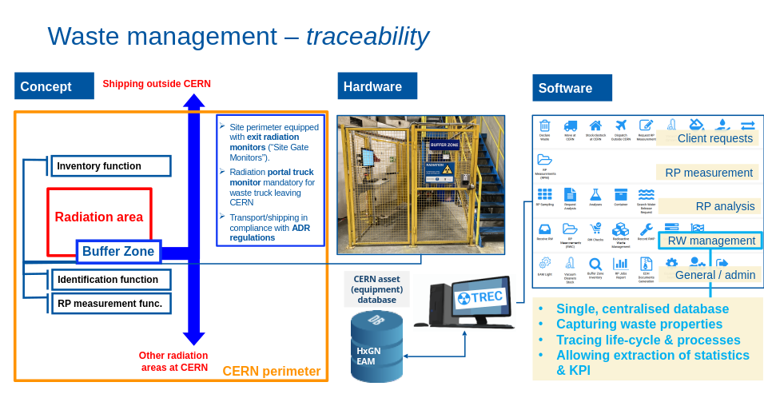
Data and tools: Waste management - Traceability
From G.Dumont, EDMS 3026072
Notes:
TEST

Slide 12
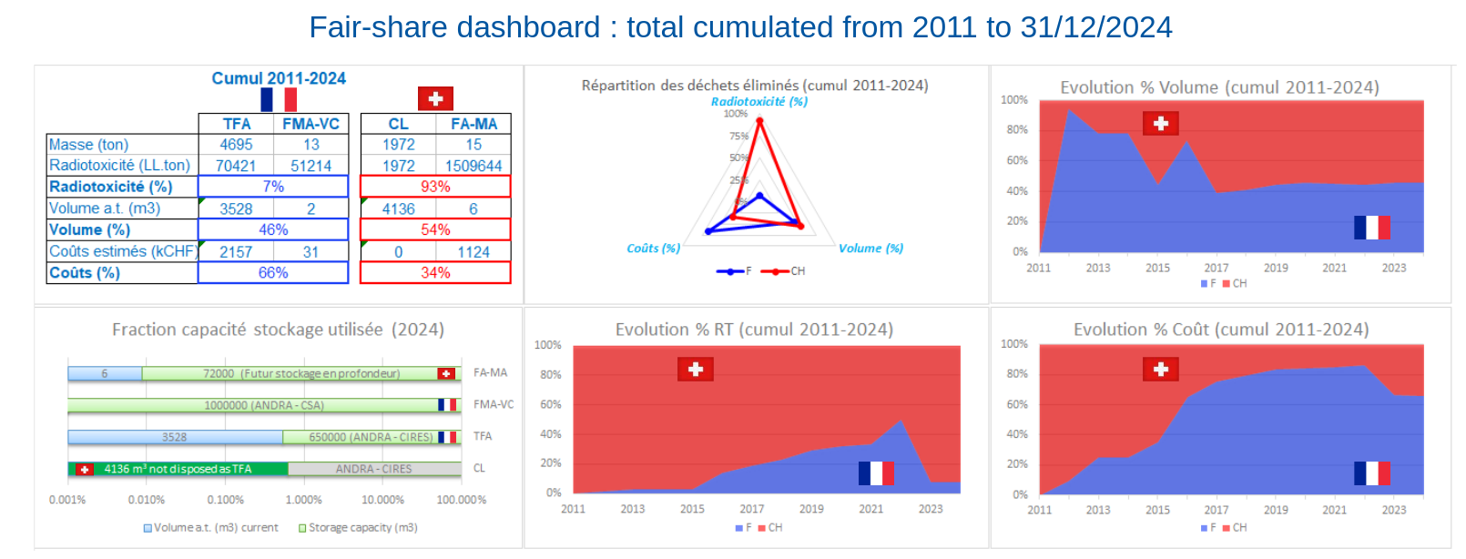
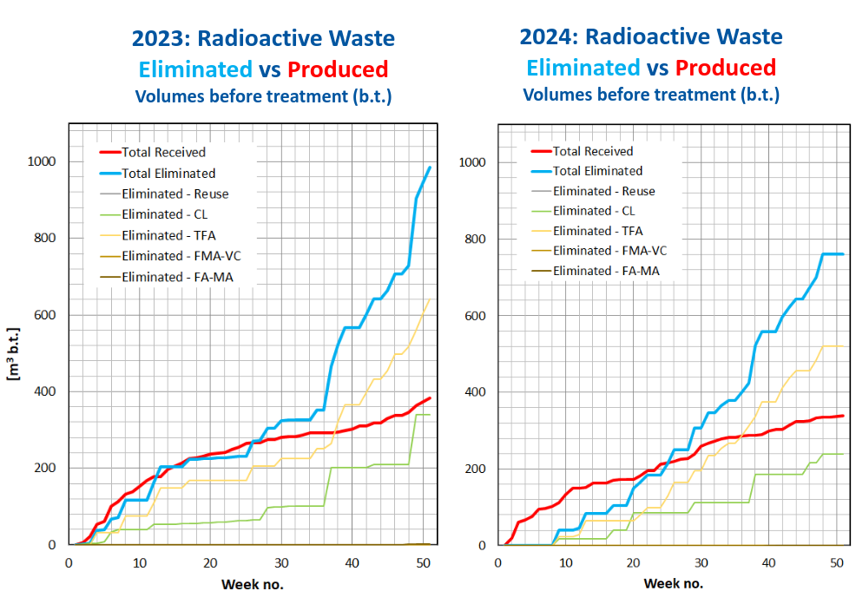
Data and tools: TREC - Extraction of statistics & KPIs
TREC allows the extraction of reliable data:
- Declaration to French/ Swiss authorities (Tripartite agreement)
- Waste management follow-up
From G.Dumont, EDMS 3026072
Notes:
TEST

Slide 13
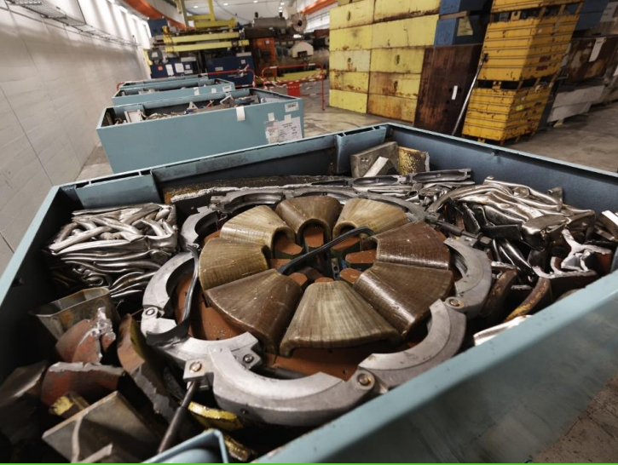
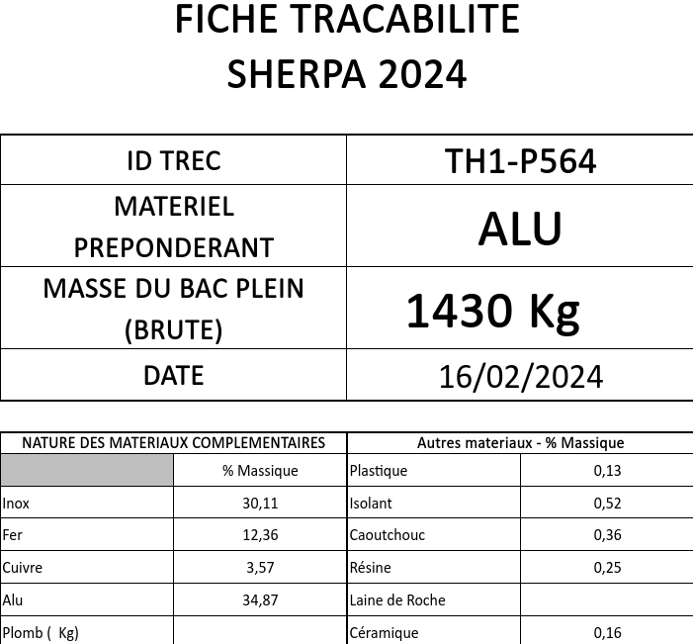
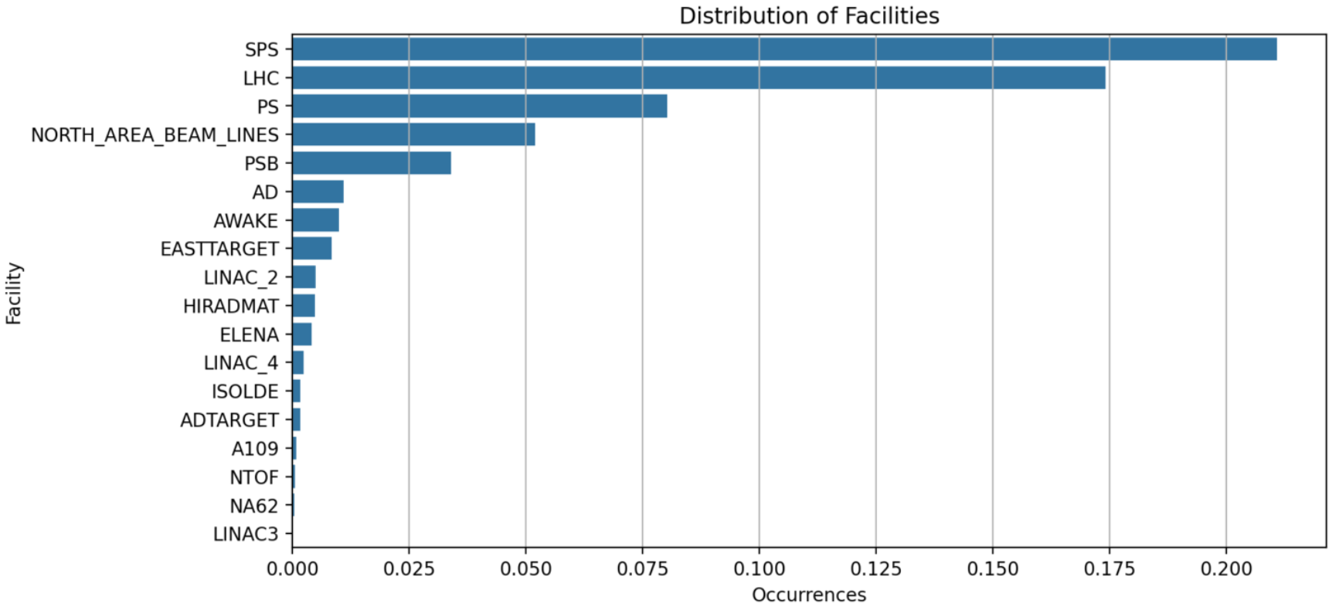
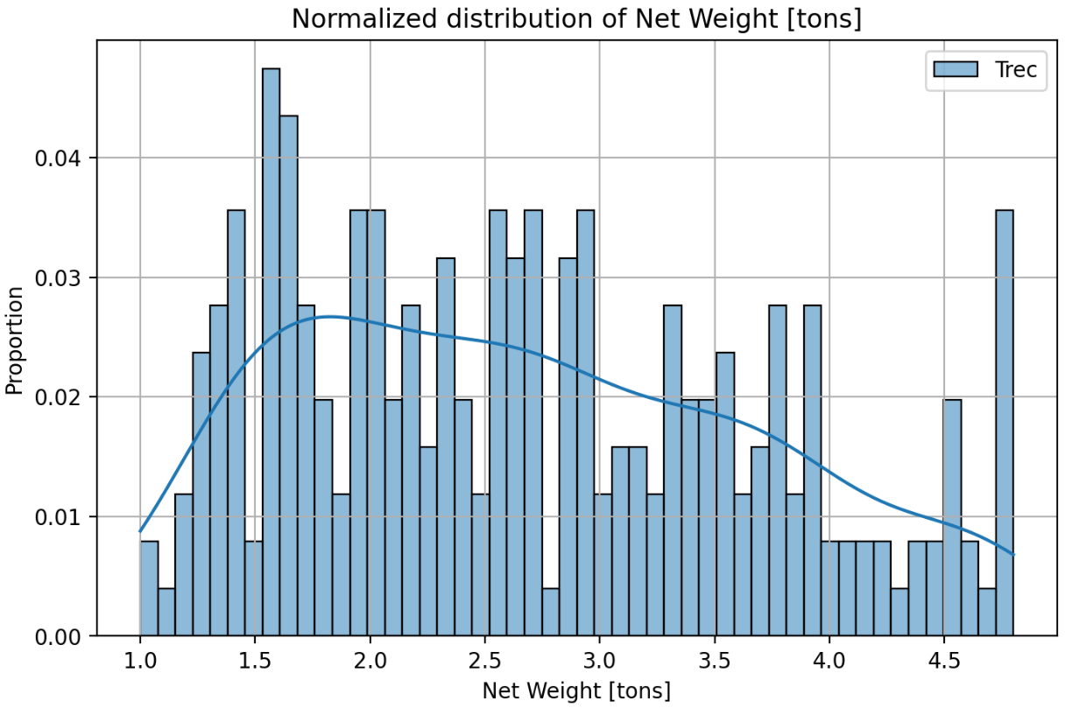
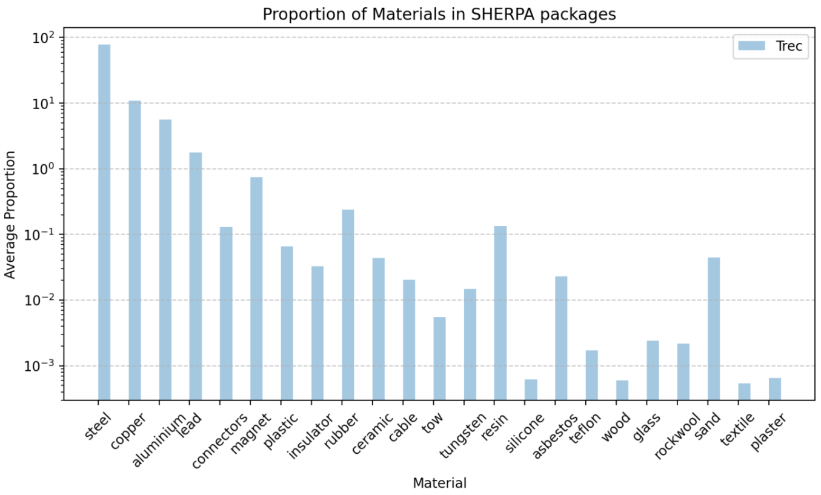
Data and tools: Radioactive waste properties
Data recovered when creating waste packages...
...and used in machine learning models for characterization.
Fig: Estimation of materials in SHERPA waste between 2020-2024
Fig: Distribution of facilities of origin for SHERPA waste and net weight of their packages, as provided by TREC
Notes:
TEST

Slide 14

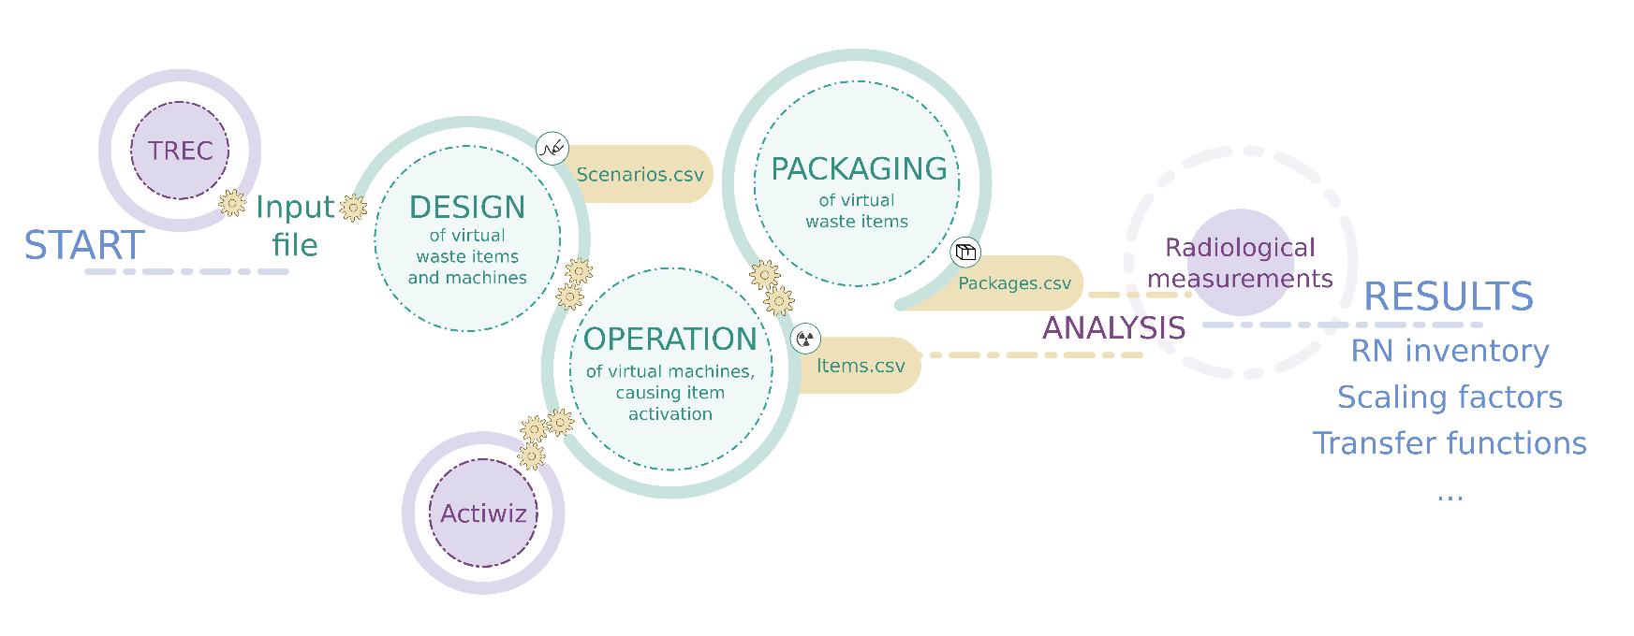



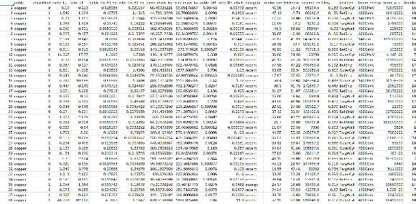

Data and tools: (Py)ActiWiz
Design:
We extract a population of virtual waste items based on the probability distributions
Operation:
ActiWiz computes the radiological properties of every virtual item

Slide 15
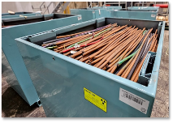
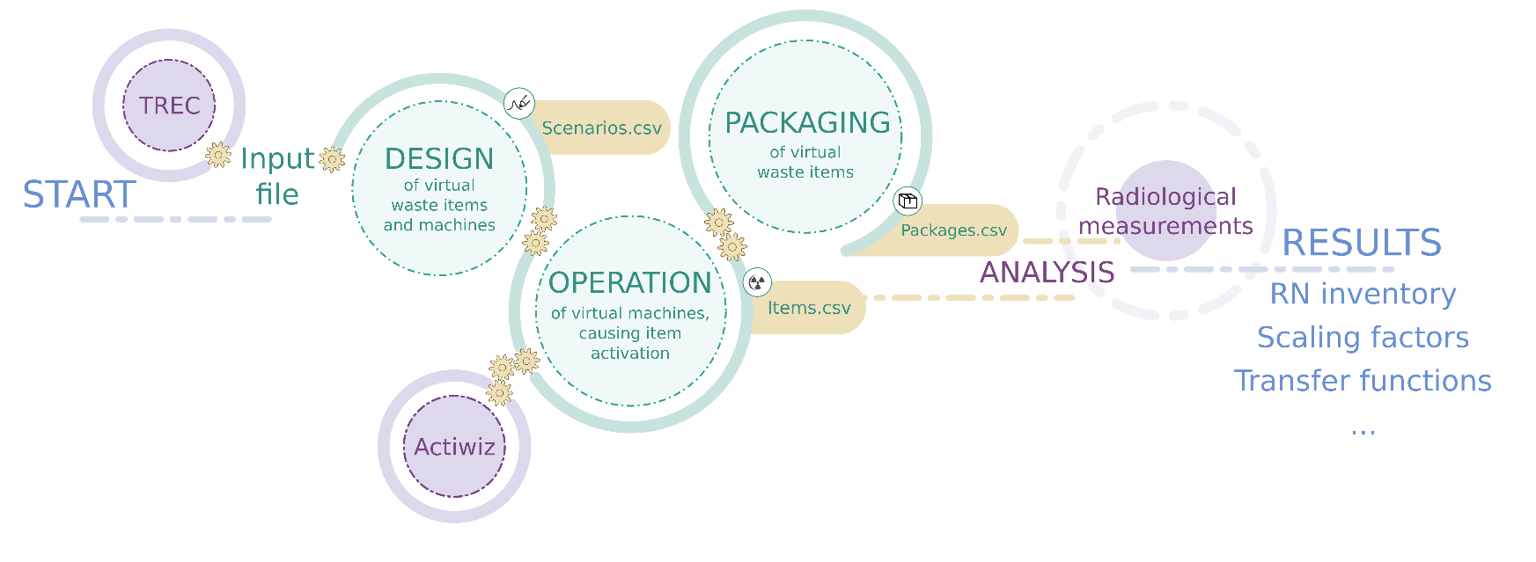
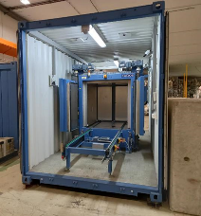

Data and tools: (Py)ActiWiz
Virtual items can be grouped together into packages
Data!! DATA!!!!
Analysis:
Simulate
  spectrometry measurements
  total gamma counting
Heterogeneous activity
Sampling

Slide 16
Outline
Machine learning
Data and tools
Application:
  Scaling factors
  Principal component analysis (PCA)
  Clearance
Conclusions

Slide 17
Scaling factors
Systematic vs probabilistic
Input parameters: material, position, geometry, history....
ActiWiz
Systematic
Probabilistic
Machine learning
Old school

Slide 18


Scaling factors
Systematic vs probabilistic
Input parameters: material, position, geometry, history....
ActiWiz
Systematic
Probabilistic
Machine learning
Old school

Slide 19
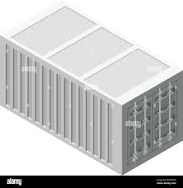
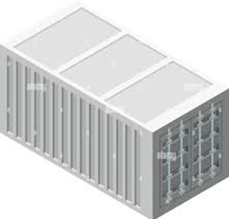
Scaling factors
Systematic vs probabilistic
Input parameters: material, position, geometry, history....
ActiWiz
Systematic
Probabilistic

Slide 20
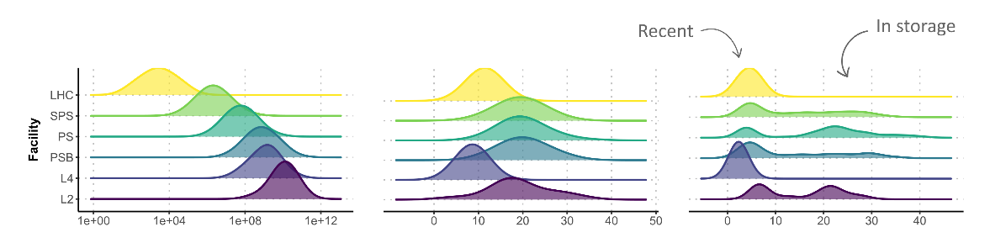
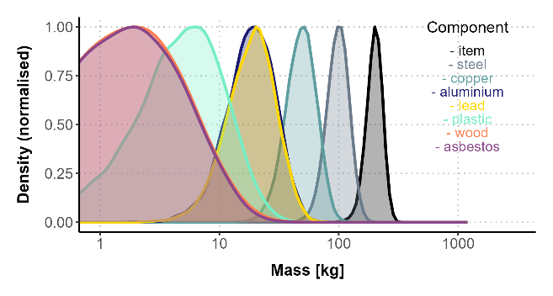
Scaling factors: input parameters
Probability distributions
Beam energy
Beam loss [p/s] Irradiation [years] Waiting [years]
Mass:
Entire waste item
Individual components making up the waste item

Slide 21
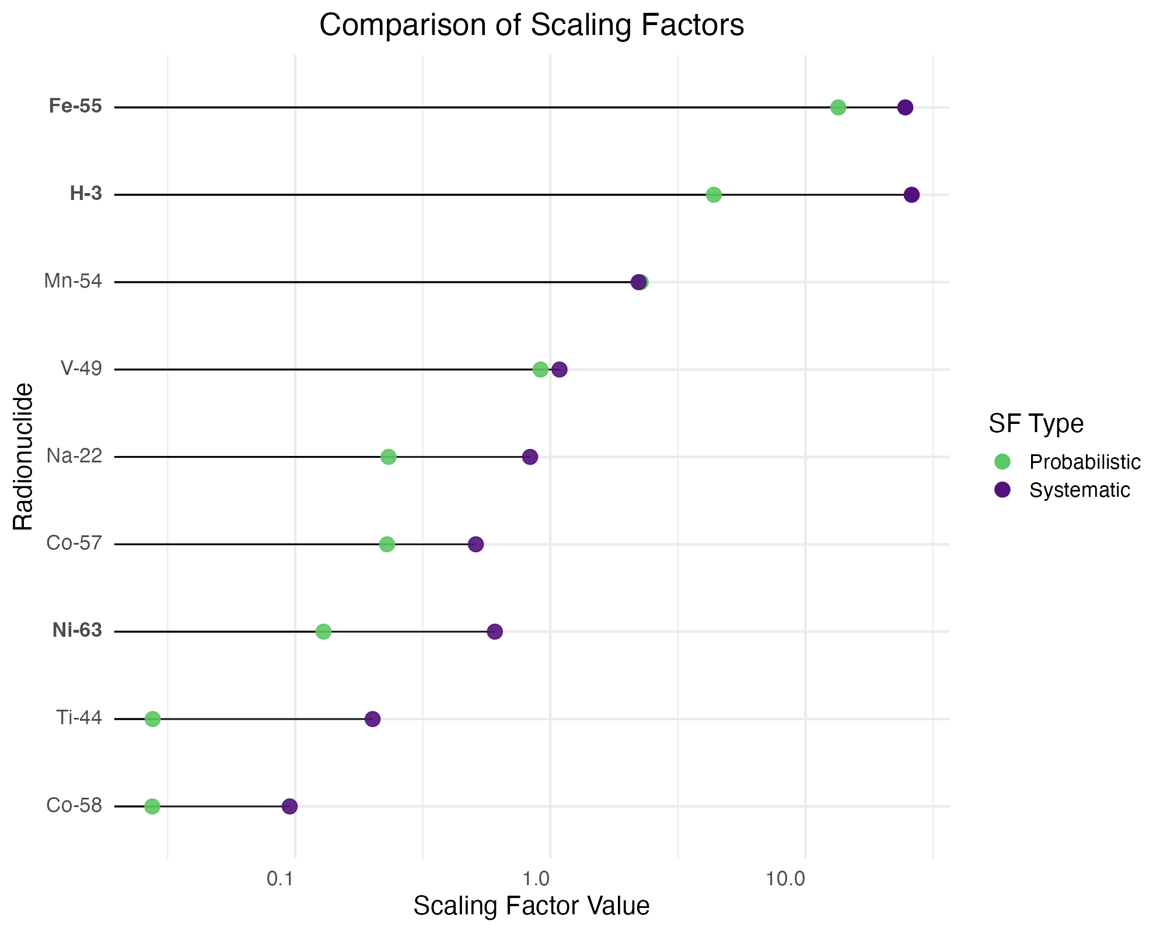
Scaling factors
Systematic vs probabilistic
Probabilistic
Scaling factors on average 2 x lower than with the systematic approach.

Slide 22

Scaling factors
Systematic vs probabilistic
Probabilistic
Scaling factors on average 2 x lower than with the systematic approach.
For crucial radionuclides, on average
3 x lower.

Slide 23
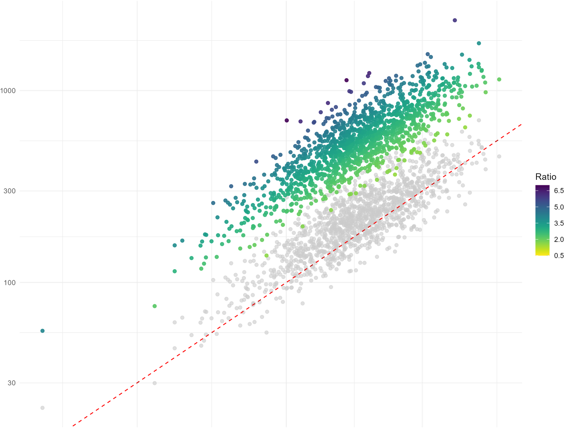
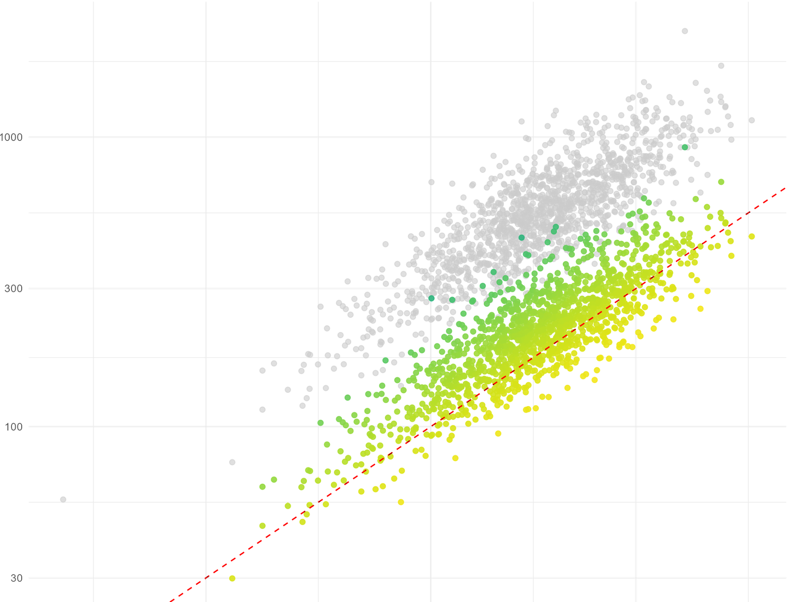

Scaling factors: impact on total activity
Systematic
Probabilistic
Predicted activity [Bq]
Predicted activity [Bq]
Ratio PE/TA
Third quartile
True activity [Bq]
True activity [Bq]

Slide 24
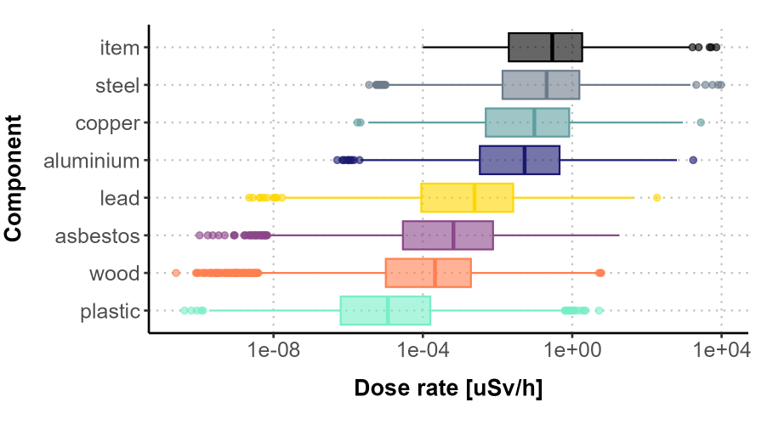
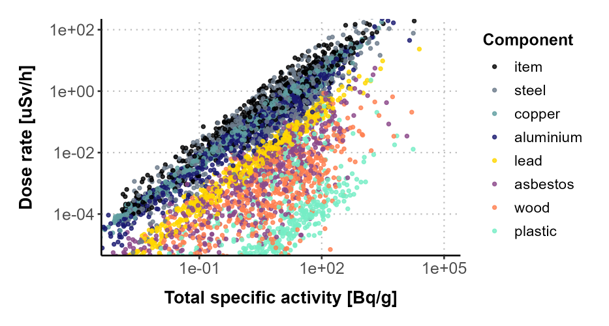



Scaling factors
Radiological properties
1 nSv/h
Invisible
Dose-rate:
Near the entire waste item
Near individual components making up the waste item
Mass
See the invisible (< 1 nSv/h)
Analyze properties of components (e.g. plastic) based on DR of the entire item

Slide 25
Outline
Machine learning
Data and tools
Application:
  Scaling factors
  Principal component analysis (PCA)
  Clearance
Conclusions

Slide 26
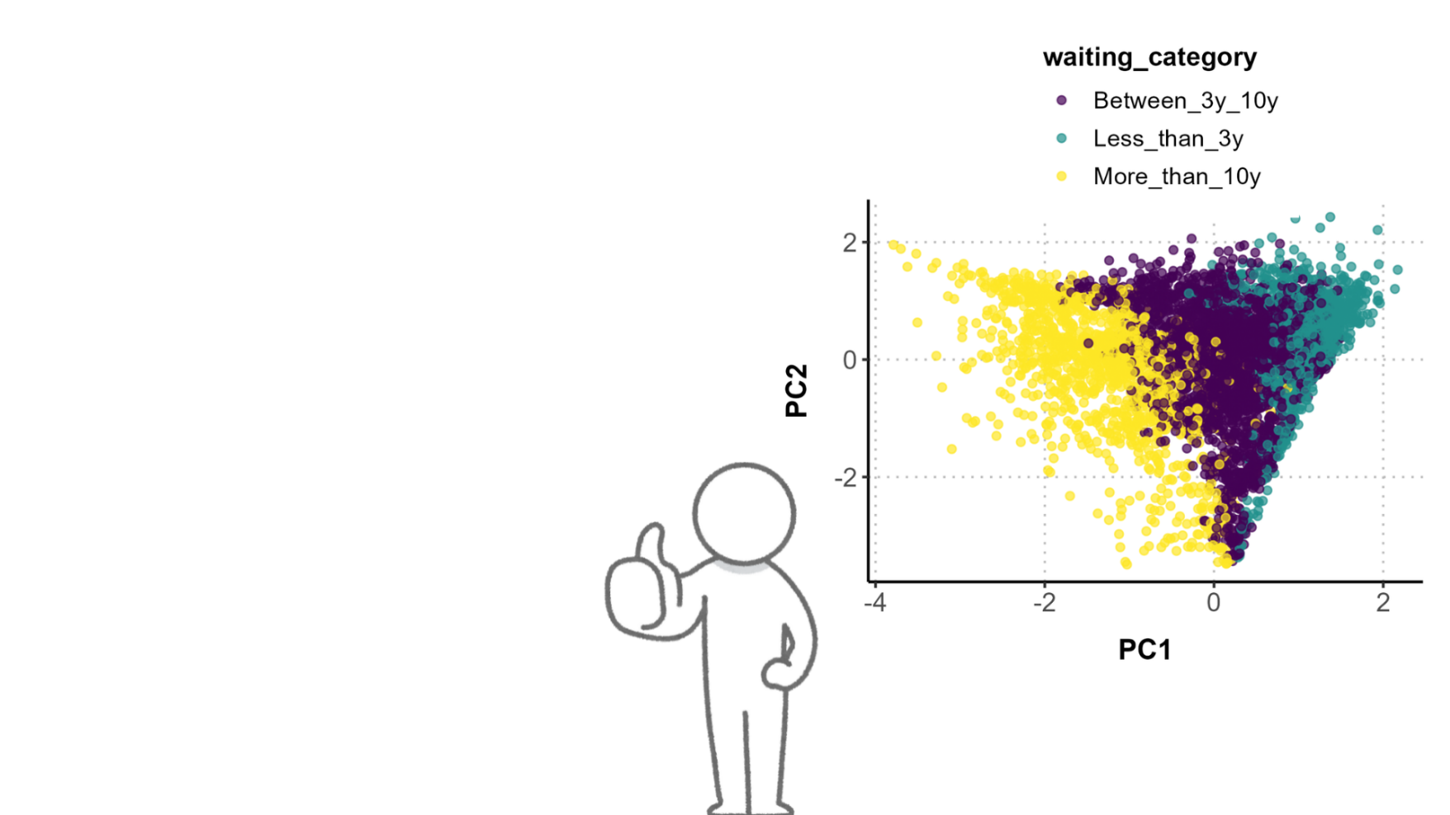
With PCA …
We can predict an item’s waiting time based only on quantities we can measure!

Slide 27
So what is this “PCA”?

Slide 28

So what is this “PCA”?
Principal Component Analysis is a method used to simplify complex data by turning it into a smaller set of new variables, called "principal components." These components capture the most important patterns or trends in the data.

Slide 29

So what is this “PCA”?
Principal Component Analysis is a method used to simplify complex data by turning it into a smaller set of new variables, called "principal components." These components capture the most important patterns or trends in the data.

Slide 30

Let’s visit a gallery!

Slide 31

Let’s visit a gallery!
A gallery is hosting an exhibition about Van Gogh and Da Vinci.
We’re approaching the first two painting, carefully reading the guide
and this is what it says:

Slide 32
Let’s visit a gallery!
Painting 1 = Painting of a man seated at a table, dressed in period clothing and a hat. He gazes slightly downward, with an introspective expression.

Slide 33
Let’s visit a gallery!
Painting 1 = Painting of a man seated at a table, dressed in period clothing and a hat. He gazes slightly downward, with an introspective expression.
Painting 2 = Painting of a man standing, dressed in period clothing and a hat. He is holding a paper and gazes slightly downward, with a serene expression.

Slide 34
Let’s visit a gallery!
Painting 1 = Painting of a man seated at a table, dressed in period clothing and a hat. He gazes slightly downward, with an introspective expression.
Painting 2 = Painting of a man standing, dressed in period clothing and a hat. He is holding a paper and gazes slightly downward, with a serene expression.
Which one is Van Gogh and which one is Da Vinci?

Slide 35
Let’s visit a gallery!
But what if …?

Slide 36
Let’s visit a gallery!
But what if …?
Painting 1
Movement
Painting 2
Colour contrast

Slide 37
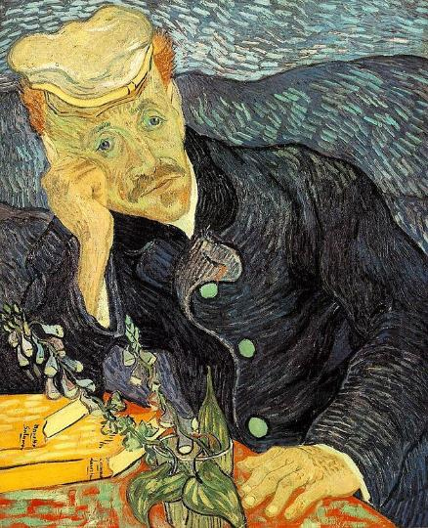
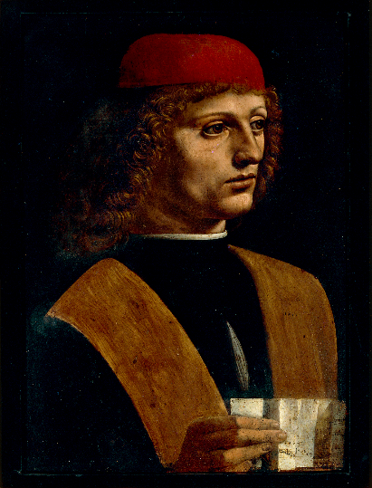
Let’s visit a gallery!
But what if …?
Is it obvious now?
Painting 1
Movement
Painting 2
Colour contrast

Slide 38
*This* is PCA!

Slide 39

So how do we use it ??

Slide 40
So how do we use it ??
Large dataset = Collection of virtual items coming out of our codes (~300 variables)

Slide 41
So how do we use it ??
Large dataset = Collection of virtual items coming out of our codes (~300 variables)
Simplified dataset = Create fewer, new variables that still describe the dataset

Slide 42

So how do we use it ??
Large dataset = Collection of virtual items coming out of our codes (~300 variables)
Simplified dataset = Create fewer, new variables that still describe the dataset
We have choice!
We can ask for these new variables to be a combination of features we can measure!

Slide 43
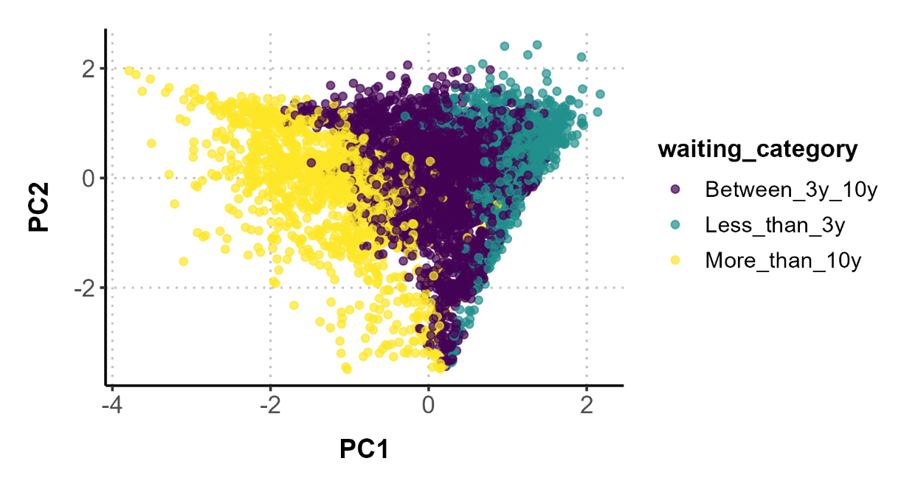
So how do we use it ??
Virtual items
Linear combinations of gamma emitters activities

Slide 44
So how do we use it ??
Virtual items
Linear combinations of gamma emitters activities
More ML:
Classification model to predict waiting time

Slide 45
So how do we use it ??
Virtual items
81% balanced accuracy
90% balanced accuracy
86% balanced accuracy

Slide 46
And what’s it for?
We have trained models to predict various quantities based on ActiWiz.
We have the tools to also train them based on g-spec results and use for quality control!

Slide 47
Outline
Machine learning
Data and tools
Application:
  Scaling factors
  Principal component analysis (PCA)
  Clearance
Conclusions

Slide 48
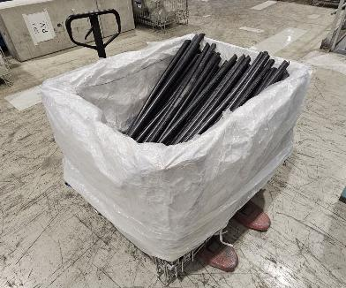
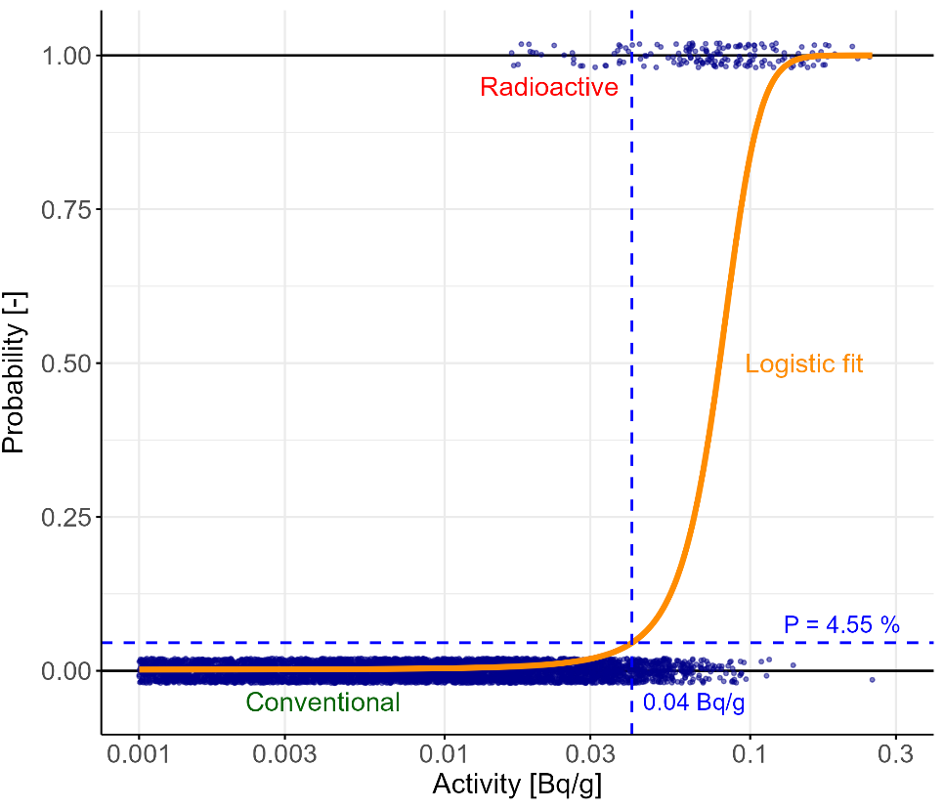
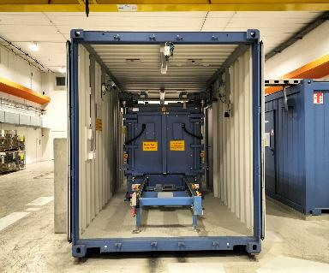



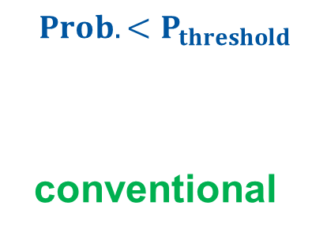


Clearance
Logistic regression
$${Activity< A}_{threshold}$$
$$A_{threshold}=0.04 Bq/g$$
Electric cables to be cleared
${Prob.<P}_{threshold}$
conventional
$P_{threshold}=5\%$
Total gamma counting

Slide 49
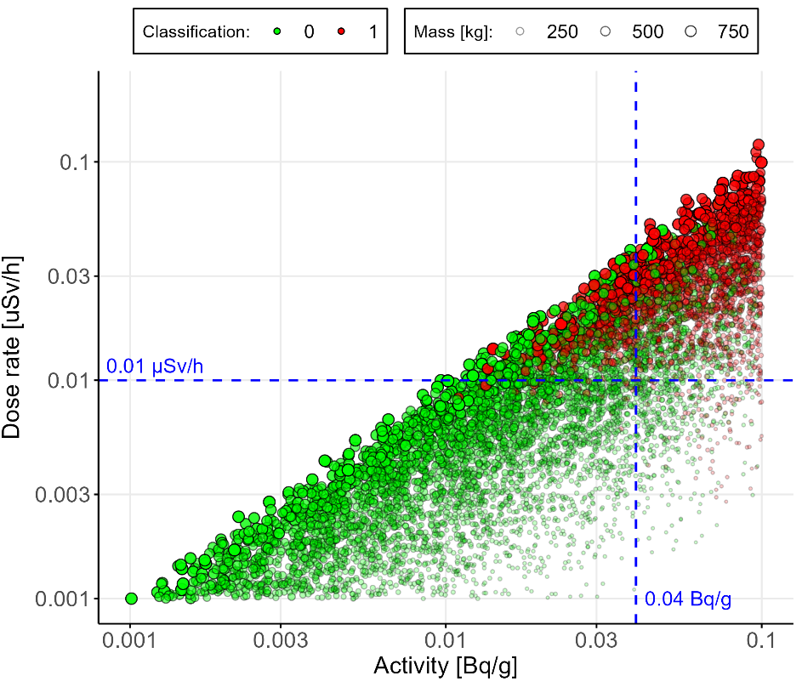


Clearance
Bubble chart
$$A_{threshold}$$
$${DR}_{threshold}$$

Slide 50
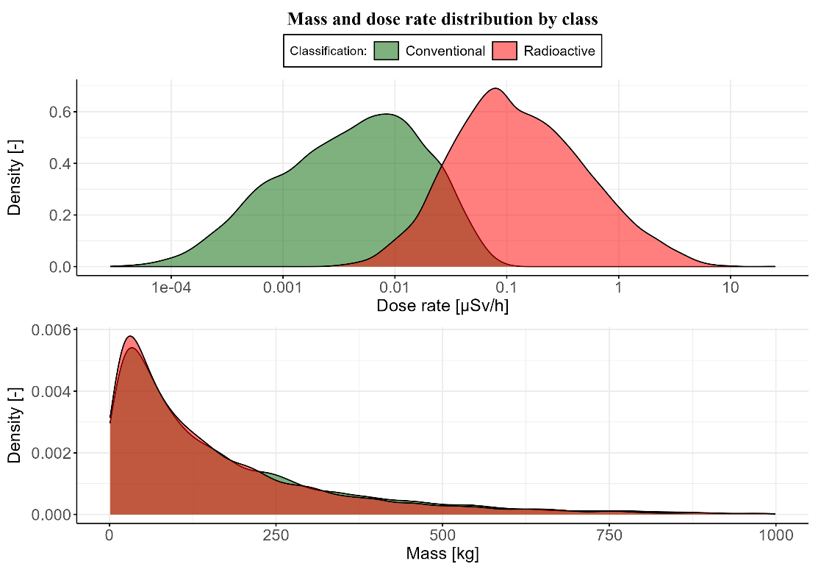
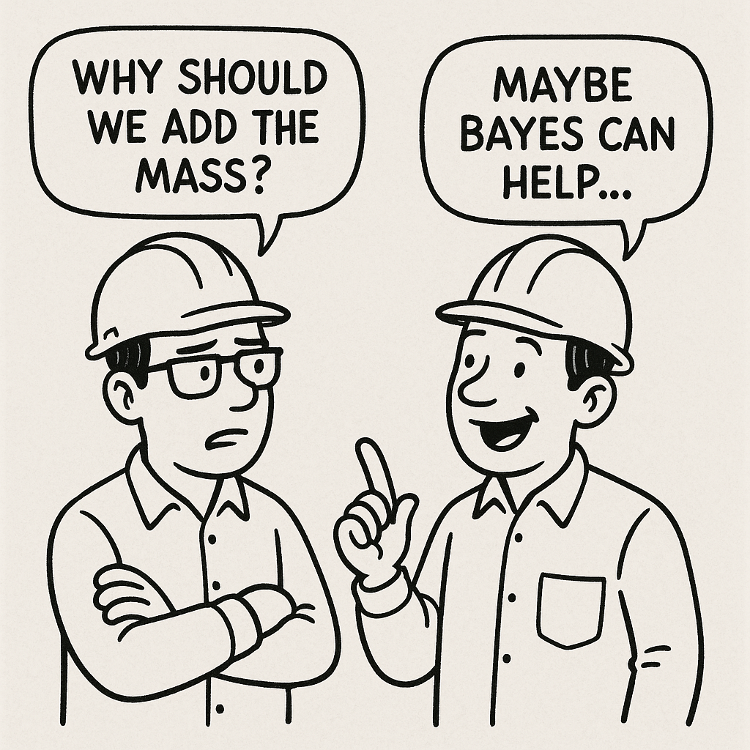
Clearance
Two predictors: mass and dose rate

Slide 51
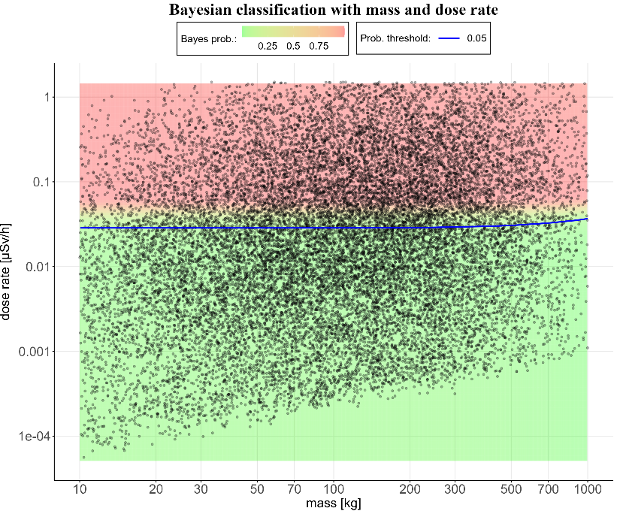
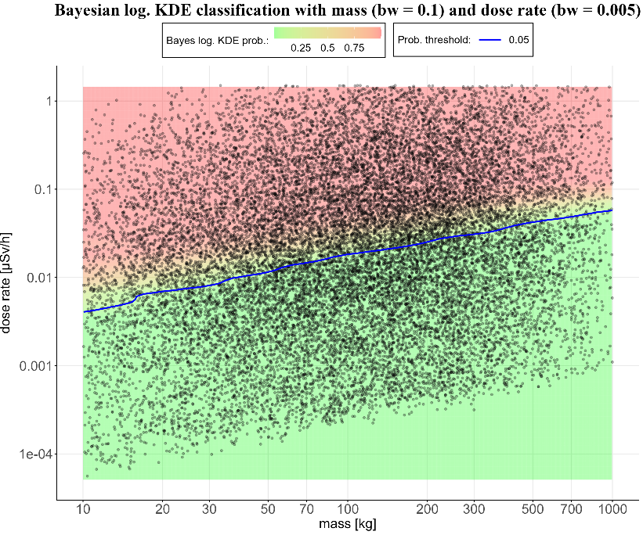
Naïve Bayes
Log. KDE Bayes

Slide 52
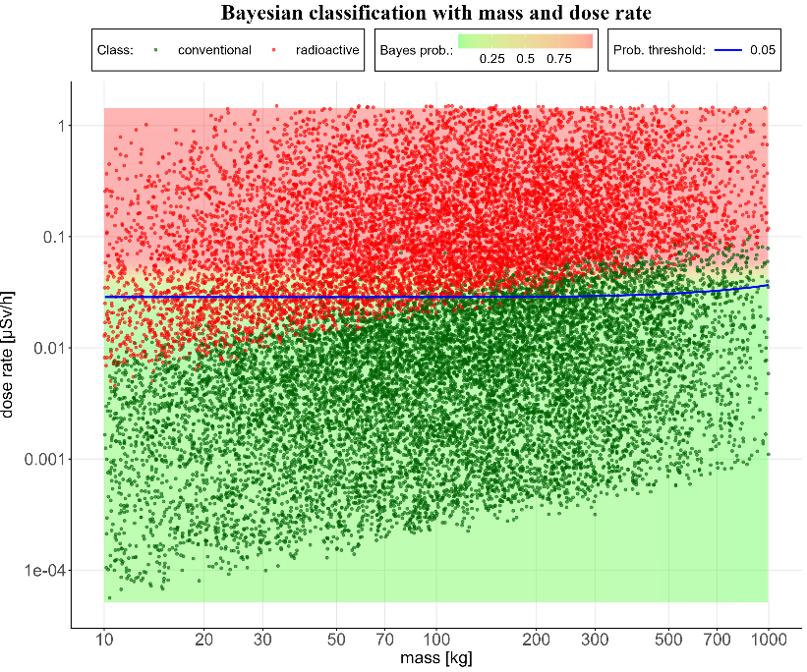
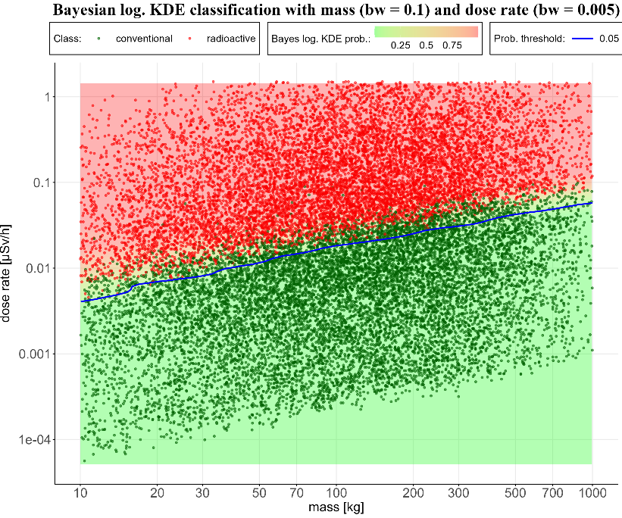


Naïve Bayes
Log. KDE Bayes
$$90\% accuracy$$
$$92\% accuracy$$

Slide 53
Outline
Machine learning
Data and tools
Application:
  Scaling factors
  Principal component analysis (PCA)
  Clearance
Conclusions

Slide 54

Conclusions
Machine learning is here to stay
CERN is at the forefront of ML for characterization:
  TREC + ActiWiz + measurements = Data
Endless opportunities:
  Impact of “authoritative” samples
  Waste sorting criteria (DR)
  Dose if sorting materials after clearance
  Impact of MDA on scaling factors
  Avoid penalizing assumptions
  ....
Machine learning is unreliable...
You should see human learning!!
Ha Ha!!

Slide 55

Conclusions
Training
  Manuals, Google certificates, Udemy classes....
Networks
  Adasci, Kaggle...
CERN
  Thematic CERN school
  Deep learning, beam dynamics
Radiation protection (current trend)
  Image recognition
  Metrology

Slide 56
Thank you!!!
Questions are welcome!!

