Slide 1
CI update
BGC CI team

Slide 2
Pulsed jet investigation
0.5 mm pulsed nozzle
  Difficulty to find a gas curtain
  Background pressure
  Different physics in the continuum flow side?
  Corrected the data collecting for background pressure.
0.1 mm pulsed nozzle
  Curtain signal found
  Need systematic study.

Slide 3
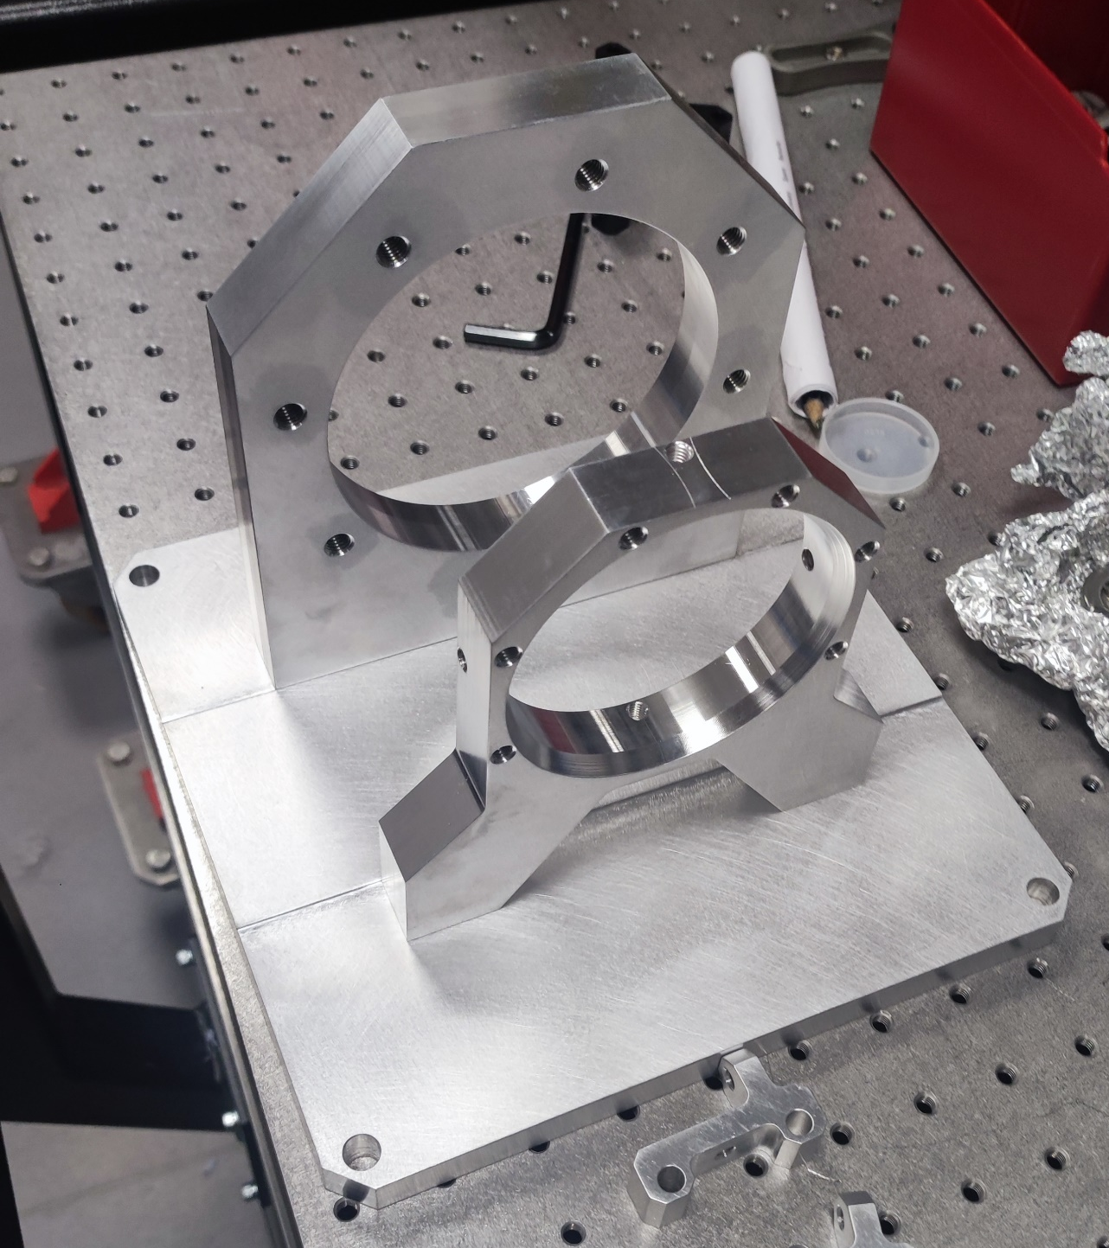
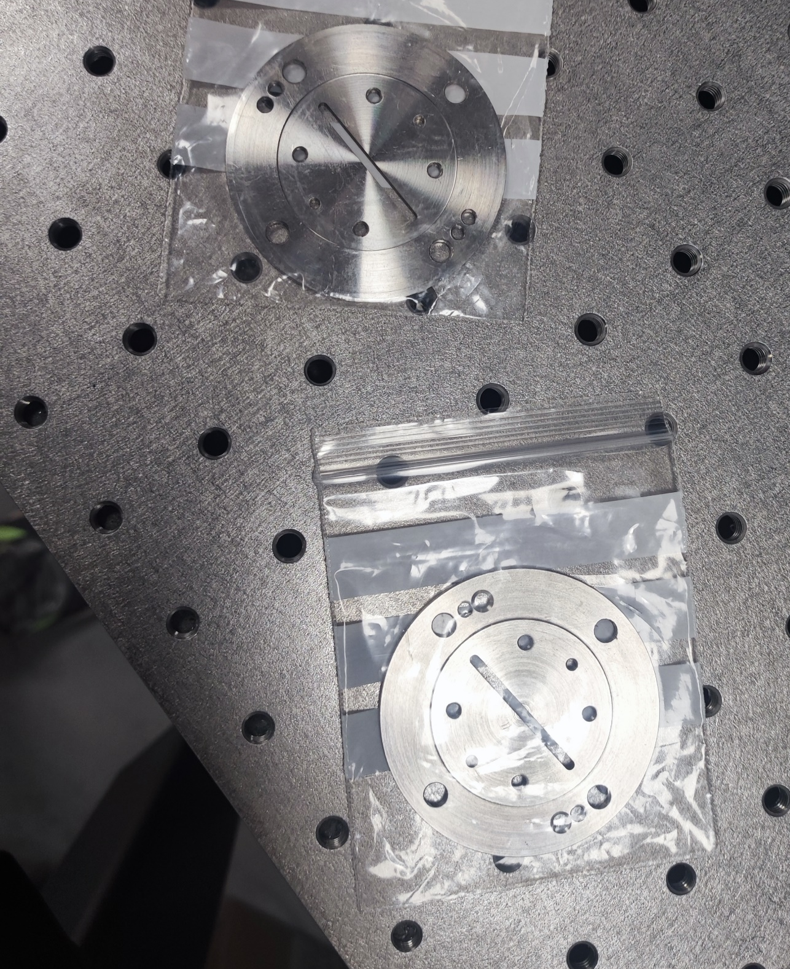
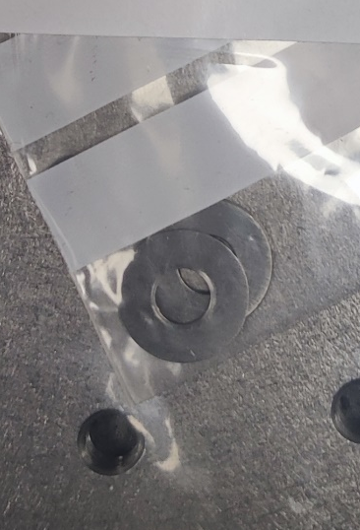
Version 4.1
Gas injection chamber
  The gas interaction chamber failed inspection; 2 more weeks needed from manufacturer.
Currently available
Alignment system
Modular design 3rd skimmer
Washer like 2nd skimmer

Slide 4
Planned journal articles
2024:
  “Beam gas curtain monitor: Vacuum studies for LHC integration and operation”
    lead by Christiana lead, published in PRAB
2025:
  “Measurements at 7 TeV with protons and lead ions”, Delayed
    Feedback received from PRL
  “Simulation and experimental studies into a supersonic gas jet curtain for beam profile monitoring”,
    Draft ready. Hao lead.
  ‘Measure the profile of a hollow electron beam at the electron beam test stand using beam gas curtain monitor’,
    Hao, Outline only
  “MOGA simulation” in progress
    lead by Oliver, potentially Vacuum.
  “V3 with full technical details” not started yet
    Mechanical design and gas flow test
    Optical system and resolution test
    LHC measurements in details (Visible and UV)
    Phys Rev AB, Lead? Danielle and Hao? ( Initially Ondrej, but full- time job now)
  “Cross section study” Data analysis in progress.
    lead by Hao/Shakti/Oliver, Phys Rev C?

Slide 5
Plan
Continue pulse jet work
Send feedback for the RPL paper
Submit the simulation paper.
Commissioning v4.1

