Slide 1
CI Update
O. Stringer, S. Sethi & H. Zhang

Slide 2
Analysis Overview
Breakdown of single beam measurement
  Frame processing
  Single photon counting
  Horizontal & vertical distributions
  Fitting vs Counting
  Cross-section calculation
Confirm the methods & flag anything
Fill 9969 (~15hr proton data, 585nm UV)

Slide 3
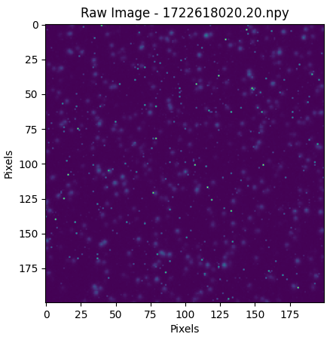
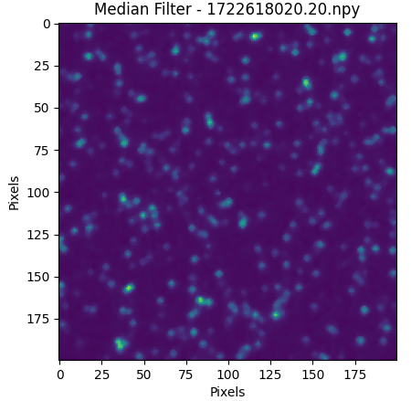
Frame Processing
Median filter (3x3)
Applied twice
Removes single pixel noise (dead pixels/camera dark counts)

Slide 4
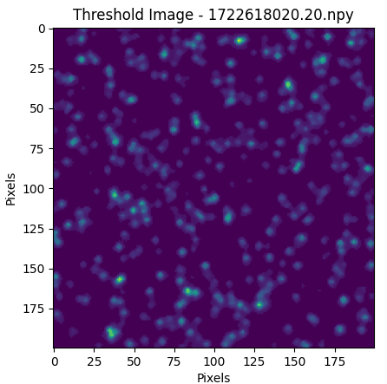
Frame Processing
Apply minimum threshold signal
Removes background static, anything remaining should be a photon

Slide 5
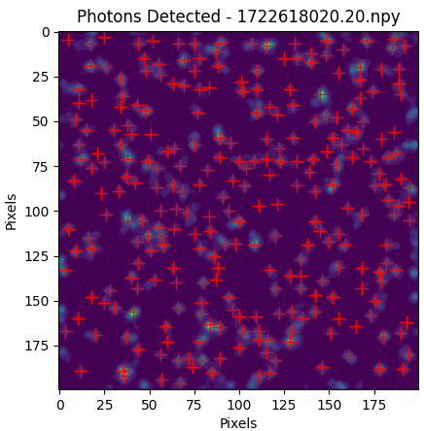
Single Photon Counting
Occasionally misses a double photon
Detect individual photons
Identify peak region, fit 2D gaussian within photon ROI and determine photon location
Misses photons on frame boundary (fitting issue)

Slide 6
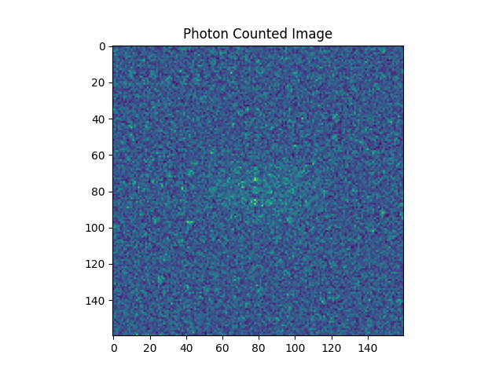
Single Photon Counting
Create a 2D histogram of all counted photons over the 120 second integration time.
Select RoI for vertical and horizontal fits & integrate over respective direction.

Slide 7
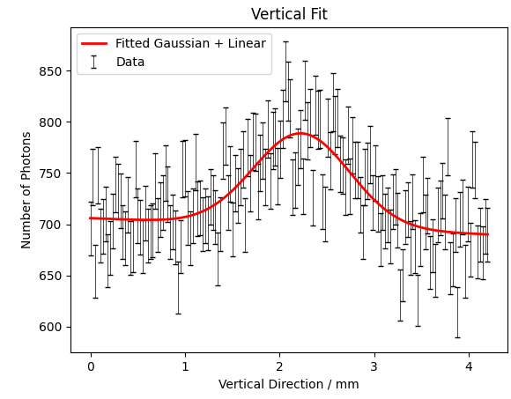
Vertical Distribution
Fit a gaussian + linear equation (beam + background)
Errors calculated using poissonian stats (error = sqrt(N))
Chi²/NDF = 1.6
Vertical distribution = beam + jet thickness

Slide 8
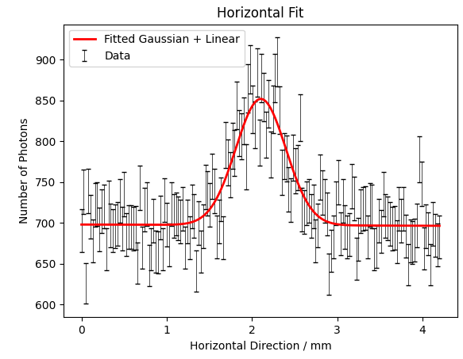
Horizontal Distribution
Chi²/NDF = 1.3
 | Fitted equation
Sigma | 0.293 ±0.015
Photon Number | 8942 (74.5 γ / s)
Photon Number Error | 577
Counting within 3 sigma
0.293 ±0.015
9224 (76.9 γ / s)
51.6

Slide 9

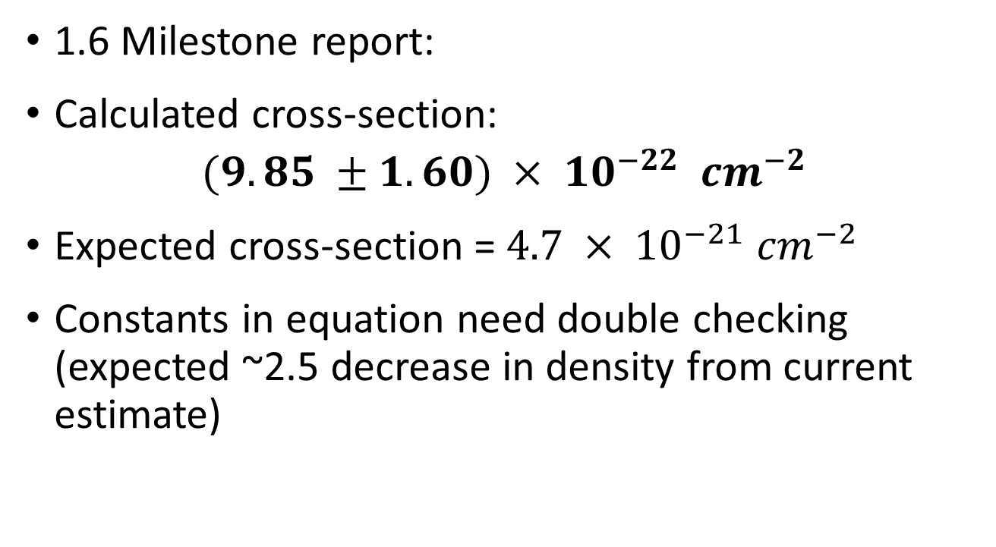
Cross-section
1.6 Milestone report:
Calculated cross-section:
$$(9.85 ±1.60) × {10}^{−22} {cm}^{−2}$$
Expected cross-section = $4.7 × {10}^{−21} {cm}^{−2}$
Constants in equation need double checking (expected ~2.5 decrease in density from current estimate)

Slide 10
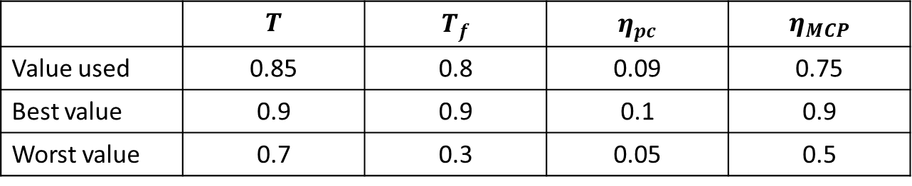
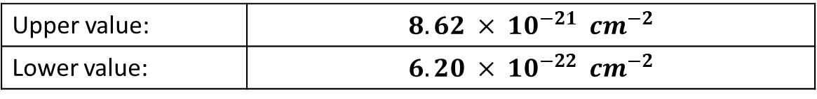
Cross-section
1.6 Milestone report gives upper & lower bounds for transmissions & efficiencies
Using these (instead of error on other terms):
 | $$T$$ | $$T_{f}$$ | $$η_{pc}$$ | $$η_{MCP}$$
Value used | 0.85 | 0.8 | 0.09 | 0.75
Best value | 0.9 | 0.9 | 0.1 | 0.9
Worst value | 0.7 | 0.3 | 0.05 | 0.5
Upper value: | $$8.62 × {10}^{−21} {cm}^{−2}$$
Lower value: | $$6.20 × {10}^{−22} {cm}^{−2}$$

Slide 11
Next Steps
Full fill analysis
  Emittance & Cross-section
  Injection, Ramp & Stable Beams
Comparison to Timber variables
  If fit/raw count residuals are negligible, cross section calculations from Timber would significantly increase data volume
Fill by fill comparison
  Background?
  UV & Vis?

Slide 12
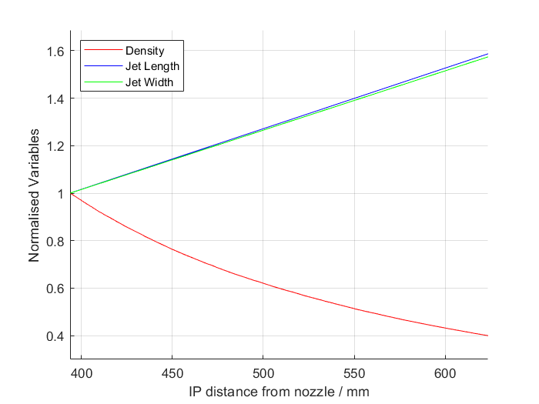
Extending BGC V4.2
V3 conditions, extending distance from 3rd skimmer to IP (extending option for V4.2)

