Slide 2
RP plans for BDF prototype target tests
C. Ahdida (HSE-RP)
WP6 meeting
18 March 2025

Slide 3
Discussion points for studies/measurements (1/2)
Update FLUKA model
  Geometry according to drawings. Special attention to target block sizes, He cooling volume and target holder/container. Base table can be done roughly. Rui to provide drawings? Use existing T6 prototype geometry from Giuseppe.
  Material compositions (elemental composition, density) to be checked
  Set up settings for prompt radiation (to score fluences) and residual radiation
FLUKA/Actiwiz Studies
  Fluences (prompt step)
    Target (for the moment full target can be scored of 1 -> allows quicker inventories for whole target; but good to score also the ones of single blocks for future benchmarks/transport/waste)
    He volume
    Target holder/container
  Radionuclide inventories (Actiwiz)
    Evaluate radionuclide inventories of target, He volume and target holder/container. Evaluate specific and total activities. For total activities use real volumes. Make a summary sheet with H-3 activities for different components
  Residual dose rates
    Evaluate residual dose rates for various cool-down times in fresh environment
    After the test, SESAME studies can be done with updated irradiation profile moving the target somewhere else (target container (?), but also in test setup (tbd))

Slide 4
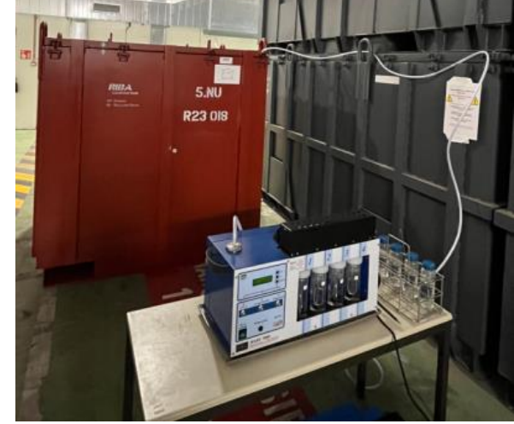
Discussion points for studies/measurements (2/2)
H-3 outgassing test setup
  Define test setup for measurement of H-3 in He-volume (e.g. connection of He inlet to bubbler, extraction of He, …) -> similar to LHC dump measurements in RWTCS? When/where…
Benchmarks
  Measure residual dose rates of target (determine w/ FLUKA same cool-down time)
  Measure residual dose rates of single blocks (when are they expected to be removed? Will they be shipped for PIE?)
  H-3 benchmark in He
Other operational measurements
  Contamination measurements (target blocks, vessel, etc)
ABEILLE H-3 Outgassing for FMAVC RW elimination to ANDRA

Slide 5
Practical points
Shared CERNBOX folder:
  T6 Prototype Target Test - Files – CERNBox
  Includes also Giuseppe’s FLUKA model
  Data sheet for gas purifiers of He skid
Link to JPARC publication on “Analysis of Radionuclides in Helium Gas Circulating Through the Target Chamber at the J-PARC Hadron Experimental Facility”
  JPSCP.33.011143
  Used HPGe and NAI(Tl) detectors for identification of radionuclides in circulating gas
Next meeting with Francesco Dragoni for the He skid details
  Setup
  Incorporating potential measurement setup in He skid?
  Using mass spectrometers in combination with another detector?

