Slide 1
Summary of HI-ECN3 impact on current EN-AA safety systems
Follow-up
B. Morand – EN-AA
2025-03-20 – EDMS 3225404

Slide 2
List of systems impacted
Standard Access control system (SUSI)
SPS PPS access safety system (ZORA)
Fire detection & Evacuation system
Gas detection system

Slide 3
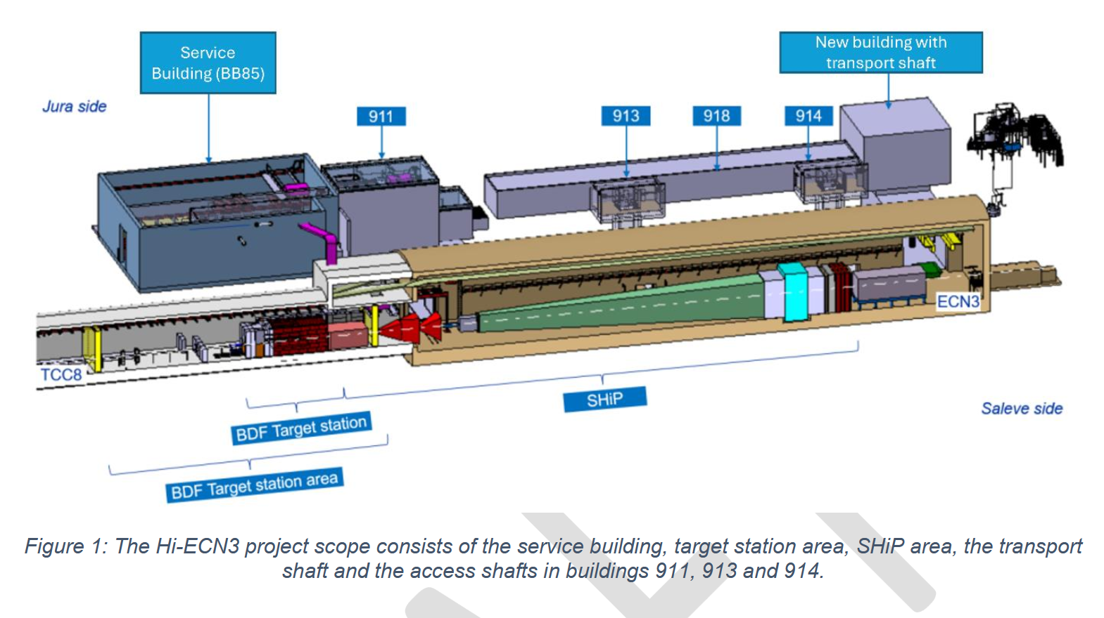
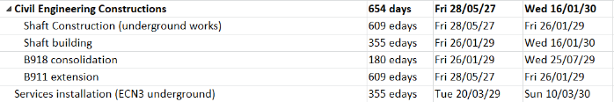
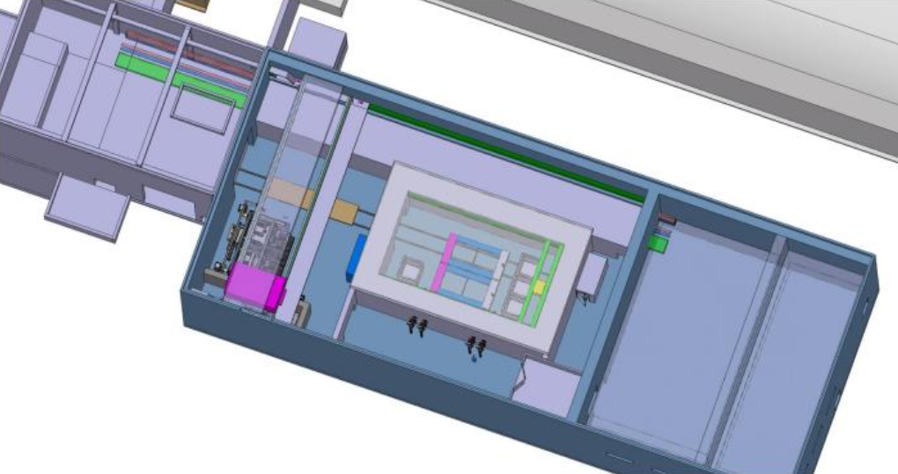
SUSI Access system
Access control for new service building (BB85).
Planning: between April 2029 & March 2030
Rough estimate: 20kCHF for installing additional standard access control outside & inside the building (without video cameras).

Slide 4
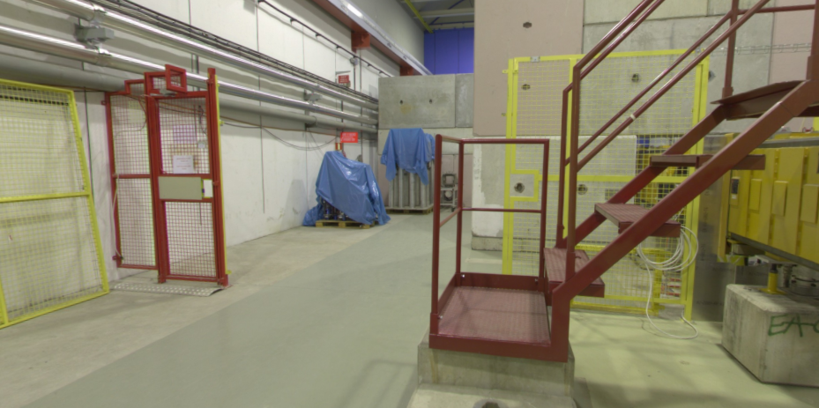
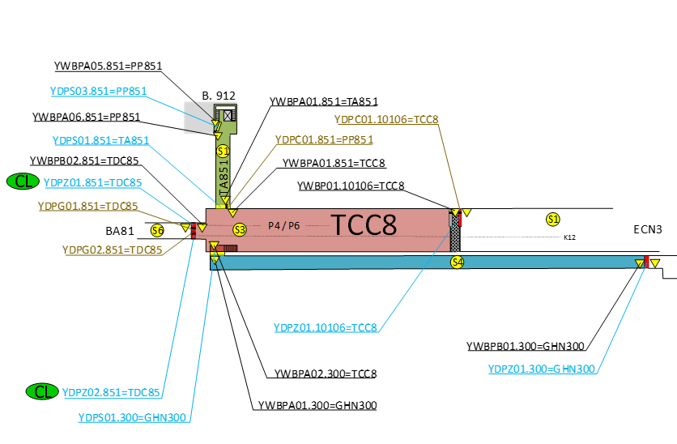
ZORA Access system for LS3
Option 1 : Reuse the former door to add a simple access control between TCC8 & ECN3.
  Used to ease the dismantling phase. A procedure shall be established.
  Workers shall enter via the access point to ensure that their DMC is activated.
  Only persons with the correct IMPACT will be able to use this access point.
Estimate = 35kCHF including:
  Mechanical adaptations (grids + door)
  Access control equipment (UTL + readers)
  Manpower (installation & tests)
  Power supply + network

Slide 5
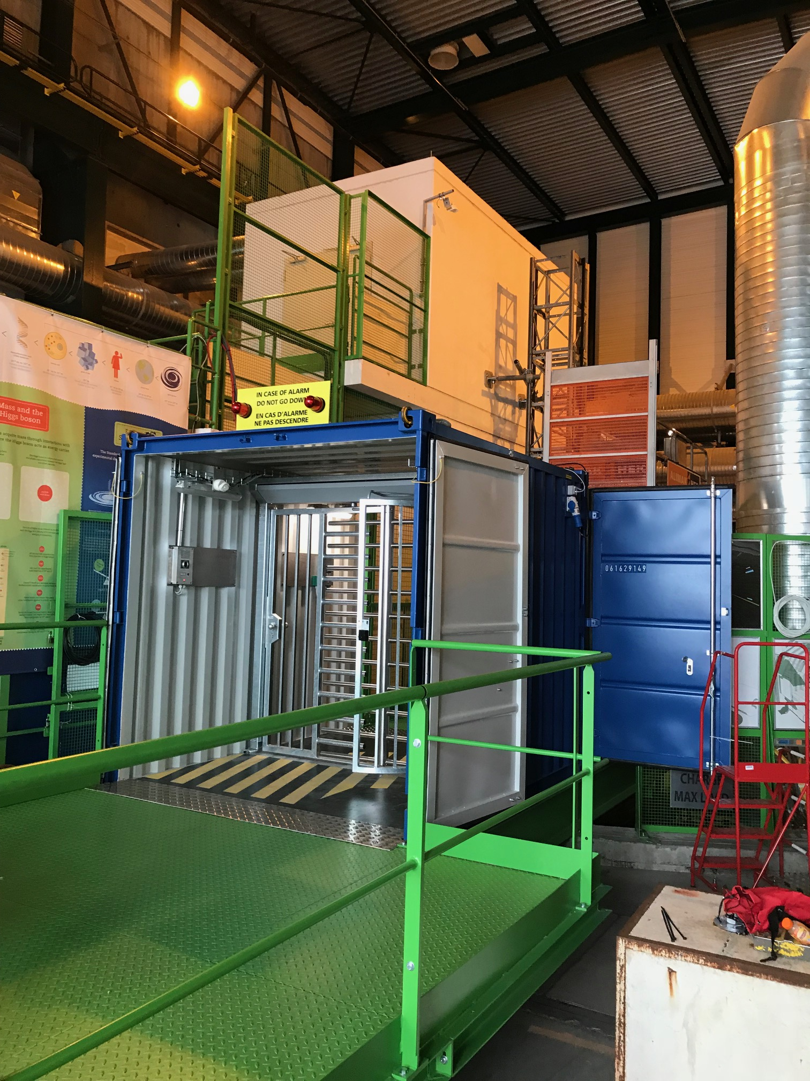
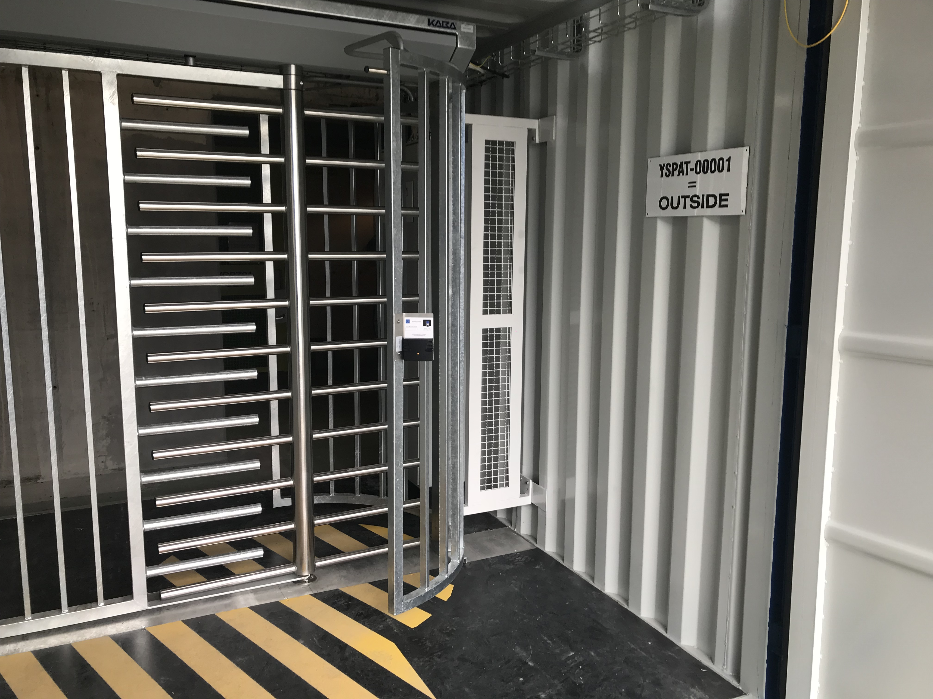
ZORA Access system for LS3 (TCC8 dismantling)
Option 2: To install the access control container
  This equipment needs to be available (only one for all CERN).
  Possible to open the side door by calling CSA agent.
Estimate = 19kCHF including:
  Mechanical adaptations (grids) 10kCHF
  Manpower (commissioning) 3kCHF
  Power supply + network 6kCHF
  Transport & manutention to be managed by the final user
Option 3: Door with padlock + procedure
  This option was abandoned because of the evacuation problems associated with it.

Slide 6
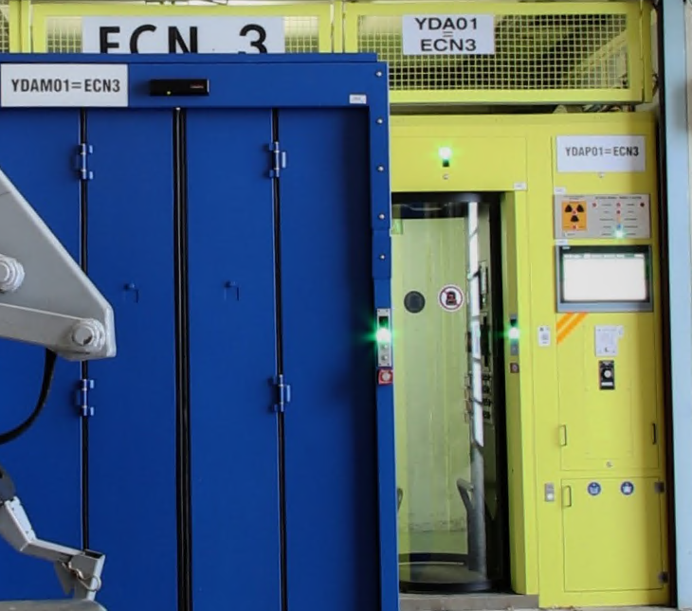
ZORA Access system for LS3
2. Remove temporarely ECN3 AP
  In order to ease the civil engineering works and to avoid premature aging of the PAD & MAD, it is proposed to remove the ECN3 access point and to replace it by a standard acces control.
Estimate = 32kCHF including:
  Manpower for dismantling and re-commissioning
  Manufacturing of grids and doors
  Access control equipment (UTL + readers)
  Power supply + network
3. RP Monitor to be interlocked
  It has to be noted that the RP monitor that was initially foreseen is not anymore needed following more precise RP studies.

Slide 7
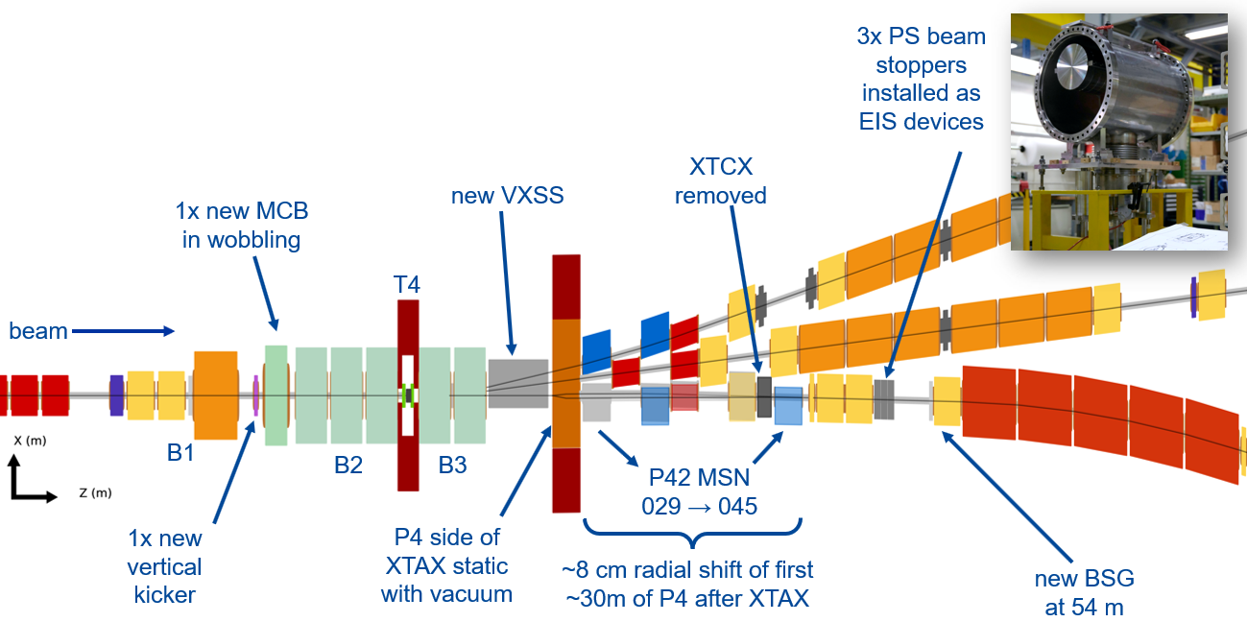
ZORA Access system post LS3
1. New beam stoppers (3 to 5)
RP assessment: https://edms.cern.ch/document/3194112/1
To prevent accidents in case of TCC8 access, and to allow
TCC8 access independently from the NA beam operation,
a movable beam stopper system shall be installed.
  Estimate = 80kCHF including:
  Dedicated crate to gather the safe signals and distribute the vetos to the x beam stoppers
  Studies, documentation, manufacturing, tests & commissioning of the crate
  Perform safety studies and update documentations of the PPS
  Implementation of the new beam stoppers (Modify electrical cabinets, PLC programs, IHMs,...)
  Safety tests & commissioning
  No budget foreseen for cables, as those initially foreseen for TAX will be used instead.

Slide 8
ZORA Access system post LS3
2. Shaft 914 end-of-zone door becomes a temporary access point
Estimate: 15kCHF
  Mechanical adaptations (door) =3kCHF
  Access control equipment (UTL + readers) = 6kCHF
  Manpower (installation & tests) = 3kCHF
  Power supply + network = 3kCHF

Slide 9
Access system for cooling station - post-LS3
For the cooling station sector, 2 options are possible:
  1- If the sector needs to be interlocked with the beam and a PAD is used to access, the estimated cost will be around 200kCHF.
  2- If it is sufficient to have a radiation monitor interlocking a standard access door, the cost of such system can be estimated to 50kCHF.

Slide 10

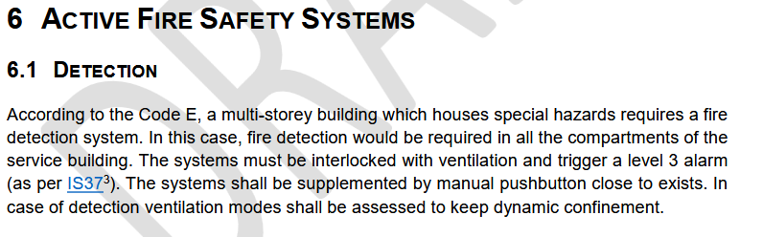
Fire detection & Evacuation
Underground:
Strategy is to keep the existing system in place until 2030 . The installation of a new system is scheduled in 2029 with 2028 dedicated to detail design.
Surface:
  New BB85
  Estimate is 70kCHF including cables
The order of magnitude of 750kCHF in addition to the NA-CONS budget seems correct.

Slide 11
Fire detection & Evacuation
NA-CONS budget dedicated to ECN3 fire detection and evacuation systems was initially estimated as follows:
Some of the equipment has already been manufactured and paid and therefore we need to find the best strategy to optimize costs due to the HI-ECN3 installation delay.

Slide 12
Gas detection system
TBD

