Slide 1
New 3D printed components to assess heat transfer of the SRA
Procurement ongoing (meeting with EOS on 18/03/25)

Slide 2
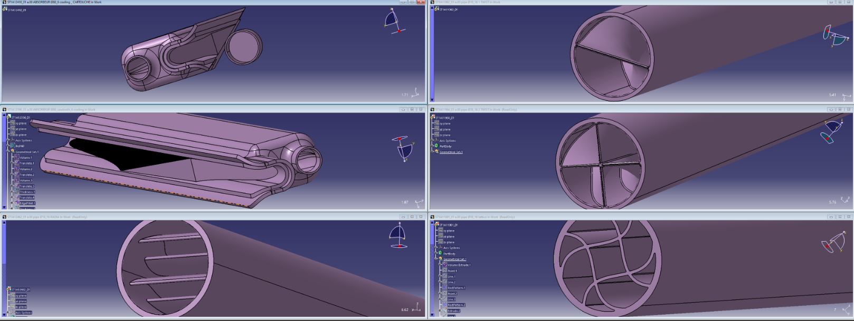

Slide 3
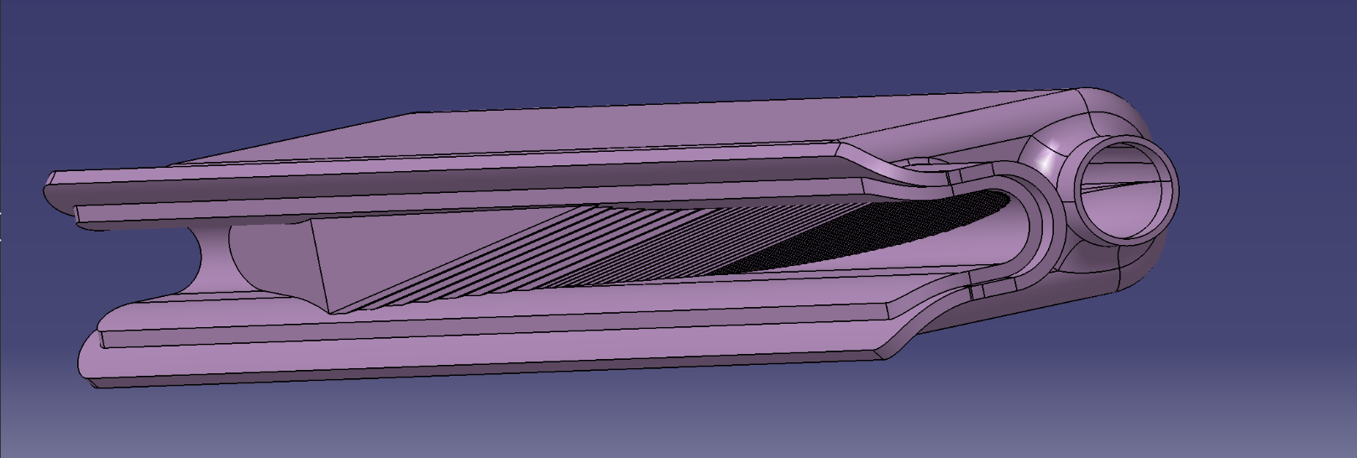

Slide 4
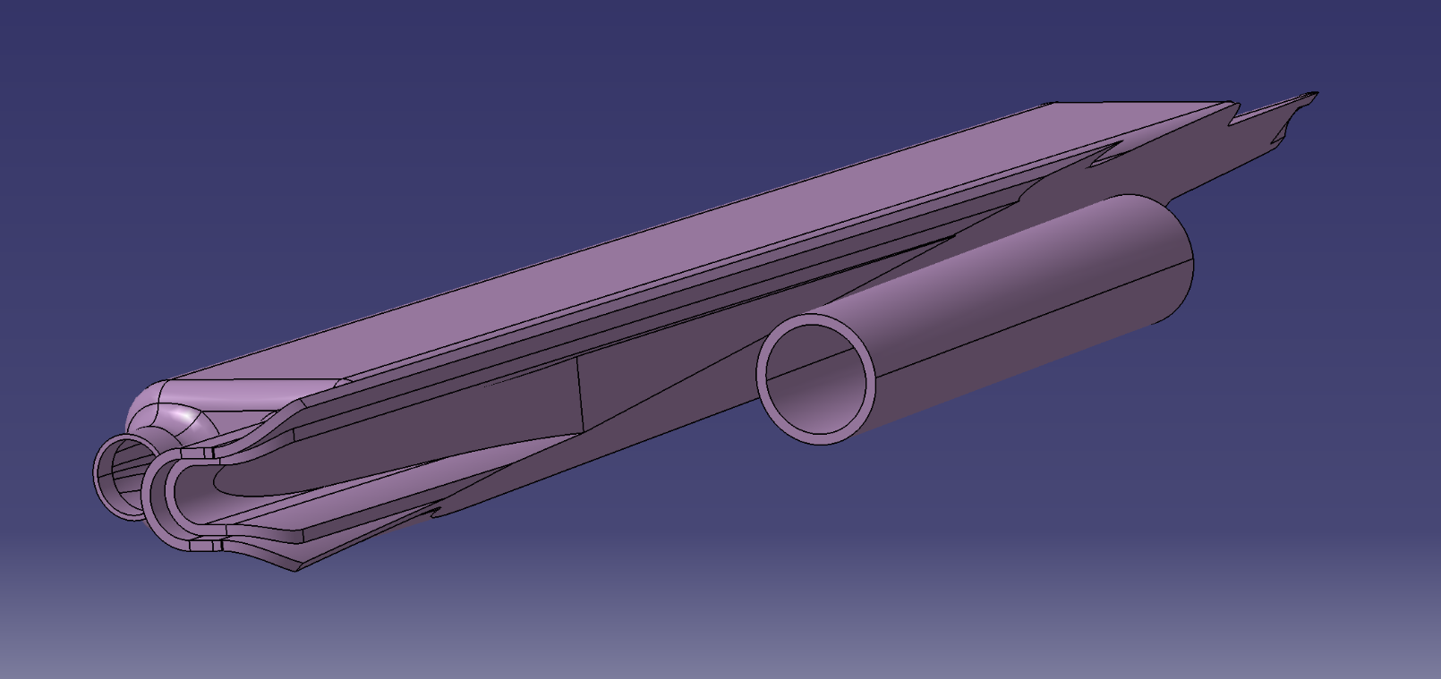
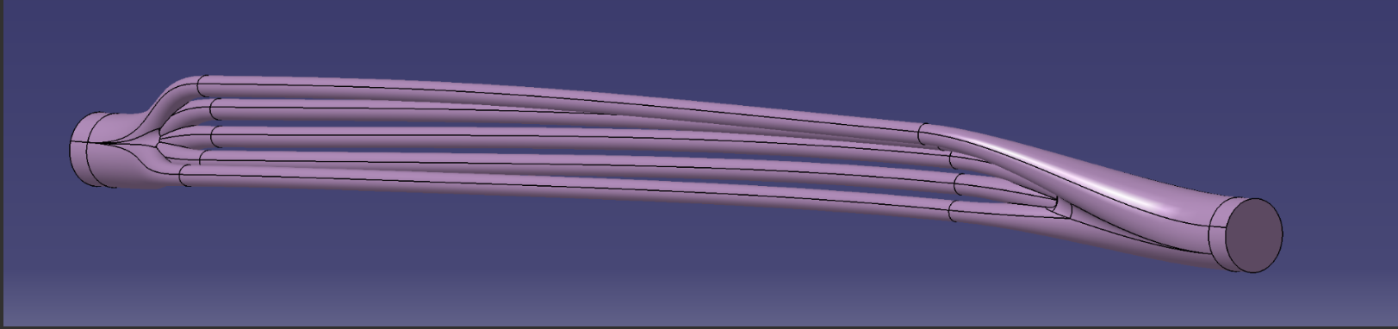

Slide 5
Extra

Slide 6
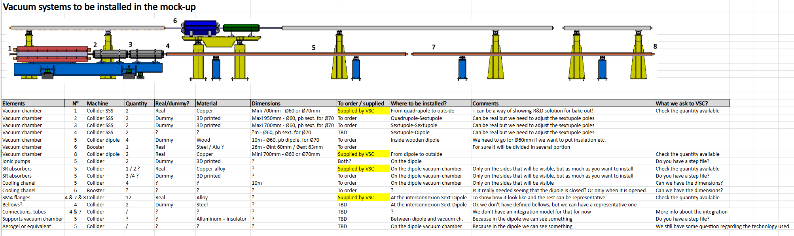
Half arc cell mock-up. Vacuum contribution

