Slide 1
RADiCAL Meeting - 21.Mar.2025
Update - Funding and Support:
  DOE Comparative Review: DOE-FOA-0003177
    Proposal submitted to DOE - by Randy - would support Caltech, Coe, Iowa, Notre Dame, Virginia
    DOE review completion still a number of weeks away due to Government funding issues
  DOE EPSCoR : DOE-FOA-0003444
    Proposal submitted to DOE - by James - would support Coe, Iowa
  DOE funding opportunity related to FCC-ee issues (not detector R&D)
    Submitted - by James - in November 2024
    Status unknown
Recent and Upcoming Meetings of Interest:
  DRD6 Spring Meeting: 2-4 April in Orsay, France. Registration available and agenda.
    https://indico.ijclab.in2p3.fr/event/11400/overview
    No registration fee for those attending remotely.
    There is no specific RADiCAL presentation planned for that meeting.
  DRD6 Autumn Meeting: Week on 15 September in Ancona, Italy. No details as yet.
    A RADiCAL presentation would be planned for this meeting.
  IEEE NSS/MIC 2025: 1-8 November, Yokohama, Japan, https://nssmic.ieee.org/2025/. No details yet on Abstract/Summary submission.
Topics of Group Interest
  Summer Test Beam Planning. RADiCAL currently in September. Week 37, In T6.
  When are other groups planning to test?
  Status and planning for analysis for RADiCAL, October 2024 Data Run

Slide 2
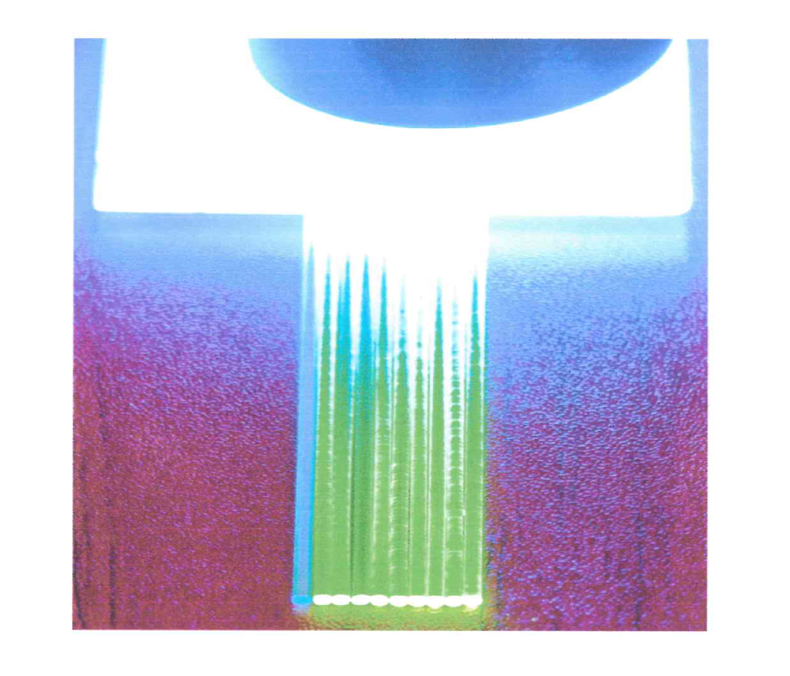
For reference. LuAG:Ce filaments were remade by SICCAS.
LuAG:Ce single ceramic filaments grown to preplace previously made and defective filaments.
In figure at right, defective filament at the left, new filaments on the right.
LYSO:Ce plate excited by 365nm UV light. The ~420nm LYSO:Ce emission excites the LuAG:Ce which emit at ~510nm.
Thanks to Renyuan and Liyuan for assistance with SICCAS. More such help will likely be needed in the future.

Slide 3
Meeting Notes/Comments
RADiCAL CALOR2024 paper now published online (7.Mar.2025). PDF is attached to this agenda. Lead author: R-Y Zhu.
Iowa/Coe have obtained a second DRS module. So including the unit and interface at Virginia, we can now readout the channels in the existing 5 capillary modules, but not moving up to 9 capillaries. This is good news for what we have in hand and the possibility of testing LuO:Yb in the current modular structure.
Test beam schedule for RADiCAL attached to this agenda.
To readout the LuO:Yb, we need flavonol-filled WLS capillary tubes.
Analysis updates…

Slide 4
Meeting Notes/Comments
Discussion points from the meeting:

