Slide 1
Projects of Interest to Discover the Cosmos
ATLAS Outreach & Education
S. Goldfarb – Launch Meeting of Discover The Cosmos – 1 Sep 2011

Slide 2
ATLAS Outreach Goals
Public Appreciation of the Scientific Goals and Achievements of ATLAS and HEP
  Targets: Members of Media, General Public
Sustained Support for ATLAS, the LHC and Particle Physics Research
  Targets: Decision Makers and Opinion Formers from Member States, Members of Industry
Attract and Retain the Next Generation of Scientists and Science Educators
  Targets: Teachers and Students

Slide 3
Projects of Interest to Cosmos
News and Educational Material on atlas.ch

Slide 4
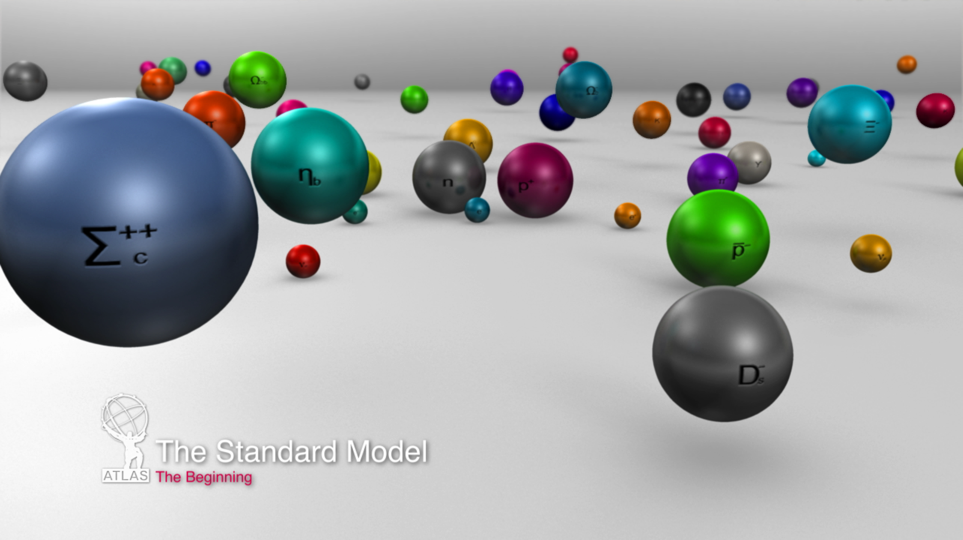
Projects of Interest to Cosmos
Educational Multimedia Material on atlas.ch
  Example: Standard Model Animation

Slide 5
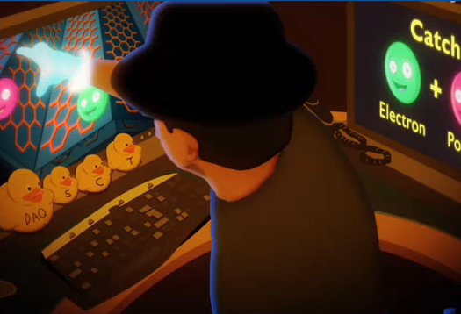
Projects of Interest to Cosmos
Educational Multimedia Material on atlas.ch
  Example: ATLAS Boogie Music Video

Slide 6
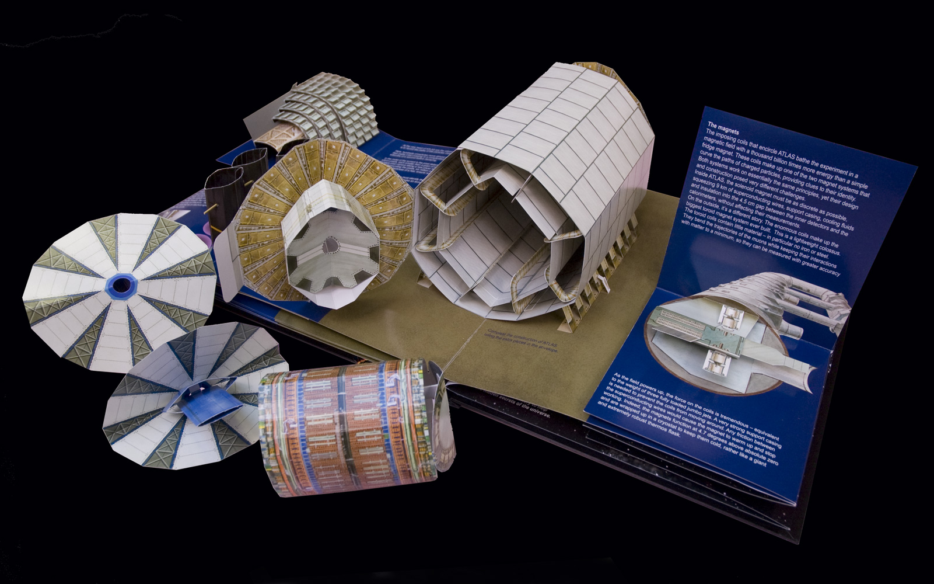
Projects of Interest to Cosmos
Educational Material in Print
  Example: ATLAS Pop-Up Book

Slide 7
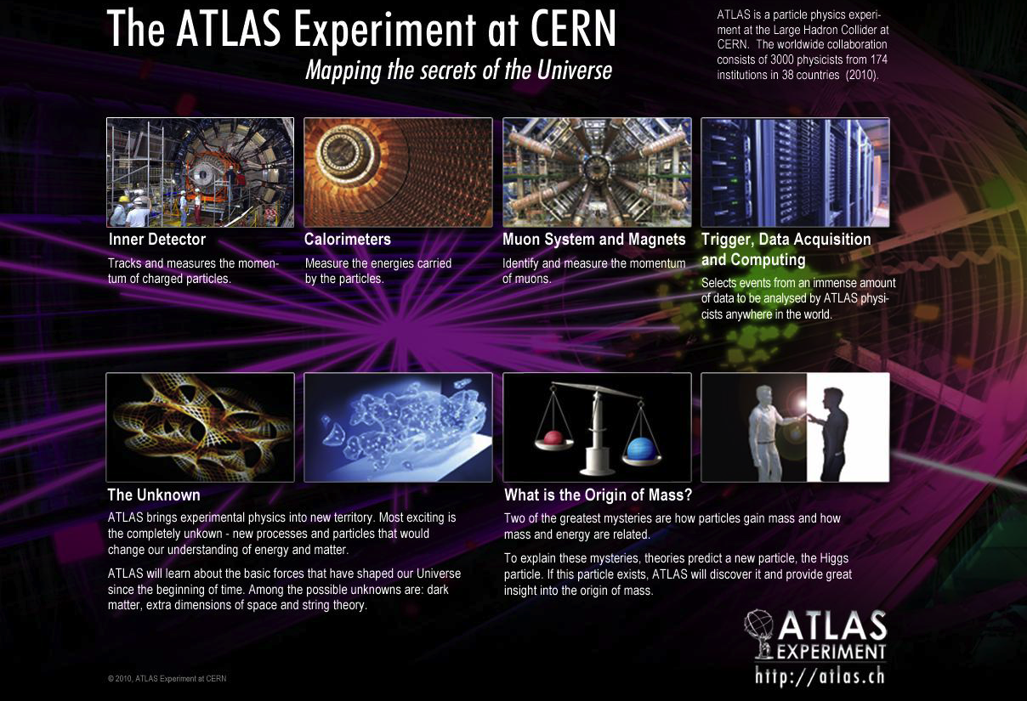
Projects of Interest to Cosmos
Educational Material in Print
  Example: ATLAS Travel Exhibit Kit

Slide 8
Projects of Interest to Cosmos
ATLAS Live Outreach Channel

Slide 9
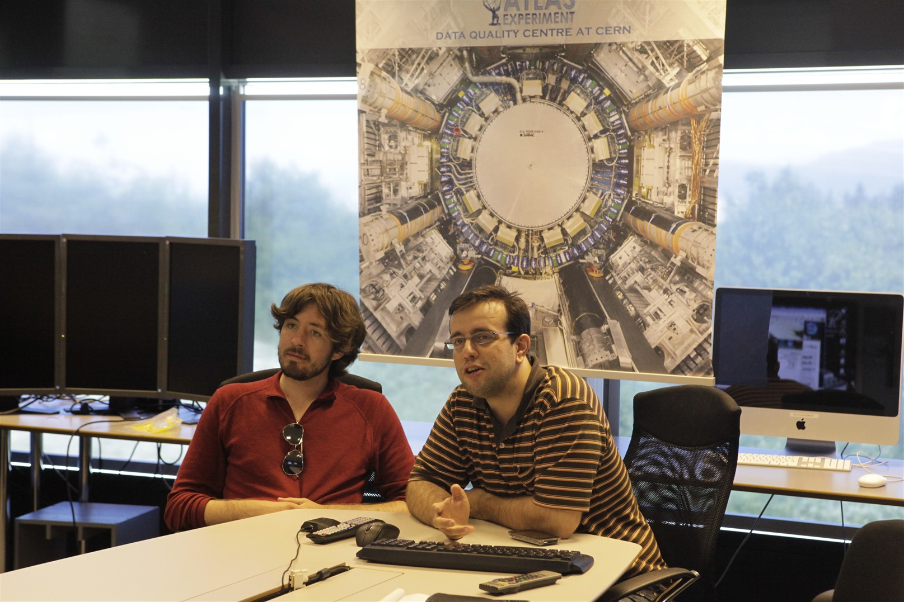
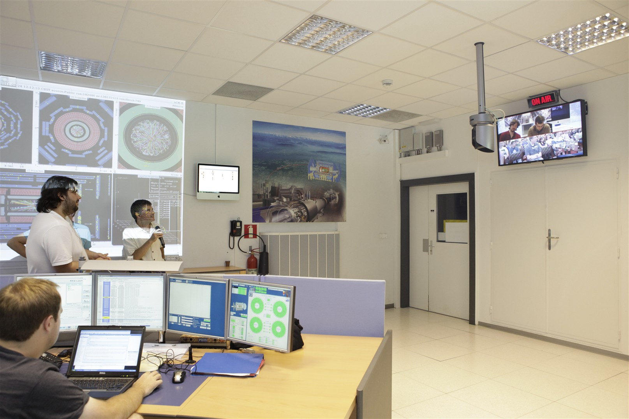
Projects of Interest to Cosmos
ATLAS Virtual Visits
  Connecting ATLAS to…

Slide 10
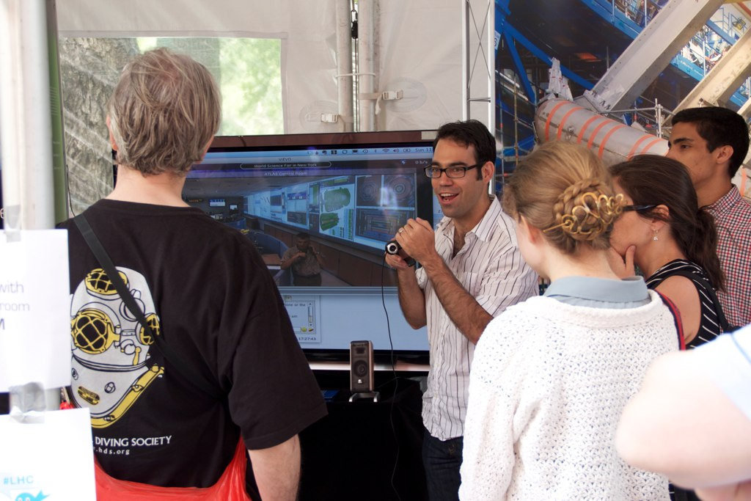
Projects of Interest to Cosmos
ATLAS Virtual Visits
  Example: World Science Fair, New York City

Slide 11
Projects of Interest to Cosmos
ATLAS Virtual Visits
  Example: Marshfield High School, Coos Bay, Oregon

Slide 12
Projects of Interest to Cosmos
ATLAS Virtual Visits
“My students … were excited … because they talked to scientists on the other side of the world. They also asked questions about dark matter (triggered by Steve question). So, overall we kindle interest in science and this is really positive! Plus, they talk and joke about particles, this means they know what they are talking about.”
Christina (Teacher from William Floyd High School)
“Thanks Steve. It is a very neat opportunity for our students. I appreciate you providing the window. Jon is a talented teacher with very high expectations for his students. I think he had fun as well.”
Jeff Eberwein (Teacher from Marshfield High School)

Slide 13
ATLAS Outreach Participation
ATLAS Outreach is looking forward to actively participating in the Discover The Cosmos Project
Please let us know how we can help!

