Slide 1

Outreach activities → COSMOS
COSMOS (UoB) team
Lynne Long, Peter Watkins, John Wilson.
COSMOS Kickoff meeting, CERN; 1-2 Sept 2011; John Wilson

Slide 2
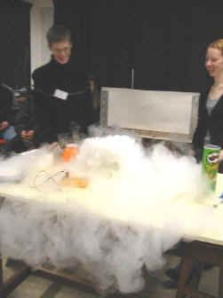
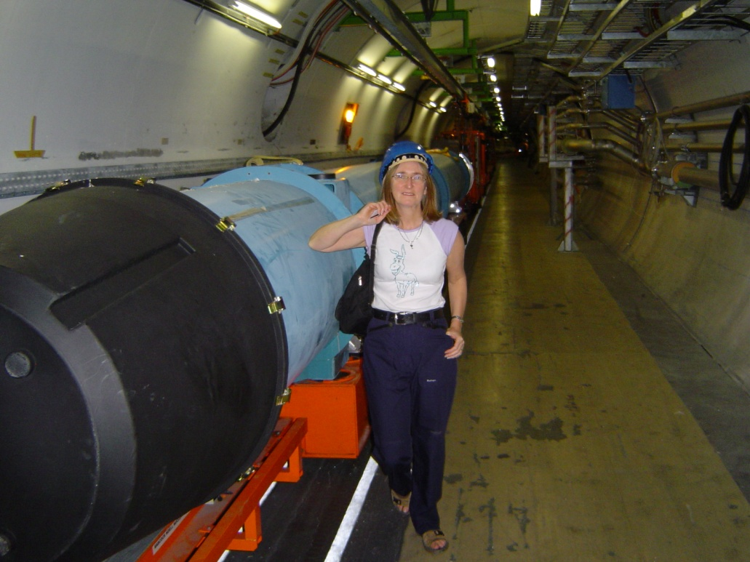
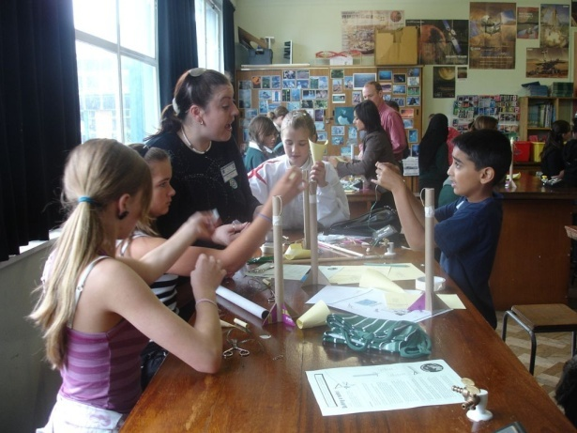
Good contact with teachers and schools
School’s Liaison Officer – Lynne Long
~50% of time on outreach
Coordinator till 2010 of IOP West Midlands Teacher Network (close connections still, local and UK wide)
Established final year undergraduate module “Teaching in Schools”: 15 students/yr
→ good insight into schools + opportunities to test
scenarios.

Slide 3
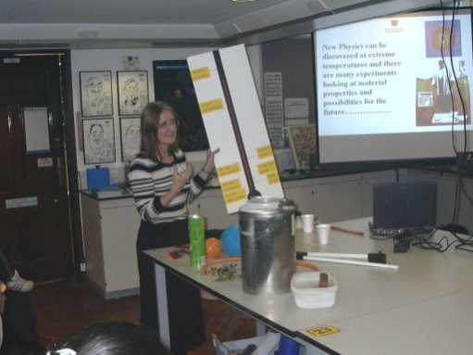
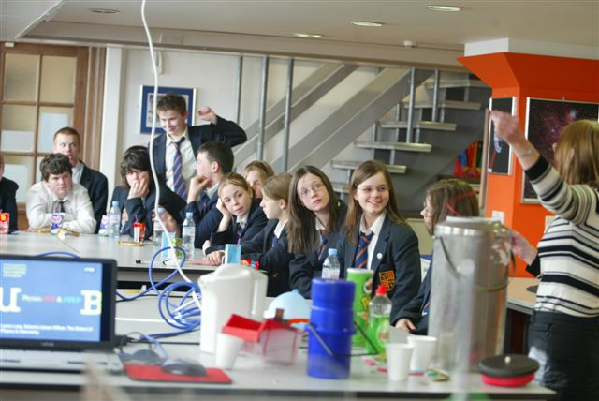
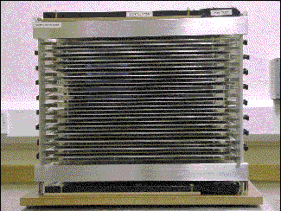
Going out to Schools
40-50 Demos/talks in schools (ages 11-18) – visits all over UK, usually with liquid nitrogen! (Lynne Long).
20-30 Spark Chamber demos to schools (mainly) in the Midlands (John Wilson).
New project: cosmic ray telescopes (scintillators+QuarkNet); loan to schools;
“hands on” experience + analysis for
students and teachers.
20-30 specialist talks (particle, astro, nuclear, superconductivity, nanophysics, etc.).
In total ~100 Talks and Demos in Schools around the UK each year.

Slide 4
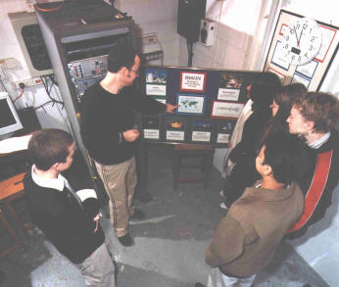
Masterclasses
PP masterclasses for yr12 students
  ~150 students – 1 day
  ~30 students for starter – ½ day.
  ► Development of MINERVA
  (Mark Stockton won UK IOP-HEPP Science in Society Prize)
  ► Link to CERN (ATLAS + panel of experts)
  ► Talks by postgrads; all PP group involved;
  demonstrations of PP detectors.
Astrophysics masterclasses for yr12 students
  1 or 2 half days per year
  30-40 students each event

Slide 5
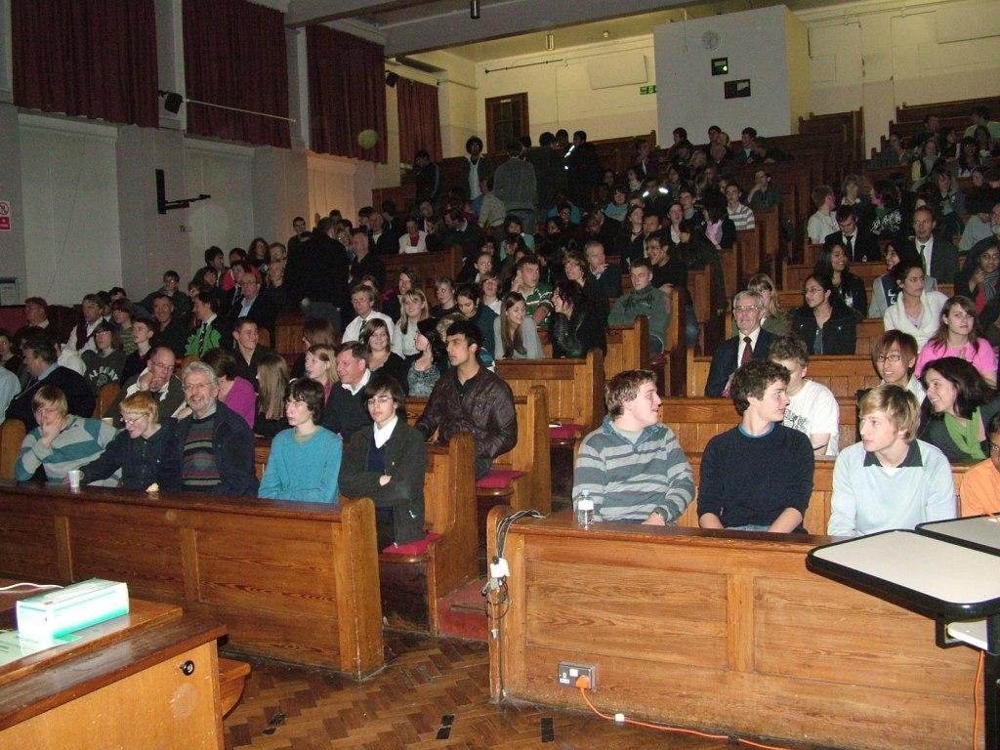
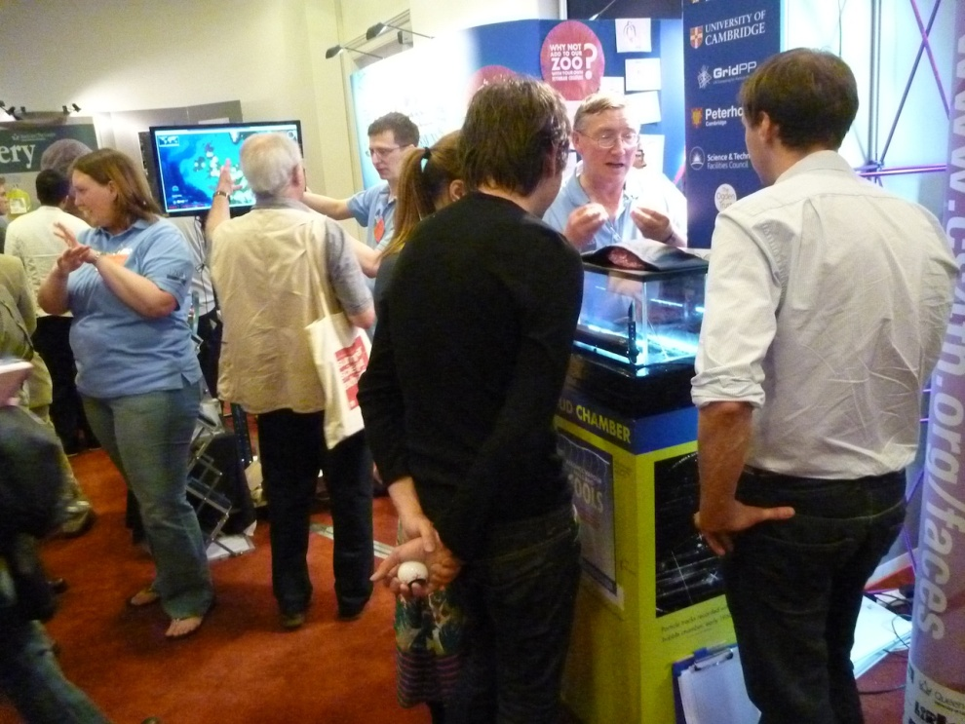
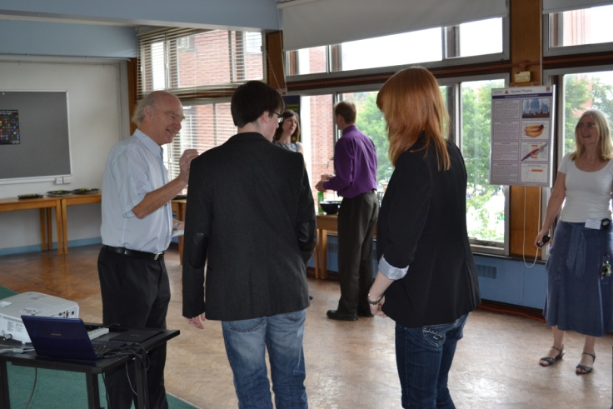
Talks, Exhibitions and Competitions
IOP evening lectures – mainly students and teachers but public also attends.
British Association Science Festival – Birmingham, Sept 2010
Royal Society Summer Science Exhibition – London, July, 2011, with Univ. of Cambridge.
Cascade (Pete Watkins) Yr12/13: PP undergrad talks + website → 3 min video on PP/Astro topic
  Finalist day; top prize is a trip to CERN.

Slide 6
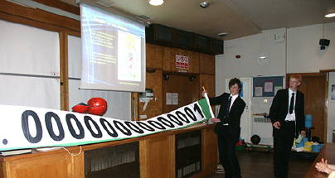
Summary of Outreach
Physics Liaison Officer drives our outreach programme
Outreach both outside and within the department
Audience ranges from Yr7 (11/12yrs) to Yr13(18yrs) + teachers/technicians
Focus of outreach is to get more good students applying to B’ham; less focus on general public.
Outreach activities reach ~ 4000 students/teachers per year.

Slide 7
Learn with ATLAS @CERN
(Lynne and Pete + B’ham undergrads and postgrads)
Prelim meetings with teachers
►curricula
►possible directions
Developed/tested web based scenarios
► schools (yrs 10-13)
►undergrads
Events on campus and in schools for feedback
Wrote up results in Physics Education

Slide 8
Leading to UoB in COSMOS:
Experience in devising new ways of communicating PP with students, teachers and public → WP2, WP3.
Implementation of PP techniques (MINERVA); use in undergrad labs and in schools → WP3, WP4.
Wide, long-standing contacts with schools
→ WP4, WP5.

