Slide 1

Beam Screen Treatment project
ICL meeting – 02/04/2025
V. Petit, G. Rosaz, M. Charrondiere – TE/VSC
On behalf of the BST project team

Slide 2
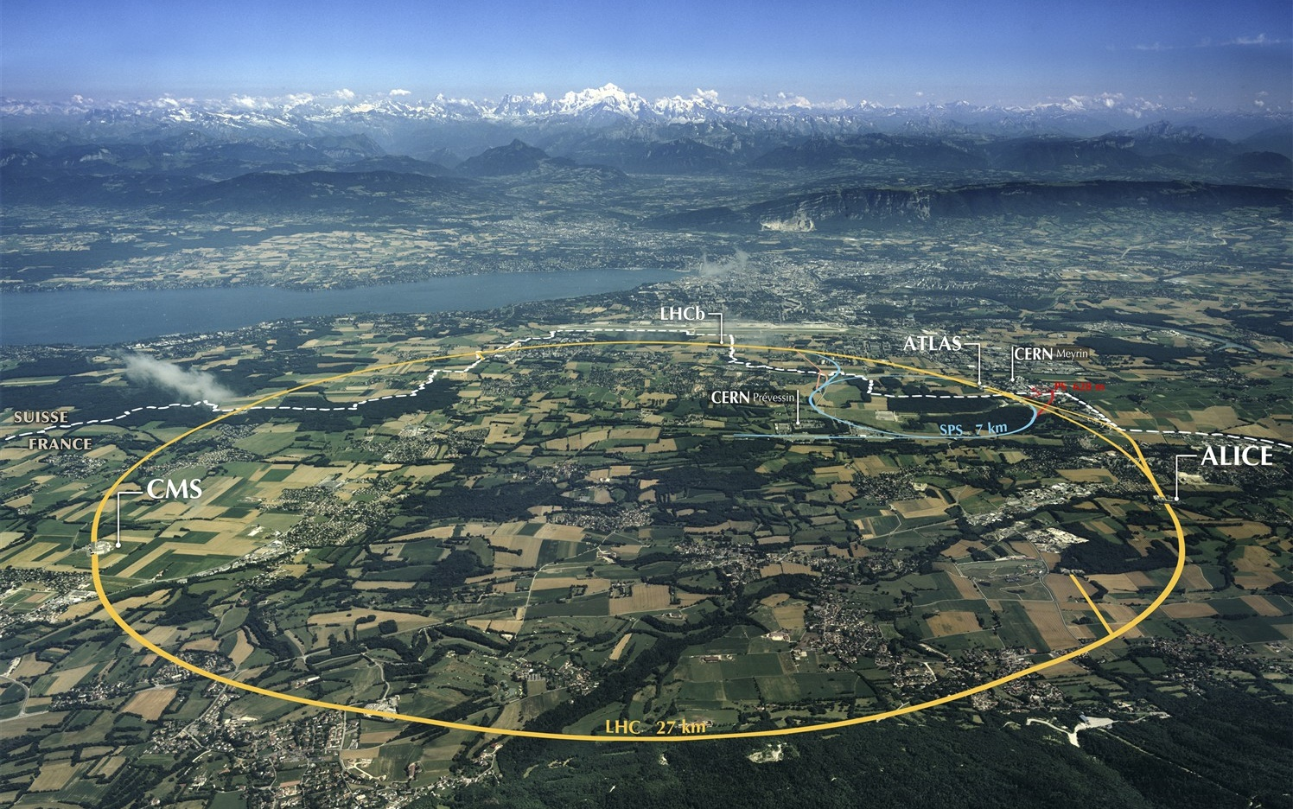
Beam Screen Treatment in the LHC arcs
Issue
Electron cloud-induced heat load on beam screens will overcome the limit of the cooling capacity in some LHC arcs for HL-LHC
Mitigation strategy
Deposit a thin amorphous carbon layer on selected arc beam screens
→ recover proper scrubbing efficiency of the beam screens
→ recover cooling margin
→ in-situ coating of about 12 km of LHC beam screens, by sections of 53 m (half-cell between 2 QQBIs ICs)
In. Triplets IP2/8
In-situ
190 m total
In. Triplets IP1/5
Ex-situ
320 m total
Matching sections
Ex-situ, in magnet
20 m total
Arcs
In-situ
≈ 12 km total
BST

Slide 3
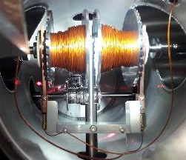
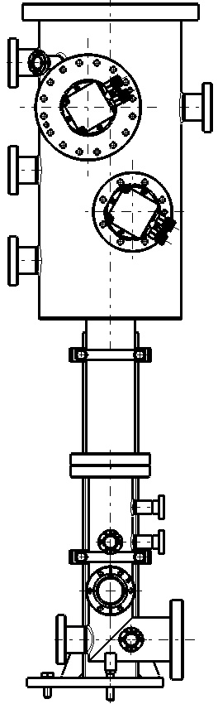
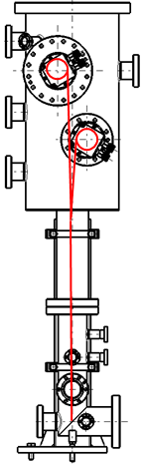
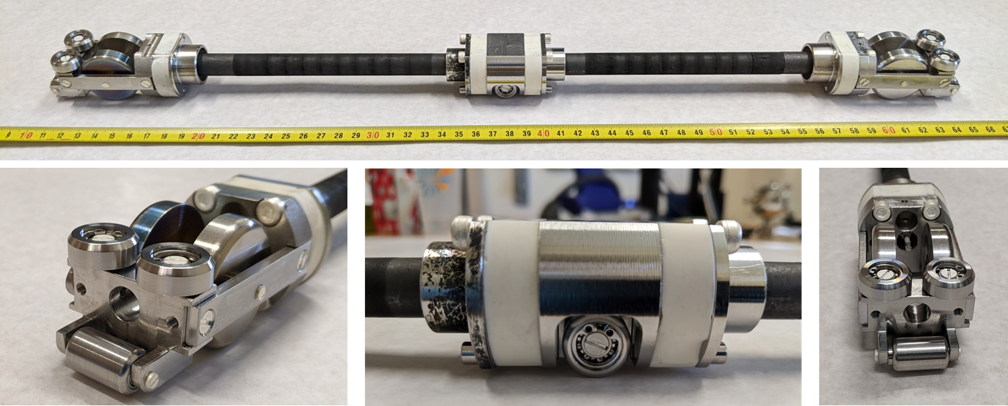
Coating system - principle
PIM
PIM
PIM + BPM
Dipole
Dipole
Dipole
Quadrupole
System developed for Q5L8 (LS2) and HL-LHC beam screen coating:
Coating train: graphite target on wheels
Plasma powering: electrical cables
Train displacement: mechanical pulling and braking cables
→ In-vacuum spool system with automated rolling/unrolling by external motors

Slide 4
Coating system - principle
PIM
PIM
PIM + BPM
Dipole
Dipole
Dipole
Quadrupole
System developed for Q5L8 (LS2) and HL-LHC beam screen coating:
Coating train: graphite target on wheels
Plasma powering: electrical cables
Train displacement: mechanical pulling and braking cables
→ In-vacuum spool system with automated rolling/unrolling by external motors

Slide 5
Coating system - principle
PIM
PIM
PIM + BPM
Dipole
Dipole
Dipole
Quadrupole
System developed for Q5L8 (LS2) and HL-LHC beam screen coating:
Coating train: graphite target on wheels
Plasma powering: electrical cables
Train displacement: mechanical pulling and braking cables
→ In-vacuum spool system with automated rolling/unrolling by external motors

Slide 6
Coating system - principle
PIM
PIM
PIM + BPM
Dipole
Dipole
Dipole
Quadrupole
System developed for Q5L8 (LS2) and HL-LHC beam screen coating:
Coating train: graphite target on wheels
Plasma powering: electrical cables
Train displacement: mechanical pulling and braking cables
→ In-vacuum spool system with automated rolling/unrolling by external motors

Slide 7
Intervention scheme
Radmon supports displacement (BE-CEM)
Racks insulation vacuum displacement (TE-VSC)
CV sensor displacement (EN-CV)
BLM Removal (SY-BI)
BPM Testing (SY-BI)
IC W bellow opening (TE-MSC)
PIMs cutting (TE-MSC)
BS treatment (TE-VSC)
BPM testing (SY-BI)
PIMs positioning / rewelding (TE-VSC / EN-MME)
PIMs radiography (EN-MME)
Beam vacuum leak testing (TE-VSC)
Interconnection Inspection
PIM shielding (TE-VSC)
IC W bellow closure (TE-MSC)
Insulation Vacuum leak test (TE-VSC)
BLM re-installation (SY-BI)
Radmon supports reinstallation (BE-CEM)
Racks insulation vacuum reinstallation (TE-VSC)
CV sensor reinstallation (EN-CV)
All identified intervening teams already contacted, on-going build-up of complete workflow and tracking tool
Coordination of activities others than BS treatment at the level of TE department (B. Di Girolamo)

Slide 8
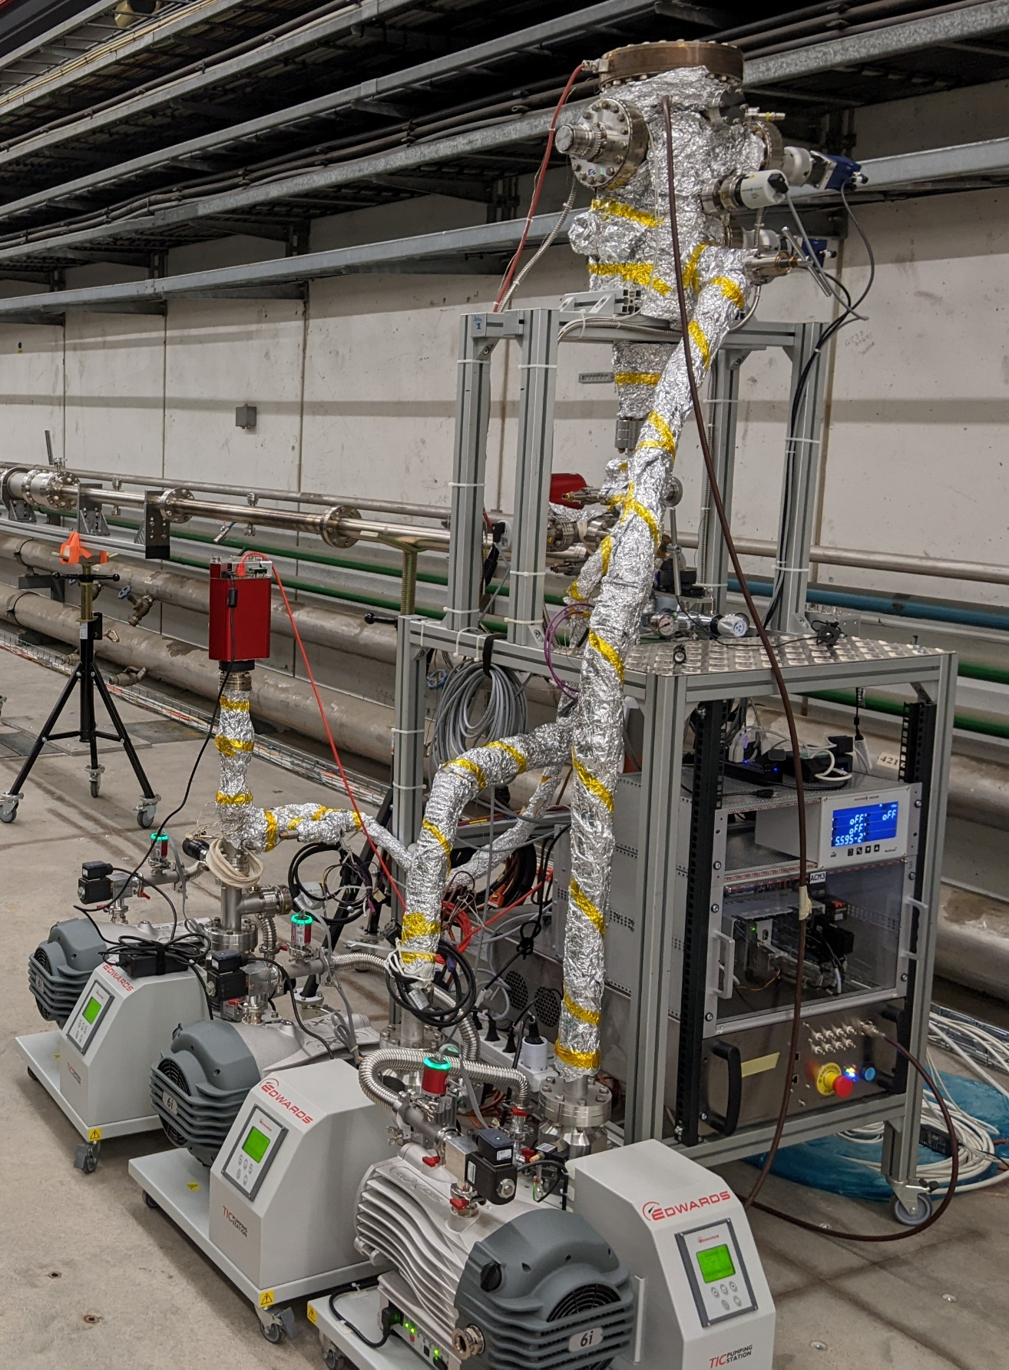
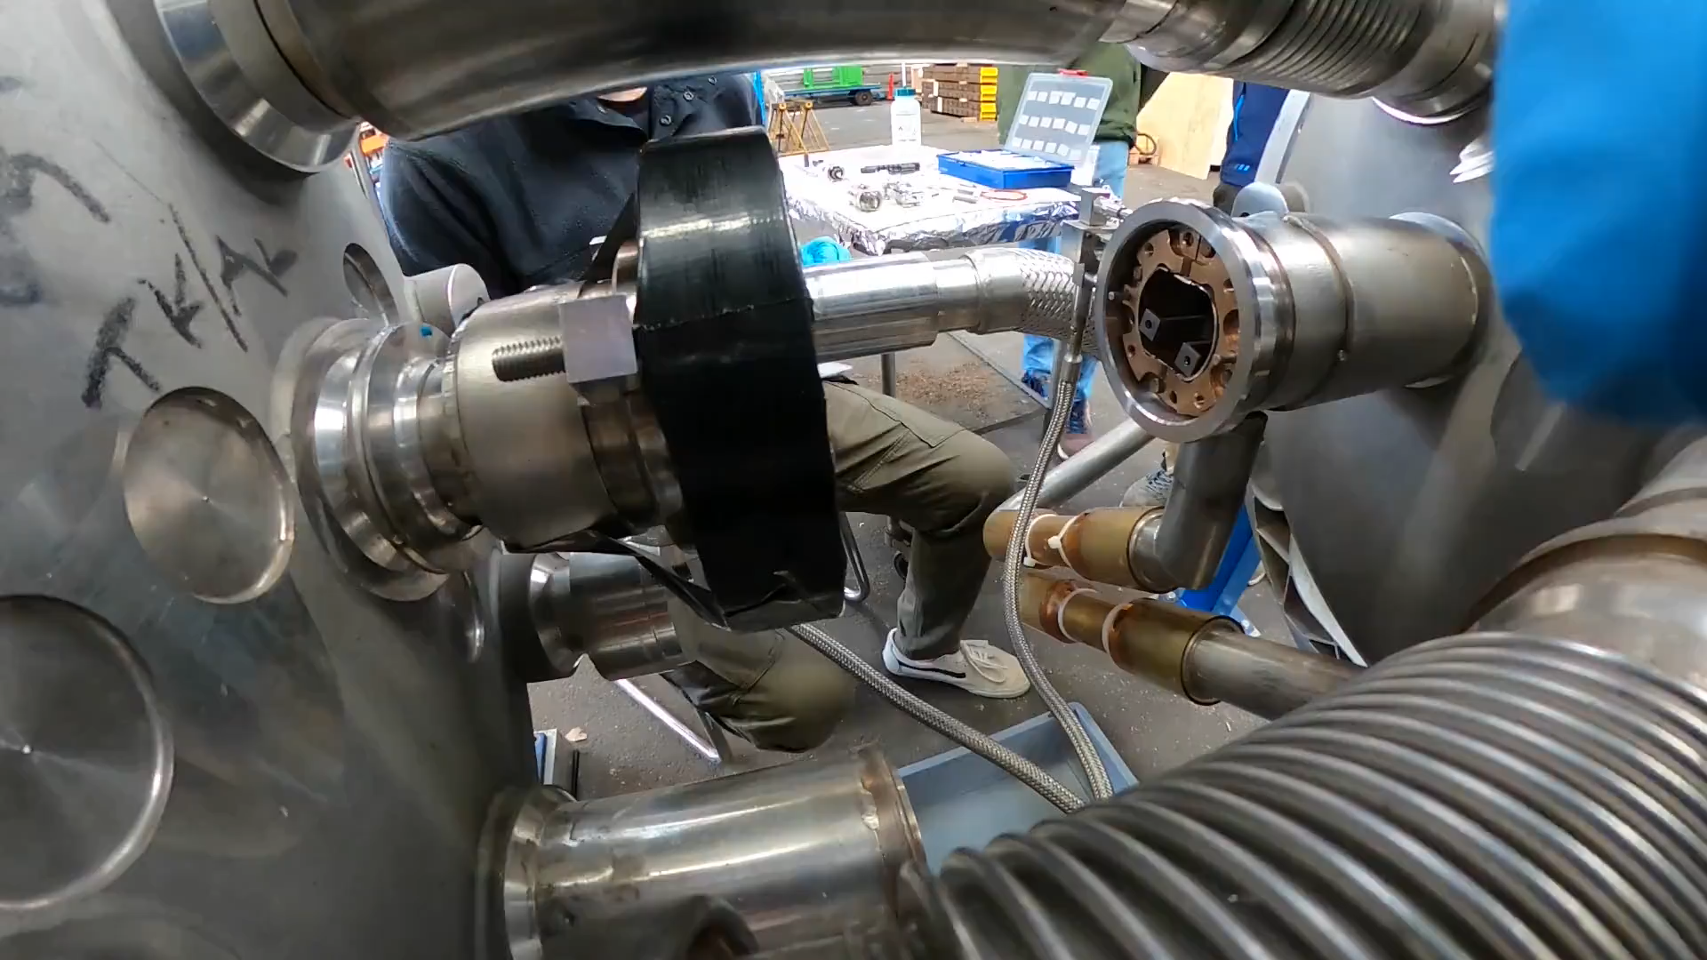
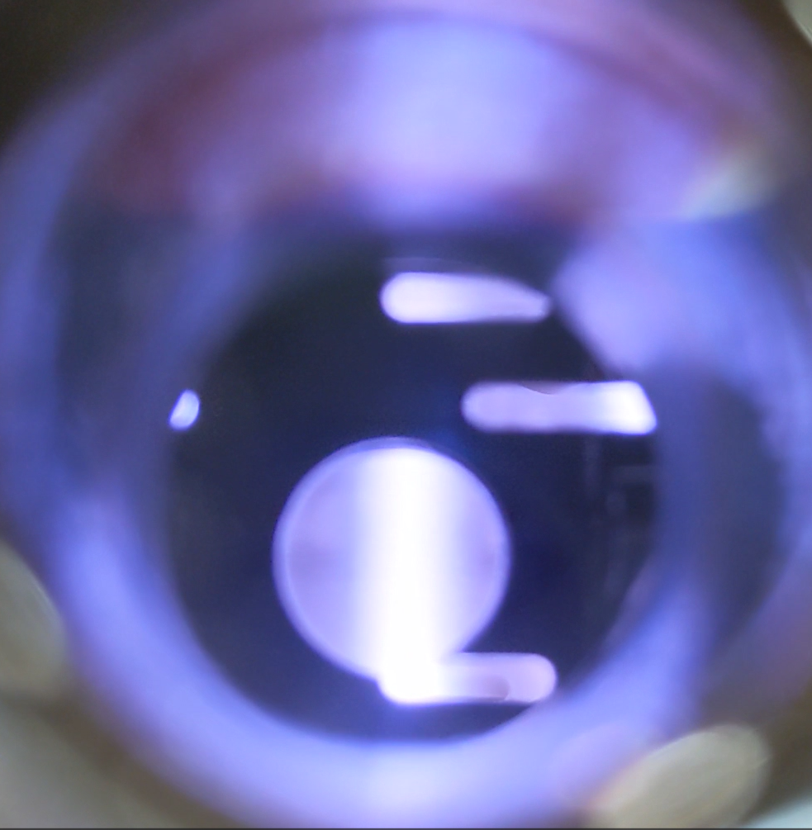
BST installation - sequence
2. Fit the coating system in the interconnection
1. Assemble the coating trains
1/interco
Coating chamber
Residual gas analyzer
Gas injection system
Gauge controller
Motor control for cable spools
3. Coat
Plasma power supplies
4. Disassemble
× 240
Pumping groups

Slide 9
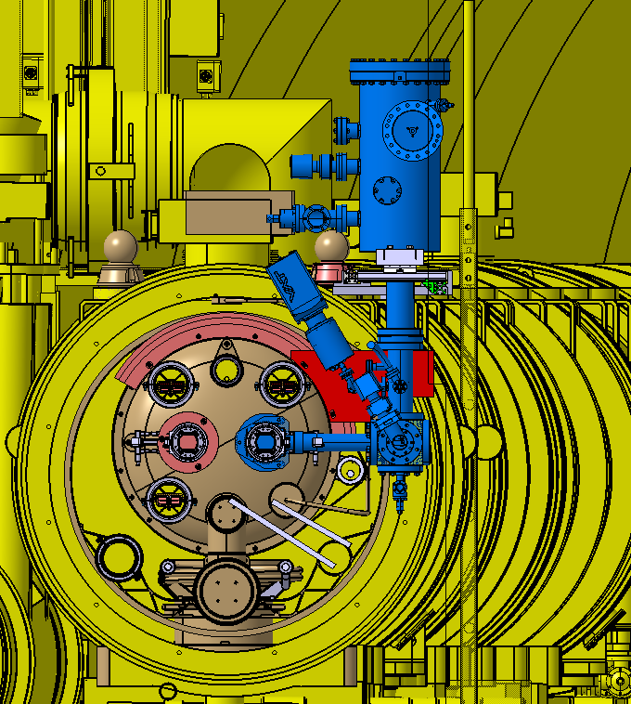
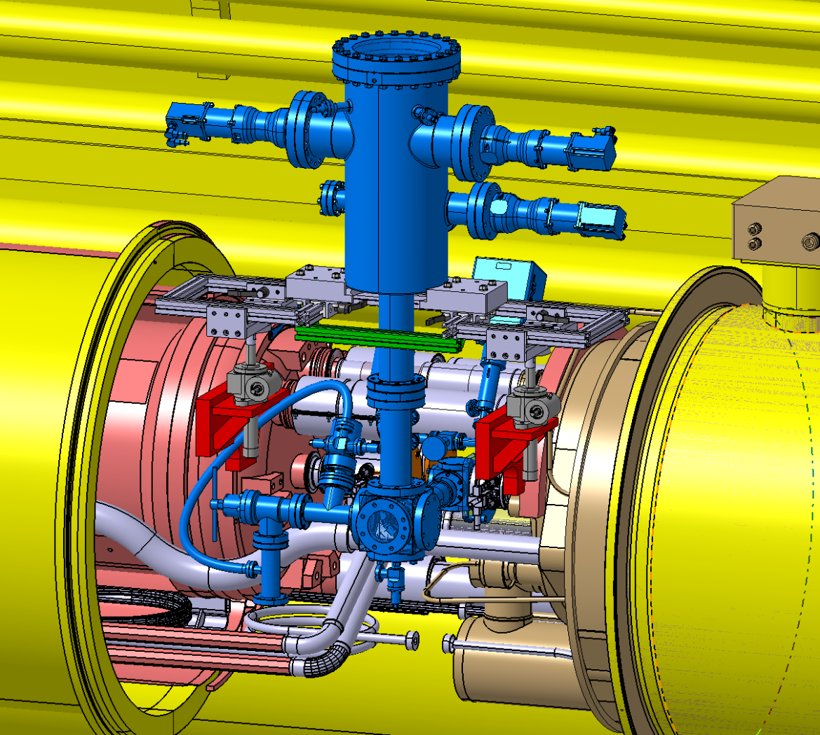
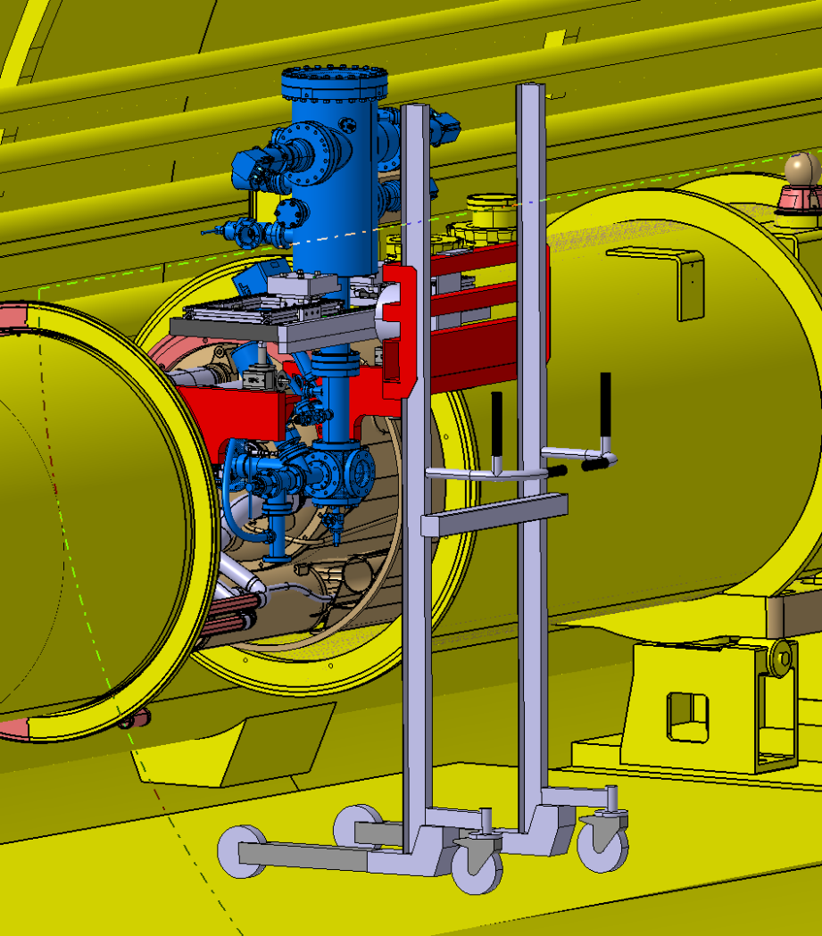
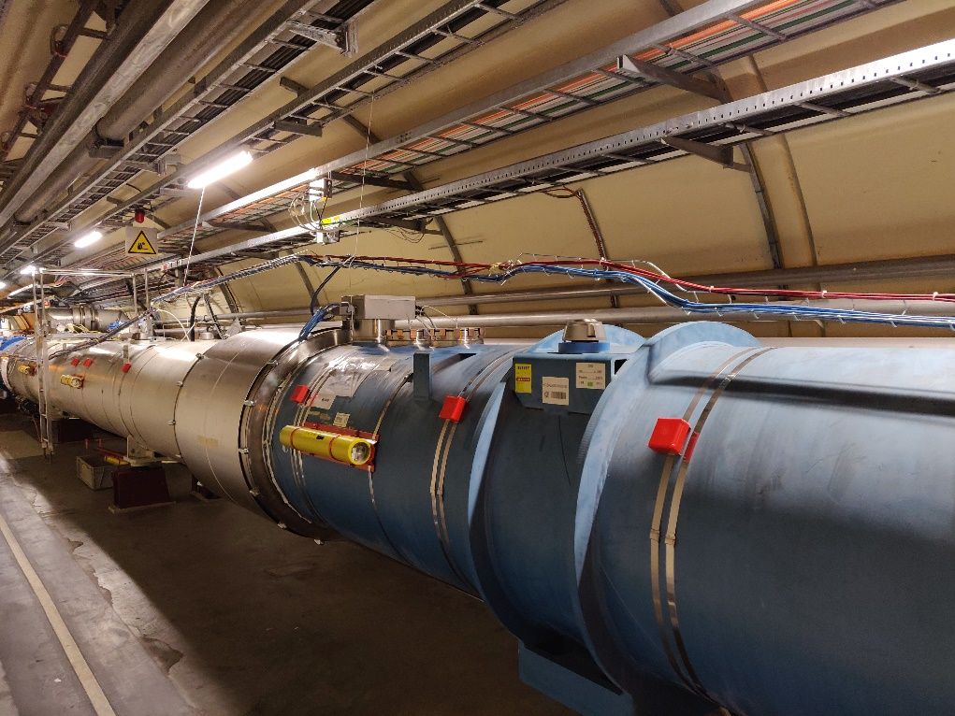
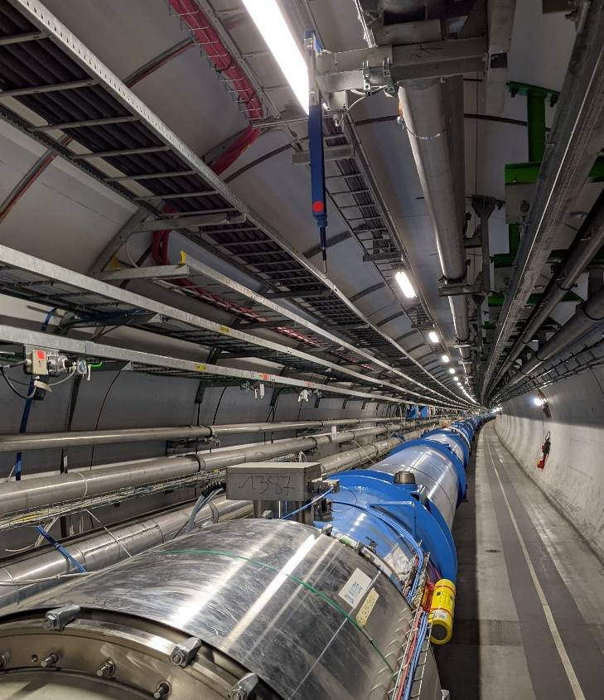
BST installation – coating chamber
Preliminary
Preliminary
Preliminary
G. Girod, EN-MME
On-going integration study
Coating chamber impinges in the transport zone in coating mode
Heavy impact on transport zone during handling of the chamber (lifter, use of monorail…)
Possible interference with cable tray for BLM (position to be defined) and EN-CV sensor (17L3)
Need for 4×10 A sockets/interco and compressed air

Slide 10
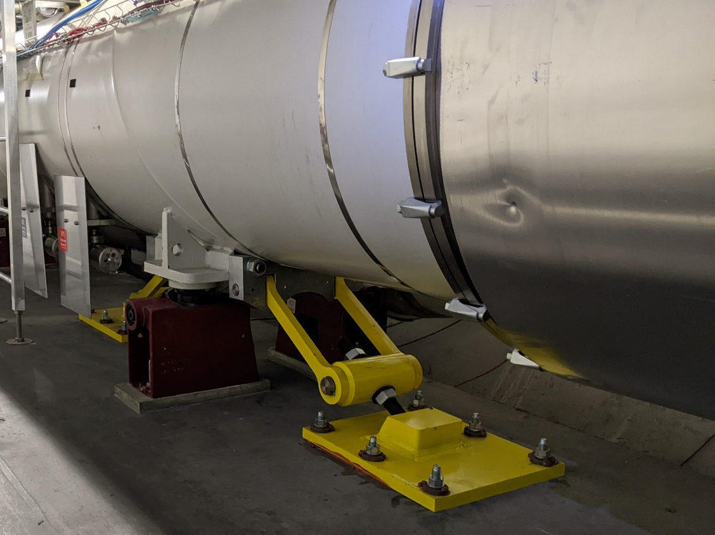
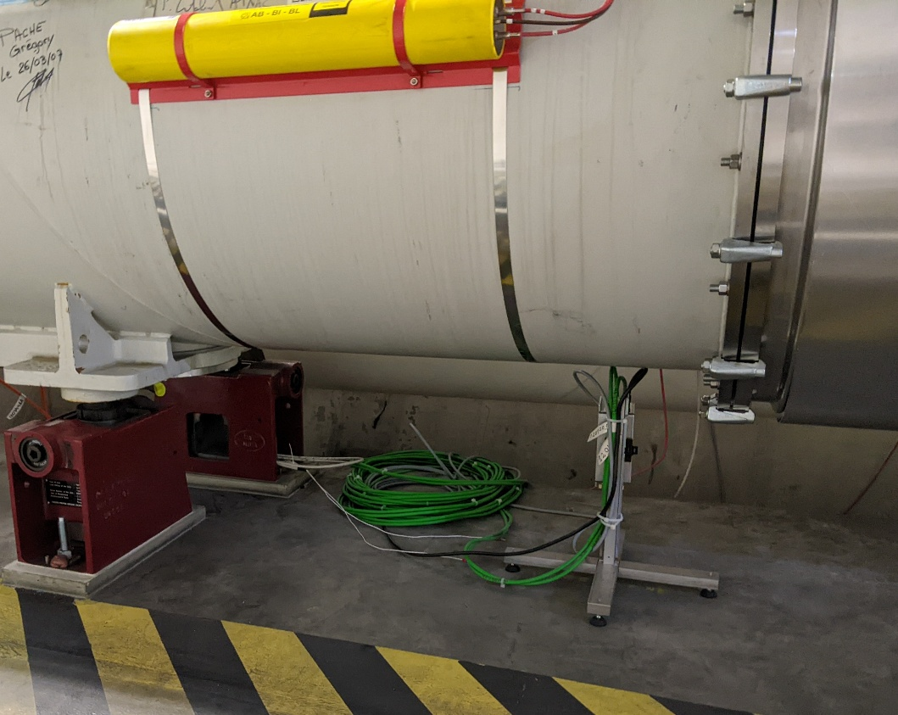
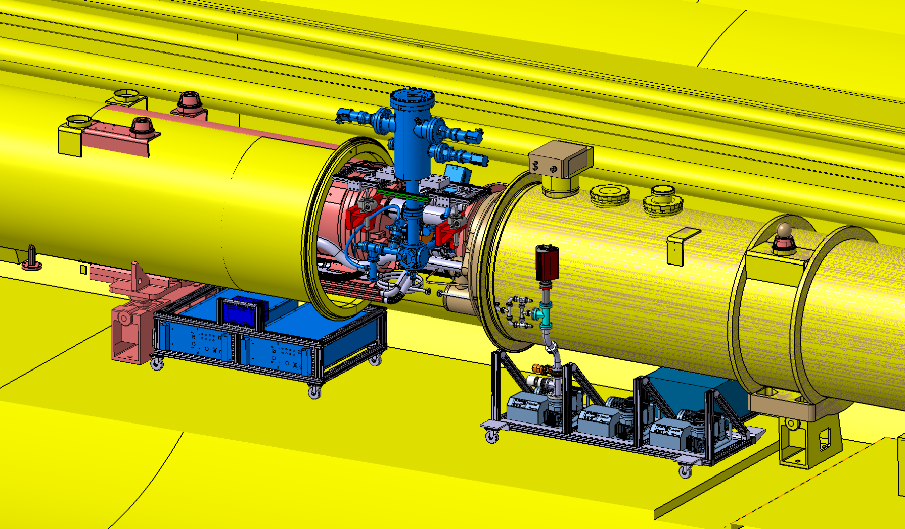
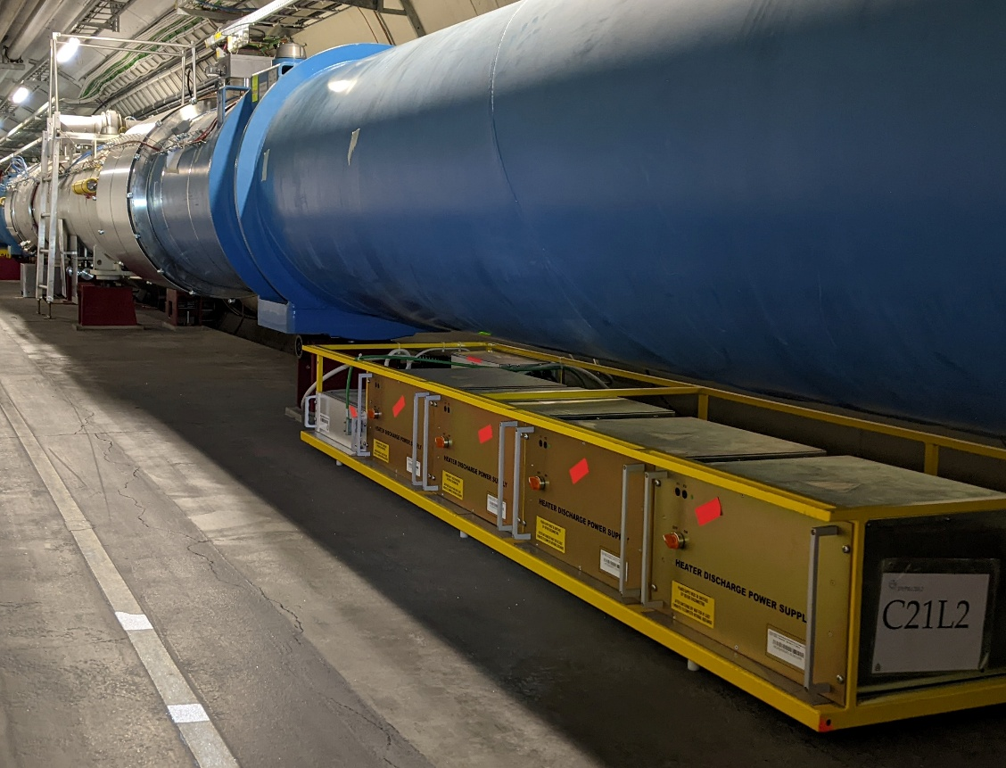
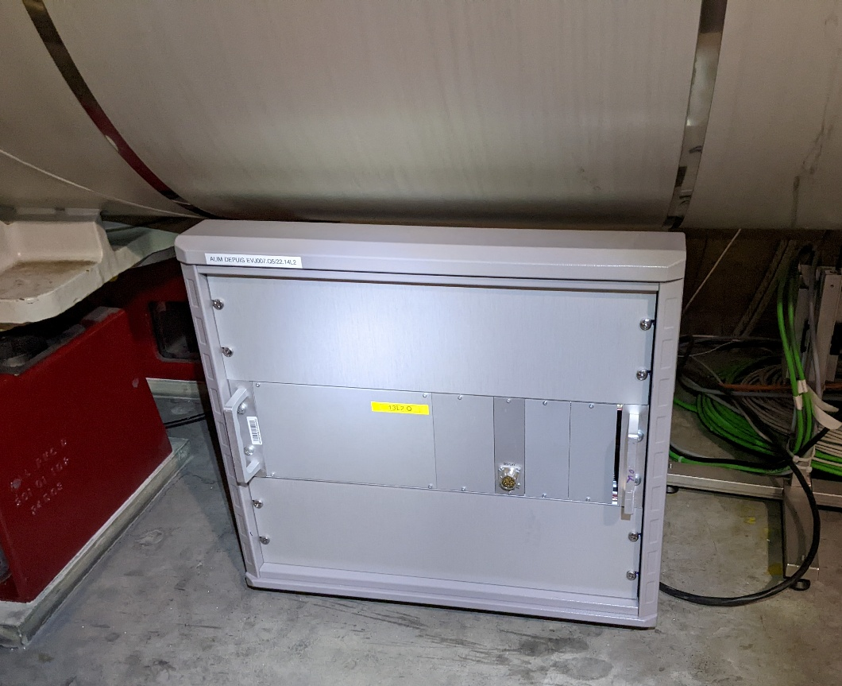
BST installation – auxiliaries
?
OK to move (4 m on the left)
No need to move identified (yet)
OK to move
Preliminary
G. Girod, EN-MME
Use the space under the cryostat to install the pumping groups, power supplies…
Visit in LHC tunnel: identification of equipment located around QQBIs, contacted owners for checking the possibility to displace
More precise need to be defined with integration study
Complete visit of interconnections to be opened during TS?/YETS

Slide 11
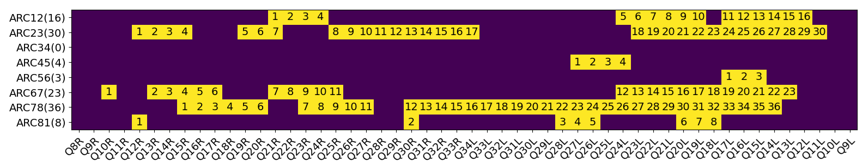
Selection of half-cells to be coated
B. Bradu, TE-CRG
Selection by Beam-Induced Heat Load Task Force of 120 half-cells to be treated (see B. Bradu's talk at Chamonix)
Equilibrate cryogenic margins along the machine
Consecutive half-cells (minimize number of interconnection openings)
→ intervention in 7 arcs, 140 QQBI interconnections to be opened (see EDMS 3106682)

Slide 12
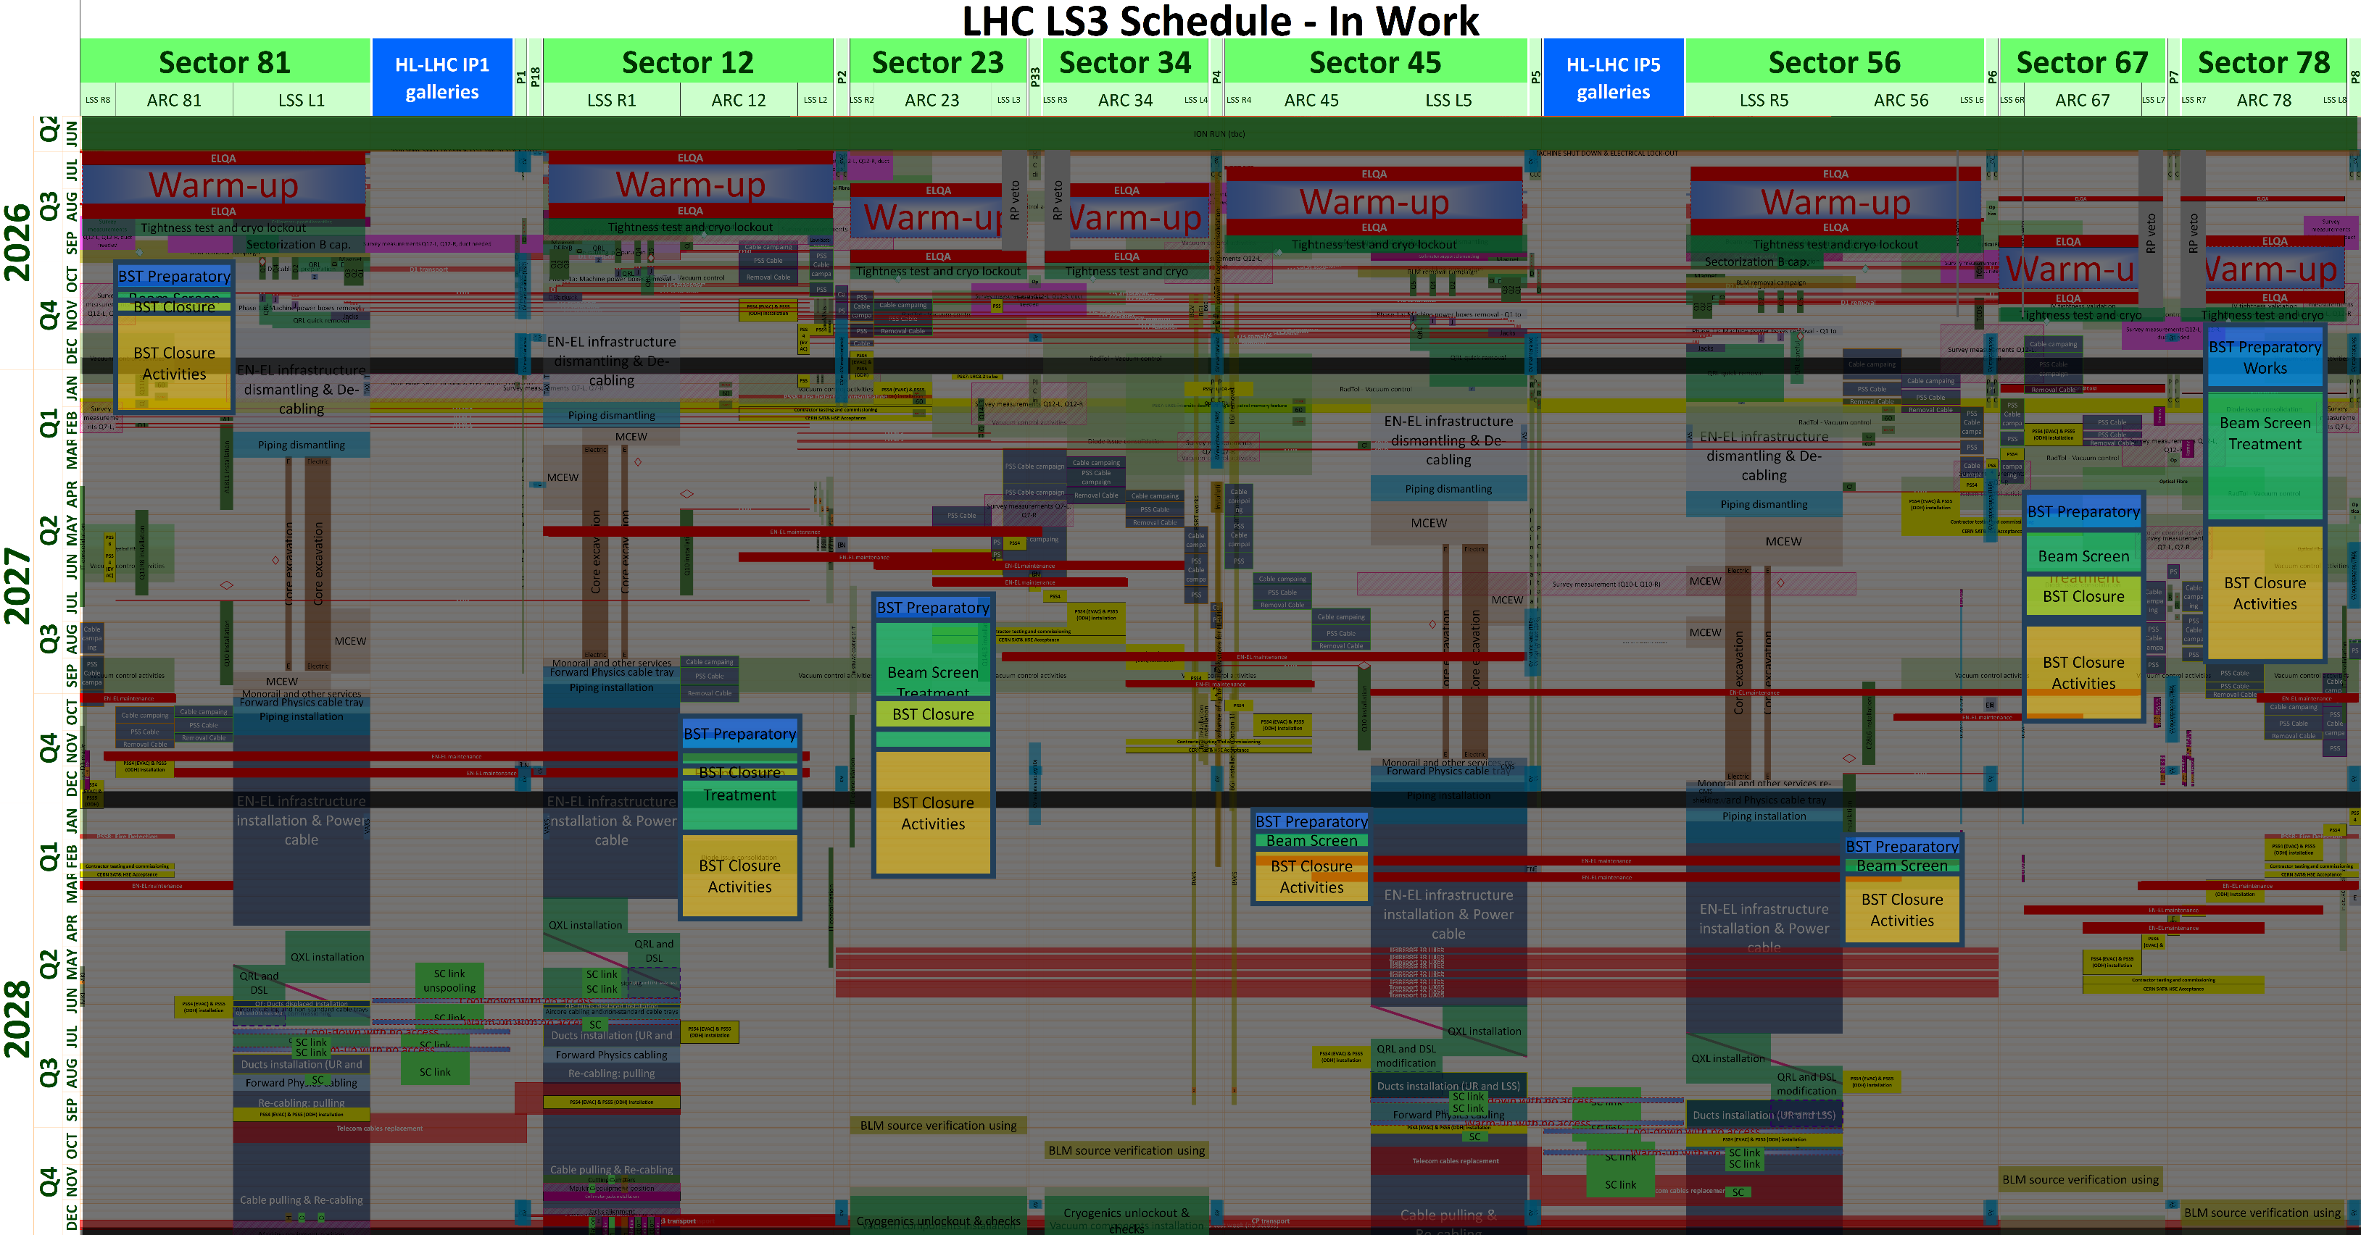
BST in LS3 master schedule
Sequential treatment of each single arc
3 coating fronts in parallel in a single arc
From Oct 2026 to Apr 2028
On-going optimization
EN-ACE

Slide 13
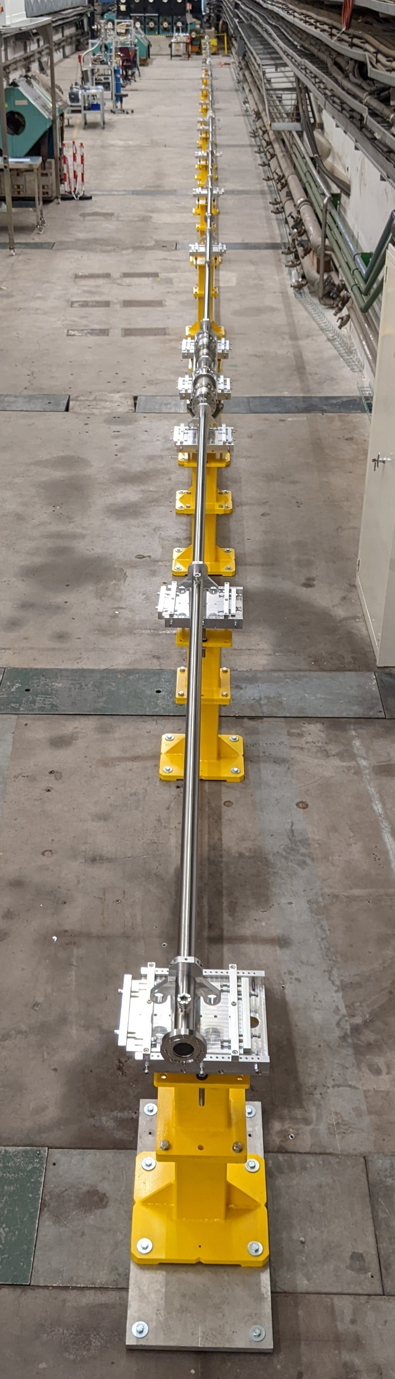
Conclusion and outcome
TT4
On-going prototyping phase
  BS treatment duration refinement
  Planning
Integration study
  External constraints (transport zone, space interco…) ↔ BST constraints (coating system, auxiliaries…)
  Requires several iterations between involved teams
  Visit of all interconnections by the end of this year
Visit possible of the coating system / mock-up in 1:1 scale in TT4
If any impact on other system/activities is missing:
  G. Rosaz (Project Leader)
  M. Charrondiere (Project Coordination)
  V. Petit (Technical Coordinator)

Slide 14
Thank you

