Slide 1
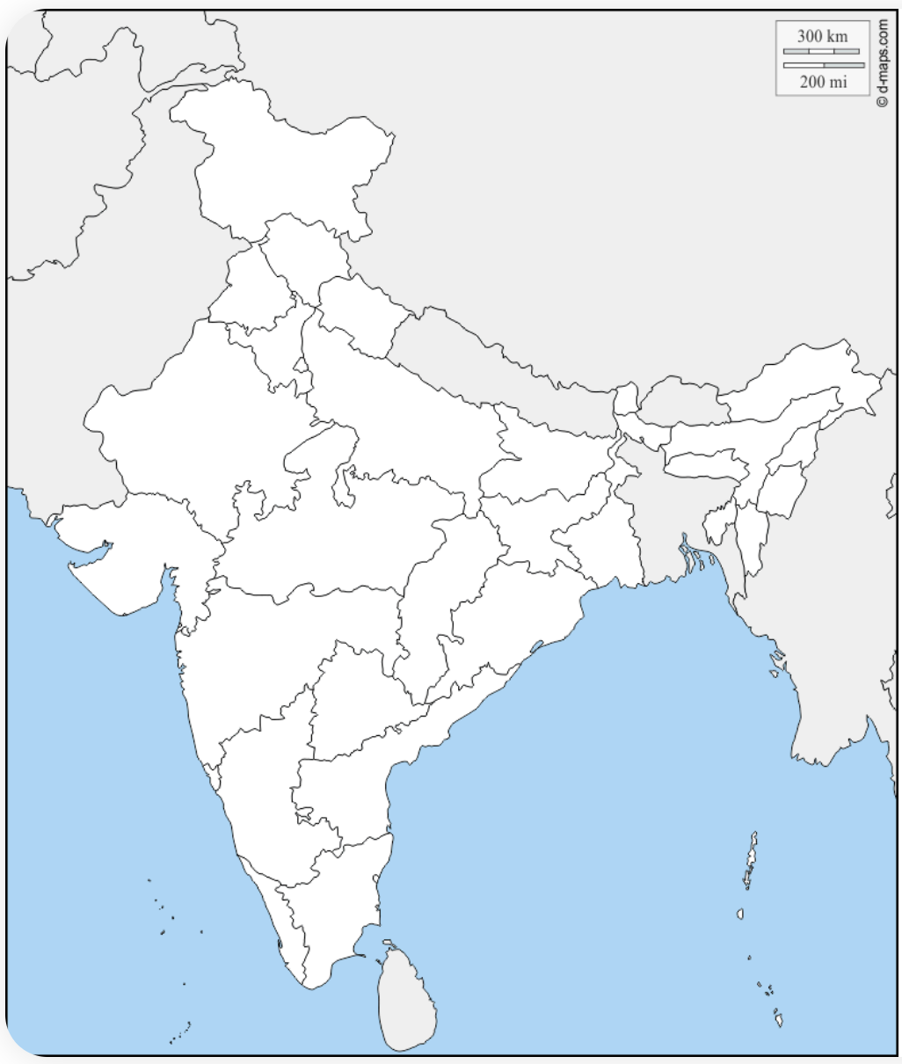

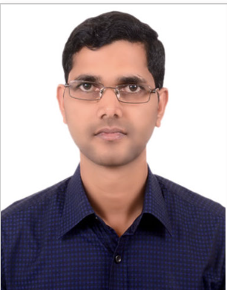
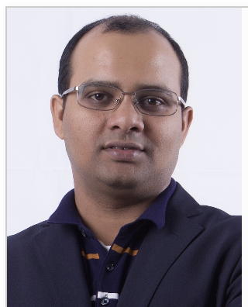
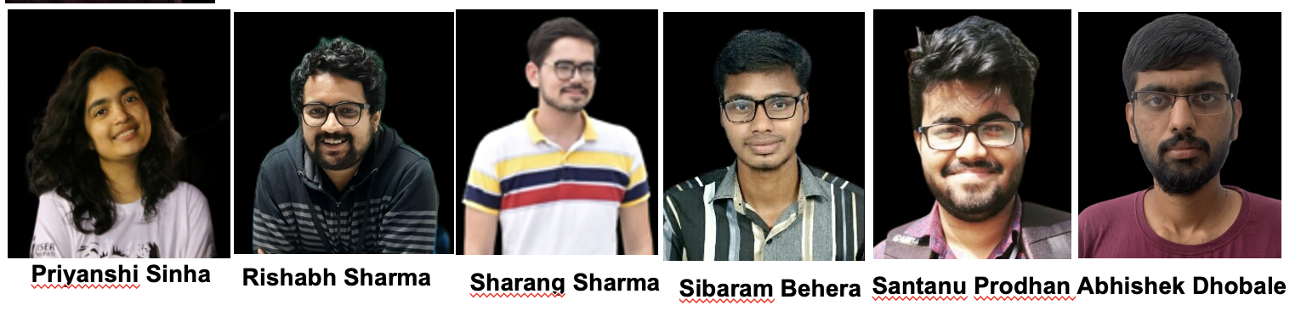
IISER Tirupati Group
Indian Institute of Science Education and Research (IISER) Tirupati is the sixth Institute in the chain of IISERs
Established in 2015 by the Govt. of India under the Ministry of Education (MoE).
Declared as Institutes of National Importance by Govt. of India
To impart quality education and setting up state-of-the-art research facilities in frontier areas of science.
Mohali
Bhopal
Kolkata
Pune
Berhampur
Tirupati
EHEP Group Members:
2 Faculty Members + 7 PhD Students
All are working in STAR experiment
Thiruvananthapuram
Chitrasen Jena
Nihar R. Sahoo

Slide 2
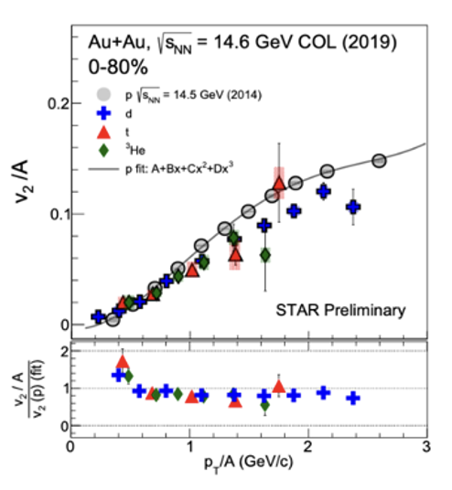
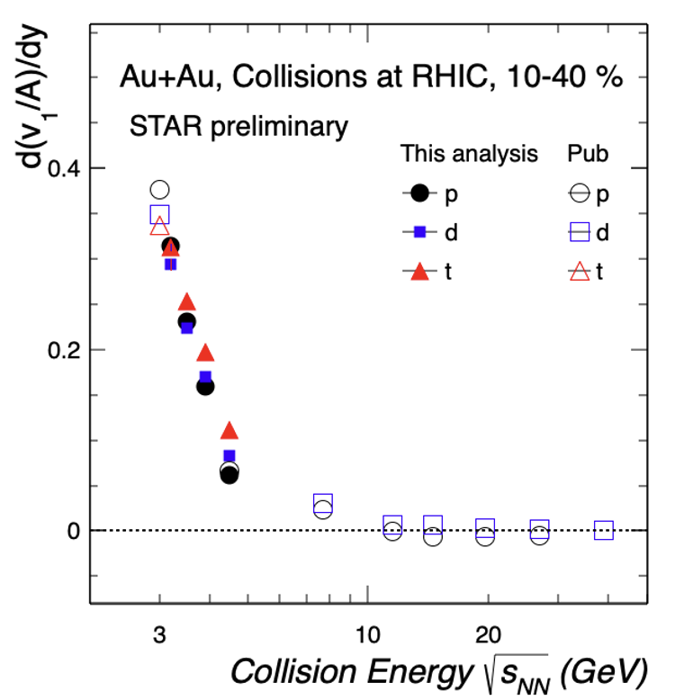
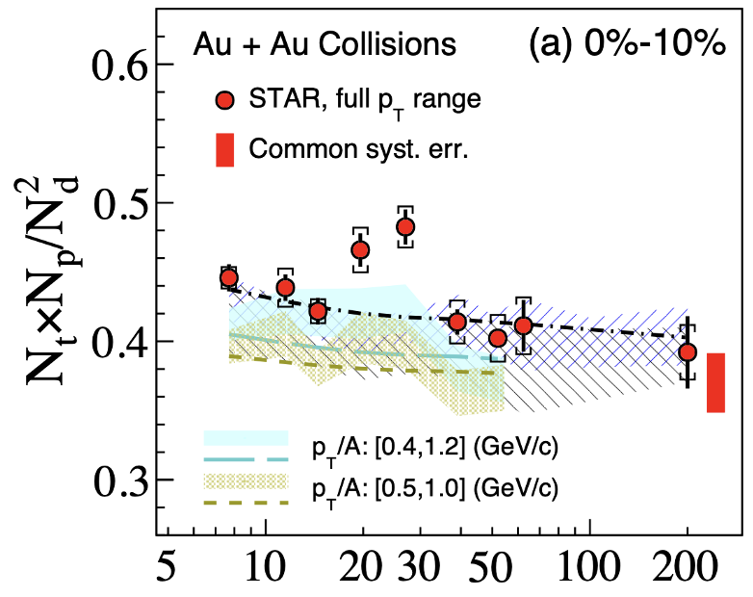

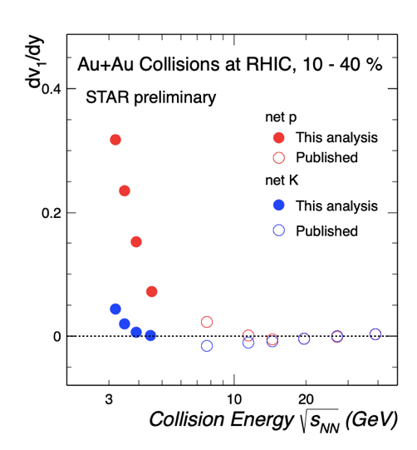
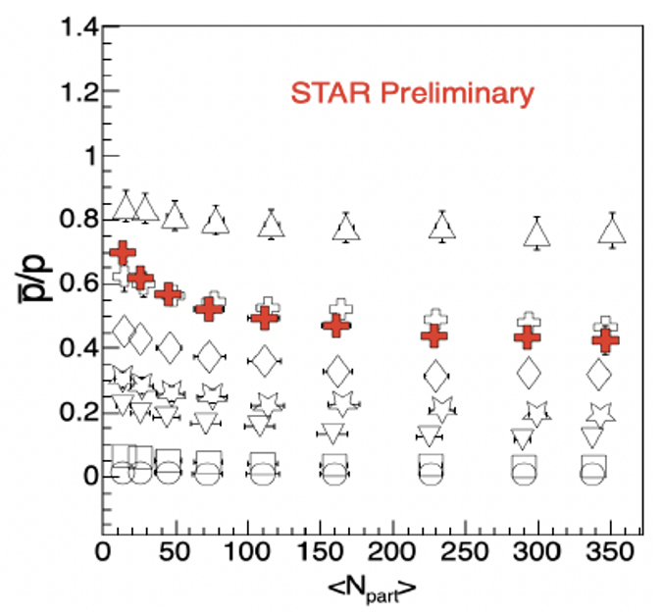
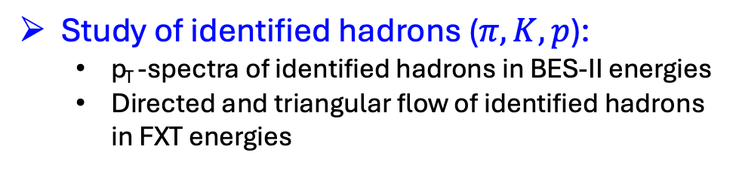
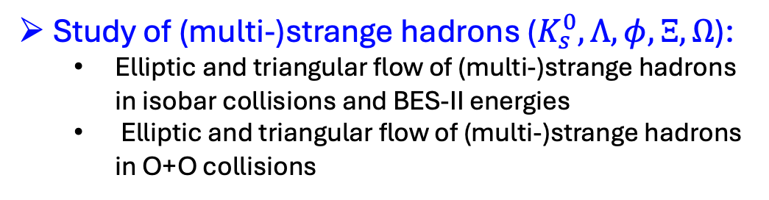
Research Expertise
STAR: PRL 130, 202301 (2023)
Study of light nuclei (d, t, ³He, ⁴He):
  p_{T} -spectra of light nuclei in BES-II energies
  Elliptic and triangular flow of light nuclei in BES-II energies
  Directed flow of light nuclei in FXT energies
Study of identified hadrons ($π, K, p$):
  p_{T} -spectra of identified hadrons in BES-II energies
  Directed and triangular flow of identified hadrons in FXT energies
Study of (multi-)strange hadrons ($K_{s}^{0}, Λ, φ, Ξ, Ω$):
  Elliptic and triangular flow of (multi-)strange hadrons in isobar collisions and BES-II energies
  Elliptic and triangular flow of (multi-)strange hadrons in O+O collisions
Other areas of expertise include resonance production and open heavy-flavour production.

Slide 3
Research Interests
Study of light nuclei and hypernuclei:
  Production of light nuclei and hypernuclei in high baryon density environment
  Measurements of yields and collective flow of light nuclei
  Precise measurements of mass, binding energy, and lifetime of hypernuclei
  Production of multistrange Λ hypernuclei
  Understanding the hyperon-nucleon (YN) interaction
Study of (multi-)strange hadrons:
  Measurements of yields and collective flow of (multi-)strange hadrons
  Sensitive probes for the early stages of heavy-ion collisions and the equation of state (EoS) of nuclear matter at high baryon densities
Depending on the availability of manpower, we may explore other research topics at CBM@FAIR.
Notes:
Strange matter
• (double-) lambda hypernuclei
• search for meta-stable objects (e.g. strange dibaryons)

